Slide 1
Introduction to common variation, quality control, GWAS, and PLINK (Part I)
Lucia Colodro Conde and Katrina Grasby

Slide 2
Introduction to common variation

Slide 3
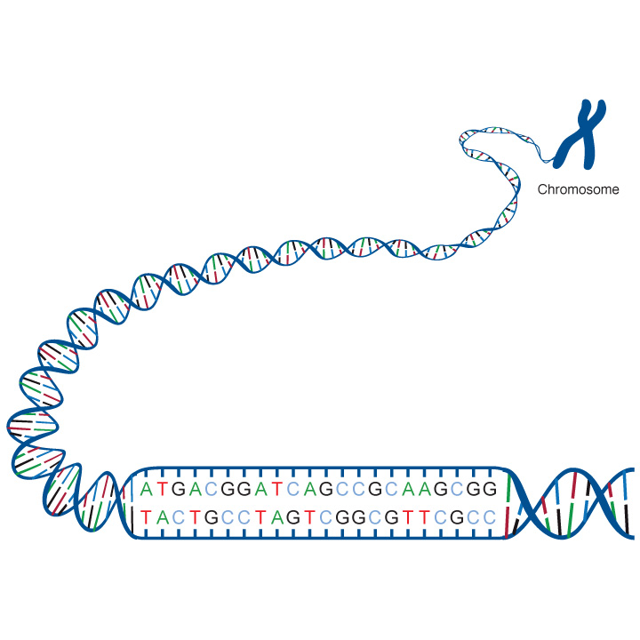
person 1
person 2
adenine (A), thymine (T), cytosine (C), guanine (G)
Genetic variation: differences in the sequence of DNA among individuals.
Mutation: a newly arisen variant

Slide 4
Genetic variant: any specific region of the genome which differs between two genomes.
Allele: version of a variant
Allele frequency: incidence of an allele in a population.
Minor allele frequency (MAF): frequency at which the less common allele occurs in a given population.

Slide 5
Rare variant: a genetic variant present in < 1% of the alleles in the population
Common variant: a genetic variant present in >= 1% of the alleles in the population
Note 1% is arbitrary

Slide 6
Effect
High
Rare variants
causing
Mendelian traits
Very unlikely
Intermediate
Low frequency variants
with intermediate effects
Modest
Common variants implicated in complex traits
Difficult to detect
Low
0.001 0.01 0.1 0.3
Allele frequency
Based on McCarthy et al (2008) Nature Reviews Genetics 9, 356-369

Slide 7
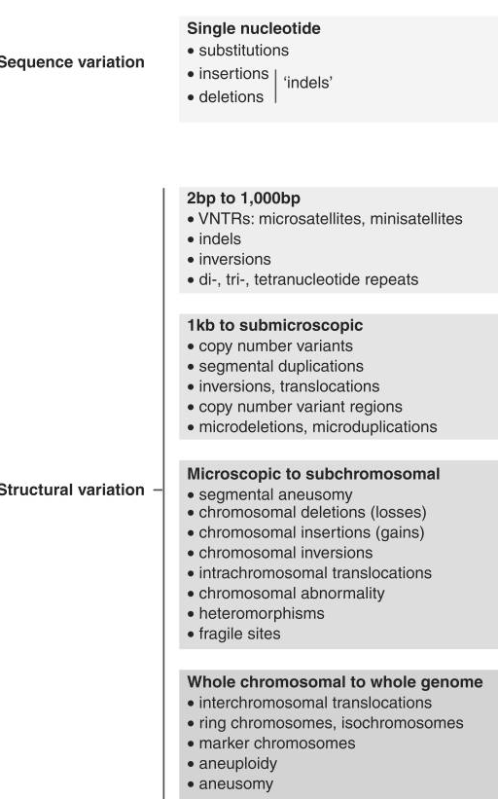
Examples of genetic variation
GWAS
Knight JC (2009). Genetics and the general physician: insights, applications and future challenge. QJM..
Sherer SW et al (2007). Challenges and standards in integrating surveys of structural variation. Nat Genet

Slide 8
SNP (single nucleotide polymorphism):
variation at a single base pair in a DNA sequence among individuals.
Chrom.
DNA sequence
Genotype
Mat
GTAACTTGGGATCTAGACCAATAGAT
GTAACTTGGGATCTAGACCAATAGAT
GTAACTTGGGATCTAGACCAATAGAT
GTAACTTGGGATCTCGACCAATAGAT
GTAACTTGGGATCTCGACCAATAGAT
GTAACTTGGGATCTCGACCAATAGAT
Person 1
A A
Pat
Mat
Person 2
A C
Pat
Person 3
Mat
C C
Pat
Slide based on Manuel Ferreira’s

Slide 9
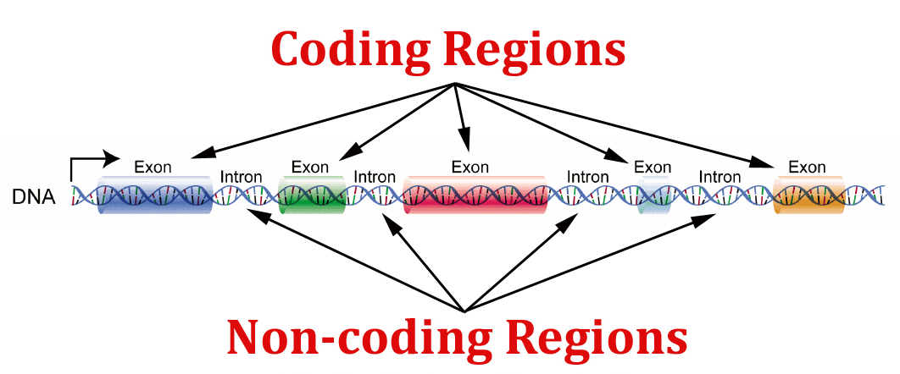
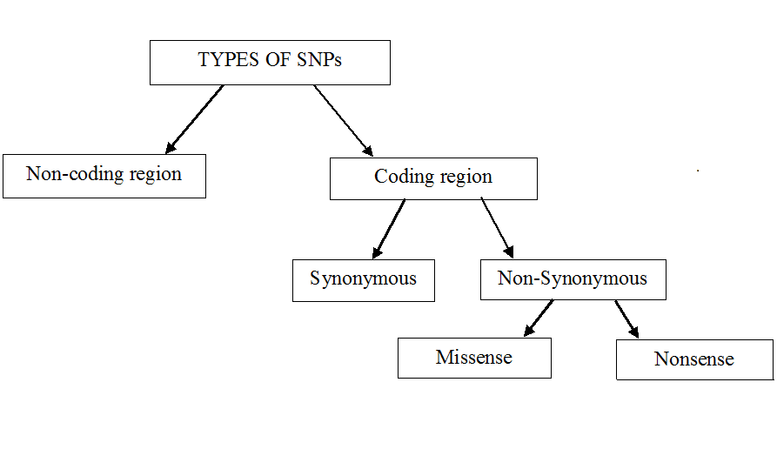
They may affect regulation of genes in coding regions
They change the amino acid sequence
They do not change the amino acid sequence
They change one amino acid in a protein (which may have an effect in the protein)
They produce a premature stop codon, that results in an incomplete and usually non-functional protein product

Slide 10
Insertion–deletion variants (indels):
one or more base pairs are present in some genomes but absent in others in relation to the reference
Chrom.
DNA sequence
Genotype
Mat
GTAACTTGGGATCTGATGACCAGATAG
GTAACTTGGGATCT---GACCAGATAG
GTAACTTGGGATCTGATGACCAGATAG
GTAACTTGGGATCTGATGACCAGATAG
GTAACTTGGGATCT---GACCAGATAG
GTAACTTGGGATCT---GACCAGATAG
Person 1
R D
Pat
Mat
Person 2
R R
Pat
Mat
Person 3
D D
Pat

Slide 11
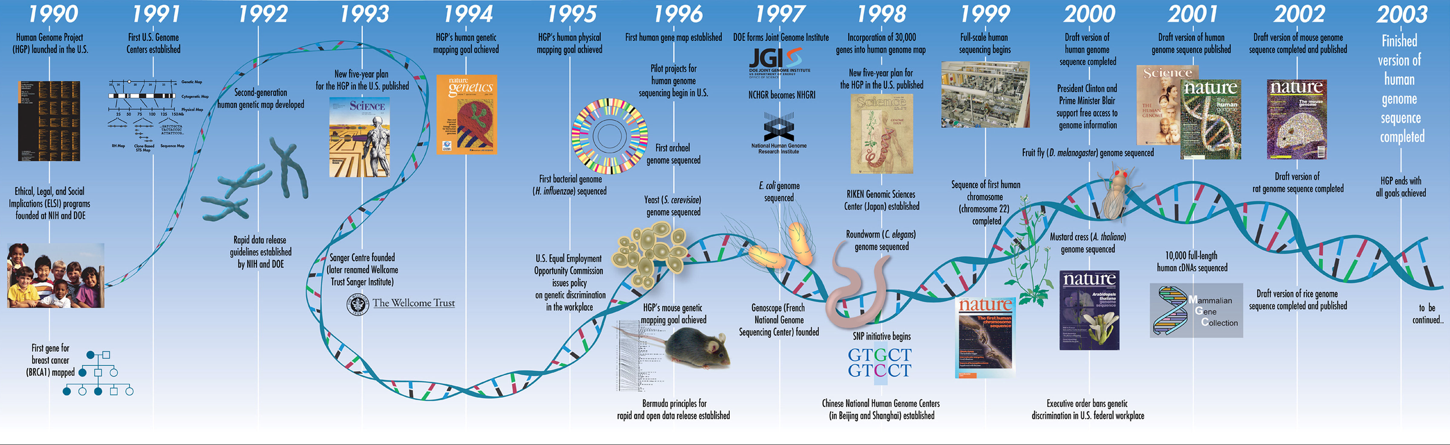
Collins et al 2003, A vision for the future of genomics research, Nature

Slide 12
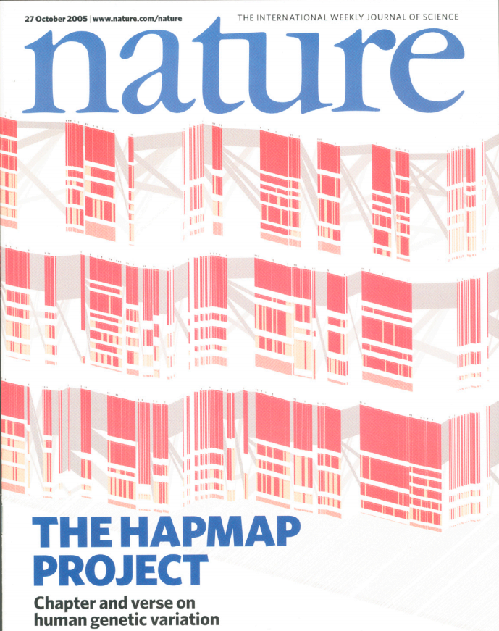
HapMap (haplotype map) Project
270 samples:
30 parent-offspring trios of the Yoruba from Ibadan, Nigeria (YRI)
30 trios of Utah residents with European ancestry (CEU)
45 individuals from Beijing, China (CHB)
45 individuals from Tokyo, Japan (JPT)
The International HapMap Consortium (2005). A haplotype map of the human genome. Nature.

Slide 13
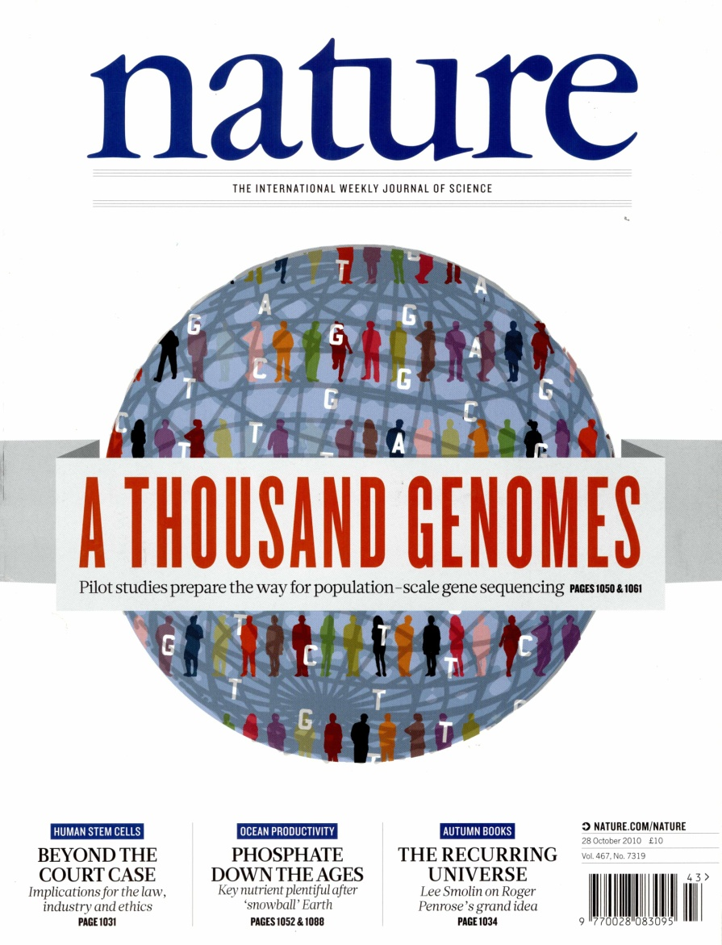
1000 Genomes Project
Phase 1: 1,092 individuals from 14 populations..
Phase 3: 2,504 individuals from 26 populations (~500 samples form each 5 continental ancestry groups, with ~5 populations for each group)
The 1000 Genomes Project Consortium (2012). An integrated map of genetic variation from 1,092 human genomes. Nature.
The 1000 Genomes Project Consortium (2015). A global reference for human genetic variation. Nature.

Slide 14
The Haplotype Reference Consortium (HRC)
The Haplotype Reference Consortium (2016). A reference panel of 64,976 haplotypes for genotype imputation. Nature Genetics.

Slide 15
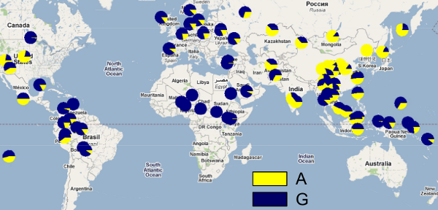
These projects have provided information on:
Patterns of human common genetic variation
Linkage disequilibrium (LD) and allele frequencies differences in populations
Tag SNPS for the design of SNP arrays to facilitate imputation and GWAS
YRI
CEU
CHB _ JPG

Slide 16
Practical. Where to start with.
GWAS have been facilitated by the development of relatively inexpensive SNP arrays.
How do we make the information provided by SNP arrays usable?

