Slide 1
Family-based association methods ->
Observations in the study are not independent
Jenny van Dongen, Dorret Boomsma, Camelia Minica, Conor Dolan,
Joshua Pritikin

Slide 2
This session
1. Family based association analyses: intro
(Dorret Boomsma)
2. Genetic association tests: Plink and R
3. Apply the GWAS results (Jenny van Dongen)

Slide 3
Data collected in families
Some methods require twin / family data:
-> heritability
-> linkage
However, when looking at association, we need to adjust for clustering in family data.

Slide 4
Focus: family-based Genome-Wide Association Studies
These are regression based approaches, with outcomes (phenotypes) and predictors (Genetic Variants (GV), or polygenic scores, other and covariates)
Ignoring clustering in family data may lead to wrong conclusions: point estimates of effects OK, but SE too small!

Slide 5
Mixed models
What does ‘mixed model’ mean?

Slide 6
What does ‘mixed model’ mean
Mixed models contain fixed effects
(parameters) and random effects
The elementary mixed model is a
two-way ANOVA model:
One fixed factor, one random factor

Slide 7
One-way fixed effect ANOVA
Evaluate the effect of a factor with a limited number of levels.
-Level effect definition: mean score
-Obtained in the population of subjects
FACTOR LEVELS
1 2 3
Y11 y21 y31
y12 y22 y32
y13 y23 y33
y14 y24 y34
y15 y25 y35
means m1 m2 m3
(the factor could represent 3 genotypes: e.g. AA, Aa and aa).

Slide 8
Procedure
randomly sample subjects from the population.
2. randomly “assign” them to the levels of the factor.
3. compute the sample means for each level.
4. “decide” if observed differences between the means are sufficient evidence for differences between the levels in the population.

Slide 9
The population is not observed and observed sample
differences might change if the experiment is repeated with the same factor levels but with a different random sample.
How to conclude that observed differences between the means can be taken as evidence for differences in the population?
We need a yardstick to measure the size of the differences between levels.

Slide 10
How to conclude that differences between level means are evidence for differences in the population?
We need a yardstick to measure the size of the differences -> the variance of the scores within the levels of the factor in the population (i.e. based on the differences of the individual scores to the level means).
Larger variance increases likelihood of observing differences in the sample if the levels have no effect.
The probability refers to repetitions of the experiment.

Slide 11
In this simple design, the levels of the factor remain the same over repeated experiments. The level effects are therefore fixed effects or parameters.
The individual scores change over experiments and are therefore called random effects (defined as deviations from the level effects).

Slide 12
The linear model: y_{ij} = m + b_{i} + e_{ij}
m = general constant; fixed effect
b_{i} = effect of factor level i; fixed effect; same levels in repeated experiments
e_{ij} = y_{ij} – (m + b_{i}) = residual: random effect (different subjects in repeated experiments)
Statistical properties of e_{ij} : mean zero and variance σ_{e}²
Models such as these, where e_{ij} is the only random effect, are called fixed effects models.

Slide 13
A change in the design: Ss are still sampled randomly from the population, but each subject is observed at each factor level.
FACTOR LEVELS
1 2 3
y11 y21 y31
y12 y22 y32
y13 y23 y33
y14 y24 y34
y15 y25 y35
means m1 m2 m3
(the factor cannot represent 3 genotypes for the same person (AA, Aa and aa) but if we have family members they can be observed at each level of the factor).
Row scores come from the same subject / family. In the previous design, y₁₁ and y₁₂ referred to different Ss, who were sampled independently. We now have within subject (or within family) correlation or covariance among y11, y12, y13.

Slide 14
The linear model now is: y_{ij} = m + a_{i} + b_{j} + e_{ij}
m = general constant; fixed effect
a_{i} = effect of subject i; random effect, since a_{i} changes over repeated experiments; mean zero; variance σ_{a}²
b_{j} = effect of factor level j; fixed effect; same levels in repeated experiments
e_{ij} = y_{ij} – ( m + a_{i} + b_{j} ) residual or error; random effect;
Model contains fixed factor effects and one random effect besides the residual. Such models are called mixed models.

Slide 15
Consequences of the model
Expected variance within the level of a factor is σ_{a}² + σ_{e}²
Covariance of observations at two different levels of the factor is σ_{a}²

Slide 16
General representation of mixed models as matrix equation:
y = Xb + Za + e
b = [ m, b1, b2, b3]’
a = [a1, a2]’
For the first two subjects:
X Z e
m b1 b2 b3 a1 a2
y11 = 1 1 0 0 1 0 e₁₁
y12 = 1 0 1 0 1 0 e₁₂
y13 = 1 0 0 1 1 0 e₁₃
y21 = 1 1 0 0 0 1 e₂₁
y22 = 1 0 1 0 0 1 e₂₂
y23 = 1 0 0 1 0 1 e₂₃

Slide 17
Specification of the covariance structure
Expected covariance matrix of the random effects: Va:
a1 a2
a1 σ_{a}² 0
a2 0 σ_{a}²
For the residuals: R = σ_{e}² I ( i.e. a diagonal matrix)

Slide 18
Linear regression (discarding covariates) in unrelated Subjects (j=1...N)
pheno_{j} = b₀ + b₁*GV_{j} + e_{j} (y = XB + e)
Wald test b₁/s.e.(b₁) s.e. (b₁) from (X^{t} V⁻¹X)⁻¹, V is cov matrix of e.
b₁
ε
pheno
GeneticVariant
linear regression (discarding covariates) twins / sibs (i=1...Nmz (Ndz) and j=1,2)
pheno_{ij} = b₀ + b₁*GV_{ij} + e_{ij} (y = XB + e)
b₁
ε₁
pheno₁
GV₁
r_{mz}
r_{dz}
.5 (dz/ sibs) or 1 (mz)
b₁
ε₂
pheno₂
GV₂
Notes:
regression of phenotype on genetic variant (GV). Top: unrelateds, bottom: twins

Slide 19
linear regression (discarding covariates) in twins / sibs
pheno_{ij} = b₀ + b₁*GV_{ij} + e_{ij} (i=1...Nmz (Ndz) and j=1,2)
b₁
e₁
pheno₁
GV₁
r
.5 (dz/ sibs) or 1 (mz)
b₁
e₂
pheno₂
GV₂
Analysis options:
A. ignore relatedness
B. model correlated background
C. discard 1 twin member (e.g., occasionally: drop 1 MZ twin)
D. GEE regression (GEE = Generalized Estimating Equations) -> prac
Notes:
What to do about the correlated residuals? A,B,C or D?

Slide 20
options: A. ignore relatedness
B. model correlated residual (background)
C. discard 1 twin member
D. GEE regression
BAD – results in downward bias in s.e. (b1) and increase in type I error rate (false positives!)
Good, linear mixed modeling or OpenMx
BAD – loss of power
Good, corrects s.e. (b1) for correlated residuals
Computational Burden:
B. 1. Genetic covariance structure modeling (ACE / ADE) in OpenMx or linear mixed modeling (SPSS, R: nlme, R: lmer) – heavy, unwieldy
B. 2. Based on genetic relatedness matrix OK: GCTA, Fast-LLM (any pedigree structure)
D.1. GEE (Generalized Estimating Equations) regression – light, simple OK in the case of nuclear family data (what about extended pedigrees?).

Slide 21
Both GEE and mixed model are suitable when independent errors' assumption is violated.
GEE takes into account the within-cluster correlations by using an empirical covariance matrix (sandwich). It can really only account for one source of clustering at a time. In a GEE we cannot put any structure the correlation pattern.
A mixed model accounts for correlated outcomes by using random effects for each cluster variable. So mixed models are more versatile .

Slide 22
Benefits of family data (in genetic association studies)
Control for factors that can spuriously influence association tests (e.g. population stratification).
Base estimates of association effects on within family tests.
QC: Can test for Mendelian transmission errors.
Can obtain estimates of transmitted and un-transmitted PRS (if family design involves parents and offspring).
Can estimate heritability from pedigree (check on phenotype data).
May be easier to recruit large numbers by targeting families.

Slide 23

Within family tests
GWAS meta-analyses for height / BMI in a Europeans (~250,000 Ss for height and ~350,000 for BMI). We re-estimated the effects of each SNP in a within-family design, which is unbiased by population stratification, and used these effect sizes to create a genetic predictor for both phenotypes (also termed ‘polygenic score’).

Slide 24
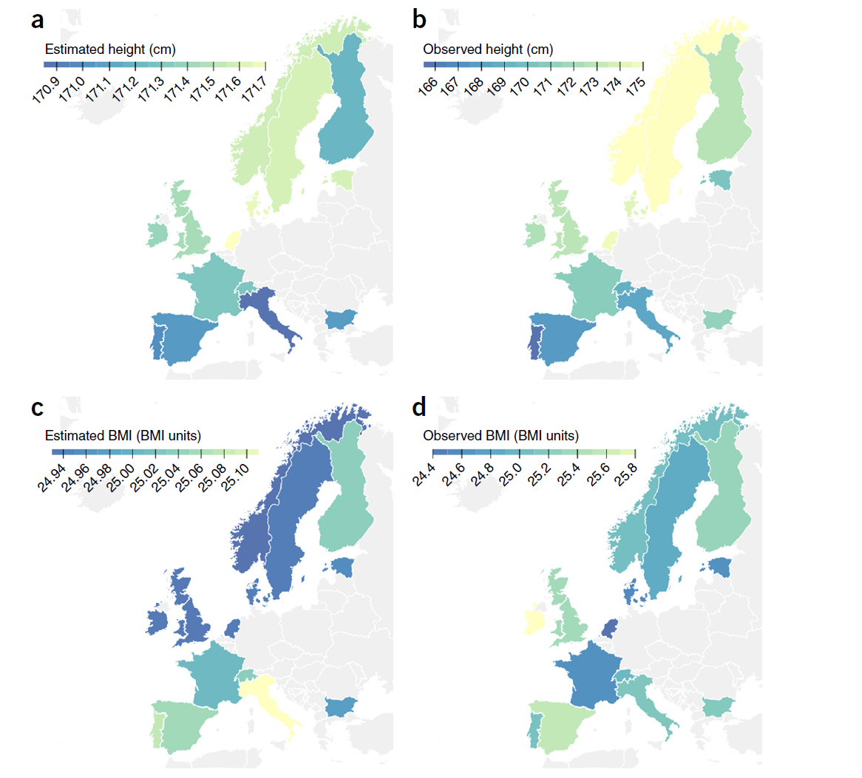
Predicted genetic means (a,c) and observed means (b,d) for height and BMI for 14 Eu nations. From recently published data, we estimated national differences in mean height and BMI, with a European average height of 171.1 cm and an average BMI of 25.0 for males.

Slide 25
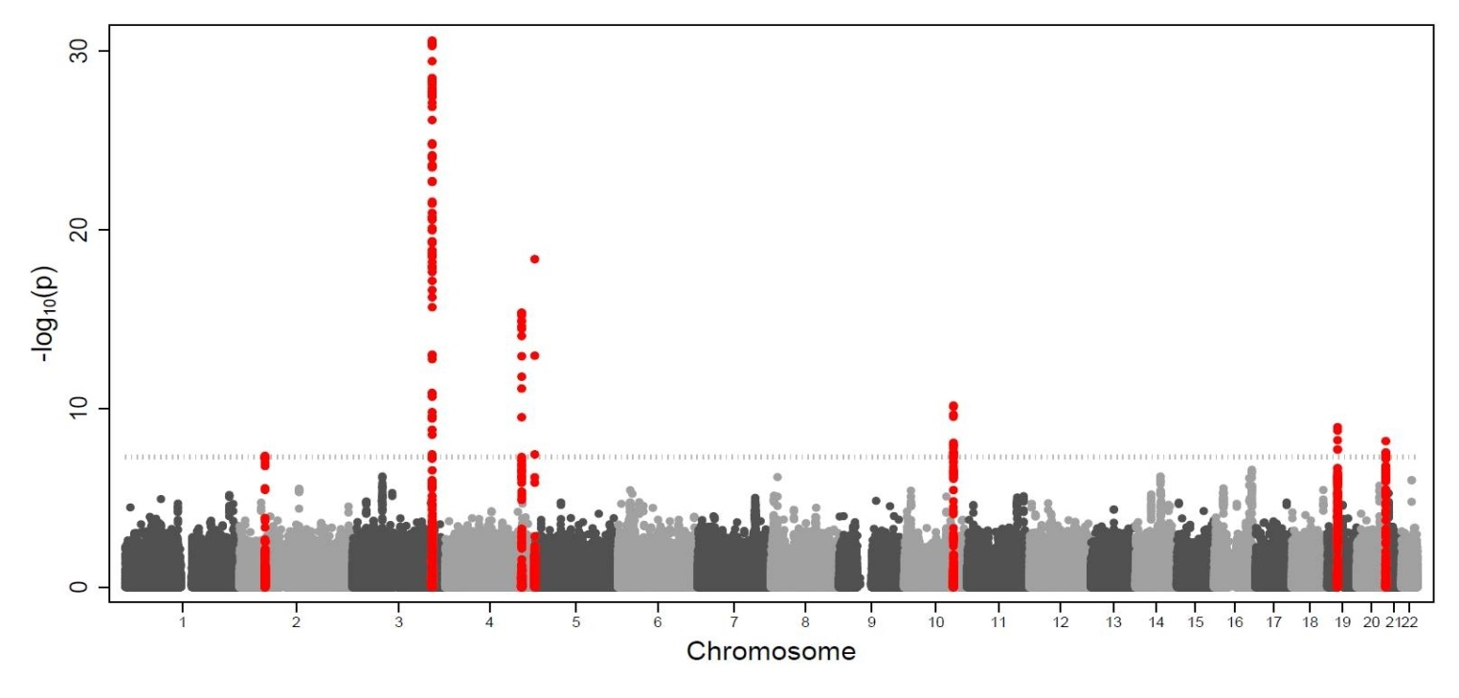
Identification of seven loci affecting mean TELOMERE length and their association with disease
Veryan Codd et al. (ENGAGE consortium) Nature Genetics, 2013
Twin registries supplied 34% of samples
TERC
TERT
NAF1
OBFC1
ZNF208
RTEL1
ACYP2

Slide 26

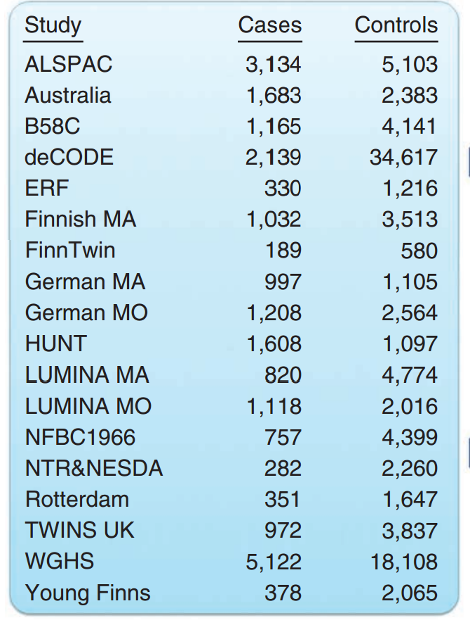
13% cases
9% controls

Slide 27
Other considerations
Does not control cryptic relatedness.
Family sizes differ (not everyone can participate with their family).
May decrease statistical power.

Slide 28
Power calculation (see R script (provided by Conor) in faculty folder)
Suppose you have N unrelated Ss and you want to calculate power?
Simple: use Gpower, R libraries (pow), or dedicated (genetics) software
Suppose you have N_{mz} and N_{dz} twin pairs and N unrelated Ss and want to calculate power?
Simple: calculate effective sample size and use standard software
N_{mz} pairs is effectively N_{1mz} = (N_{mz}*2) / (1 + r_{mz})
N_{dz} pairs is effectively N_{1dz} = (N_{dz}*2) / (1 + r_{dz})
N unrelateds N=N_{1u}
Total effective sample size N = N_{1u} + N_{1mz} + N_{1dz}.
r_{mz} and r_{dz} are phenotypic (intraclass) correlation coefficients.

Slide 29
General equation is NE = (K*M) / (1 + (M-1)*r)
Applied to N_{mz} pairs
NE = effective sample size
K = number of clusters N_{mz} pairs
M = number of members per cluster M=2 (for pairs!)
r = intra-class correlation rmz
Suppose we have MZ pairs, with and without siblings and
DZ pairs with and without siblings
Rough and ready: suppose we have
300 MZ + 0 sibs, i.e., 600 individuals
200 MZ + 1 sibs, i.e., 400 + 200 = 600 individuals
150 MZ + 2 sibs, i.e., 300 + 300 = 600 individuals
Calculate NE for each using the intraclass correlation (average phenotypic relatedness)
Notes:
N_{Effective} = (k*m) / (1 + (m-1)*r), where 'k 'is the number of clusters, ‘m’ is the number of patients per cluster, and ‘r’ is the intracluster coefficient (ICC).

Slide 30
rmz = .5
rfs (full sib) = .25
300 MZ + 0 sibs, i.e., 600 individuals
1 .5
.5 1 r=.5 NE=300*2/(1+.5) = ~400
200 MZ + 1 sibs, i.e., 400 + 200 = 600 individuals
1 .5 .25
.5 1 .25
.25 .25 1 r =~.333 NE=(200*3)/(1+.333) = ~450
150 MZ + 2 sibs, i.e., 300 + 300 = 600 individuals
1 .5 .25 .25
.5 1 .25 .25
.25 .25 1 .25
.25 .25 .25 .25 r= ~.29 NE=(150*4)/(1+.29) = ~465
Total sample size in individuals = 600+600+600 = 1800
Total effective sample size = 400 +450 + 465 =1315

Slide 31
R2=1%
alpha=.001
unrelated N=2000
Ndz=1000 pairs
NE_{mz}=
(N_{mz}*2)/(1+r_{mz})
Nmz=1000 pairs
NE_{dz}=
(N_{dz}*2)/(1+r_{dz})
unrelated N=1000
r_{dz} = .5*r_{mz}
Notes:
# function (power)
powf=function(r2,N,alpha)
# power given r2 noncentral F distribtion
# just 1 predictor test of R2 = test of b1
# y = b0 + b1*x + e
{
N2=N-2
f2=r2/(1-r2) # assumption r2<1
lam=f2*(N2) # the non-centrality parameters of the F distribution under the alt
cv=qf(alpha,1,(N2),lower=F) # critical value under the null (central F)
power=pf(cv,ncp=lam,1,(N2),lower=F) # the power
}
#
Nmz=1000
Ndz=1000
Ns=2000
r2=.01
alpha=.001
rho=seq(0,.9,len=20)
pows1=rep(0,20)
pows2=rep(0,20)
powdz=rep(0,20)
powmz=rep(0,20)
ii=0
for (r in rho) {
ii=ii+1
NEmz=(Nmz*2)/(1+r)
NEdz=(Ndz*2)/(1+(r/2))
Ns=Ns
pows1[ii]=powf(r2,Ns,alpha)
pows2[ii]=powf(r2,Ndz,alpha)
powdz[ii]=powf(r2,NEdz,alpha)
powmz[ii]=powf(r2,NEmz,alpha)
}
plot(rho,pows1,xlim=c(.0,.95),ylim=c(.35,1),type='b',pch='u',col=1,
main='power based on effective N',xlab='mz pheno. corr',ylab='power')
lines(rho,powdz,type='b',pch='d',col=2)
lines(rho,powmz,type='b',pch='m',col=3)
lines(rho,pows2,type='b',pch='u',col=1)

