Slide 1
Quality Control & Meta-Analysis in METAL
Meike Bartels & Bart Baselmans

Slide 2
Multivariate GWAMA
Michel Nivard & Aysu Okbay

Slide 4
VU Summerschool: 6 July to 20 July 2019

Slide 5
We hope to welcome you in sept 2018!
Interested in this unique Master programme in the Netherlands?
Visit our website or
email rm.gbh.fgb@vu.nl
5

Slide 6
GWAMA Genome-Wide Association Meta-Analysis
Large collaborative studies to increase sample size
Different cohorts run their own GWA and upload summary statistics
To make these projects successful and trustworthy, we need rigorous organisation AND quality control (QC)

Slide 7
SOP Standard Operating Procedure

Slide 10
298,420 individuals
181 scientists
145 institutions
167 different files

Slide 11
EasyQC
For the well-being GWAMA, we used EasyQC for QC-ing the GWAS summary statistics
Positive experience because it provides guidelines how to perform QC at the:
study file level
meta-file level
meta-analysis OUTPUT level

Slide 12
What needs to be detected
File name errors -> sounds simple, but with 167 files it is essential that all files can be traced back to a specific cohort
Incorrect specification of the Phenotype
Flipped alleles
Duplicated SNPs
Bad imputation quality
Association issues from incorrect analysis models
Population stratification
Unaccounted relatedness of individuals

Slide 13
These errors
Limit the contribution of a specific cohort to the meta-analysis
or
Inflate the number of inflate the number of false positive

Slide 14
Descriptive Summary Statistics
Participating cohorts were asked to complete a descriptive statistics summary file for their sample
8 cohorts did not specify their question, or did not report the distribution of the question (no categories specified)
3 cohorts gave lower values to higher wellbeing (reversed coding)
8 cohorts did not map the categories to numeric values, but where the first option was higher wellbeing (suspicious reversed coding)

Slide 15
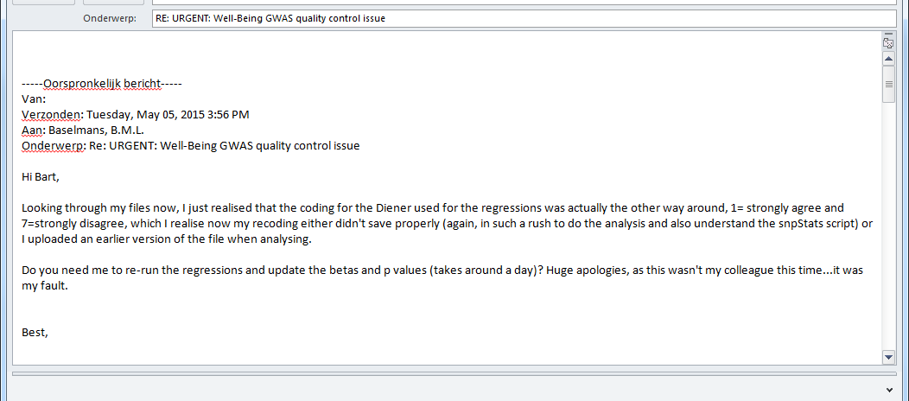
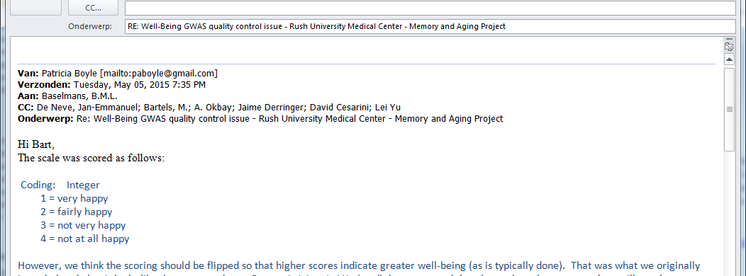

Slide 17
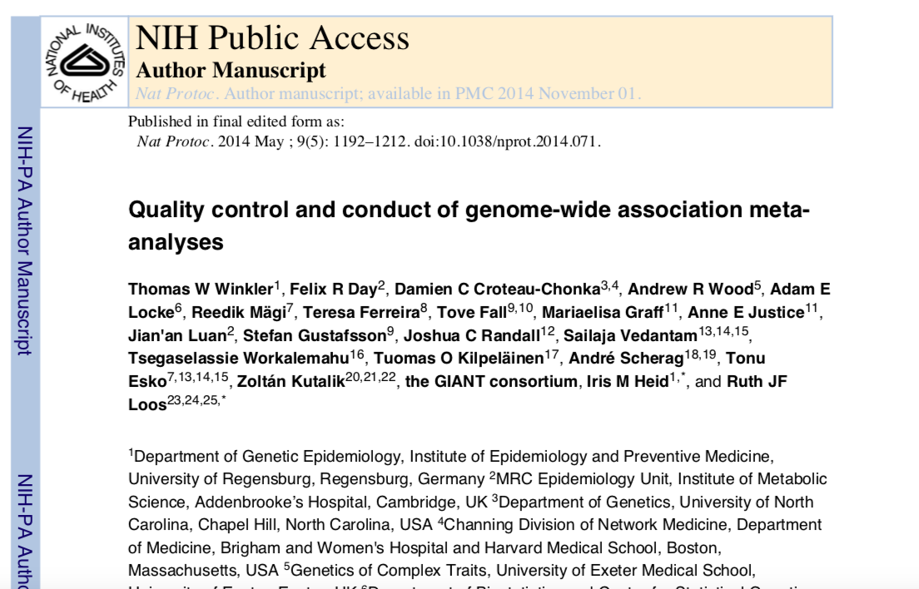

Slide 20
QC workflow- step 1
Step 1: File level QC
This stage involves cleaning of the data
Deleting poor quality data
Provide summaries to judge data quality
Think about
Monomorphic SNPs
Missingness (e.g. P-values, Beta’s, SE’s and more)
Nonsensical information (e.g Alleles other than A, C, G or T, or p-values larger than 1 or smaller than 0 etc)
Low number of individuals per SNP (GIANT < 30)
Harmonization of SNP identifiers using maps with unique SNP identifiers and genomic positions

Slide 21
QC workflow – step 2
Step 2: Meta level QC
This stage consists of the cross-study comparison of statistics and comparison to reference panels to identify study specific problems.
Think about
QQ-plots – to detect early signs of inflation that might be an indication of relatedness problems
PZ plots -> by B/SE you calculate the corresponding Z statistics. From Z you can obtain P, which can be compared to the actual reported P-value.
AF plots -> compare the reported allele frequencies to a reference data set

Slide 22
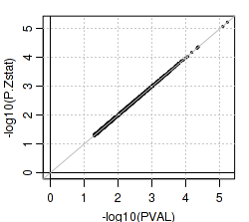
PZ plot

Slide 23
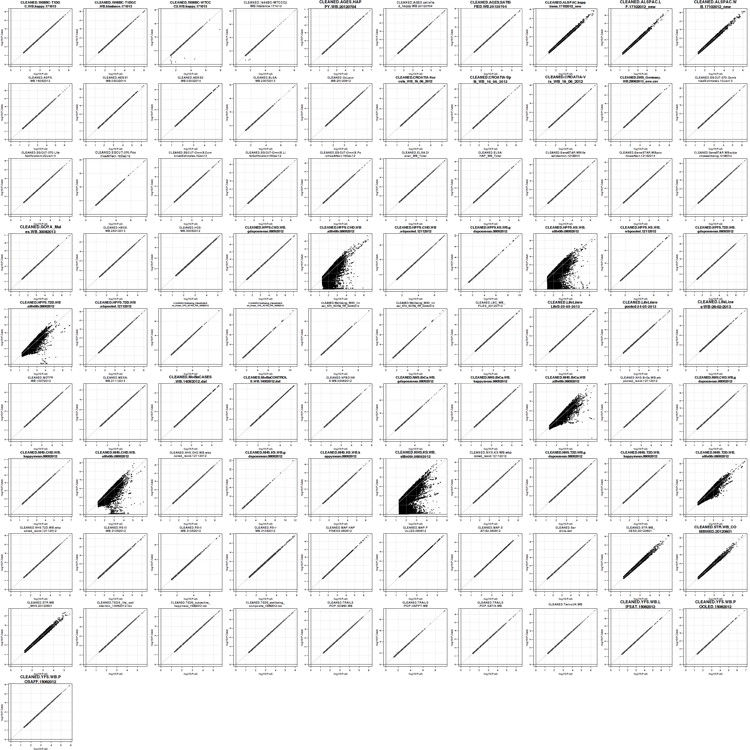

Slide 24
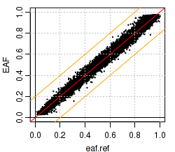
AF plot

Slide 25
AF correct but different ancestry
(d) wrong allele consistently labeled as effect allele
(e) a fraction of the effect alleles mis-specified, e.g. MAF instead of the effect allele or incorrectly assigning strand

Slide 27
QC workflow – step 3
Compare results with the other data-analyst and resolve any issues remaining

Slide 29
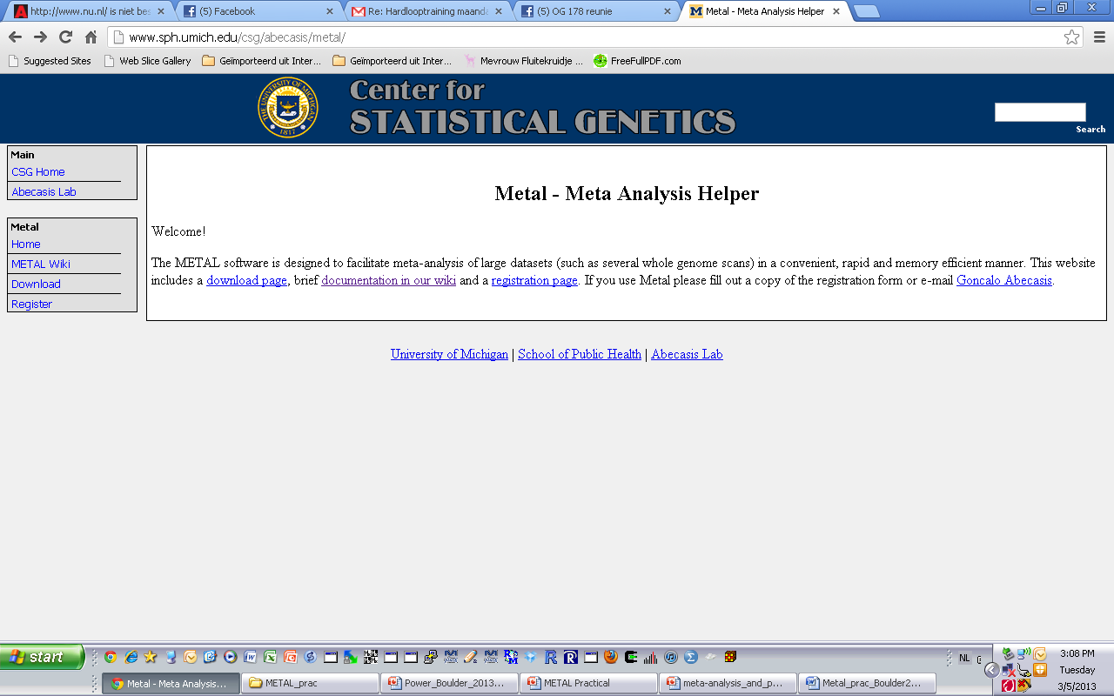
METAL
http://www.sph.umich.edu/csg/abecasis/metal/
Documentation can be found at the metal wiki:
http://genome.sph.umich.edu/wiki/Metal_Documentation

Slide 30
METAL
Metal is flexible
By default, METAL combines p-values across studies (sample size, direction of effect)
Alternative, standard error based weights (but beta and standard error use same units in all studies)

Slide 31
METAL
Requires results files
‘Driver’ file
Describes the input files
Defines meta-analysis strategy
Names output file

Slide 32
Steps
Check format of results files
Ensure all necessary columns are available
Modify files to include all information
Prepare driver file
Ensure headers match description
Crosscheck each results file matches Process name
Run metal

Slide 33
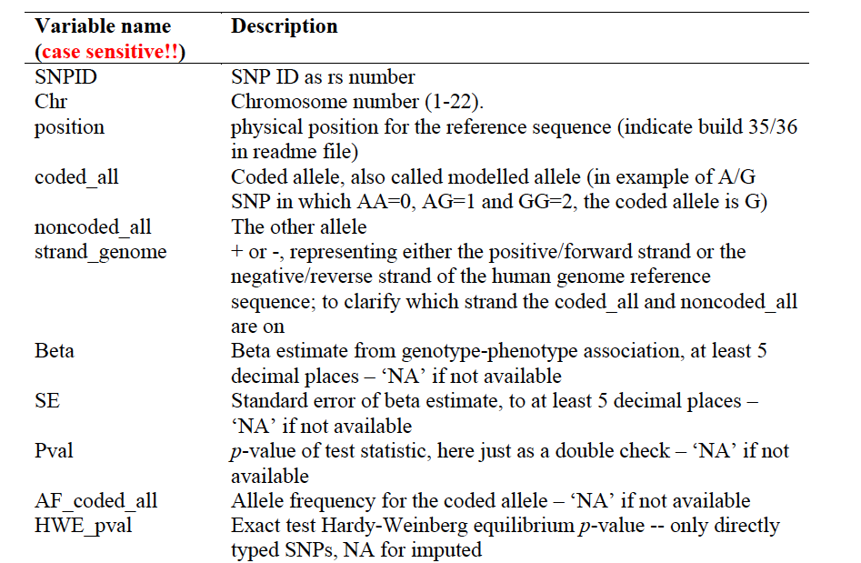
Results Files
Previously asked for standard columns in SOP
In QC all files are checked (and if necessary corrected)

Slide 34
INPUT FILES
We will use two GWAs results dataset
- results1.txt
- results2.txt

Slide 35
Columns METAL uses
SNP
OR
SE [for standard error meta-analysis]
P-value [for Z-score meta-analysis]
If we had two samples of different sizes we would have to add an N/weight column

Slide 36
Meta-analysis running
We will run meta-analysis based on effect size and on test statistic
For the weights of test statistic, I’ve assumed that the sample sizes are the same
METAL defaults to weight of 1 when no weight column is supplied

Slide 37
Step 2: driver file: meta_run_file
# PERFORM META-ANALYSIS based on effect size and on test statistic
# Loading in the input files with results from the participating samples
# Note: Order of samples is …[sample size, alphabetic order,..]
# Phenotype is ..
# MB March 2019
MARKER SNP
ALLELE A1 A2
PVALUE P
EFFECT log(OR)
STDERR SE specifies column names
PROCESS results1.txt
PROCESS results2.txt processes two results files
OUTFILE meta_res_Z .txt Output file naming
ANALYZE Conducts Z-based meta-analysis from test statistic
CLEAR Clears workspace
SCHEME STDERR Changes meta-analysis scheme to beta + SE
PROCESS results1.txt
PROCESS results2.txt processes two results files
OUTFILE meta_res_SE .txt Output file naming
ANALYZE Conducts effect size meta-analysis

Slide 38
Larger Consortia
# Labels
SEPARATOR TAB
MARKER cptid
ALLELE EFFECT_ALLELE OTHER_ALLELE
EFFECT BETA
PVALUE PVAL
FREQ EAF
WEIGHT N
# Options
SCHEME SAMPLESIZE
MINMAXFREQ ON
AVERAGEFREQ ON
GENOMICCONTROL 0.999
# Process files
PROCESS CLEANED.1958T1D.LS.gz
PROCESS CLEANED.BASE.LS.gz
PROCESS CLEANED.HNRSoexpr.LS.gz
PROCESS CLEANED.HRS.LS.gz
PROCESS CLEANED.NHSBRCA.LS.gz
PROCESS CLEANED.RUSHMAP.LS.gz
PROCESS CLEANED.1958WTC.LS.gz
PROCESS CLEANED.EGCUT370.LS.gz
PROCESS CLEANED.HNRSomni1.LS.gz
PROCESS CLEANED.KORAF3.LS.gz
PROCESS CLEANED.NHSCHD.LS.gz
PROCESS CLEANED.TEDS.LS.gz
PROCESS CLEANED.AGES.LS.gz
PROCESS CLEANED.EGCUTOMNI.LS.gz
PROCESS CLEANED.HPFSCHD.LS.gz
Etc
####################################################################
# Analyse and output
MINWEIGHT 50000
ANALYZE HETEROGENEITY
QUIT

Slide 39
Running metal
metal < metal_run_file
metal is the command
metal_run_file is the driver file
This will output information on the running of METAL things to standard out [the terminal]
It will spawn 4 files:
2 results files: meta_res_Z1.txt + meta_res_SE1.txt
2 info files: meta_res_Z1.txt.info + meta_res_SE1.txt.info

Slide 40
Output
Overview of METAL commands
Any errors
And your best hit from meta-analysis

Slide 41
METAL Practical
Copy files from faculty/meike/2019/metal to your own folder
Open Metal_prac_Boulder2019.pdf
follow along
run the meta-analysis
create Manhattan plots

Slide 42
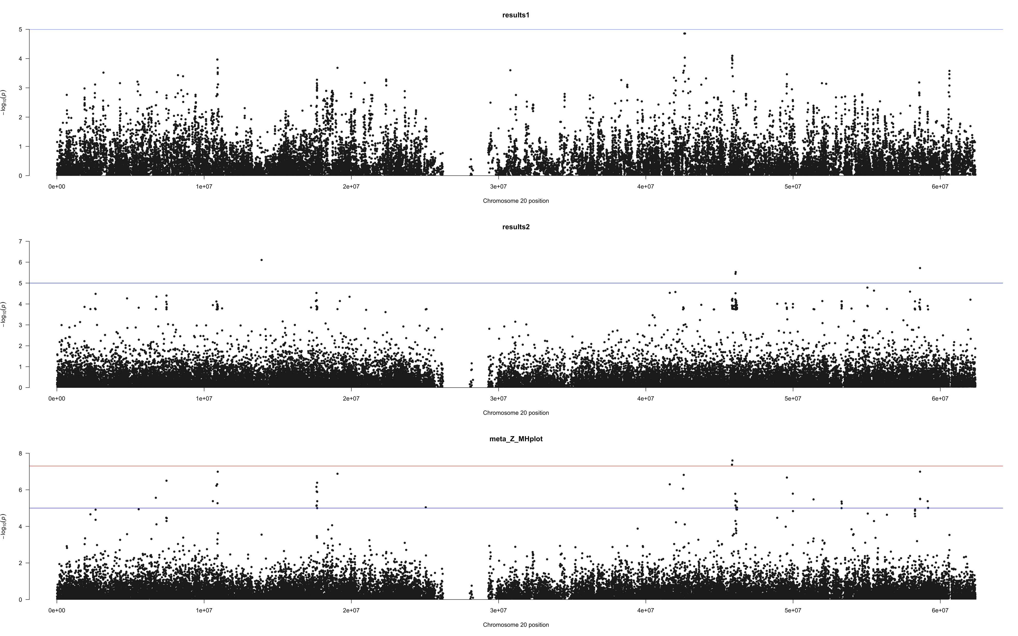

Slide 43
Okbay et al., Nature Genetics, 2016

Slide 44
Depressive Symptoms and Neuroticism
Okbay et al., Nature Genetics, 2016

Slide 45
Genetic Correlations
Okbay et al., Nature Genetics, 2016

Slide 46
Okbay et al., Nature Genetics, 2016

Slide 47
Nat Genet. 2019 Mar;51(3):445-451.

Slide 49
Two Multivariate Approaches
1. N-weighted multivariate GWAMA (N-GWAMA)
with a unitary effect of the SNP on all traits
2. Model-averaging GWAMA (MA-GWAMA)
in which we relaxed the assumption of a
unitary effect of the SNP on all traits.

Slide 51
https://github.com/baselmans/multivariate_GWAMA

