Slide 1
Genetic epidemiology in the genomic age: Missing Heritability &
The Role of Twin Studies in the Genomic Era
Michel Nivard, Conor Dolan & Nick Martin

Slide 2
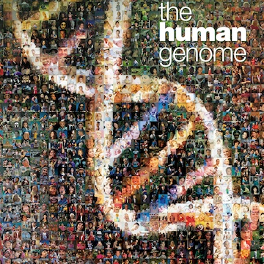
The genomic era: Mapping the genome
2001 Draft of the human genome released, 2003 final sequenced genome released.
The final genome contained ~ 3 Billion base pairs

Slide 3
The genomic era: Mapping the genome

Slide 4
The genomic era: Mapping genomic variation
2005-10-24: HapMap Public Release #19
Genome sequence for 270 individuals
4 populations
Human genome project: GCTATCGATCACT

Slide 5
The genomic era: Mapping genomic variation
2005-10-24: HapMap Public Release #19
Genome sequence for 270 individuals
4 populations
Human genome project: GCTATCGATCACT
HAPMAP:
GCTATCGATCACT
GCTATCGGTCACT
GCTATCGATCACT
GCTATCGGTCACT

Slide 6
1
2
3
4
5
6
7
8
9
10
11
12
13
14
15
16
17
18
19
20
21
22

Slide 7
1
2
3
4
5
6
7
8
9
10
11
12
13
14
15
16
17
18
19
20
21
22
X
Y

Slide 8
Inheretance & recombination
Mom
Dad

Slide 9
Inheretance & recombination
Mom
Dad

Slide 10
Inheretance & recombination
Mom
Dad
You!

Slide 11
Why does recombination matter?
You!
Genetic material in a specific part of the genome travels as a group across generations!

Slide 12
The genomic era: genotyping tag SNPs
how many angels on the head of a pin? I don’t know

Slide 13
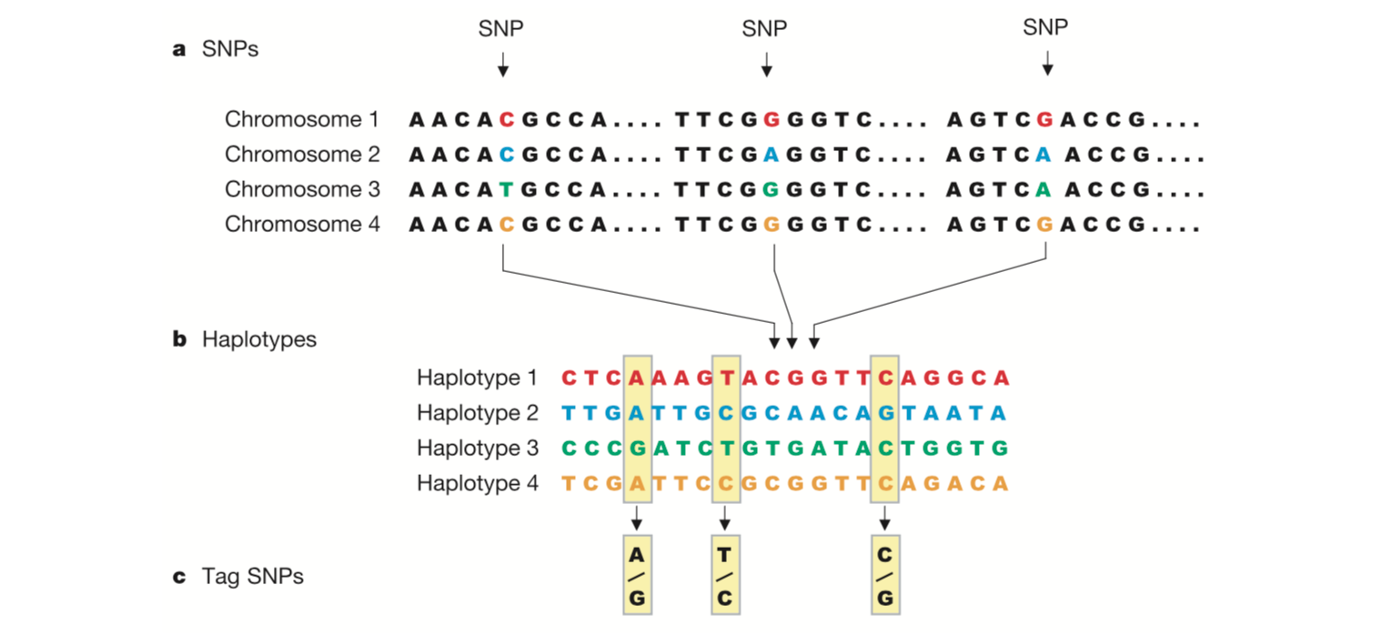
The genomic era: Mapping genomic variation
The International HapMap Consortium figure-1 Nature (2003)

Slide 14
The genomic era: Mapping genomic variation
this SNP will be associated with disease
Notes:
<number>

Slide 15
The genomic era: Case control studies
Controls
Cases
G/T
G/G
T/T
T/T
T/T
T/G
T/G
T/T
T/G
T/G
G/G
T/G
T/G
T/T
Allele G is ‘associated’ with disease
Notes:
<number>

Slide 16
The genomic era: Case control studies
Each individual contributes two counts to 2x2 table.
Test of association
where
X² has χ² distribution with 1 degrees of freedom under null hypothesis.
 | Cases | Controls | Total
G | n_{1A} | n_{1U} | n_{1·}
T | n_{0A} | n_{0U} | n_{0·}
Total | n_{·A} | n_{·U} | n··

Slide 17

The genomic era: continuous phenotype
Y_{i} = α + βX_{i} + e_{i}
where
Y_{i} = trait value for individual i
X_{i} = number of ‘A’ alleles an individual has
1.2
1
0.8
Y
0.6
0.4
0.2
0
X
0
1
2
$\text{Association} \text{test} \text{is} \text{whether} \text{β} ≠0$
Notes:
<number>

Slide 18
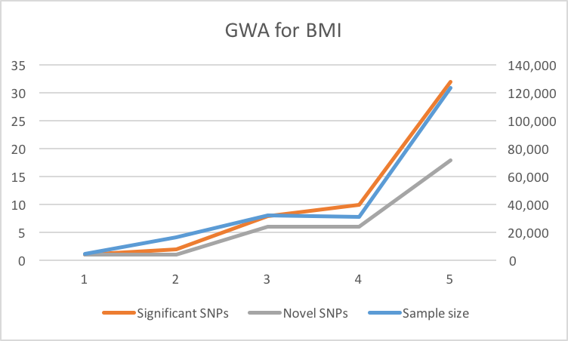
The genomic era: BMI
2007
2007
2008
2008
2010

Slide 19
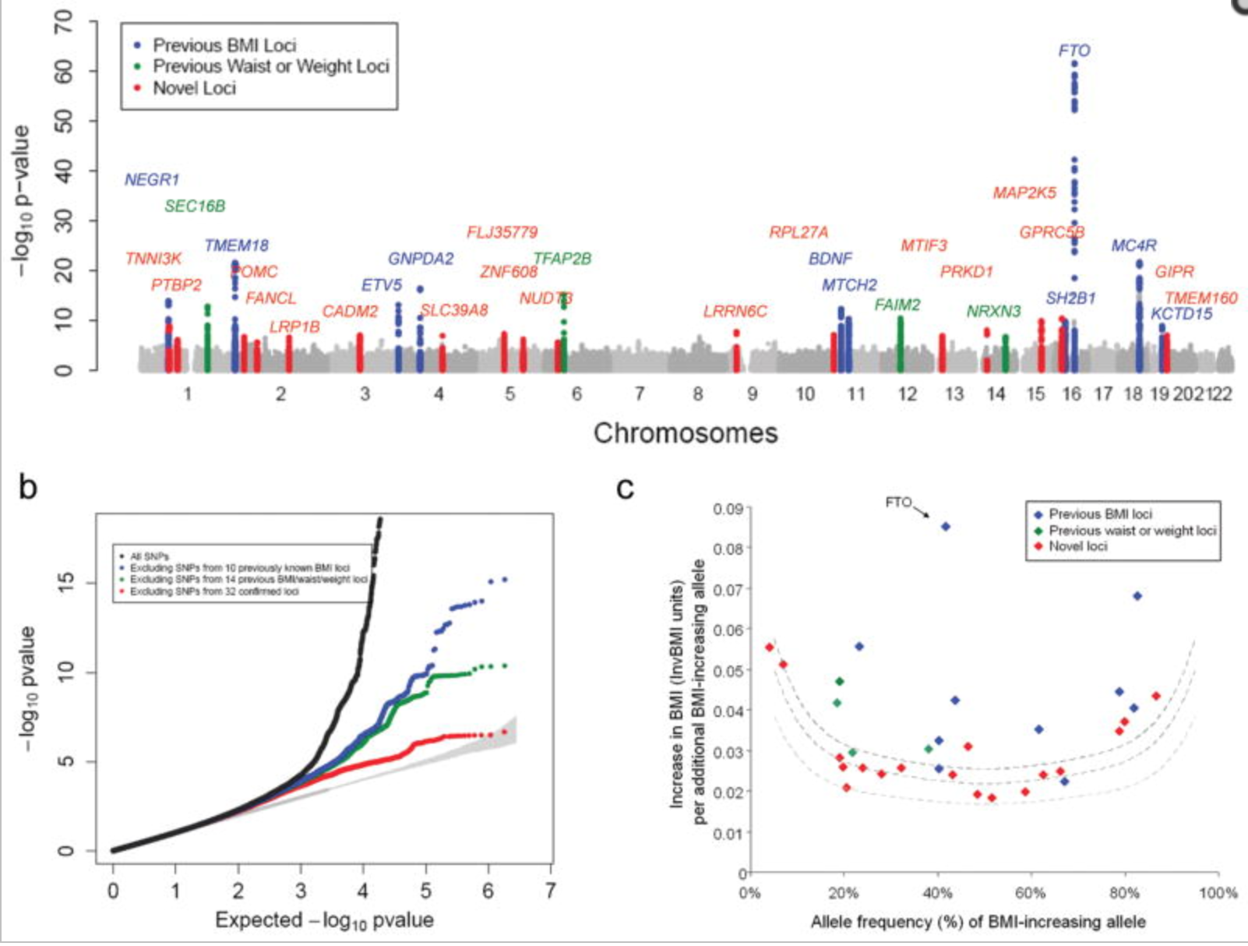
The genomic era: BMI

Slide 20

The genomic era: “Missing“ heritability
B. Maher The case of the missing heritability
Nature 2008

Slide 21

The genomic era: “Missing“ heritability
The variance explained by genotyped loci
related to complex traits, is substantially
smaller than the additive genetic variance
estimated in twin studiers of the same traits
B. Maher The case of the missing heritability
Nature 2008

Slide 22
“Missing” heritability: BMI
Elks et al (2012) Meta analysis of twin studies:
Variance in BMI explained by additive genetic effects:
75% (74%-76%)

Slide 23
“Missing” heritability: BMI
Elks et al (2012) Meta analysis of twin studies:
Variance in BMI explained by additive genetic effects:
75% (74%-76%)
Speliotes et al GWA BMI 2010 (n= 123,865):
Strongest locus: 0.34% of variance in BMI
All significant loci(32): 1.45% of variance in BMI
99.5%
98.1%
96.4%

Slide 24
“Missing” heritability: BMI
Elks et al (2012) Meta analysis of twin studies:
Variance in BMI explained by additive genetic effects:
75% (74%-76%)
Speliotes et al GWA BMI 2010 (n= 123,865):
Strongest locus: 0.34% of variance in BMI
All significant loci(32): 1.45% of variance in BMI
Locke et al GWA BMI 2015 (n= 339,224):
All significant loci(97): 2.7% of variance in BMI
99.5%
98.1%
96.4%

Slide 25
“Missing” heritability: BMI
Elks et al (2012) Meta analysis of twin studies:
Variance in BMI explained by additive genetic effects:
75% (74%-76%)
Speliotes et al GWA BMI 2010 (n= 123,865):
Strongest locus: 0.34% of variance in BMI
All significant loci(32): 1.45% of variance in BMI
Locke et al GWA BMI 2015 (n= 339,224):
All significant loci(97): 2.7% of variance in BMI
All loci: 2.7% of variance in BMI
99.5%
98.1%
96.4%

Slide 26
“Missing” heritability: BMI
Elks et al (2012) Meta analysis of twin studies:
Variance in BMI explained by additive genetic effects:
75% (74%-76%)
Yang et al (2012) GCTA:
16.5% of variation in BMI explained by genotyped SNPs
Lock et al (2015) GCTA:
21.6% of variation in BMI explained by measured SNPs
71.2%
78%
99.5%
98.1%
96.4%

Slide 27
“Missing” heritability: BMI
Elks et al (2012) Meta analysis of twin studies:
Variance in BMI explained by additive genetic effects:
75% (74%-76%)
Yang et al (2014) GCTA-LDMS:
27% of variance explained by imputed SNPs
71.2%
78%
64%
99.5%
98.1%
96.4%

Slide 28
“Missing” heritability: BMI
Elks et al (2012) Meta analysis of twin studies:
Variance in BMI explained by additive genetic effects:
75% (74%-76%)
Yang et al (2014) GCTA-LDMS:
27% of variance explained by imputed SNPs
Hypothesized causes
Rare genetic variation
Overestimation of additive variance in twin models
71.2%
78%
64%
99.5%
98.1%
96.4%

Slide 29
“Missing” heritability: BMI
Elks et al (2012) Meta analysis of twin studies:
Variance in BMI explained by additive genetic effects:
75% (74%-76%)
Yang et al (2014) GCTA-LDMS:
27% of variance explained by imputed SNPs
Hypothesized causes
Rare genetic variation
Overestimation of additive variance in twin models
71.2%
78%
64%
99.5%
98.1%
96.4%

Slide 30
“Missing” heritability: BMI
Hypothesized causes
1. Rare genetic variation
2. Overestimation of additive variance in twin model
  Allow for common environment
    h² 75% -> 62%
65.2%
74.2%
56.5%
99.4%
97.7%
95.6%

Slide 31
“Missing” heritability: BMI
Hypothesized causes
1. Rare genetic variation
2. Overestimation of additive variance in twin model
  Allow for common environment
    h² 75% -> 62%
  Rely on family members instead of twins
    h² 75% -> 46%
53.0%
65.2%
41.3%
99.3%
97.7%
96.8%

Slide 32
“Missing” heritability: BMI
Hypothesized causes
1. Rare genetic variation
2. Overestimation of additive variance in twin model
  Allow for common environment
    h² 75% -> 62%
  Rely on family members instead of twins
    h² 75% -> 46%
  Fit the Nuclear Twin-Family model
53.0%
65.2%
41.3%
99.3%
97.7%
96.8%

Slide 33
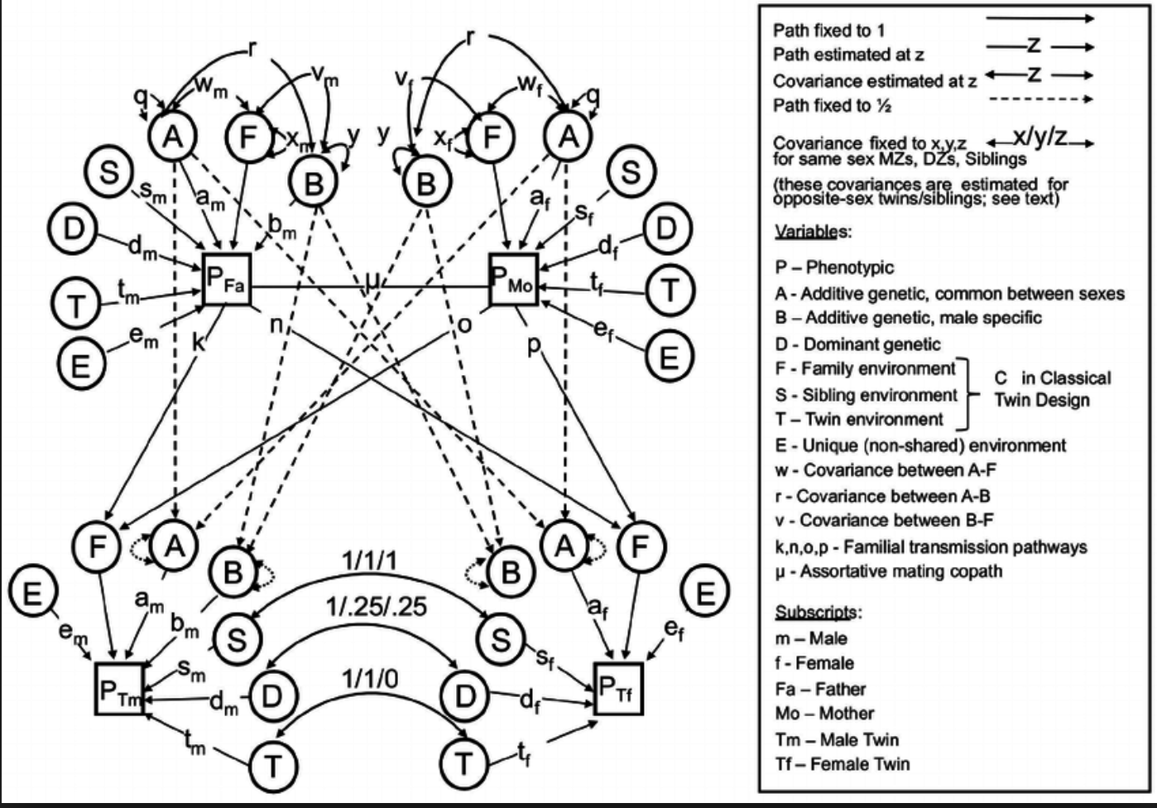
“Missing” heritability: BMI
Hypothesized causes
1. Rare genetic variation
2. Overestimation of additive variance in twin model
  Allow for common environment
    h² 75% -> 62%
  Rely on family members instead of twins
    h² 75% -> 46%
  Fit the Nuclear Twin-Family model
    Non-random mating
    Dominance variation
    Common environment
Maes, Eaves, Neale 1997

Slide 34
“Missing” heritability: BMI
Hypothesized causes
1. Rare genetic variation
2. Overestimation of additive variance in twin model
  Allow for common environment
    h² 75% -> 62%
  Rely on family members instead of twins
    h² 75% -> 46%
  Fit the Nuclear Twin-Family model
    h² 75% -> ~37%
42.0%
57.0%
27.5%
99.1%
96.1%
92.7%

Slide 35
“Missing” heritability: BMI
Hypothesized causes
1. Rare genetic variation
2. Overestimation of additive variance in twin model
  Allow for common environment
    h² 75% -> 62%
  Rely on family members instead of twins
    h² 75% -> 46%
  Fit the Nuclear Twin-Family model
    h² 75% -> ~37%
27.5% aprox 95% C.I: 17.0% to 38.0%
42.0%
57.0%
99.1%
96.1%
92.7%

Slide 36
“Missing” heritability: BMI
27.5% aprox C.I: 17.0% to 38.0%
The ratio of the “ Best” estimate based on genotyped distantly related individuals over
the “ Best” estimate form a complex twin-family
Twin model captures:
Additive genetic variation
Dominance variation
Common environment “Special twin environment”
Assortment
Twin model assumes:
Absence of GxAge interaction
GCTA captures:
99% of common additive genetic effects, 68% of additive rare genetic effects*
GCTA assumes:
No assortment
* Yang et al 2014

Slide 37
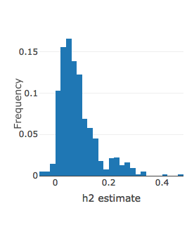
“Missing” heritability: EVERYTHING!
Raymond Walters, Ben Neale and many others used UK-biobank ()
1. a 500.000 person health survey in the UK)
2. Genetic data available
3. Estimate (SNP) heritability of 2000+ traits
4. www. nealelab.is/blog
5. http://ldsc.broadinstitute.org/ldhub/

Slide 38
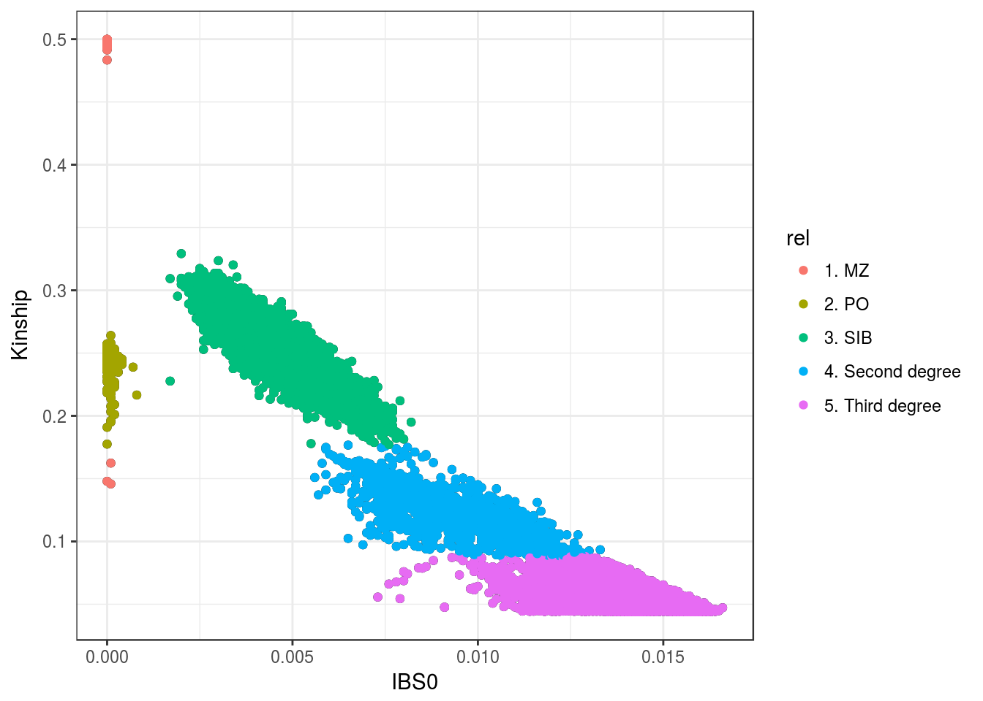
“Missing” heritability: EVERYTHING!
UK biobank also has relatives in it!
Michel Nivard
Matthijs van der Zee
Hill Fung Ip
Bart Baselmans
Eco de Geus
Meike Bartels
Dorret I Boomsma
Andrea Ganna
Ben Neale
Raymond Walters

Slide 39
“Missing” heritability: EVERYTHING!
Covariance sibs: .5* Va + Vc + .25*Vd
Covariance parent offspring : .5* Va + Vc
Covariance uncle-niece: .25*Va
Covariance cousins: .125*Va
Michel Nivard
Matthijs van der Zee
Hill Fung Ip
Bart Baselmans
Eco de Geus
Meike Bartels
Dorret I Boomsma
Andrea Ganna
Ben Neale
Raymond Walters

Slide 40
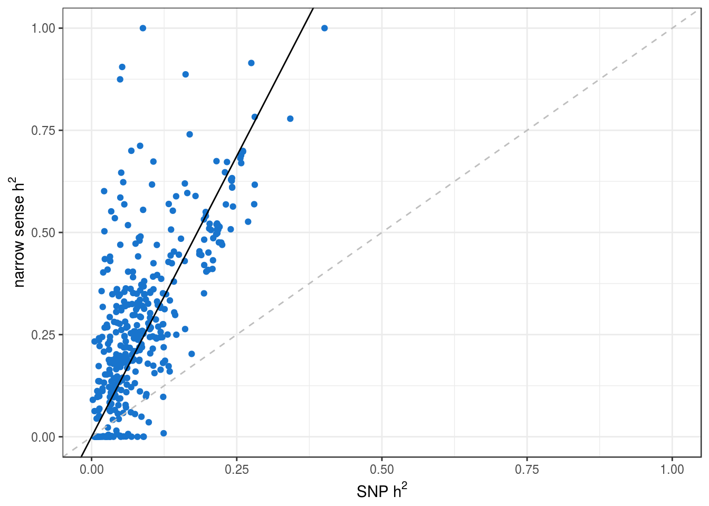
“Missing” heritability: EVERYTHING!
Michel Nivard
Matthijs van der Zee
Hill Fung Ip
Bart Baselmans
Eco de Geus
Meike Bartels
Dorret I Boomsma
Andrea Ganna
Ben Neale
Raymond Walters

Slide 41
“Missing” heritability: EVERYTHING!
Michel Nivard
Matthijs van der Zee
Hill Fung Ip
Bart Baselmans
Eco de Geus
Meike Bartels
Dorret I Boomsma
Andrea Ganna
Ben Neale
Raymond Walters

Slide 42
“Missing” heritability: EVERYTHING!
Michel Nivard
Matthijs van der Zee
Hill Fung Ip
Bart Baselmans
Eco de Geus
Meike Bartels
Dorret I Boomsma
Andrea Ganna
Ben Neale
Raymond Walters

Slide 43
“Missing” heritability: EVERYTHING!
Michel Nivard
Matthijs van der Zee
Hill Fung Ip
Bart Baselmans
Eco de Geus
Meike Bartels
Dorret I Boomsma
Andrea Ganna
Ben Neale
Raymond Walters

Slide 44
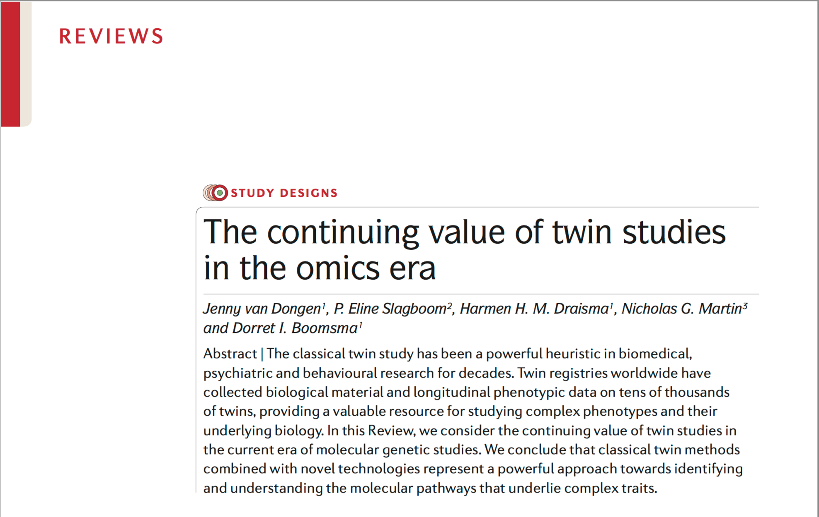
The (gen)omic era: the continued relevance of twin studies.
Van Dongen, J., Slagboom, P. E., Draisma, H. H., Martin, N. G., & Boomsma, D. I. (2012). The continuing value of twin studies in the omics era. Nature Reviews Genetics, 13(9), 640-653.

Slide 45
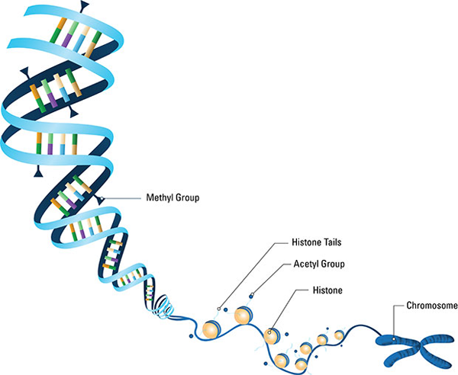
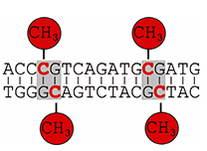
Epigenetic variation
CpG methylation can vary across the lifespan

Slide 46
Epigenetic variation
CpG methylation can vary across the lifespan
CpG methylation can vary across tissues

Slide 47
Epigenetic variation
CpG methylation can vary across the lifespan
CpG methylation can vary across tissues
CpG methylation changes the expression of genes

Slide 48
Epigenetic variation
CpG methylation can vary across the lifespan
CpG methylation can vary across tissues
CpG methylation changes the expression of genes
CpG Methylation is NOT identical in MZ twins, and does NOT correlate .5 between DZ twins

Slide 49
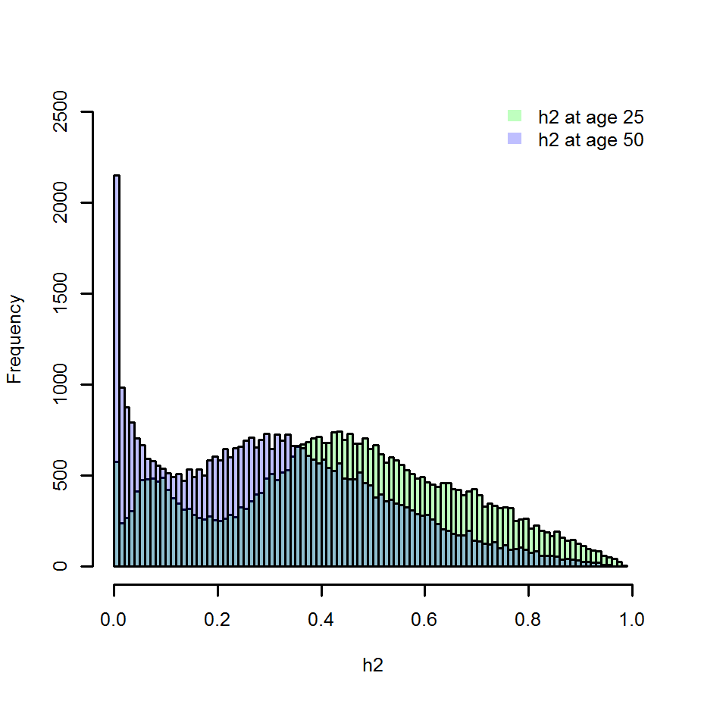
Heritability of CpG methylation
Van Dongen et al. 2016

Slide 50
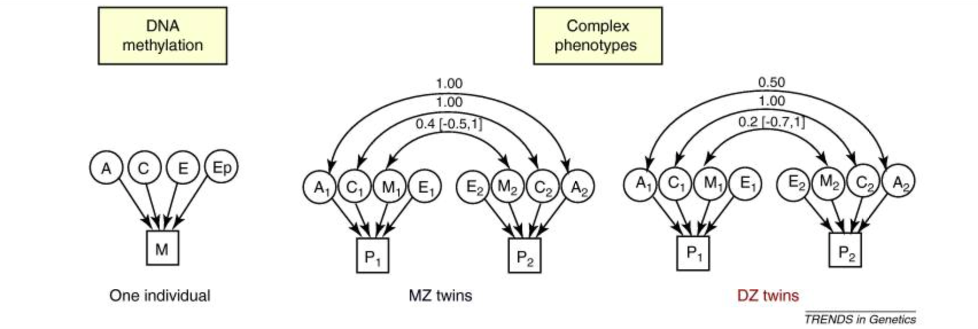
CpG Methylation in the twin model

Slide 51
CpG Methylation in the twin model
Bell & Spector (2011)

Slide 52
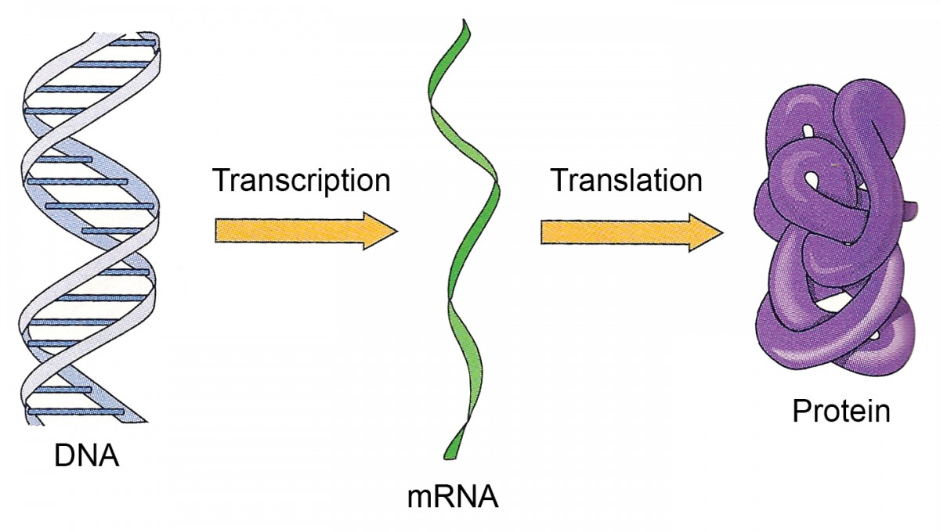
CpG Methylation in the twin model
CpG Methylation

Slide 53
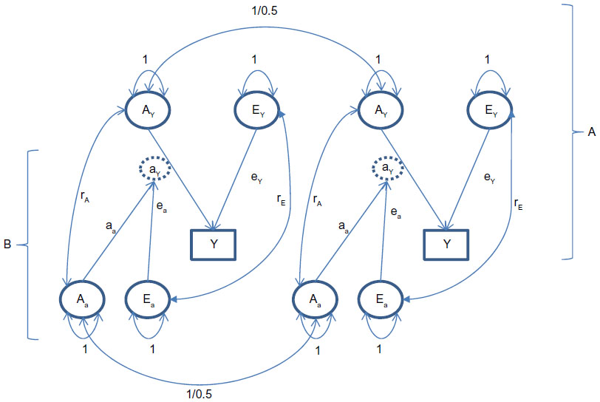
CpG Methylation in the twin model
Dolan et al. 2015

Slide 54
CpG Methylation in the twin model
Dolan et al. 2015

Slide 55
CpG Methylation in the twin model: Caveats
1. The causality is problematic
y
M

Slide 56
CpG Methylation in the twin model: Caveats
1. The causality is problematic
y
M
OR
y
M

Slide 57
CpG Methylation in the twin model: Caveats
1. The causality is problematic
y
M
OR
y
M
OR
y
M

Slide 58
CpG Methylation in the twin model: Caveats
1. The causality is problematic
y
M
OR
y
M
OR
y
M
Brain
Blood
M
y
M

Slide 59
CpG Methylation in the twin model: Caveats
The causality is problematic
The DZ and MZ might behave largely additive

Slide 60
CpG Methylation in the twin model: Caveats
The causality is problematic
The DZ and MZ might behave largely additive
MZ= 1/ DZ= .5
A
A
T1
T2

Slide 61
CpG Methylation in the twin model: Caveats
The causality is problematic
The DZ and MZ might behave largely additive
Methylation varies over time
MZ= 1/ DZ= .5
A
A
T1
T2
MZ= ~ .4/ DZ= ~ .2
M
M

Slide 62
CpG Methylation in the twin model: Caveats
The causality is problematic
The DZ and MZ might behave largely additive
Methylation varies over time
Anxiety wave 1
Anxiety wave 2
Anxiety wave 3
Anxiety wave 4

Slide 63
CpG Methylation in the twin model: Caveats
The causality is problematic
The DZ and MZ might behave largely additive
Methylation varies over time
Methyl?
Anxiety wave 1
Anxiety wave 2
Anxiety wave 3
Anxiety wave 4

Slide 64
CpG Methylation in the twin model: Caveats
The causality is problematic
The DZ and MZ might behave largely additive
Methylation varies over time
Methyl?
Anxiety wave 1
Anxiety wave 2
Anxiety wave 3
Anxiety wave 4

Slide 65
CpG Methylation in the twin model: Caveats
The causality is problematic
The DZ and MZ might behave largely additive
Methylation varies over time
Methyl?
Methyl?
Methyl?
Methyl?
Anxiety wave 1
Anxiety wave 2
Anxiety wave 3
Anxiety wave 4

Slide 66
The next step: Gene expression

Slide 67
Heritability of gene expression
Wright et al. (2014):
Assessed gene expression profiles in 2,752 twins
Assessedd the relationship between Gene expression
and DNA sequence
Wright, F. A., Sullivan, P. F., Brooks, A. I., Zou, F., Sun, W., Xia, K., ... & Abdellaoui, A. (2014). Heritability and genomics of gene expression in peripheral blood. Nature genetics, 46(5), 430-437.

Slide 68
Heritability of gene expression
Wright, F. A., Sullivan, P. F., Brooks, A. I., Zou, F., Sun, W., Xia, K., ... & Abdellaoui, A. (2014). Heritability and genomics of gene expression in peripheral blood. Nature genetics, 46(5), 430-437.

Slide 69
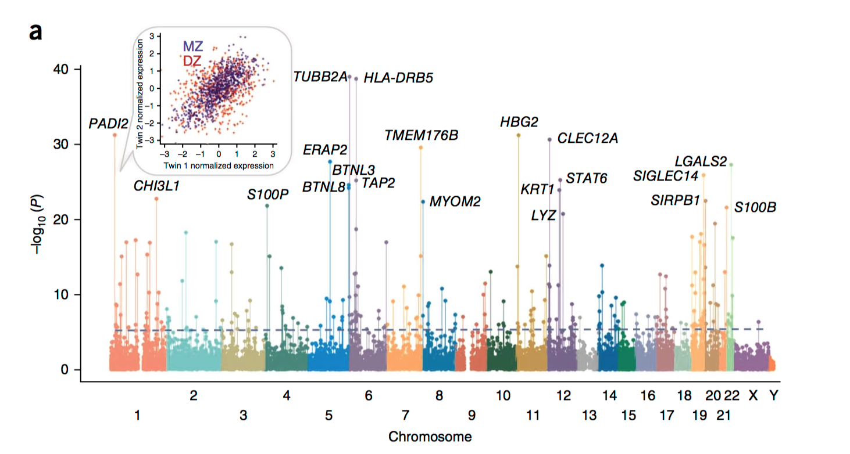
Heritabillity of gene expression
Wright, F. A., Sullivan, P. F., Brooks, A. I., Zou, F., Sun, W., Xia, K., ... & Abdellaoui, A. (2014). Heritability and genomics of gene expression in peripheral blood. Nature genetics, 46(5), 430-437.

Slide 70
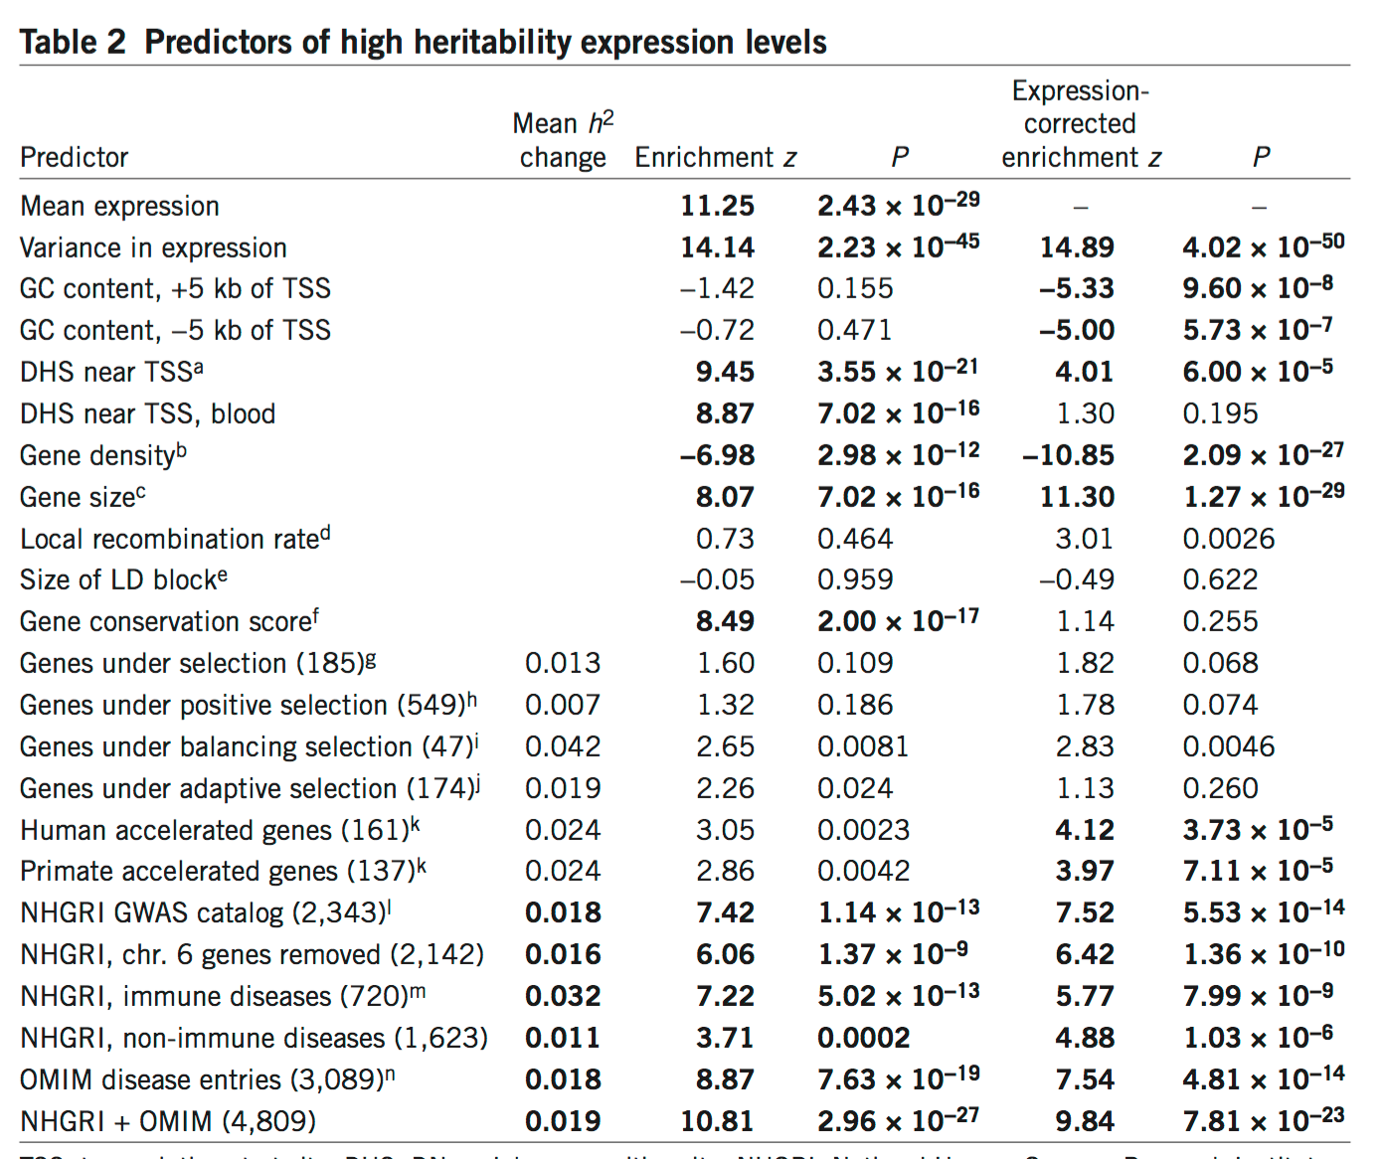
Heritability of gene expression
Not all genes are equally heritable!
Wright, F. A. et al (2014)

Slide 71
Heritability of gene expression
Genes near regions that can be epigenetically
Modified, are less heritable.
Wright, F. A. et al (2014)

Slide 72
Heritability of gene expression
Large genes are more heritable, Genes in gene dense regions are less heritable.
Wright, F. A. et al (2014)

Slide 73
Heritability of gene expression
Genes associate to disease, and near genome wide
Signals for complex traits show increased heritability
Wright, F. A. et al (2014)

Slide 74
How can all of this help your research?
Tissue Gene expression:
http://www.gtexportal.org/home/
Developmental transcriptome:
http://www.brainspan.org/rnaseq/search/index.html
Developmental epigenome:
http://www.brainspan.org/static/download.html

Slide 75
Genetic epidemiology in the genomic age: Missing Heritability & The Role of Twin Studies in the Genomic Era
The twin study has continued use in the (gen)omic era.
Missing heritability may still be as problem but we have gotten a reasonable handle on its magnitude.

