Slide 1



Power and p-values
Denotes
He-man
Denotes
practical
Benjamin Neale
March 8th, 2018
International Twin Workshop, Boulder, CO

Slide 2
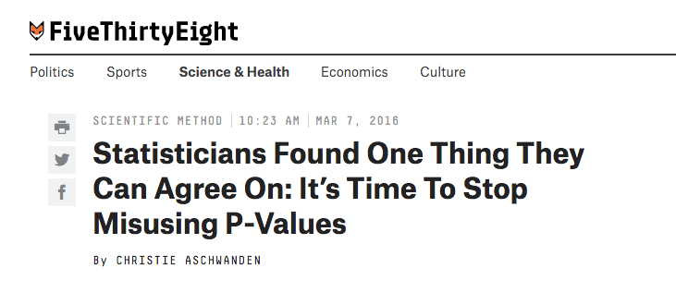
p-values are in the press

Slide 3
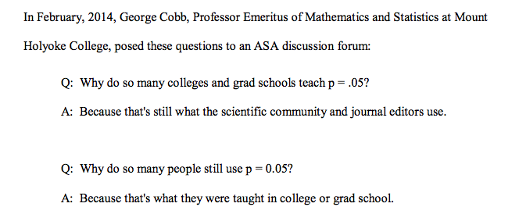
What we’ve been teaching

Slide 4
What exactly is a p-value?
A way to ask if the data are consistent with a null model

Slide 5
What’s a null model?
The baseline model for comparison, usually no effect [e.g. no heritability]

Slide 6
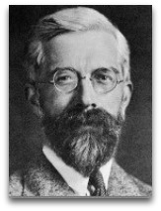
Whose fault is it anyway?
Distrust of his aunt’s claims of being able to discriminate between milk in first or tea in first

Slide 7

Hypothesis testing
Alternative hypothesis
Some effect
Null hypothesis
No effect

Slide 8
Possible scenarios
Statistics
 | Reject H₀ | Fail to reject H₀
H₀ is true | α | 1-α
H_{a} is true | 1-β | β
Truth
α=type 1 error rate
β=type 2 error rate
1-β=statistical power

Slide 9
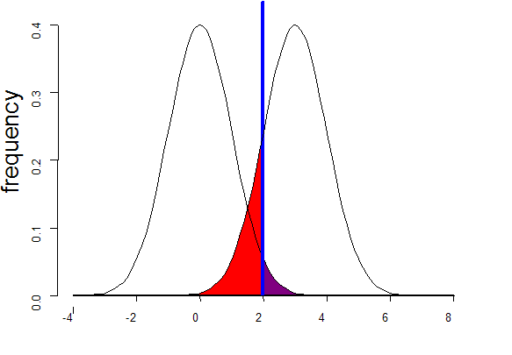
Standard Case
Sampling distribution if H₀ were true
Sampling distribution if H_{A} were true
alpha 0.05
POWER:
1 - β
β
α
T
Non-centrality parameter

Slide 10
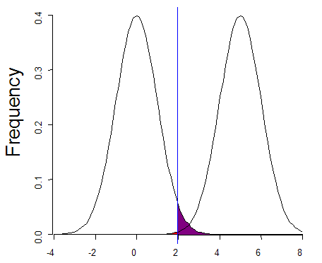
Increased effect size
Sampling distribution if H₀ were true
Sampling distribution if H_{A} were true
alpha 0.05
POWER:
1 - β ↑
β
α
T
Non-centrality parameter

Slide 11
Standard Case
Sampling distribution if H₀ were true
Sampling distribution if H_{A} were true
alpha 0.05
POWER:
1 - β
β
α
T
Non-centrality parameter

Slide 12
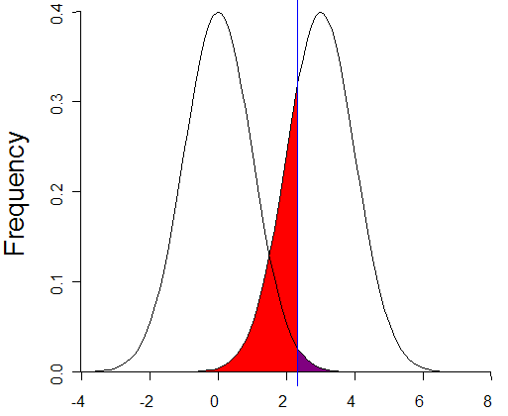
More conservative α
Sampling distribution if H₀ were true
Sampling distribution if H_{A} were true
alpha 0.01
POWER:
1 - β ↓
β
α
T
Non-centrality parameter

Slide 13
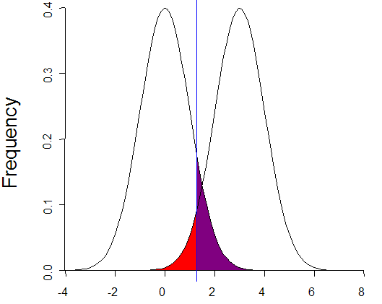
Less conservative α
Sampling distribution if H₀ were true
Sampling distribution if H_{A} were true
alpha 0.10
POWER:
1 - β ↑
β
α
T
Non-centrality parameter

Slide 14
Standard Case
Sampling distribution if H₀ were true
Sampling distribution if H_{A} were true
alpha 0.05
POWER:
1 - β
β
α
T
Non-centrality parameter

Slide 15
Increased sample size
Sampling distribution if H₀ were true
Sampling distribution if H_{A} were true
alpha 0.05
POWER:
1 - β ↑
β
α
T
Non-centrality parameter

Slide 16
Increased sample size
Sampling distribution if H₀ were true
Sampling distribution if H_{A} were true
alpha 0.05
POWER:
1 - β ↑
Sample size scales linearly with chi square NCP
β
α
T
Non-centrality parameter

Slide 17
Statistical Analysis
Rejection of H₀
Non-rejection of H₀
Type I error
at rate α
Nonsignificant result
(1- α)
H₀ true
Truth
Significant result
(1-β)
Type II error
at rate β
H_{A} true

Slide 18
What is power?
Definitions of power
The probability that the test will reject the null hypothesis if the alternative hypothesis is true
The chance the your statistical test will yield a significant result when the effect you are testing exists

Slide 19
Practical 1
We are going to simulate a normal distribution using R
We can do this with a single line of code, but let’s break it up

Slide 20
Simulation functions
R has functions for many distributions
Normal, χ², gamma, beta (others)
Let’s start by looking at the random normal function: rnorm()

Slide 21
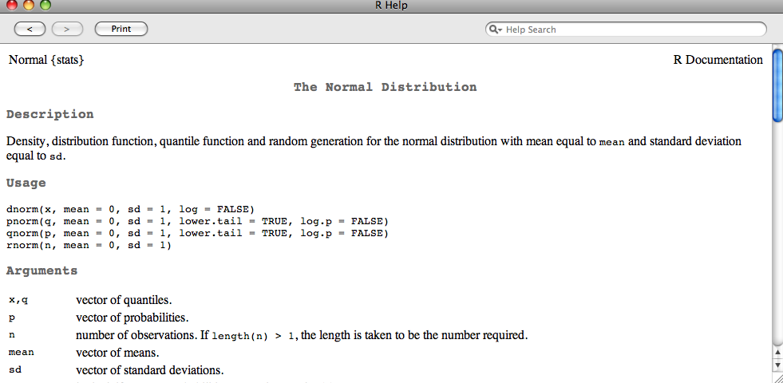
rnorm Documentation
In R: ?rnorm

Slide 22
rnorm syntax
rnorm(n, mean = 0, sd = 1)
Function name
Mean of distribution
with default value
Number of observations to simulate
Standard deviation of distribution
with default value

Slide 23
R script: Norm_dist_sim.R
This script will plot 4 samples from the normal distribution
Look for changes in shape
Thoughts?

Slide 24
One I made earlier

Slide 25
Concepts
Sampling variance
  We saw that the ‘normal’ distribution from 100 observations looks stranger than for 1,000,000 observations
Where else may this sampling variance happen?
How certain are we that we have created a good distribution?

Slide 26
Mean estimation
Rather than just simulating the normal distribution, let’s simulate what our estimate of a mean looks like as a function of sample size
We will run the R script mean_estimate_sim.R

Slide 27
R script: mean_estimate_sim.R
This script will plot 4 samples from the normal distribution
Look for changes in shape
Thoughts?

Slide 28
One I made earlier

Slide 29
Standard Error
We see an inverse relationship between sample size and the variance of the estimate
This variability in the estimate can be calculated from theory
SE_{x} = s/√n
SE_{x} is the standard error, s is the sample standard deviation, and n is the sample size

Slide 30
Key Concept 1
The sampling variability in my estimate affects my ability to declare a parameter as significant (or significantly different)

Slide 31
Power definition again
The probability that the test will reject the null hypothesis if the alternative hypothesis is true

Slide 32
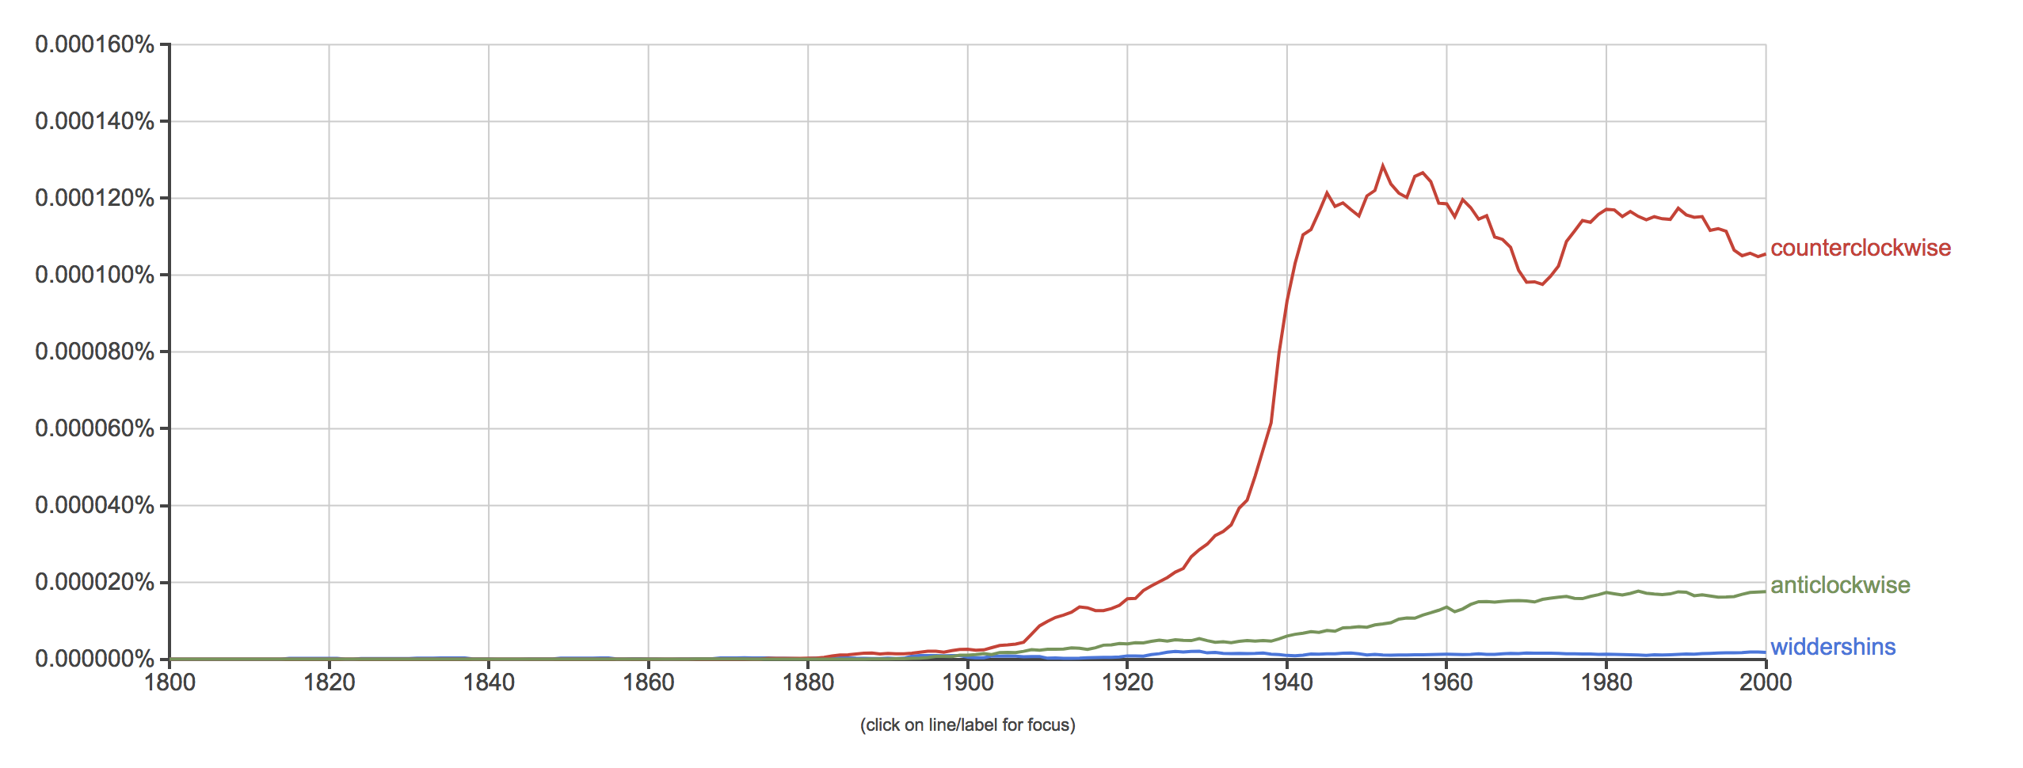
What about when you have the total population?

Slide 33
Ascertainment
Why being picky can be good and bad

Slide 34
Bivariate plot for actors in Hollywood

Slide 35
Bivariate plot for actors who “made it” in Hollywood

Slide 36
Bivariate plot for actors who “made it” in Hollywood
P<2e-16

Slide 37
What happened?
Again – you’re meant to say something
I’m waiting…

Slide 38
Ascertainment
Bias in your parameter estimates
  Bias is a difference between the “true value” and the estimated value
Can apply across a range of scenarios
  Bias estimates of means, variances, covariances, betas etc.

Slide 39
When might we want to ascertain?
For testing means, ascertainment increases power
For characterizing variance:covariance structure, ascertainment can lead to bias

Slide 40
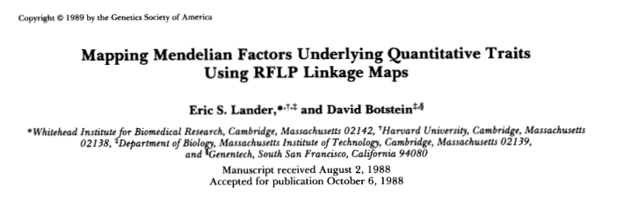
When might we want to ascertain?
For testing means, ascertainment increases power
For characterizing variance:covariance structure, ascertainment can lead to bias

Slide 41
Practical!
Power calculations using NCP
We create the model
  specifying our effect sizes
We then simulate data
  empirical = T means that the simulated data matches the specifications [within some error]
The chi square can then be used to generate power

