Slide 1
(Re) introduction to the OS and R Sarah Medland Boulder 2018

Slide 2
Getting the most out of the workshop
Ask questions!!!
Don’t sit next to someone you already know
Work with someone with a different skillset and different experience level
Use the workshop laptop
You will have access to your files after you leave
Come to the social functions
Ask questions!!!

Slide 3
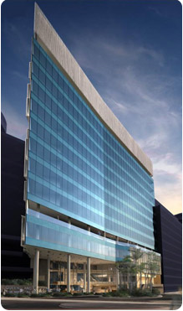
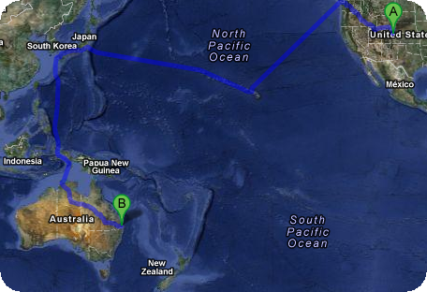
I work in Brisbane at QIMR
Sarah Medland

Slide 4
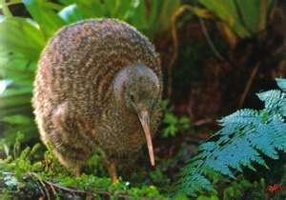
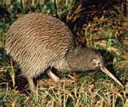
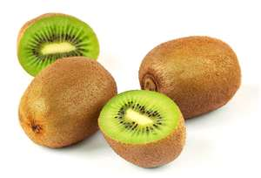
not

Slide 5
Morning sessions
Optional
Feel free to wander in and out/check email etc
Topics
Shift in response to feedback
Tomorrow: R intro
Wednesday: PCA
Thursday: Family Based association
Friday: TBA

Slide 6
Superfast intro to Linux

Slide 7
This year’s OS
Debian (linux)
Free
Many free software packages available
Open office
R
PSPP
Terminal
Based on Unix
long and venerable history
http://en.wikipedia.org/wiki/Unix

Slide 8
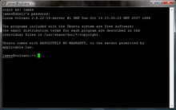
Close but not the same…
Most basic shortcuts will work
crtl+C for copy crtl+V for paste etc
Supports folder based navigation
/\ BIG PROBLEM is \ vs /
You will have used some version of unix previously

Slide 9
File hygiene is very important
Files are stored in Unix format not DOS or Mac
Changes the line ending characters
Use dos2unix, unix2dos, mac2unix, unix2mac to change formats
Can use the file command to check format
Unix systems are case sensitive!
NO SPACES in your file/directory names!!
Wildcards ie dos2unix *.dat

Slide 10
It is (relatively) easy to break a server and very easy to break a queuing system
So it is worth doing a bit of googling and talking to your sysadmins before jumping in.
UNIX was not designed to stop its users from doing stupid things, as that would also stop them from doing clever things.
— Doug Gwyn

Slide 11
Superfast intro to R

Slide 12
What is it?
R is an interpreted computer language.
System commands can be called from within R
R is used for data manipulation, statistics, and graphics. It is made up of:
operators (+ - <- * %*% …) for calculations on arrays & matrices
large, coherent, integrated collection of functions
facilities for making unlimited types of publication quality graphics
user written functions & sets of functions (packages); 800+ contributed packages so far & growing
Notes:
12

Slide 13
Advantages
Fast** and free.
State of the art: Statistical researchers provide their methods as R packages. SPSS and SAS are years behind R!
great graphics.
Active user community
Excellent for simulation, programming, computer intensive analyses, etc.
Forces you to think about your analysis.
Interfaces with database storage software (SQL)
Notes:
13

Slide 14
Disadvantages
Not user friendly @ start - steep learning curve, minimal GUI.
No commercial support; figuring out correct methods or how to use a function on your own can be frustrating.
Easy to make mistakes and not know.
Working with large datasets is limited by RAM!!!
Data prep & cleaning can be messier & more mistake prone in R vs. SPSS or SAS
Hostility on the R listserve
Notes:
14

Slide 15
Learning R....
Notes:
15

Slide 16
R-help listserve....
Once you appreciate that you have seriously misread the page, things will become a lot clearer. (2005)
You will need to do your homework a lot more carefully, as it seems you don't have enough knowledge to recognise the errors you are making. (2007)
Well, don't try to use a Makefile as you do not know what you are doing. (2013)
It is user lack-of-understanding: there is no error here. (2013)
Notes:
16

Slide 17
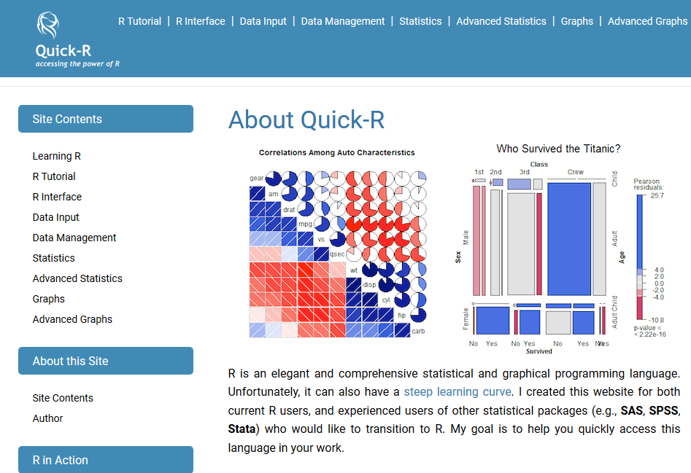
Quick R
Notes:
17

Slide 18
Quick R
Notes:
18

Slide 19
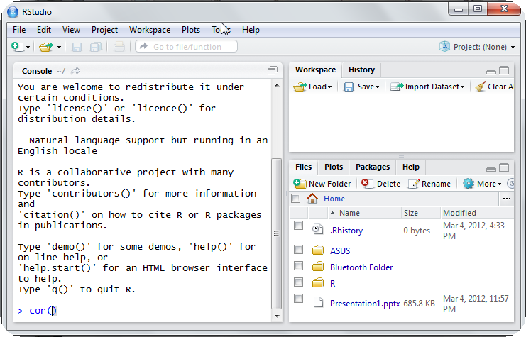
Using R this week
R-studio http://rstudio.org/

Slide 20
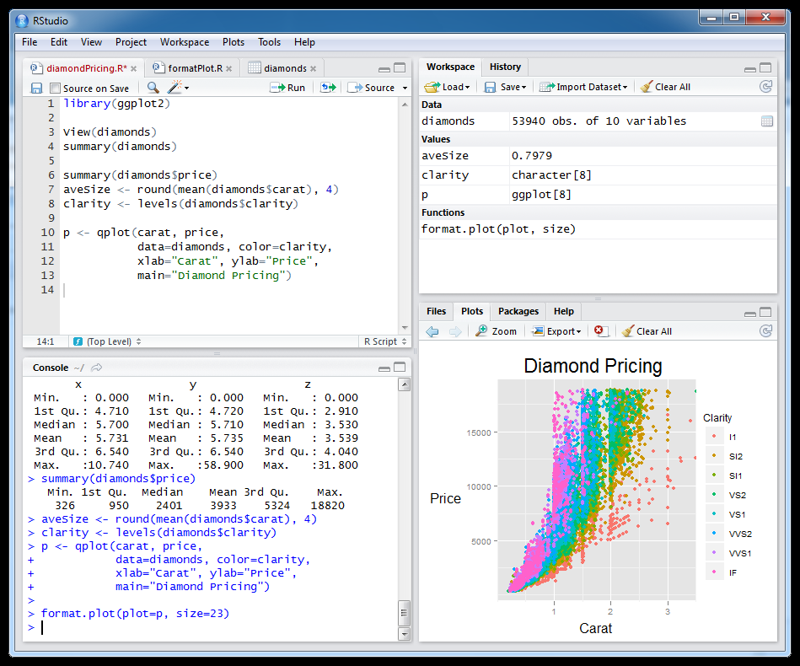
Setting this up at home
Install R first
Install R studio
Install packages

Slide 21
Start up R via R studio
4 windows:
Syntax – can be opened in regular txt file - saved
Terminal – output & temporary input - usually unsaved
Data manager – details of data sets and variables
Plots etc
Notes:
21

Slide 22
R sessions are interactive
Notes:
22

Slide 23
GETTING STARTED

Slide 24
How to use help in R?
R has a help system built in.
If you know which function you want help with simply use ?_______ or help(_____) with the function in the blank.
?hist.
help(hist)
If you don’t know which function to use, then use help.search(“_______”).
help.search(“histogram”).

Slide 25
Importing Data
First make sure your data is in an easy to read format such as space, tab or CSV
Use code:
D <- read.table(“ozbmi2.txt”,header=TRUE)
D <-read.table(“ozbmi2.txt”,na.strings=“-99”,header=TRUE)
D <- read.table(“ozbmi2.csv”, sep=“,”
header=TRUE)
D <- read.csv(“ozbmi2.csv”, header=TRUE)

Slide 26
Exporting Data
Tab delimited
write.table(D, “newdata.txt”,sep=“\t”)
csv
write.csv(D, “newdata.csv”)
Other options include writing to xls, spss, sas and other formats

Slide 27
Checking data
#list the variables in D
names(D)
# dimensions of D
dim(D)
# print the first 10 rows of D
head(D, n=10)
#referring to variables in D
#format is Object$variable
head(D$age, n=10)

Slide 28
Basic Manipulation
#You can make new variables within an existing object
D$newage<- D$age*100
#Or overwrite a variable
D$age<- D$age*100
#Or recode a variable
#D$catage <- ifelse(D$age > 30, c("older"), c("younger"))

Slide 29
Describing data
#Mean and variance
mean(D$age, na.rm =TRUE)
var(D$age , na.rm =TRUE)

Slide 30
Describing data
A bit more info
summary(D$age)
summary(D$age[which(D$agecat==1)])
What about a categorical variable
table(D$agecat)
table(D$agecat,D$zyg)

Slide 31
Some basic analysis
Correlations anyone?
cor(D$wt1,D$bmi1, use="complete")
cor(D$ht1,D$bmi1, use="complete")

Slide 32
Basic plots
Histogram
#basic
hist(D$age)
#basic
hist(D$age, breaks=12, col=‘red’)
# Add labels
hist(D$age, breaks=12, col='red', xlab='age in years',main='Histogram of age‘)

Slide 33
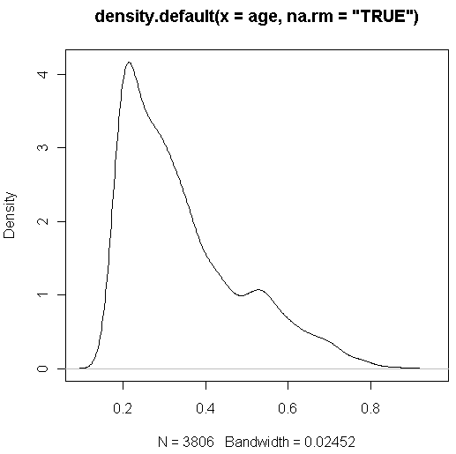
Looking at your data...
#Kernal density plot
density(D$age, na.rm = "TRUE")
# returns the density data

Slide 34
Looking at your data...
#Kernal density plot by zyg?
library(sm)
attach(D)
# create value labels
zyg.f <- factor(zyg, levels= seq(1,5), labels = c("MZF", "MZM", "DZF", "DZM", "DZOS"))
# plot densities
sm.density.compare(age, zyg, xlab="Years")
title(main="Years by ZYG")
# add legend
colfill<-c(2:(2+length(levels(zyg.f))))
legend(.8,3, levels(zyg.f), fill=colfill)

Slide 35
Huh what?
> library(sm)
Error in library(sm) : there is no package called 'sm'
> sm.density.compare(age, zyg, xlab="Years")
Error: could not find function "sm.density.compare"

Slide 36
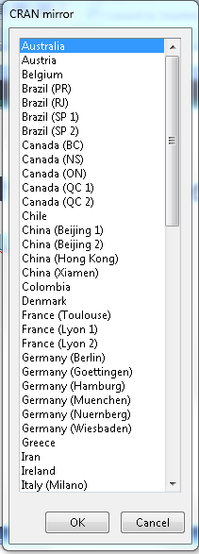
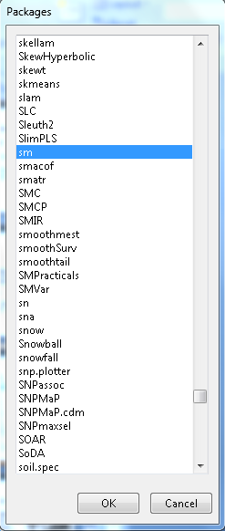
Adding a package...
install.packages()

Slide 37
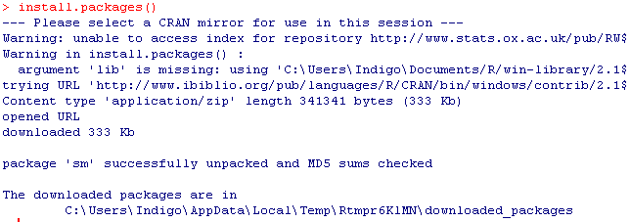

Slide 38
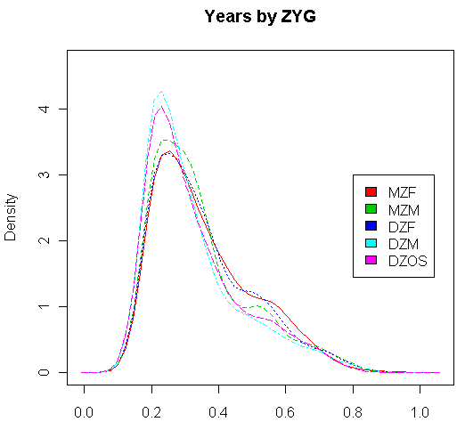
Looking at your data...
#Kernal density plot by zyg?
library(sm)
attach(D)
# create value labels
zyg.f <- factor(zyg, levels= seq(1,5),
labels = c("MZF", "MZM", "DZF", "DZM", "DZOS"))
# plot densities
sm.density.compare(age, zyg, xlab="Years”)
title(main="Years by ZYG")
# add legend
colfill<-c(2:(2+length(levels(zyg.f))))
legend(.8,3, levels(zyg.f), fill=colfill)

Slide 39
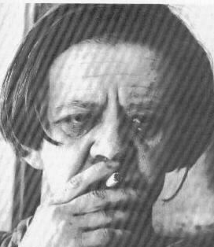
Final Words of Warning
“Using R is a bit akin to smoking. The beginning is difficult, one may get headaches and even gag the first few times. But in the long run, it becomes pleasurable and even addictive. Yet, deep down, for those willing to be honest, there is something not fully healthy in it.” --Francois Pinard
Notes:
39

