Slide 1












31st International Workshop on Statistical Genetic Methods for Human Complex Traits - 2018
Mike Neale (director)
Sarah Medland(co)
David Evans
Ben Neale
Hermine Maes
Conor Dolan
Lucia Colodro Conde
Nathan Gillespie
Brad Verhulst
Tim Bates
John Hewitt (host)
Jeff Lessem
Matt Keller
Stacey Cherny
Elizabeth Prom-Wormley
Nick Martin
Eveline de Zeeuw
Michel Nivard
Rob Kirkpatrick
Pete Hatemi
Mike Hunter

Slide 2
The Causes of Variation
2018 International Workshop on Statistical Genetic Methods for Human Complex Traits
Boulder, CO.
Nick Martin
Queensland Institute of Medical Research
Brisbane, Australia
March 5, 2018

Slide 3
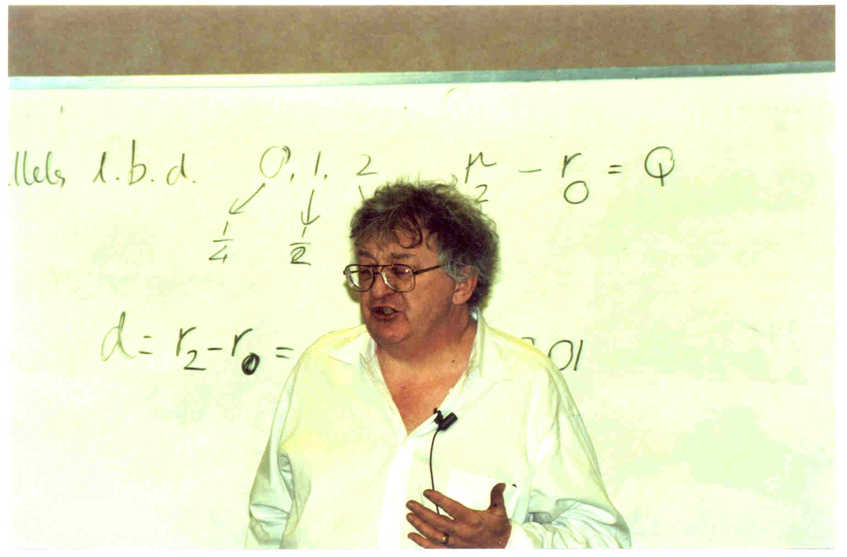
Lindon Eaves

Slide 4
GOALS – “Orientation”
To outline some of the basic issues that we shall address this week
To set some of the issues in their historical context in the story of genetics and its application to human variation.

Slide 5
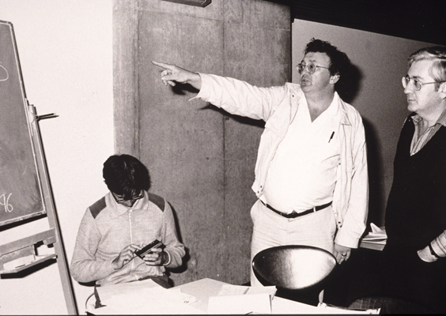
David Fulker

Slide 6
“Genetics”
The Study of
Variation and Heredity

Slide 7
“Variation”
“Why aren’t we all the same?”

Slide 8
“Heredity”
“Why do things run in families?”

Slide 9
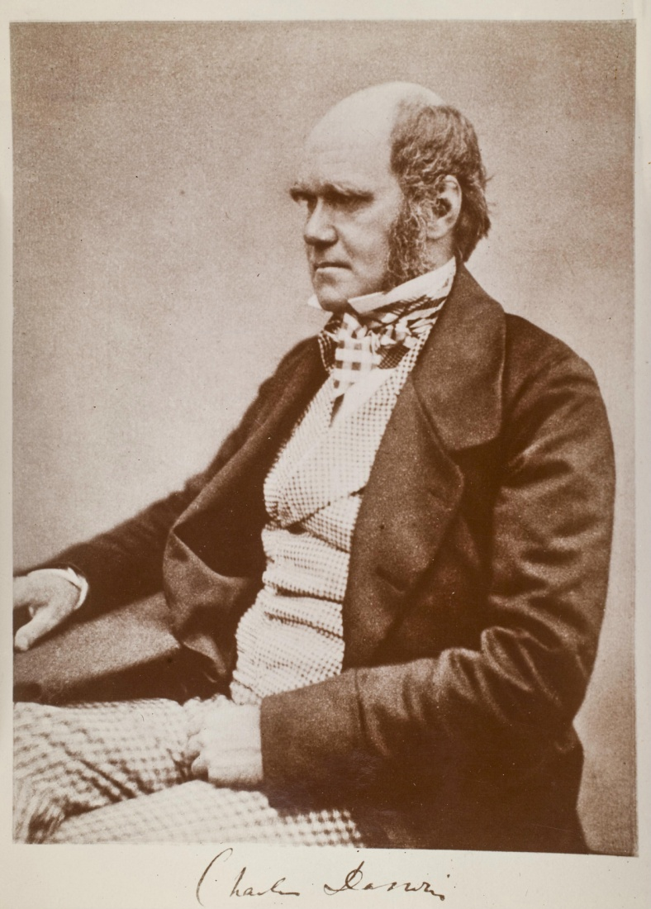
Charles Darwin (1809-1882)
1859: On the Origin of Species

Slide 10
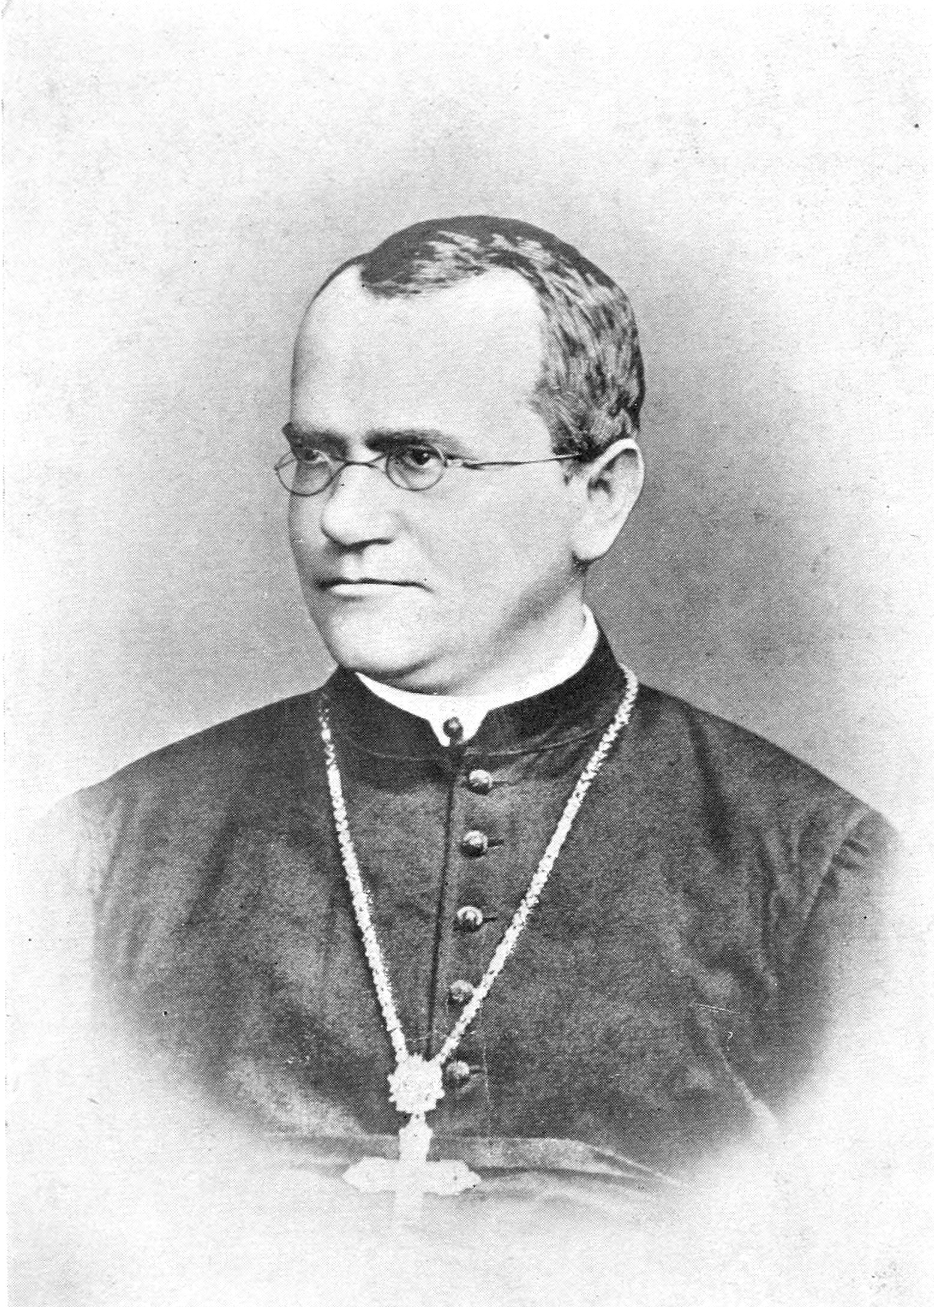
Gregor Mendel (1822-1885)
1865: Experiments in Plant Hybridisation

Slide 11
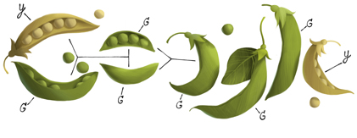
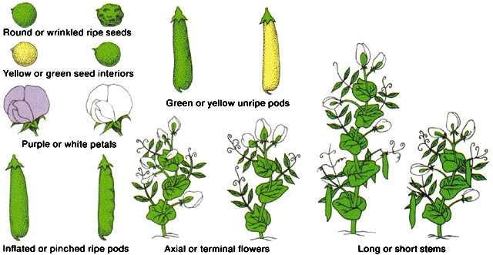
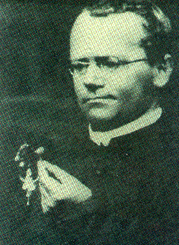
Mendel 1865 – genetics of discrete traits

Slide 12
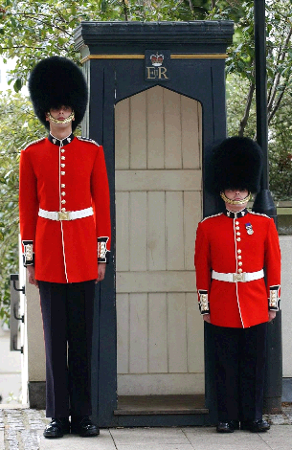
But (despite appearances) humans are not like peas
………

Slide 13
Continuous variation

Slide 14
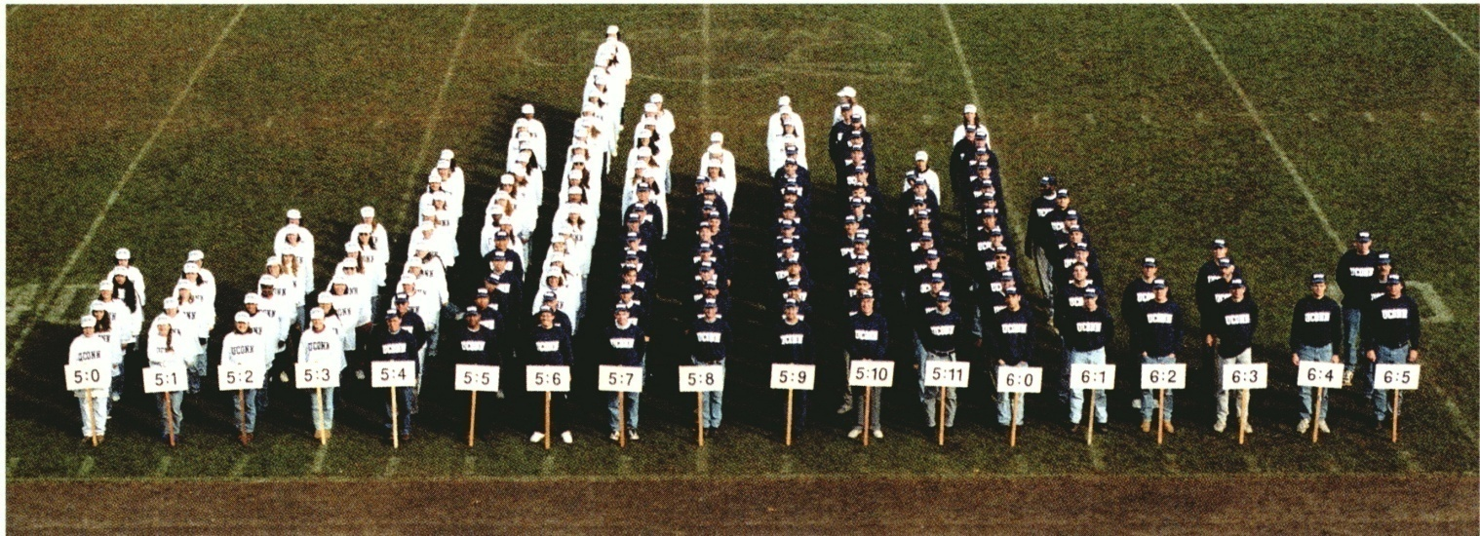
….the true distribution of height

Slide 15
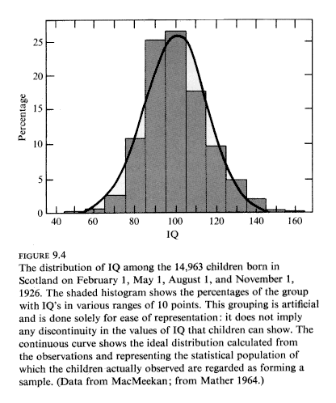

Slide 16
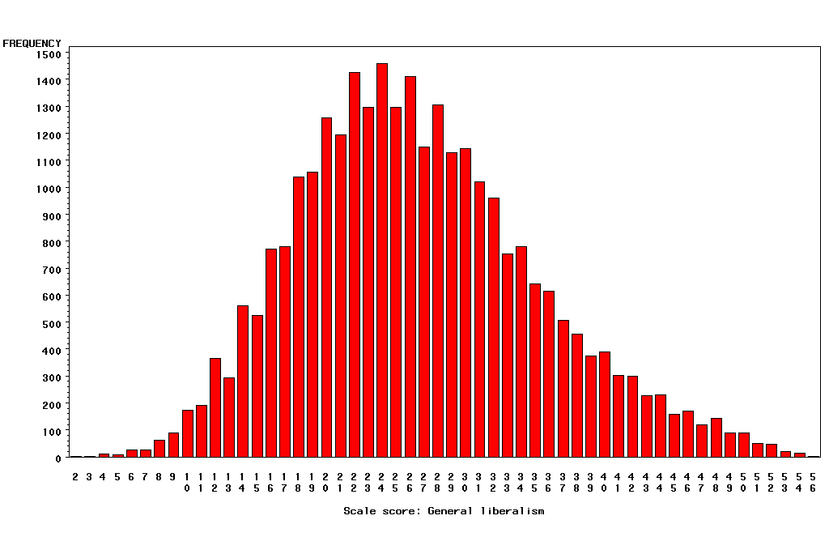
“Liberalism”

Slide 17
Categorical Outcomes
Often called “threshold traits” because people “affected” if they fall above some level (“threshold”) of a measured or hypothesized continuous trait.

Slide 18
Multifactorial Threshold Model
of Disease – normally distributed “liability”
Multiple thresholds
Single threshold
unaffected affected
normal
mild
mod
severe
Disease liability
Disease liability

Slide 19
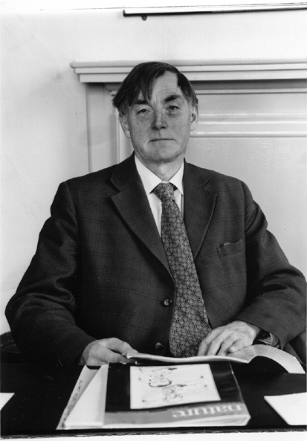
Douglas Scott Falconer, FRS, FRSE (1913-2004)
1965 Inheritance of liability to certain diseases estimated from
incidence among relatives., Ann. Hum. Genet.29:51ff.
1960 Introduction to Quantitative Genetics. Edinburgh: Oliver and Boyd.

Slide 20
“Heredity”

Slide 21
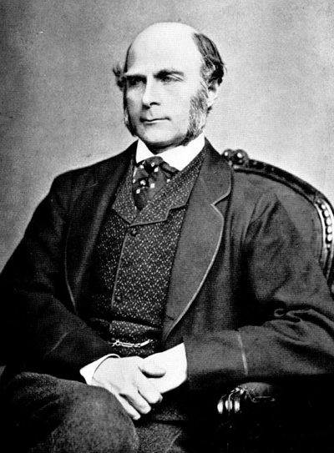
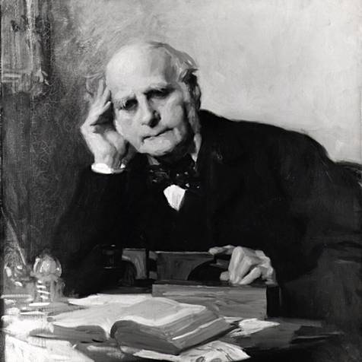
Francis Galton (1822-1911)
1869: Hereditary Genius
1883: Inquiries into Human Faculty and its Development
1884-5: Anthropometic Laboratory at “National Health Exhibition”
Notes:
Astonishing intellectual curiosity: 3-volume biography by his graduate student (Karl Pearson). Self-styled “gentleman”
i.e. didn’t need to earn his living. Could afford to do research. Many interests: numbers (devised vest with grid of pockets to accumulate contingency table from observations); finger-prints; composite photographs; family history (pedigree methods); statistics (devised correlation coefficient);
Measured family resemblance; collected first “twin” data (though Augustine hit on the method in the 4th Cent. Ch. 5 of Civitas Dei.)

Slide 22
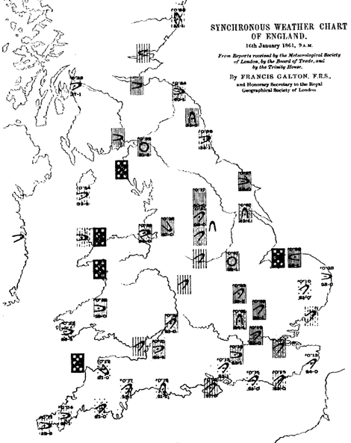
Galton’s Other Work e.g. Meteorology

Slide 23
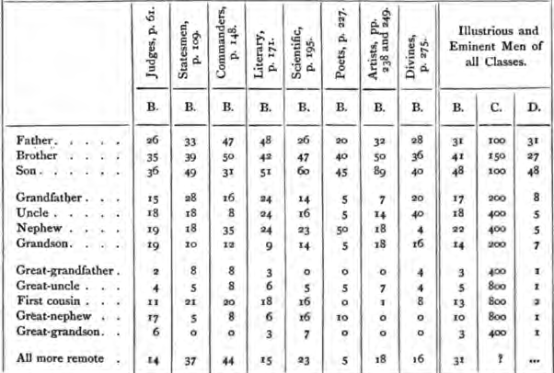
Hereditary Genius (1869, p 317)

Slide 24
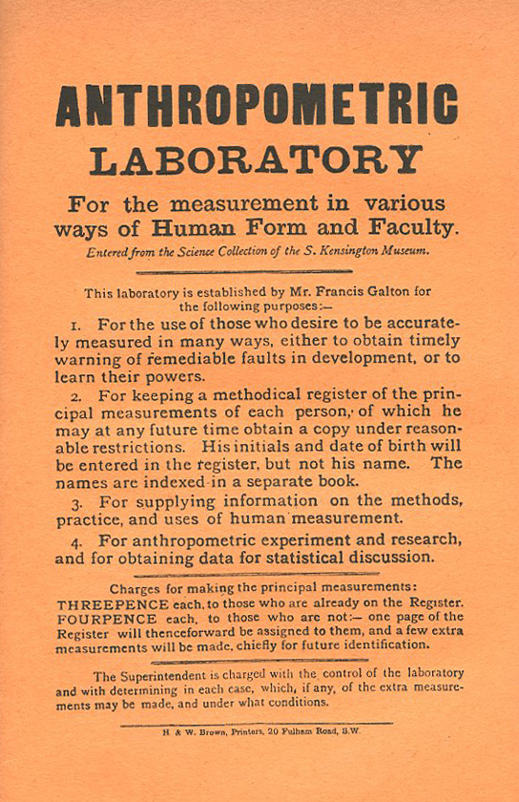
Galton’s Anthropometric Laboratory (1884-1885)

Slide 25
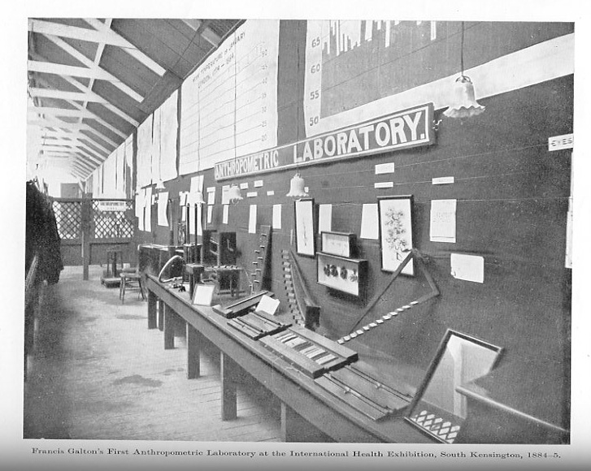

Slide 26
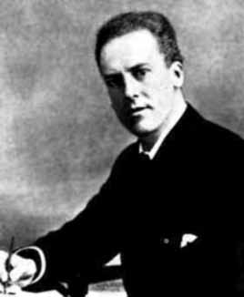
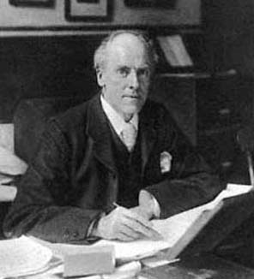
Karl Pearson (1857-1936)
1903: On the Laws of Inheritance in Man: I Physical Characteristics (with Alice Lee)
1904: II Mental and Moral Characteristics
1914: The Life, Letters and Labours of Francis Galton

Slide 27
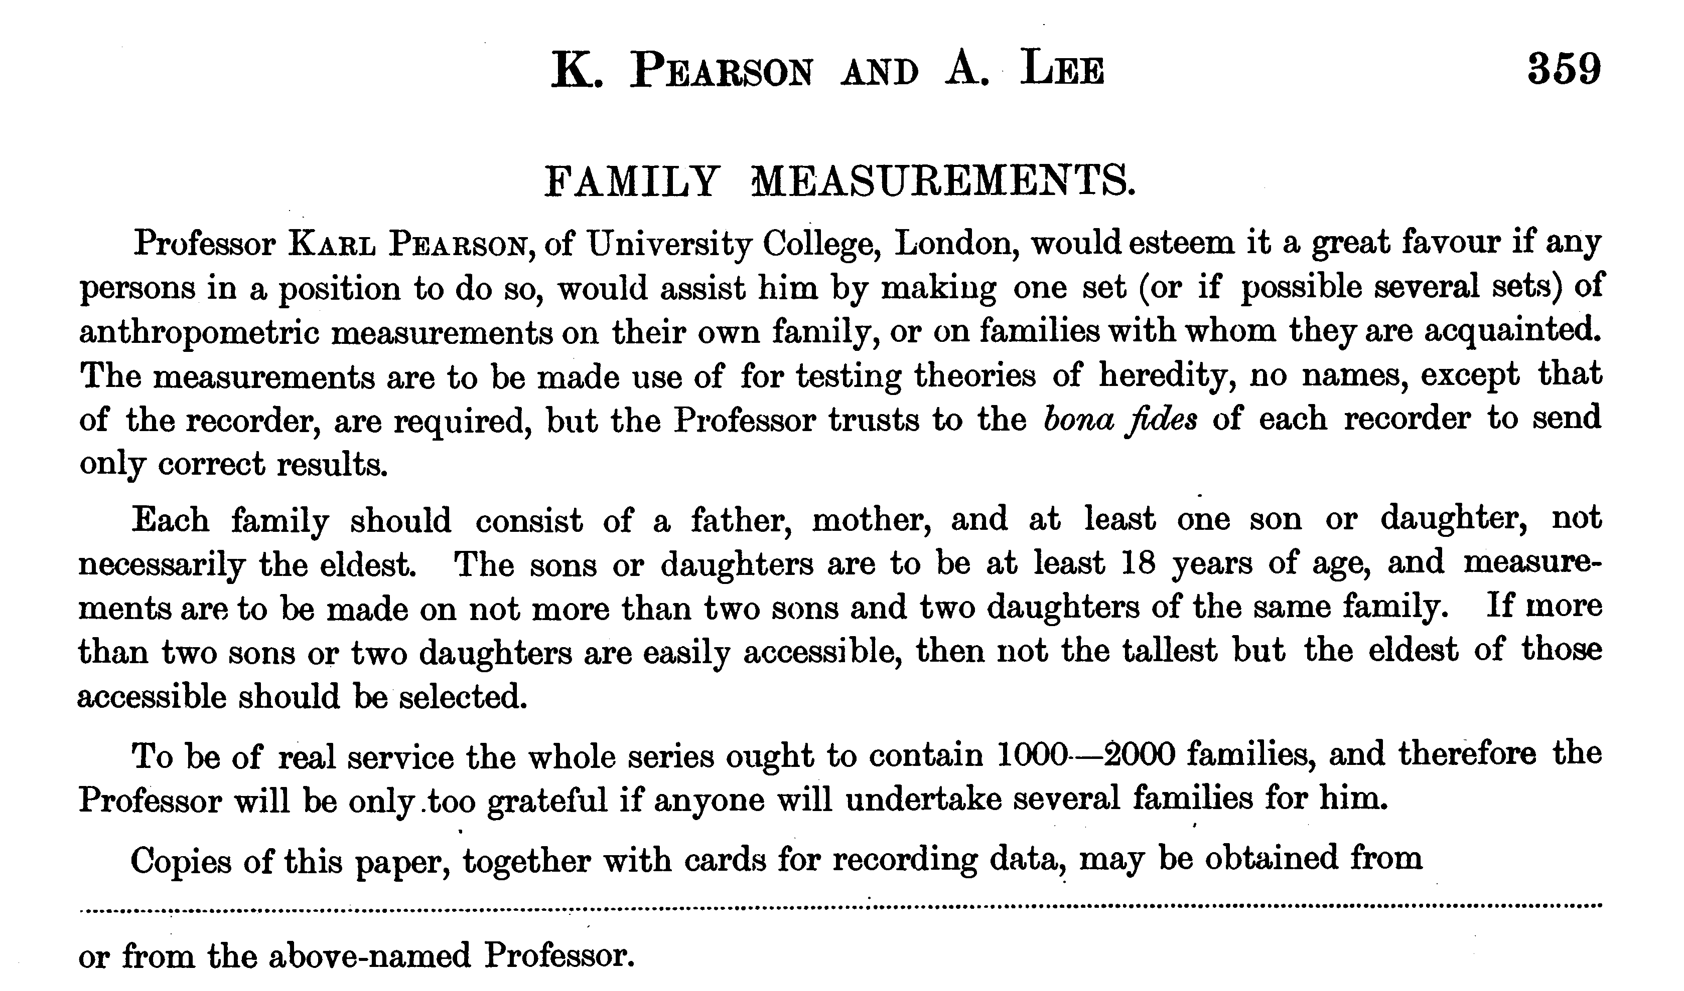

Slide 28
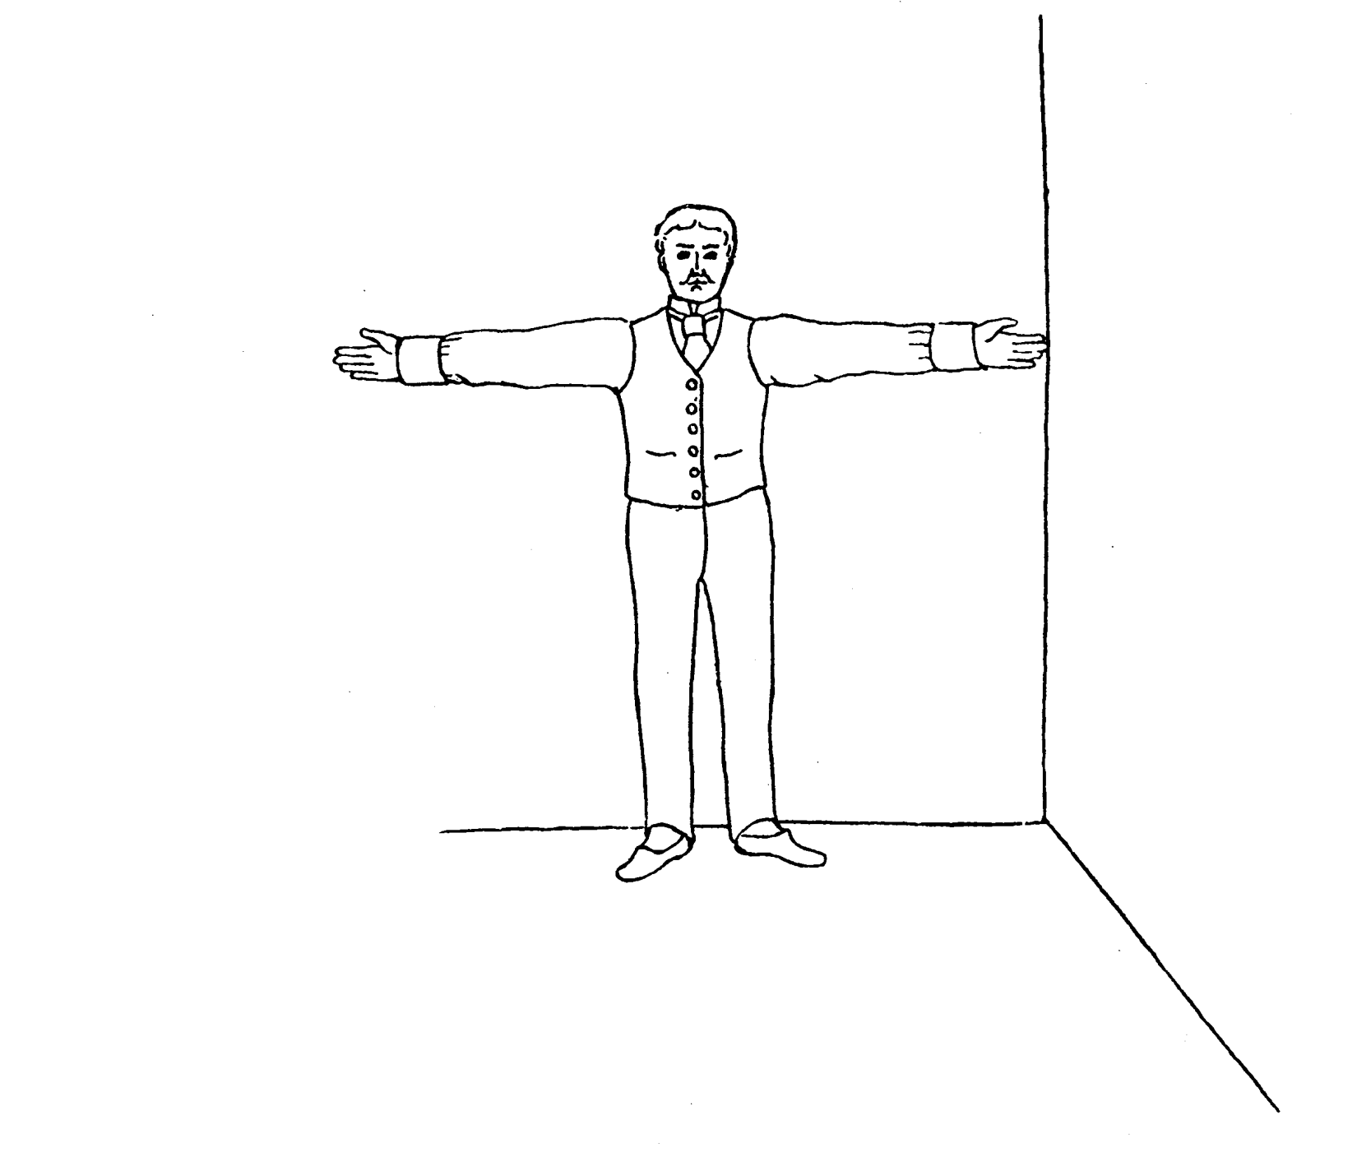
Pearson and Lee’s diagram for measurement of “span” (finger-tip to finger-tip distance)

Slide 29
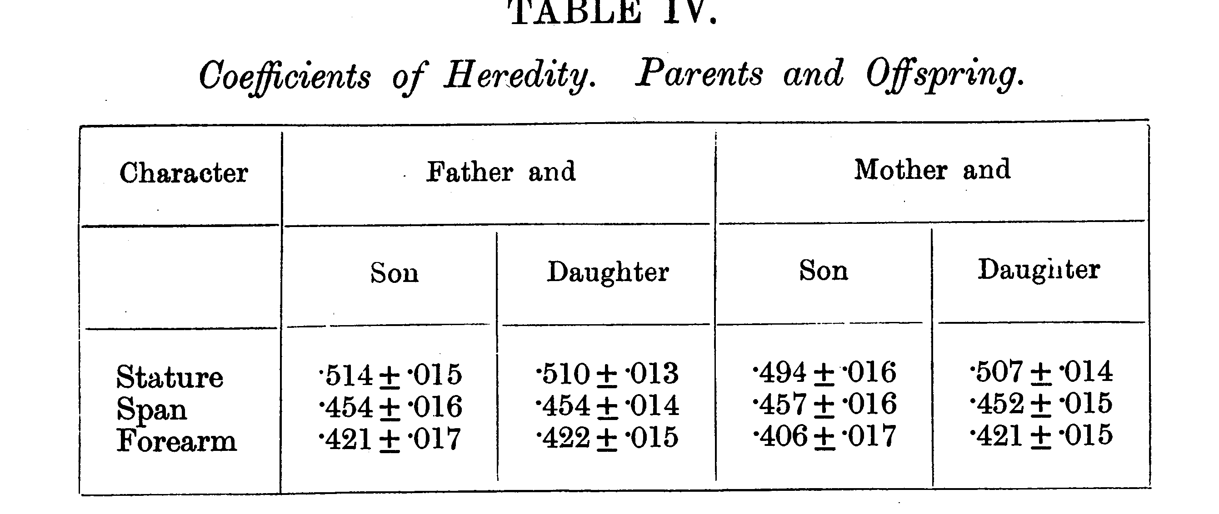
From Pearson and Lee (1903) p.378

Slide 30
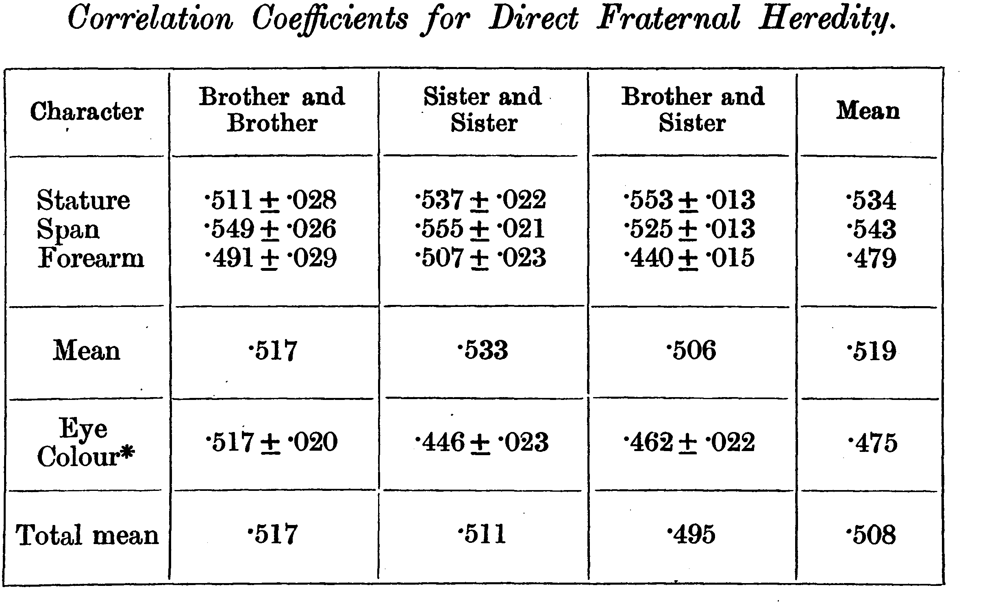
From Pearson and Lee (1903) p.387

Slide 31
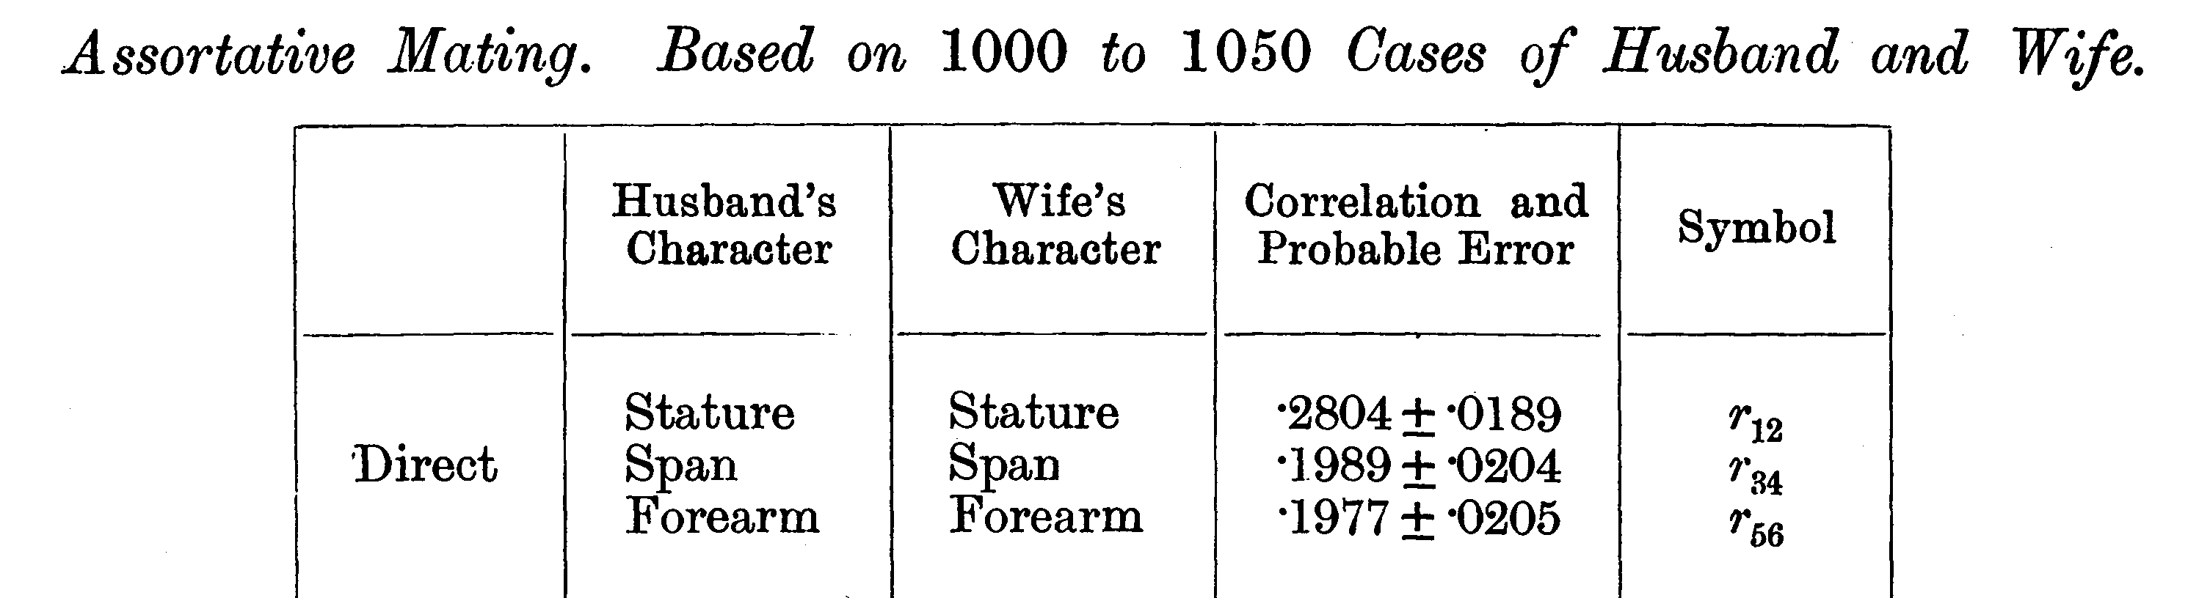
From Pearson and Lee (1903) p. 373

Slide 32
Modern Data
The Virginia 30,000 (N=29691)
The Australia 22,000
(N=20480)

Slide 33
ANZUS 50K: Extended Kinships of Twins
Parents of Twins
Siblings of Twins
Spouses of Twins
Twins
Offspring of Twins
© Lindon Eaves, 2009

Slide 34
Overall sample sizes
Relationship | # of pairs
Parent-offspring Siblings | 25018 18697
Spouses | 8287
DZ Twins MZ Twins | 5120 4623

Slide 35
Nuclear Family Correlations for Stature
(Virginia 30,000 and OZ 22,000)
Notes:
Notice: effects of mother and father equal; correlations for sibs close to parents;
Slight correlation between mates (assortative mating).

Slide 36
Nuclear Family Correlations for Stature and Liberalism/Conservatism
(Virginia 30,000)
Notes:
Compare with stature: notice how much greater assortative mating.

Slide 37
Nuclear Family Correlations for Liberalism/Conservatism
(Virginia 30,000 and Australia 22,000)

Slide 38
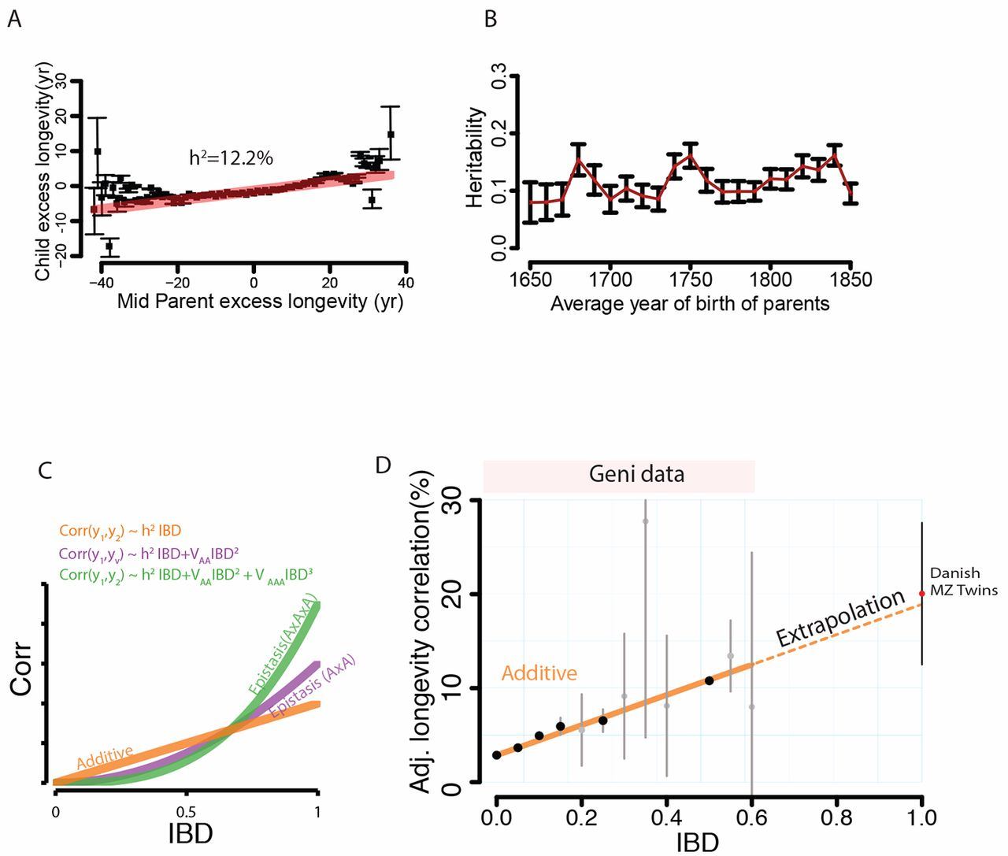
Quantitative analysis of population-scale family trees with millions of relatives
Joanna Kaplanis et al. Science 01 Mar 2018:

Slide 39
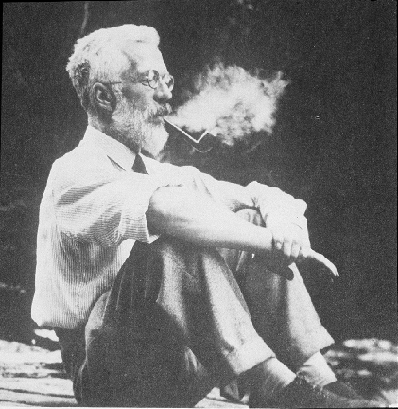
Ronald Fisher (1890-1962)
1918: On the Correlation Between Relatives on the Supposition of Mendelian Inheritance
1921: Introduced concept of “likelihood”
1930: The Genetical Theory of Natural Selection
1935: The Design of Experiments

Slide 40
Fisher developed mathematical theory that reconciled Mendel’s work with Galton and Pearson’s correlations

Slide 41
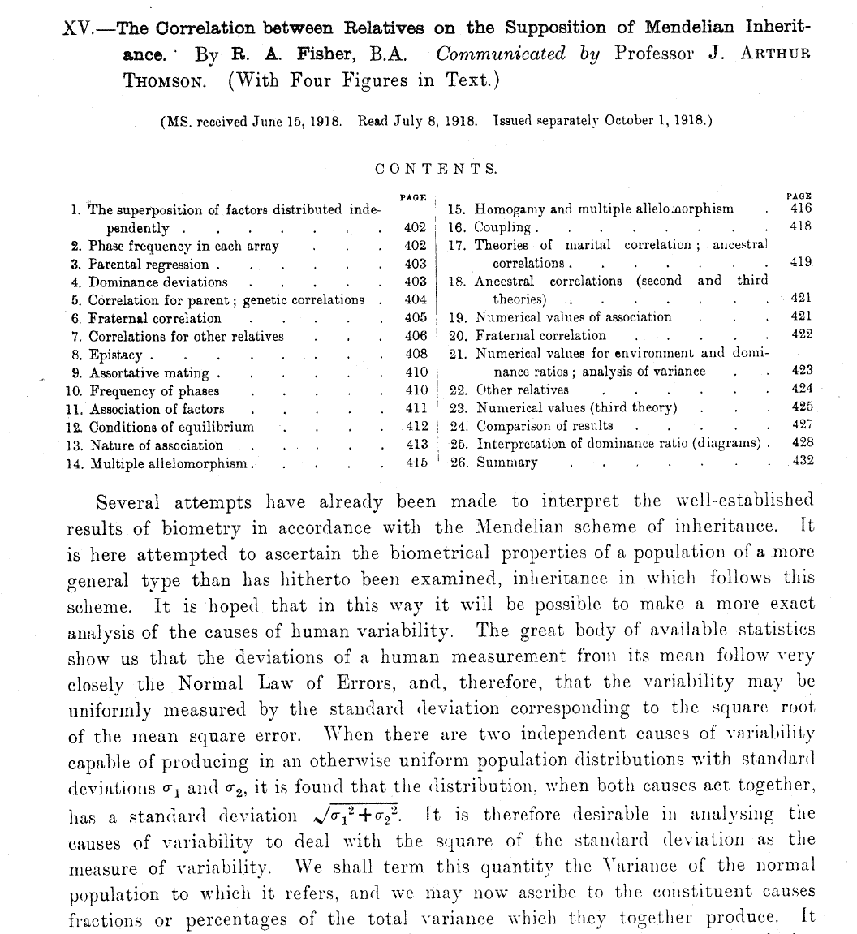
RA Fisher (1918). Transactions of the Royal Society
of Edinburgh
52: 399-433.

Slide 42
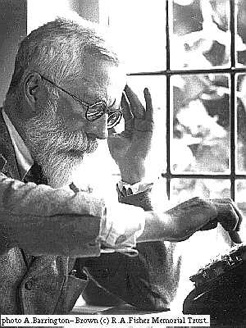
R.A. Fisher, 1918
The explanation of quantitative inheritance in Mendelian terms
1 Gene
→ 3 Genotypes
→ 3 Phenotypes
2 Genes
→ 9 Genotypes
→ 5 Phenotypes
3 Genes
→ 27 Genotypes
→ 7 Phenotypes
4 Genes
→ 81 Genotypes
→ 9 Phenotypes

Slide 43
Fisher (1918): Basic Ideas
Continuous variation caused by lots of genes (“polygenic inheritance”)
Each gene followed Mendel’s laws
Environment smoothed out genetic differences
Genes may show different degrees of “dominance”
Genes may have many forms (“multiple alleles”)
Mating may not be random (“assortative mating”)
Showed that correlations obtained by e.g. Pearson and Lee were explained well by polygenic inheritance
Let to “Biometrical Genetics” (Mather, Jinks etc.)

Slide 44
The (Really!) BIG Problem
Families are a mixture of genetic and social factors

Slide 45
The Extended Phenotype
World
Parents
Me
Spouse
Siblings
Child
Extended Phenotype

Slide 46
Variance components
Additive
Genetic
Effects
Dominance
Genetic
Effects
Unique
Environment
Shared
Environment
E
C
A
D
c
a
e
d
Phenotype
P = eE + aA + cC + dD

Slide 47
Galton’s Solution:
      Twins
      (Though Augustine may have got there first – 5th cent.)

Slide 48
One (?ideal) solution
Twins separated at birth

Slide 49
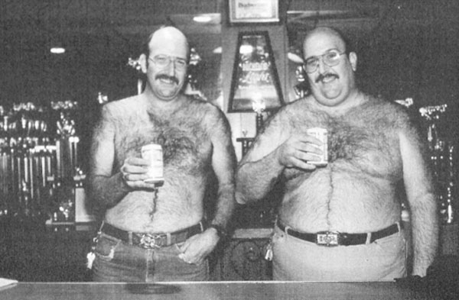
MZ twins reared apart - note the same way of supporting their cans of beer

Slide 50
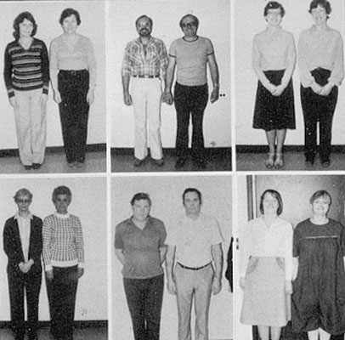
Body postures of MZ twins reared apart
Body postures of DZ twins reared apart

Slide 51
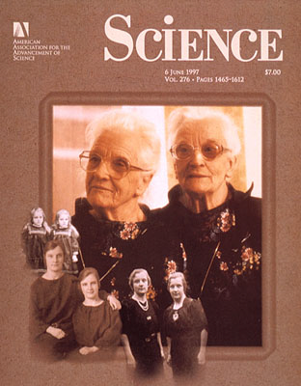

Slide 52
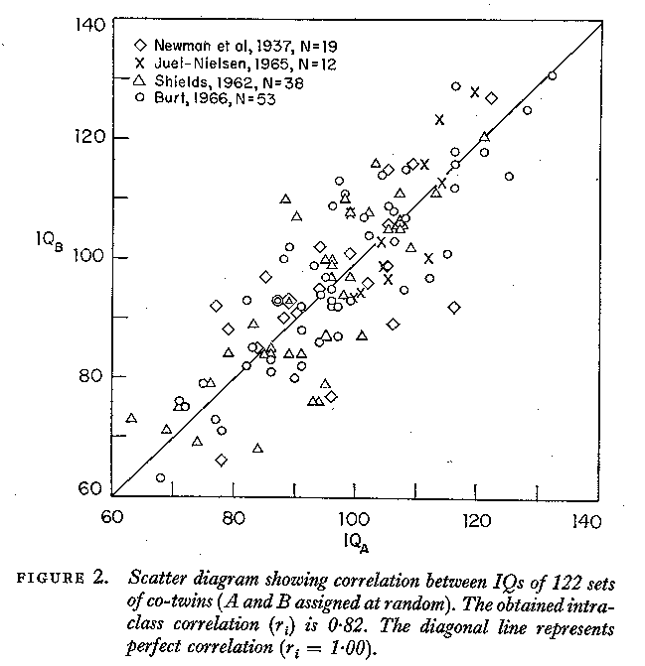

Slide 53
But separated MZs are rare

Slide 54
An easier alternative:
Identical and non-identical twins reared together
Galton (again!)……Or was it ?
Twin Research and Human Genetics 12: 237–245, 2009
Poll, H. (1914). Über Zwillingsforschung als Hilfsmittel
menschlicher Erbkunde. Zeitschrift für Ethnologie 46, 87–105.

Slide 55
Identity at marker loci - except for rare mutation
MZ and DZ twins: determining zygosity using ABI Profiler™ genotyping
(9 STR markers + sex)
MZ
DZ
DZ

Slide 56
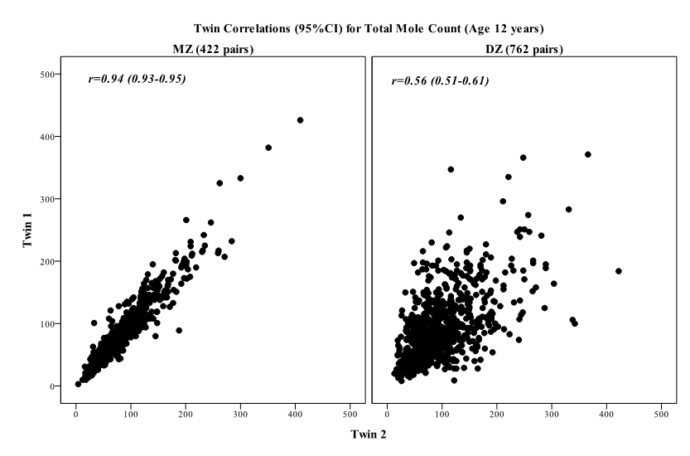
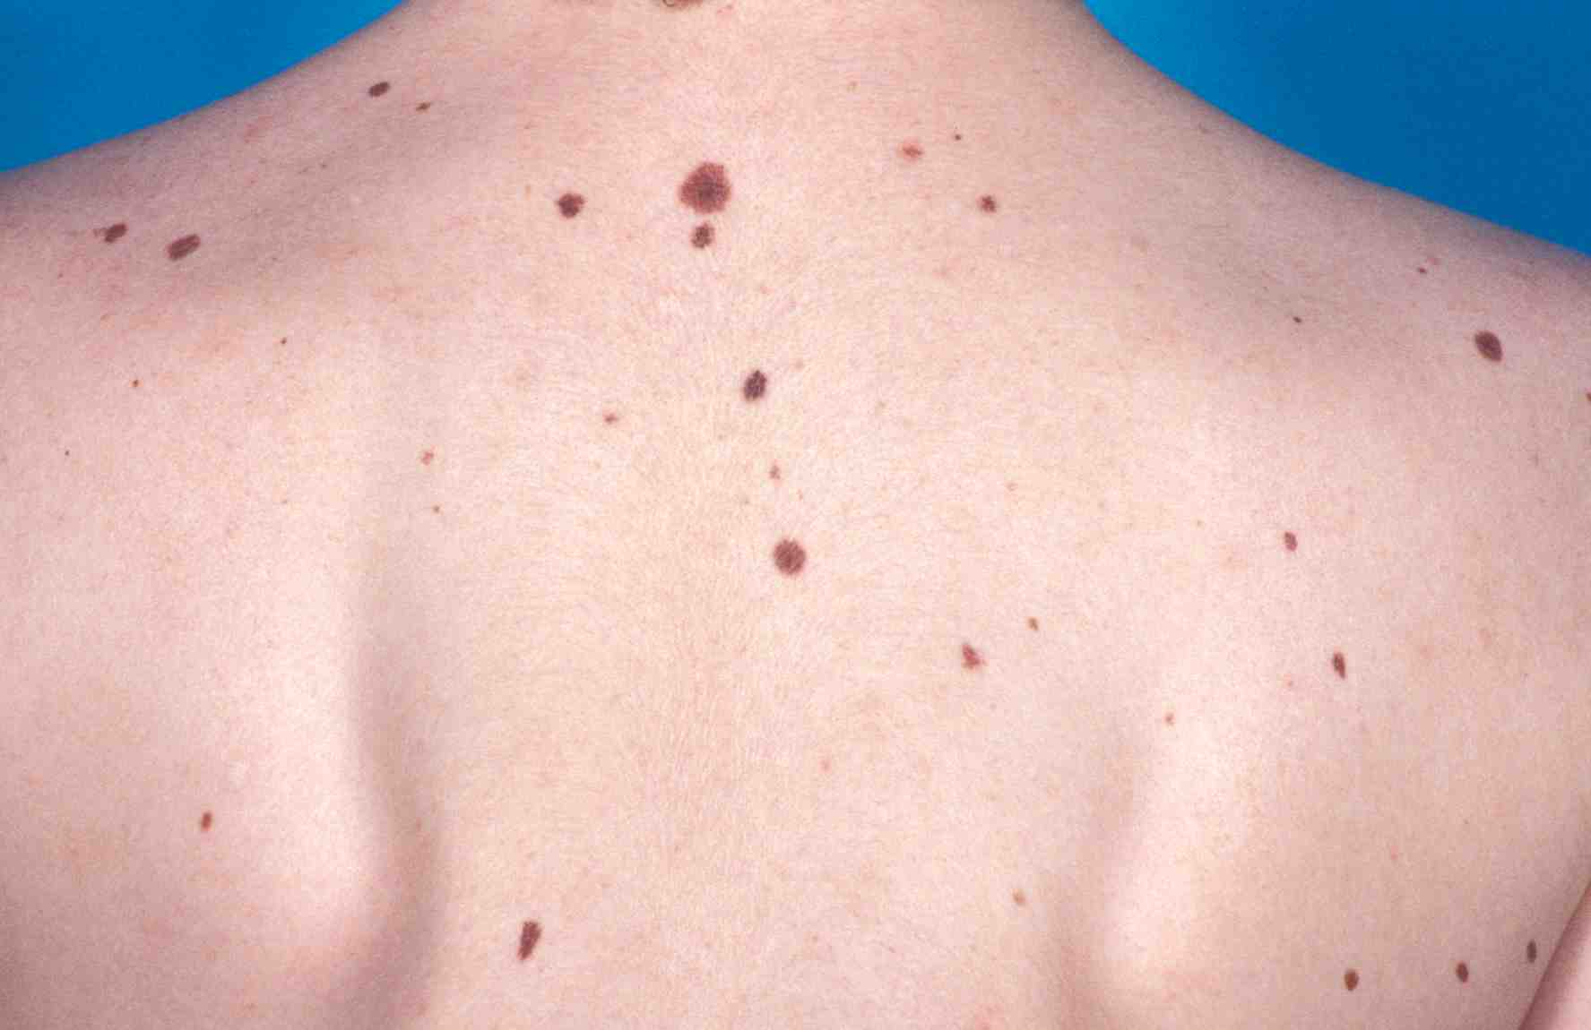
Twin correlations for total mole count

Slide 57
Three scenarios
Twin Correlation
Causes of Variation

Slide 58
Twin Correlations for Adult Stature
(Virginia 30,000 and Australia 22,000)

Slide 59
Structural equation modeling
Both continuous and categorical variables
Systematic approach to hypothesis testing
Tests of significance
Can be extended to:
  More complex questions
  Multiple variables
  Other relatives

Slide 60
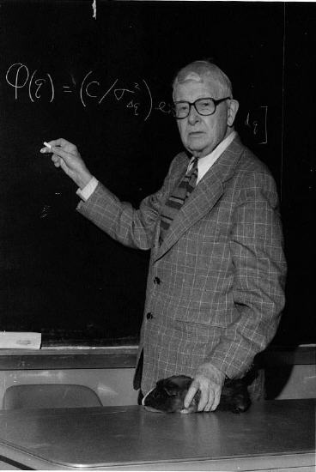
Sewall Wright (1889-1988)
1984. Evolution and the Genetics of Populations:
Genetics and Biometric Foundations (4 vols.)
1934. The method of path coefficients. Ann. Math. Staiist. 5: 161-215

Slide 61
Path diagram for the effects of genes and environment on phenotype
Genotype
Environment
G
r
Latent variables
E
h
e
P
Measured variable
Phenotype

Slide 62
ACE Model for twin data
1
MZ=1.0 / DZ=0.5
E
C
A
A
C
E
e
c
a
a
c
e
P_{T1}
P_{T2}

Slide 63
Sources of variation in QCST results
Additive
genetic
Shared
environment
Non-shared
environment

Slide 64
Are there common genetic and environmental factors influencing Verbal IQ, Performance IQ and QCST results?
A1
A2
C1
.43
.66
.79
.48
.74
.41
VIQ
PIQ
QCST
.43
.53
.34
E1
E2
E3

Slide 65
Genetic variation in developmental change: time series with common genes and time-specific environmental “innovations”
Genes
G
h
h
h
h
h
Phenotype
T0
b
T1
b
T2
b
T4
b
T5
Age
e
e
e
e
e
E1
E2
E3
E4
E5
Environment

Slide 66
α_{cm}
α_{cm}
ρ_{cf}
ρ_{mf}
ρ_{mm}
ρ_{cm}
Male- specific Additive Genes
Male- specific Additive Genes
Gender-common Additive Genes
Extended kinship model
twins
siblings
parents
children
grandparents
aunts, uncles
cousins
Gender-common Additive Genes
Female Unique Environment
Male Unique Environment
0.5
0.5
0.5
e_{f}
0.5
h_{mm}
e_{m}
0.5
Female Twin Environment
h_{fc}
0.5
0.5
Male Twin Environment
0.5
h_{mc}
t_{f}
t_{m}
Female Sibling Environment
s_{f}
μ
s_{m}
Female parent
Male parent
Male Sibling Environment
d_{f}
w_{mf}
w_{fm}
w_{mm}
d_{m}
Female Dominant Genes
w_{ff}
Male Dominant Genes
Gender-common Additive Genes
Female Unique Environment
Male- specific Additive Genes
Male- specific Additive Genes
Male Unique Environment
Gender-common Additive Genes
h_{fc}
e_{f}
h_{mm}
e_{m}
h_{mc}
r_{t}
t_{m}
t_{f}
Female Twin Environment
Male Twin Environment
Female twin
s_{f}
s_{m}
Male twin
Female Sibling Environment
r_{s}
Male Sibling Environment
d_{f}
d_{m}
Female Dominant Genes
r_{d}
Male Dominant Genes

Slide 67
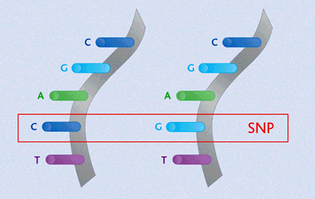
Finding the genes - association
Looks for correlation between specific alleles and phenotype (trait value, disease risk) using single nucleotide polymorphisms (SNPs)

Slide 68
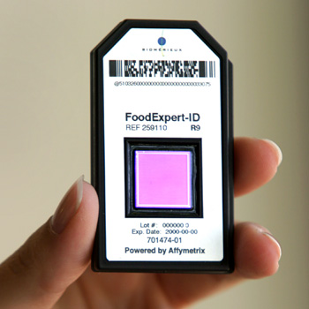
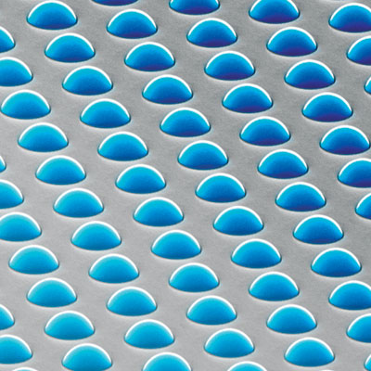
High density SNP arrays – up to 1 million SNPs

Slide 69
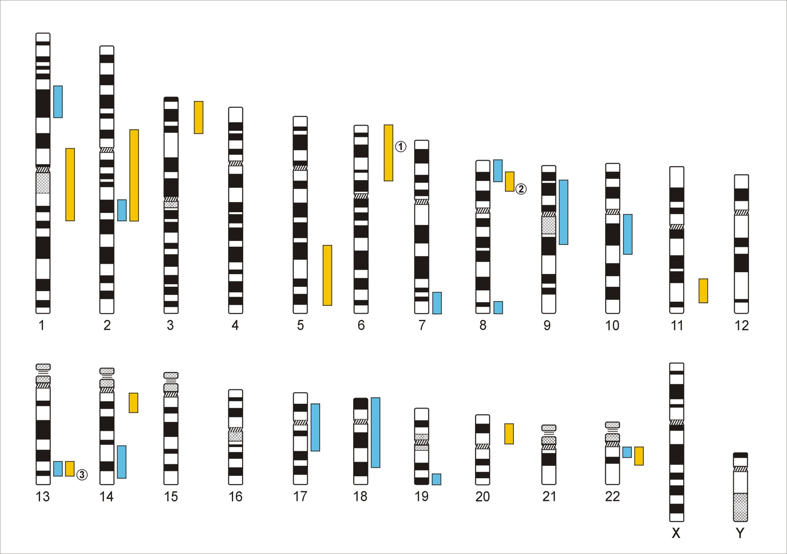
Genome-Wide Association Studies
500,000 – 5,000,000 SNPs
Human Genome - 3,1x10⁹ Base Pairs
Notes:
In a GWA the Genome which contains xx SNPs is examined using … SNPs

Slide 70
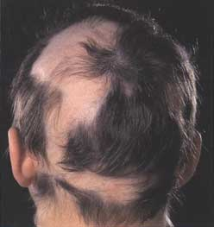
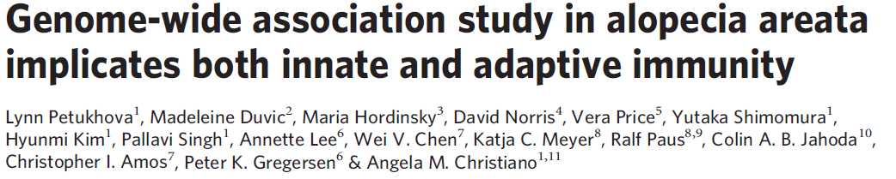
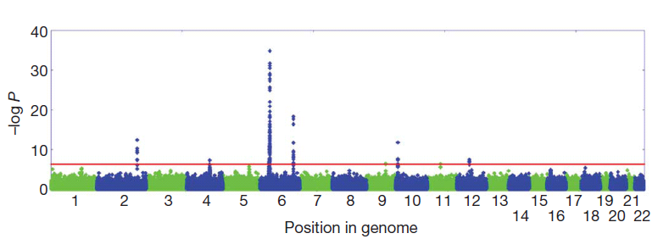

Slide 71
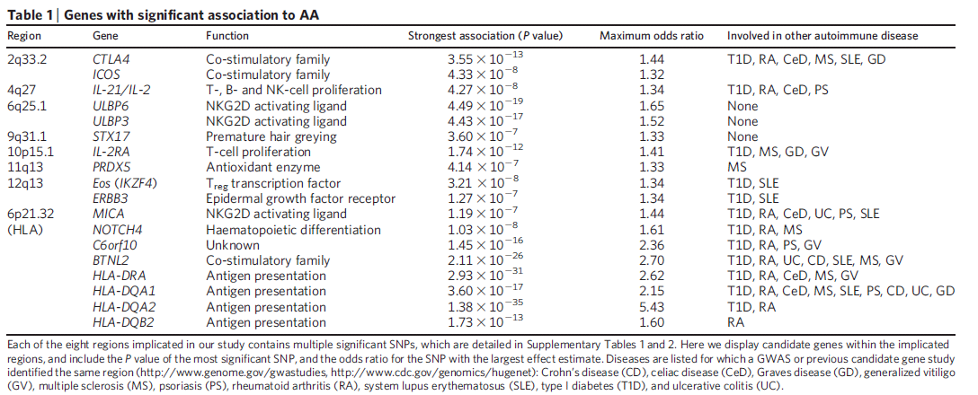
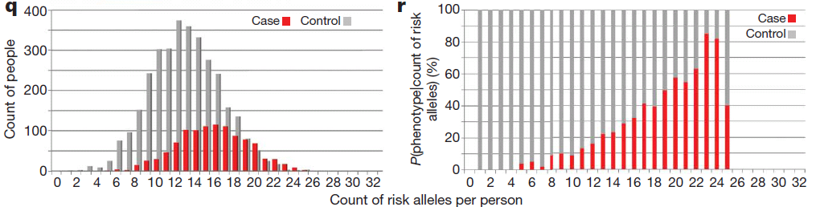

Slide 72
Schizophrenia GWAS associations from the meta-analysis of CLOZUK and PGC
total 40,675 cases and 64,643 controls 179 independent GWS SNPs (p<5x10⁻⁸) mapping to 145 independent loci
AF Pardiñas … JTR Walters, Nature Genetics 25/2/18

Slide 73
Major Depressive Disorder
130,664 MDD cases , 330,470 controls → 44 independent loci ( P < 5e-8)
Genes that are targets of antidepressant medications were strongly enriched for MDD association signals (P=8.5e-10)
NR Wray….PF Sullivan: bioRxiv Jul. 24, 2017; Nature Genetics, in press

Slide 74
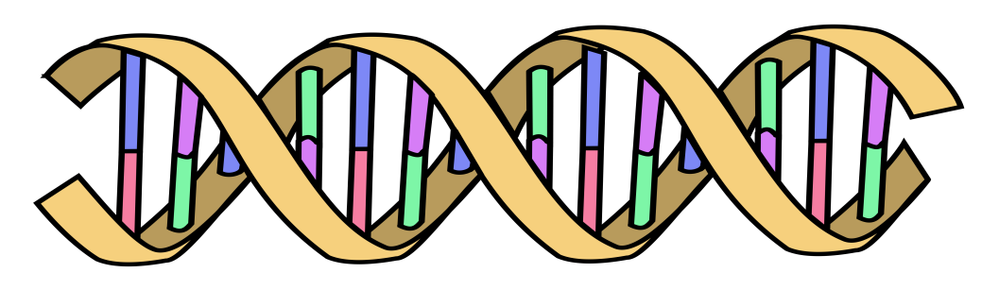
Polygenic Risk Scores
Polygenic Risk Scores capture (part of) someone’s genetic “risk” by summing all risk alleles weighted by the effect sizes estimated in a Genome-Wide Association Study (GWAS)
1×-.02 + 2×.01 + 1×.002 + 0×.03 + 2×.025
Polygenic score:
AC
CC
TT
.052
GG
AT
Effect sized from GWAS
β_{C}=-.02
β_{G}=.01
β_{A}=.002
β_{G}=.03
β_{T}=.025

Slide 75
MDD Polygenic Risk Score predicts risk in independent samples
Odd ratios of MDD per PRS decile relative to the first decile for iPSYCH and anchor cohorts.
Interdecile risk ~2.5

Slide 76
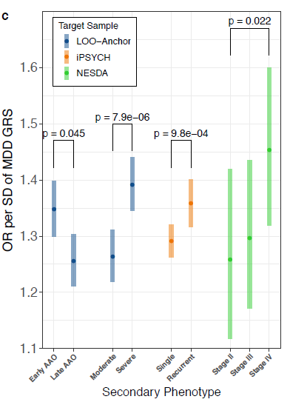
MDD Polygenic Risk Score predicts age at onset, recurrence, and severity
in independent samples
MDD PRS (from out-of-sample discovery sets) were significantly higher in MDD cases with:
earlier age at onset; more severe MDD symptoms (based on number of criteria endorsed)
recurrent MDD compared to single episode
chronic/unremitting MDD (“Stage IV” compared to “Stage II”, first-episode MDD)
Error bars represent 95% CI

Slide 77
A Basic Model
Phenotype=Genotype+Environment
P=G+E {+f(G,E)}
f(G,E) = G-E “Interplay”
i.e. Genotype-environment interaction (GxE) and G-E correlation (rGE)

Slide 78
GxE Interaction and Correlation
GxE: SENSITIVITY to E controlled by G
rGE: EXPOSURE to E correlated with (“depends on”) G
Lots of good plant and animal models for both

Slide 79
DIATHESIS-STRESS MODEL IN DEPRESSION
Depression = Diathesis + Stress + Diathesis * Stress
(Disruption of psychological equilibrium)
(Predisposition, Vulnerability)
Hypothesised contribution to risk
Our model:
Depression = PRS + PSLE + NSLE + SS + PRS * PSLE + PRS*NSLE + PRS*SS
PRS: Polygenic Risk Score
PSLE: Personal Stressful Life Event, NSLE: Network Stressful life event, SS Social Support
Familial relatedness modelled using a kinship matrix or a genetic relatedness matrix calculated from SNPs.
All analyses controlled for age, age², sex, age*sex and age²*sex interactions, study, array, and the first four genetic principal components
Scores regressed for covariates to avoid false positive interactions

Slide 80
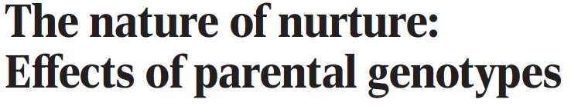
parental genes that are not transmitted to a child may affect the child through their impacts on the parents’ phenotypes (“genetic nurture” aka gene-environment correlation)
Used results from a meta-analysis of educational attainment (EA, n=300,000)
Polygenic score computed for the non-transmitted alleles of 21,637 probands with parents genotyped has an estimated effect on EA of the child that is 30% (p = e−14) of that of the transmitted polygenic score.
Genetic nurturing effects of this polygenic score extend to other traits.
Paternal and maternal polygenic scores have similar effects on EA
Mothers contribute more than fathers to nutrition- and heath-related traits.

Slide 81
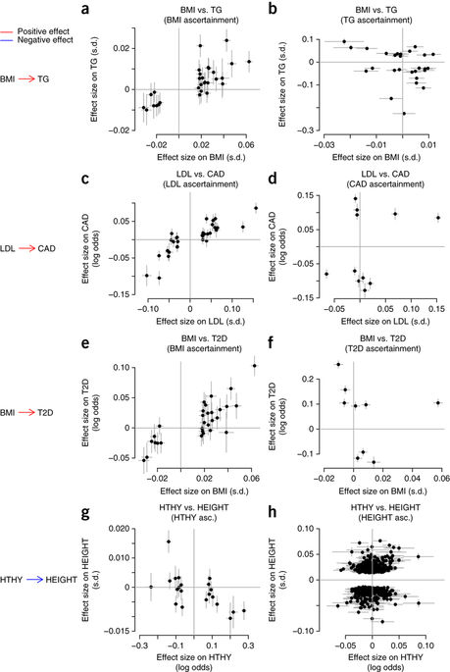
Detection and interpretation of shared genetic influences on 42 human traits
Joseph K Pickrell, Tomaz Berisa, Jimmy Z Liu, Laure Ségurel, Joyce Y Tung & David A Hinds.
Nature Genetics 48; 709–717, 2016
Powerful GWAS for traits A and B can help determine direction of causation

Slide 82
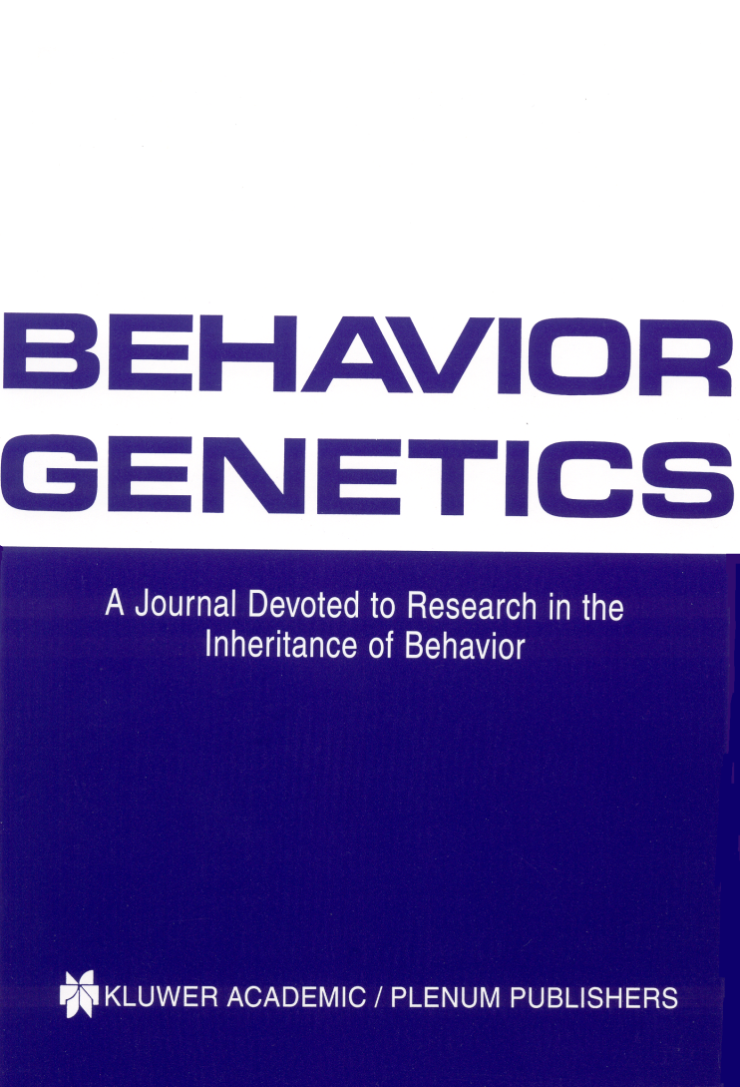
We also run two journals (1)
Editor: John Hewitt
Editorial assistant Christina Hewitt
Publisher: Kluwer /Plenum
Fully online
http://www.bga.org

Slide 83

Editor: Nick Martin
Publisher: Cambridge University Press
Fully online
Fast turnaround
First submission free to workshop participants!!!!!☺

Slide 84
How twin studies changed research agendas
Autism – “caused by cold mothers”
  10/11 MZ pairs concordant, 2/11 DZs concordant
ADHD – “caused by food dyes”
Twin studies found h² ~0.8
3. Multiple sclerosis - “caused by a virus”
MZ concordance 26%, DZ concordance 2%
Martin, Boomsma & Machin (1997) Nature Genetics 17: 387

Slide 85

GWAS for moliness(11 studies, 23,000 subjects, 5 hits)
David Duffy, Gu Zhu

Slide 86
x
1/4
1/4
1/4
1/4

Slide 87
IDENTITY BY DESCENT
Sib 1
Sib 2
4/16 = 1/4 sibs share BOTH parental alleles IBD = 2
8/16 = 1/2 sibs share ONE parental allele IBD = 1
4/16 = 1/4 sibs share NO parental alleles IBD = 0

Slide 88

Why do we use the average sib values of r_{a} = 0.5 and r_{d} = 0.25 when we can estimate the (almost) exact values for each sib pair from marker data ?
Classical twin design revisited:
Heritability estimation without MZ twins

Slide 89



Slide 90


Slide 91


Slide 92

MAIN EFFECTS OF STRESS SCORES
Depression score associated with Personal (PSLE) and network (NSLE) stressful life events and perceived social support (SS). Note sex differences.
♀ females
♂males

Slide 93
TEST OF INTERACTION
Significant interaction
No interaction
No interaction

