Slide 1
Mendelian Randomization (Using genes to tell us about the environment)
David Evans
University of Queensland
University of Bristol

Slide 2
RCTs are the Gold Standard in Inferring Causality
RANDOMISED CONTROLLED TRIAL
RANDOMISATION METHOD
EXPOSED:
INTERVENTION
CONTROL:
NO INTERVENTION
CONFOUNDERS EQUAL BETWEEN GROUPS
OUTCOMES COMPARED BETWEEN GROUPS

Slide 3
Observational Studies
RCTs are expensive and not always ethical or practically feasible
Association between environmental exposures and disease can be assessed by observational epidemiological studies like case-control studies or cohort studies
The interpretation of these studies in terms of causality is problematic

Slide 4
CHD risk according to duration of current Vitamin E
supplement use compared to no use
RR
Rimm et al NEJM 1993; 328: 1450-6

Slide 5
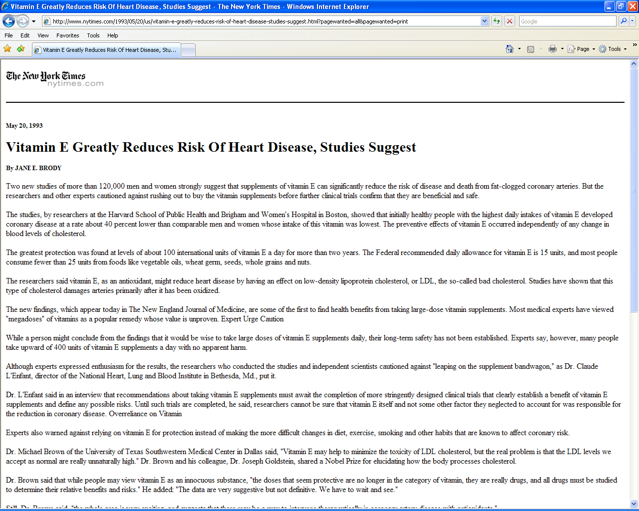

Slide 7
Use of vitamin supplements by US adults, 1987-2000
Percent
Source: Millen AE, Journal of American Dietetic Assoc 2004;104:942-950

Slide 8
Vitamin E levels and risk factors: Women’s Heart Health Study
Childhood SES
Manual social class
No car access
State pension only
Smoker
Daily alcohol
Exercise
Low fat diet
Obese
Height
Leg length
Lawlor et al, Lancet 2004

Slide 9
Vitamin E supplement use and risk of Coronary Heart Disease
1.0
Stampfer et al NEJM 1993; 328: 144-9; Rimm et al NEJM 1993; 328: 1450-6; Eidelman et al Arch Intern Med 2004; 164:1552-6

Slide 10
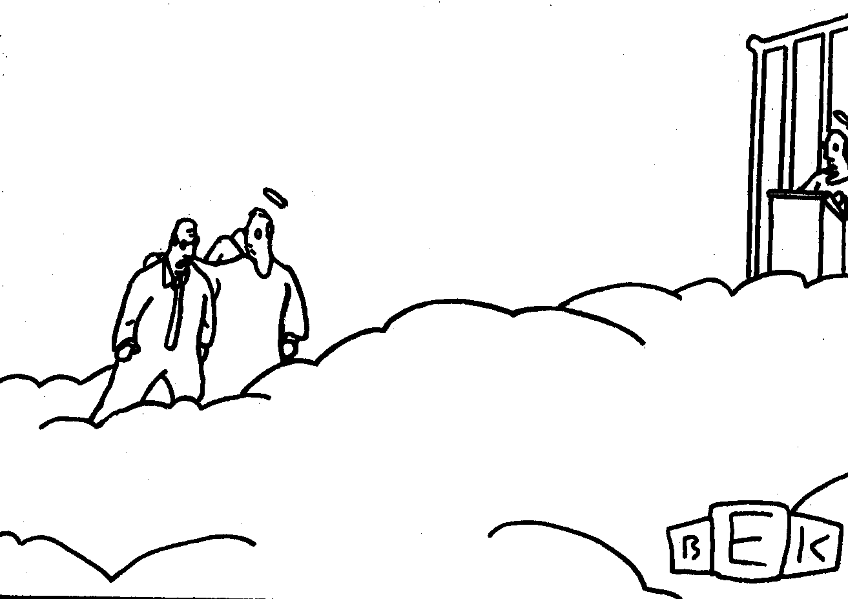
“Well, so much for antioxidants.”

Slide 11
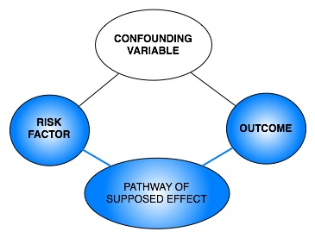
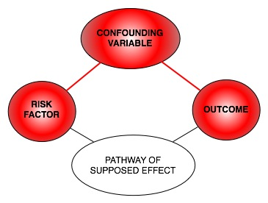
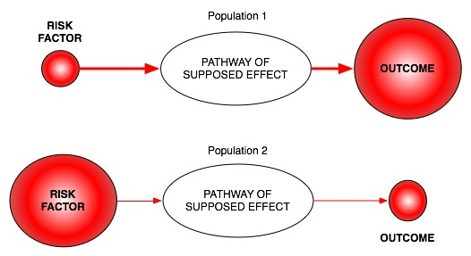
Classic limitations to “observational” science
Confounding
Reverse Causation
Bias

Slide 12
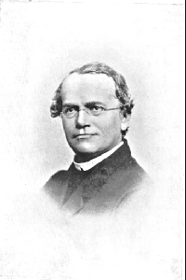
An Alternative to RCTs: Mendelian randomization
In genetic association studies the laws
of Mendelian genetics imply that
comparison of groups of individuals
defined by genotype should only differ
with respect to the locus under study
(and closely related loci in linkage
disequilibrium with the locus under study)
Genotypes can proxy for some modifiable
risk factors, and there should
be no confounding of genotype by
behavioural, socioeconomic or
physiological factors (excepting those
influenced by alleles at closely proximate
loci or due to population stratification)
Mendel in 1862

Slide 13
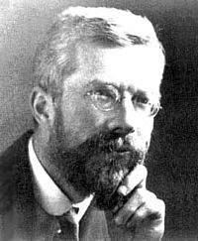
Fisher and Confounding
“Generally speaking the geneticist, even if he
foolishly wanted to, could not introduce
systematic errors into comparison of
genotypes, because for most of the relevant
time he has not yet recognized them”
Fisher (1952)

Slide 14
Mendelian randomisation and RCTs
MENDELIAN RANDOMISATION
RANDOMISED CONTROLLED TRIAL
RANDOM SEGREGATION OF ALLELES
RANDOMISATION METHOD
EXPOSED: FUNCTIONAL ALLELLES
CONTROL: NULL ALLELLES
EXPOSED:
INTERVENTION
CONTROL:
NO INTERVENTION
CONFOUNDERS EQUAL BETWEEN GROUPS
CONFOUNDERS EQUAL BETWEEN GROUPS
OUTCOMES COMPARED BETWEEN GROUPS
OUTCOMES COMPARED BETWEEN GROUPS

Slide 15
Mendelian Randomization- Core Assumptions
Confounders
SNP
Exposure
Outcome
(1) SNP is associated with the exposure
(2) SNP is not associated with confounding variables
(3) SNP only associated with outcome through the exposure

Slide 16
Equivalence Between Directed Acyclic Graphs and SEMs
Confounders
SNP
Exposure
Outcome
ξ₁
ξ₂
SNP
Exposure
Outcome
β_{x}
β_{Y}

Slide 17
Why Perform MR?
Assess causal relationship between two variables
Estimate magnitude of causal effect

Slide 18
Calculating Causal Effect Estimates
Confounders
SNP
Exposure
Outcome
β_{SNP-EXPOSURE}
β_{EXP-OUTCOME}
β_{SNP-OUTCOME}
2SLS:
(1) Regress exposure on SNP
(2) Regress outcome on predicted exposure from 1st stage regression
(3) Adjust standard errors
Wald Test:
β_{SNP-OUTCOME}
/
β_{SNP-EXPOSURE}
*Can be used in different samples (“Two sample MR”)

Slide 19
Calculating the Causal Effect via SEM
Confounders
SNP
Exposure
Outcome
ξ₁
ξ₂
SNP
Exposure
Outcome
β_{x}
β_{Y}

Slide 20
Limitations to Mendelian Randomisation
1- Pleiotropy
2- Population stratification
3- Canalisation
4- Power (also “weak instrument bias”)
5- The existence of instruments

Slide 21
MR References

