Slide 2
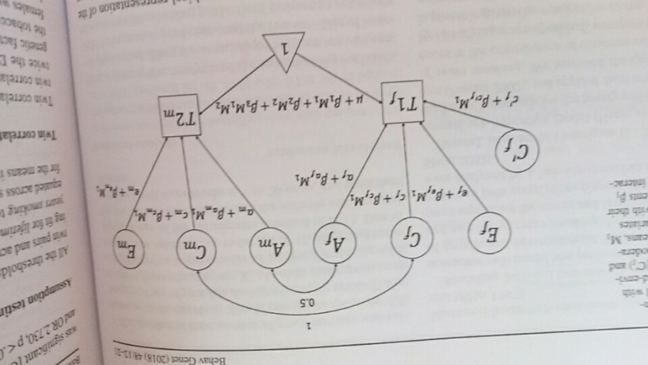
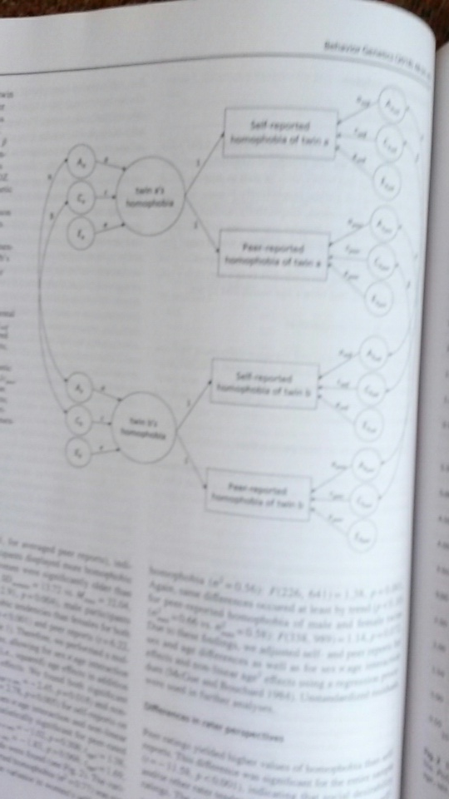
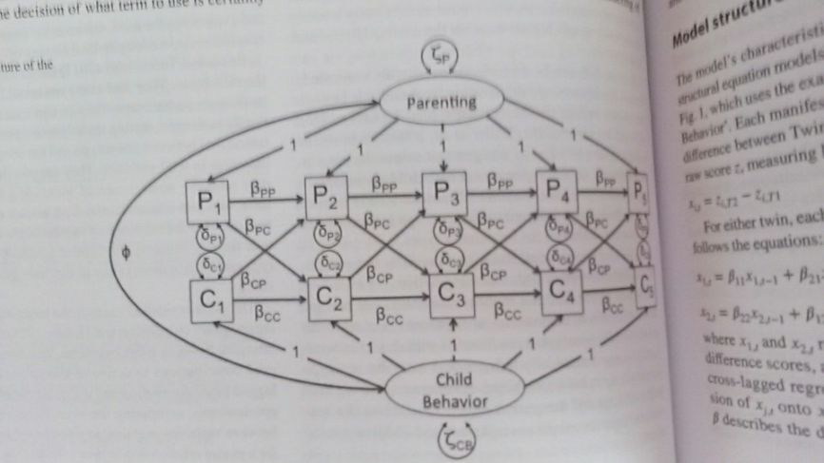
Journal Behavior Genetics. January 2018
moderation model
common pathway model
cross-lagged model

Slide 3
Genetic simplex model
in the classical twin design
&
variations including G-E covariance
Conor Dolan & Eveline de Zeeuw
Boulder Workshop 2018

Slide 4
Two general approaches to longitudinal modeling
(not mutually exclusive)
Markov models:
(Vector) autoregressive models for continuous data
(Hidden) Markov transition models discrete data
Growth curve models:
Focus on linear and non-linear growth curves
Typically multilevel or random effects model
Which to use?
Use the model that fit the theory & hypotheses

Slide 5
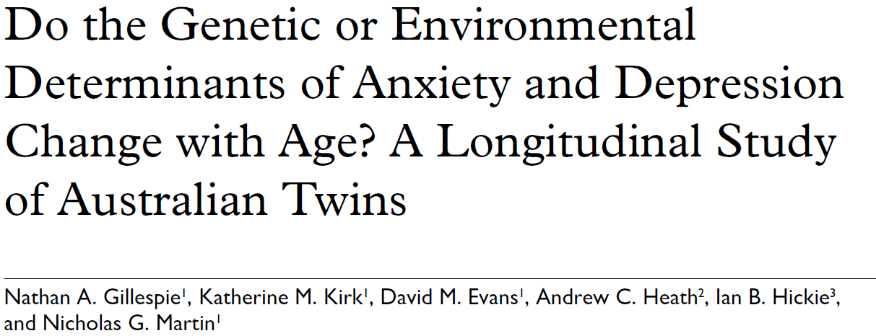
Growth curve modeling ? If you’re interested in growth
trajectories. Linear or non-linear:
Autoregressive modeling ? If you’re mainly interested in stability.
Can be combined (as demonstrated by Nathan Gillespie)

Slide 6
First order autoregression model. The simplex model.
ζx
ζx
ζx
b2,1
b3,2
b4,3
x1
x2
x3
x4
1
1
1
1
y1
y2
y3
y4
1
1
1
1
e1
e2
e3
e4
b₀₂
b₀₃
b₀₁
b₀₄
1
Notes:
Ar(1) as a phenotypic model. Interest in stability, not interest in individual growth curves

Slide 7
just an aside....nr 1
s²x
b0
1
X
e
N=100
x=rnorm(N,100,15) # generate data with mean 100 std = 15
print(mean(x)) # show the mean
print(lm(x~1)$coefficients) # regression on unit vector
> print(mean(x)) ...... the mean
[1] 102.3678
> unit=rep(1,N)
> lm(x~1)$coefficients .... regression on unit vector
(Intercept)
102.3678

Slide 8
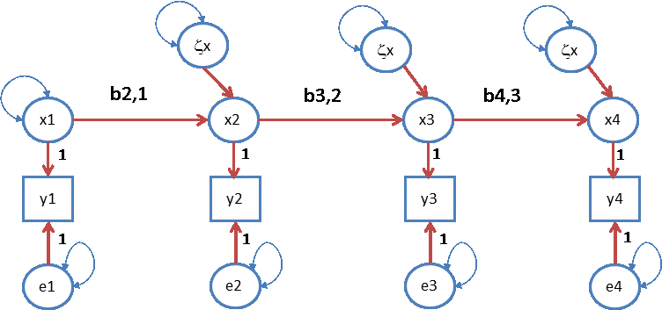
First order autoregression model.
var(x₁)
true score
var(e₁)
“error”
y_{ti} = b_{0t} + x_{ti} + e_{ti}
x_{ti} = b_{t-1,t} x_{t-1i} + ζx_{ti}
Notes:
Ar(1) as a phenotypic model. Regression models. Regression info

Slide 9
just an aside....nr 2 Identification:
can we obtain unique estimates of the parameters in our model given the available information
can we obtain unique estimates of the parameters in our ACDE model given the MZ and DZ 2x2 covariance matrices. NOPE...
You can try, but different starting values will produce different estimates. Estimates not unique ..... useless

Slide 10
First order autoregression model.
var(e₁)
var(e₄)
Identification issue: var(e₁) and var(e_{t}) are not identified. Solution set to zero, or equate
var(e₁) = var(e₂) , var(e₃) = var(e₄)
Notes:
Ar(1) as a phenotypic model

Slide 11
y_{ti} = b_{0t} + x_{ti} + e_{ti}
var(e₁)
var(e₄)
Oh....just linear regression models!
x_{ti} = b_{t-1,t} x_{t-1i} + ζx_{ti}
var(e₁)
var(e₄)
Notes:
Ar(1) as a phenotypic model

Slide 12
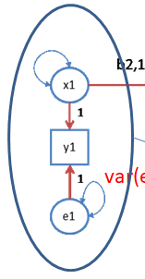
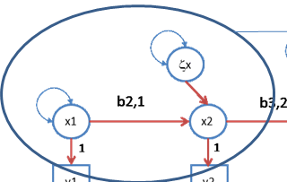
regression model... decomposition of variance
var(y_{t}) = var(x_{t}) + var(e_{t})
var(x_{t}) = b_{t-1,t}² var(x_{t-1}) + var(ζx_{t})
cov(x_{t},x_{t-1}) = b_{t-1,t}var(x_{t-1})
cov(y_{t},y_{t-1}) = b_{t-1,t}var(x_{t-1})
Standardized stats part I:
“Reliability” at each t, rel(y_{t}) :
rel(y_{t}) = var(x_{t}) / {var(x_{t}) + var(e_{t})}
Interpretation: % of variance in y_{t} due to latent x_{t}
An R² statistic....

Slide 13
var(y_{t}) = var(x_{t}) + var(e_{t})
var(x_{t}) = b_{t-1,t}² var(x_{t-1}) + var(ζx_{t})
cov(x_{t},x_{t-1}) = b_{t-1,t}var(x_{t-1})
cov(y_{t},y_{t-1}) = b_{t-1,t}var(x_{t-1})
Standardized stats part II:
Stability at level of X, stab(X_{t},X_{t-1}):
b_{t-1,t}² var(x_{t}) / {b_{t-1,t}² var(x_{t-1}) + var(ζx_{t})}
Interpretation: % of the variance in x_{t} due to x_{t-1}
An R² statistic....

Slide 14
var(y_{t}) = var(x_{t}) + var(e_{t})
var(x_{t}) = b_{t-1,t}² var(x_{t-1}) + var(ζx_{t})
cov(x_{t},x_{t-1}) = b_{t-1,t}var(x_{t-1})
cov(y_{t},y_{t-1}) = b_{t-1,t}var(x_{t-1})
Standardized stats part III:
Correlation t,t-1, cor(x_{t}, x_{t-1}):
b_{t-1,t} var(x_{t-1}) / {sd(y_{t-1}) * sd(y_{t})}
sd(y_{t}) = √(var(x_{t}) + var(e_{t}))
var(x_{t}) = b_{t-1,t} var(x_{t-1}) + var(ζx_{t})
Interpretation: strength of linear relationship

Slide 15
.51
.51
.51
ζx
ζx
ζx
1
.7
.7
.7
x1
x2
x3
x4
1
1
1
1
y1
y2
y3
y4
1
1
1
1
e1
e2
e3
e4
.25
.25
.25
.25
Covariance matrix
1.250 0.70 0.49 0.343
0.700 1.25 0.70 0.490
0.490 0.70 1.25 0.700
0.343 0.49 0.70 1.250
Correlation matrix
1.0000 0.560 0.392 0.2744
0.5600 1.000 0.560 0.3920
0.3920 0.560 1.000 0.5600
0.2744 0.392 0.560 1.0000
symbols too small: sorry!

Slide 16
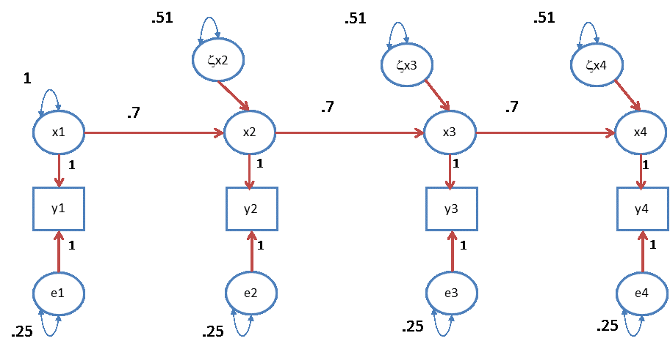
reliability: rel(x_{t}) = var(x_{t}) / {var(x_{t}) + var(e_{t})}
= 1/ (1+.25) = 1/1.25 = .8
R²: b_{t-1,t}² var(x_{t-1}) / {b_{t-1,t}² var(x_{t-1}) + var(ζx_{t})}
= {.7² * 1} / (.7² * 1 + .51) = .49/1 = .49
cor(t,t+1) : b_{t-1,t} var(x_{t-1}) / {sd(y_{t-1}) * sd(y_{t})}
={.7 * 1} / {√ 1.25*√1.25} = .56

Slide 17
0
0
0
ζx2
ζx3
ζx4
x1
x2
x3
x4
1
1
1
1
y1
y2
y3
y4
1
1
1
1
e1
e2
e3
e4
What happens if var(ζxt) = 0?

Slide 18
Special case: factor model var(ζx_{t}) (t=2,3,4) = 0
b_{2,1}
b_{3,2}
b_{4,3}
x1
x2
x3
x4
1
1
1
1
y1
y2
y3
y4
1
1
1
1
e1
e2
e3
e4
x1
y1
y2
y3
y4
1
1
1
1
e1
e2
e3
e4

Slide 19
Multivariate decomposition of phenotypic covariance matrix (TxT, say T=4):
Σ_{ph} = Σ_{A} + Σ_{C} + Σ_{E}
Σ_{ph1} Σ_{ph12}
Σ_{ph12} Σ_{ph2} =
Σ_{A} + Σ_{C} + Σ_{E} r⊗Σ_{A} + Σ_{C} + Σ_{E}
r⊗Σ_{A} + Σ_{C} + Σ_{E} Σ_{A} + Σ_{C} + Σ_{E}
(r=1 or .5)

Slide 20
Σ_{ph} = Σ_{A} + Σ_{C} + Σ_{E}
Estimate Σ_{A} directly, unstructured
a TxT covariance matrix, with
T*(T+1) / 2 elements
T=4 ...... T*(T+1) / 2 = 10

Slide 21
Σ_{ph} = Σ_{A} + Σ_{C} + Σ_{E}
Model Σ_{A} using a simplex model
Σ_{A} = (Ι−Β)_{A}⁻¹ Ψ_{A} (Ι−Β)_{A}^{-1t} + Θ_{A}
R script involves matrix notation .....

Slide 22
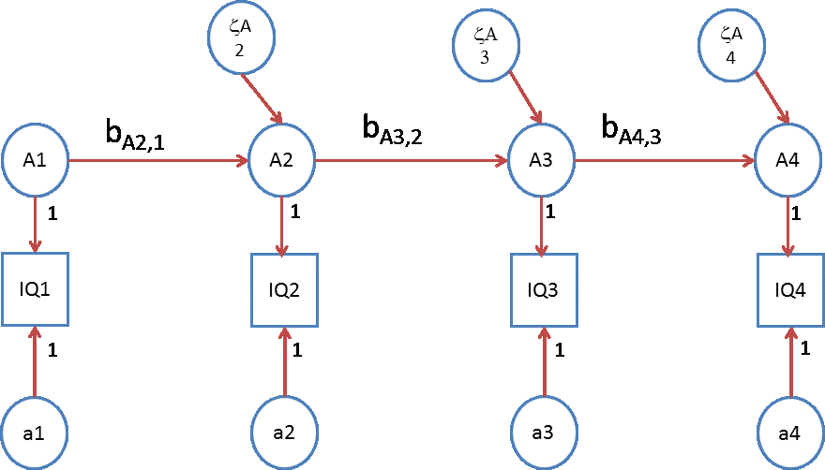
Σ_{A} = (Ι−Β_{A}) ⁻¹ Ψ_{A} (Ι−Β_{A}) ⁻¹ ^{t} + Θ_{A}
Β_{A} = 0 0 0 0
b_{A21} 0 0 0 0 b_{A32} 0 0
0 0 b_{A43} 0

Slide 23
Σ_{A} = (Ι−Β_{A}) ⁻¹ Ψ_{A} (Ι−Β_{A}) ⁻¹ ^{t} + Θ_{A}
Ψ_{A} = var(A₁) 0 0 0
0 var(ζ_{A2}) 0 0 0 0 var(ζ_{A3}) 0
0 0 0 var(ζ_{A4})

Slide 24
Σ_{A} = (Ι−Β_{A}) ⁻¹ Ψ_{A} (Ι−Β_{A}) ^{−1τ} + Θ_{A}
Θ_{A} = var(a₁) 0 0 0
0 var(a₂) 0 0 0 0 var(a₃) 0
0 0 0 var(a₄)
required:
var(a1) = var(a2)
var(a3) = var(a4)

Slide 25
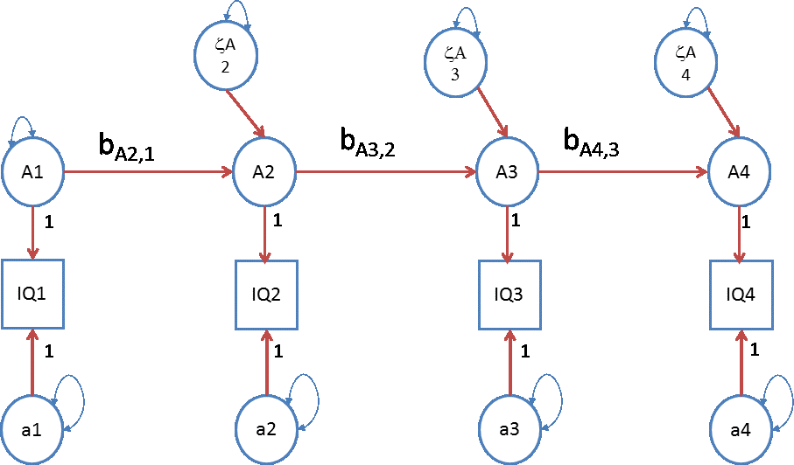
The genetic A simplex .....
.... same applies to C and E

Slide 26
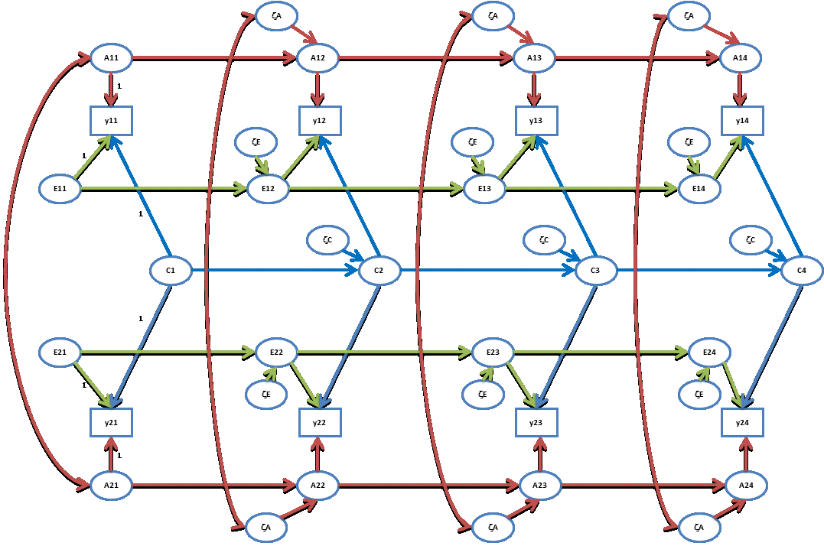

Slide 27
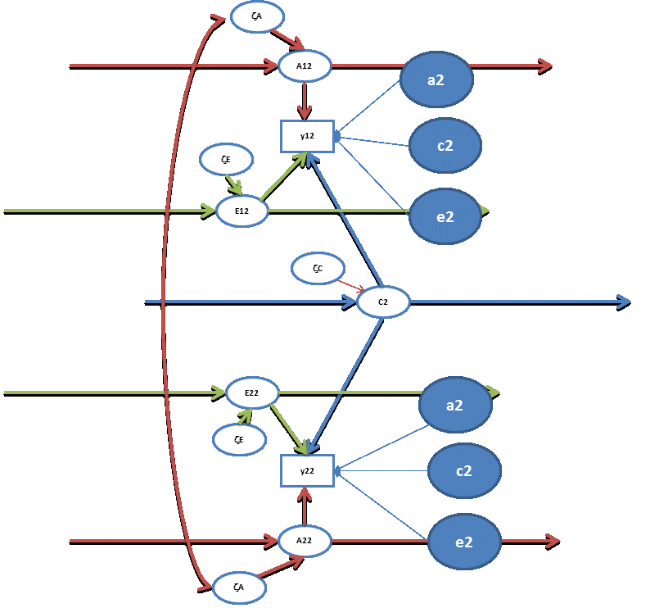
Occasion specific effects
required:
var(a1) = var(a2)
var(a3) = var(a4)
var(e1) = var(e2)
var(e3) = var(e4)
var(c1) = var(c2)
var(c3) = var(c4)

Slide 28
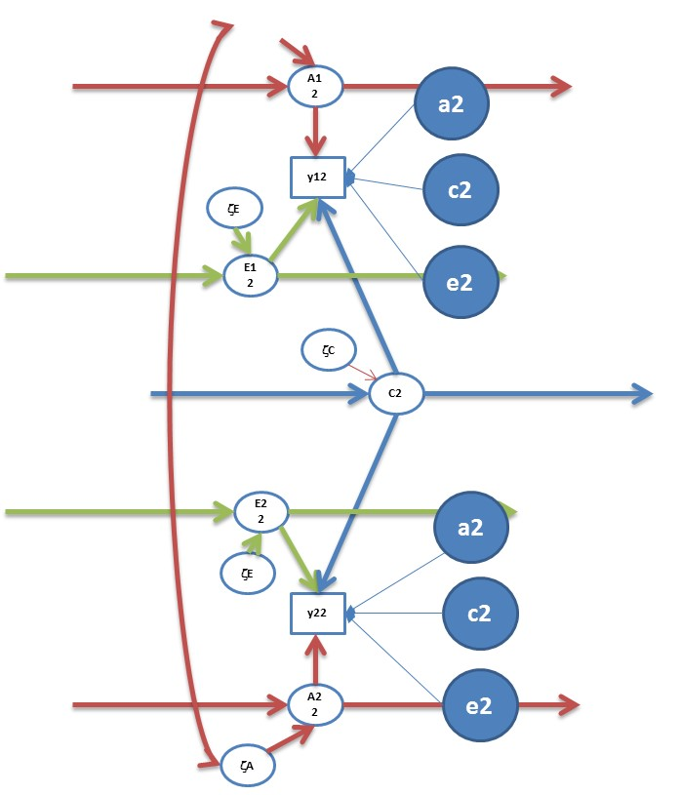
Question: h², c², and e² at each time point?
var(y_{t}) =
{var(A_{t}) + var(a_{t})} +
{var(C_{t}) + var(c_{t})} +
{var(E_{t}) + var(e_{t})}
h²= {var(A_{t}) + var(a_{t})} / var(y_{t})
c²= {var(C_{t}) + var(c_{t})} / var(y_{t})
e²= {var(E_{t}) + var(e_{t})} / var(y_{t})

Slide 29
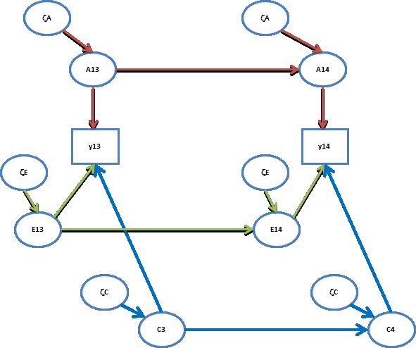
Q: contributions to stability (A,C,E) t-1 to t?
b_{At-1,t}² var(A_{t-1}) / {b_{At-1,t}² var(A_{t-1}) + var(ζA_{t})}
b_{Ct-1,t}² var(C_{t-1}) / {b_{Ct-1,t}² var(C_{t-1}) + var(ζC_{t})}
b_{Et-1,t}² var(E_{t-1}) / {b_{Et-1,t}² var(E_{t-1}) + var(ζE_{t})}
R² (pheno) =
R² (add gen) +
R² (shared env) +
R² (unshared env)

Slide 30
contributions of A to Phenotypic stability t-1 to t
b_{At-1,t}² var(A_{t-1})
{b_{At-1,t}² var(A_{t-1}) + var(ζA_{t})} + {b_{Ct-1,t}² var(C_{t-1}) + var(ζC_{t})}
+ {b_{Et-1,t}² var(E_{t-1}) + var(ζE_{t})}

Slide 31
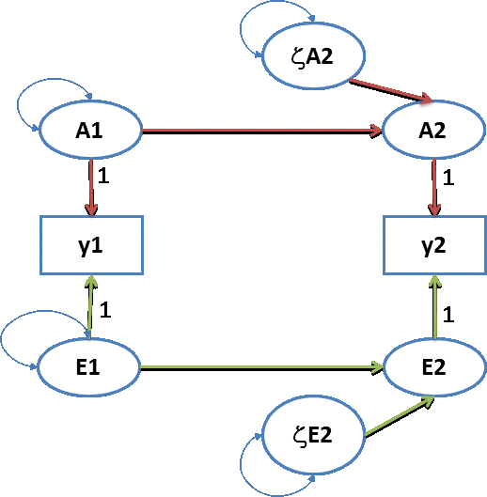
.0195
Σ_{A} = .2 .184
.184 .2
.2
.95
Σ_{E} = .8 .4
.4 .8
.8
Σ_{y} = Σ_{A} + Σ_{E} = 1 .584
.584 1
.5
.6
h² at t=1? answer: .2 (e²=.8)
h² at t=2? answer: .2 (r²=.8)
correlation between A1 and A2? .184 / (√.2*√.2) = .92
correlation between E1 and E2? . 4 / (√.8*√.8) = .50
covariance between Y1 and Y2? .584
contribution of A to covariance Y1 and Y2? .184/.584 = .315
contribution of E to covariance Y1 and Y2? .4/.584 = .685

Slide 32
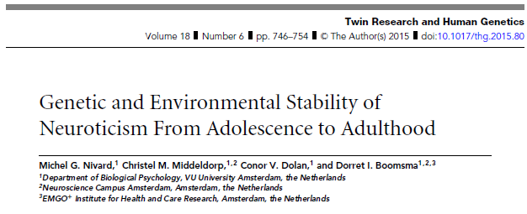

Slide 33
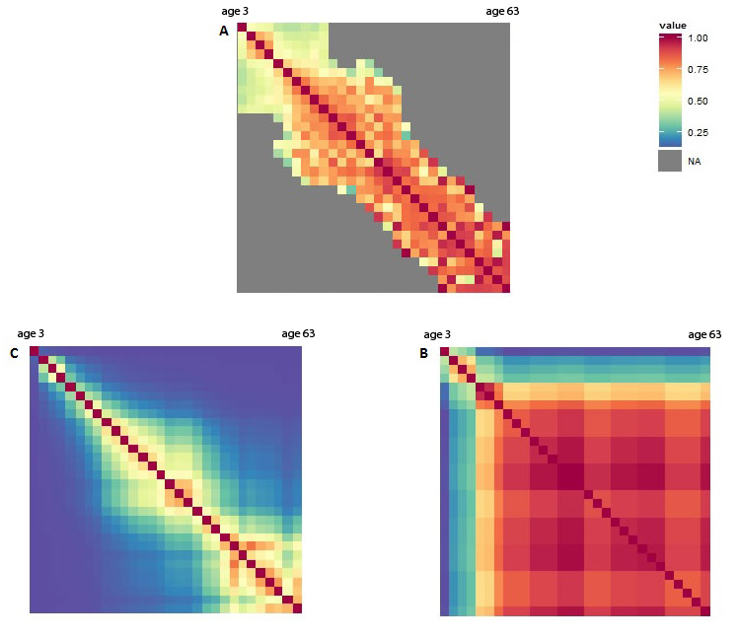
Phenotypic
Nivard et al, 2014
A
E
Anx/dep stability due to A and E from 3y to 63 years

Slide 34
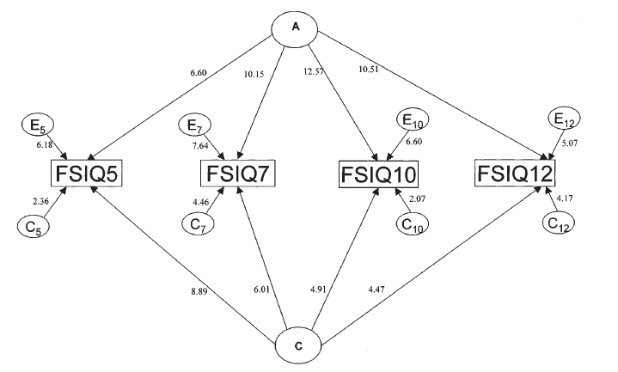
see slide 18
‘continuity in cognitive abilities is mainly due to additive genetic factors’ (p. 245).
Bartels M, Rietveld MJH, Baal van GCM, Boomsma DI. (2002) Behavior Genetics, 32, 237-249.
Notes:
Another twin study. This time "Full Scale IQ". A and C are sources of stability. However A is waxing, C is waning. Ultimately, C influences disappear (as the children enter early adulthood). The contribution of A increases. The numbers shown are unstandardized path coefficients. As these increase for A but descrease for C, this tell us that the increase in heritability is actually due to the increase of A and decrease of C.

Slide 35
Birley et al. Behav Genet 2005

Slide 36
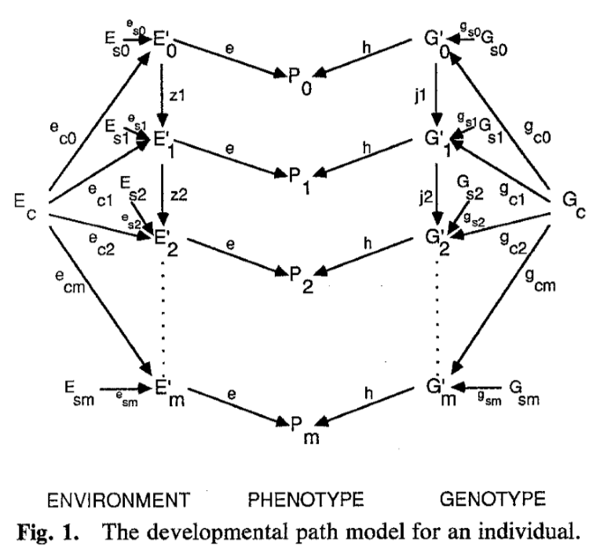

Slide 37
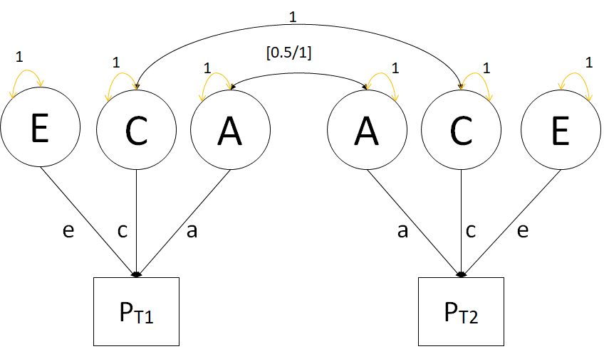
Eveline’s practical: the basic genetic simplex model applied to IQ at 4 occasions.....
But first .... variations on the genetic simplex model which include GE-covariance
What is GE-covariance ?

Slide 38
https://genepi.qimr.edu.au/staff/classicpapers/
“(.....), it is possible, ….., to parameterize genotype environment covariance in a variety of ways consistent with meaningful biological and psychological theories. We may distinguish the following three kinds of CovGE which can be specified in terms of a theoretical model” (p. 8).
Environments selected by genotypes (Scarr & McCartny, 1983;
Plomin, DeFries & Loehlin, 1977).
Sibling effects (Carey, 1986, Behav Genet 16:319–341).
Cultural transmission (Keller, et al, Twin Res & Hun Gen 2011).
Notes:
Now the fact that A and E are uncorrelated is statistically very pleasant, but does not necessarily sit well with substantive theory. 40 years ago Eaves et al. discussed possible sources of GE-covariance. They emphasized that any attempt to incorporate such covariance should be based on a theory or process relevant to the phenotype of interest. They presented several plausible sources of GE-covariance, which the denoted “environments selected by genotypes, sibling effects, and cultural transmission”. In earlier work, we extended the simplex model, to include form of the processes of sibling interaction and of environments selected by genotypes.

Slide 39
Environments selected by genotypes (Scarr & McCartny, 1983; Plomin, DeFries & Loehlin, 1977) – niche picking
Sibling effects (Carey, 1986, Behav Genet 16:319–341) – mutual influences
Notes:
Now the fact that A and E are uncorrelated is statistically very pleasant, but does not necessarily sit well with substantive theory. 40 years ago Eaves et al. discussed possible sources of GE-covariance. They emphasized that any attempt to incorporate such covariance should be based on a theory or process relevant to the phenotype of interest. They presented several plausible sources of GE-covariance, which the denoted “environments selected by genotypes, sibling effects, and cultural transmission”. In earlier work, we extended the simplex model, to include form of the processes of sibling interaction and of environments selected by genotypes.

Slide 40
Environments selected by genotypes (Scarr & McCartny, 1983; Plomin, DeFries & Loehlin, 1977) – niche picking
“Niche-picking”
During development children seek out and create and are furnished surrounding (E) that fit their phenotype.
A smart child growing up will pick the niche that fits her/her phenotypic intelligence.
A anxious child growing up may pick out the niche that least aggrevates his / her phenotypic anxiety.
Phenotype of twin 1 at time t -> environment of twin 1 at time t+1

Slide 41
Sibling effects (Carey, 1986, Behav Genet 16:319–341) – mutual influences
Mutual influences
During development children’s behavior may contribute to the environment of their siblings.
A smart child growing up will pick the niche that fits her/her phenotypic intelligence and in so doing may influence (contribute to) the environment of his or her sibling.
A behavior of an anxious child may be a source of stress for his or her siblings.
Phenotype of twin 1 at time t -> environment of twin 2 at time t+1

Slide 42
a
a
a
A
A
A
A
y
y
y
y
e
e
e
E
E
E
E
c
c
c
C
C
C
C
E
E
E
E
e
e
e
y
y
y
y
A
A
A
A
a
a
a
A, C, E uncorrelated

Slide 43
a
a
a
A
A
A
A
y
α₁
y
α₂
y
α₃
y
e
e
e
E
E
β₂
E
β₃
E
β₁
c
c
c
C
C
C
C
E
E
E
E
β₁
β₂
β₃
e
e
e
α₁
α₂
α₃
y
y
y
y
A
A
A
A
a
a
a
A and E correlated (with phenotype mediating)

Slide 44
Identification #1 T=4
ph_{ti}→E_{(t+1)j} (i=j) ph_{ti}→E_{(t+1)j} (i≠j)
α₁, α₂, α₃ β₁, β₂, β₃ (not ID)
α₁, α₂=α₃ β₁, β₂=β₃
Presence of C not relevant to this results
(holds in ACE and in AE model)

Slide 45
a
a
a
A
A
A
A
y
α₁
y
α₂
y
α₂
y
e
e
e
E
E
β₂
E
β₂
E
β₁
c
c
c
C
C
C
C
E
E
E
E
β₁
β₂
β₃
e
e
e
α₁
α₂
α₃
y
y
y
y
A
A
A
A
a
a
a

Slide 46
N required given plausible values ACE α₁, α₂=α₃ & β₁, β₂=β₃
Hypothesis: α₁=α₂=α₃=0 & β₁= β₂=β₃ =0 (4df)
α_{k} β_{k} ~N (power=.80)
.10 .10 11700
.10 .15 4700
.15 .10 12100
.15 .15 4800

Slide 47
ζA
ζA
ζA
A11
A12
A13
A14
1
y*11
y*12
y*13
y*14
α₁
E
α₂
ζE
α₃
ζE
1
β₁
β₂
β₃
E11
E12
E13
E14
1
ζC
ζC
ζC
No Good
C1
C2
C3
C4
1
E21
E22
E23
E24
1
β₁
β₂
β₃
ζE
ζE
ζE
α₁
α₂
α₃
y*21
y*22
y*23
y*24
1
A21
A22
A23
A24
ζA
ζA
ζA

Slide 48
ζA
ζA
ζA
A11
A12
A13
A14
1
y*11
α₁
y*12
α₂
y*13
α₃
y*14
ζE
ζE
ζE
1
β₁
β₂
β₃
E11
E12
E13
E14
E21
E22
E23
E24
β₁
β₂
β₃
1
ζE
ζE
ζE
y*21
α₁
y*22
α₂
y*23
α₃
y*24
1
A21
A22
A23
A24
ζA
ζA
ζA

Slide 49
N required given plausible values AE α₁, α₂=α₃ & β₁, β₂=β₃
α_{k} β_{k} ~N (power=.80)
.10 .10 620
.10 .15 260
.15 .10 580
.15 .15 240
Good......
Hypothesis: α₁=α₂=α₃=0 & β₁= β₂=β₃ =0 (4df)

Slide 50
True AE+α_{k} & β_{k} (Nmz=Ndz=1000)
α_{k} b_{k} ACE simplex
df=61
.10 .10 5.44
.10 .15 11.22
.15 .10 5.62
.10 .15 11.54
(approximate model equivalence)
Notes:
Overall chi2 fit of false model to true model. Not a ratio test of specific hypothesis.

Slide 51
ζA
ζA
ζA
A11
A12
A13
A14
1
y*11
α₁
y*12
α₂
y*13
α₃
y*14
ζE
ζE
ζE
1
β₁
β₂
β₃
E11
E12
E13
E14
E21
E22
E23
E24
β₁
β₂
β₃
1
ζE
ζE
ζE
y*21
α₁
y*22
α₂
y*23
α₃
y*24
1
A21
A22
A23
A24
ζA
ζA
ζA
Q: GE-cov ...EEcov

Slide 52
Anxious depression
Twins aged 3,7,10,12 Netherlands Twin Register (NTR), which includes the Young NTR (YNTR; van Beijsterveldt, Groen-Blokhuis, Hottenga, et al., 2013)
ASEBA CBCL instruments (Achenbach), maternal ratings
Observed 89%, 54%, 45%, 37% (NMZ=3480)
Observed 89%, 50%, 39%, 32% (NDZ=3145)

Slide 53
Phenotypic correlations
FIML phenotypic twin correlations
MZ: .71 (3), .58 (7), .58 (10), and .63 (12).
DZ: .31 (3), .36 (7), .35 (10), and .40 (12).
From 7y onwards looks like ACE model

Slide 54
Model logl npar AIC BIC
1 ACE -69528.5 28 139113 139303
2 AC(r1)E -69528.5 24 139105 139268
3 AE -69537.9 20 139115 139251
4 AE + α_{k}, β_{k} -69519.3 24 139086 139249
5 AE + β_{k} -69522.1 22 139088 139237
6 ACE ph->ph (2) -69522.0 24 139093 139256
7 ACE ph->ph (1) -69537.1 22 139119 139268

Slide 55
Conclusion:
Not a AC(rank1)E model but Ph->E model
AE + β_{k}, i.e., ph_{ti}→E_{(t+1)j} (i≠j)
β₁=0.123 (s.e. .041)
β₂ = β₃ = 0.062 (s.e. .027)

Slide 56
a
a
a
A
A
A
A
1
y
y
y
y
β₁
e
β₂
e
β₂
e
1
E
E
E
E
E
E
E
E
1
β₁
β₂
β₂
e
e
e
y
y
y
y
1
A
A
A
A
a
a
a
β₁=0.123 (s.e. .041) and β₂ = β₃ = 0.062 (s.e. .027)

Slide 57
