Slide 1
Introduction to Biometrical Genetics
{in the classical twin design}
Conor Dolan et al.
Vrije Universiteit
Boulder 2018 Workshop
Slide acknowledgement: Manuel Ferreira, Pak Sham, Shaun Purcell, Sarah Medland, and Sophie van der Sluis

Slide 2
Slides: 3-7 .... what’s it all about? individual differences
Slides: 8-15 ..... how to quantify individual differences
Slides: 16-18 .... genetic terminology, QTL
Slides: 19-27 ... mean & variance as function of QTL
Slides: 28- 30... interpretation of variance components in regression
Slides: 31- 43 ... covariance as function of QTL and IBD
Slides: 44-48 ... intro to practical (there is no practical!)

Slide 3
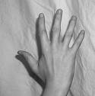
“Having 5 fingers genetically determined”
“DNA includes a blueprint to build a hand”
Notes:
Why is the question incorrect?
If there is no variation in the phenotype, it cannot be related to variation in the genotype.
The right question concerns variation.

Slide 4
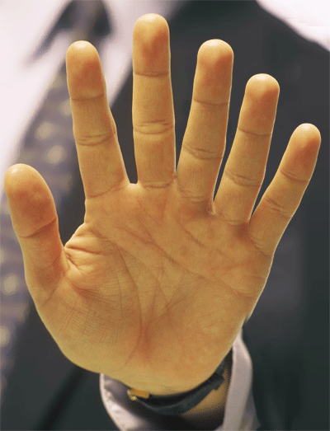
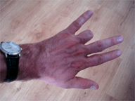
normal
polydactyly
angry dog
Behavior genetic research is concerned with
relating individual differences in phenotypes to individual differences at the genetic level and individual differences in environmental influences
Notes:
Beh Gen research is about explaining DIFFerences in the numbers of fingers
Due to genetic causes or environmental causes? Or both?
The difference between hand one and hand two is 1 (5 fingers-6 fingers), this difference is due to a genetic difference.
The difference between one and three is 1 finger, this difference is due to a environmental difference.

Slide 5
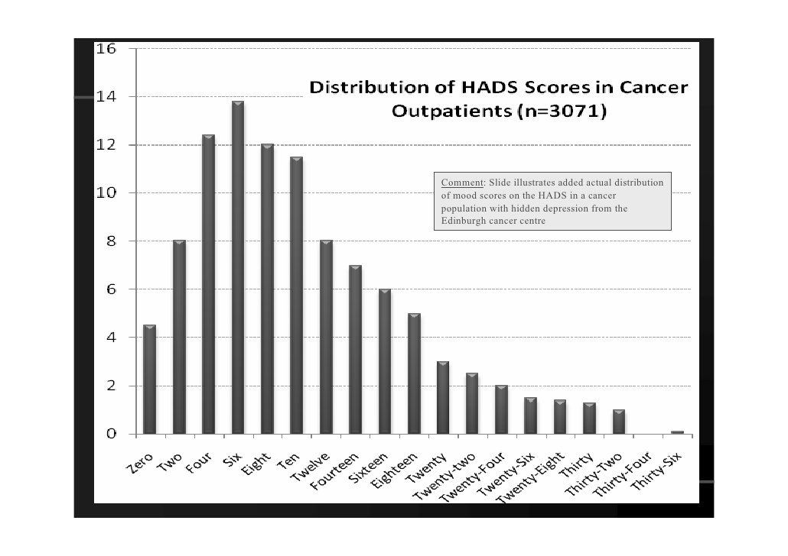
Phenotype: continuously varying, genetically complex,
e.g. (ideally) normally distributed
e.g., binary (dichotomous, 0-1 coded) phenotype
(based on continuous phenotype; liability threshold model).
Normal
Depressed
0
1
The phenotype is a quantitative trait, a metric trait, a complex trait

Slide 6
Genetically complex:
Individual differences in the phenotype are subject to the effects of many genes of small effects, a.k.a. polygenes, minor genes. How many? Hundreds (Educational Attainment, Height) … Thousands….?
Phenotypic individual differences are attributable to genetic individual differences in a large number of polygenes, a.k.a. QTLs (quantitative trait loci).
Polygenicity implies phenotypic continuous distributions (Nick Martin’s intro talk)

Slide 7
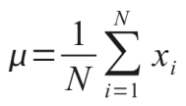

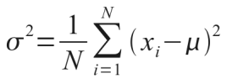
People differ phenotypically
Q. How to quantify individual differences?
The variance: s², σ², σ²_{X} , var(X), V_{X}
mean (X)
variance (X)
x_{i} is the phenotypic value of person i (i=1,...,N)
Notes:
We want to explain why people differ. That is: explain the phenotypic variance. Variance is an important statistical concept, as it quantifies individual differences.

Slide 8
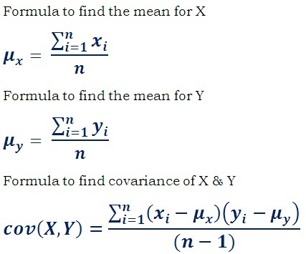
We need the covariance: express the phenotypic
relatedness among family members

Slide 9
Means, Variances and Covariances
Notes:
Remember the formula for mean, variance, and covariance

Slide 10

1,1,2,2,3,4,5,5,6,6
mean = (1+1+2+2+3+4+5+5+6+6)/10
= 36/12 = 3.5
f(1) = 2/10 = .2 .2*1 +
f(2) = 2/10 = .2 .2*2 +
f(3) = 1/10 = .1 .1*3 +
f(4) = 1/10 = .1 .1*4 +
f(5) = 2/10 = .2 .2*5 +
f(6) = 2/10 = .2 .2*6
----------
3.5
# in R
x=c(1,1,2,2,3,4,5,5,6,6)
mean(x)

Slide 11
1,1,2,2,2,3,4,5,5,5,6,6
mean = 3.5
f(1) = 2/10 = .2 .2*(1-3.5)² +
f(2) = 2/10 = .2 .2*(2-3.5)² +
f(3) = 1/10 = .1 .1*(3-3.5)² +
f(4) = 1/10 = .1 .1*(4-3.5)² +
f(5) = 2/10 = .2 .2*(5-3.5)² +
f(6) = 2/10 = .2 .2*(6-3.5)²
----------------
variance = 3.45
stdev = √variance
stdev = √3.45 = 1.857
# in R
x=c(1,1,2,2,3,4,5,5,6,6)
var(x)
Notes:
X=c(1,1,2,2,3,4,5,5,6,6)
mean(X)
var(X)*9/10
# check
f=c(.2,.2,.1,.1,.2,.2)
x=c(1,2,3,4,5,6)-mean(X)
sum(f*x^2)

Slide 12
covariance
correlation
Cor(X,Y) = Cov(X,Y) / √ [Var(X)*var(Y)] =
= Cov(X,Y) / [stdev(X)*stdev(Y)]
Cor(X,Y) is – stand-alone - interpretable
MZ covariance is 291.... uninterpretable
MZ correlation is .80 .... interpretable

Slide 13

To what extent, and how, are
individual differences in genetic makeup, and
individual differences in environmental factors, related to
phenotypic (observed) individual differences ?
To what extent, and how, do
individual differences in genetic makeup, and
individual differences in environmental factors, explain
phenotypic (observed) variance?

Slide 14
terminology
QTL Quantative trait locus: a sequence of DNA base pairs (may be a SNP: single base pair).
Locus: the site of the specific QTL on a chromosome (22 pairs + XY). Humans are dipoid (22 pairs autosomal chromosomes + sex chromosomes XY or XX).
Allele: an alternative form of a gene at a locus
Genotype: the combination of alleles at a particular locus
Phenotype: an observed characteristic, which displays individual differences (in part due to genetic differences)

Slide 15
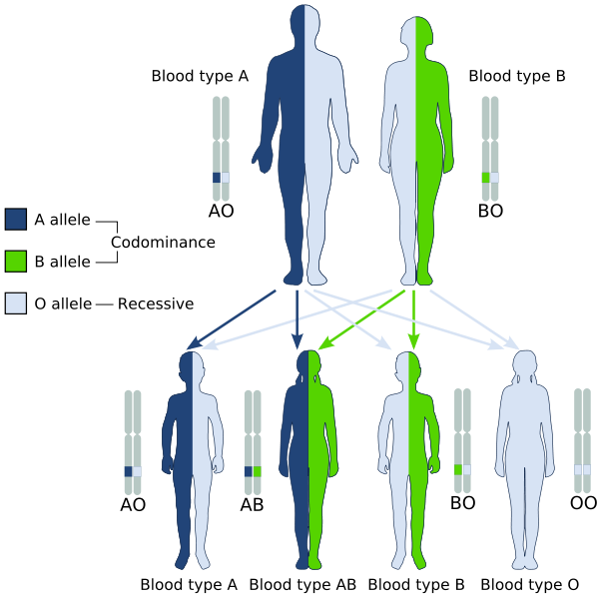
chromosome 9
location 9q34.2
Mendel’s law of
segregration
Notes:
A text from the WIKI page (“abo blood group”)
The ABO blood type is controlled by a single gene (the ABO gene) with three types of alleles inferred from classical genetics: i, I^{A}, and I^{B}. The gene encodes a glycosyltransferase—that is, an enzymethat modifies the carbohydrate content of the red blood cell antigens. The gene is located on the long arm of the ninth chromosome (9q34). The ABO locus, which is located on chromosome 9, contains 7 exons that span more than 18 kb of genomic DNA. Exon 7 is the largest and contains most of the coding sequence. The ABO locus has three main alleleic forms: A, B, and O. The A allele encodes a glycosyltransferase that bonds α-N-acetylgalactosamine to the D-galactose end of the H antigen, producing the A antigen. The B allele encodes a glycosyltransferase that bonds α-D-galactose to the D-galactose end of the H antigen, creating the B antigen.
In the case of the O allele, when compared to the A allele, exon 6 lacks one nucleotide (guanine), which results in a loss of enzymatic activity. This difference, which occurs at position 261, causes a frameshift that results in the premature termination of the translation and, thus, degradation of the mRNA. This results in the H antigen remaining unchanged in case of O groups.

Slide 16

Example of a QTL: FNBP1L gene
The FNBP1L gene has been associated with intelligence in two studies:
* "Genome-wide association studies establish that human intelligence is highly heritable and polygenic". 2011, Mol. Psychiatry 16 (10): 996–1005.doi:10.1038/mp.2011.85)
* "Childhood intelligence is heritable, highly polygenic and associated with FNBP1L". Mol. Psychiatry 19(2): 2538. doi:10.1038/mp.2012.184. Authors include Sarah Medland & Nick Martin.
This gene is on chromosome 1 (1p22,1), and it comprises 106531 bases (106.5Kb). Within this gene the SNP rs236330 specifically is associated with intelligence.

Slide 17
Population level
Allele frequencies (QTL: diallelic autosomal; e.g., SNP rs236330)
A single locus, with two alleles
  - Biallelic a.k.a. diallelic
  - in GWAS: Single nucleotide polymorphism, SNP
Alleles A and a
- Frequency of A is p
- Frequency of a is q = 1 – p
frequencies in the population
Every individual inherits two alleles
- A genotype is the combination of the two alleles
- e.g. AA, aa (the homozygotes) or Aa (the heterozygote)
……………………genotype frequencies?

Slide 18
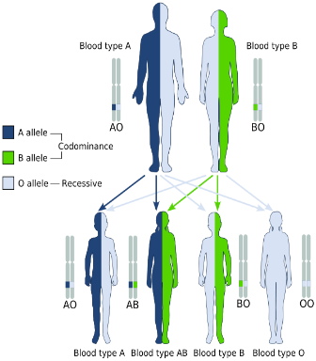
Biometrical model for single biallelic QTL
Biallelic locus
- Genotypes: AA, Aa, aa
- Genotype frequencies: p², 2pq, q²
Mother’s gametes (egg)
A (p)
a (q)
Genotype frequencies (Random mating)
Father’s gametes
sperm
A (p)
AA (p²)
Aa (pq)
a (q)
aA (qp)
aa (q²)
Hardy-Weinberg Equilibrium frequencies
P (AA) = p²
P (Aa) = 2pq
p² + 2pq + q² = 1
P (aa) = q²

Slide 19
Phenotype level: contribution to continuous variation
Biometric Model
aa
Aa
AA
– a
d
+a
Genotypic effect
μ – a
μ + d
μ + a
means within each genotype (aa, Aa, AA)
......conditional on genotype
take all aa individuals and calculate their mean phenotypic value:
μ – a (the phenotypic mean conditional on genotype aa)

Slide 20
Biometrical model for single biallelic QTL
1. Contribution of the QTL to the Mean
Genotypes
AA
Aa
aa
Effect, x
μ + a
μ +d
μ - a
Frequencies, f(x)
p²
2pq
q²
(μ+a)(p²) + (μ+d)(2pq) + (μ–a)(q²) =
μ + a(p²) + d(2pq) – a(q²) =
μ + a(p-q) + 2pqd. (pop pheno mean)
contribution of the QTL to the population phenotypic mean
m= a(p-q) + 2pqd

Slide 21
Biometrical model for single biallelic QTL
2. Contribution of the QTL to the Variance (X)
Genotypes
AA
Aa
aa
Effect (x)
μ + a
μ + d
μ - a
Frequencies, f(x)
p²
2pq
q²
s²_{QTL}
= (a-m)²p² + (d-m)²2pq + (-a-m)²q²
m= a(p-q) + 2pqd

Slide 22
Biometrical model for single biallelic QTL
s²_{QTL}
= (a-m)²p² + (d-m)²2pq + (-a-m)²q²
= 2pq[a+(q-p)d]² + (2pqd)²
= s²_{QTL(A)} + s²_{QTL(D)}
Additive or linear effects give rise to variance component
s²_{QTL(A)} =2*pq[a+(q-p)d]²
Dominance or within local allelic interaction effects give rise to variance component
s²_{QTL(D)} =(2pqd)²
Notes:
# numerical check
rm(list=ls(all=TRUE))
N=1000
a=1.5
ds=c(1.5)
mu=10
#for (d in ds) {
d=ds
dose=c(a,d,-a)+mu
p=.3
q=1-p
gf=c(p^2,2*p*q,q^2)
ns=round(N*gf)
i1=c(rep(1,ns[1]),rep(2,ns[2]),rep(3,ns[3]))
g=dose[i1]
mean(g[i1==1])
mean(g[i1==2])
mean(g[i1==3])
mean(g)
mean(g[i1==1])*(sum(i1==1)/N)+
mean(g[i1==2])*(sum(i1==2)/N)+
mean(g[i1==3])*(sum(i1==3)/N)
#
m=a*(p-q)+2*p*q*d
mu+m
# 2pq[a+(q-p)d]2 + (2pqd)2
dose=dose-mu
sA=2*p*q*(dose[1]+(q-p)*dose[2])^2
sD=(2*p*q*dose[2])^2
sG=(a-m)^2*p^2 + (d-m)^2*2*p*q + (-a-m)^2*q^2
print(c(sG, sA+sD, sA, sD, var(g)))

Slide 23
Biometrical model for single biallelic QTL
s²_{QTL}
= (a-m)²p² + (d-m)²2pq + (-a-m)²q²
= 2pq[a+(q-p)d]² + (2pqd)²
= s²_{QTL(A)} + s²_{QTL(D)}
Additive effects: s²_{QTL(A)} =2*pq[a]²
Dominance effects: s²_{QTL(D)} = 0
aa
Aa
AA
– a
d=0
+a

Slide 24
Biometrical model for single biallelic QTL
s²_{QTL}
= (a-m)²p² + (d-m)²2pq + (-a-m)²q²
= 2pq[a+(q-p)d]² + (2pqd)²
= s²_{QTL(A)} + s²_{QTL(D)}
Additive effects: s²_{QTL(A)} =2*pq[a+(q-p)d]²
Dominance effects: s²_{QTL(D)} = (2pqd)²
aa
Aa
AA
– a
d
+a

Slide 25
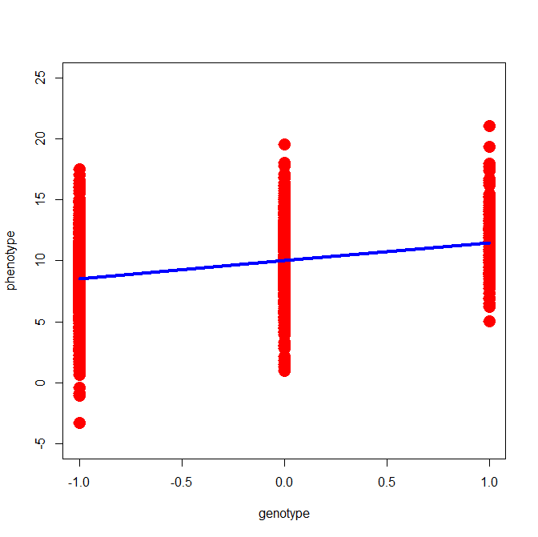
Suppose we measure the QTL and the phenotype and regress X on QTL.The scatterplot of the data
(aa coded -1; Aa coded 0; AA coded 1).
we ask:
how much of the phenotypic
variance is explained by the
predictor (QTL)
In the following slides we look at the regression lines only
(not plotting the residuals – just to avoid clutter).

Slide 26
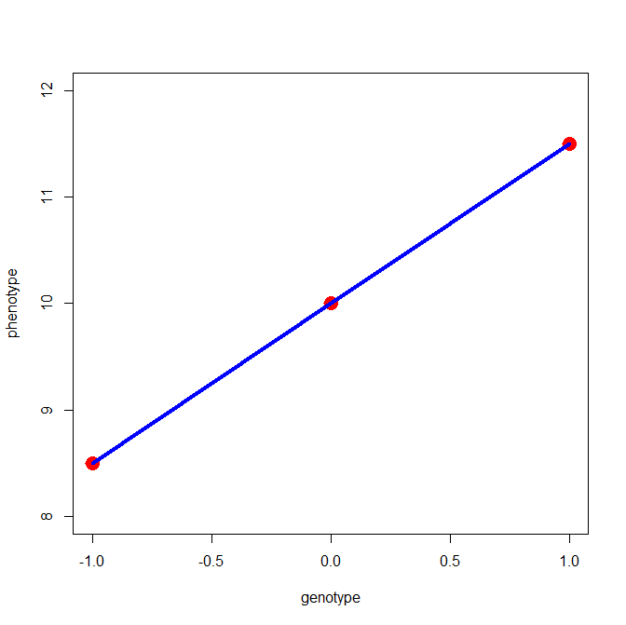
μ+a
Explained variance:
s²_{QTL(A)} =2*pq[a]²
s²_{QTL(D)} = 0
μ-a
aa
AA
Aa
aa
Aa
AA
– a
0
+a

Slide 27
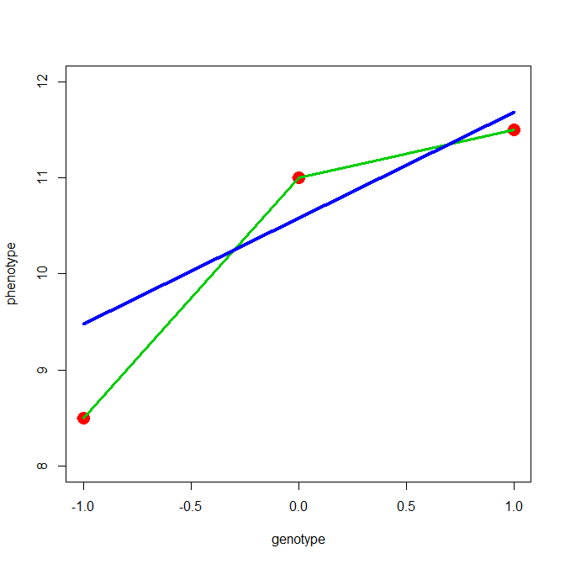
μ+a
μ+d
Explained variance (blue line):
s²_{QTL(A)} =2*pq[a+(q-p)d]²
Not explained
s²_{QTL(D)} = (2pqd)²
μ-a
aa
AA
Aa
aa
Aa
AA
– a
d
+a

Slide 28
s²_{QTL(A)} always greater than zero
s²_{QTL(D)} can be zero (additive model d=0)

Slide 29
Biometrical model for single biallelic QTL
3. Contribution of the QTL to the Cov (X,Y)
AA
(a-m)
Aa
(d-m)
aa
(-a-m)
AA
(a-m)
(a-m)²
(a-m)
(d-m)
(a-m)
(-a-m)
Aa
(d-m)
(a-m)
(d-m)
(d-m)²
(d-m)
(-a-m)
aa
(-a-m)
(a-m)
(-a-m)
(d-m)
(-a-m)
(-a-m)²
m= a(p-q) + 2pqd
What about the f(xi, y_{i})?

Slide 30
Biometrical model for single biallelic QTL
3A. Contribution of the QTL to the Cov (X,Y) – MZ twins
AA
(a-m)
Aa
(d-m)
aa
(-a-m)
AA
(a-m)
p²
(a-m)²
0
(a-m)
(d-m)
0
(a-m)
(-a-m)
Aa
(d-m)
0
(a-m)
(d-m)
2pq
(d-m)²
0
(d-m)
(-a-m)
aa
(-a-m)
0
(a-m)
(-a-m)
0
(d-m)
(-a-m)
q²
(-a-m)²
Covar (X_{i},X_{j})
= (a-m)²p² + (d-m)²2pq + (-a-m)²q²
= 2pq[a+(q-p)d]² + (2pqd)²
= s²_{QTL(A)} + s²_{QTL(D)}

Slide 31
Biometrical model for single biallelic QTL
3B. Contribution of the QTL to the Cov (X,Y) – Parent-Offspring
AA
(a-m)
Aa
(d-m)
aa
(-a-m)
AA
(a-m)
p³
(a-m)²
p²q
(a-m)
(d-m)
0
(a-m)
(-a-m)
Aa
(d-m)
p²q
(a-m)
(d-m)
pq
(d-m)²
pq²
(d-m)
(-a-m)
aa
(-a-m)
0
(a-m)
(-a-m)
pq²
(d-m)
(-a-m)
q³
(-a-m)²

Slide 32
given an AA parent, an AA offspring can come from either AA x AA or AA x Aa parental mating types
AA x AA will occur p² × p² = p⁴
and have AA offspring Prob(AA)=1
AA x Aa will occur p² × 2pq = 2p³q
and have AA offspring Prob(AA)=0.5
and have Aa offspring Prob(Aa)=0.5
Therefore, P(AA parent & AA offspring) = p⁴ + .5*2*p³q
= p³(p+q)
= p³

Slide 33
So can be complicated, but can also be simple ….
Parent
AA
(a-m)
Aa
(d-m)
aa
(-a-m)
AA
(a-m)
p³
(a-m)²
p²q
(a-m)
(d-m)
0
(a-m)
(-a-m)
Offspring
Aa
(d-m)
p²q
(a-m)
(d-m)
pq
(d-m)²
pq²
(d-m)
(-a-m)
aa
(-a-m)
0
(a-m)
(-a-m)
pq²
(d-m)
(-a-m)
q³
(-a-m)²
why zero probability?

Slide 34
Biometrical model for single biallelic QTL
3B. Contribution of the QTL to the Cov (X,Y) – Parent-Offspring
AA
(a-m)
Aa
(d-m)
aa
(-a-m)
AA
(a-m)
p³
(a-m)²
p²q
(a-m)
(d-m)
0
(a-m)
(-a-m)
Aa
(d-m)
p²q
(a-m)
(d-m)
pq
(d-m)²
pq²
(d-m)
(-a-m)
aa
(-a-m)
0
(a-m)
(-a-m)
pq²
(d-m)
(-a-m)
q³
(-a-m)²
Cov (X_{i},X_{j})
= (a-m)²p³ + … + (-a-m)²q³
= pq[a+(q-p)d]²
= ½ s²_{QTL(A)}

Slide 35
Biometrical model for single biallelic QTL
3C. Contribution of the QTL to the Cov (X,Y) – Unrelated individuals
p²
2pq
q²
AA
(a-m)
Aa
(d-m)
aa
(-a-m)
p²
AA
(a-m)
p⁴
(a-m)²
2p³q
(a-m)
(d-m)
p²q²
(a-m)
(-a-m)
2pq
Aa
(d-m)
2p³q
(a-m)
(d-m)
4p²q²
(d-m)²
2pq³
(d-m)
(-a-m)
q²
aa
(-a-m)
p²q²
(a-m)
(-a-m)
2pq³
(d-m)
(-a-m)
q⁴
(-a-m)²
Cov (X_{i},X_{j})
= (a-m)²p⁴ + … + (-a-m)²q⁴
= 0
Notes:
#check
p=.3
q=1-p
tb=matrix(c(
p^4,2*p^3*q,p^2*q^2,
2*p^3*q, 4*p^2*q^2, 2*p*q^3,
p^2*q^2, 2*p*q^3, q^4),3,3,byrow=T)
sum(tb)

Slide 36
Follow same method for full sibs and DZ twins
Derive genotype frequences ....
s1 | s2 | eff | eff |  | frequency (p(A)=p, p(a)=1-p)
AA | AA | a | a | r1 | p**4+p**3*q+p**2*q**2/4
aa | aa | -a | -a | r2 | p**2*q**2/4+p*q**3+q**4
Aa | Aa | d | d | r3 | p**3*q+3*p**2*q**2+p*q**3
AA | Aa | a | d | r4 | p**3*q+p**2*q**2/2
Aa | AA | d | a | r4 | p**3*q+p**2*q**2/2
Aa | aa | d | -a | r5 | p**2*q**2/2+p*q**3
aa | Aa | -a | d | r5 | p**2*q**2/2+p*q**3
AA | aa | a | -a | r6 | p**2*q**2/4
aa | AA | -a | a | r6 | p**2*q**2/4
Notes:
p1=p**4+p**3*q+p**2*q**2/4+p**2*q**2/4+p*q**3+q**4+
p**3*q+3*p**2*q**2+p*q**3+
p**3*q+p**2*q**2/2+
p**3*q+p**2*q**2/2+
p**2*q**2/2+p*q**3+
p**2*q**2/2+p*q**3+
p**2*q**2/4+
p**2*q**2/4

Slide 37
Biometrical model for single biallelic QTL
3B. Contribution of the QTL to the Cov (X,Y) – DZ twins
AA
(a-m)
Aa
(d-m)
aa
(-a-m)
AA
(a-m)
r1
(a-m)²
r4
(a-m)
(d-m)
r6
(a-m)
(-a-m)
Aa
(d-m)
r4
(a-m)
(d-m)
r2
(d-m)²
r5
(d-m)
(-a-m)
aa
(-a-m)
r6
(a-m)
(-a-m)
r5
(d-m)
(-a-m)
r3
(-a-m)²
Cov (X_{i},X_{j})
= (a-m)²r1 + … + (-a-m)²r3
= ½ 2pq[a+(q-p)d]² + ¼(2pqd)²
= ½ s²_{QTL(A)} + ¼ s²_{QTL(D)}

Slide 38

John Cleese ... A famous British person

Slide 39
Random segregation and identity-by-descent (IBD) in sibpairs
x
1/4
1/4
1/4
1/4

Slide 40
IDENTITY BY DESCENT (IBD) MZs
Sib 1
2
0
0
0
0
2
0
0
Sib 2
0
0
2
0
0
0
0
2
100% MZ sibs share BOTH parental alleles IBD = 2
0 sibs share ONE parental allele IBD = 1
0 sibs share NO parental alleles IBD = 0

Slide 41
IDENTITY BY DESCENT (IBD) DZs
Sib 1
2
1
1
0
1
2
0
1
Sib 2
1
0
2
1
0
1
1
2
4/16 = 1/4 sibs share BOTH parental alleles IBD = 2
8/16 = 1/2 sibs share ONE parental allele IBD = 1
4/16 = 1/4 sibs share NO parental alleles IBD = 0

Slide 42
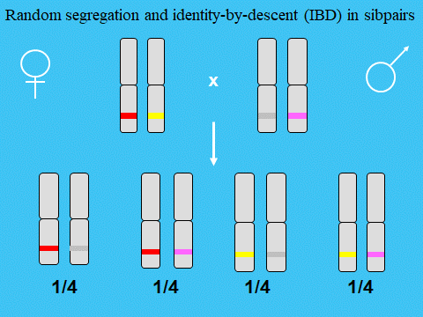
What about parent offsping?
many alleles do they share IBD?

Slide 43
Biometrical model for single biallelic QTL
3D. Contribution of the QTL to the Cov (X,Y) – DZ twins and full sibs
# identical alleles inherited from parents
2
1
(father)
1
(mother)
0
¼ (2 alleles) + ½ (1 allele) + ¼ (0 alleles)
MZ twins
P-O
Unrelateds
= ¼ Cov(MZ) + ½ Cov(P-O) + ¼ Cov(Unrel)
DZ
Cov (X_{i},X_{j})
= ¼(s²_{QTL(A)} + s²_{QTL(D)}) + ½(½ s²_{QTL(A)} ) + ¼ (0)
= ½ s²_{QTL(A)} + ¼ s²_{QTL(D)}

Slide 44
Biometrical model predicts contribution of a QTL to the mean, variance and covariances of a trait (discarding environmental effects)
1 QTL
Var (X)
= s²_{QTL(A)} + s²_{QTL(D)}
Cov (MZ)
= s²_{QTL(A)} + s²_{QTL(D)}
Cov (DZ)
= ½ s²_{QTL(A)} + ¼ s²_{QTL(D)}
Cov (P-O)
= ½ s²_{QTL(A)}
Multiple QTL
Var (X)
= Σ(s²_{QTL(A)} ) + Σ(s²_{QTL(D)}) = V_{A} + V_{D}
Cov (MZ)
= Σ(s²_{QTL(A)} ) + Σ(s²_{QTL(D)}) = V_{A} + V_{D}
Cov (DZ)
= Σ(½ s²_{QTL(A)} ) + Σ(¼ s²_{QTL(D) L}) = ½V_{A} + ¼V_{D}
Cov (P-O)
= Σ(½ s²_{QTL(A)} ) = ½V_{A}

Slide 45
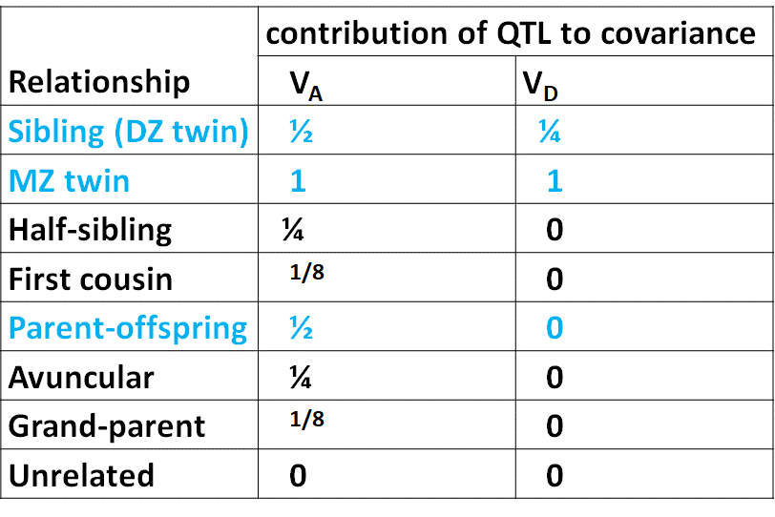
Contributions of V_{A} and V_{D} to covariances between relatives
average proportion of alleles shared identically by descent
proportion of IBD=2
These proportions tell use how much of V_{A} &V_{D}
contribute to the phenotypic covariance among family members
(useful info in extended twin design / extended pedigrees

Slide 46
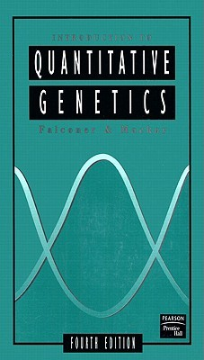
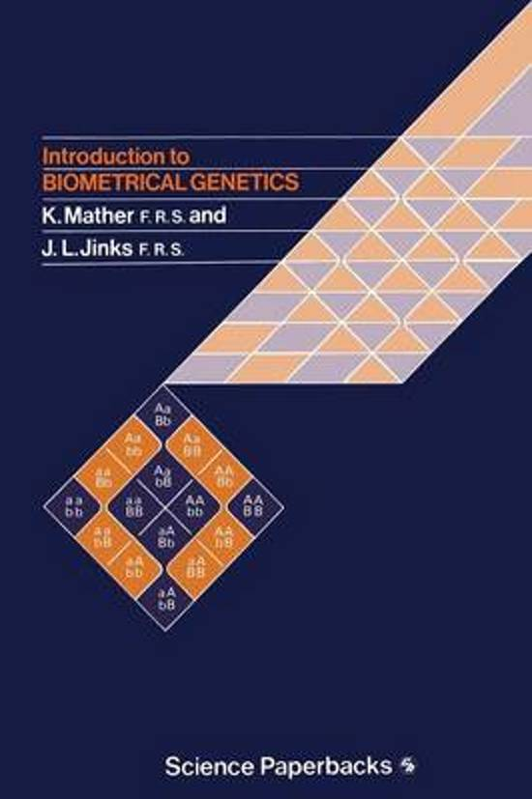
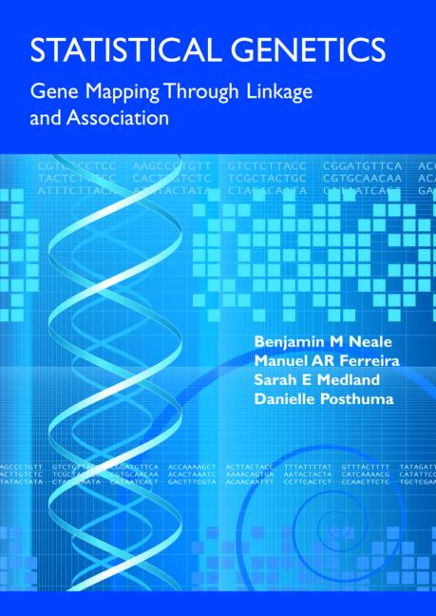
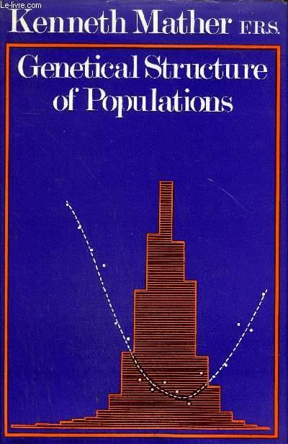
Slide acknowledgement: Manuel Ferreira, Pak Sham, Shaun Purcell, Sarah Medland, and Sophie van der Sluis
see also Manuel AR Ferreira’s
http://slidegur.com/doc/4322268/biometrical-genetics

Slide 47
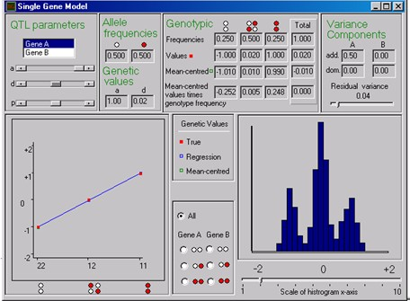
sgene.exe

