Slide 1
Practical Part 1. Single QTL model
1.1 Given QTL data
Calculate allele frequencies p(A) & p(a) assuming
H-W equilibrium from genotype frequencies
p(A) = p(AA) + ½ p(Aa)
p(a) = p(aa)+ ½ p(Aa)
1.2 Regress phenotype on QTL in two models:
A) additive model B) additive + dominance model

Slide 2
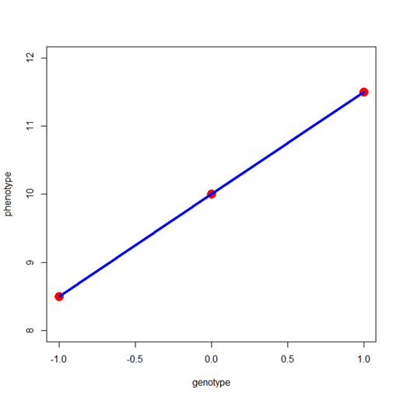
A) The linear regression model.
x_{i} = a₀ + a*QTL_{i} + e_{i}
s²(x) = a²*s²(QTL) + s²(e)
QTL is coded -1 (aa) 0 (Aa) 1 (AA)
a²*s²(QTL) is the additive genetic variance: contribution of the QTL to phenotypic individual differences. s²(e) is the residual (dominance + environmental) ……. a²*s²(QTL) = s²_{QTL(A)}
parameter a is the the effect of the QTL given addititve model
aa
Aa
AA
s²_{QTL(A)} =2*pq[a]²
– a
0
+a

Slide 3
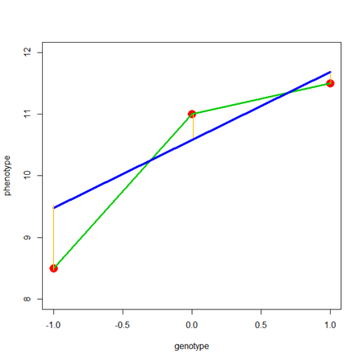
B) The linear regression model (non-linear).
x_{i} = a₀ + a*QTL_A_{i} + d*QTL_D_{i} + e_{i}
QTL_A is coded -1,0,1
QTL_D is coded 1 0 1 (p=q=.5)
explained variance = a²*s²(QTL_A) + d²*s²(QTL_D) = s²_{QTL(A)} + s²_{QTL(A)}
aa
Aa
AA
s²_{QTL(A)} =2*pq[a+(q-p)d]²
s²_{QTL(D)} = (2pqd)²
– a
d
+a

Slide 4
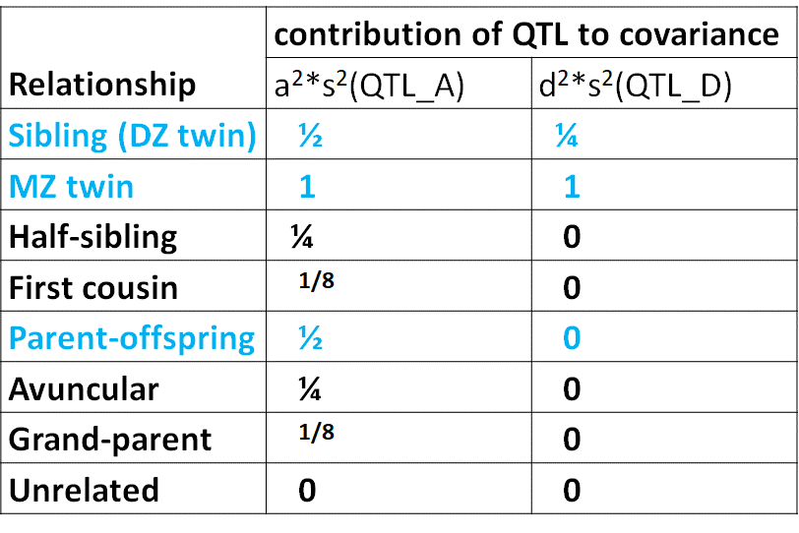
Given estimates of p(A), q(a), a and d, calculate
expected contribution to the phenotypic variance (A and D components)
2) expected covariance of MZ, DZ and Parent-Offspring
s²_{QTL(A)} =2*pq[a+(q-p)d]²
s²_{QTL(D)} = (2pqd)²

Slide 5
Practical Part 2.
Suppose we have twin data, but not the measured QTL?
Fit the ADE twin model
If the QTL is the only source of genetic differences in the phenotypethen the variance components estimated in the ADE twin model should equal the variance components obtained in the regression analyses. Try it out using data.
Generalizes from regression model with 1 QTL to M QTLs.
The twin model gives you the explained variance expected in the regression of phenotype on M QTLs (but none of the QTLs are measured)....

Slide 6
# annotated RCODE to do the practical
#
rm(list=ls(all=TRUE)) # clear memory
#
data1=read.table('data1.dat',header=TRUE,row.names=NULL) # read the data
# to read the data you have to navigate to the dir containing the data
# menu: File. Option: Change Dir.....
#
head(data1) # variable names: T1QTL and T1pheno
N=dim(data1)[1] # sample size
print(N)
# using “table function to get genotype counts
Gcounts=table(data1$T1QTL) # genotype coding -1=aa, 0=Aa, 1=AA
Gfreq=Gcounts/N # genotype frequencies
# estimate allele frequencies
p_est=Gfreq[3]+.5*Gfreq[2] # allele freq A
q_est=Gfreq[1]+.5*Gfreq[2] # allele freq a
# p allele freq
print(Gfreq ) # genotype freqs
print(p_est) # allele freq (A)

Slide 7
T1QTL T1pheno
1 0 1.77
2 1 0.80
3 0 -0.12
4 0 0.55
5 1 0.13
0 1.13
# sample size
[1] 5000
# genotype freqs
-1 0 1
0.2568 0.4986 0.2446
> print(p_est) # allele freq (A)
1
0.4939
variable names
+ first 6 cases.
total sample size
genotype frequencies
allele (A) frequency
(HW equilibrium)

Slide 8
# plot the data pheno on QTL – scatter plot
plot(data1$T1pheno~data1$T1QTL,col='grey')
# calculate the phenotypic means within each genotype
# the phenotypic means “conditional on genotype”
m_aa=mean(data1$T1pheno[data1$T1QTL==-1])
m_Aa=mean(data1$T1pheno[data1$T1QTL==0])
m_AA=mean(data1$T1pheno[data1$T1QTL==1])
# show the conditional means in the scatter plot
lines(c(-1,0,1),c(m_aa,m_Aa,m_AA),type='p',lwd=8,col='red')
#

Slide 9
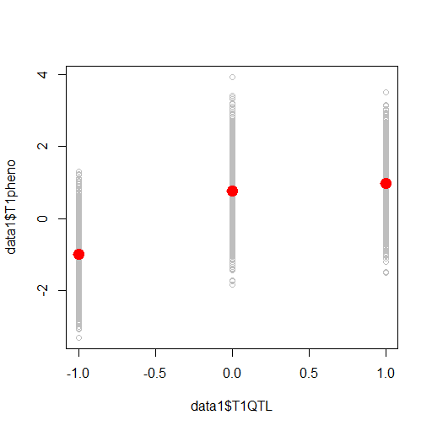
scatter plot of the data
conditonal means in red

Slide 10
# regress phenotype on QTL - first the addititve model
mlin1=lm(T1pheno~T1QTL,data=data1)
summary(mlin1) # show regression results
bs1=mlin1$coefficients # extract the regression coefficients
print(bs1) # parameters
# plot the regression line as fitted
lines(c(-1,0,1),bs1[1]+bs1[2]*c(-1,0,1),type='l',lwd=3,col='blue')

Slide 11
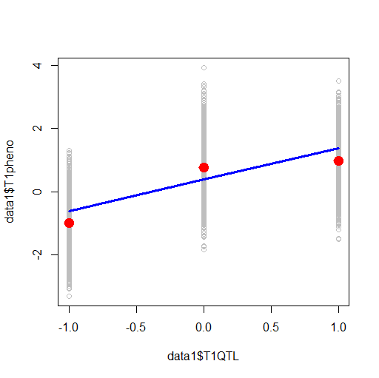
Coefficients:
Estimate Std. Error t value Pr(>|t|)
(Intercept) 0.37866 0.01252 30.25 <2e-16 ***
T1QTL 0.99134 0.01768 56.08 <2e-16 ***
Multiple R-squared: 0.3863
> print(bs1) # parameters
(Intercept) T1QTL
0.3786623 0.9913396
linear model
(no dominance)
linear model parameters
(no dominance)
Model does not fit the data really.

Slide 12
# regress phenotype on QTL - A+D model
# note that I(T1QTL^2) = c(-1 0 1)^2 = c(1 0 1) #
mlin2=lm(T1pheno~T1QTL+I(T1QTL^2),data=data1)
bs2=mlin2$coefficients
print(bs2) # show the parameters b0, b1 (a) and b2 (d)
# plot the regression line
lines(c(-1,0,1),bs2[1]+bs2[2]*c(-1,0,1)+bs2[3]*c(1,0,1),type='l',lwd=3,col='green')
#
# get the explained variances model A and model B
expl1v=var(mlin1$fitted.values) # S2A
expl2v=var(mlin2$fitted.values) # S2D + S2A
# show the total explained variance (covariance components)
print(c(expl1v, expl2v))
#

Slide 13
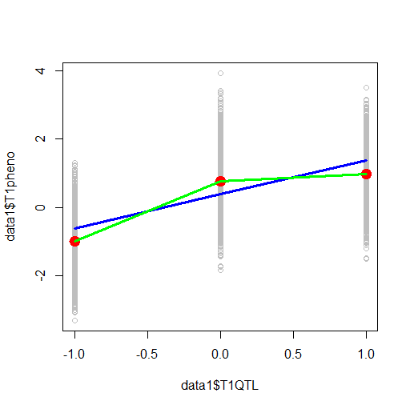
(Intercept) T1QTL I(T1QTL^2)
0.7664862 0.9819503 -0.7737103
additive + dominance
> print(c(expl1v, expl2v))
[1] 0.4927052 0.6423467
Accurate model !

Slide 14
#
print(c(expl1v,expl2v))
a=bs2[2]
d=bs2[3]
print(c(p_est,q_est,a,d))
S_A=2*p_est*q_est*(a+(q_est-p_est)*d)^2
S_D=(2*p_est*q_est*d)^2
S_G=S_A + S_D
print(S_A)
print(S_D)
print(c(S_G,expl2v))
print(var(data1$T1pheno))

Slide 15
p(A)
p(a)
a and d
> print(c(p_est,q_est,a,d))
0.4939000 0.5061000 0.9819503 -0.7737103
> print(S_A)
0.4728184
> print(S_D)
0.1496124
> print(c(S_G,expl2v))
0.6224308 0.6423467
> print(var(data1$T1pheno))
[1] 1.275602
s²_{QTL(A)} =2*pq[a+(q-p)d]²
s²_{QTL(D)} = (2pqd)²
s²_{QTL(A) +} s²_{QTL(D)}
phenotypic variance

Slide 16
S_phen=var(data1$T1pheno)
covPO=.5*S_A
# expected cov dz1 - dz2
covDZ=.5*S_A + .25*S_D
# expected cov mz1 - mz2
covMZ=S_A + S_D
print(c(S_phen,S_A,S_D,S_G,covPO,covDZ,covMZ))
#

Slide 17
> print(c(S_phen,S_A,S_D,S_G,covPO,covDZ,covMZ))
1.2756021 0.4728184 0.1496124 0.6224308 0.2364092 0.2738123 0.6224308
1.2756021 Phenotypic variance
0.4728184 add gen variance
0.1496124 dominance variance
0.6224308 total genetic variance
0.2364092 contribution to parent-offspring covariance
0.2738123 contribution to DZ covariance
0.6224308 contribution to MZ covariance

Slide 18
library(umx)
data4=read.table('data4.dat',header=TRUE,row.names=NULL)
head(data4)
N=dim(data4)[1] # sample size
#
mzData=data4[data4$zyg==1,6:9] # create MZ and
dzData=data4[data4$zyg==2,6:9] # DZ dataframes
#
round(cov(mzData),3) # the covariance matrices
round(cov(dzData),3) # the covariance matrices

Slide 19
> round(cov(mzData),3)
Mpheno Fpheno T1pheno T2pheno
Mpheno 1.238 0.010 0.299 0.295
Fpheno 0.010 1.331 0.266 0.270
T1pheno 0.299 0.266 1.297 0.678
T2pheno 0.295 0.270 0.678 1.282
> round(cov(dzData),3)
Mpheno Fpheno T1pheno T2pheno
Mpheno 1.257 -0.001 0.215 0.201
Fpheno -0.001 1.272 0.218 0.261
T1pheno 0.215 0.218 1.269 0.294
T2pheno 0.201 0.261 0.294 1.284
phenotypic
covariance matrix
MZ
phenotypic
covariance matrix
DZ
based on regression results
0.2364092 contribution to parent-offspring covariance
0.2738123 contribution to DZ covariance
0.6224308 contribution to MZ covariance

Slide 20
# fit the ADE variance component model
selDVs=colnames(mzData)[3:4]
ADE=umxACEv(name = "ADE", selDVs, selCovs=NULL, dzData, mzData, dzCr = .25,
covMethod=NULL)
# Baseline=mxRefModels(ADE,run=TRUE)
# mxCompare(Baseline,ADE)
summary(ADE)$parameters
#

Slide 21
> summary(ADE)$parameters
name matrix row col Estimate
2 A_r1c1 top.A 1 1 0.5138449
3 C_r1c1 top.C 1 1 0.1581402
4 E_r1c1 top.E 1 1 0.6101012
based on twin model
QTL not measured
based on direct regression with measured QTL
S_A = .4728
S_D = .1496
Message: Suppose a phenotype is subject to effects of M QTLs.
QTLs of unknown location, not measured
What the Twin Model does: Twin model provides estimates of explained variance in the regression of phenotype on M QTLS – without having measured the QTLs

