Slide 1
Heterogeneity:
Sex-limitation Models
Eveline de Zeeuw
(Meike, Brad, Sarah, Hermine, Ben, Elizabeth, and most of the rest of the faculty that has contributed bits and pieces to various versions of this talk)
Notes:
Credits
Practical
Questions
Research Interests

Slide 2
COPY FILES FROM:
Faculty/eveline/2018/sexLim

Slide 3
Heterogeneity
Univariate Analysis:
  What are the contributions of additive genetic, dominance/shared environmental and unique environmental factors to the variance?
Heterogeneity:
  Are the contributions of genetic and environmental factors equal for different groups, sex, cohort, SES, age, environmental exposure, etc.?
Notes:
Assumption of homogenetity
Definition of Heterogeneity
Examples
Environment: GxE interaction (in the next session)
Sex: sex-limitation

Slide 4
Sex Limitation = Sex Differences
Notes:
If you have data on both male and female twins

Slide 5
Mean Differences
Regression coefficients (β) capture the differences between the mean levels of the trait between sexes
Not generally what we are talking about when discussion of sex limitation, but very important nonetheless.

Slide 6
Variance Differences
The key question is why there is more or less variation in one sex rather than the other
σ² capture the differences between the variation around the mean across the sexes

Slide 7
Both Mean and Variance Differences
If mean differences exist, but are ignored, they can induce variance differences
Makes it very important to include separate means for sex when looking at sex limitation models

Slide 8
Causes of Variance Differences
Independent variables (millions of them) can influence the trait to different extents in different groups
or
Different independent variables can influence the trait in the different groups.
Notes:
How can you have differences in variance?
Gene and environment effects
Examples

Slide 9
The Language of Heterogeneity
Are the differences due to differences in the magnitude of the effects (quantitative differences)?
  Is the contribution of genetic/environmental factors greater/smaller in males than in females?
Are the differences due to differences in the nature of the effects (qualitative differences)?
  Are there different genetic/environmental factors influencing the trait in males and females?

Slide 10
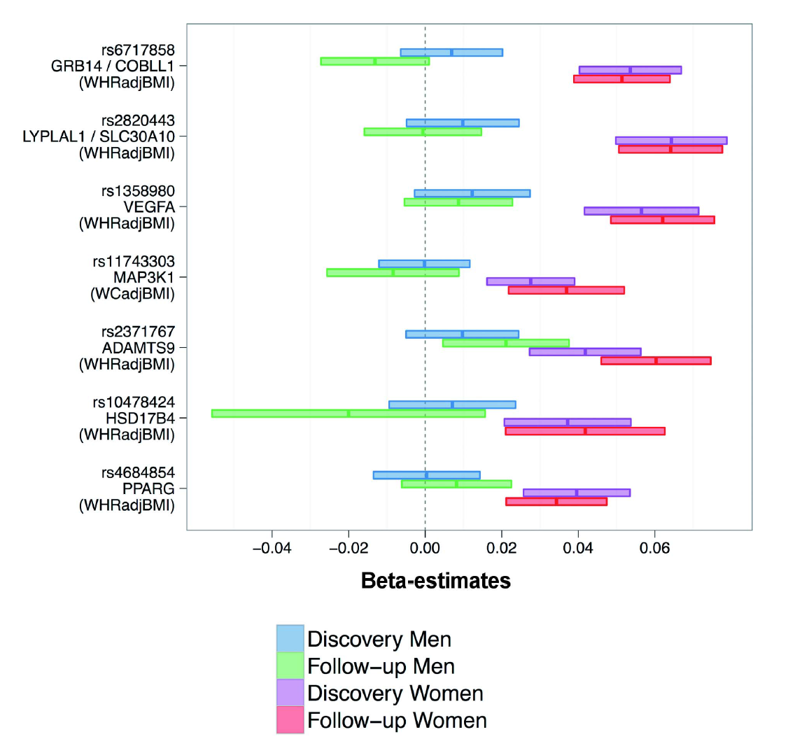
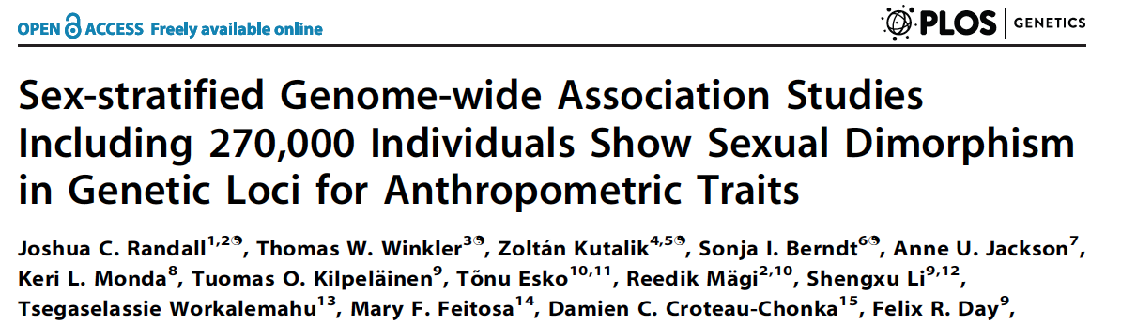
On all of the SNPs presented, women are affected by the polymorphism, while men are not.
Ergo, different genes “cause” the trait in males and females!
Or
Molecular evidence of qualitative sex limitation

Slide 11
Look at the Correlations!
Notes:
First impression
Expectations

Slide 12
Non Sex-Limitation Model
 | Male | Male
Male | a² + c² + e² | (½)a² + c²
Male | (½)a² + c² | a² + c² + e²
 | Female | Female
Female | a² + c² + e² | (½)a² + c²
Female | (½)a² + c² | a² + c² + e²
Notes:
Path coefficients instead of direct variance components estimation
4 groups
Different means for boys and girls

Slide 13
Non Sex-Limitation Model
No heterogeneity
The same proportion (%) of variance due to A, C, E equal between groups
Total variance equal between groups
  V_{m} = V_{f}
Variance Components are equal between groups
  A_{m} = A_{f}
  C_{m} = C_{f}
  E_{m} = E_{f}

Slide 15
Multiple Non Sex-Limitation Models
It does not test whether the heterogeneity is significant
It does not attempt to explain the sex differences
It does not include useful information from dizygotic opposite-sex twins
Notes:
Proportion of DZO twin pairs

Slide 16
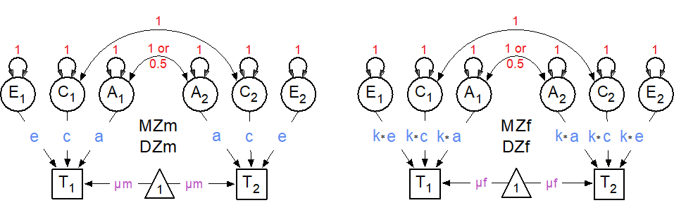
Scalar Sex-limitation Model
 | Male | Male
Male | a² + c² + e² | (½)a² + c²
Male | (½)a² + c² | a² + c² + e²
 | Female | Female
Female | k(a² + c² + e²) | k((½)a² + c²)
Female | k((½)a² + c²) | k(a² + c² + e²)

Slide 17
Scalar Sex-limitation Model
Scalar sex-limitation (a quantitative model)
The proportion (%) of variance due to A, C, E alters by a scalar (single value)
Total variance not equal between groups
  Vm = k* Vf
  Am = k* Af
  Cm = k* Cf
  Em = k* Ef
k is scalar

Slide 18
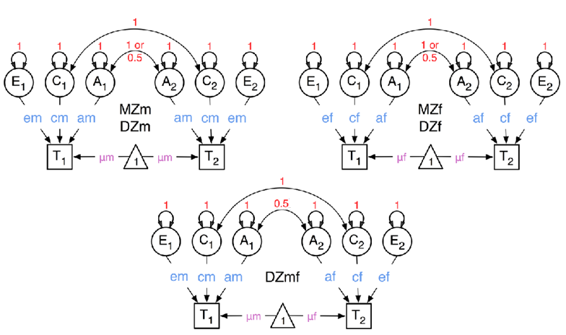
Non-scalar Sex-limitation Model
 | Male | Male
Male | a_{m}² + c_{m}² + e_{m}² | (½)a_{m}² + c_{m}²
Male | (½)a_{m} ²+ c_{m}² | a_{m}² + c_{m}² + e_{m}²

Slide 19
Non-scalar Sex-limitation Model
 | Female | Female
Female | a_{f}² + c_{f}² + e_{f}² | (½)a_{f} ²+ c_{f}²
Female | (½)a_{f}² + c_{f}² | a_{f}² + c_{f}² + e_{f}²

Slide 20
Non-scalar Sex-limitation Model
 | Male | Female
Male | a_{f}² + c_{f}² + e_{f}² | ½a_{m}a_{f} + c_{m}c_{f}
Female | ½a_{f}a_{m} + c_{f}c_{m} | a_{f}² + c_{f}² + e_{f}²
Notes:
See why path coefficients are necessary

Slide 21
Non-scalar Sex-limitation Model
Non-scalar sex-limitation with opposite sex pairs (a quantitative model)
The total variance and proportion (%) of variance due to A, C, E are estimated separately for each group
  Vm ≠ Vf
  Am ≠ Af
  Cm ≠ Cf
  Em ≠ Ef
Notes:
Am and Af are now linked through DZO correlation

Slide 22

General Non-scalar Sex-limitation Model
 | Male | Male
Male | a_{m}² + c_{m}² + e_{m}² | (½)a_{m}² + c_{m}²
Male | (½)a_{m}²+ c_{m}² | a_{m}² + c_{m}² + e_{m}²
Notes:
rC instead of rA possible
Alternative parameterization possible
Possibility for direct variance estimation

Slide 23
General Non-scalar Sex-limitation Model
 | Female | Female
Female | a_{f}² + c_{f}² + e_{f}² | (½)a_{f} ²+ c_{f}²
Female | (½)a_{f}² + c_{f}² | a_{f}² + c_{f}² + e_{f}²

Slide 24
General Non-scalar Sex-limitation Model
 | Male | Female
Male | a_{m}² + c_{m}² + e_{m}² | ½r_{A}a_{m}a_{f} + c_{m}c_{f}
Female | ½r_{A}a_{f}a_{m} + c_{f}c_{mf} | a_{f}² + c_{f}² + e_{f}²

Slide 25
General Non-scalar Sex-limitation Model
Non-scalar sex-limitation with opposite sex pairs (a quantitative & qualitative model)
The total variance and proportion (%) of variance due to A, C, E are estimated separately for each group
  Vm ≠ Vf
  Am ≠ Af
  Cm ≠ Cf
  Em ≠ Ef
Genetic correlation (rA) between DZO twins is estimated freely

Slide 26
Sex Limitation Models
Model Type | Data Requirements
Non Sex-Limitation Model (Classical Twin Model) | MZ & DZ Twins
Scalar Sex-limitation Model | MZm, MZf, DZm & DZf Twins
Non-scalar Sex-Llmitation Model | MZm, MZf, DZm, DZf & DZo Twins
General Non-scalar Sex-limitation Model | MZm, MZf, DZm, DZf & DZo Twins

Slide 27
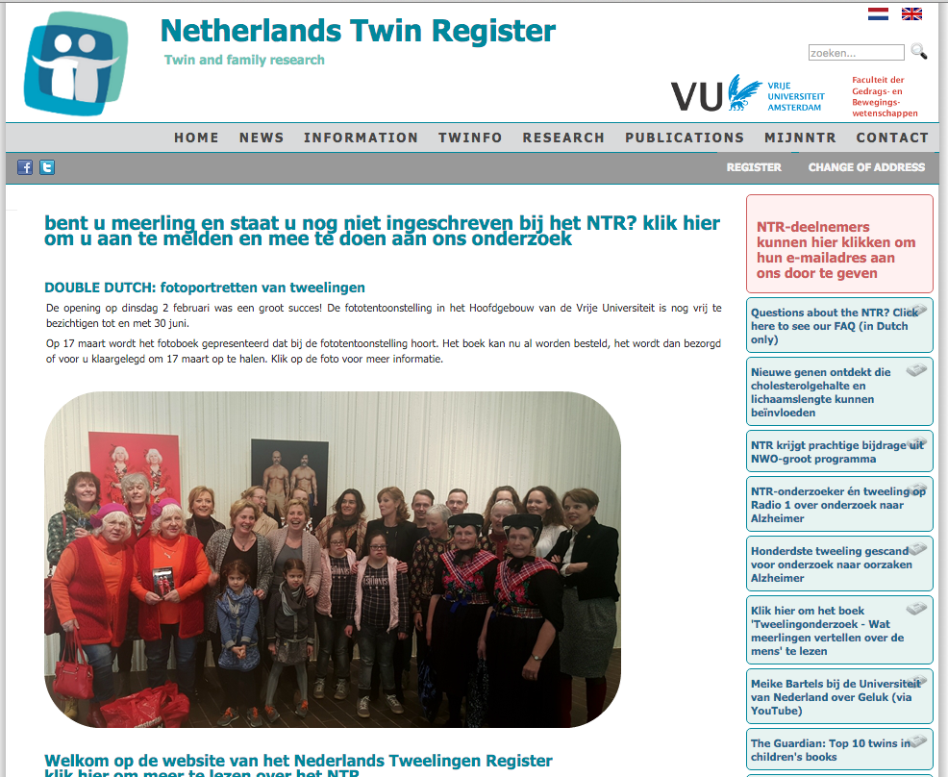
Example

Slide 28
Measurement Instrument
Educational achievement test
  Total score: Ranked from highest (1) to lowest (50) and standardized
  Subscores: Mathematics, Language, Study Skills, World Studies
Administered in last grade of primary school (~age 12)
1181 MZM, 1185 DZM, 1445 MZF, 1175 DZF and 2396 DZO pairs

Slide 29
Twin Correlations
Notes:
Spoiler

Slide 30
Practical
Open oneACEc
Boys (left) and Girls (right)
  1 = MZM, 2 = DZM, 3 = MZF, 4 = DZF, 5 = DZO
Walk through the script
Run the script
Report the mean and the standardized variance components
Be sure that you know what you are doing

Slide 32
Results
 | Boys | Girls
Mean | -.02 | .11
A | .69 | .72
C | .09 | .08
E | .22 | .20

Slide 33
Practical
Open oneACE5c
Walk through the first part of the script
Run it
You run the submodels
  For each model fill in the question marks
Be sure that you know what you are doing

Slide 35
Results Model Fitting
Model | EP | -2LL | df | AIC | Δ-2LL | Δdf | P
oneACErq5c | 9 | 35764.08 | 13678 | 8408.08 | - | - | -
oneACEq5c | 8 | 35764.19 | 13679 | 8406.19 | .11 | 1 | .738
oneACE5c | 5 | 35766.18 | 13682 | 8402.18 | 2.11 | 4 | .716
Model | EP | -2LL | df | AIC | Δ-2LL | Δdf | P
oneACE5c | 5 | 35766.18 | 13682 | 8402.18 | - | - | -
oneAE5c | 4 | 35775.05 | 13683 | 8409.05 | 8.87 | 1 | .003
oneCE5c | 4 | 36462.77 | 13683 | 9096.77 | 696.58 | 1 | <.001
oneE5c | 3 | 38865.18 | 13684 | 11497.18 | 3098.99 | 2 | <.001
Notes:
SLSQP for Confidence Intervals
omxRunCI
summary(fitACErq, verbose = T)

Slide 36
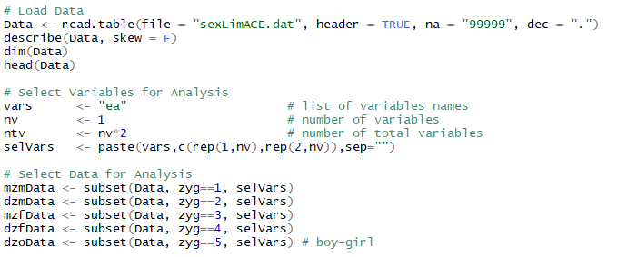
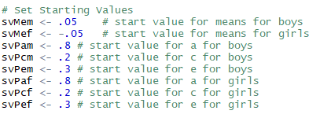
Data

Slide 37
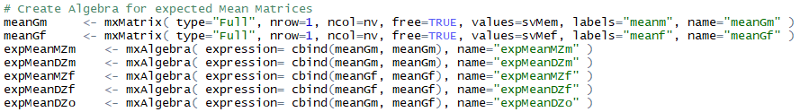
Means

Slide 38
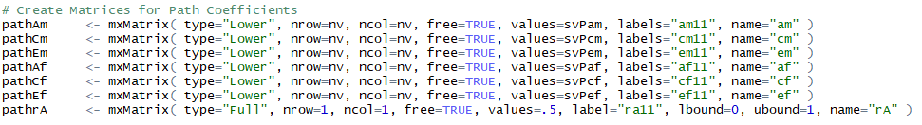
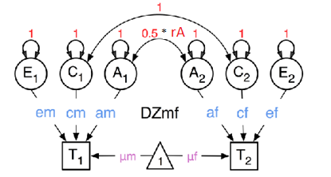
Path Coefficients

Slide 39
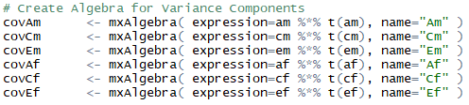
Variance Components

Slide 40
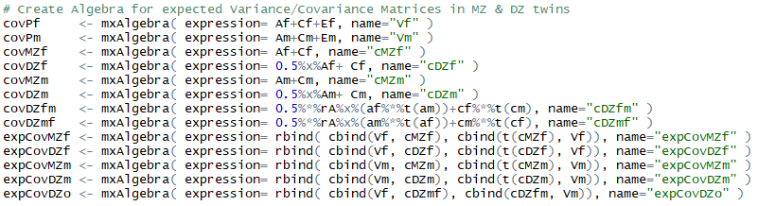
Covariances

Slide 41
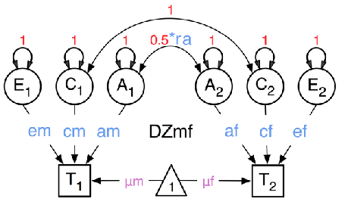
Covariances

Slide 42
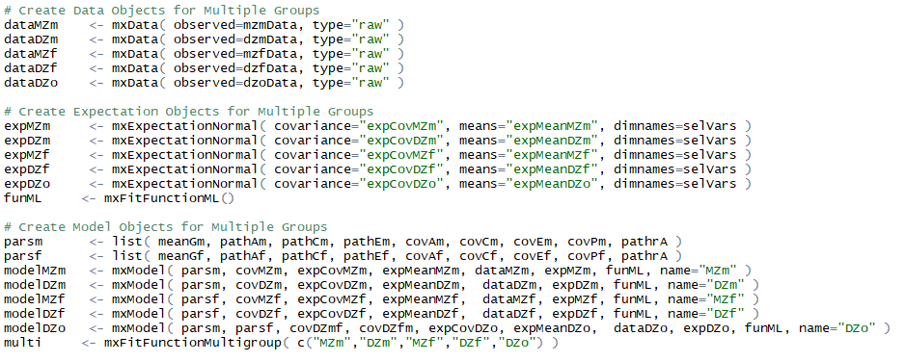

Slide 43
