Slide 1
Bivariate Genetic Analysis Practical
Lucia Colodro Conde, Elizabeth Prom-Wormley, and Hermine Maes
with thanks to Meike Bartels and Dorret Boomsma
In \\workshop\Faculty\lucia\Wednesday_biv_practical
, Open twoACE_vc_nl_biv_2gr.R

Slide 2
Twin Covariances/ Correlations
What are our initial expectations after looking at the covariance and correlation matrices by zygosity?

Slide 3
MZCov
 | gff_T1 | hap_T1 | gff_T2 | hap_T2
gff_T1 | 0.96 | 0.40 | 0.56 | 0.31
hap_T1 | 0.40 | 1.08 | 0.33 | 0.40
gff_T2 | 0.56 | 0.32 | 1.14 | 0.35
hap_T2 | 0.30 | 0.40 | 0.35 | 0.94
DZCov
 | gff_T1 | hap_T1 | gff_T2 | hap_T2
gff_T1 | 1.08 | 0.44 | 0.46 | 0.18
hap_T1 | 0.44 | 1.04 | 0.31 | 0.15
gff_T2 | 0.46 | 0.30 | 1.09 | 0.34
hap_T2 | 0.18 | 0.15 | 0.34 | 0.92

Slide 4
Conclusions
Twin Covariances/ Correlations
Within individual cross-trait covariance implies common aetiological influences
Cross-twin cross-trait covariance implies common aetiological influences are familial
Whether familial influences genetic or environmental shown by MZ:DZ ratio of cross- twin cross-trait covariances

Slide 5
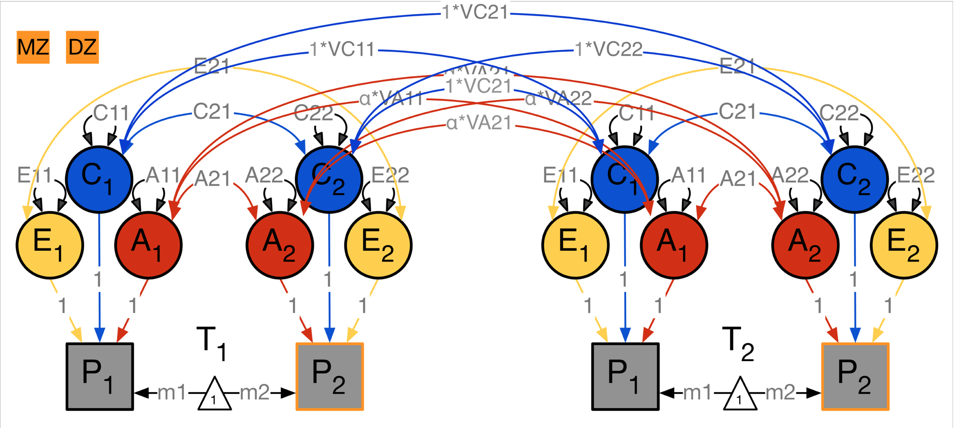
Bivariate Genetic Model

Slide 6
Important Questions to Answer
“What is the variance due to genetic and environmental contributions for a measure?”
  Variance Decomposition -> Heritability, (Shared) environmental influences
“How much of the phenotypic correlation is accounted for by genetic and environmental influences?”
  Covariance Decomposition -> The influences of genes and environment on the covariance between the two variables
“Is there a large overlap in gene/ environmental sets?”
  Genetic and Environmental correlations -> the overlap in genes and environmental effects

Slide 7
covA <- mxMatrix( type="Symm", nrow=nv, ncol=nv, free=TRUE, values=valDiag(svPa,nv), labels=labLower("VA",nv), name="VA" )

Slide 8
Looking at VA fitACE$matrices$VA
SymmMatrix 'VA'
$labels
[,1] [,2]
[1,] "VA11" "VA21"
[2,] "VA21" "VA22"
$free
[,1] [,2]
[1,] TRUE TRUE
[2,] TRUE TRUE
$values
[,1] [,2]
[1,] 0.27159025 0.17308458
[2,] 0.17308458 0.52264878

Slide 9
1- “What is the variance is due to genetic and environmental contributions for a specific measure?”
Variance Decomposition -> Heritability, (Shared) environmental influences
STANDARDIZED VARIANCES
fitACE$algebras$SV
$SV
mxAlgebra | 'SV'
$formula: | cbind(VA/V, | VC/V, | VE/V)
$result:
 | SA | SA | SC | SC | SE | SE
SV | 0.25 | 0.45 | 0.30 | 0.38 | 0.44 | 0.16
SV | 0.45 | 0.51 | 0.38 | -0.11 | 0.16 | 0.60

Slide 10
Important Questions to Answer
“What is the variance due to genetic and environmental contributions for a measure?”
  Variance Decomposition -> Heritability, (Shared) environmental influences
“How much of the phenotypic correlation is accounted for by genetic and environmental influences?”
  Covariance Decomposition -> The influences of genes and environment on the covariance between the two variables
“Is there a large overlap in gene/ environmental sets?”
  Genetic and Environmental correlations -> the overlap in genes and environmental effects

Slide 11

Genetic Correlation
$$\frac{{VA}_{12}}{\sqrt{\left.{VA}_{11}∗VA_{22}\right)}}$$
r_{g}=
corA <- mxAlgebra( expression=solve(sqrt(I*VA))%&%VA, name ="rA" )

Slide 12
Genetic Correlation
Interpreting Results
If r_{g} = 1
  Two sets of genes overlap completely
Careful! If a11 and a22 are near zero then shared genes do not contribute to correlation

Slide 13
Genetic Correlation
High genetic correlation = large overlap in genetic effects on the two phenotypes
Does it mean that the phenotypic correlation between the traits is largely due to genetic effects?
No: the substantive importance of a particular rG depends the value of the correlation and the value of VAs
  i.e. importance is also determined by the heritability of each phenotype

Slide 14
Extra Considerations- Genetic Correlations

Slide 15

Two Paper and Pencil Tasks
Consider two traits with a rP = 0.40 :
h²_{P1} = 0.7 and h²_{P2} = 0.6 with rG = .3
  What is the correlation due to additive genetic effects = ?
  What is the contribution to phenotypic correlation attributable to additive genetic effects = ?
Consider again two traits with a rP = 0.40 :
h²_{P1} = 0.2 and h²_{P2} = 0.3 with rG = 0.8
  Correlation due to additive genetic effects = ?
  Contribution to phenotypic correlation attributable to additive genetic effects = ?
Correlation due to A: $\sqrt{h_{P1}^{2}}∗r_{G}∗ \sqrt{h_{P2}^{2}}$
Divide by rP to find contribution to phenotypic correlation.

