Slide 1
Univariate Modeling in umx
Timothy C. Bates
tim.bates@ed.ac.uk

Slide 2
Roadmap for this interactive tutorial on Univariate Twin Analysis
Introducing and installing umx
Using umx to model genetic and environmental effects on total variance of a trait
umxACEv models with ACE and ADE decomposition
Comparing models
umxCompare to compare umxACEv() and umxACE() models
Testing fit of reduced models
umxModify to create AE, CE and E-Only Models

Slide 3
Installing umx
Typically installing umx from CRAN will be fine
install.packages("umx")
At the workshop, we’ll use the development version so new features can be rolled out to everyone during the workshop
devtools::install_github("tbates/umx")
Potential hassle: Dependencies
umx will try and install all its dependencies, but cannot always catch everything it needs
The response is straightforward: Read those messages and just install the package(s) being requested
So if the message “There is no package "XML" ”
install.packages("XML")
devtools::install_github("tbates/umx")

Slide 4
What version of umx do I have?
umxVersion()
umx version: 2.2.0
OpenMx version: 2.9.4 [GIT v2.9.4]
R version: R version 3.4.3 (2017-11-30)
Platform: x86_64-apple-darwin15.6.0 MacOS: 10.13.4
Default optimiser: CSOLNP
NPSOL-enabled?: Yes
OpenMP-enabled?: Yes
You can update OpenMx thusly:
install.OpenMx(loc = c("NPSOL", "travis", "CRAN", "open travis build page")

Slide 5
If you don’t have umx 2.2.0 (Jeff already pushed this to shop laptops)
If using your own laptop, get the latest version with:
# if you have not already
install.packages("devtools")
devtools:install_github("tbates/umx")
Whenever you update a package, pays to restart R

Slide 6
A good editor is very helpful: TextMate 2 bundle
Scripting and analysis are greatly enhanced by working in a great environment.
My favorite is TextMate 2
It has bundles supporting R and for OpenMx
(maintained by us)

Slide 7
General production line
make → modify → compare → summarize → plot
m1 = umxACE(mzData = mzData, dzData= dzData)
m2 = umxModify(m1, "c_r1c1", comparison = TRUE)
umxCompare(m1, m2)
umxSummary(m1)
plot(m1)

Slide 8
Twin Modeling Functions
umxACEv
umxACE
umxCP
umxIP
umxGxE
umxGxE_biv
umxGxE_window
umxSexLim
Each has a umxSummary() and plot() method
umxSummaryACEcov
umxSummaryACEv
umxSummaryACE
umxSummaryCP
umxSummaryGxE_biv
umxSummaryGxE
umxSummaryIP
umxSummarySexLim

Slide 9
Many other handy functions
Other Reporting Functions
umxAPA:
formats many things
parameters()
Show model parameters
umx_set_optimizer()
Current Optimizer is: 'CSOLNP'. Options are: 'CSOLNP', 'SLSQP', and 'NPSOL'
Twin Data functions
umx_long2wide()
umx_wide2long()
umx_make_TwinData()
Simulate twin data, inc GxE
umx_make_MR_data()
umx_residualize()
Flexible residualization of data, inc. twin data
umx_scale_wide_twin_data()
Allows scaling of wide data

Slide 10
Let’s run an ACE analysis
umxACEv()
Read the help ?umxACEv
umxACE()
Read the help ?umxACE

Slide 11
umxACEv: Lots of parameters… most can be ignored!
umxACEv(name = "ACE", selDVs, selCovs = NULL, covMethod = c("fixed", "random"), dzData, mzData, suffix = NULL, dzAr = 0.5, dzCr = 1, addStd = TRUE, addCI = TRUE, numObsDZ = NULL, numObsMZ = NULL, boundDiag = NULL, weightVar = NULL, equateMeans = TRUE, bVector = FALSE, thresholds = c("deviationBased", "WLS"), autoRun = getOption("umx_auto_run"), sep = NULL, optimizer = NULL)
nb: Not all options are completed as yet. e.g. fixed-effect covariates; WLS-based optimization

Slide 12
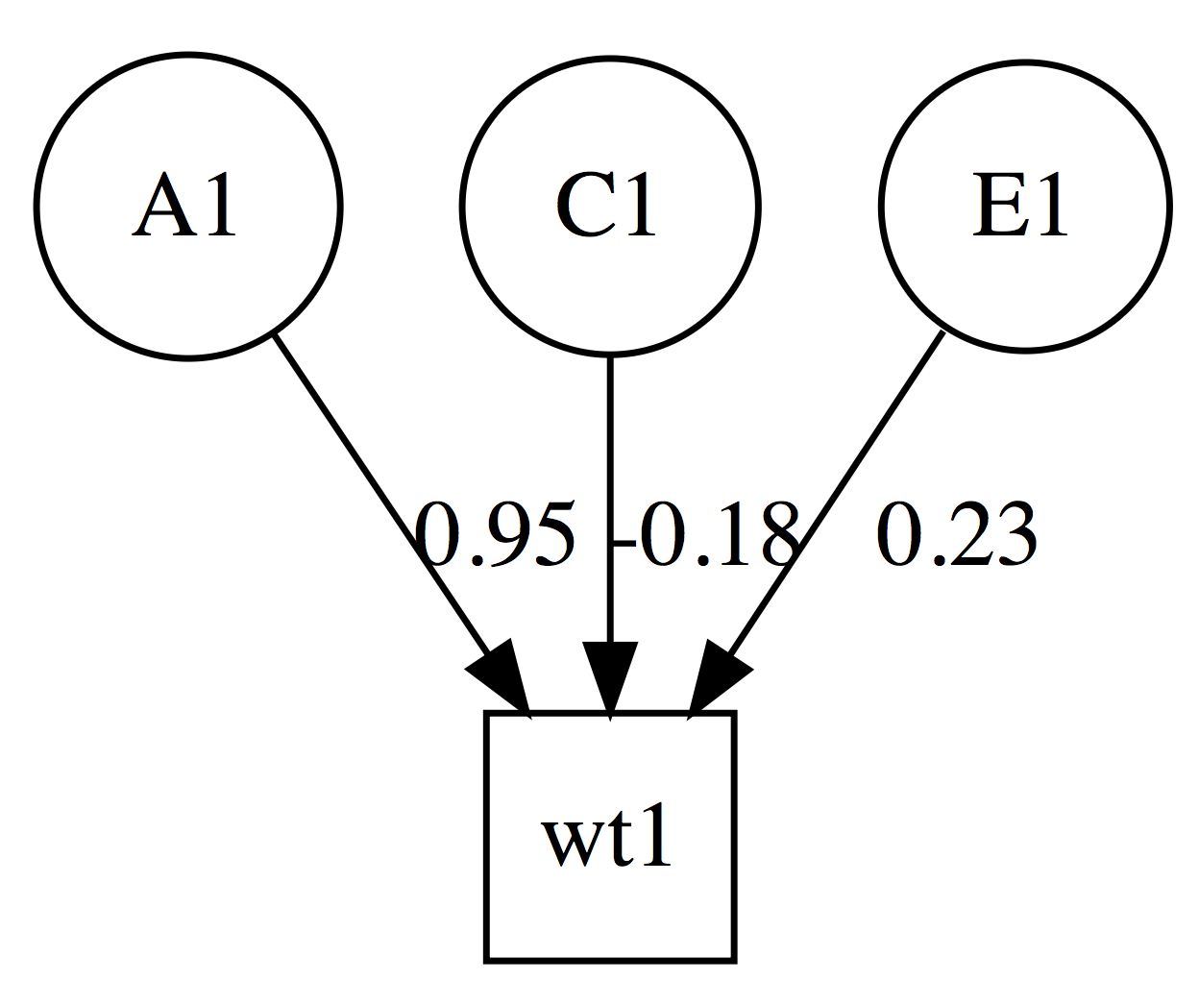
umxACEv: just the parameters we need
m1 = umxACEv(selDVs = "wt", suffix ="", dzData=dzData, mzData=mzData)
All variables continuous
treating data as raw
Running ACE with 4 parameters
ACE -2×log(Likelihood) 27278.55 (df=4)
Standardized solution
| | A1| C1| E1|
|:---|----:|-----:|----:|
|wt1 | 0.95| -0.18| 0.23|

Slide 13
plot(model)
plot() will make a graph, and open it in your browser
Can also output pdf or .dot
OmniGraffle or VISIO to edit plots for publication.
umx_set_auto_plot(TRUE/FALSE)
umx_set_plot_file_suffix()

Slide 14
What’s in the file plot() saves? Graphviz “dot” language (like S (R’s parent), invented at Bell Laboratories
digraph G { splines = "FALSE"; # Latents a1 [shape = circle]; c1 [shape = circle]; e1 [shape = circle]; # Manifests ht1 [shape = square]; a1 -> ht1 [label = "0.92"]; c1 -> ht1 [label = "0.14"]; e1 -> ht1 [label = "0.36"]; {rank = same; ht1 }; {rank = min ; a1 }; {rank = max ; c1; e1 }; }

Slide 15
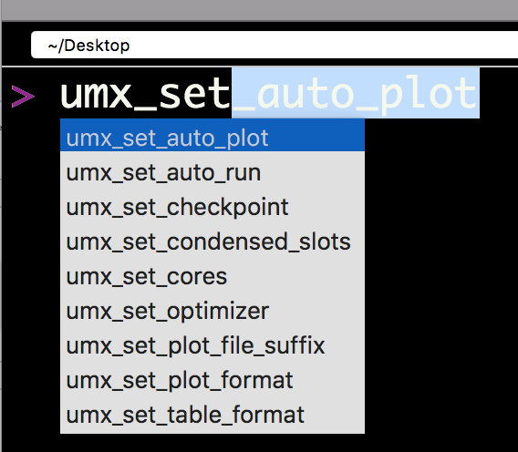
Table output
Markdown by default
Can be latex, html,…
umx_set_table_format()
Current format is'markdown'. Valid options are 'latex', 'html', 'markdown', 'pandoc', and 'rst'>

Slide 16
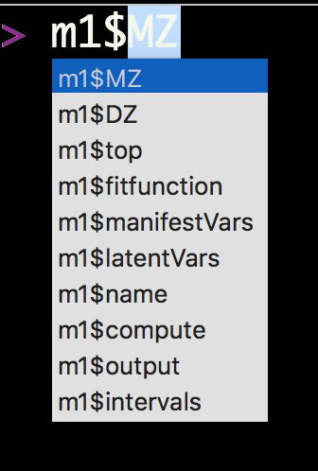
What’s inside this model?
“top” is a model that contains all the shared matrices and algebras
MZ is a model contains the MZ data and how to optimize this
DZ is a model contains the DZ data and how to optimize this

Slide 17
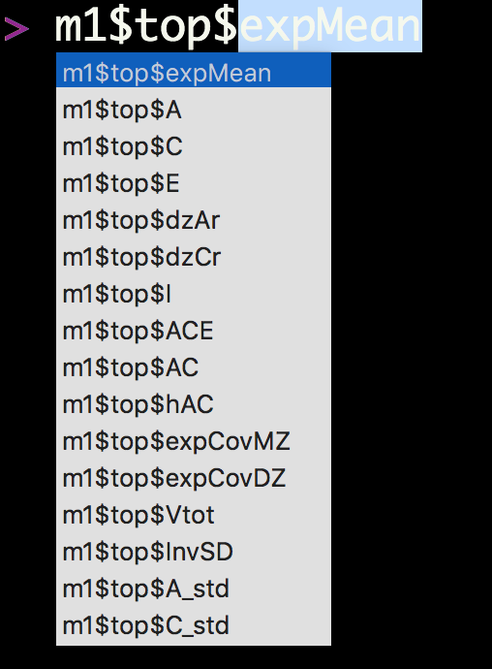
What’s inside top?
A, C, and E are matrices for our three variance components.
dzAr and dzCr are our .5 and 1 expected correlations for DZs

Slide 18
FullMatrix 'expMean’
$labels wt1 wt2
means "expMean_r1c1" "expMean_r1c1”
$values wt1 wt2
means 58.81 58.81
$free wt1 wt2
means TRUE TRUE

Slide 19
SymmMatrix 'A'
$labels [,1]
[1,] "A_r1c1”
$values [,1]
[1,] 82.36
$free [,1]
[1,] TRUE
$lbound: No lower bounds assigned.
$ubound: No upper bounds assigned.

Slide 20
m1$top$ACE
mxAlgebra 'ACE’
$formula: A + C + E
$result: [,1]
[1,] 86.61276
dimnames: NULL

Slide 21
m1$top$expCovMZ
mxAlgebra 'expCovMZ’
$formula: rbind(cbind(ACE, AC), cbind(AC, ACE))
$result: wt1 wt2
wt1 86.61 66.35
wt2 66.35 86.61
dimnames: [1] "wt1" "wt2"
[2] "wt1" "wt2"

Slide 22
Univariate model of weight
#' # ======================= #' # = Univariate model of weight = #' # ======================= #' require(umx) #' data(twinData) # ?twinData from Australian twins. #' #' # Things to note: ACE model of weight will return a NEGATIVE variance in C. #' # This is exactly why we have ACEv! It suggests we need a different model #' # In this case: ADE. #' # Other things to note: #' # 1. umxACEv can figure out variable names: provide "sep" and "wt" -> "wt1" "wt2" #' # 2. umxACEv picks the variables it needs from the data. #' #' selDVs = "wt" #' mzData <- twinData[twinData$zygosity %in% "MZFF", ] #' dzData <- twinData[twinData$zygosity %in% "DZFF", ] #' m1 = umxACEv(selDVs = selDVs, sep = "", dzData = dzData, mzData = mzData)

Slide 23
ADE model
ADE model
What’s the difference for ACE and ADE?
Just change dzCr to .25

Slide 24
Evidence for dominance ? (DZ correlation set to .25)
m2 = umxACEv("ADE", selDVs ="wt", sep = "", dzData = dzData, mzData = mzData, dzCr = .25)
note: the underlying matrices are still called A, C, and E. I catch this in the summary table, so columns are labeled A, D, and E.
However, currently, the plot will say A, C, E.

Slide 25
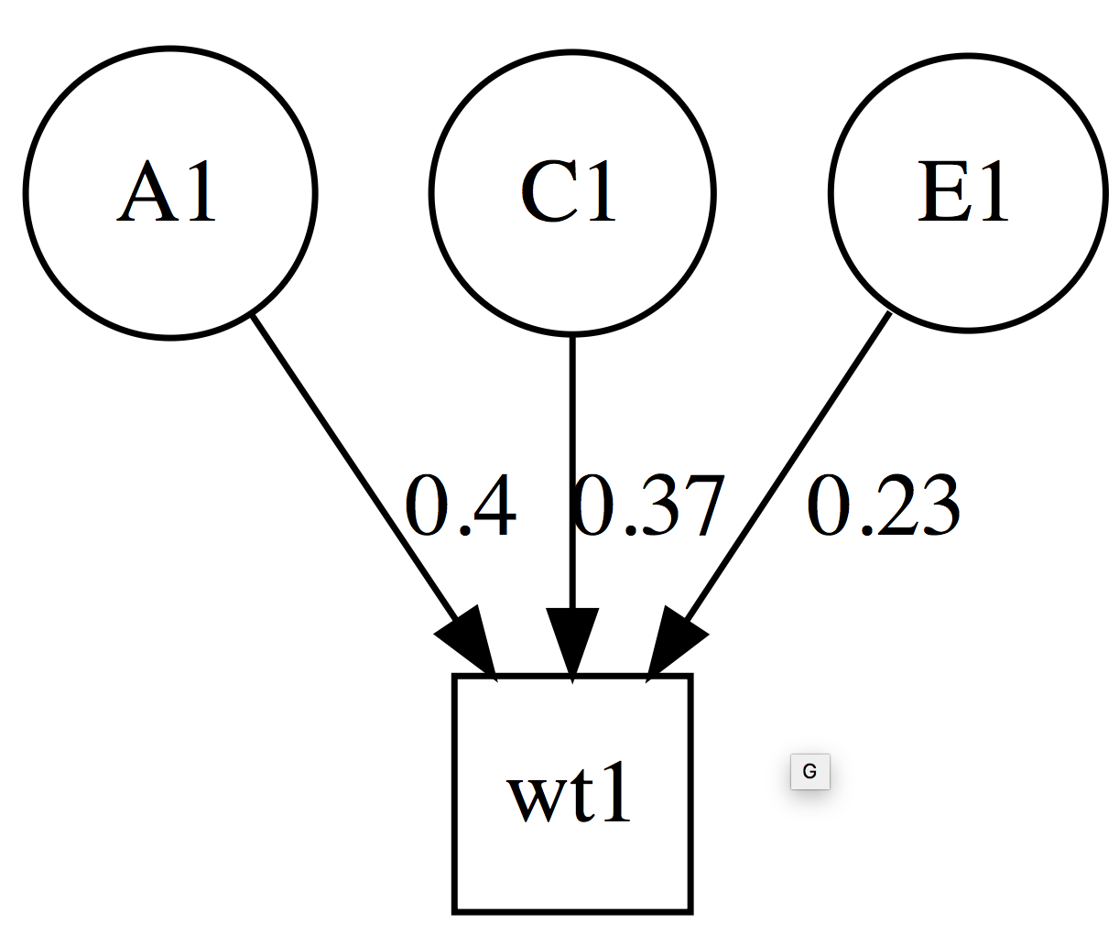
Table and plot: what changed?
| | A1| D1| E1|
|:---|---:|----:|----:|
|wt1 | 0.4| 0.37| 0.23|

Slide 26
Something to Try:
umxSummary(m2, report="html ")
What happened?

Slide 27
Modify model
umxModify allows you to modify, re-run and summarize a model.
umxModify(lastFit, update = NULL, master = NULL, regex = FALSE, free = FALSE, value = 0, newlabels = NULL, freeToStart = NA, name = NULL, verbose = FALSE, intervals = FALSE, comparison = FALSE, autoRun = TRUE)

Slide 28
Modify model
Drop parameter C_r1c1, run model, and show comparison
m3 = umxModify(m2, update = "C_r1c1", name = ”AE", comparison = T)

Slide 29
We can modify this model, dropping dominance component (matrix is still called C)
m3= umxModify(m2,update="C_r1c1",comparison=T, name="AE")
| | A1|D1 | E1|
|:---|----:|:--|----:|
|wt1 | 0.76|. | 0.24|
|Model | EP|∆ -2LL |∆ df |p | AIC | Compare with Model|
|:-----|--:|:------|:----|:-----|--------:|:------------------|
|ADE | 4| | | | 19506.55| |
|AE | 3|8.675 |1 |0.003 | 19513.23|ADE |

Slide 30
We can modify this model, dropping A component
m4= umxModify(m2,update="A_r1c1",comparison=T, name="DE")
umxCompare(m2, c(m3, m4))
|Model | EP|∆ -2LL |∆ df |p | AIC|Compare with Model |
|:-----|--:|:---------|:----|:-----|--------:|:------------------|
|ADE | 4| | | | 19506.55| |
|AE | 3|8.6750179 |1 |0.003 | 19513.23|ADE |
|DE | 3|8.2983642 |1 |0.004 | 19512.85|ADE |

Slide 31
Well done!
#================================================== # = Well done!
# = Now you can make and modify twin models
# = in umx ☺
#==================================================

Slide 32
umxACE
?umxACE
m1=umxACE(selDVs="wt", sep="", dzData=dzData,mzData=mzData)
ACE -2 × log(Likelihood)'log Lik.' 27287.23 (df=4)
Standardized solution
| | a1|c1 | e1|
|:---|----:|:--|----:|
|wt1 | 0.87|. | 0.49|

Slide 33
umxACE with dominance instead of C
m2 = umxACE("ADE", selDVs = selDVs, sep="", dzData = dzData, mzData = mzData, dzCr = .25)
umxCompare(m2, m1) # ADE seems better?
| | a1| d1| e1|
|:---|----:|----:|----:|
|wt1 | 0.63| 0.61| 0.48|

Slide 34
What about if we compare umxACEv and umxACE?
m1 = umxACEv("ADEvari", selDVs = selDVs, sep="", dzData = dzData, mzData = mzData, dzCr = .25)
m2 = umxACE("ADEchol", selDVs = selDVs, sep="", dzData = dzData, mzData = mzData, dzCr = .25)
umxCompare(m1,m2)
|Model | EP|∆ -2LL |∆ df |p | AIC|Compare with Model |
|:-------|--:|:------|:----|:--|--------:|:------------------|
|ADEvari | 4| | | | 19506.55| |
|ADEchol | 4|0 |0 | | 19506.55|ADEvari |

Slide 35
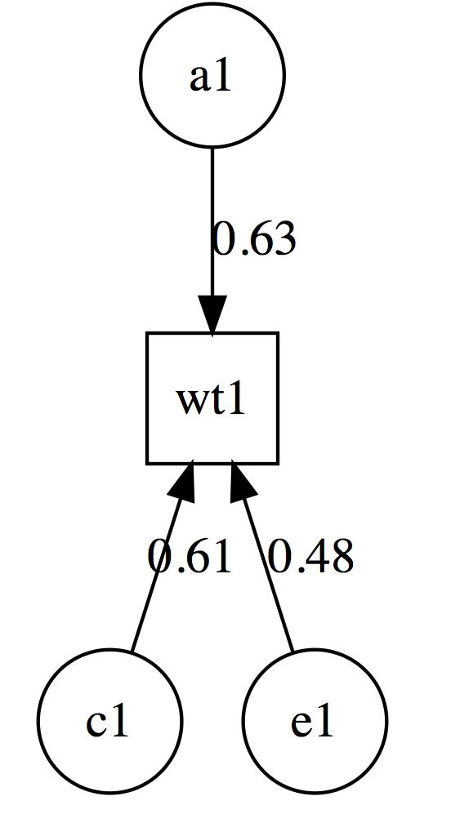
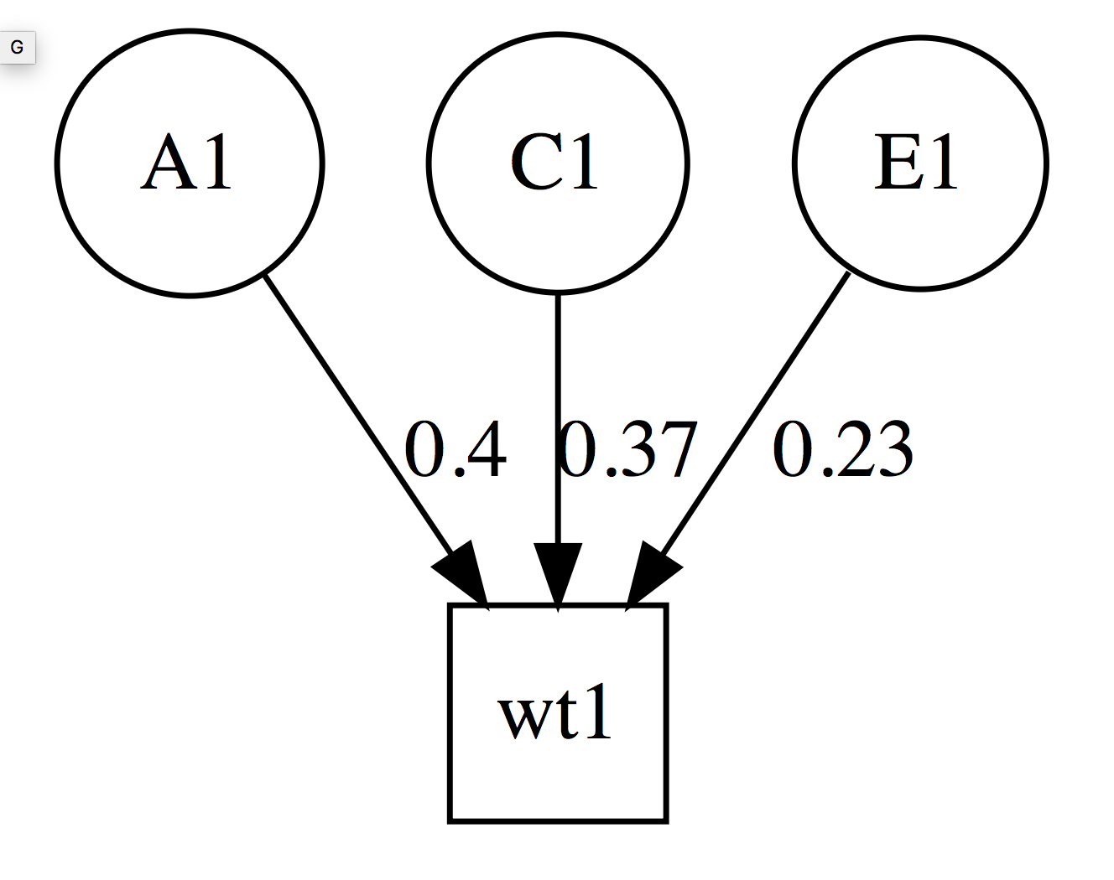
.48 = sqrt(.23)

Slide 36
We can do much more… and will sample across the week.
Common Pathway
umxCP()
Independent Pathway
umxIP()
Gene-environment interaction
umxGxE()
Path-based SEM
umxRAM + umxPath
EFA
umxEFA()

