Slide 1
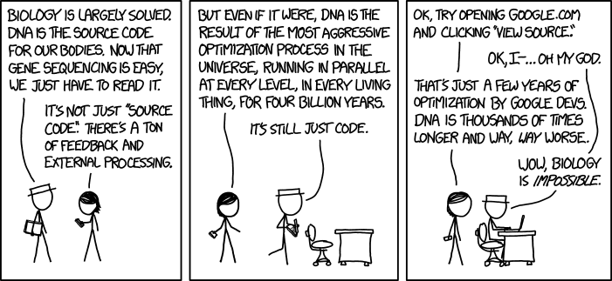
Causation Models in Twin Studies
Brad Verhulst

Slide 2
Experimentation: The Gold Standard for Assessing Causality
The Logic of Experimentation:
Take individuals drawn at random from a population
If you have selected (ascertained) samples some of the logic may not be sound and you may (probably will) have bias parameter estimates.
Convenience samples (such as undergrads) are not inherently problematic, but they may impede generalizability
Randomly assign them to one of two (or more) groups
Everyone had the same opportunity to be in each group, so there should be no meaningful differences between groups
This requires groups to be of sufficient size to allow for random variation in the population to be distributed across the groups
Expose Group A to Treatment A and Group B to Treatment B
Such as Drug vs Placebo, treatment vs control …
If there are any post treatment differences between Group A and Group B, then the difference must be caused by the difference in treatments

Slide 3
But …
Many of the questions that we are interested in cannot be manipulated
Research Question:
Do extraverted individuals have higher levels of substance use initiation?
Difficult to manipulate Extraversion
Does Childhood Maltreatment increase the risk of depression?
Probably shouldn’t abuse children to test scientific hypotheses

Slide 4
Discordant MZ Twin Design
MZ twins share a high level of genetic and environmental factors
Probably better than any propensity score matching algorithm that you could ever imagine
If something randomly happened to one MZ twin, subsequent differences between twins may be attributable to this random event.

Slide 5
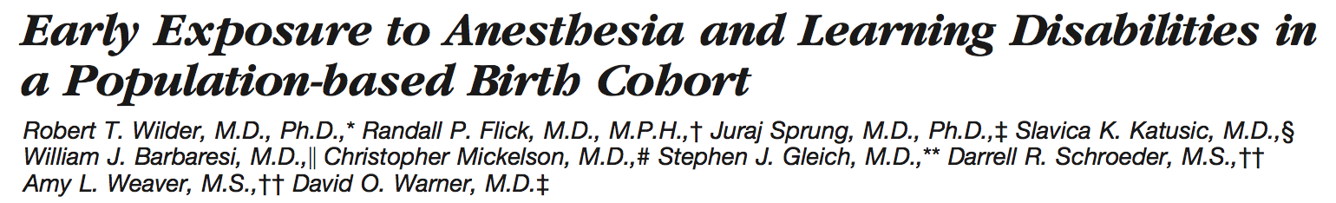
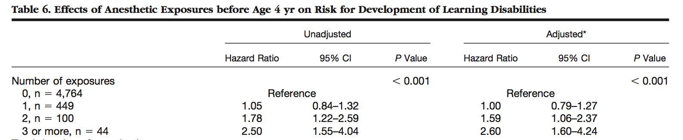
Strong Evidence for an association between Early Anesthesia Exposure and Learning Disabilities
Does Early Anesthesia Exposure cause Learning Disabilities?

Slide 6
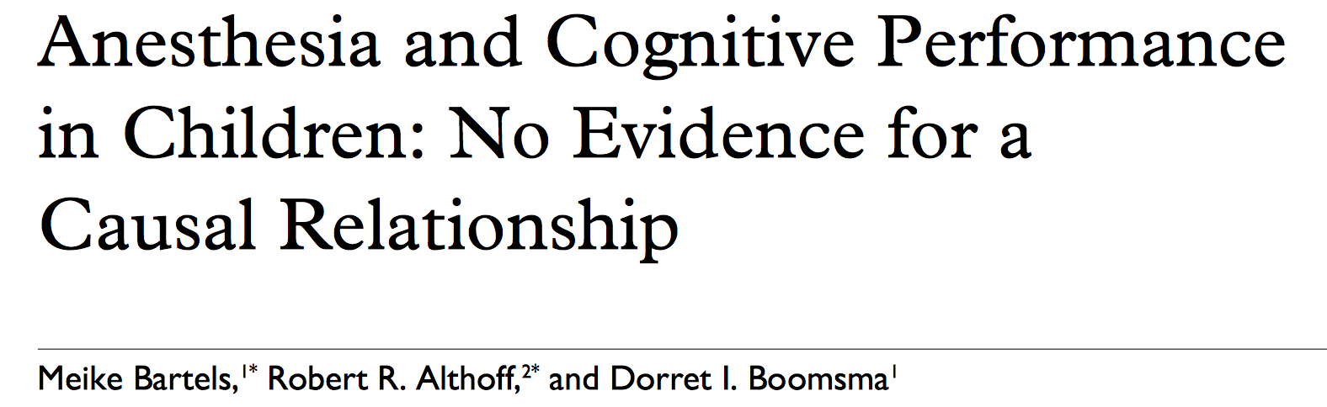
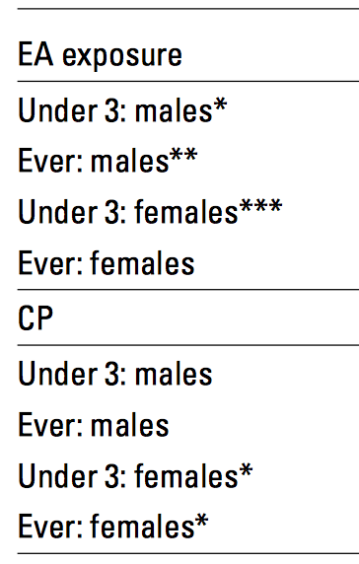
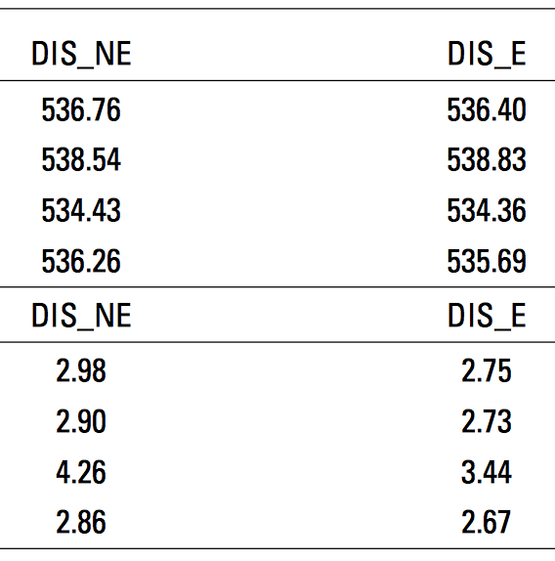
There are no differences between MZ twins based on Early Exposure to Anesthesia Exposure

Slide 7
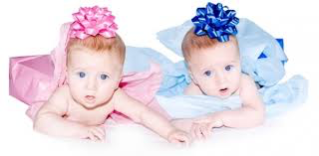
Okay, but there are DZ twins too
While DZ twins do not share the same degree of genetic relatedness, they can still tell us something about the casual relationship between two variables

Slide 8
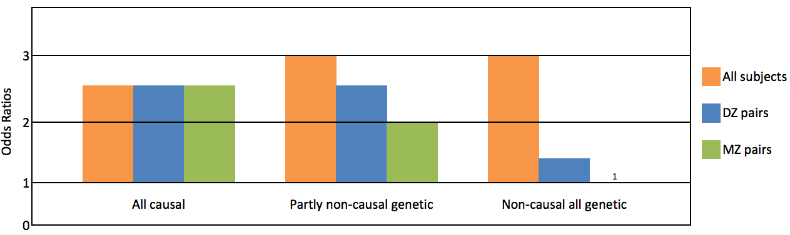
If risk factor-outcome association is:
Causal
Controlling for background & genetic effects makes no difference
Estimates (ORs) are same
Partly due to G factors influencing risk & outcome
Association strongest in entire sample (no control),
Intermediate for DZs (full E, part G control)
Lowest for MZ (full G & E control)
Entirely genetic
MZ ORs approach 1, DZ ORs are midway
Courtesy of Gillespie & Kendler

Slide 9
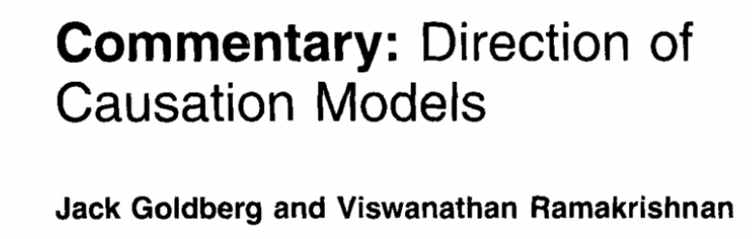
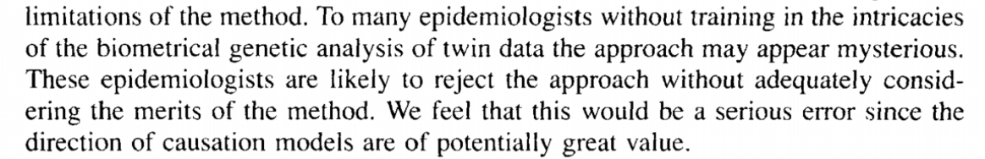

Slide 11
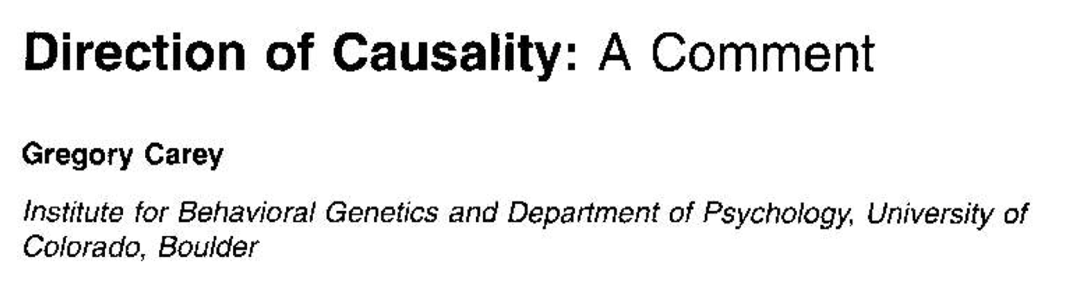
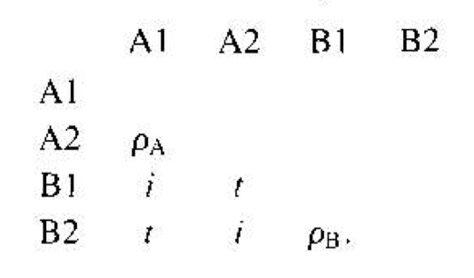
In Siblings (not twins):
If A → B: t=iρ_{A}
If B → A: t=iρ_{B}
If ρ_{A} = ρ_{B} then both models (A → B & B → A) give the same expectations

Slide 12
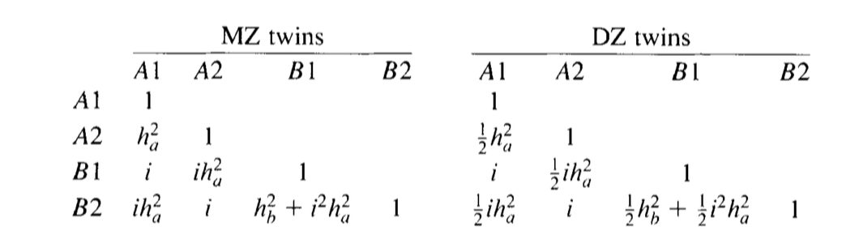
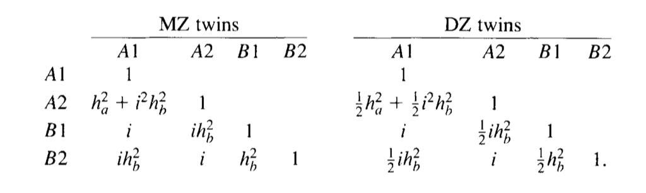
If there are differences in the modes of transmission (which you know because you have twin data), then you can resolve this issue.
In the case where A → B (A is AE and B is AE) the expected MZ and DZ correlation matrices would be:
In the case where A → B (A is AE and B is AE) the expected MZ and DZ correlation matrices would be:
If h_{a} = h_{b}, then causation cannot be resolved

Slide 14
What would be expect the Var-Cov Matrix to look like if V₁ → V₂
(I – B)⁻¹ (A + C + E) (I – B)^{-1T}
-1
1 | 0 | 0 | 0
0 | 1 | 0 | 0
0 | 0 | 1 | 0
0 | 0 | 0 | 1
-
0 | 0 | 0 | 0
β | 0 | 0 | 0
0 | 0 | 0 | 0
0 | 0 | β | 0
A₁ | 0 | 0 | 0
0 | A₂ | 0 | 0
A₁ | 0 | A₁ | 0
0 | A₂ | 0 | A₂
+
C₁ | 0 | 0 | 0
0 | C₂ | 0 | 0
C₁ | 0 | C₁ | 0
0 | C₂ | 0 | C₂
E₁ | 0 | 0 | 0
0 | E₂ | 0 | 0
0 | 0 | E₁ | 0
0 | 0 | 0 | E₂
+

Slide 15
(I – B)⁻¹ (A + C + E) (I – B)^{-1T}
Let’s Assume:
V₁ → V₂ β = .3 V₁ is ACE V₂ is AE
-1
1 | 0 | 0 | 0
0 | 1 | 0 | 0
0 | 0 | 1 | 0
0 | 0 | 0 | 1
-
0 | 0 | 0 | 0
.3 | 0 | 0 | 0
0 | 0 | 0 | 0
0 | 0 | .3 | 0
.33 | 0 | 0 | 0
0 | .50 | 0 | 0
.33 | 0 | .33 | 0
0 | .50 | 0 | .50
+
.33 | 0 | 0 | 0
0 | 0 | 0 | 0
.33 | 0 | .33 | 0
0 | 0 | 0 | 0
.34 | 0 | 0 | 0
0 | .50 | 0 | 0
0 | 0 | .34 | 0
0 | 0 | 0 | .50
+

Slide 16
MZ Twins
DZ Twins
1.00
.30 | 1.09
.66 | .198 | 1.00
.198 | .559 | .30 | 1.09
1.00
.30 | 1.09
.495 | .149 | 1.00
.149 | .295 | .30 | 1.09
V₁: .66/.495 = 1.333
V₁|V₂: .198/.149 = 1.329
V₂: .559/.295 = 1.89

Slide 17
V₂→ V₁
MZ Twins
DZ Twins
1.09
.30 | 1.00
.705 | .15 | 1.09
.15 | .50 | .30 | 1.00
1.09
.30 | 1.00
.518 | .075 | 1.09
.075 | .250 | .30 | 1.00
V₁: .705/.518 = 1.36
V₁|V₂: .15/.075 = 2.00
V₂: .50/.25 = 2.00

Slide 18
When is the Direction of Causation Model Appropriate
Strong hypothesis about the causal direction
No confounding intermediate variables
When the modes of transmission are distinct

Slide 19
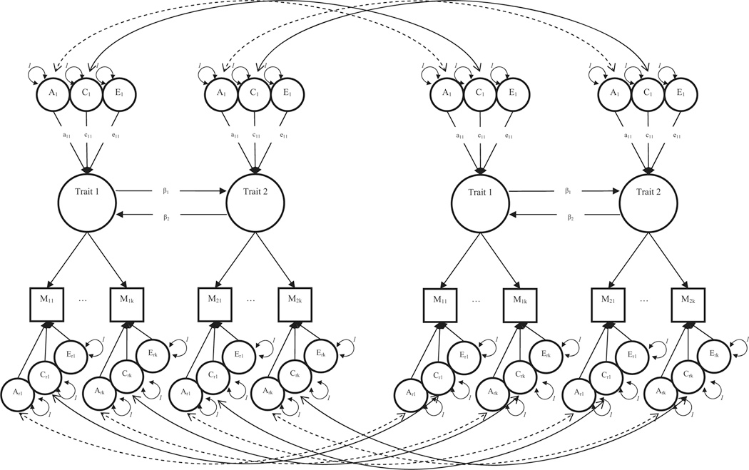
Where do things go wrong? Differential measurement error

