Slide 1
Genetic epidemiology in the genomic age: Missing Heritability &
The Role of Twin Studies in the Genomic Era
Michel Nivard, Conor Dolan & Nick Martin

Slide 2
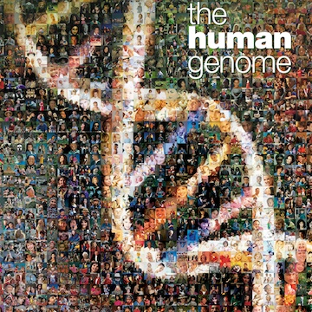
The genomic era: Mapping the genome
2001 Draft of the human genome released, 2003 final sequenced genome released.
The final genome contained ~ 3 Billion base pairs

Slide 3
The genomic era: Mapping the genome

Slide 4
The genomic era: Mapping genomic variation
2005-10-24: HapMap Public Release #19
Genome sequence for 270 individuals
4 populations
Human genome project: GCTATCGATCACT
HAPMAP:
GCTATCGATCACT
GCTATCGGTCACT
GCTATCGATCACT
GCTATCGGTCACT

Slide 5
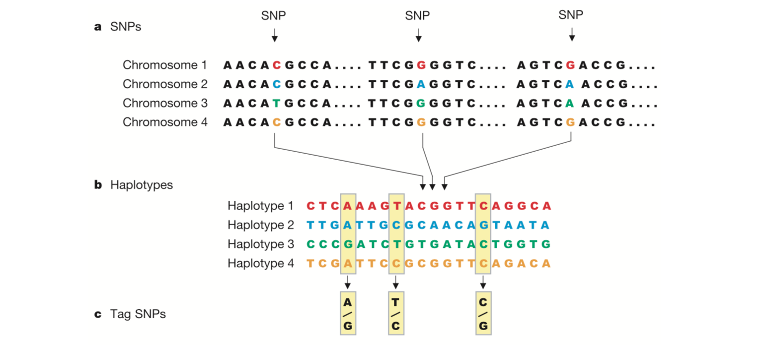
The genomic era: Mapping genomic variation
The International HapMap Consortium figure-1 Nature (2003)

Slide 6
The genomic era: genotyping tag SNPs
how many angels on the head of a pin? I don’t know

Slide 7
The genomic era: Mapping genomic variation

Slide 8
The genomic era: Mapping genomic variation
time

Slide 9
The genomic era: Mapping genomic variation
this SNP will be associated with disease

Slide 10
The genomic era: Case control studies
Controls
Cases
G/T
G/G
T/T
T/T
T/T
T/G
T/G
T/T
T/G
T/G
G/G
T/G
T/G
T/T
Allele G is ‘associated’ with disease

Slide 11
The genomic era: Case control studies
Each individual contributes two counts to 2x2 table.
Test of association
where
X² has χ² distribution with 1 degrees of freedom under null hypothesis.
 | Cases | Controls | Total
G | n_{1A} | n_{1U} | n_{1·}
T | n_{0A} | n_{0U} | n_{0·}
Total | n_{·A} | n_{·U} | n··

Slide 12

The genomic era: continuous phenotype
Y_{i} = α + βX_{i} + e_{i}
where
Y_{i} = trait value for individual i
X_{i} = number of ‘A’ alleles an individual has
1.2
1
0.8
Y
0.6
0.4
0.2
0
X
0
1
2
$$\text{Association} \text{test} \text{is} \text{whether} \text{β} ≠0$$

Slide 13
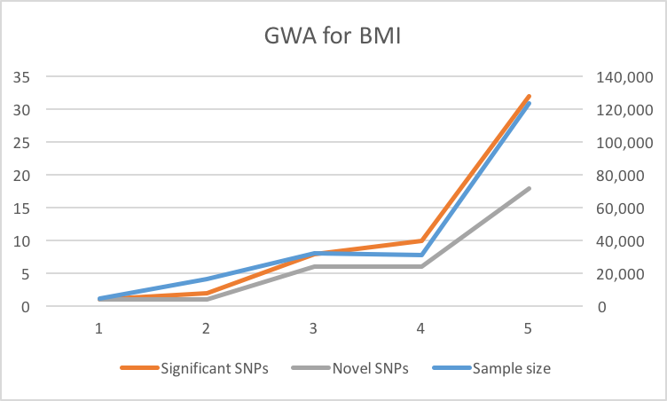
The genomic era: BMI
2007
2007
2008
2008
2010

Slide 14
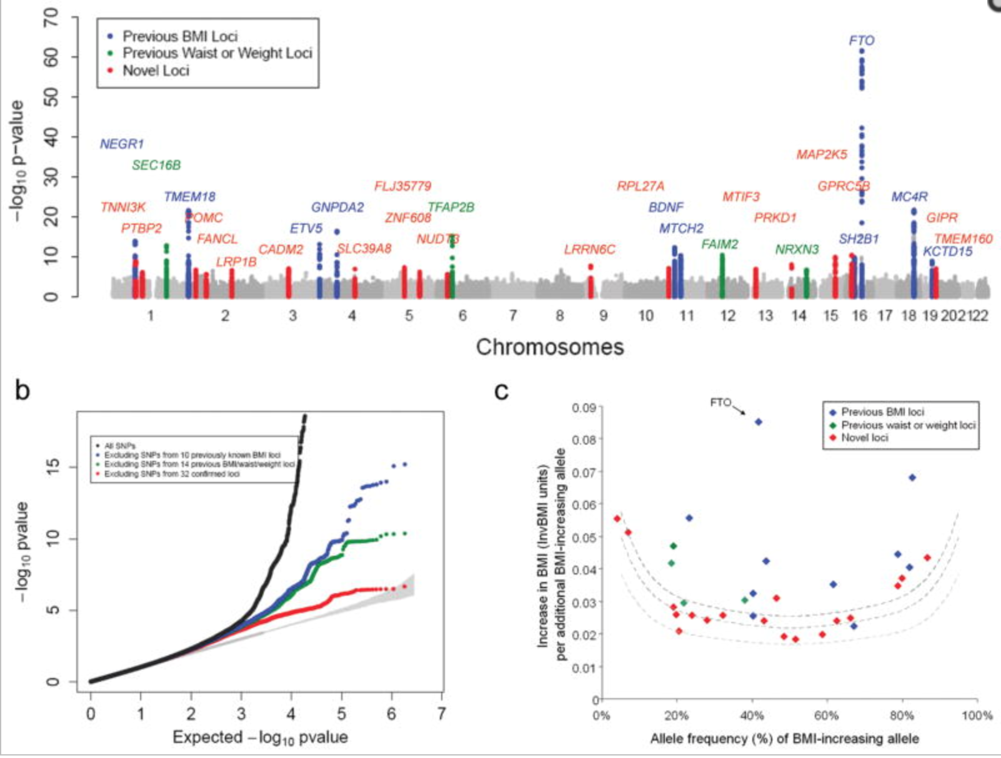
The genomic era: BMI

Slide 15

The genomic era: “Missing“ heritability
B. Maher The case of the missing heritability
Nature 2008

Slide 16

The genomic era: “Missing“ heritability
The variance explained by genotyped loci
related to complex traits, is substantially
smaller than the additive genetic variance
estimated in twin studiers of the same traits
$h_{missing}^{2}=1−(\frac{R_{snp}^{2}}{h^{2}})$
B. Maher The case of the missing heritability
Nature 2008

Slide 17
“Missing” heritability: BMI
Elks et al (2012) Meta analysis of twin studies:
Variance in BMI explained by additive genetic effects:
75% (74%-76%)

Slide 18
“Missing” heritability: BMI
Elks et al (2012) Meta analysis of twin studies:
Variance in BMI explained by additive genetic effects:
75% (74%-76%)
Speliotes et al GWA BMI 2010 (n= 123,865):
Strongest locus: 0.34% of variance in BMI
All significant loci(32): 1.45% of variance in BMI
99.5%
98.1%
96.4%

Slide 19
“Missing” heritability: BMI
Elks et al (2012) Meta analysis of twin studies:
Variance in BMI explained by additive genetic effects:
75% (74%-76%)
Speliotes et al GWA BMI 2010 (n= 123,865):
Strongest locus: 0.34% of variance in BMI
All significant loci(32): 1.45% of variance in BMI
Locke et al GWA BMI 2015 (n= 339,224):
All significant loci(97): 2.7% of variance in BMI
99.5%
98.1%
96.4%

Slide 20
“Missing” heritability: BMI
Elks et al (2012) Meta analysis of twin studies:
Variance in BMI explained by additive genetic effects:
75% (74%-76%)
Speliotes et al GWA BMI 2010 (n= 123,865):
Strongest locus: 0.34% of variance in BMI
All significant loci(32): 1.45% of variance in BMI
Locke et al GWA BMI 2015 (n= 339,224):
All significant loci(97): 2.7% of variance in BMI
All loci: 2.7% of variance in BMI
99.5%
98.1%
96.4%

Slide 21
“Missing” heritability: BMI
Elks et al (2012) Meta analysis of twin studies:
Variance in BMI explained by additive genetic effects:
75% (74%-76%)
Yang et al (2012) GCTA:
16.5% of variation in BMI explained by genotyped SNPs
Lock et al (2015) GCTA:
21.6% of variation in BMI explained by measured SNPs
71.2%
78%
99.5%
98.1%
96.4%

Slide 22
“Missing” heritability: BMI
Elks et al (2012) Meta analysis of twin studies:
Variance in BMI explained by additive genetic effects:
75% (74%-76%)
Yang et al (2014) GCTA-LDMS:
27% of variance explained by imputed SNPs
71.2%
78%
64%
99.5%
98.1%
96.4%

Slide 23
“Missing” heritability: BMI
Elks et al (2012) Meta analysis of twin studies:
Variance in BMI explained by additive genetic effects:
75% (74%-76%)
Yang et al (2014) GCTA-LDMS:
27% of variance explained by imputed SNPs
Hypothesized causes
Rare genetic variation
Overestimation of additive variance in twin models
71.2%
78%
64%
99.5%
98.1%
96.4%

Slide 24
“Missing” heritability: BMI
Elks et al (2012) Meta analysis of twin studies:
Variance in BMI explained by additive genetic effects:
75% (74%-76%)
Yang et al (2014) GCTA-LDMS:
27% of variance explained by imputed SNPs
Hypothesized causes
Rare genetic variation
Overestimation of additive variance in twin models
71.2%
78%
64%
99.5%
98.1%
96.4%

Slide 25
“Missing” heritability: BMI
Hypothesized causes
1. Rare genetic variation
2. Overestimation of additive variance in twin model
  Allow for common environment
    h² 75% -> 62%
65.2%
74.2%
56.5%
99.4%
97.7%
95.6%

Slide 26
“Missing” heritability: BMI
Hypothesized causes
1. Rare genetic variation
2. Overestimation of additive variance in twin model
  Allow for common environment
    h² 75% -> 62%
  Rely on family members instead of twins
    h² 75% -> 46%
53.0%
65.2%
41.3%
99.3%
97.7%
96.8%

Slide 27
“Missing” heritability: BMI
Hypothesized causes
1. Rare genetic variation
2. Overestimation of additive variance in twin model
  Allow for common environment
    h² 75% -> 62%
  Rely on family members instead of twins
    h² 75% -> 46%
  Fit the Nuclear Twin-Family model
53.0%
65.2%
41.3%
99.3%
97.7%
96.8%

Slide 28
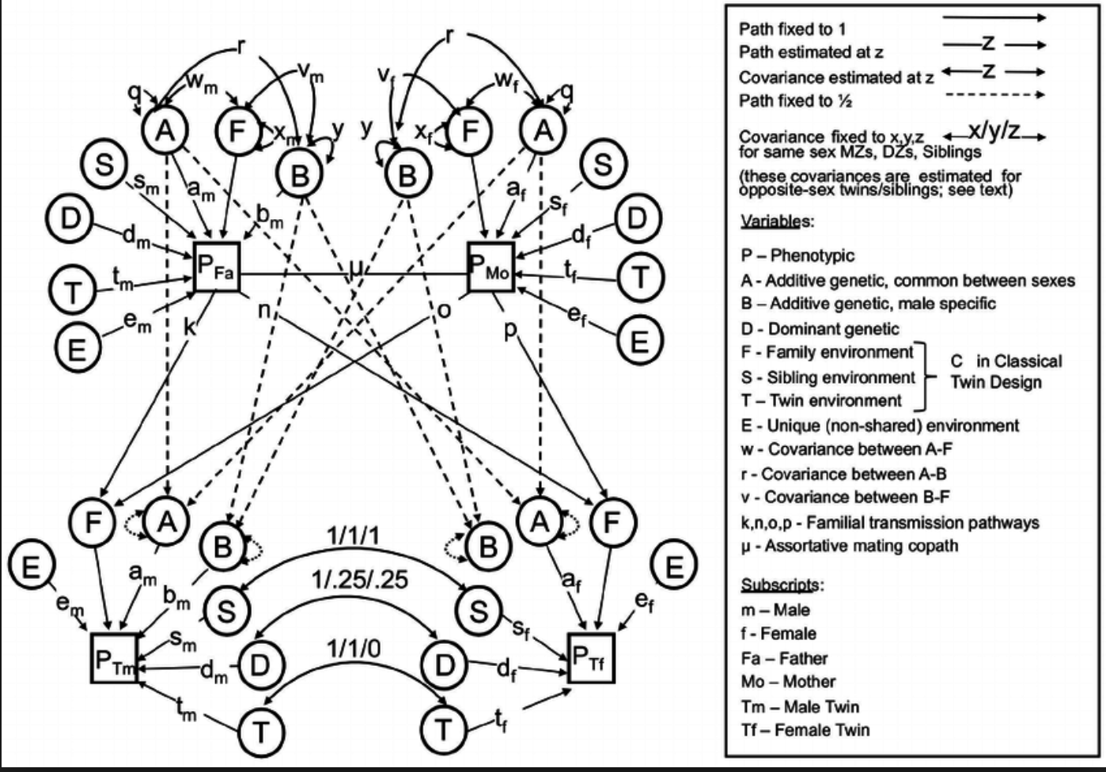
“Missing” heritability: BMI
Hypothesized causes
1. Rare genetic variation
2. Overestimation of additive variance in twin model
  Allow for common environment
    h² 75% -> 62%
  Rely on family members instead of twins
    h² 75% -> 46%
  Fit the Nuclear Twin-Family model
    Non-random mating
    Dominance variation
    Common environment
Maes, Eaves, Neale 1997

Slide 29
“Missing” heritability: BMI
Hypothesized causes
1. Rare genetic variation
2. Overestimation of additive variance in twin model
  Allow for common environment
    h² 75% -> 62%
  Rely on family members instead of twins
    h² 75% -> 46%
  Fit the Nuclear Twin-Family model
    h² 75% -> ~37%
42.0%
57.0%
27.5%
99.1%
96.1%
92.7%

Slide 30
“Missing” heritability: BMI
Hypothesized causes
1. Rare genetic variation
2. Overestimation of additive variance in twin model
  Allow for common environment
    h² 75% -> 62%
  Rely on family members instead of twins
    h² 75% -> 46%
  Fit the Nuclear Twin-Family model
    h² 75% -> ~37%
27.5% aprox 95% C.I: 17.0% to 38.0%
42.0%
57.0%
99.1%
96.1%
92.7%

Slide 31
“Missing” heritability: BMI
27.5% aprox C.I: 17.0% to 38.0%
The ratio of the “ Best” estimate based on genotyped distantly related individuals over
the “ Best” estimate form a complex twin-family
Twin model captures:
Additive genetic variation
Dominance variation
Common environment “Special twin environment”
Assortment
Twin model assumes:
Absence of GxAge interaction
GCTA captures:
99% of common additive genetic effects, 68% of additive rare genetic effects*
GCTA assumes:
No assortment
* Yang et al 2014

Slide 32
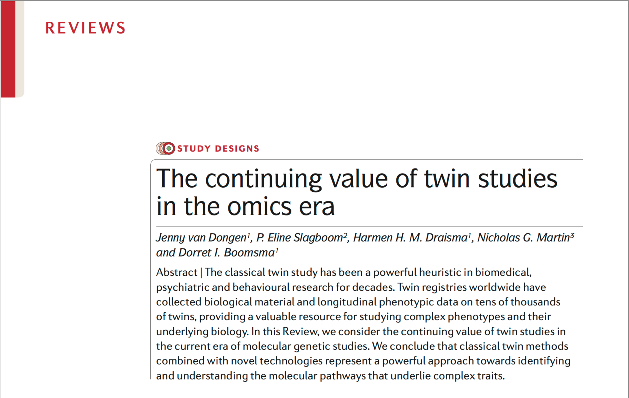
The (gen)omic era: the continued relevance of twin studies.
Van Dongen, J., Slagboom, P. E., Draisma, H. H., Martin, N. G., & Boomsma, D. I. (2012). The continuing value of twin studies in the omics era. Nature Reviews Genetics, 13(9), 640-653.

Slide 33
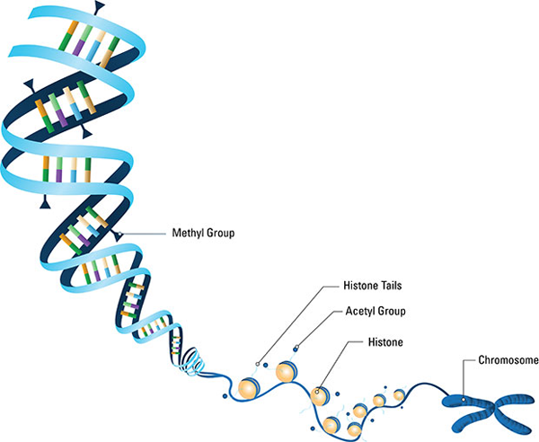
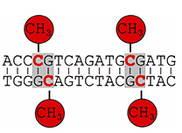
Epigenetic variation
CpG methylation can vary across the lifespan

Slide 34
Epigenetic variation
CpG methylation can vary across the lifespan
CpG methylation can vary across tissues

Slide 35
Epigenetic variation
CpG methylation can vary across the lifespan
CpG methylation can vary across tissues
CpG methylation changes the expression of genes

Slide 36
Epigenetic variation
CpG methylation can vary across the lifespan
CpG methylation can vary across tissues
CpG methylation changes the expression of genes
CpG Methylation is NOT identical in MZ twins, and does NOT correlate .5 between DZ twins

Slide 37
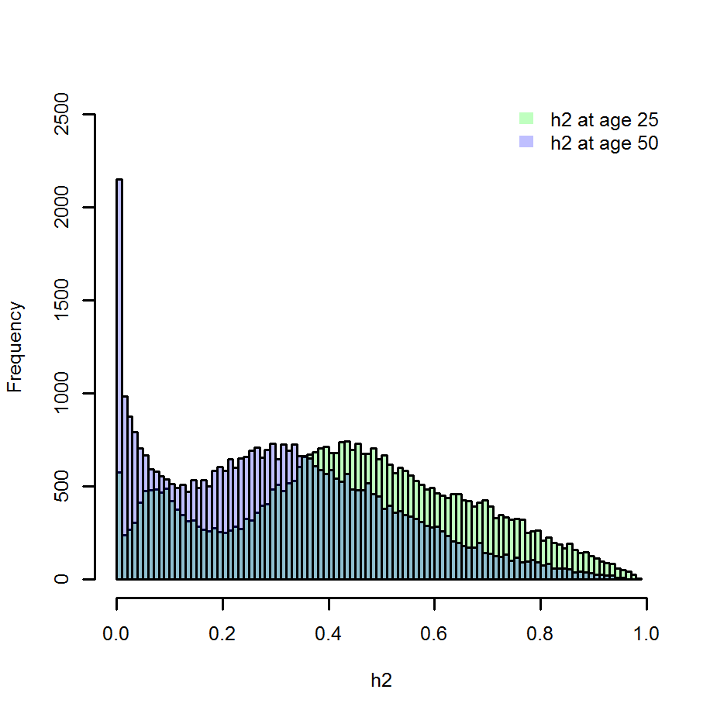
Heritability of CpG methylation
Van Dongen et al. 2016

Slide 38
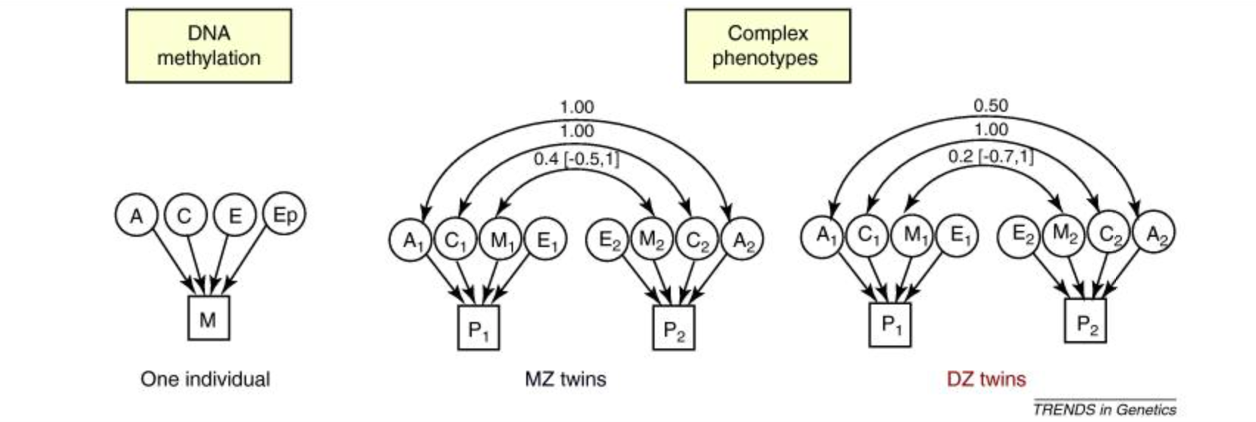
CpG Methylation in the twin model

Slide 39
CpG Methylation in the twin model
Bell & Spector (2011)

Slide 40
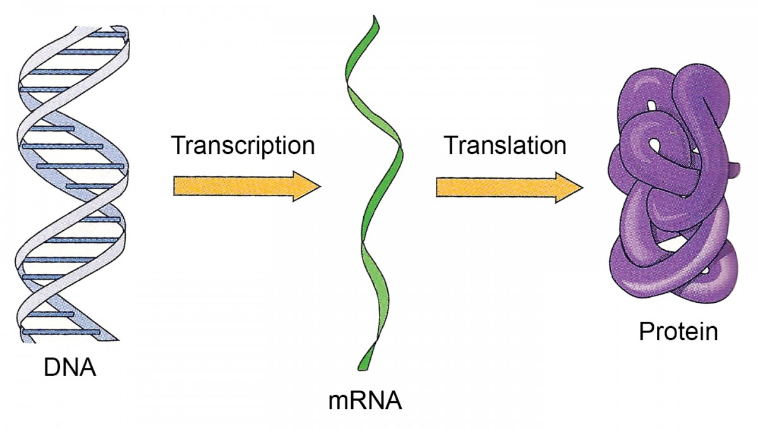
CpG Methylation in the twin model
CpG Methylation

Slide 41
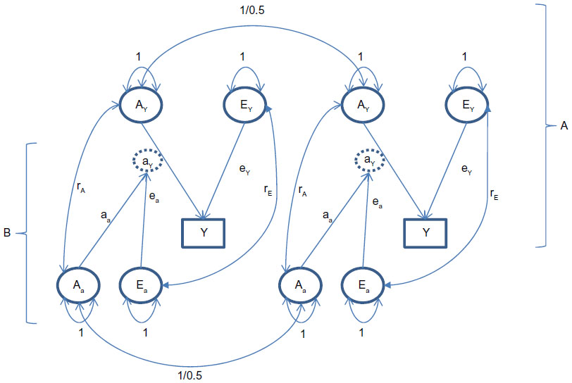
CpG Methylation in the twin model
Dolan et al. 2015

Slide 42
CpG Methylation in the twin model
Dolan et al. 2015

Slide 43
CpG Methylation in the twin model: Caveats
1. The causality is problematic
y
M

Slide 44
CpG Methylation in the twin model: Caveats
1. The causality is problematic
y
M
OR
y
M

Slide 45
CpG Methylation in the twin model: Caveats
1. The causality is problematic
y
M
OR
y
M
OR
y
M

Slide 46
CpG Methylation in the twin model: Caveats
1. The causality is problematic
y
M
OR
y
M
OR
y
M
Brain
Blood
M
y
M

Slide 47
CpG Methylation in the twin model: Caveats
The causality is problematic
The DZ and MZ might behave largely additive

Slide 48
CpG Methylation in the twin model: Caveats
The causality is problematic
The DZ and MZ might behave largely additive
MZ= 1/ DZ= .5
A
A
T1
T2

Slide 49
CpG Methylation in the twin model: Caveats
The causality is problematic
The DZ and MZ might behave largely additive
Methylation varies over time
MZ= 1/ DZ= .5
A
A
T1
T2
MZ= ~ .4/ DZ= ~ .2
M
M

Slide 50
CpG Methylation in the twin model: Caveats
The causality is problematic
The DZ and MZ might behave largely additive
Methylation varies over time
Anxiety wave 1
Anxiety wave 2
Anxiety wave 3
Anxiety wave 4

Slide 51
CpG Methylation in the twin model: Caveats
The causality is problematic
The DZ and MZ might behave largely additive
Methylation varies over time
Methyl?
Anxiety wave 1
Anxiety wave 2
Anxiety wave 3
Anxiety wave 4

Slide 52
CpG Methylation in the twin model: Caveats
The causality is problematic
The DZ and MZ might behave largely additive
Methylation varies over time
Methyl?
Anxiety wave 1
Anxiety wave 2
Anxiety wave 3
Anxiety wave 4

Slide 53
CpG Methylation in the twin model: Caveats
The causality is problematic
The DZ and MZ might behave largely additive
Methylation varies over time
Methyl?
Methyl?
Methyl?
Methyl?
Anxiety wave 1
Anxiety wave 2
Anxiety wave 3
Anxiety wave 4

Slide 54
The next step: Gene expression

Slide 55
Heritability of gene expression
Wright et al. (2014):
Assessed gene expression profiles in 2,752 twins
Assessedd the relationship between Gene expression
and DNA sequence
Wright, F. A., Sullivan, P. F., Brooks, A. I., Zou, F., Sun, W., Xia, K., ... & Abdellaoui, A. (2014). Heritability and genomics of gene expression in peripheral blood. Nature genetics, 46(5), 430-437.

Slide 56
Heritability of gene expression
Wright, F. A., Sullivan, P. F., Brooks, A. I., Zou, F., Sun, W., Xia, K., ... & Abdellaoui, A. (2014). Heritability and genomics of gene expression in peripheral blood. Nature genetics, 46(5), 430-437.

Slide 57
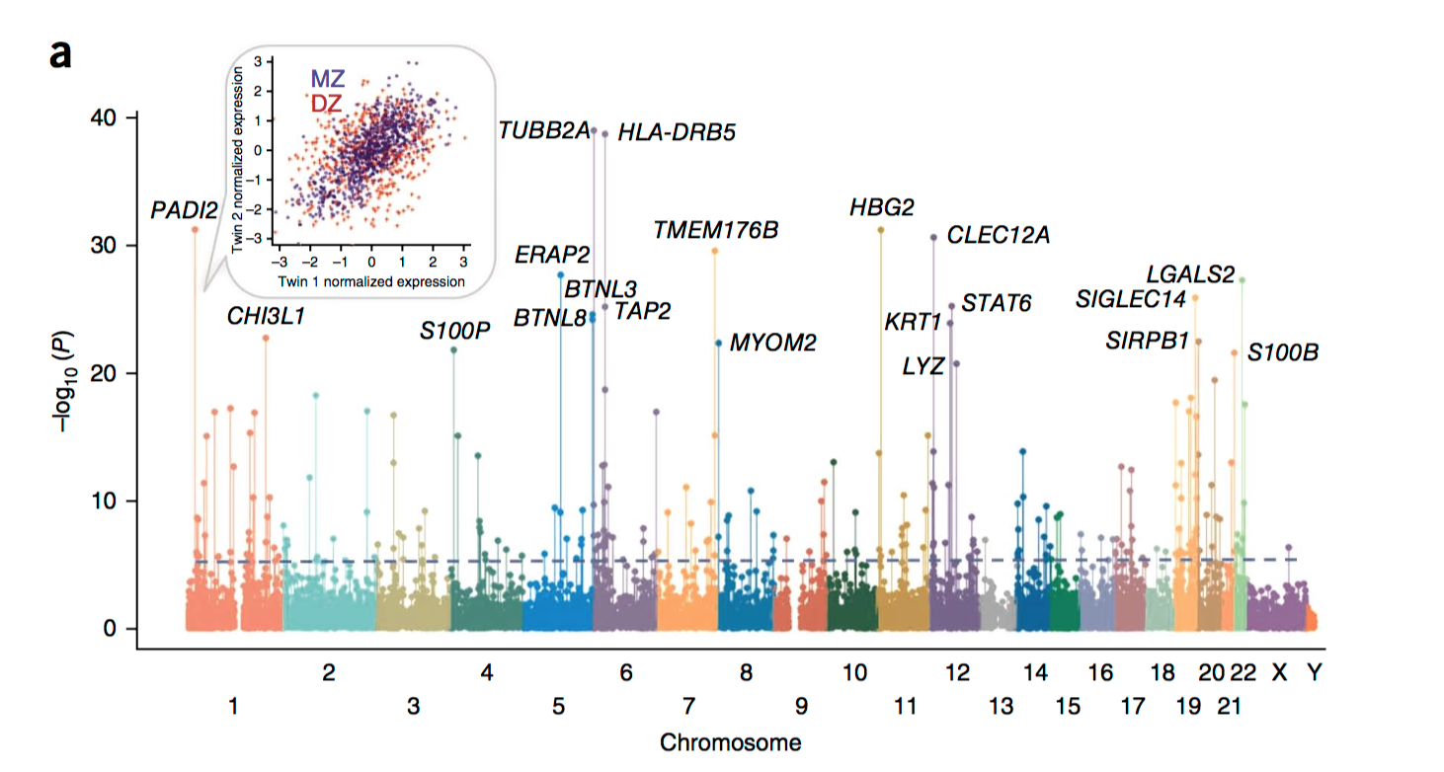
Heritabillity of gene expression
Wright, F. A., Sullivan, P. F., Brooks, A. I., Zou, F., Sun, W., Xia, K., ... & Abdellaoui, A. (2014). Heritability and genomics of gene expression in peripheral blood. Nature genetics, 46(5), 430-437.

Slide 58
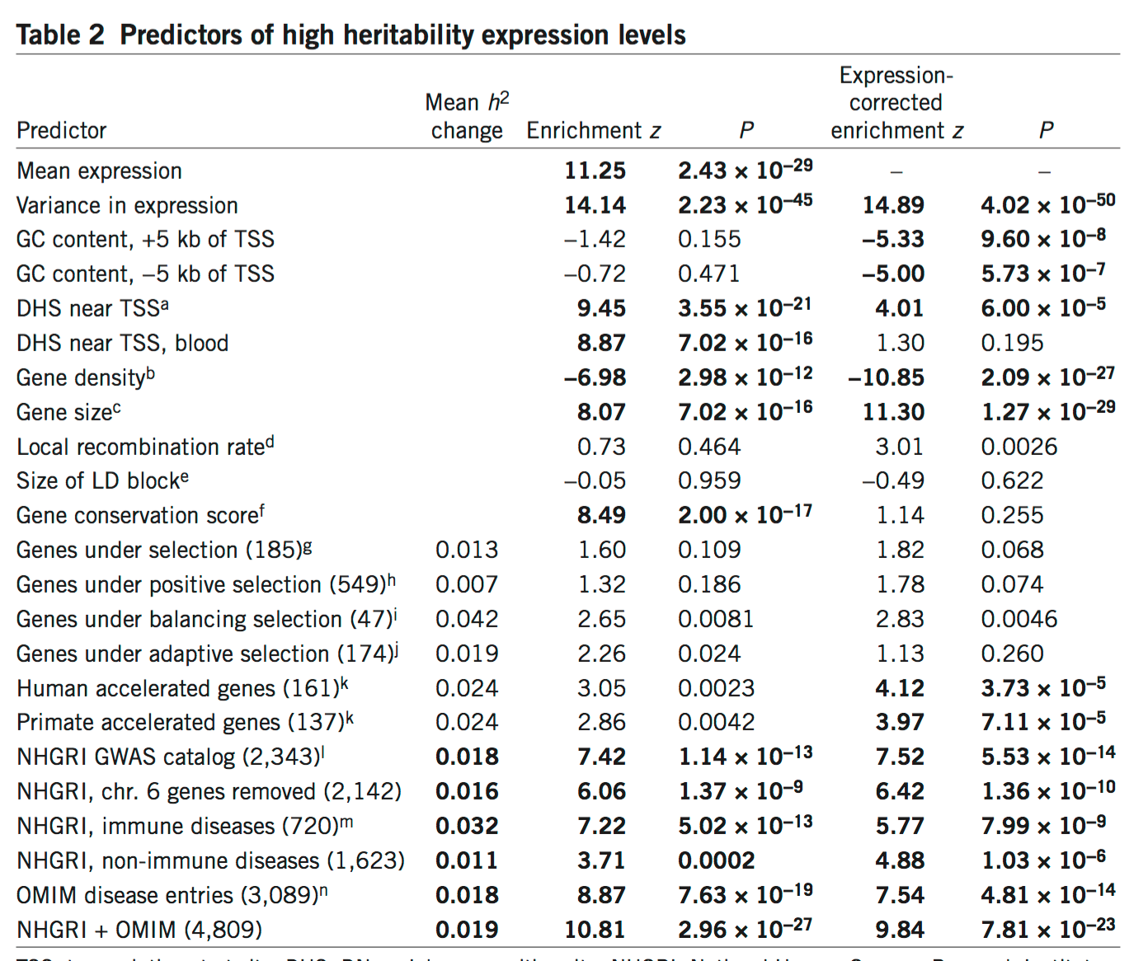
Heritability of gene expression
Not all genes are equally heritable!
Wright, F. A. et al (2014)

Slide 59
Heritability of gene expression
Genes near regions that can be epigenetically
Modified, are less heritable.
Wright, F. A. et al (2014)

Slide 60
Heritability of gene expression
Large genes are more heritable, Genes in gene dense regions are less heritable.
Wright, F. A. et al (2014)

Slide 61
Heritability of gene expression
Genes associate to disease, and near genome wide
Signals for complex traits show increased heritability
Wright, F. A. et al (2014)

Slide 62
How can all of this help your research?
Tissue Gene expression:
http://www.gtexportal.org/home/
Developmental transcriptome:
http://www.brainspan.org/rnaseq/search/index.html
Developmental epigenome:
http://www.brainspan.org/static/download.html

Slide 63
Genetic epidemiology in the genomic age: Missing Heritability & The Role of Twin Studies in the Genomic Era
The twin study has continued use in the (gen)omic era.
Missing heritability seems not to be a massive problem.

