Slide 1
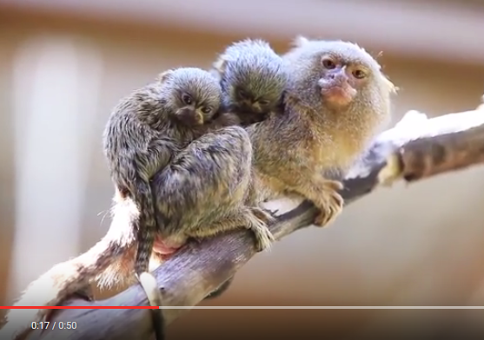
More on thresholds
Sarah Medland

Slide 2
A plug for OpenMx?
Very few packages can handle ordinal data adequately…
OpenMx can also be used for more than just genetic analyses
  Regression
  Polycohoric correlations
  Factor analysis...

Slide 3
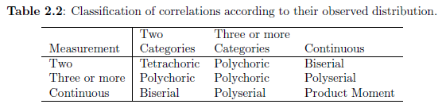
Names for different types of thresholds
http://ibgwww.colorado.edu/workshop2004/cdrom/HTML/book2004a.pdf

Slide 4
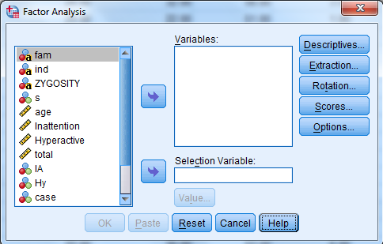
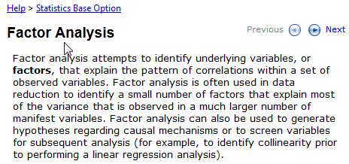
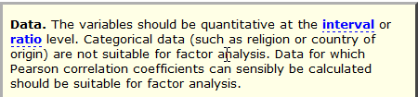

Slide 5
Two approaches to the liability threshold model
Problem
  Ordinal data has 1 less degree of freedom
    MZcov, DZcov, Prevalence
    No information on the variance
  Thinking about our ACE/ADE model
    4 parameters being estimated
    A C E mean
  ACE/ADE model is unidentified without adding a constraint

Slide 6
Two approaches to the liability threshold model with binary data
Solution?
Traditional
  Maps data to a standard normal distribution
  Total variance constrained to be 1
Alternate
  Fixes an alternate parameter (usually E)
  Estimates the remaining parameters

Slide 7
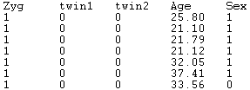
Traditional Approach
Imagine we have a set of binary data
Trait – lifetime cannabis use
  Never Smoked/Ever Smoked

Slide 8
Twin 1 cannabis use
0 = never used

Slide 9
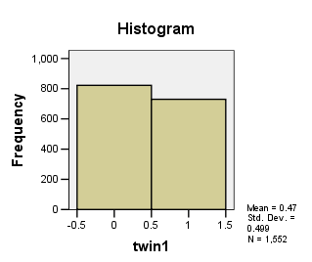
Twin 1 cannabis use

Slide 10
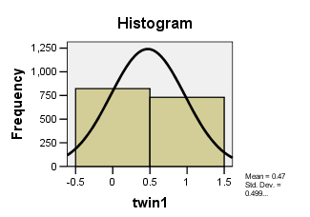
Twin 1 cannabis use
Liability or ‘risk’ of initiation distribution
Just because an individual has never used cannabis does not mean their ‘risk’ of initiation is zero

Slide 11
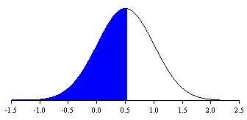
Mean = .47
SD =.499
Non Smokers =53%
The observed phenotype is an imperfect measurement of an underlying continuous distribution
ie Obesity vs BMI
MDD vs quantitative depression scales

Slide 12
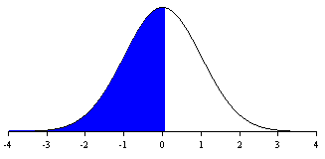
Raw data distribution
Mean = .47
SD =.499
Non Smokers =53%
Threshold =.53
Standard normal distribution
Mean = 0
SD =1
Non Smokers =53%
Threshold =.074

Slide 13
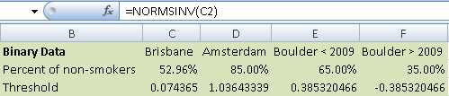
Threshold = .074 – Huh what?
How can I work this out
  Excell
    =NORMSINV()
    Thresholds.xls
  R
    qnorm(.5296)

Slide 14
Why rescale the data this way?
Convenience
  Variance always 1
  Mean is always 0
  We can interpret the area under a curve between two z-values as a probability or percentage

Slide 15
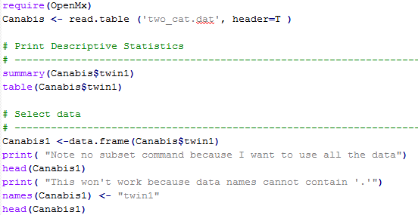
Threshold.R

Slide 16
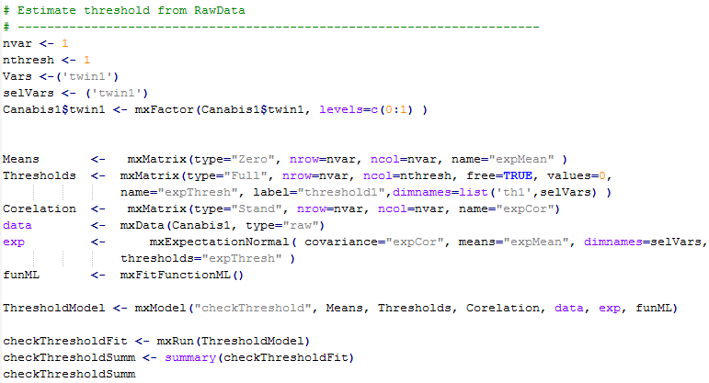
Threshold.R

Slide 17

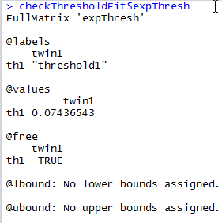
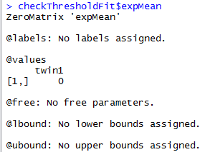
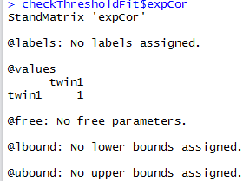
Threshold = .075 – Huh what?

Slide 18
What about more than 2 categories?
Very similar
  We create a matrix containing the 1st threshold and the displacements between subsequent matrices
  We then add the 1st threshold and the displacement to obtain the subsequent thresholds

Slide 19

Mx Threshold Specification: 3+ Cat.
Threshold matrix: T Full 2 2 Free
Twin 1 Twin 2
2.2
-3
-1
0
1.2
3
1st threshold
increment

Slide 20
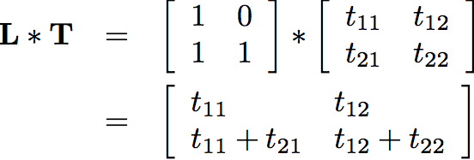
Mx Threshold Specification: 3+ Cat.
Threshold matrix: T Full 2 2 Free
Twin 1 Twin 2
2.2
-3
-1
0
1.2
3
1st threshold
increment
MxAlgebra L%*%T

Slide 21
Mx Threshold Specification: 3+ Cat.
Threshold matrix: T Full 2 2 Free
Twin 1 Twin 2
2.2
-3
-1
0
1.2
3
1st threshold
increment
MxAlgebra L%*%T
2nd threshold

Slide 22
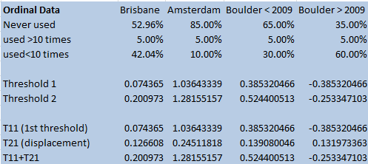
Check the xls spreadsheet…

Slide 23
Two approaches to the liability threshold model
Solution?
Traditional
  Maps data to a standard normal distribution
  Total variance constrained to be 1
Alternate
  Fixes an alternate parameter
    Binary or Ordinal data fix E
    Ordinal data fix 1st two thresholds (aka invariant threshold approach)
  Estimate the remaining parameters

Slide 24
Fixed Thresholds
?
0
?
1

Slide 25
Models are equivalent, but…
Alternate approach means the data is no longer mapped to a standard normal
No easy conversion to %
Makes it difficult to compare between groups as the scaling is now arbitrary

Slide 26
We are going to run traditional and Fixed Thresholds ACE models with ordinal data
  twinAceOrd-Traditional.R
  twinAceOrd-FixThreshold.R
There is are other scripts in the folder – take a look later
  twinAceBin-Traditional.R
  twinAceBin-FixE.R
  twinAceOrd-FixE.R

Slide 27
Lisbon Castle

