Slide 1
Univariate modeling
Sarah Medland

Slide 2
Starting at the beginning…
Data preparation
The algebra style used in Mx expects 1 line per case/family
(Almost) limitless number of families and variables
Missing data
Default missing code is NA
No missing covariates/definition variables!
Quick R - http://www.statmethods.net/

Slide 3

Selecting and sub-setting data
Make separate data sets for the MZ and DZ
Check data is numeric and behaves as expected
cov (dzData, use=“complete”)

Slide 4
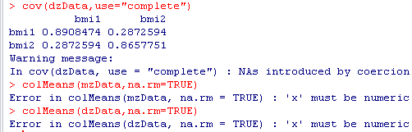
Common problem
Problem: data contains a non numeric value
Equivalent Mx Classic error - Uh-oh... I'm having trouble reading a number in D or E format

Slide 5
Important structural stuff
openMx has a very fluid and flexible stucture
Each code snippet is being saved as an object
We tend to reuse the object names in our scripts
This makes it very important to create a new project for each series of analyses
Remember the project also contains the data so these files can become very large.

Slide 6
Matrices are the building blocks
Many types eg. type="Lower"
Denoted by names eg. name="a“
Size eg. nrow=nv, ncol=nv
All estimated parameters must be placed in a matrix & Mx must be told what type of matrix it is
mxMatrix( type="Lower", nrow=nv, ncol=nv, free=TRUE, values=.6, label="a11", name="a" ), #X

Slide 7
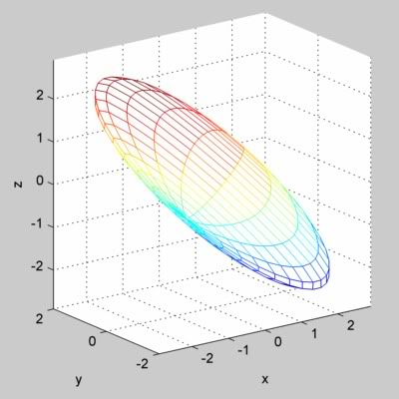
Choosing the model
Thinking about parameter space…
Imagine an ACE model
Solution space bounded
by CIs

Slide 8
Choosing the model
ACE vs ADE
With twins alone can’t joint estimate ACDE
Options
Add in an extra relationship
Fix one of these parameters and estimate the other 3
Accept this limitation
All models are wrong some are useful (George E. P. Box)
Reject the twin model, pretend genes have no influence and interpret biological inheritance as a social phenomenon
No 1 size fits all solution

Slide 9
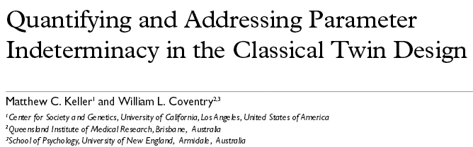
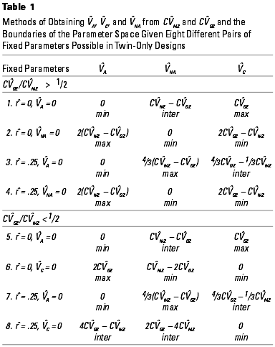
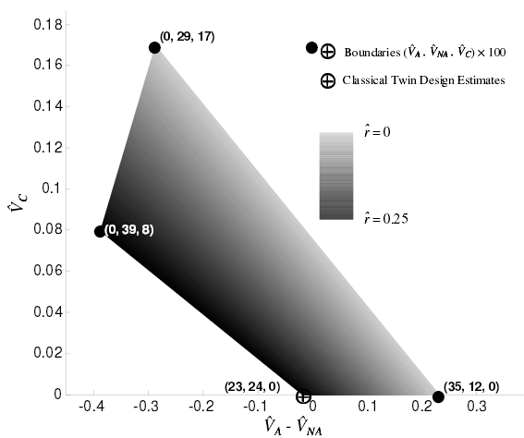
Choosing the model

Slide 10
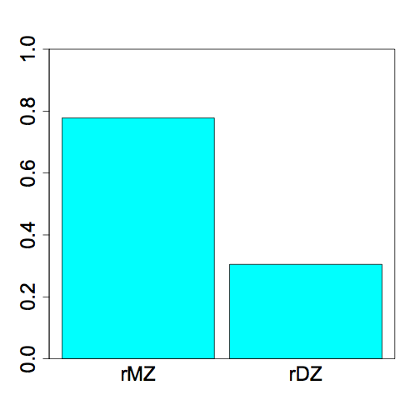
Yesterday we ran an ADE Model
Why?
0.78
0.30

Slide 11
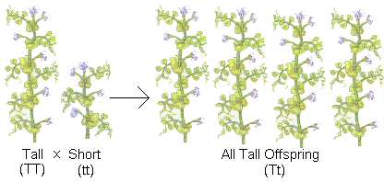
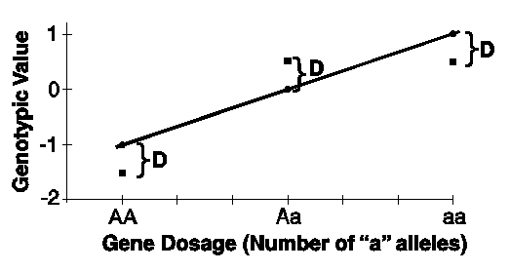
What is D again?
Dominance refers to non-additive genetic effects resulting from interactions between alleles at the same locus or different loci (epistasis)

Slide 12
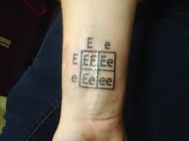
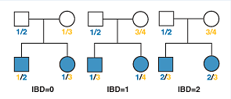
What is D again?
DZ twins/full siblings share
~50% of their segregating DNA &
for ~25% loci they share not only the genotype but also the parental origin of each allele

Slide 13
DZ twins/full siblings share
~50% of their segregating DNA &
for ~25% loci they share not only the genotype but also the parental origin of each allele
This is where the .5A comes from
Consider a mating between mother AB x father CD:
Sib2 | Sib1
 |  | AC | AD | BC | BD
 | AC | 2 | 1 | 1 | 0
 | AD | 1 | 2 | 0 | 1
 | BC | 1 | 0 | 2 | 1
 | BD | 0 | 1 | 1 | 2
This is where the .25D comes from
IBD 0 : 1 : 2 = 25% : 50% : 25%

Slide 14
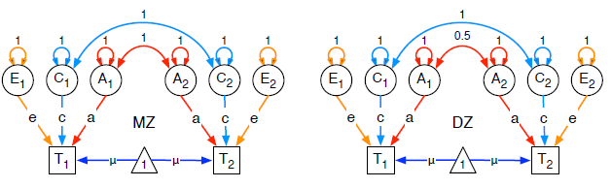
Today we will run an ACE model
MZ DZ
a²+c²+e² | a²+c²
a²+c² | a²+c²+e²
a²+c²+e² | .5a²+c²
.5a²+c² | a²+c²+e²

Slide 15
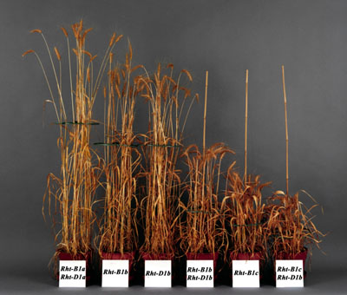
Today we will run an ACE model
Additive genetic effects
Why is the coefficient for DZ pairs .5?
Average genetic sharing between siblings/DZ twins
Sib2 | Sib1
 |  | AC | AD | BC | BD
 | AC | 2 | 1 | 1 | 0
 | AD | 1 | 2 | 0 | 1
 | BC | 1 | 0 | 2 | 1
 | BD | 0 | 1 | 1 | 2
MZ DZ
a²+c²+e² | a²+c²
a²+c² | a²+c²+e²
a²+c²+e² | .5a²+c²
.5a²+c² | a²+c²+e²

Slide 16
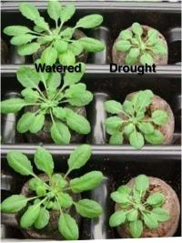
Today we will run an ACE model
Common environmental effects
Coefficient =1 for MZ and DZ pairs
Equal environment assumption – for all the environmental influences THAT MATTER there is ON AVERAGE no differences in the degree of environmental sharing between MZ and DZ pairs
MZ DZ
a²+c²+e² | a²+c²
a²+c² | a²+c²+e²
a²+c²+e² | .5a²+c²
.5a²+c² | a²+c²+e²

Slide 17
Today we will run an ACE model
Open RStudio
faculty/sarah/2016/Tuesday1
Copy everything

Slide 18
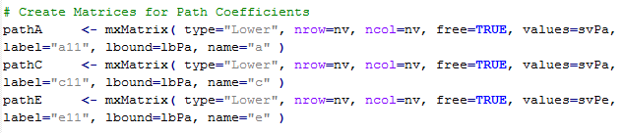
Today we will run an ACE model

Slide 19
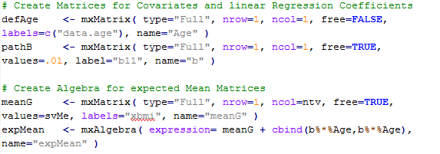
We are going to include the effect of age on the means

Slide 20


Covariances
MZ DZ
a²+c²+e² | a²+c²
a²+c² | a²+c²+e²
a²+c²+e² | .5a²+c²
.5a²+c² | a²+c²+e²

Slide 21
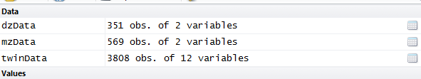
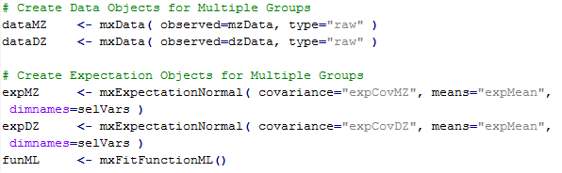
To fit a model to data, the differences between the observed covariance matrix and model-implied expected covariance matrix are minimized.
Objective functions are functions for which free parameter values are chosen such that the value of the objective function is minimized.
mxFitFunctionML() uses full-information maximum likelihood to provide maximum likelihood estimates of free parameters in the algebra defined by the covariance and means arguments.

Slide 22
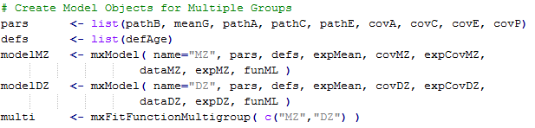
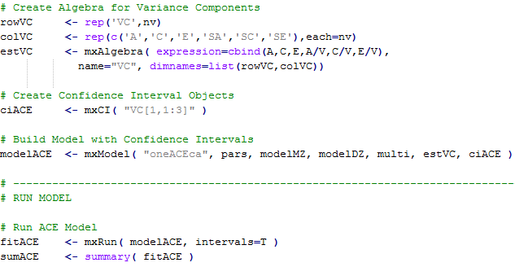

Slide 23
What to report
Summary statistics
Usually from a simplified ‘saturated’ model
Standardized estimates
Easier to conceptualise
ie 40% of the phenotypic variance vs a genetic effect of 2.84
Can easily be returned to original scale if summary statistics are provided

Slide 24
What to report
Path coefficients
Very important in multivariate analyses
Gives a much clearer picture of the directionality of effects
Variance components/proportion of variance explained
Genetic correlations

Slide 25
How to report it?
Path diagram
onyx (java based cross platform)
http://onyx.brandmaier.de/
Clasic MX GUI (complex to setup in mac)
http://www.vipbg.vcu.edu/vipbg/mxgui/
umx with graphviz (complex to setup in windows)
See Tim’s talk from yesterday
omnigraffle (mac only)
https://www.omnigroup.com/omnigraffle

Slide 26
General Advice/Problem solving
Scripting styles differ
Check the sample description
Learn to love the webpage
Comments are your friends

Slide 27
Bus shelter on the road to Sintra (Portugal)

