Slide 1
Introduction to OpenMx
Sarah Medland

Slide 2
What is OpenMx?
• Free, Open-source, full–featured SEM package
• Software which runs on Windows, Mac OSX, and Linux
• A package in the R statistical programing environment
• Two main approaches to writing OpenMx models – Path or Matrix Specification

Slide 3
• R is a functional language
• Easy to define new functions
• Items are stored as Objects
• OpenMx uses functions to build objects
• Arguments to the function have an order
• Order can be changed by naming arguments

Slide 4
Matrices are the building blocks
Matrix: a rectangular array of elements arranged in rows and columns.
The order or dimension of a matrix is defined by the number of row and columns in the matrix.
The order of a matrix is generally referred to as M x N (where M is the number of rows and N is the number of columns)
Matrix A is a 3 x 3 matrix.
Each element in the matrix is referred to by its placement in a row and column, where a_{ij} is the element in Matrix A in the i^{th} row and j^{th} column.
Therefore, e is element a_{(2,2)}
Columns
a | d | g
b | e | h
c | f | i
A =
(3x3)
Rows

Slide 5
Matrices are the building blocks
mxMatrix( type="Lower", nrow=nv, ncol=nv, free=TRUE, values=.6, label="a11", name="a" ), # additive genetic path coefficients
Many types eg. type="Lower"
Denoted by names eg. name="a“
Size eg. nrow=nv, ncol=nv
Estimated parameters must be placed in a matrix & Mx must be told what type of matrix it is

Slide 6
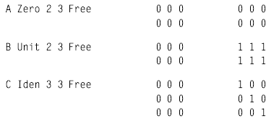
Matrices are the building blocks
mxMatrix( type=“Zero", nrow=2, ncol=3, name="a" )
mxMatrix( type=“Unit", nrow=2, ncol=3, name="a" )
mxMatrix( type=“Ident", nrow=3, ncol=3, name="a" )

Slide 7
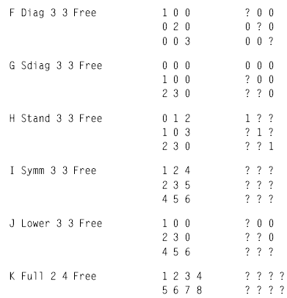
Matrices are the building blocks
mxMatrix( type=“Diag", nrow=3, ncol=3, free=TRUE, name="a" )
mxMatrix( type=“Sdiag", nrow=3, ncol=3, free=TRUE, name="a" )
mxMatrix( type=“Stand", nrow=3, ncol=3, free=TRUE, name="a" )
mxMatrix( type=“Symm", nrow=3, ncol=3, free=TRUE, name="a" )
mxMatrix( type=“Lower", nrow=3, ncol=3, free=TRUE, name="a" )
mxMatrix( type=“Full", nrow=2, ncol=4, free=TRUE, name="a" )
Many types

Slide 8
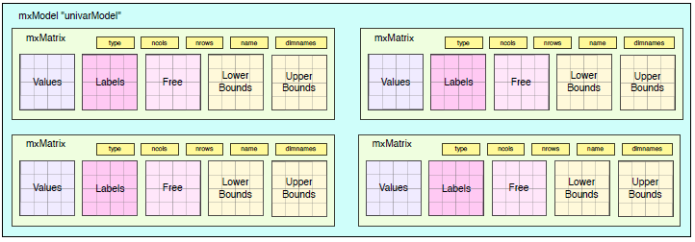
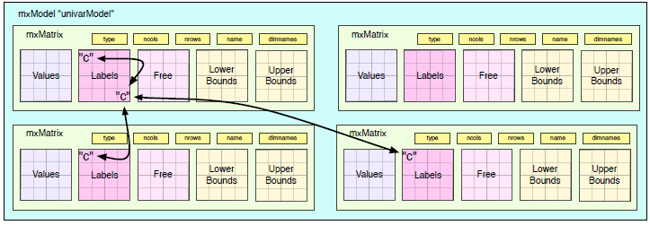
A model can have many matrices
Equate parameters using labels
Notes:
Matrices inside Objects and build via this to trouble shoot

Slide 9
Matrix Operations
Matrix Addition and Subtraction:
Matrices must be the same size
If the matrices are of different orders, it is impossible to add them
2 | 1
3 | 5
6 | 2
4 | 8
7 | 2
9 | 6
2+4 | 1+8
3+7 | 5+2
6+9 | 2+6
6 | 9
10 | 7
15 | 8
+
=
=
2 | 1
3 | 5
6 | 2
+
4 | 7 | 9
8 | 2 | 6
=
Undefined

Slide 10
Dot Product
Also known as the element-wise product
OpenMx symbol *
A₁₁ | A₁₂ | A₁₃
A₂₁ | A₂₂ | A₂₃
A₃₁ | A₃₂ | A₃₃
B₁₁ | B₁₂ | B₁₃
B₂₁ | B₂₂ | B₂₃
B₃₁ | B₃₂ | B₃₃
A₁₁B₁₁ | A₁₂B₁₂ | A₁₃B₁₃
A₂₁B₂₁ | A₂₂B₂₂ | A₂₃B₂₃
A₃₁B₃₁ | A₃₂B₃₂ | A₃₃B₃₃
AB
=
=
•

Slide 11
Matrix Multiplication (Star product)
Number of columns of the first matrix must equal the number of rows of the second matrix.
Product will have as many rows as the first matrix and as many columns as the second matrix.
OpenMx symbol %*%
C = A ^{x} B
2 | 1
3 | 5
6 | 2
3 | 4 | 7
5 | 6 | 1
C
=
x
60
60 | 37
60 | 37
34
60 | 37
34 | 37
3*2 + 4*3 + 7*6
3*2 + 4*3 + 7*6 | 3*1 + 4*5 + 7*2
3*2 + 4*3 + 7*6 | 3*1 + 4*5 + 7*2
5*2 + 6*3 + 1*6
3*2 + 4*3 + 7*6 | 3*1 + 4*5 + 7*2
5*2 + 6*3 + 1*6 | 5*1 +6*5 + 1*2
=
=

Slide 12
Kroneker Product
OpenMx symbol %x%

Slide 13

Quadratic Product
$\text{The} \text{quadratic} \text{product} \text{is} \text{extremely} \text{useful} \text{in} \text{statistical} \text{analysis}\text{ (}\text{particularly} \text{in} \text{Structural} \text{Equation} \text{Modeling}\text{)}$
$\text{OpenMx} \text{symbol}\text{ \%\&\%}$
$A\%\&\%B=ABAT= \left[\begin{matrix}a11 & a12 \\ a21 & a22\end{matrix}\right]$x$\left[\begin{matrix}b11 & b12 \\ b21 & b22\end{matrix}\right]$x$\left[\begin{matrix}a11 & a21 \\ a12 & a22\end{matrix}\right]$

Slide 14
Our first OpenMx script
Linear regression ( aka simple regression, Ordinary Least Squares Regression, linear model)
Raw data
Describe the relationship between two variables, X and Y, as a straight line
The regression of BMI on variable Age
Does age predict BMI?
BMI=weight in kg/ (height in m)²

Slide 15
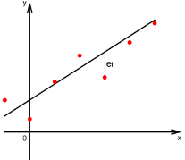

Linear Regression
The regression of variable Y on variable X is given by:
$$y_{i}=β_{0}+β_{1}x_{i}+ε_{i} i=1,…,n$$
where:
$β_{0}$ (Intercept) value of y when x=0
$β_{1}$ (Slope) increase in Y for each unit change in X
$ε_{i}$ (Random Error) $ε_{i}\sim N(0,σ^{2})$
Linear Function: $β_{0}+β_{1}x_{i}$ = E ( Y | X = $x_{i}$ )

Slide 16
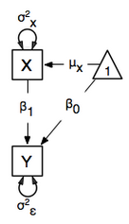
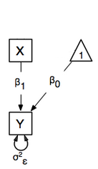
As a path diagram

Slide 17
Starting at the beginning…
Data preparation
The algebra style used in OpenMx expects 1 line per case/family
(Almost) limitless number of families and variables
Data needs to be read into R before it can be analysed
(the commands to read the data can be nested within the R script)
Default missing code is now NA

Slide 18
Saving your output
Numerous options
Saving workspace most common but could potentially lead to IRB issues
Sink and history both miss sections
Today we will use the teaching demos package records everything that goes in and comes out
require (TeachingDemos)
txtStart(file="linearRegression.omx", commands=TRUE, results=TRUE)
txtStop()

Slide 19
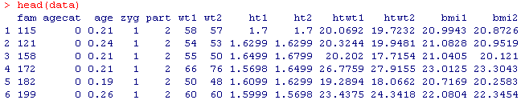
Getting your data into R
Open RStudio
Example data:ozbmi2.txt
OZbmi<-read.table("ozbmi2.txt", header=T, na.strings = "NA")
head(data)
# using subset function create new dataset without missing data
OZbmi <- subset(data, age !="NA" , select=c(bmi1, age))

Slide 20
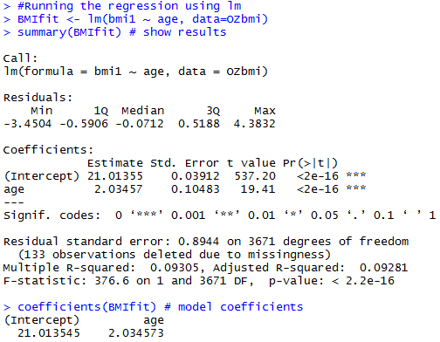
Regression using lm
BMIfit <- lm(bmi1 ~ age, data=OZbmi)
summary(BMIfit) # show results
coefficients(BMIfit) # model coefficients

Slide 21

Regression using OpenMx
Model contains:
4 matrices and 3 estimated parameters
BMI
Free observed variable
$β_{0}$ and ${σ2}_{ε}^{}$are estimated
Age
Fixed observed variable
Regression of BMI on Age
$β_{1}$ is estimated

Slide 22
Regression using OpenMx
# Variance/Covariance matrix
Variance <- mxMatrix(
type="Full",
nrow=1,
ncol=1,
free=TRUE,
values=11,
labels='resid',
name="residualVar" )

Slide 23
Regression using OpenMx
require (OpenMx)
depVar <- 'bmi1‘
# Variance/Covariance matrix
Variance <- mxMatrix( type="Full", nrow=1, ncol=1, free=TRUE,
values=11, labels='resid', name="residualVar" )
# Regression betas
b0 <-mxMatrix(type="Full", nrow=1, ncol=1, free=T, values=22,
labels="beta0", name="Intercept" )
b1 <-mxMatrix(type="Full", nrow=1, ncol=1, free=T, values=0,
labels="beta1", name="bAge" )
# Independent variable
x <-mxMatrix(type="Full", nrow=1, ncol=1, free=F,
labels="data.age", name="Age" )

Slide 24
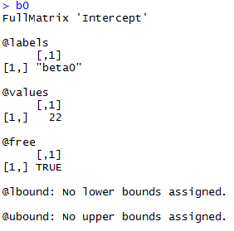
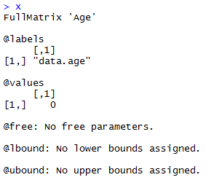

Slide 25


# Building the model ($y_{i}=β_{0}+β_{1}x_{i}$)
expMean <- mxAlgebra(intercept + bAge%x%Age, name="regress")
# Specify the data
regData <- mxData( observed=OZbmi, type="raw" )
inclusions <- list(Variance, b0, b1, bAge, expMean)

Slide 26
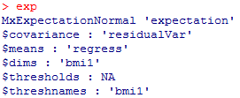
# Finally, we call up the results of the algebras as the arguments for the expectation function.
# The dimnames map the data to the model.
# NOTE- The matrix names defined in mxMatrix() statements are used here NOT the objects that are used to store the matrices.
exp <- mxExpectationNormal( covariance="residualVar", means="regress", dimnames=depVar )

Slide 27
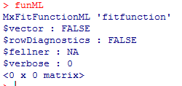
#The fit function declares that the model is fit using maximum likelihood.
# When combined with raw data this means full information maximum likelihood (FIML) is optimized.
funML <- mxFitFunctionML()

Slide 28
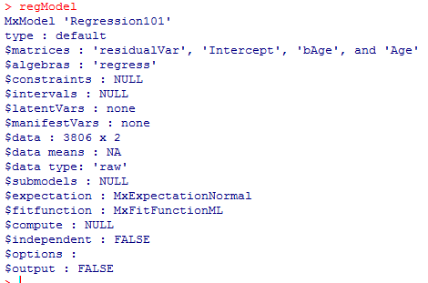
#Build the model - specify the name of the model, the objects referenced, the data and the objective
regModel <- mxModel( "Regression101", inclusions, regData, exp, funML )
# Run the model & summarize output
regFit <- mxRun( regModel, intervals=FALSE )
regSum <- summary( regFit )

Slide 29
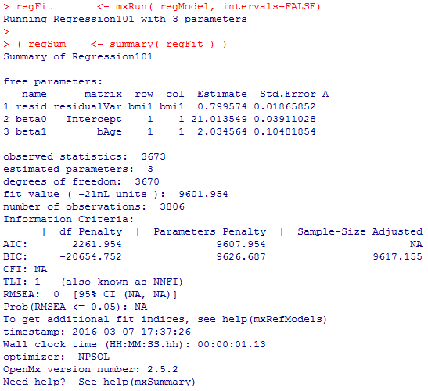

Slide 30
Intuitive Logic of Optimization
Start with an arbitrary set of initial parameters values. (Starting Values)
Determine a direction of movement for the parameters (larger or smaller)
Determine a step length to move (how much larger or smaller)
Rinse and repeat until some termination criteria is reached and then stop.

Slide 31
Maximum Likelihood Estimation
Let us assume that X is an i.i.d. random variable with a probability of p(x|θ) = P(X=x), where θ is a parameter
We know that if observations are independent, then the joint probability of their occurrence is the product of the individual probabilities.
Hence:

Slide 32
#Looking at the optimization process
# ReRunning to look at optimization
regModel <- mxOption(regModel,"Checkpoint Units", "iterations")
regModel <- mxOption(regModel,"Checkpoint Count", 1)
regFit <- mxRun( regModel, intervals=FALSE, checkpoint=T )

Slide 33


OpenMx vs lm
OpenMx
regSum$parameters
Lm

Slide 34
Is beta1 different from 0?
# Go back and pickup the model so that we can run significance tests
ageEfModel <- regFit
#set beta 1 to 0
ageEfModel <- omxSetParameters( ageEfModel, label="beta1",
free=FALSE, values=0 )
ageEfFit <- mxRun(ageEfModel, intervals=FALSE)
(ageEfSumm <- summary(ageEfFit))

Slide 35
# difference in fit
deltaLL <-ageEfSumm$Minus2LogLikelihood - regSum$Minus2LogLikelihood
# difference in df
deltaDF <-ageEfSumm$degreesOfFreedom - regSum$degreesOfFreedom
# significance test
pchisq(deltaLL, lower.tail=F, deltaDF)

Slide 36
Questions?
Bus shelter on the road to Sintra (Portugal)

