Slide 1
(Re) introduction to Linux
Sarah Medland
Boulder 2016

Slide 2
Getting the most out of the workshop
Ask questions!!!
Don’t sit next to someone you already know
Work with someone with a different skillset and different experience level
Use the workshop laptop
  You will have access to your files after you leave
Come to the social functions
Ask questions!!!

Slide 3
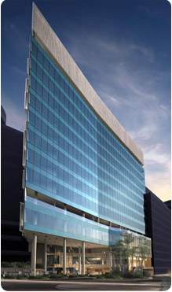
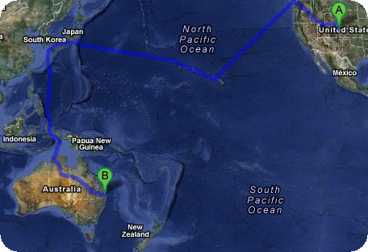


I work in Brisbane at QIMR
Sarah Medland

Slide 4

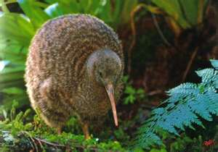
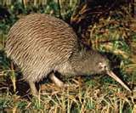
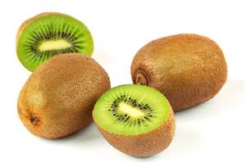
not

Slide 5
Morning sessions
Optional
  Feel free to wander in and out/check email etc
Topics
  Shift in response to feedback
  Tomorrow: R intro
  Wednesday: PCA
  Thursday: Family Based association
  Friday: TBA

Slide 6
Superfast intro to Linux

Slide 7

This year’s OS
Debian (linux)
  Free
  Many free software packages available
    Open office
    R
    PSPP
    Terminal
Based on Unix
  long and venerable history
  http://en.wikipedia.org/wiki/Unix

Slide 8




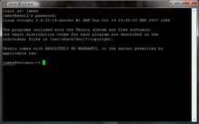
Close but not the same…
Most basic shortcuts will work
  crtl+C for copy crtl+V for paste etc
Supports folder based navigation
/\ BIG PROBLEM is \ vs /
You will have used some version of unix previously

Slide 9
File hygiene is very important
Files are stored in Unix format not DOS or Mac
  Changes the line ending characters
  Use dos2unix, unix2dos, mac2unix, unix2mac to change formats
  Can use the file command to check format
Unix systems are case sensitive!
NO SPACES in your file/directory names!!
Wildcards ie dos2unix *.dat

Slide 10
Superfast intro to R

Slide 11
What is it?
R is an interpreted computer language.
  System commands can be called from within R
R is used for data manipulation, statistics, and graphics. It is made up of:
  operators (+ - <- * %*% …) for calculations on arrays & matrices
  large, coherent, integrated collection of functions
  facilities for making unlimited types of publication quality graphics
  user written functions & sets of functions (packages); 800+ contributed packages so far & growing
Notes:
11

Slide 12
Advantages
Fast** and free.
State of the art: Statistical researchers provide their methods as R packages. SPSS and SAS are years behind R!
2nd only to MATLAB for graphics.
Active user community
Excellent for simulation, programming, computer intensive analyses, etc.
Forces you to think about your analysis.
Interfaces with database storage software (SQL)
Notes:
12

Slide 13
Disadvantages
Not user friendly @ start - steep learning curve, minimal GUI.
No commercial support; figuring out correct methods or how to use a function on your own can be frustrating.
Easy to make mistakes and not know.
Working with large datasets is limited by RAM!!!
Data prep & cleaning can be messier & more mistake prone in R vs. SPSS or SAS
Hostility on the R listserve
Notes:
13

Slide 14

Learning R....
Notes:
14

Slide 15

R-help listserve....
Notes:
15

Slide 16
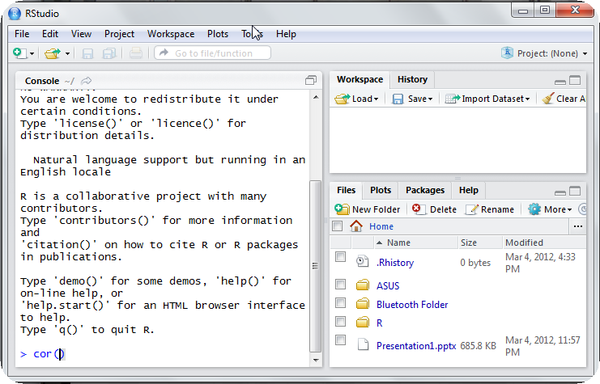
Using R this week
R-studio http://rstudio.org/

Slide 17
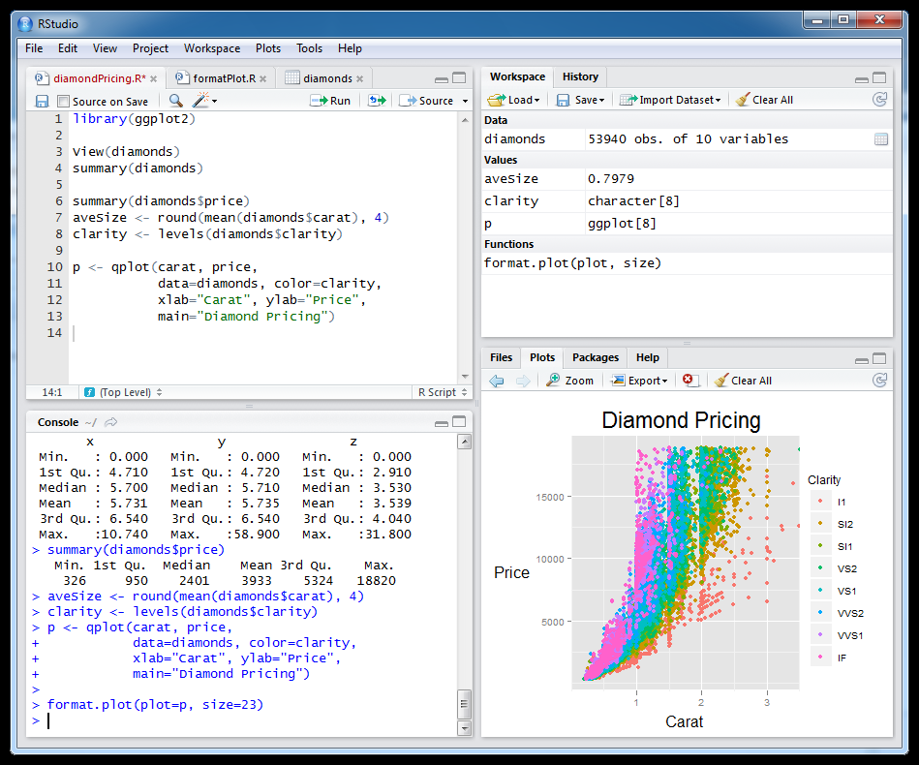
Setting this up at home
Install R first
Install R studio
Install packages

Slide 18
Start up R via R studio
4 windows:
  Syntax – can be opened in regular txt file - saved
  Terminal – output & temporary input - usually unsaved
  Data manager – details of data sets and variables
  Plots etc
Notes:
18

Slide 19
R sessions are interactive
Notes:
19

Slide 20
GETTING STARTED

Slide 21
How to use help in R?
  R has a help system built in.
  If you know which function you want help with simply use ?_______ or help(_____) with the function in the blank.
    ?hist.
    help(hist)
  If you don’t know which function to use, then use help.search(“_______”).
    help.search(“histogram”).

Slide 22
Importing Data
First make sure your data is in an easy to read format such as space, tab or CSV
Use code:
  D <- read.table(“ozbmi2.txt”,header=TRUE)
  D <-read.table(“ozbmi2.txt”,na.strings=“-99”,header=TRUE)
  D <- read.table(“ozbmi2.csv”, sep=“,”
  header=TRUE)
  D <- read.csv(“ozbmi2.csv”, header=TRUE)

Slide 23
Exporting Data
Tab delimited
  write.table(D, “newdata.txt”,sep=“\t”)
  To xls
  library(xlsReadWrite)
  write.xls(D, “newdata.xls")

Slide 24
Checking data
#list the variables in D
  names(D)
# dimensions of D
  dim(D)
# print the first 10 rows of D
  head(D, n=10)
#referring to variables in D
#format is Object$variable
  head(D$age, n=10)

Slide 25
Basic Manipulation
#You can make new variables within an existing object
  D$newage<- D$age*100
#Or overwrite a variable
  D$age<- D$age*100
#Or recode a variable
  #D$catage <- ifelse(D$age > 30,
  c("older"), c("younger"))

Slide 26
Checking data
#Mean and variance
  mean(D$age, na.rm =TRUE)
  var(D$age , na.rm =TRUE)
#For a number of variables
  lapply(D, mean, na.rm=TRUE)
  sapply(D, mean, na.rm=TRUE)

Slide 27
Checking data
A bit more info
  summary(D$age)
  summary(D$age[which(D$agecat==1)])
What about a categorical variable
  table(D$agecat)
  table(D$agecat,D$zyg)

Slide 28
Some basic analysis
typing D$ is getting annoying so we can attach the data
  attach(D)
  table(agecat,zyg)
  #detach(D)
  Correlations anyone?
  cor(wt1,bmi1, use="complete")
  cor(ht1,bmi1, use="complete")

Slide 29
regression
Multiple Linear Regression
  fit <- lm(bmi1 ~ age + zyg, data=D)
  summary(fit)
  # Other useful functions
  coefficients(fit) # model coefficients
  confint(fit, level=0.95) # CIs for model parameters
  anova(fit) # anova table
  vcov(fit) # covariance matrix for model parameters

Slide 30
Basic plots
Histogram
#basic
  hist(age)
#basic
  hist(age, breaks=12, col=‘red’)
  # Add labels
  hist(age, breaks=12, col='red', xlab='age in years',main='Histogram of age‘)

Slide 31
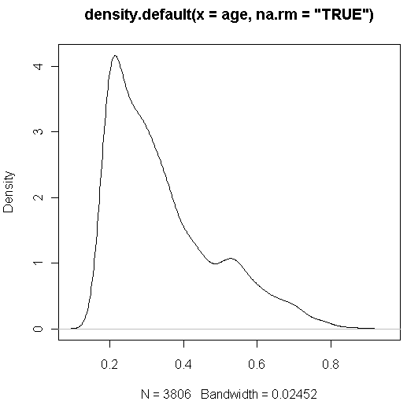
Looking at your data...
  #Kernal density plot
  d <- density(age, na.rm = "TRUE") # returns the density data
  plot(d) # plots the results

Slide 32
Looking at your data...
  #Kernal density plot by zyg?
  library(sm)
  # create value labels
  zyg.f <- factor(zyg, levels= seq(1,5),
  labels = c("MZF", "MZM", "DZF", "DZM", "DZOS"))
  # plot densities
  sm.density.compare(age, zyg, xlab="Years")
  title(main="Years by ZYG")
  # add legend
  colfill<-c(2:(2+length(levels(zyg.f))))
  legend(.8,3, levels(zyg.f), fill=colfill)

Slide 33
Huh what?
  > library(sm)
  Error in library(sm) : there is no package called 'sm'
  > sm.density.compare(age, zyg, xlab="Years")
  Error: could not find function "sm.density.compare"

Slide 34
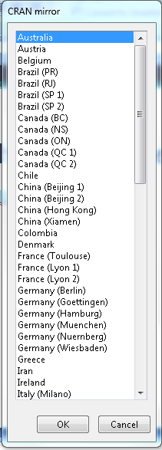
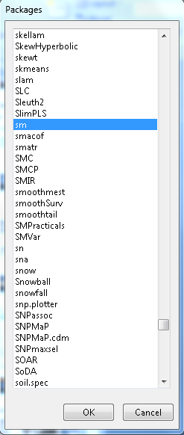
Adding a package...
  install.packages()

Slide 35
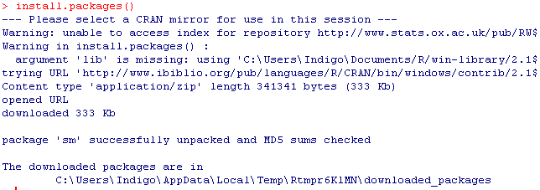

Slide 36
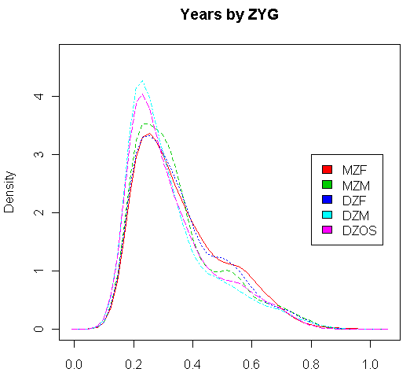
Looking at your data...
  #Kernal density plot by zyg?
  library(sm)
  # create value labels
  zyg.f <- factor(zyg, levels= seq(1,5),
  labels = c("MZF", "MZM", "DZF", "DZM", "DZOS"))
  # plot densities
  sm.density.compare(age, zyg, xlab="Years”)
  title(main="Years by ZYG")
  # add legend
  colfill<-c(2:(2+length(levels(zyg.f))))
  legend(.8,3, levels(zyg.f), fill=colfill)

Slide 37
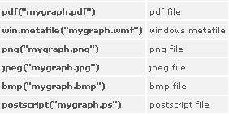
That’s great but how do I save it?
  # make a png file to hold the plot
  png("zygdensity.png")
  # create value labels
  zyg.f <- factor(zyg, levels= seq(1,5),
  labels = c("MZF", "MZM", "DZF", "DZM", "DZOS"))
  # plot densities
  sm.density.compare(age, zyg, xlab="Years”)
  title(main="Years by ZYG")
  # add legend via mouse click
  colfill<-c(2:(2+length(levels(zyg.f))))
  legend(.8,3, levels(zyg.f), fill=colfill)
  # close the png file to allow viewing
  dev.off()
Notes:
37

Slide 38
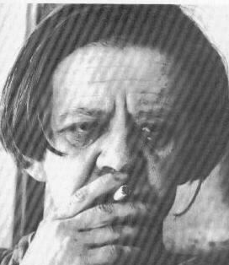
Final Words of Warning
“Using R is a bit akin to smoking. The beginning is difficult, one may get headaches and even gag the first few times. But in the long run, it becomes pleasurable and even addictive. Yet, deep down, for those willing to be honest, there is something not fully healthy in it.” --Francois Pinard
Notes:
38

Slide 39


explodingdog.com
Time for coffee

Slide 40
Vienna

