Slide 1
Assumption Testing/ Saturated Models
//faculty/sarah/2016/Friday
Sarah Medland

Slide 2
Prior to estimating heritability
Need to examine the data check for homogeneity of
  means, variance/standard deviation, covariance/correlation
  Between co-twins, across zygosity groups
Determine what covariates should be applied
Sometimes referred to as a saturated model (esp in NL publications)

Slide 3
In its simplest form…
Data set is subset by zygosity (2, 5 or 6 groups)
Estimate the means and variances of the two co-twins within each zygosity group
Estimate the covariation between co-twins for each zyg group
Within each zyg group 5 parameters estimated
  2 Means, 2 Variances, 1 Covariance
In subsequent models we test for homogeneity of these parameters by setting them to be equal and comparing the fit of the constrained model to that of the previous model

Slide 4
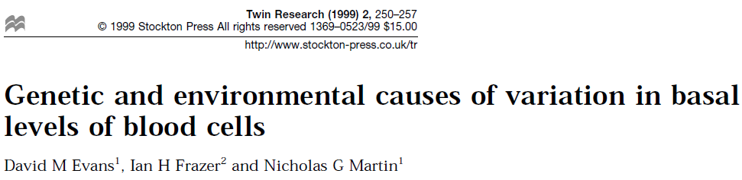
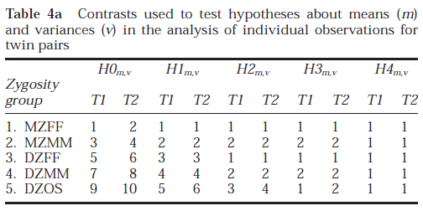
Great example paper

Slide 5
Our script
continuousAsumptionsSD.R
In each of the 5 zyg groups we will
  extract a subset of the data
  estimate 2 means
  apply an age correction to the means
  estimate 2 sd & 1 co-twin correlation
  multiply the correlation by the sd to produce a covariance matrix
  compile a model which includes data, means model & covariance model

Slide 6

Calculating the covariance matrix
Remember a correlation is a standardised covariance
  Covariance = $σ_{XY}=E\left[\left(X−E\left[X\right]\right)\left(Y−E\left[Y\right]\right)\right]$
  Correlation = $ρ_{XY}=\frac{E\left[\left(X−E\left[X\right]\right)\left(Y−E\left[Y\right]\right)\right]}{σ_{X}σ_{Y}}$
So you can rescale the correlation matrix by pre- and post-multiplying by a diagonal matrix that contains the standard deviations

Slide 7
Lisbon Castle

