Slide 1

The genetics of complex traits
Amazing progress (much by ppl in this room)
Nick Martin
Queensland Institute
of Medical Research
Brisbane
Boulder workshop
March 11, 2016

Slide 2
Genetic Epidemiology:
Stages of Genetic Mapping
Are there genes influencing this trait?
  Genetic epidemiological (twin / family) studies OR heritability based on measured genetic variants
What are those genes?
  Association analysis (meta-analysis / pathway)
How do they work beyond the sequence?
  Epigenetics, transcriptomics, proteomics
What can we do with them ?
  Translational medicine

Slide 3
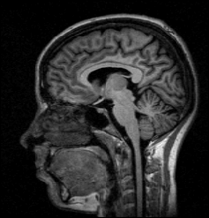
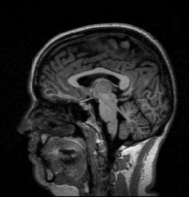
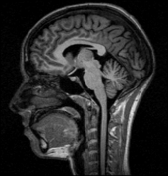
Brain volume (ml) in MZ twin pairs
Brain volume in DZ twin pairs
Twin 1
Twin 1
1400
1400
1200
1200
1000
1000
Twin 2
Twin 2
800
800
800
1000
1200
1400
800
1000
1200
1400

Slide 4
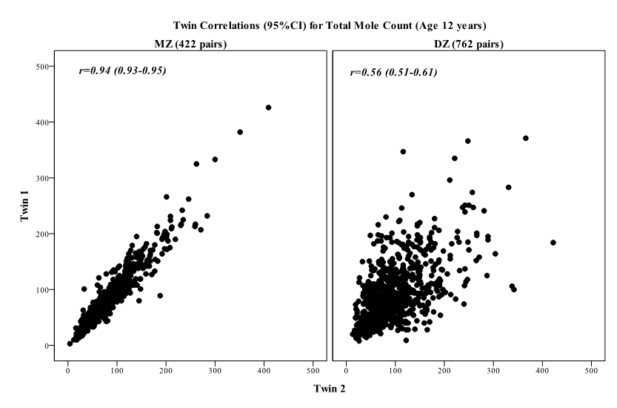
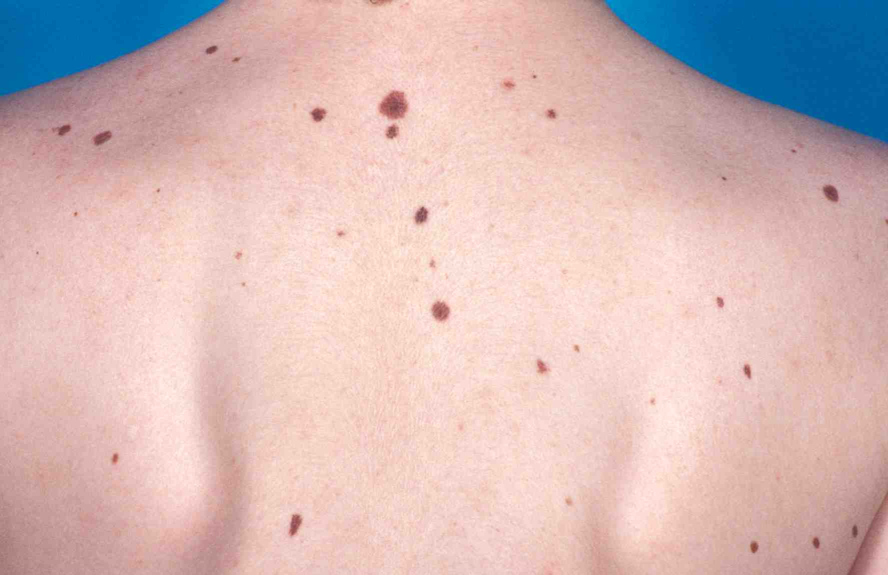
Twin correlations for total mole count

Slide 5
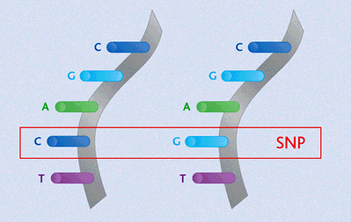
Finding the genes - association
Looks for correlation between specific alleles and phenotype (trait value, disease risk) using single nucleotide polymorphisms (SNPs)

Slide 6
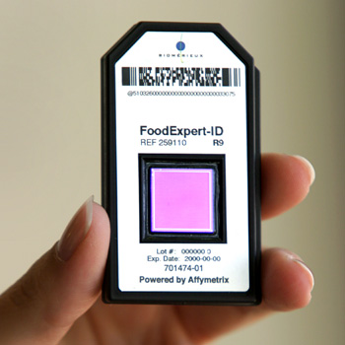

High density SNP arrays – up to 1 million SNPs

Slide 7
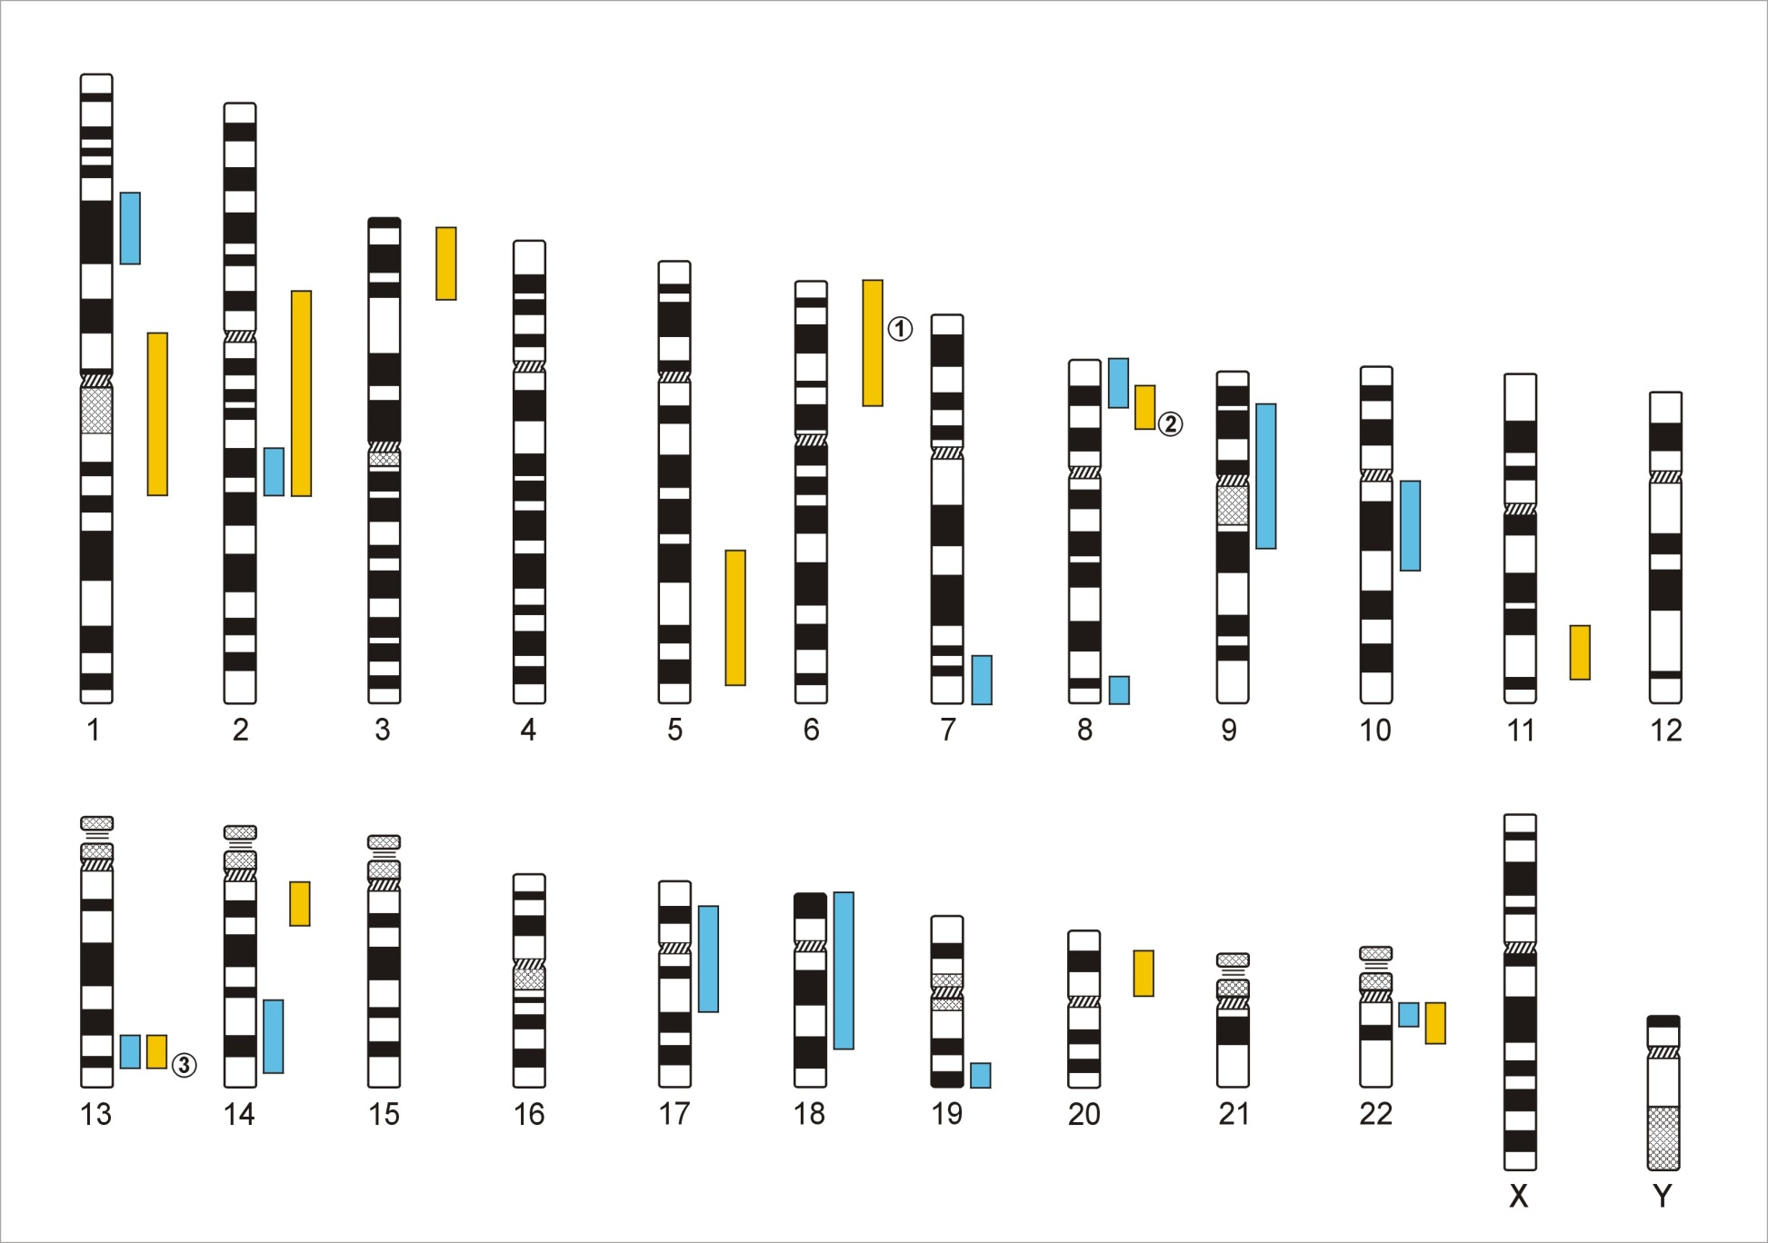
Genome-Wide Association Studies
500,000 – 5,000,000 SNPs
Human Genome - 3,1x10⁹ Base Pairs
Notes:
In a GWA the Genome which contains xx SNPs is examined using … SNPs

Slide 8
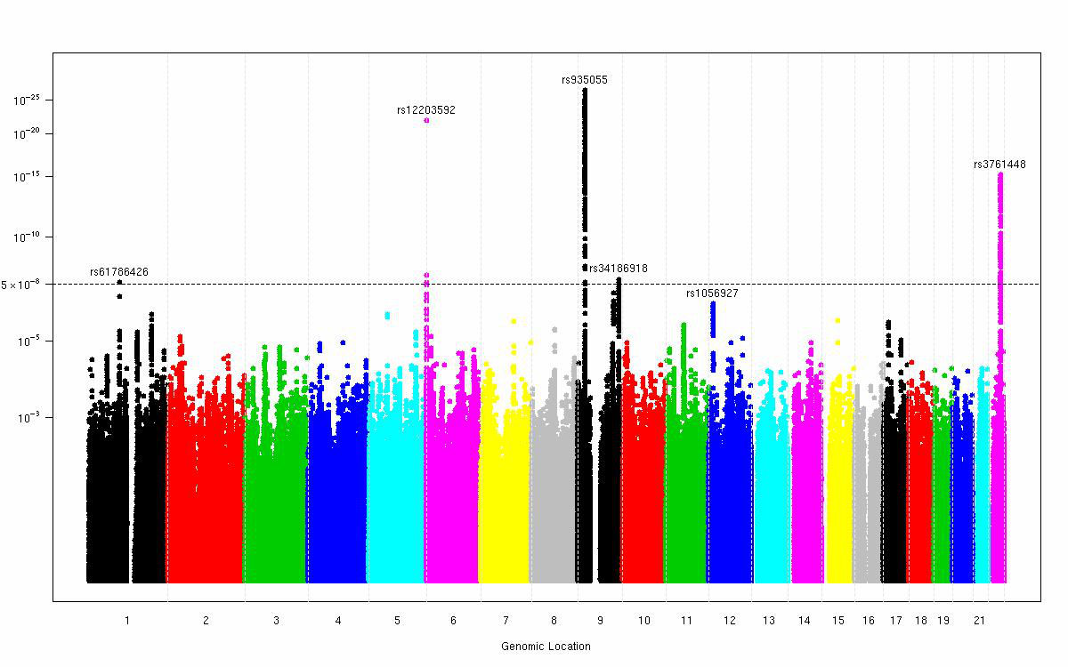
GWAS for moliness(11 studies, 23,000 subjects, 5 hits)
David Duffy, Gu Zhu

Slide 9
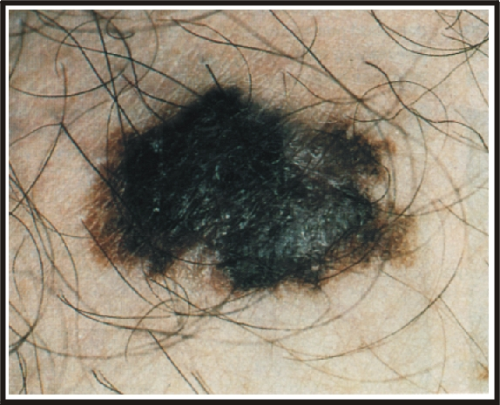
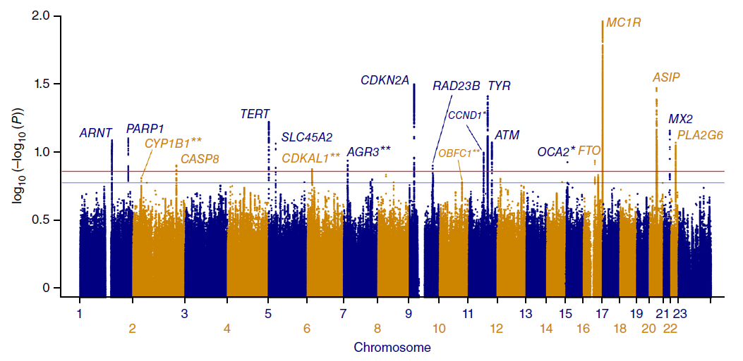
Melanoma
11 studies,
15,990 cases, 26,409 controls
20 loci (5 new)
Matthew Law

Slide 10
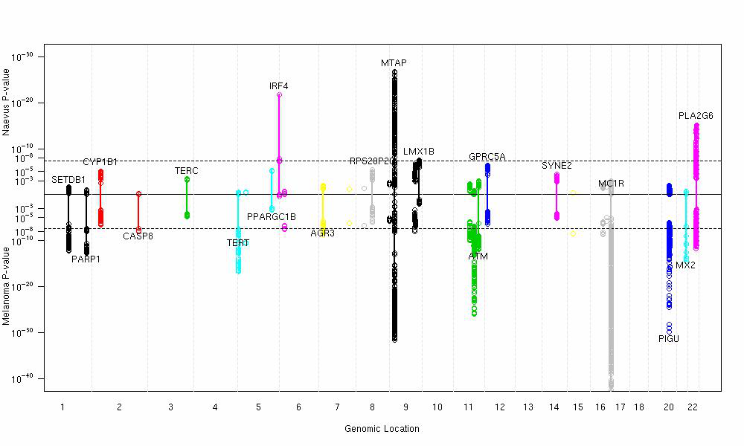
GWAS meta-analysis for moliness + melanoma
David Duffy

Slide 11
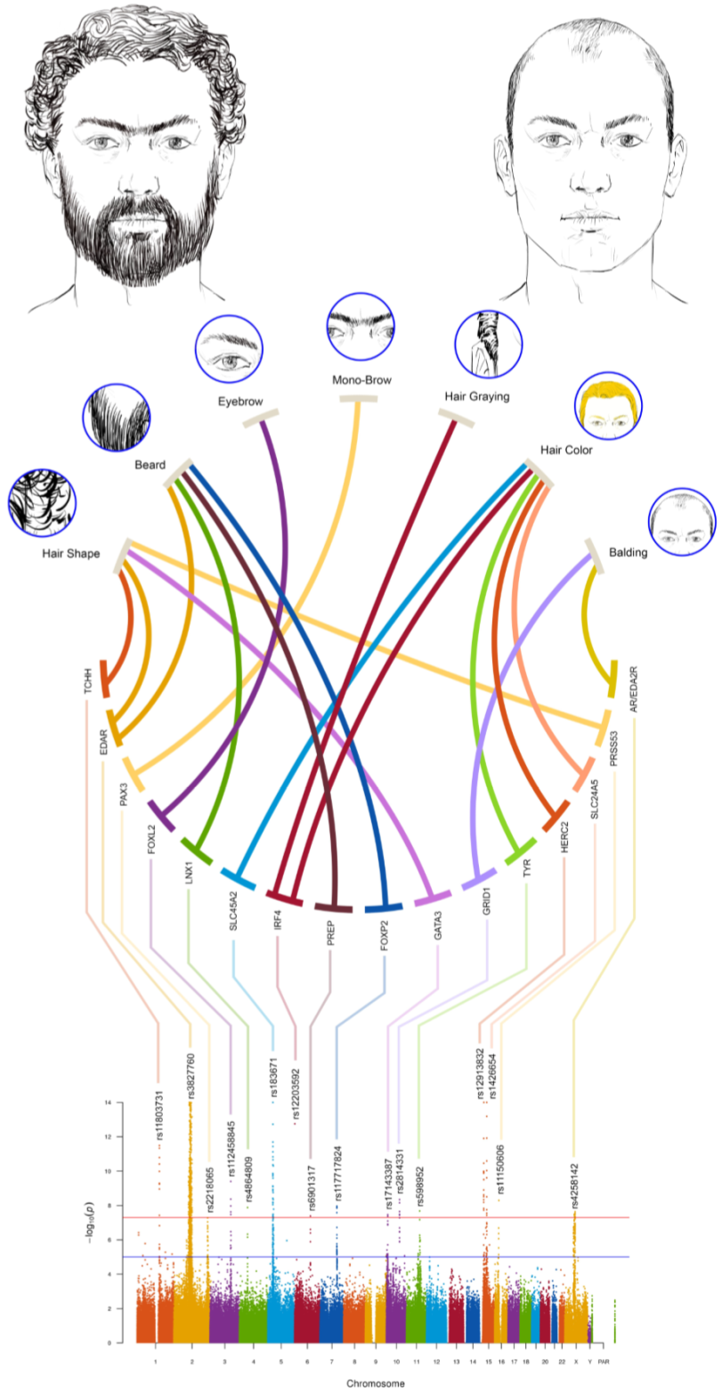

THE GENETIC BASIS OF VARIATION IN FACIAL AND SCALP HAIR: A GENOME-WIDE ASSOCIATION STUDY IN ADMIXED LATIN AMERICANS
Kaustubh Adhikari…Carla
Gallo… Andrés RuizLinares
GWAS in > 6,000 Latin Americans for features of scalp hair (shape, color, graying, baldness) and facial hair (beard thickness, mono brow, eye-brow thickness).
GW significant association at 14 genomic regions with at least one of the hair features examined (p-values 5×10⁻⁸ to 3×10⁻¹¹⁹).
Two traits (scalp hair shape and beard thickness) are associated with SNPs in the ectodysplasin A receptor gene region, a key regulator of embryonic skin appendage development.
The other associated regions include novel loci for scalp hair shape and baldness, and the first reported loci for hair graying, mono-brow, and eye-brow and beard thickness.
The novel variant associated with scalp hair shape is a Q30R substitution in the Protease Serine S1 family member 53 (PRSS53). We demonstrate that this enzyme is highly expressed in the hair follicle, especially the inner root sheath, and that the Q30R substitution affects enzyme processing and secretion.
The genome regions associated with hair features are enriched for signals of selection, consistent with proposals regarding the evolution of human hair.
Nat Commun. 2016 Mar;7:10815.

Slide 12

http://enigma.loni.ucla.edu/

Slide 13
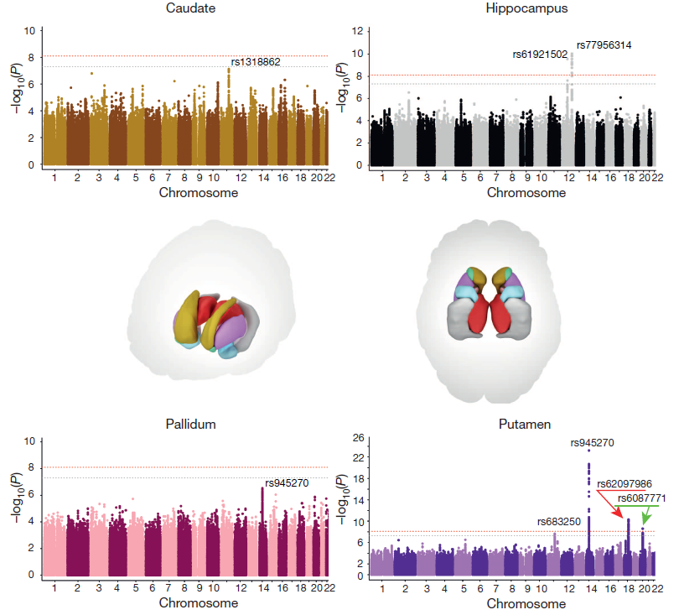

Slide 15
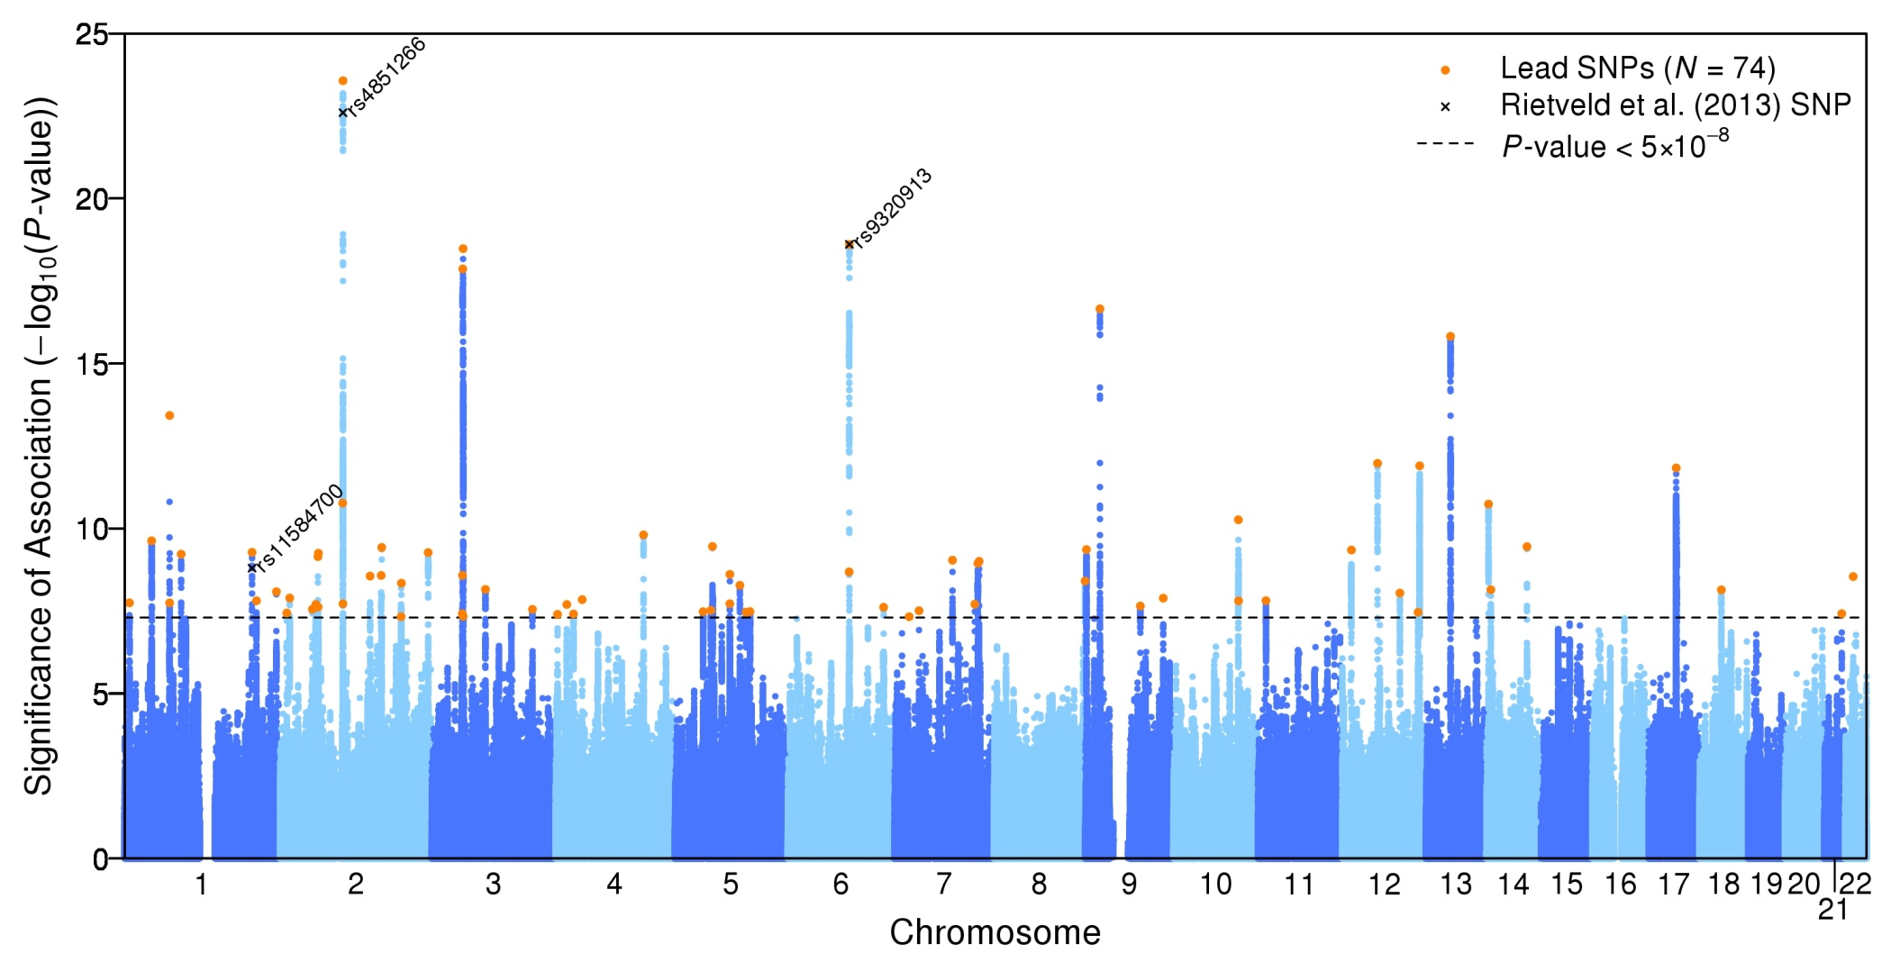
EduYears (N = 293,723)
SNPs in orange are the approximately 74 independent genome-wide significant associations (“lead SNPs”). The black x’s labeled with rs numbers are the 3 Rietveld et al.¹⁴ SNPs.

Slide 16
Genetic overlap between EduYears and other traits.
Results from Linkage-Disequilibrium (LD) Score regressions: estimates of genetic correlation with brain volume, neuropsychiatric, behavioral, and anthropometric traits for which GWAS summary statistics were available in the public domain.

Slide 17


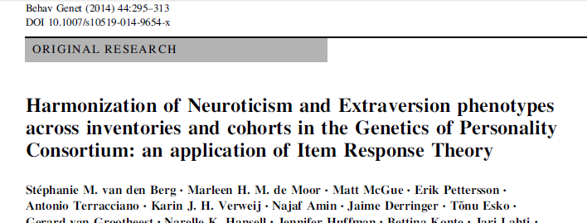
Personality Genomics Consortium
Meta-analysis for IRT-based Neuroticism and Extraversion: 28 cohorts
Marleen de Moor
Stephanie van den Berg

Slide 18
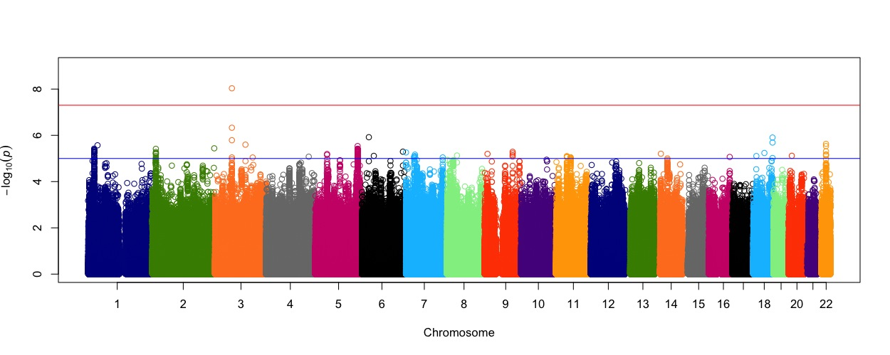
Neuroticism: N ~ 63,000
Meta-analysis with 1000G imputation for all 28 studies
A genome-wide significant SNP was found on 3p14 in the MAGI1 gene (rs35855737; P=9.26 x 10⁻⁹).
JAMA Psychiatry. 2015 Jul;72(7):642-50.

Slide 19
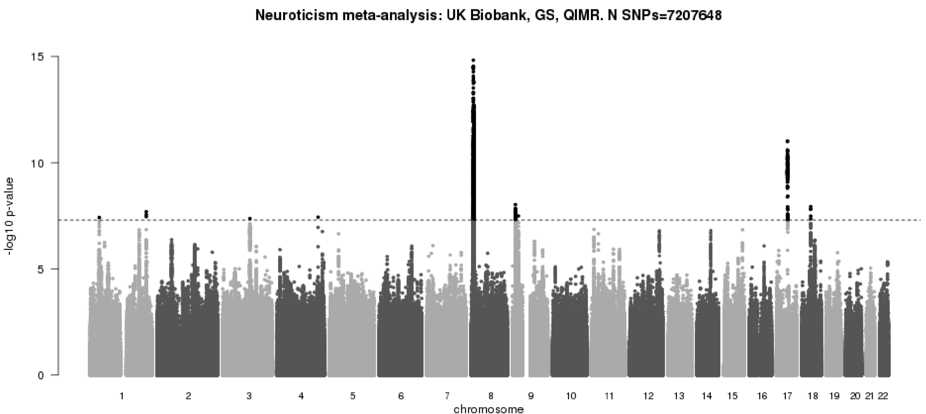
Neuroticism: UK Biobank, n > 106,000 identifies 9 neuroticism-associated loci
Daniel J Smith, Valentina Escott-Price, Gail Davies, Mark Bailey, Lucía Colodro-Conde, …, Ian Deary, Michael O’Donovan
Molecular Psychiatry, accepted 3/3/16

Slide 20
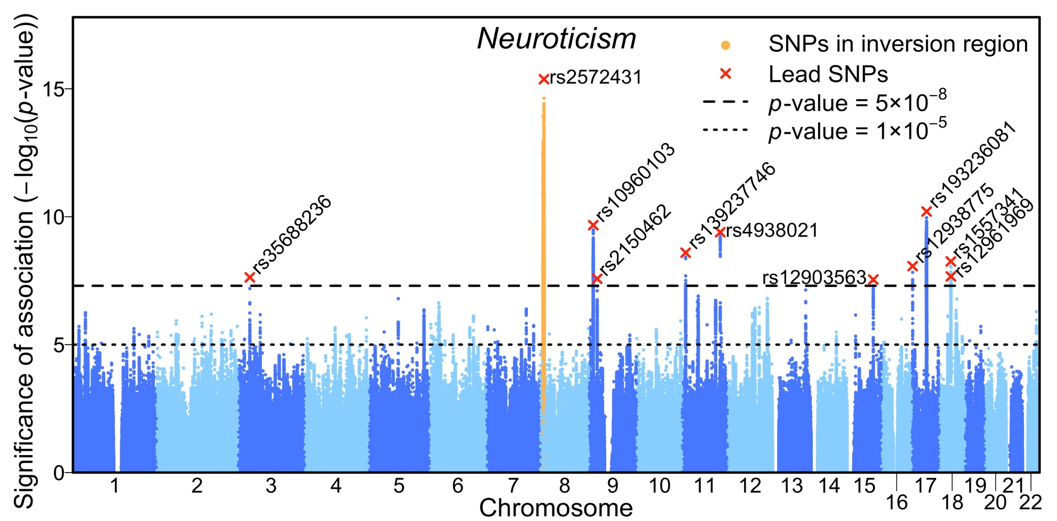
Neuroticism: UK Biobank + Personality Genomics Consortium m-a (N = 170,910) identifies 11 loci (2 more than UKB alone)
ALARM! power of meta-analysis versus a single large uniformly phenotyped and genotyped resource?
Nature Genetics, accepted 2/3/16

Slide 21
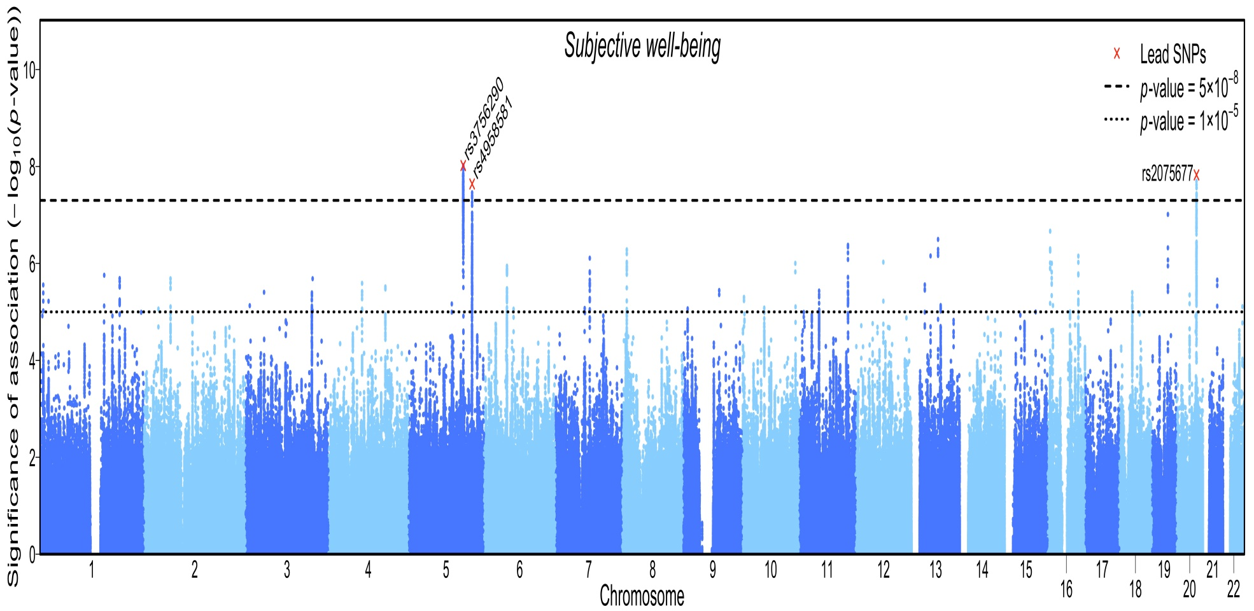
Subjective well-being : N = 298,420
Bartels et al: Nature Genetics, accepted 2/3/16

Slide 22
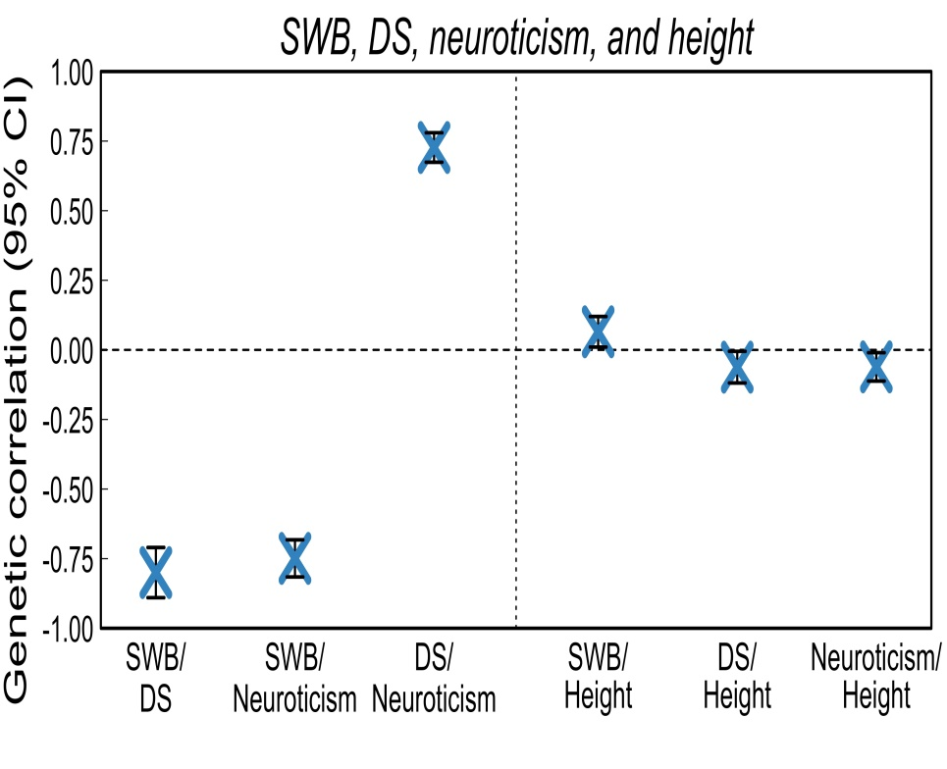
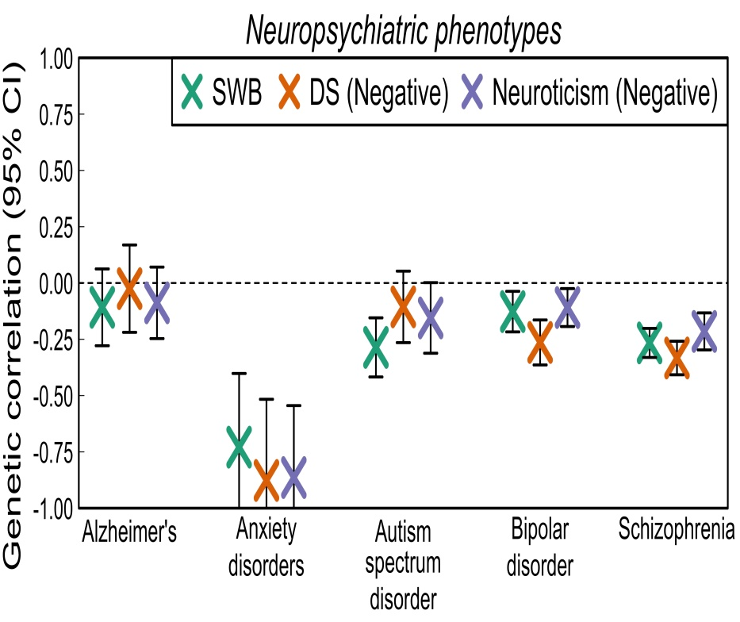
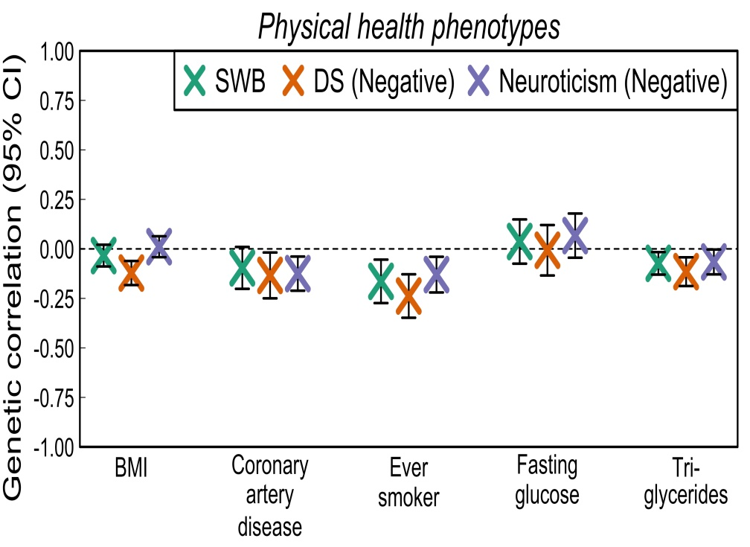

Slide 23
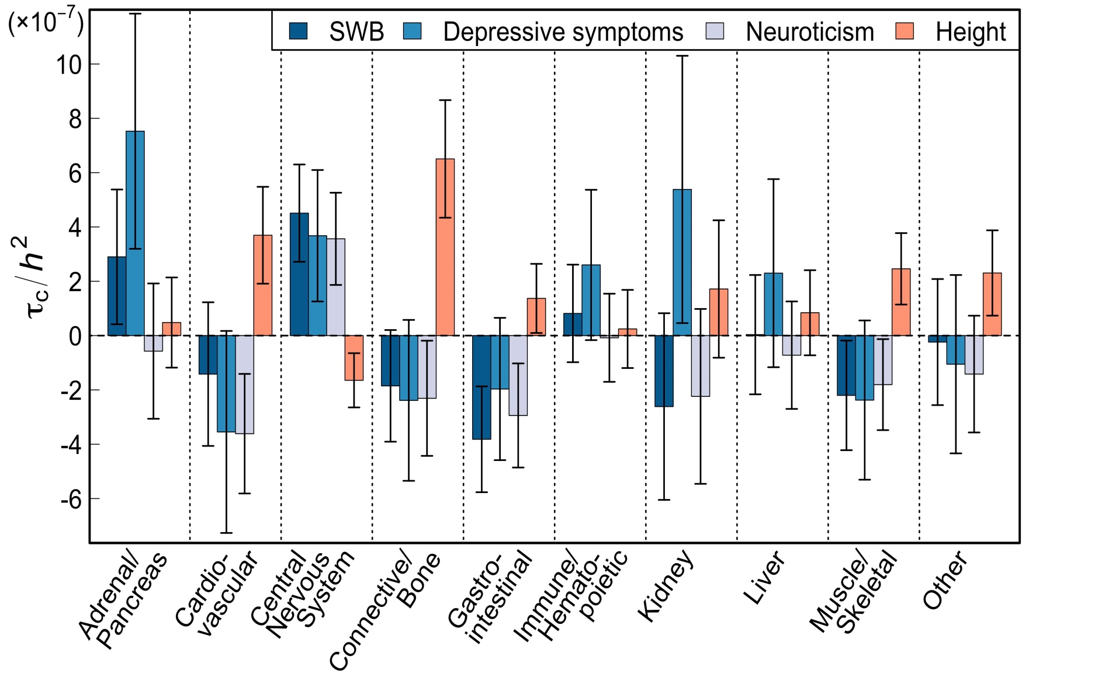
Across our phenotypes, loci regulating expression in central nervous system and adrenal/pancreas tissues are strongly enriched for association and contrast with Height
Michel Nivard

Slide 24
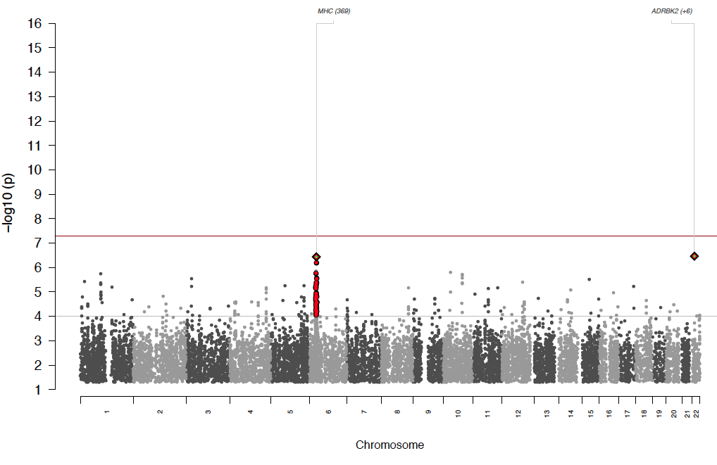
Schizophrenia 2009
ISC 2009
3K cases
Dramatic progress in GWAS for Schizophrenia

Slide 25
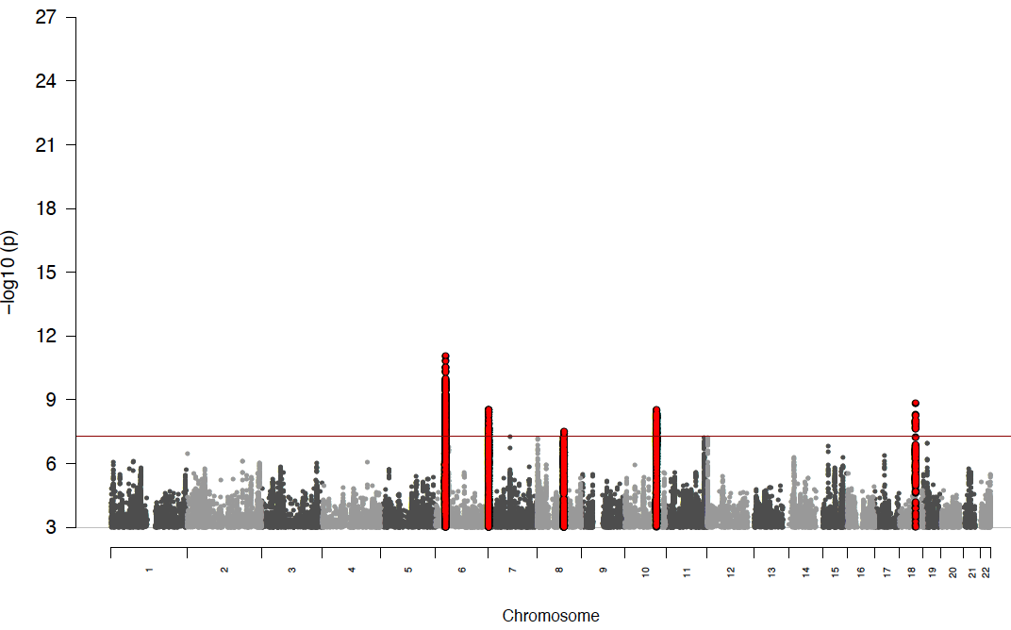
ISC 2009
3K cases
PGC1 - 2011
9K cases
5 loci

Slide 26
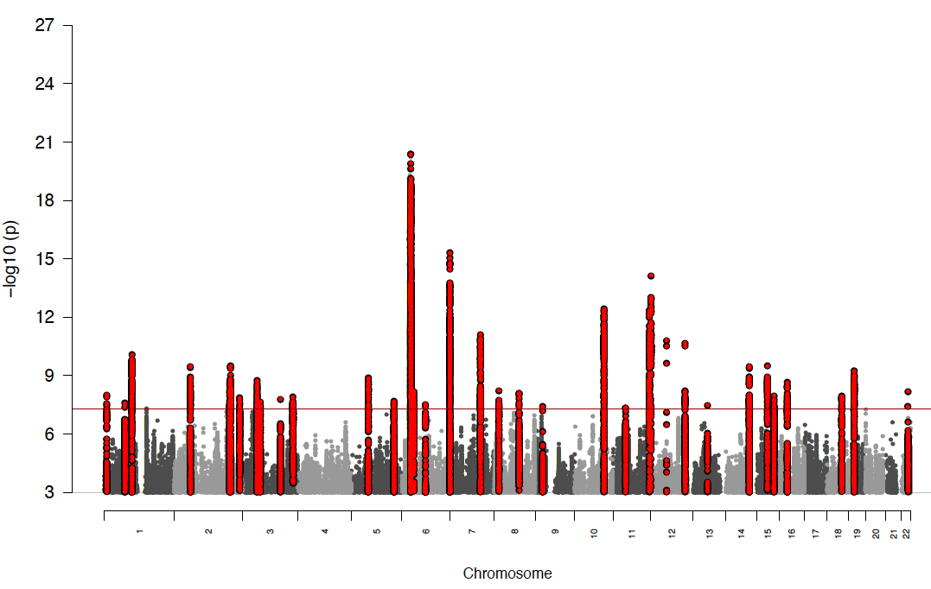
ISC 2009
3K cases
PGC1
9K cases
5 loci
PGC1 + Sweden
2012 - 14K cases
22 loci

Slide 27
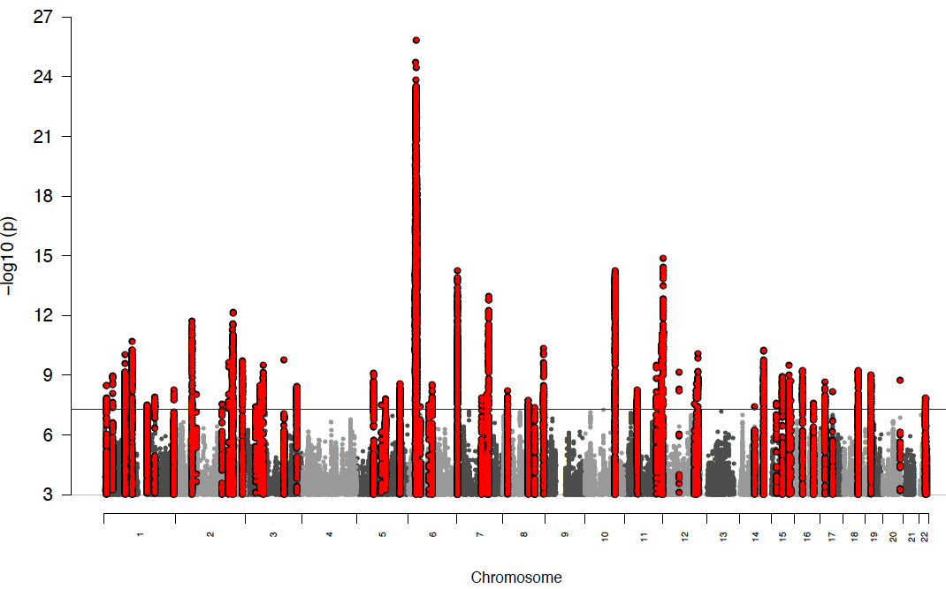
ISC 2009
3K cases
PGC1
9K cases
5 loci
PGC1 + Sweden
14K cases
22 loci
PGC2 2013
31K cases
78 loci
Rank #3

Slide 28
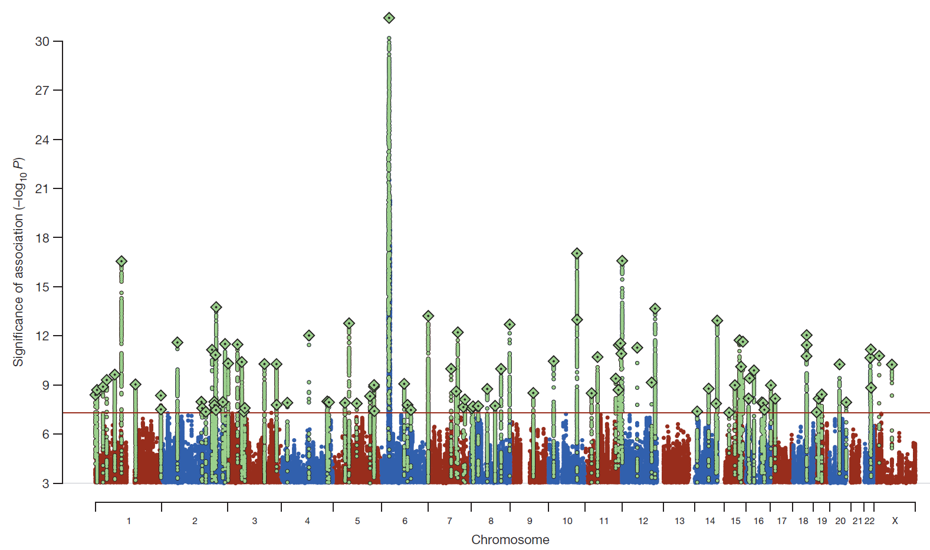
Schizophrenia: meta-analysis of 49 case control samples (34,241 cases and 45,604 controls)
JULY 2014
128 independent SNPs
(P<5e-8, r²<0.1, 3Mb windows)
108 different regions (conservative)
2 4 J U LY 2 0 1 4 | VO L 5 1 1 | N AT U R E | 4 2 1

Slide 29
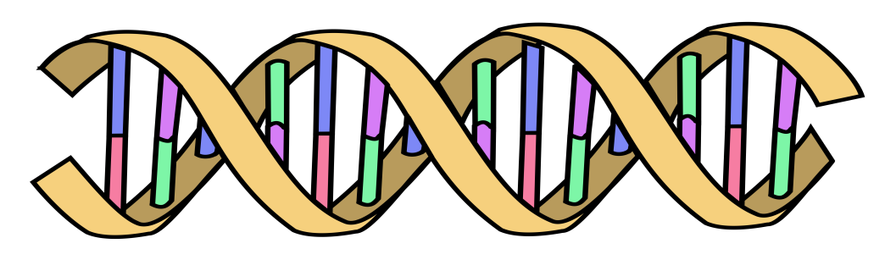

Polygenic Risk Scores
Polygenic Risk Scores capture (part of) someone’s genetic “risk” by summing all risk alleles weighted by the effect sizes estimated in a Genome-Wide Association Study (GWAS)
1×-.02 + 2×.01 + 1×.002 + 0×.03 + 2×.025
Polygenic score:
AC
GG
CC
TT
.052
AT
Effect sized from GWAS
β_{C}=-.02
β_{G}=.01
β_{A}=.002
β_{G}=.03
β_{T}=.025

Slide 30
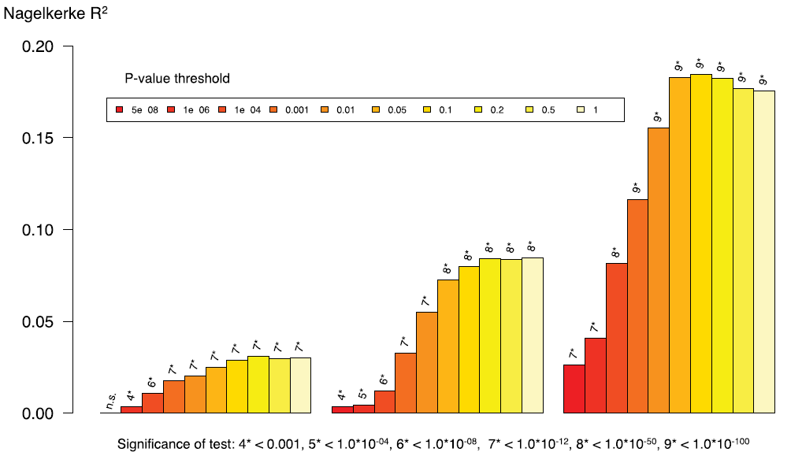
Polygenic risk score for schizophrenia using MGS sample as target
and ISC, PGC1, and PGC2 as prediction samples (minus MGS!)
PGC2
32,838 cases
44,357 controls
PGC1
9,320 cases
10,228 controls
ISC
2,615 cases
3,338 controls

Slide 31
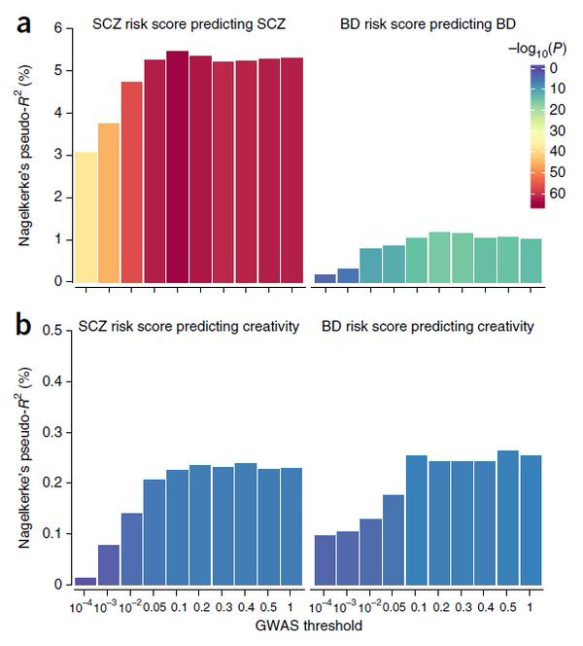
Polygenic Risk Scores: SCZ & BIP vs Creativity
Higher polygenic scores for schizophrenia and bipolar disorder associated with artistic society membership or creative profession in Iceland & replication cohorts.
Abdel Abdellaoui

Slide 32
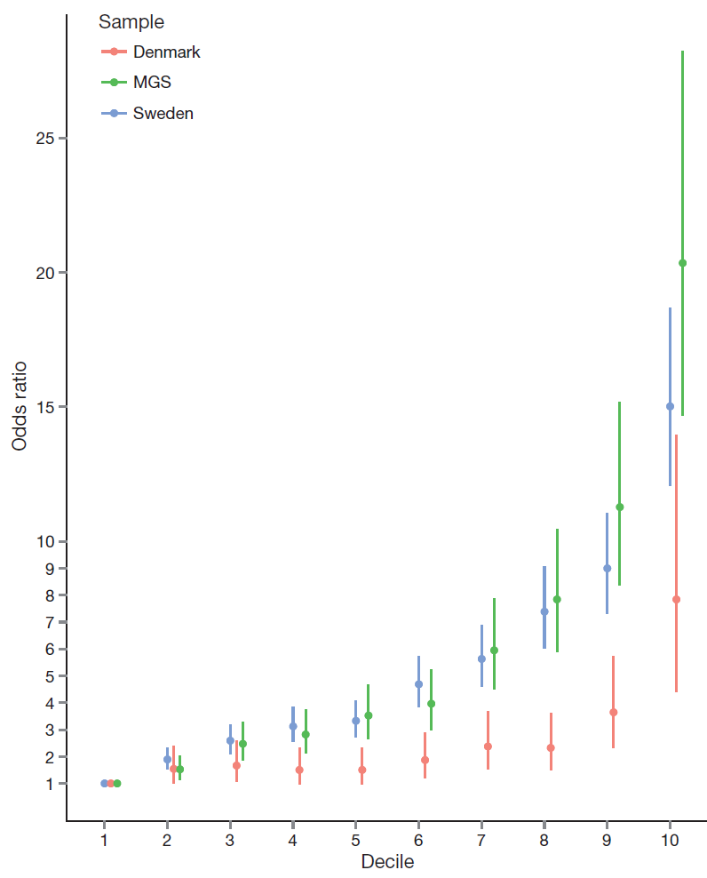
Odds ratio for schizophrenia by
polygenic risk score (PRS) decile in the Sweden, Denmark, and Molecular Genetics of Schizophrenia (US+Oz) studies.
includes Oz
“Given the need for measures that index liability to schizophrenia, the ability to stratify individuals by PRS offers new opportunities for clinical and epidemiological research.”
Risk alleles and weights were derived from ‘leave one out’ analyses in which those samples were excluded from the GWAS meta-analysis. The threshold for selecting risk alleles was P<0.05.

Slide 33
Schizophrenia: meta-analysis of 49 case control samples (34,241 cases and 45,604 controls)
JULY 2014
128 independent SNPs
(P<5e-8, r²<0.1, 3Mb windows)
108 different regions (conservative)
2 4 J U LY 2 0 1 4 | VO L 5 1 1 | N AT U R E | 4 2 1

Slide 34
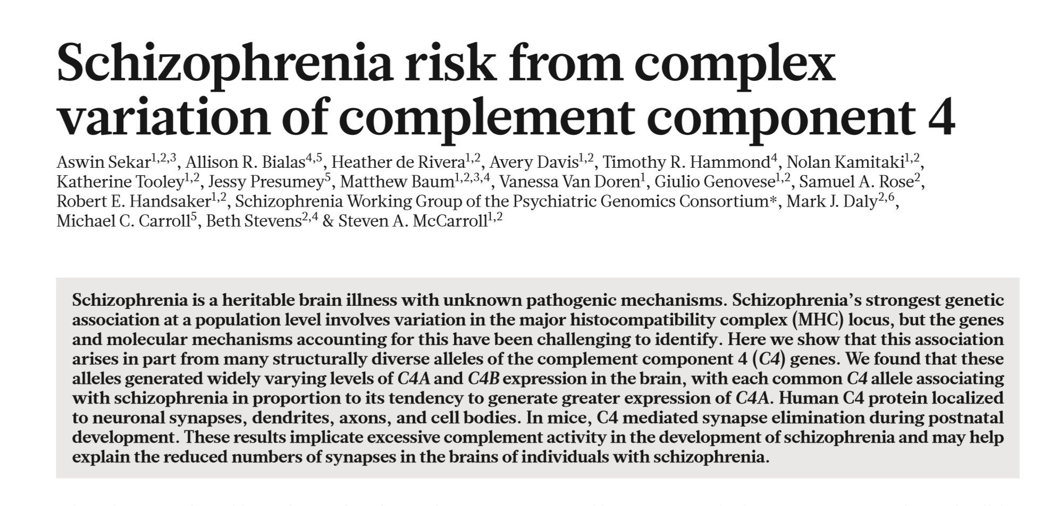
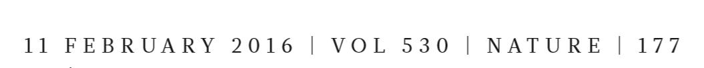

Slide 35

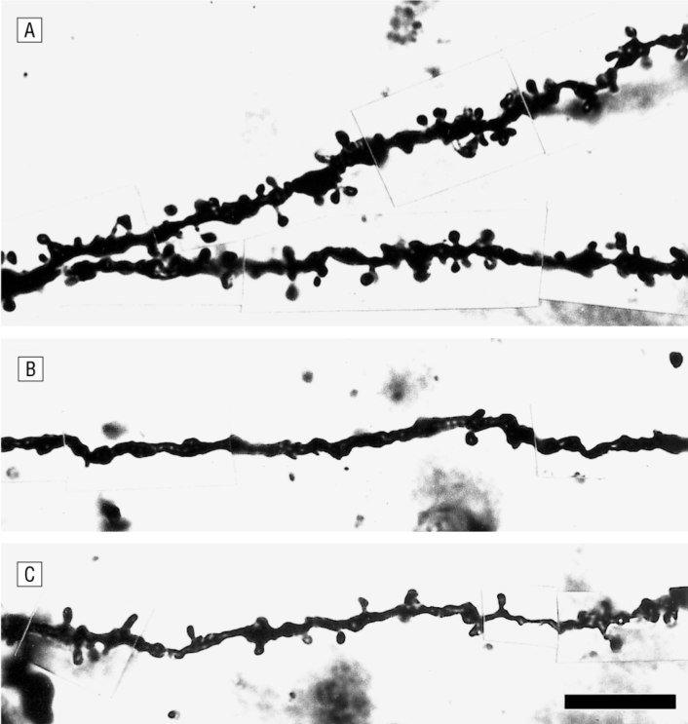
From: Decreased Dendritic Spine Density on Prefrontal Cortical Pyramidal Neurons in Schizophrenia
Arch Gen Psychiatry. 2000;57(1):65-73. doi:10.1001/archpsyc.57.1.65
Basilar dendrites and spines on dorsolateral prefrontal cortex layer 3 pyramidal neurons from normal control subject (A) and 2 subjects with schizophrenia (B and C). The calibration bar equals 10 µm.

Slide 36
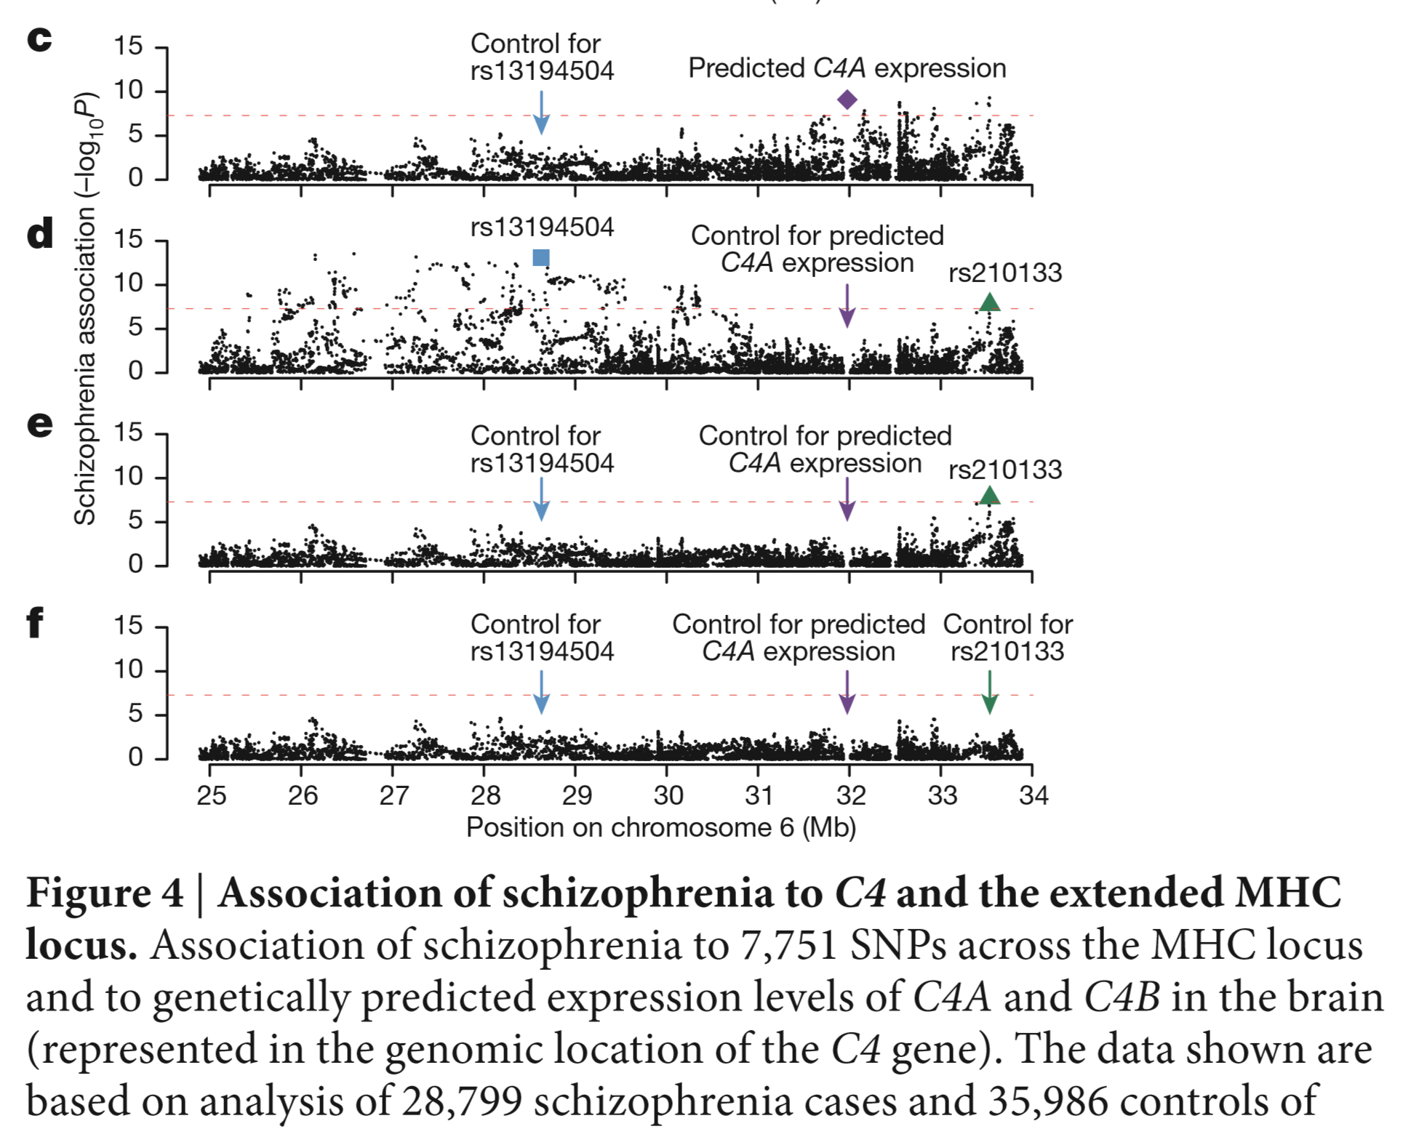

Slide 37
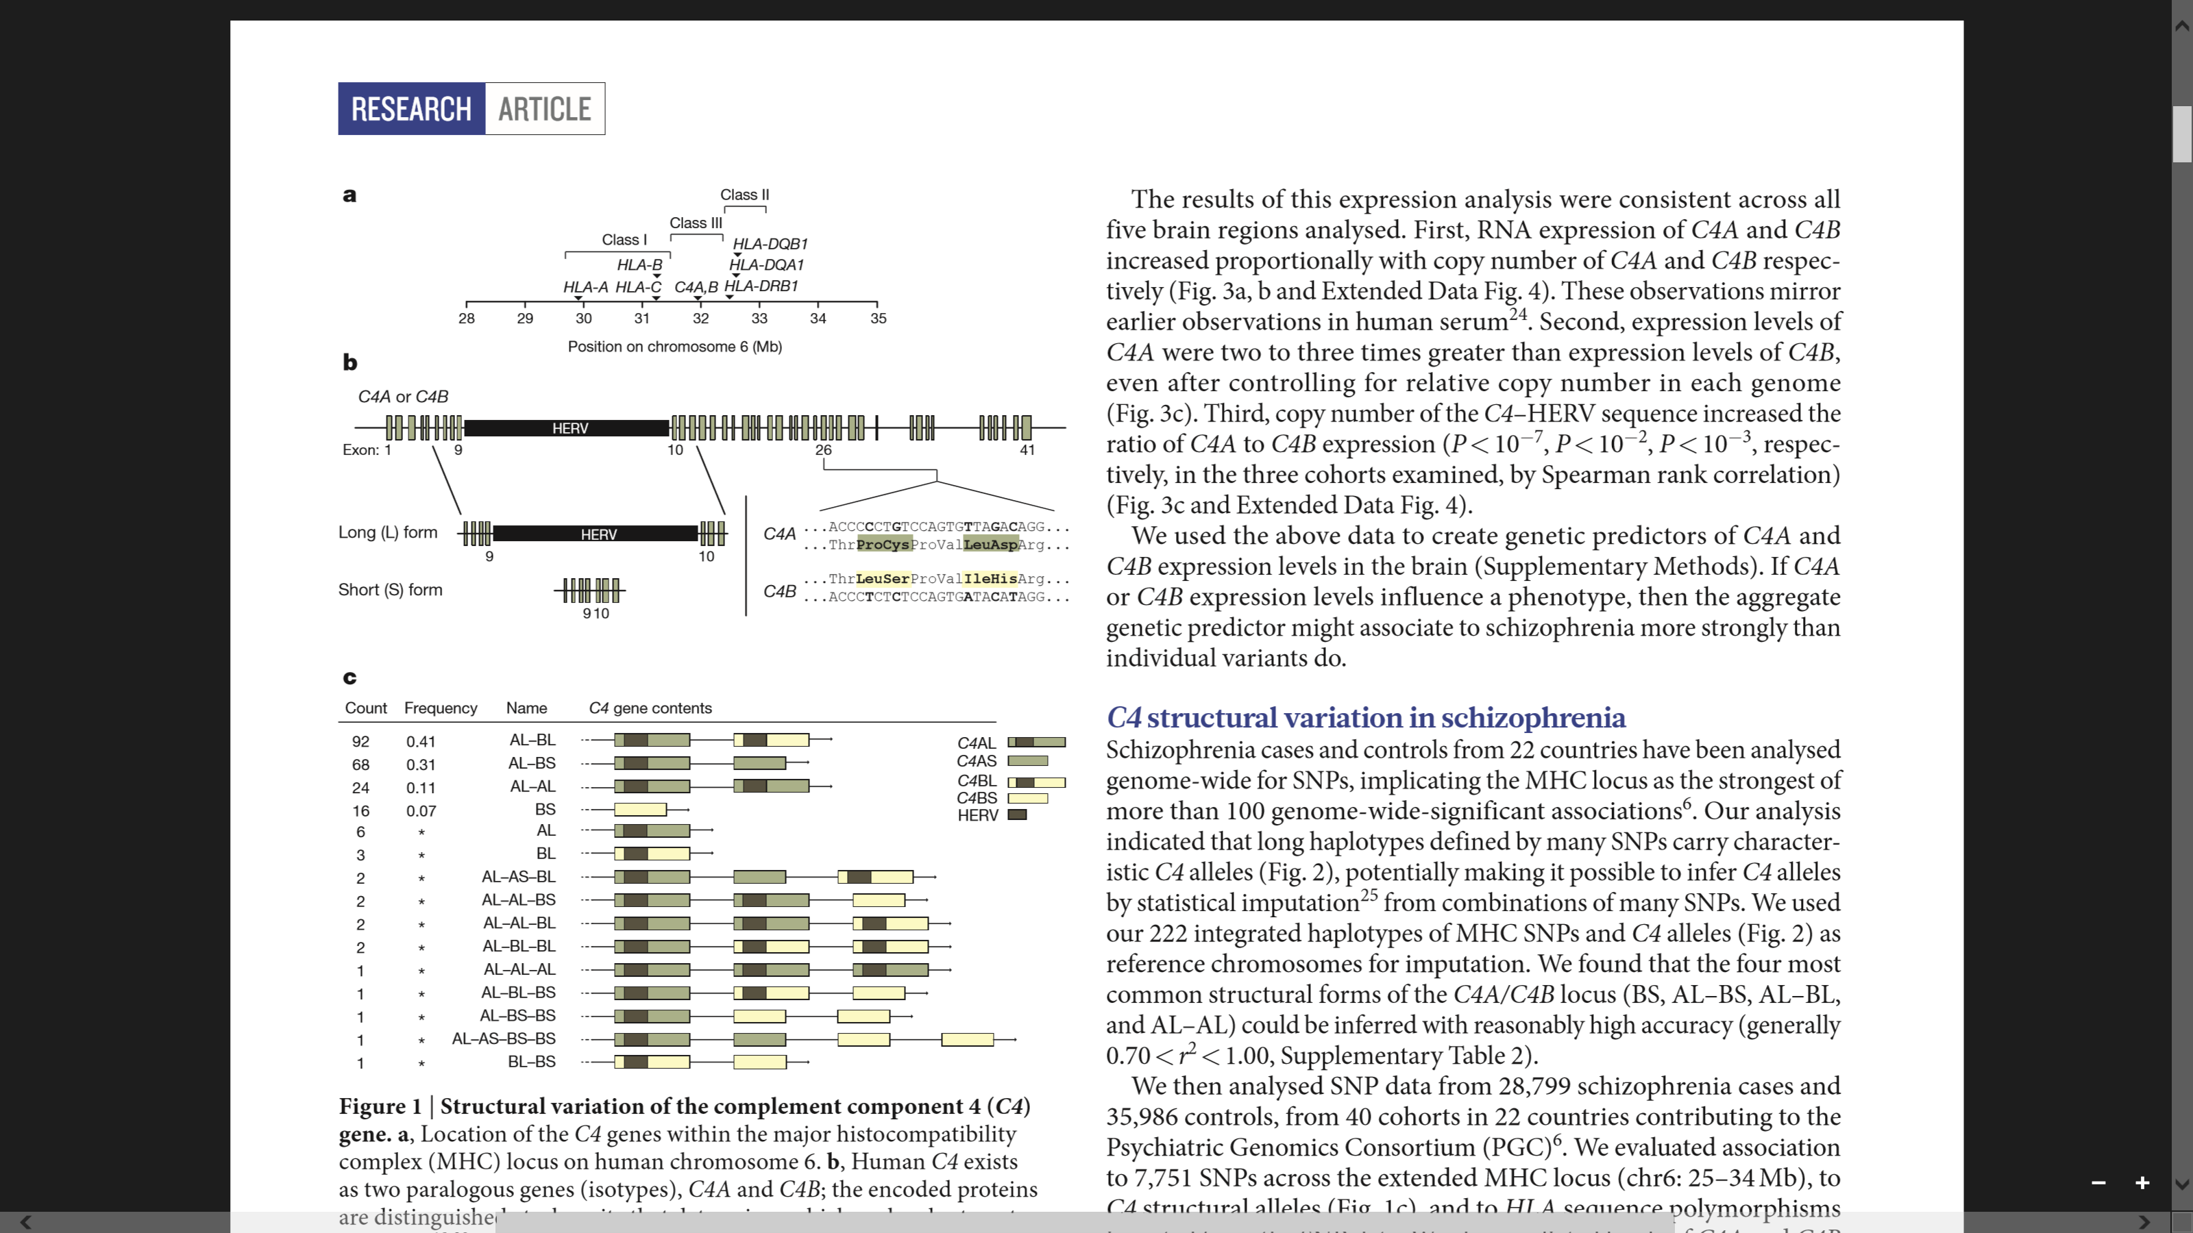


Slide 38
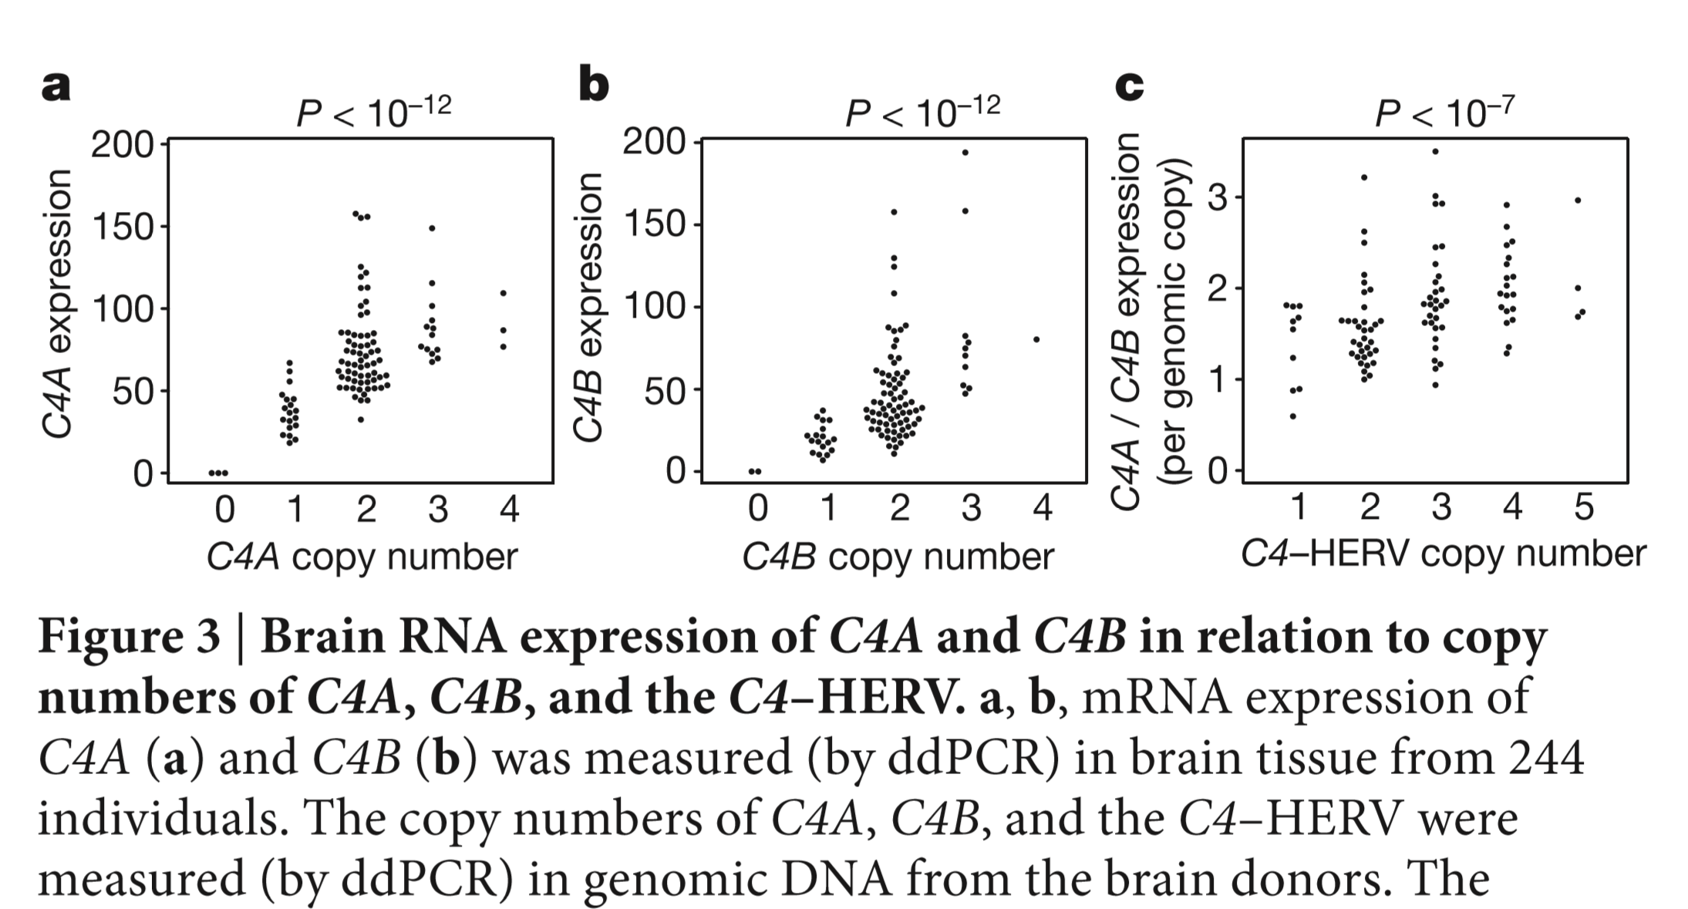

Slide 39
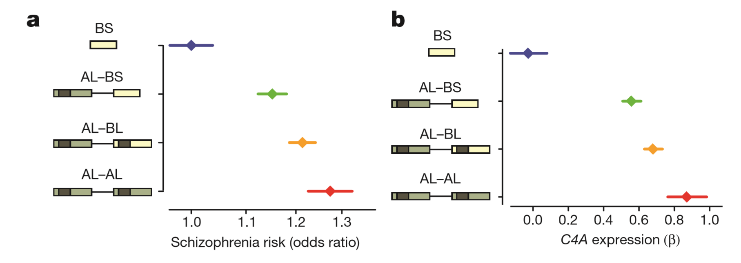
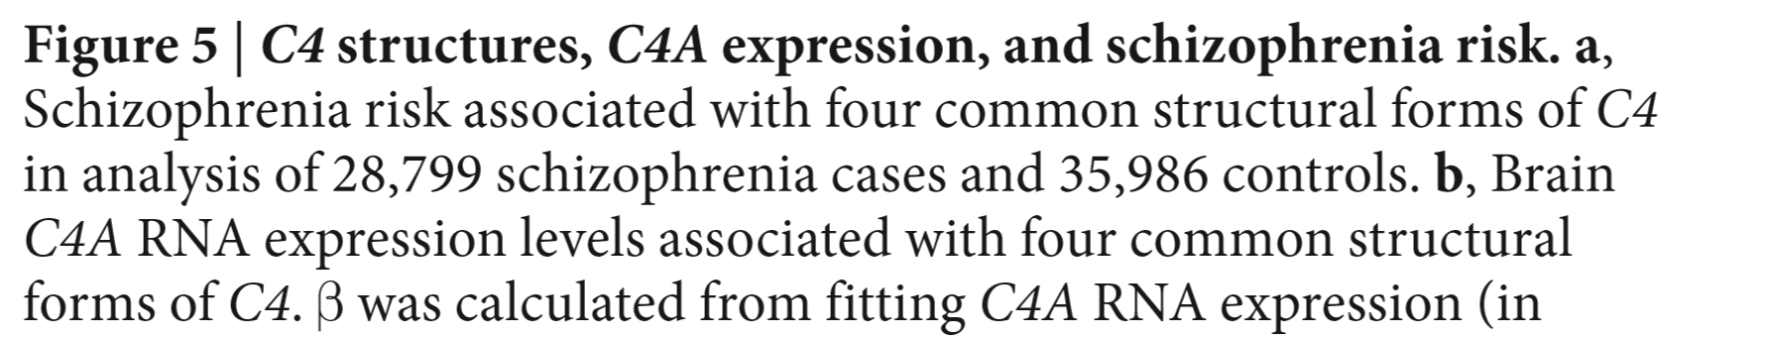

Slide 40
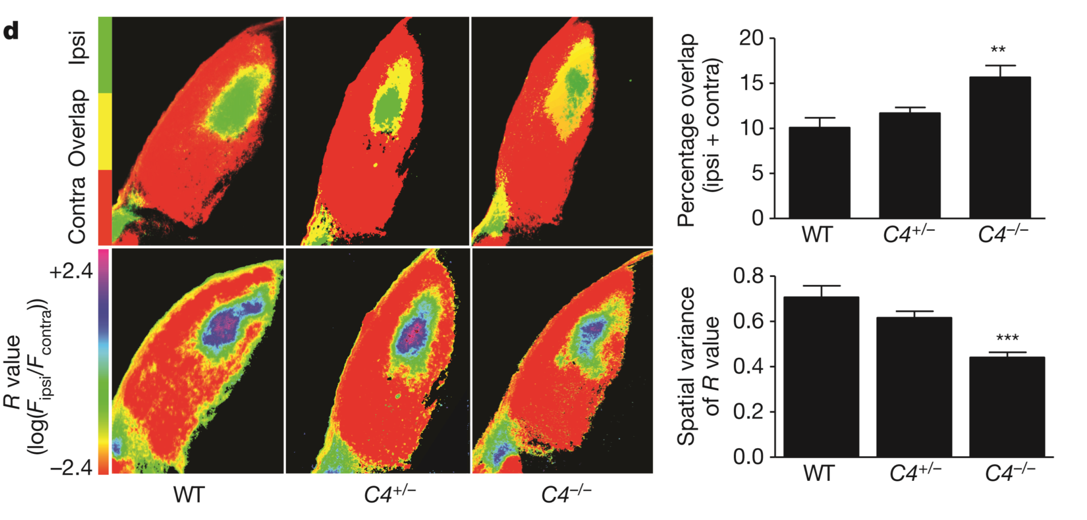
Impairments in schizophrenia tend to affect higher cognitive functions and recently expanded brain regions. Waves of postnatal synapse elimination occur in many brain regions. Synaptic projections from retinal ganglion cells (RGCs) onto thalamic relay neurons within the dorsal lateral geniculate nucleus (dLGN) of the visual thalamus undergo activity-dependent synaptic refinement. We found that C4 RNA was expressed in the LGN and in RGCs purified from the retina during the period of synaptic pruning.
Synaptic refinement in mice with 0, 1, or 2 copies of C4. These images represent the segregation of ipsilateral and contralateral RGC projections to the dLGN

Slide 41
3 Stages of Genetic Mapping
Are there genes influencing this trait?
  Genetic epidemiological studies
What are those genes?
  Association analysis
What can you do with them?
  Translational research

Slide 42
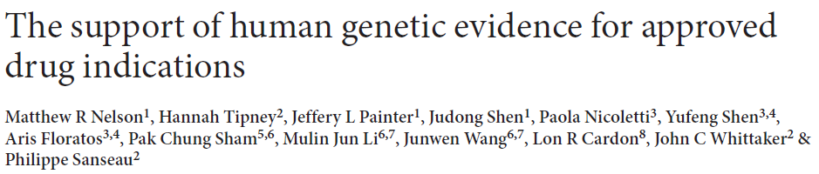
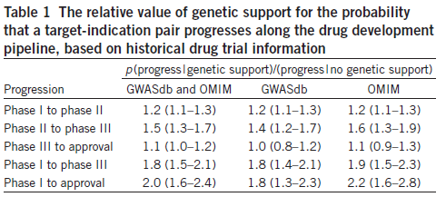
“We estimate that selecting genetically supported targets could double the success rate in clinical development. Therefore, using the growing wealth of human genetic data to select the best targets and indications should have a measurable impact on the successful development of new drugs.”

Slide 43
The End

