Slide 1
Combining SEM & GREML in OpenMx
Rob Kirkpatrick
3/11/16

Slide 2
Overview
Introduction.
mxGREML Design.
mxGREML Implementation.
Applications.
Miscellany.

Slide 3
A
E
1
1
F
Y₁
Y₂
Y₃
Notes:
This is the within-person part of the model. ‘G’ is the person’s diagonal element of the GRM.

Slide 4
There will be n double-headed paths coming from each person’s A! This fact is represented with one or more GRMs.
A
Notes:
The between-person model would look something like this. This is where the GRM comes in.

Slide 5
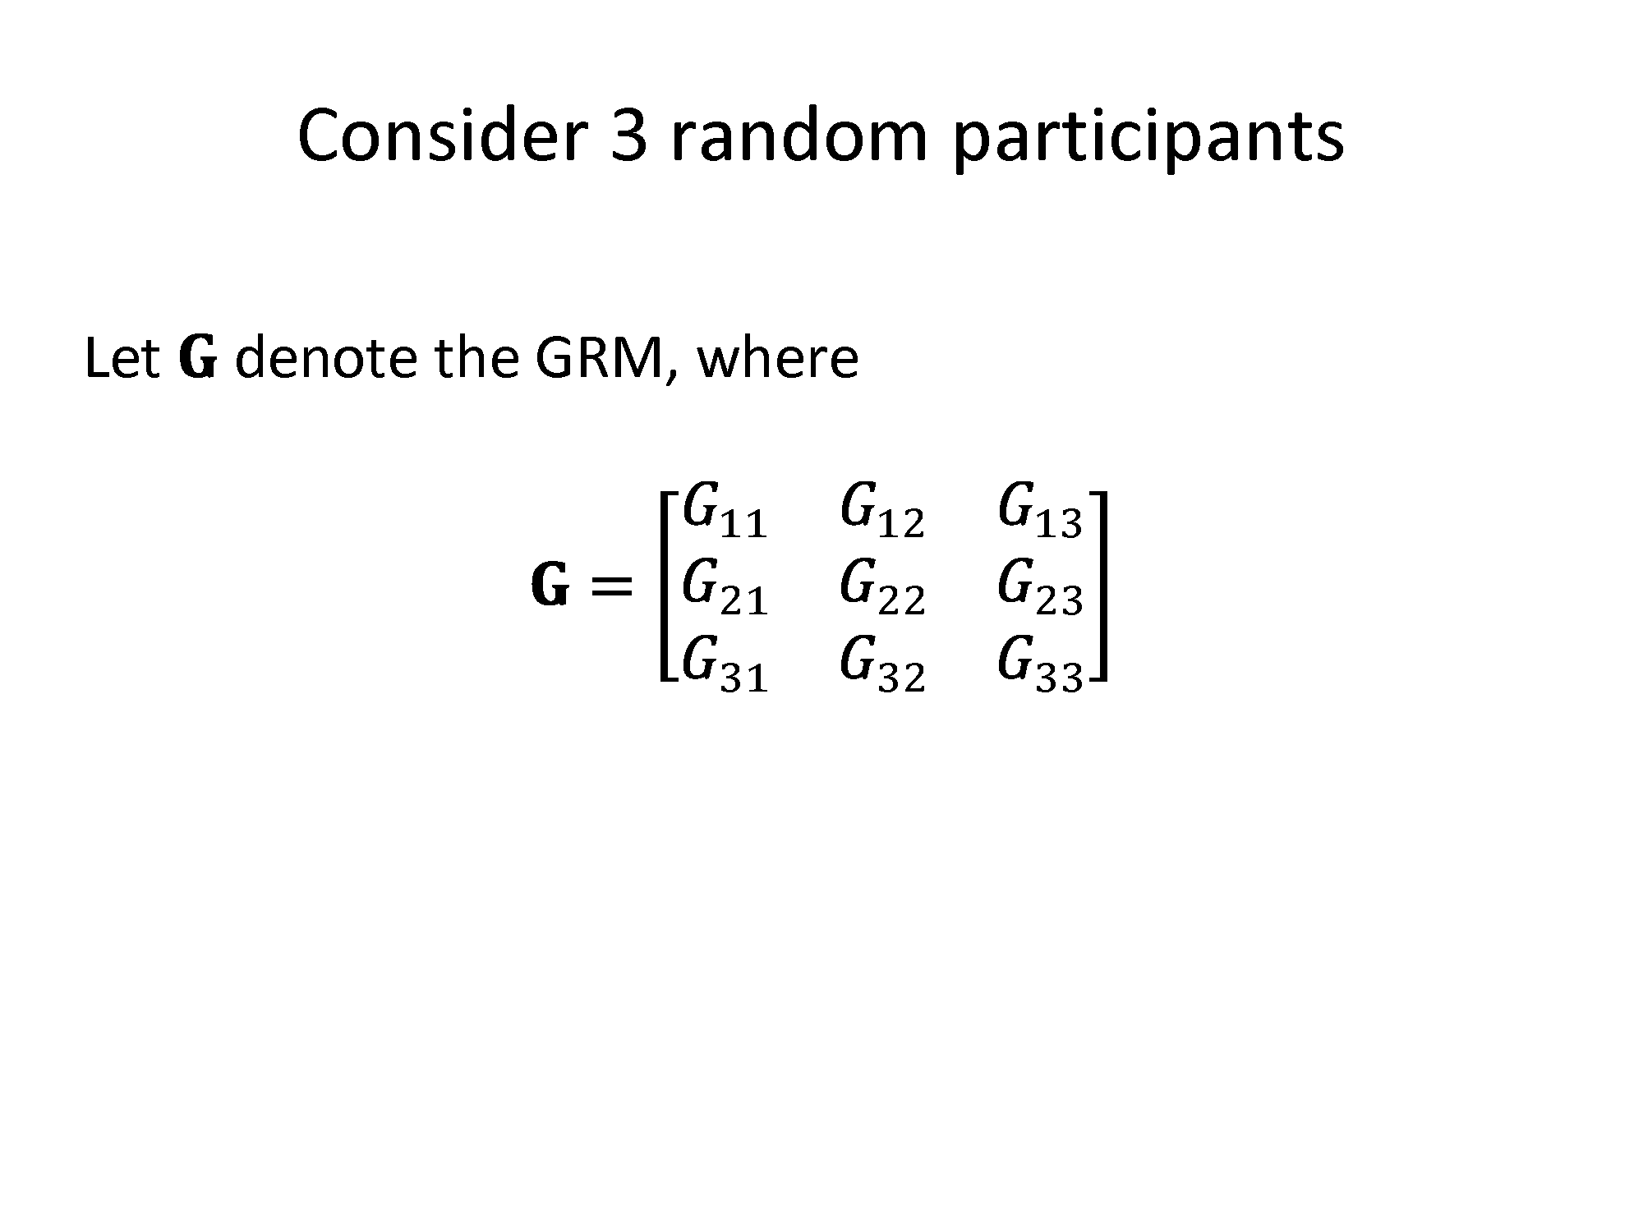
Notes:
Consider 3 random participants

Slide 6
Consider 3 random participants…
A₂
A₃
A₁
Notes:
G_ij is the element in the ith row and jth column of the GRM. Bear in mind that the GRM is symmetric, so for a given i and j, G_ij is the same as G_ji.

Slide 7
Biometric SEM with Unrelateds
Freed from assumptions of twin/family/adoption study.
Use observed, genotyped markers to assess relatedness & explain variance or risk.
In particular—explain variance in latent variables…
“Bin” markers (e.g., chromosome or biological pathway).

Slide 8
Biometric SEM with Unrelateds
Caveats:
Does not directly contribute to discovering & identifying causal polymorphisms underlying trait.
REML seems not to be appropriate for case-control studies of disease.¹
¹Golan, D., et al. (2014). PNAS, 111(49), E5272–E5281. doi: 10.1073/pnas.1419064111

Slide 9
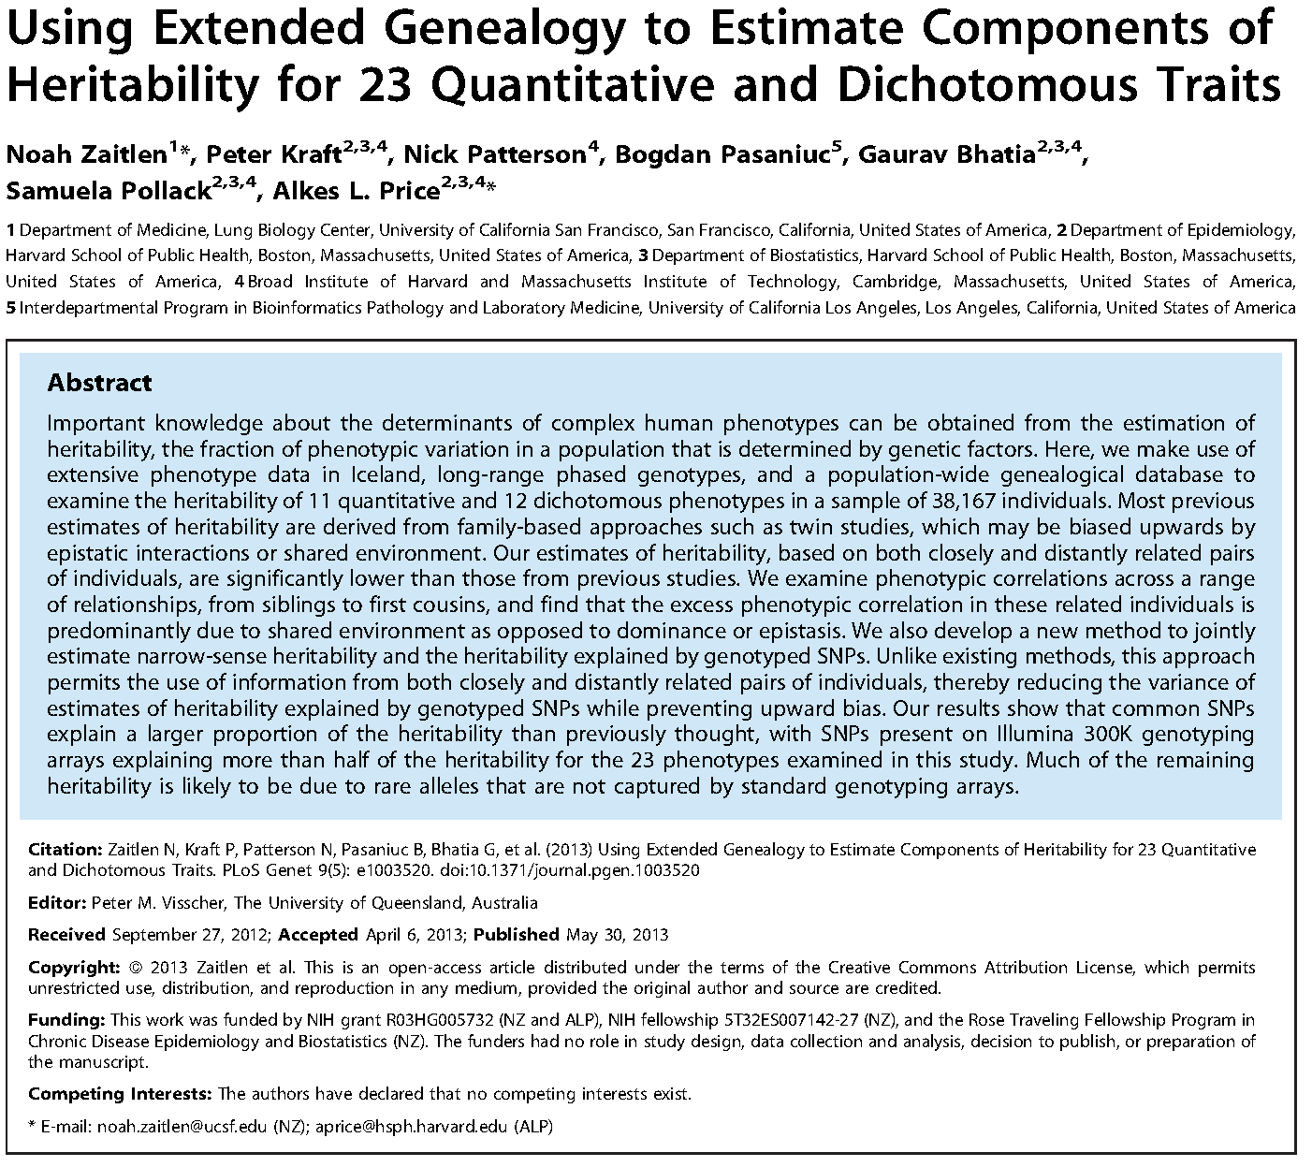

Slide 10
II. mxGREML Design

Slide 11
Overview of GREML in OpenMx
All participants’ scores on all phenotypes get “stacked” into a single vector, y.
“Definition variables” not allowed/needed.
Ordinal phenotypes must be treated as continuous…
User must specify model for y.
Mean of y conditioned on covariates, which are columns of matrix X.
var(y) is covariance matrix, V, which user must define.

Slide 12
GREML in OpenMx is flexible
Key distinguishing characteristic from other analyses in OpenMx (e.g., FIML): phenotype vector y is a single realization of a random vector that cannot, in general, be partitioned into independent subvectors.
(Applicable to analyses in disciplines other than genetics.)
Notes:
Flexibility was the chief design consideration—bringing the flexibility and generality of OpenMx to data-analysis problems involving GRMs. Simple GREML-type models should be done in GCTA, because GCTA is optimized for the purpose. Not much point using OpenMx for things that GCTA can do, and more quickly.
For instance, GREML enables a quite flexible, albeit computationally inefficient, way of doing multilevel analyses in OpenMx.

Slide 13
GREML in OpenMx: assumptions
Conditional on covariates X, phenotype vector y is a single draw from a multivariate-normal distribution having (in general) dense covariance matrix, V.
The parameters of V are of primary interest.
Random effects are normally distributed.
GLS regression (using V⁻¹) is adequate model for phenotypic mean.
Notes:
‘V’ matrix can be sparse, but at present, OpenMx doesn’t know how to internally represent it as a sparse matrix w/r/t storage and operations. Parameters in ‘V’ are variance components, genetic correlations, etc. Random effects, including residual, assumed to be normal.

Slide 14
III. mxGREML Implementation

Slide 15
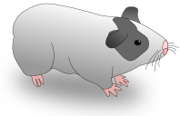
Models in OpenMx 2.x
“Objectives” from version 1 now split between:
Expectation
Model’s specification.
For example, MxExpectationNormal specified in terms of covariance, means, and (sometimes) thresholds.
Fitfunction
Loss function to be minimized.
For instance, MxFitFunctionML uses -2 times multivariate-normal loglikelihood.

Slide 16
Overview of mxGREML Feature
0. Condensed matrix slots.
1. GREML expectation.
2. Data-handling helper function.
3. GREML fitfunction.

Slide 17
Large Matrices and Memory Efficiency
Demo script…
Main idea—when your OpenMx script involves large matrices that contain no free parameters:
Place options(mxCondenseMatrixSlots=TRUE) near beginning of script.
Always access slots of MxMatrix objects with $, and never with @.

Slide 18
GREML Expectation
Compatible with GREML fitfunction and ML fitfunction.
Requires raw continuous data.
User tells it:
Which algebra/matrix is V.
Whether & with what arguments to call mxGREMLDataHandler() at runtime.
Whether & how to resize V at runtime due to missing data.

Slide 19
mxGREMLDataHandler()
User provides:
Dataframe or matrix, in “wide” format.
Column names of phenotypes (for y).
Column names of covariates (for X).
Creates X & y, and automatically trims NAs out of them.
Can be called by user, or automatically at runtime.
Can structure data for multiple phenotypes or for clustered/repeated measures.

Slide 20
GREML fitfunction
Can OPTIONALLY accept analytic first partial derivatives of V:
User needs to know some calculus…
User provides names of matrices/algebras that equal first partial derivatives of V w/r/t free parameters.
OpenMx uses them to calculate derivatives of REML loglikelihood during optimization.
Calculating derivatives of REML logL is distributed over multiple processors.
Notes:
Analytic derivatives of the restricted loglikelihood can be used to speed up optimization (evaluating the fitfunction is costly).

Slide 21
GREML fitfunction
With custom compute plan using Newton-Raphson:
Backend does average-information REML¹.
OpenMx gives analytic standard errors from average-information matrix at solution.
Note: N-R cannot handle MxConstraints.
Both REML and ML -2logL returned from backend; use the ML -2logL for model comparison.
¹Johnson, D. L., & Thompson, R. (1995). Journal of Dairy Science, 78, 449-456.

Slide 22
IV. Applications

Slide 23
Two Demo Scripts In My Folder
For your reference; we won’t go over them.
One is a trivially simple example.
The other carries out the factor model diagrammed earlier in this presentation.
Warning! They use some advanced features:
Custom compute plan.
Newton-Raphson optimizer.
Analytic derivatives.

Slide 24
Validation
Reproduced FIML and GCTA results from Eaves et al. (2014) simulation.
Reproduced GCTA results for FSIQ reported in Kirkpatrick et al. (2014).
Eaves, L. J., et al. (2014). Behavior Genetics, 44, 445-455.
Kirkpatrick, R. M., et al. (2014). PLoS ONE 9(11): e112390.

Slide 25
Potential Applications
Use GRM(s) & sample of classically unrelated participants to model:
Initiation & frequency of drug use.
Common vs. independent pathways.
Continuous biometric moderation (a la Purcell, 2002).
Latent Growth-Curve analysis…

Slide 26
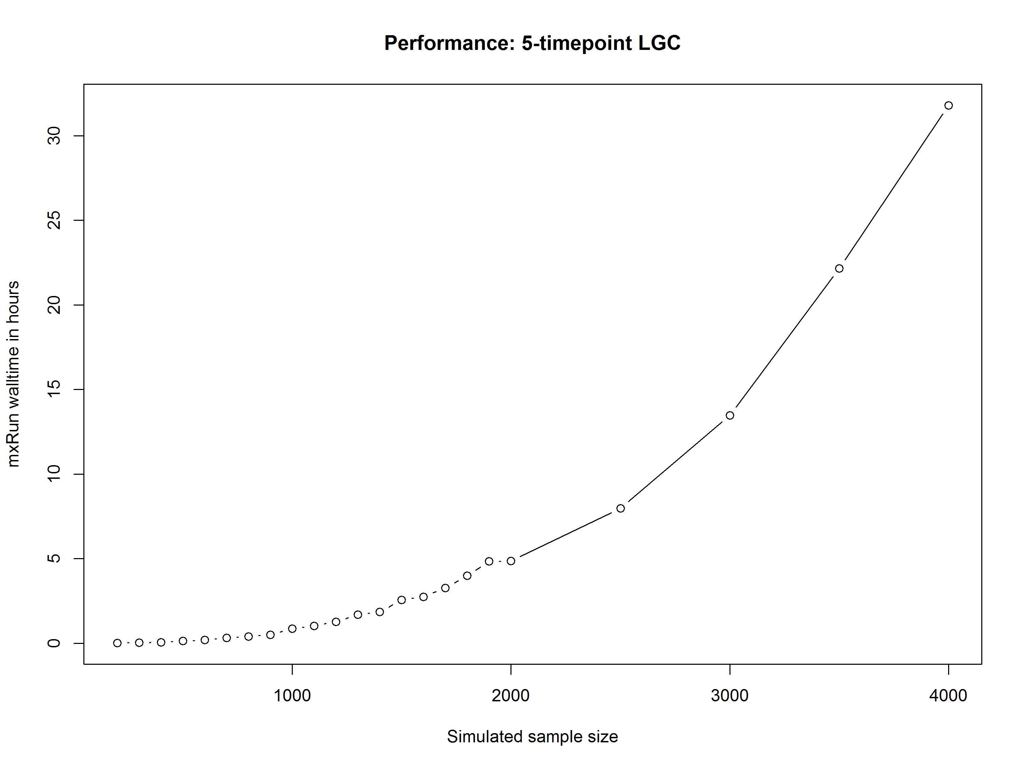
Notes:
I made a mistake when running these simulations, so this graph depicts conservative estimates of speed.

Slide 27
Potential Applications
Use GRM(s) & sample of classically unrelated participants to model:
Initiation & frequency of drug use.
Common vs. independent pathways.
Continuous biometric moderation (a la Purcell, 2002).
Latent Growth-Curve analysis.
Multicategory ordinal phenotypes.

Slide 28
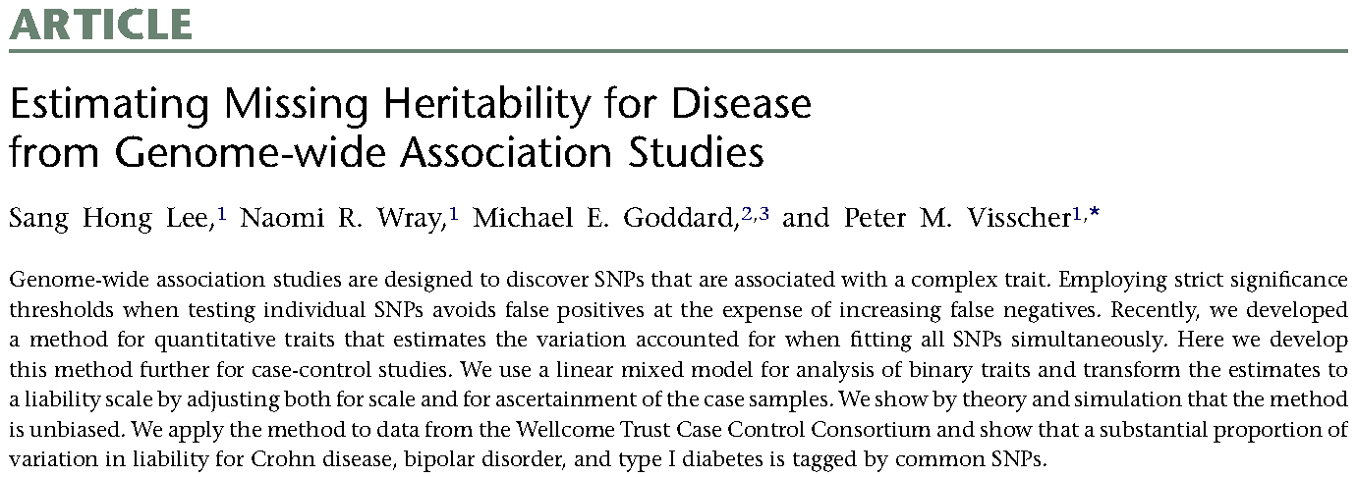

GREML with Binary Phenotypes
DOI 10.1016/j.ajhg.2011.02.002

Slide 29
Multicategory Ordinal GREML
Under suitable conditions¹, h² of ordinal phenotype is squared polyserial correlation between observed phenotype scores and latent genetic liability.
Analyze ordinal scores as though continuous, and then adjust h² on observed scale to h² on latent scale via generalization of Dempster-Lerner-Robertson transformation¹.
Must treat thresholds as though known, even though estimated from data.
¹Dempster, E. R., & Lerner, I. M. (1950). Genetics 35(212), 212-236.

Slide 30
V. Miscellaney

Slide 31
Miscellaneous—stuff I didn’t really cover
Be careful using GREML with any kind of ascertained sample.
Use of >1 GRM (or other such “relatedness matrix”).
GREML with family data.
Technical aspects of computing GRMs.
Computational shortcuts available for simple models (e.g., diagonalization).

Slide 32
Possible Improvements
More-robust N-R optimizer.
Enabling N-R to find confidence intervals.
Interface to provide NPSOL & CSOLNP with analytic derivatives of constraints.
User-specified sparse matrices?

Slide 33
Acknowledgements
NIH grant DA026119
Mike Neale (PI)
Lindon Eaves
Mike Hunter & Joshua Pritikin
The rest of the OpenMx Development Team

