Slide 1
Model assumptions & extending the twin model
Matthew Keller
Hermine Maes
Brad Verhulst
Lindon Eaves
Boulder 2016

Slide 2
Acknowledgments
John Jinks
David Fulker
Robert Cloninger
Lindon Eaves
Andrew Heath
Sarah Medland, Pete Hatemi, Will Coventry, Hermine Maes, Mike Neale

Slide 3
First annual OpenMx HACKATHON!
Friday morning (8 am) session
I’ll give you an .RData file of twin data and a specific question to test. Your job is to write an OpenMx script—from scratch—that gets the right answer!
  The instructor has limited ability in OpenMx – it’s up to you!
  Cheating isn’t bad here—it’s encouraged! Use your old scripts or help from anyone in the class.
  You have an hour to write script and to produce and interpret estimates.

Slide 4
Files you will need are in Faculty drive: /matt/Assumptions_2016
Assumptions2016_mck.pdf (PPT presentation)
CTD.ACDE-param.indet_2016.R (OpenMx script)
PDFs of papers describing details of what we go over here & that correspond to the approach/notation I'm using here

Slide 5
Structural Equation Modeling (SEM) in BG
SEM is great because…
  Directs focus to effect sizes, not “significance”
  Forces consideration of causes and consequences
  Explicit disclosure of assumptions
Potential weakness…
  Parameter reification: “Using the CTD we found that 50% of variation is due to A and 20% to C.”
  Should you believe that 50% of variation is truly additive genetic?

Slide 6
True parameters vs. Estimated parameters
A C D E: true (unknowable) values of A, C, D, E in the population (short for V_{A}, V_{C}, V_{D}, and V_{E})
A’, C’, D’, E’: estimated values of A, C, D, E.
A’, C’, D’, E’, will differ from A, C, D, E due to:
1) sampling variability
2) bias
NOTE: I’m using Y’ rather than the usual Ŷ to denote estimates of Y simply due to technical (PPT) issues!

Slide 7
Quiz Question 1
1) A’ ,C’, and D’ cannot be estimated simultaneously in the classical twin design (i.e., the design that uses MZ and DZ twins only) model because: [choose all that apply]
a) these estimates are too highly correlated (multicolinearity problems)
b) they can be estimated simultaneously; you just have to fix one of them to some specific value
c) there are more informative statistics than parameters to be estimated
d) there are fewer informative statistics than parameters to be estimated

Slide 8
The Classical Twin Design
1
1.00 / .25
E
C
D
A
1.00 / .5
A
D
C
E
c
d
a
a
d
c
e
e
Tw1
Tw2
Notes:
8

Slide 9
Why can’t we estimate C’ & D’ at same time using twins only?
Solve the following two equations for A’, C’, & D’:
CVmz = A + D + C
CVdz = 1/2A + 1/4D + C
3 unknowns, 2 informative equations. It can't be done. The model is “unidentified”.
In practice, you can detect non-identification by noting that (a) model estimates depend on starting values AND (b) all final models have identical likelihoods
Notes:
9
‘Full’ Model: requires various different types of relative to uniquely solve for each of the unknowns.
Thus let’s start with ACE.

Slide 10
Indeterminacy: Practical 1
Open up CTD.ACDE-param.indet.R in R
Run this script (estimating A, D, and C using twins only) until you see “# END PRACTICAL 1.” Don't close the script or R, as we'll use this same script again for other Practicals
Write down your -2 log likelihood and your estimates of A, C, and D
Compare these to your neighbor's results
WHY is the -2LL the same despite different estimates (that depend on arbitrary start values)?
Notes:
10
‘Full’ Model: requires various different types of relative to uniquely solve for each of the unknowns.
Thus let’s start with ACE.

Slide 11
The CTD: Two statistics give info about within-family resemblance
1
1.00 / .25
E
C
D
A
1.00 / .5
A
D
C
E
c
d
a
a
d
c
e
e
Tw1
Tw2
MZ covariance
DZ covariance
Vp
Vp
CVmz
Vp
CVdz
Vp
Notes:
11

Slide 12
ACE Model
1
1.00 / .25
E
C
D
A
1.00 / .5
A
D
C
E
d=0
a
d=0
c
d=0
a
c
e
e
Tw1
WHEN
CVmz < 2CVdz
Tw2
Vp
Vp
CVmz
Vp
CVdz
Vp
Notes:
12

Slide 13
ACE Algebra
Assume D = 0. Solve for A’ & C’
CVmz = A + C
CVdz = ½ A + C
2 unknowns, 2 independently informative equations:
A’ = 2(CVmz-CVdz)
C’ = 2CVdz-CVmz
Note: if we tried to estimate D’, it would necessarily hit the 0 boundary anyway and the model wouldn't fit as well (because D’ 'wants' to go negative), so it makes sense to solve for C’
Notes:
13

Slide 14
The CTD: ADE Model
1
1.00 / .25
E
C
D
A
1.00 / .5
A
D
C
E
c=0
d
a
a
d
c=0
e
e
Tw1
WHEN
CVmz > 2CVdz
Tw2
Vp
Vp
CVmz
Vp
CVdz
Vp
Notes:
14

Slide 15
PRACTICAL 2: ADE Algebra & Indeterminacy
Assume C = 0. Solve for A’ & D’ (here CVmz=.73 & CVdz=.35)
CVmz = A + D
CVdz = ½A + ¼D
Then reopen CTD.ACDE-param.indet.R in R & run
FROM “# START PRACTICAL 2”
TO “# END PRACTICAL 2”
Did you get roughly the same answer for your ADE model as your formula suggested?
Did the ACE model fit as well as the ADE model? Why?
What happened to estimates of C & D in the DCE model?
Derive a general formula for getting these. Then solve for them in this case.
Notes:
15

Slide 16
Quiz Question 1 again – What do you think now?
1) A’, D’, & C’ cannot be estimated simultaneously in the classical twin design (i.e., the design that uses MZ and DZ twins only) model because: [choose all that apply]
a) these estimates are too highly correlated (multicolinearity problems)
b) they can be estimated simultaneously; you just have to fix one of them to some specific value
c) there are more informative statistics than parameters to be estimated
d) there are fewer informative statistics than parameters to be estimated

Slide 17
Quiz Question 2
2) If the assumptions of the CTD model that either D or C is zero is violated (i.e., A, C, and D simultaneously affect the phenotype)... [choose all that apply]
a) the interpretation of the estimated parameters should be altered; e.g., A’ should be considered an amalgam of A & D (in ACE model) or of A & C (in ADE model)
b) there is no point in doing the analysis at all
c) the point estimates of the estimated parameters will be biased

Slide 18
Bias in parameter estimates for violation of assumption that either D or C is 0
In ACE Models (bias induced in setting D’ = 0):
A’ = A + 3/2D
C’ = C – ½D
In ADE Models (bias induced in setting C’ = 0):
A’ = A + 3C
D’ = D - 2C
Notes:
18

Slide 19
Quiz Question 3
3) An ADE model finds that A’ = .30 and D’ = .10. This implies that shared environmental factors do not influence the trait in question.
a) TRUE
b) FALSE

Slide 20
Quiz Question 4
4) We run an ADE model and find that A’ = .69 and that D’ = .05. If in truth, C = .10, what will the effect on the estimated parameters be? [choose all that apply]
a) A’ will be biased (too low)
b) A’ will be biased (too high)
c) D’ will be biased (too low)
d) D’ will be biased (too high)
e) there is no affect on the estimated parameters; however by not estimating C (aka, fixing it to zero), we underestimated C

Slide 21
PRACTICAL 3: Sensitivity analysis
Sensitivity analysis: studying what the effects are on estimated parameters when assumptions are wrong
In CTD.ACDE-param.indet.R, run:
FROM “# START PRACTICAL 3”
TO “# END PRACTICAL 3”
Run one section at a time and change the value of C from 0 to other values (remember, C=c^2) in an ADE model. What happens to estimates of A and D depending on different assumed values of C?
At end, look at -2LL 3-D plot of parameter space
Notes:
21

Slide 22
Some points to consider about the biases discussed to this point
Epistasis (across loci interactions) can increase the degree of the biases because it can reduce the CV(DZ):CV(MZ) ratio even further than the expected 1:4 under dominance.
However, the degree of bias rests on how strong non-additive genetic influences are. This is an active area of debate in the field.
Epistatic effects will generally come out in the estimates of D. Thus, interpret D’ broadly, as a rough estimate of V_{NA}
My take: V_{A} is almost certainly greater than V_{NA}, and evidence for much V_{D} per se is scant. But some traits may show high enough V_{NA} to bias estimates of V_{C} and V_{D} (V_{NA}) down and V_{A} up considerably from twin studies.
Notes:
22

Slide 23
Quiz Question 5
5) What are the typical assumptions of a classical twin model? [choose all that apply]
a) only genetic factors cause MZ twins to be more similar to each other than DZ twins
b) either D or C is equal to zero
c) no epistasis
d) no assortative mating
e) no gene-environment interactions or correlations

Slide 24
What are the effects of violations of assumptions in the CTD?
a) Only genetic factors cause MZ twins to be more similar to each other than DZ twins: A and D are overestimated and C is underestimated
b) Either D or C is equal to zero: A is overestimated and D and C are underestimated
c) No epistasis: D or A is overestimated and C is underestimated
d) No assortative mating: A and D are underestimated and C is overestimated
e) No gene-environment interactions or correlations: AxC: A overestimated; AxE: E overestimated; passive Cov(A,C): C overestimated

Slide 25
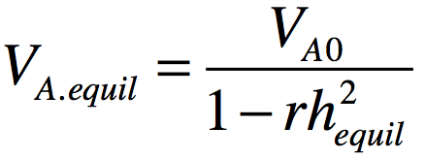
Assortative mating (AM) consequence on V_{A}
AM: phenotypic correlation between mating partners
Many examples (e.g., height ~.2; IQ ~ .3; Social attitudes ~ .5)
If AM leads to genetic similarity in partners (as it does if due to choice for similarity), there are genetic consequences. E.g.:
  Height V_{A} increases in the population because ‘tall’ (‘short’) alleles are more concentrated in individuals than expected.
  E.g., if you’re a ‘tall’ allele that just got put into a new egg and are waiting around to see what other height genes you’ll get paired with from that sperm swimming to you, they are more likely than chance to be other ‘tall’ alleles (both at the same locus and at others; & this just considers the effects on V_{A} in 1st gen)

Slide 26
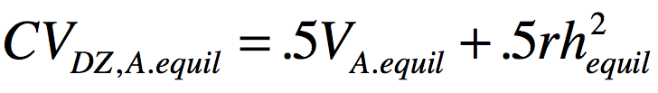
AM consequence on relative covariance
AM increases genetic covariances and correlations between relatives (e.g., sibs, parents, cousins, etc).
  While MZ genetic covariance increases, it’s correlation is already 1 so it doesn’t increase
Consider again being a ‘tall’ allele in a zygote. This time you are watching your co-twin’s zygote get formed. Regardless of whether you exist (are IBD) in your co-twin’s egg, you can expect more tall alleles swimming to your co-twin’s egg.
Thus, you can also expect to share more ‘tall’ alleles with your sibling(s).
The covariance between DZ twins due to additive genetics is:

Slide 27
Quiz Question 6
6) In the CTD, say that CV(MZ) < 2CV(DZ), so we fit an ACE model. How would AM tend to affect parameter estimates? [choose all that apply]
a) deflates estimates of A
b) inflates estimates of A
c) deflates estimates of C
d) inflates estimates of C

Slide 28
Quiz Question 7
7) Let's say we add parents to the CTD. That gives us 2 additional relative covariance estimate to work with (parent-offspring and spousal) in addition to the normal CV(MZ) and CV(DZ) and allows us to ___________ [choose all that apply]
a) estimate A, C, & D simultaneously
b) account for the effects of assortative mating
c) account for passive G-E covariance
d) reduce the bias in estimates of A, C, and D vis a vis the CTD

Slide 29
Classical Twin Design (CTD)
Assumption biased up biased down
  Either D or C is zero A C & D
  No assortative mating C D
  No A-C covariance C D & A
1
A
1/.25
A
E
C
C
E
a
c
c
a
e
e
D
D
d
d
P_{T1}
P_{T2}

Slide 30
Adding parents gets us around all these assumptions
Assumption biased up biased down
  Either D or C is zero
  No assortative mating
  No A-C covariance
^{We don’t have to make these}
w
q
q
A
A
w
x
C
C
x
a
E
E
a
D
c
e
e
c
D
d
d
P_{Fa}
µ
P_{Ma}
m
m
m
m
A
A
C
1/.25
C
E
a
a
E
e
c
D
D
c
e
d
d
P_{T1}
P_{T2}

Slide 31
We can model C as either S or F
With parents, we can break “C” up into:
S = env. factors shared only between sibs
F = familial env factors passed from parents to offspring
But we can only estimate one of these (or more technically, one of A, S, F, & D)
S
C
F
1
1
A
1/.25
A
F
A
A
F
E
a
C
C
a
E
E
S
1/.25
S
E
e
c
D
D
c
e
e
f
a
s
s
a
f
e
d
d
d
D
D
d
P_{T1}
P_{T2}
P_{T1}
P_{T2}

Slide 32
Nuclear Twin Family Design (NTFD)
q
w
w
q
A
F
x
x
F
A
S
f
E
E
f
S
s
a
e
e
a
s
D
d
d
D
P_{Fa}
µ
P_{Ma}
m
m
m
m
Note: m estimated and f fixed to 1
z_{s}
F
A
A
F
E
S
z_{d}
S
E
f
a
s
s
a
f
e
e
D
D
d
d
P_{T1}
P_{T2}

Slide 33
PRACTICAL 4: NTFD analysis
In CTD.ACDE-param.indet.R, run:
FROM “# START PRACTICAL 4”
TO “# END PRACTICAL 4”
What are the estimated values of A, D, & S? [Note: S = sib environment, equivalent to C in the CTD]
Notes:
33

Slide 34
Simulated (true) vs. CTD vs. NTFD results
TRUE values CTD estimates NTFD estimates
A = .30 A’ = .68 A’ = .32
D = .30 D’ = .04 D’ = .29
S = .10 S’ = 0 S’ = .13
Notes:
34

Slide 35
Nuclear Twin Family Design (NTFD)
q
w
w
q
A
F
x
x
F
A
S
f
E
E
f
S
s
a
e
e
a
s
D
d
d
D
P_{Fa}
µ
P_{Ma}
m
m
m
m
Note: m estimated and f fixed to 1
z_{s}
F
A
A
F
E
S
z_{d}
S
E
f
a
s
s
a
f
e
e
D
D
d
d
P_{T1}
P_{T2}
Assumptions:
  Only can estimate 3 of 4: A, D, S, and F (bias is variable)
  Assortative mating due to primary phenotypic assortment (bias is variable)

Slide 36
Stealth
Include twins and their sibs, parents, spouses, and offspring…
  Gives 17 unique covariances (MZ, DZ, Sib, P-O, Spousal, MZ avunc, DZ avunc, MZ cous, DZ cous, GP-GO, and 7 in-laws)
  88 covariances with sex effects

Slide 37
Additional obs. covs with Stealth allow estimation of A, S, D, F, T
A
S
F
D
T
can be estimated simultaneously
= env. factors shared only between twins
T
1
F
A
A
F
E
S
1/.25
S
E
f
a
s
s
a
f
e
e
D
1/0
D
d
d
d
P_{T1}
t
T
T
t
P_{T2}
(Remember: we’re not just estimating more effects. More importantly, we’re reducing the bias in estimated effects –although perhaps at the expense of more variance in estimates)

Slide 38
Stealth
q
w
w
q
A
F
x
x
F
A
S
f
E
E
f
S
s
a
e
e
a
s
D
d
d
D
T
t
P_{Fa}
µ
P_{Ma}
t
T
m
m
m
m
q
w
1
w
q
A
F
x
F
A
1/.25
A
F
x
F
A
S
E
E
S
S
E
E
S
s
a
f
e
f
a
s
s
a
f
e
e
f
a
s
D
e
D
1/0
D
D
d
d
d
d
T
t
P_{Fa}
µ
P_{T1}
t
T
T
t
P_{T2}
µ
P_{Ma}
t
T
m
m
m
m
A
F
F
A
S
E
E
S
s
a
f
e
e
f
a
s
D
d
d
D
T
t
P_{Ch}
P_{Ch}
t
T

Slide 39
Stealth
Assumption biased up biased down
  Primary assortative mating A, D, or F A, D, or F
  No epistasis A, D S
  No AxAge D, S A

Slide 40
Stealth
Assumption biased up biased down
  Primary assortative mating A, D, or F A, D, or F
  No epistasis A, D S
  No AxAge D, S A
Primary AM: mates choose each other based on phenotypic similarity
Social homogamy: mates choose each other due to environmental similarity (e.g., religion)
Convergence: mates become more similar to each other (e.g., becoming more conservative when dating a conservative)

Slide 41
Cascade
~
µ
~
~
~
~
P_{Fa}
P_{Ma}
~
~
~
t
d
s
~
~
s
d
t
q
w
a
~
~
a
w
q
f
~
~
f
A
F
e
e
F
A
S
x
x
S
a
f
E
E
f
a
D
s
e
e
s
D
d
d
T
t
P_{Fa}
P_{Ma}
t
T
m
m
m
m
~
µ
~
~
~
~
~
~
P_{Sp}
P_{T1}
P_{T2}
µ
P_{Sp}
~
~
~
t
d
s
~
~
~
~
s
d
t
q
w
a
~
~
f
a
1
a
~
~
a
w
q
f
~
~
~
~
f
~
~
f
A
F
e
e
F
A
s
s
A
F
e
e
F
A
x
~
1/.25
~
x
S
E
E
S
d
d
S
E
E
S
a
f
f
a
~
~
a
f
f
a
s
e
e
s
t
t
s
e
e
s
D
d
d
D
1/0
D
d
d
D
T
t
P_{Fa}
P_{T1}
t
T
T
t
P_{T2}
P_{Ma}
t
T
m
m
m
m
A
F
F
A
S
E
E
S
s
a
f
e
e
f
a
s
D
d
d
D
T
t
P_{Ch}
P_{Ch}
t
T

Slide 42
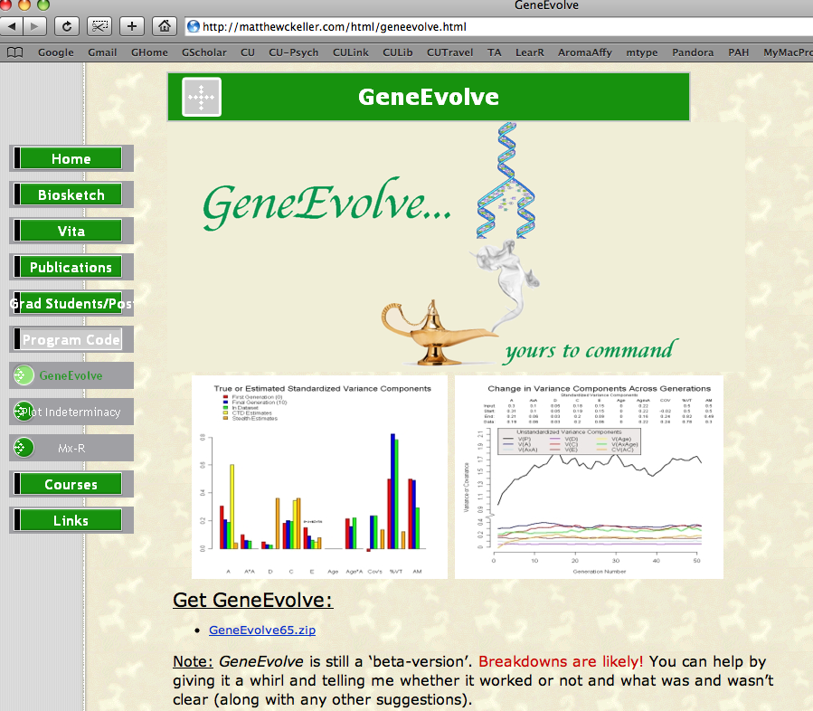
Simulation program: GeneEvolve

Slide 43
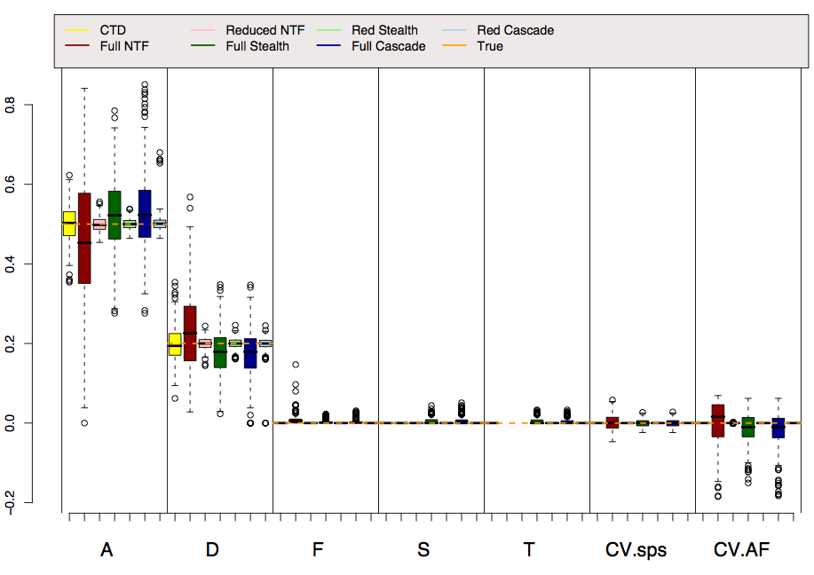
Reality: A=.5, D=.2

Slide 44
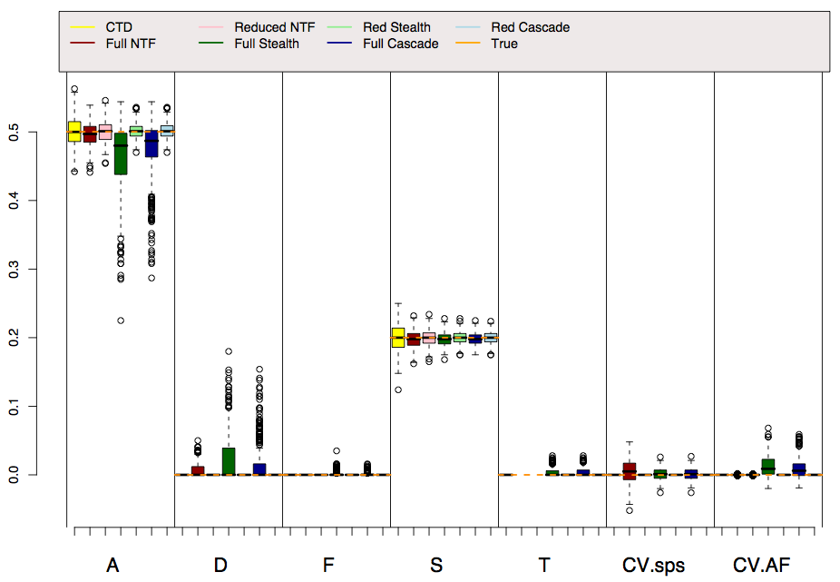
Reality: A=.5, S=.2

Slide 45
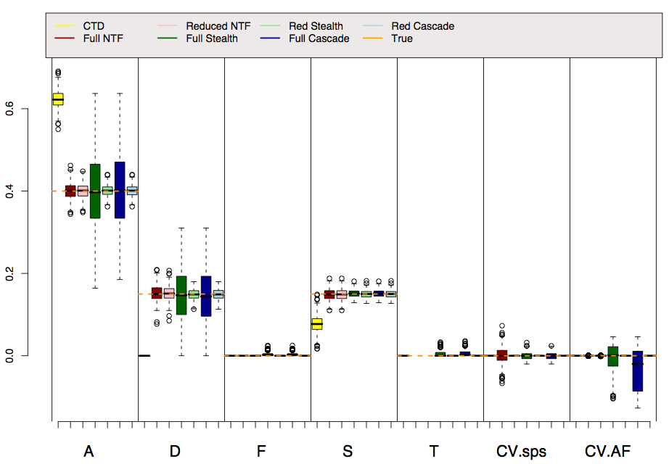
Reality: A=.4, D=.15, S=.15

Slide 46
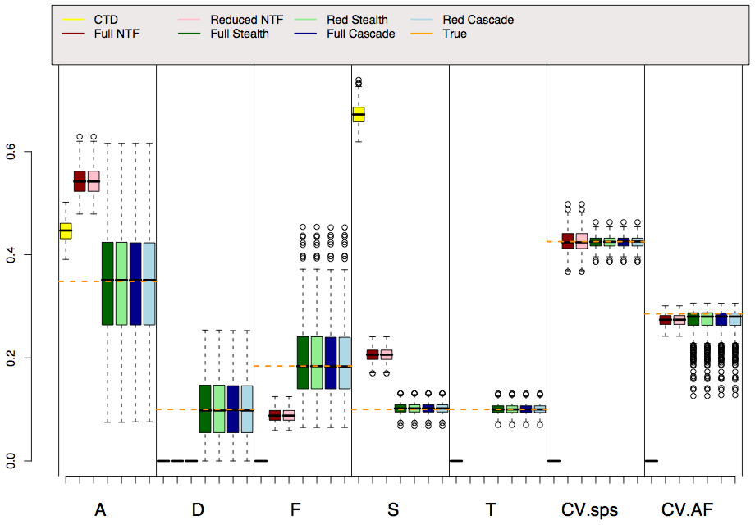
Reality: A=.35, D=.15, F=.2, S=.15, T=.15, AM=.3

Slide 47
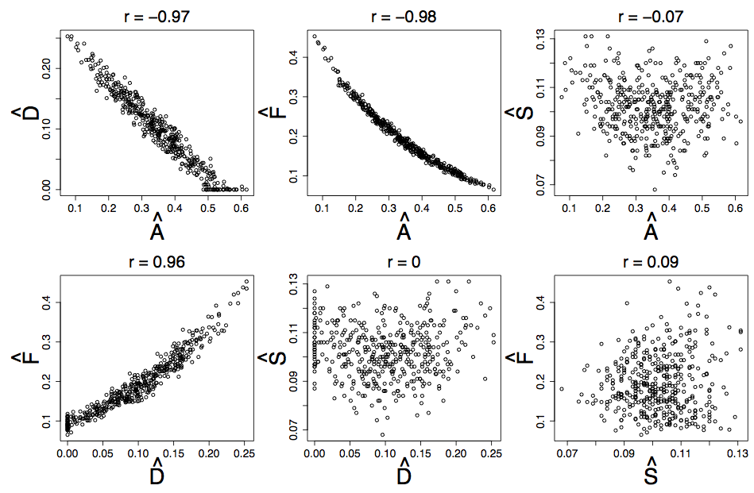
A,D, & F estimates are highly correlated in Stealth & Cascade

Slide 48
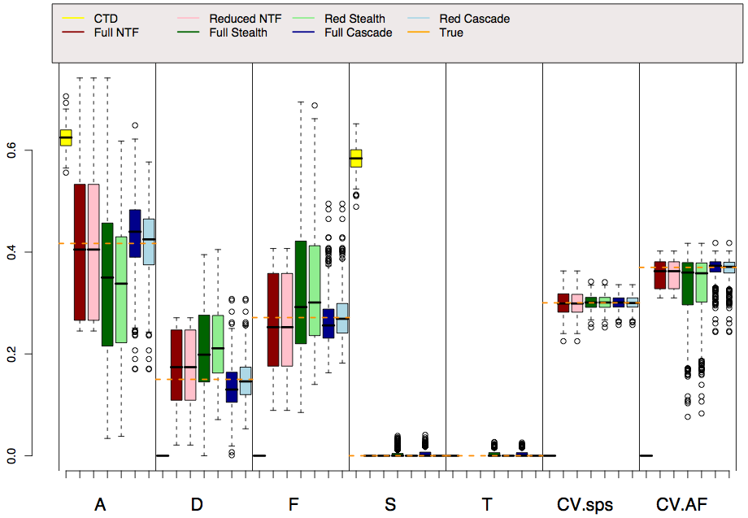
Reality: A=.45, D=.15, F=.25, AM=.3 (Soc Hom)

Slide 49
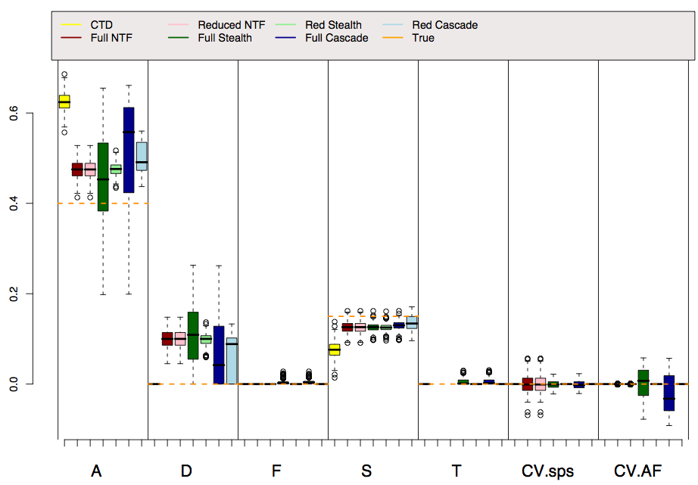
Reality: A=.4, A*A=.15, S=.15

Slide 50
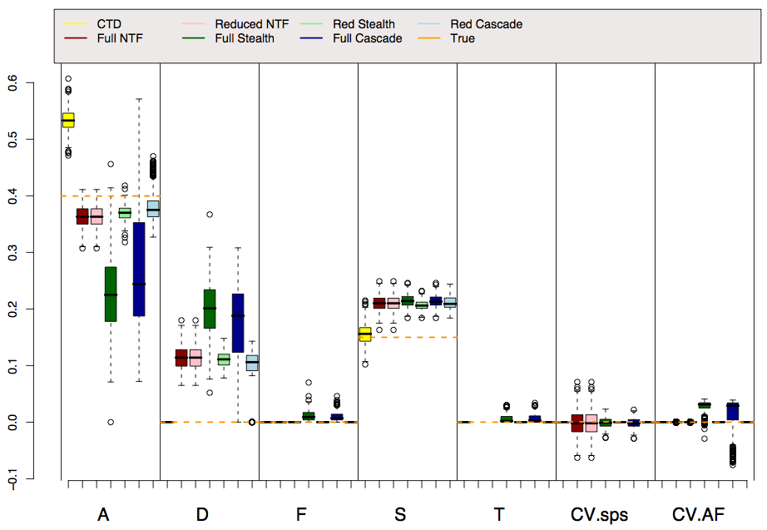
Reality: A=.4, A*Age=.15, S=.15

Slide 51
Conclusions
All models require assumptions. Generally, more assumptions = more biased estimates
Simulations provide independent assessments of the NTFD, Stealth, and Cascade models
  These complicated models work as designed, but they have drawbacks
In all models, but especially the CTD, be cautious of reifying parameter estimates!
  A is amalgam of mostly A but also D & C. A (in ACE models) or A+D (in ADE models) is a decent estimate of broad sense h².
  D & C are likely to be underestimates

Slide 52
Discussion questions
Are extended twin family methods worth the trouble? Or should we simply adjust our interpretations of estimates from simpler models?
Should we report full or reduced parameter estimates?
Should we fit variances of latent variables rather than pathways, and hence allow variance component estimates to go negative?

Slide 53
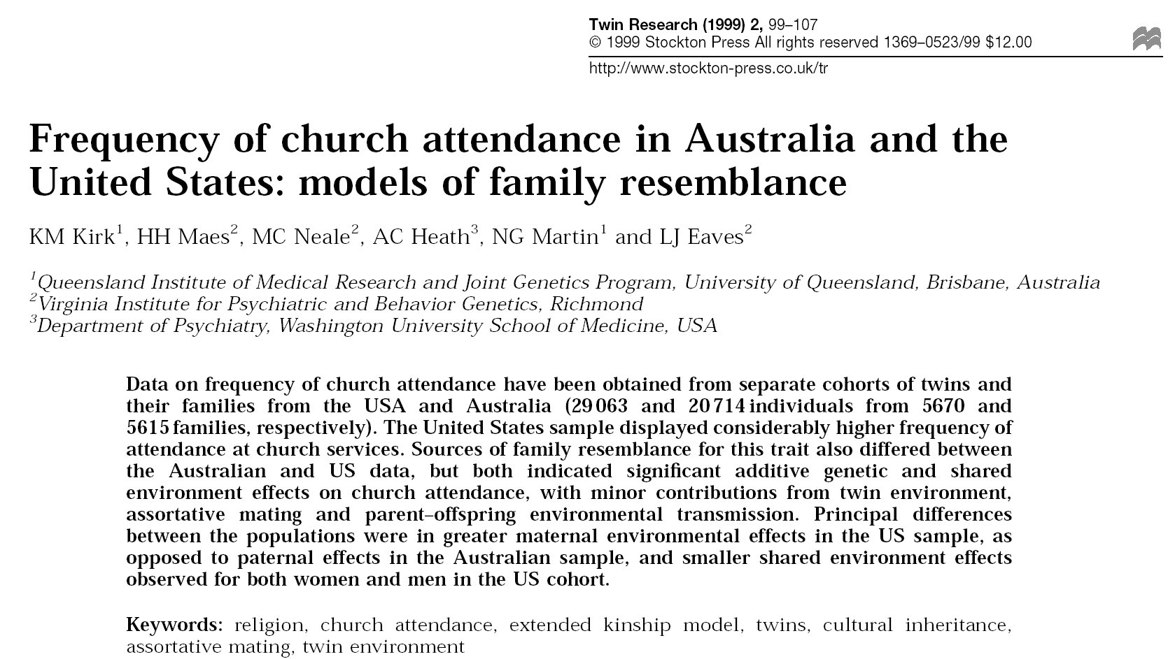
Stealth application

Slide 54
Further reading on this lecture
Eaves LJ, Last KA, Young PA, Martin NG (1978) Model-fitting approaches to the analysis of human behaviour. Heredity 41:249-320
Fulker DW (1982) Extensions of the classical twin method. Human Genetics. Part A: The Unfolding Genome (Progress in Clinical and Biological Research Vol 103A). p. 395-406
Fulker DW (1988) Genetic and cultural transmission in human behavior. Proceedings of the Second International conference on Quantitative Genetics
Eaves LJ, Heath AC, Martin NG, Neale MC, Meyer JM, Silberg JL, Corey LA, Truett K, Walter E (1999) Comparing the biological and cultural inheritance of stature and conservatism in the kinships of monozygotic and dizygotic twins. In: Cloninger CR (Ed) Proceedings of 1994 APPA Conference. p. 269-308
Keller MC & Coventry WL (2005). Quantifying and addressing parameter indeterminacy in the classical twin design. Twin Research and Human Genetics, 8, 201-213
Keller MC, Medland SE, Duncan LE, Hatemi PK, Neale MC, Maes HHM, Eaves LJ. Modeling extended twin family data I: Description of the Cascade Model. Twin Research and Human Genetics, 29, 8-18.
Keller MC, Medland SE, & Duncan LE (2010). Are extended twin family designs worth the trouble? A comparison of the bias, precision, and accuracy of parameters estimated in four twin family models. Behavior Genetics.

