Slide 1
Mendelian Randomization
(Using genes to tell us about the environment)
David Evans
University of Queensland
University of Bristol

Slide 2
Some Criticisms of DOC Modelling in Twins
Measurement error
Power (both variables need to have radically different aetiologies)
Only useful for testing strong hypotheses about causation
We now have genotypes for use in Mendelian randomization studies

Slide 3
This Session
The problem with observational studies
What is Mendelian Randomization (MR)?
Examples of MR in research
  Opportunities for SEM (mediation/network models)
  Pharmacogenomics
Using R to perform MR

Slide 4
RCTs are the Gold Standard in Inferring Causality
RANDOMISED CONTROLLED TRIAL
RANDOMISATION METHOD
EXPOSED:
INTERVENTION
CONTROL:
NO INTERVENTION
CONFOUNDERS EQUAL BETWEEN GROUPS
OUTCOMES COMPARED BETWEEN GROUPS

Slide 5
Observational Studies
RCTs are expensive and not always ethical or practically feasible
Association between environmental exposures and disease can be assessed by observational epidemiological studies like case-control studies or cohort studies
The interpretation of these studies in terms of causality is problematic

Slide 6
CHD risk according to duration of current Vitamin E
supplement use compared to no use
RR
Rimm et al NEJM 1993; 328: 1450-6

Slide 7
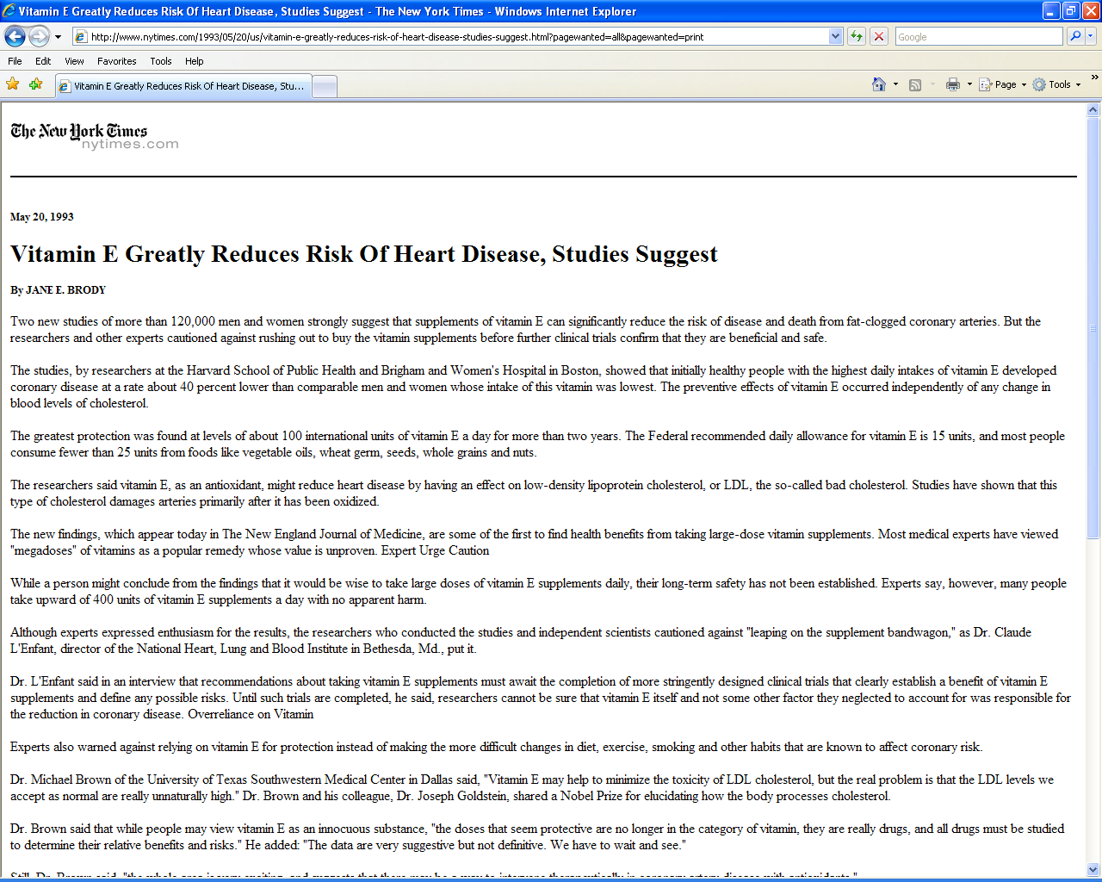

Slide 8


Slide 9
Use of vitamin supplements by US adults, 1987-2000
Percent
Source: Millen AE, Journal of American Dietetic Assoc 2004;104:942-950

Slide 10
Vitamin E levels and risk factors: Women’s Heart Health Study
Childhood SES
Manual social class
No car access
State pension only
Smoker
Daily alcohol
Exercise
Low fat diet
Obese
Height
Leg length
Lawlor et al, Lancet 2004

Slide 11
Vitamin E supplement use and risk of Coronary Heart Disease
1.0
Stampfer et al NEJM 1993; 328: 144-9; Rimm et al NEJM 1993; 328: 1450-6; Eidelman et al
Arch Intern Med 2004; 164:1552-6

Slide 12
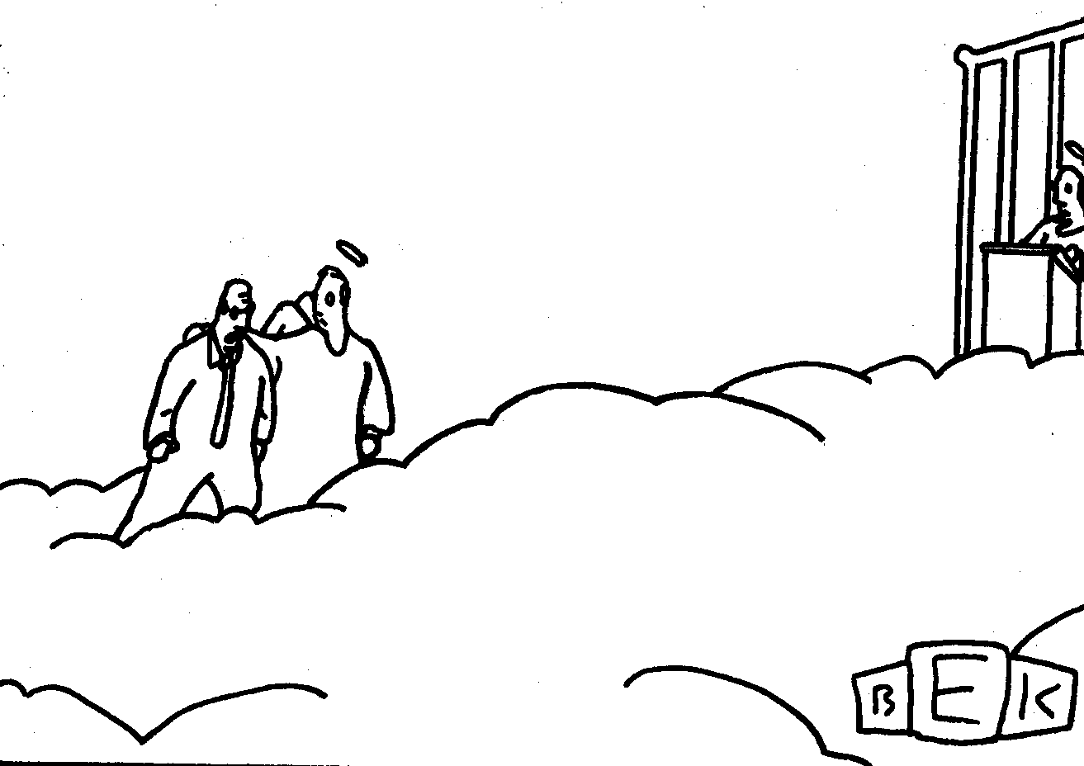
“Well, so much for antioxidants.”

Slide 13
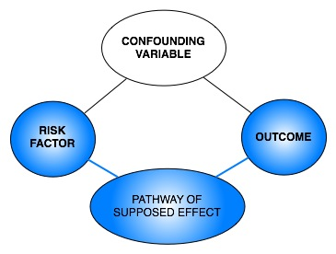
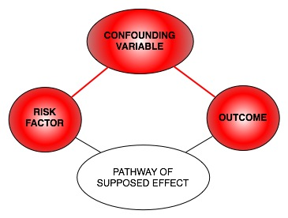
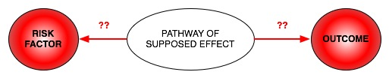
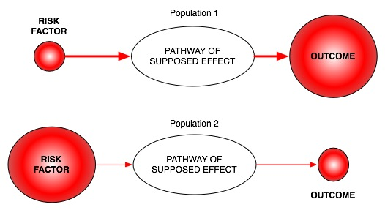
Classic limitations to “observational” science
Confounding
Reverse Causation
Bias

Slide 14
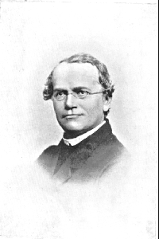
An Alternative to RCTs: Mendelian randomization
In genetic association studies the laws
of Mendelian genetics imply that
comparison of groups of individuals
defined by genotype should only differ
with respect to the locus under study
(and closely related loci in linkage
disequilibrium with the locus under study)
Genotypes can proxy for some modifiable
risk factors, and there should
be no confounding of genotype by
behavioural, socioeconomic or
physiological factors (excepting those
influenced by alleles at closely proximate
loci or due to population stratification)
Mendel in 1862

Slide 15
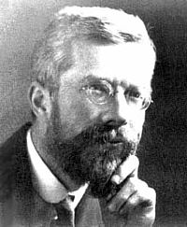
Fisher and Confounding
“Generally speaking the geneticist, even if he
foolishly wanted to, could not introduce
systematic errors into comparison of
genotypes, because for most of the relevant
time he has not yet recognized them”
Fisher (1952)

Slide 16
Mendelian randomisation and RCTs
MENDELIAN RANDOMISATION
RANDOMISED CONTROLLED TRIAL
RANDOM SEGREGATION OF ALLELES
RANDOMISATION METHOD
EXPOSED: FUNCTIONAL ALLELLES
CONTROL: NULL ALLELLES
EXPOSED:
INTERVENTION
CONTROL:
NO INTERVENTION
CONFOUNDERS EQUAL BETWEEN GROUPS
CONFOUNDERS EQUAL BETWEEN GROUPS
OUTCOMES COMPARED BETWEEN GROUPS
OUTCOMES COMPARED BETWEEN GROUPS

Slide 17
Mendelian Randomization- Core Assumptions
Confounders
SNP
Exposure
Outcome
(1) SNP is associated with the exposure
(2) SNP is not associated with confounding variables
(3) SNP only associated with outcome through the exposure

Slide 18
Equivalence Between Directed Acyclic Graphs and SEMs
Confounders
SNP
Exposure
Outcome
ξ₁
ξ₂
SNP
Exposure
Outcome
β_{x}
β_{Y}

Slide 19
Why Perform MR?
Assess causal relationship between two variables
Estimate magnitude of causal effect

Slide 20
Calculating Causal Effect Estimates
Confounders
SNP
Exposure
Outcome
β_{SNP-EXPOSURE}
β_{EXP-OUTCOME}
β_{SNP-OUTCOME}
2SLS:
(1) Regress exposure on SNP
(2) Regress outcome on predicted exposure from 1st stage regression
(3) Adjust standard errors
Wald Test:
β_{SNP-OUTCOME}
/
β_{SNP-EXPOSURE}
*Can be used in different samples (“Two sample MR”)

Slide 21
Examples – using instruments for adiposity
U
Adiposity
Traits of metabolism
FTO
If adiposity DOES NOT causally affect metabolic traits, then the FTO variant should NOT be related to these metabolic traits
If adiposity causally affects metabolic traits, then the FTO variant should also be related to these metabolic traits to the extent to which it affects adiposity

Slide 22
Do intermediate metabolic traits differ as one would expect
given a FTO-BMI effect?
Given the per allele FTO effect of ~0.1SD and known observational
estimates one can derive an expected, per allele, effect on metabolic traits
Phenotype | Expected Change | Observed Change | Observed Change (BMI adjusted)
Fasting insulin | 0.038 (0.033, 0.043) | 0.039 (0.013,0.064) | -0.005 (-0.027, 0.018)
Fasting Glucose | 0.018 (0.014, 0.021) | 0.024 (0.001, 0.048) | 0.006 (-0.017, 0.029)
Fasting HDL | -0.026 (-0.029, -0.023) | -0.032 (-0.057, -0.008) | -0.004 (-0.027, 0.019)
…
N~12,000 samples of European ancestry

Slide 23
Bidirectional MR

Slide 24
CRP and BMI
C-Reactive Protein (CRP) is a biomarker of inflammation
It is associated with BMI, metabolic syndrome, CHD and a number of other diseases
It is unclear whether these observational relationships are causal or due to confounding or reverse causality
This question is important from the perspective of drug development

Slide 25
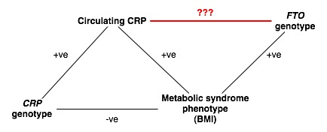
“Bi-directional Mendelian Randomization”
???

Slide 26
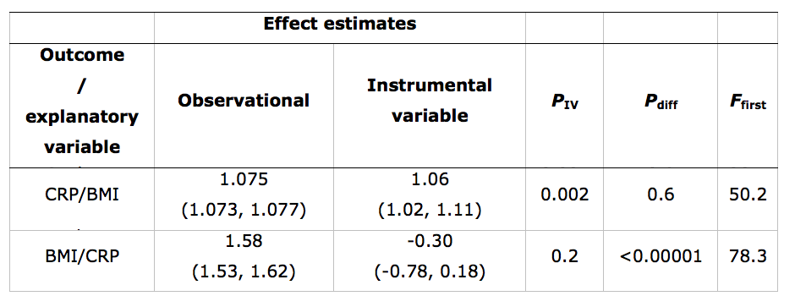
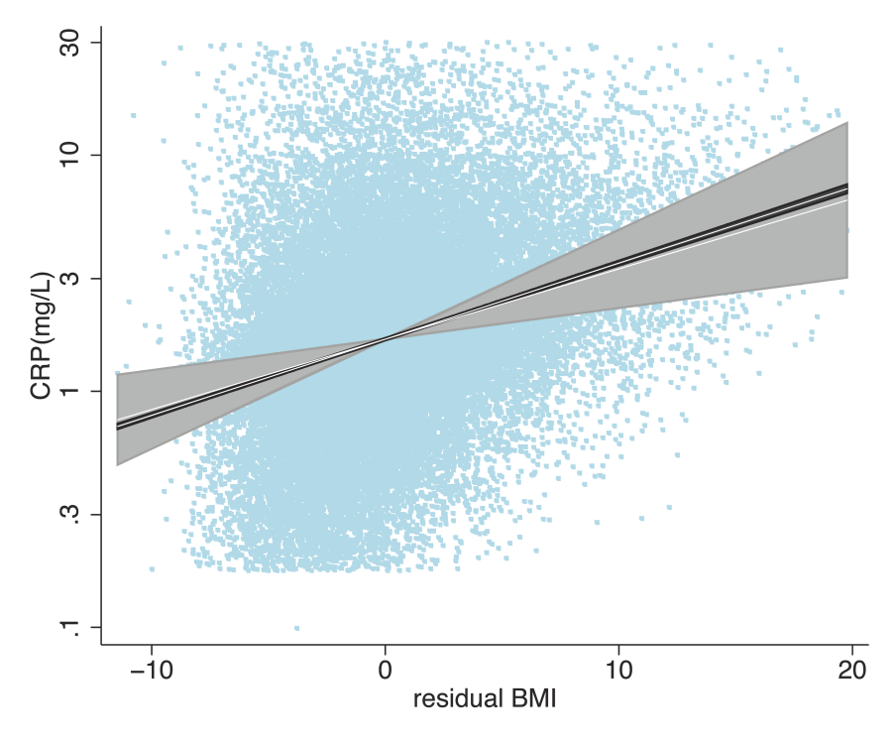
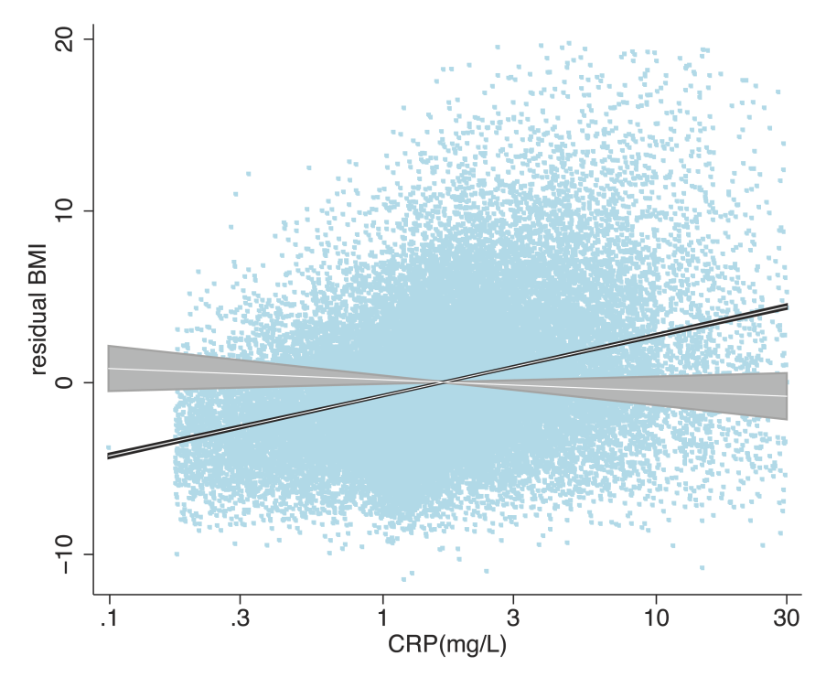

Slide 27
Using MR to Inform Mother-Offspring Associations

Slide 28
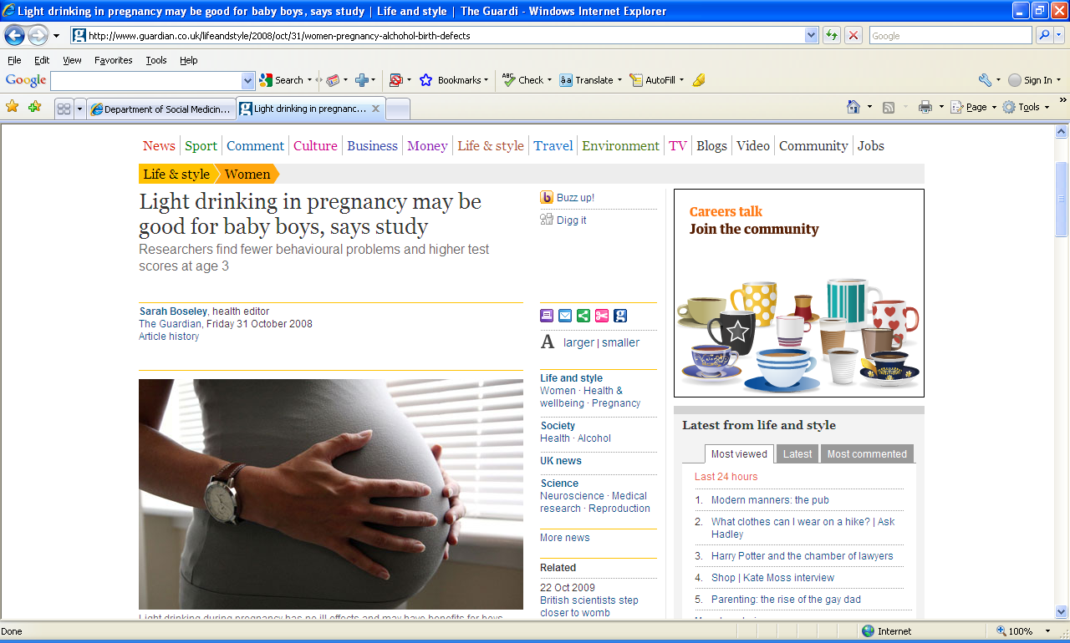

Slide 29
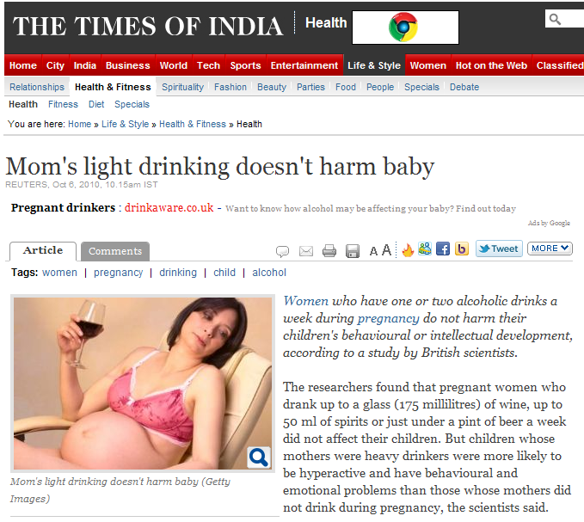

Slide 30
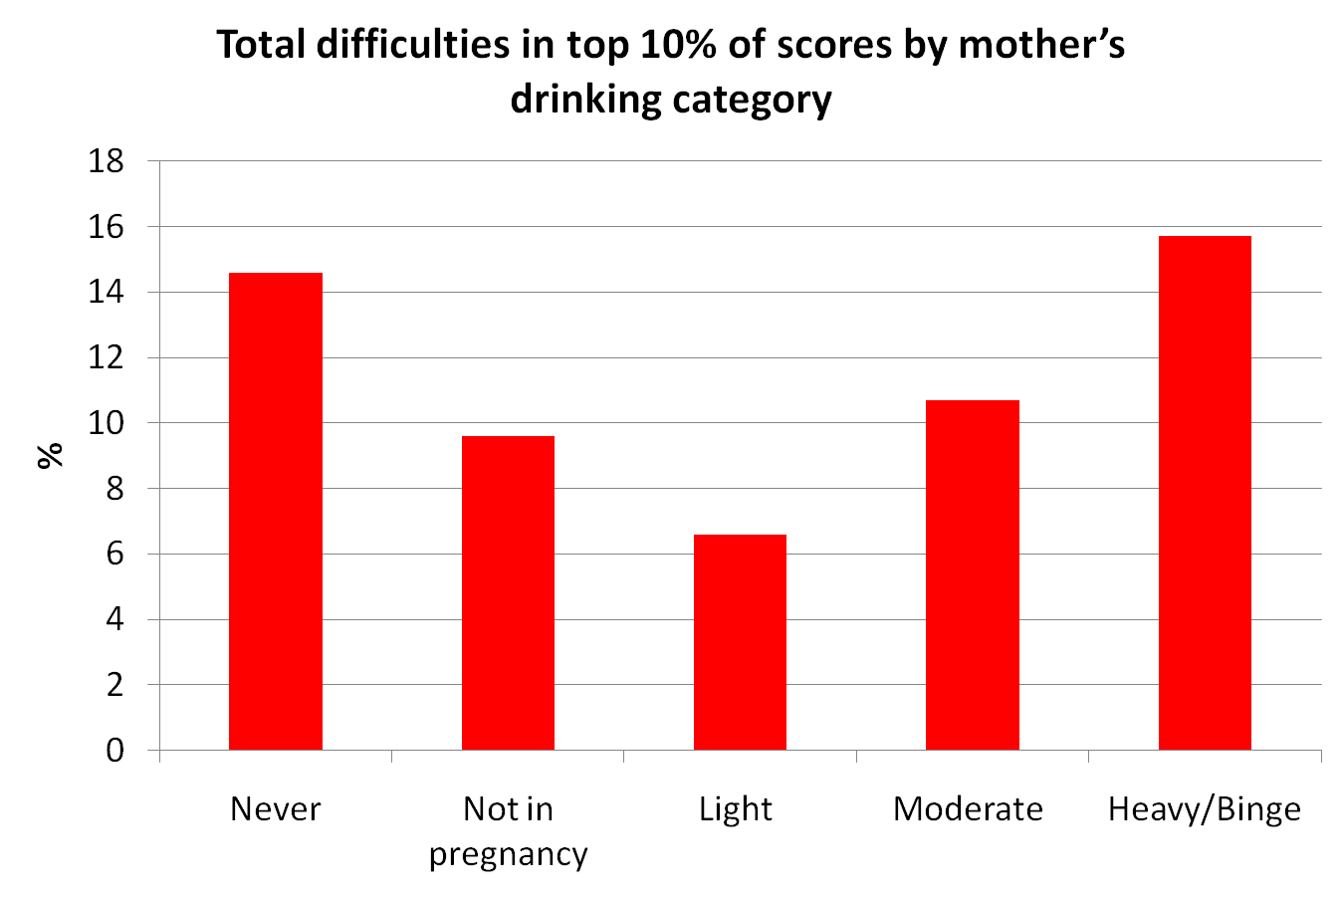
Kelly Y, Sacker A, Gray R et al. J Epidemiol Community Health (2010), doi:10.1136/jech.2009.103002

Slide 31
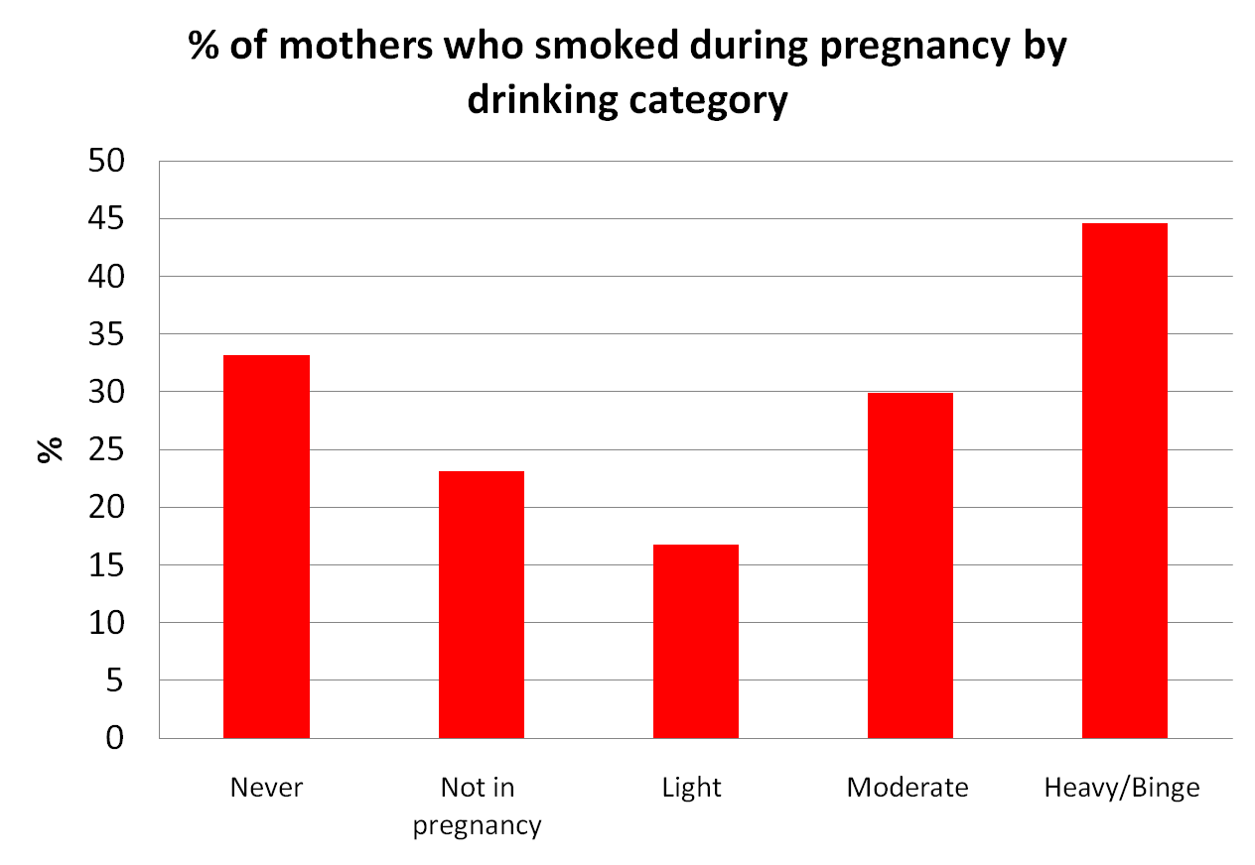
Kelly Y, Sacker A, Gray R et al. J Epidemiol Community Health (2010), doi:10.1136/jech.2009.103002

Slide 32
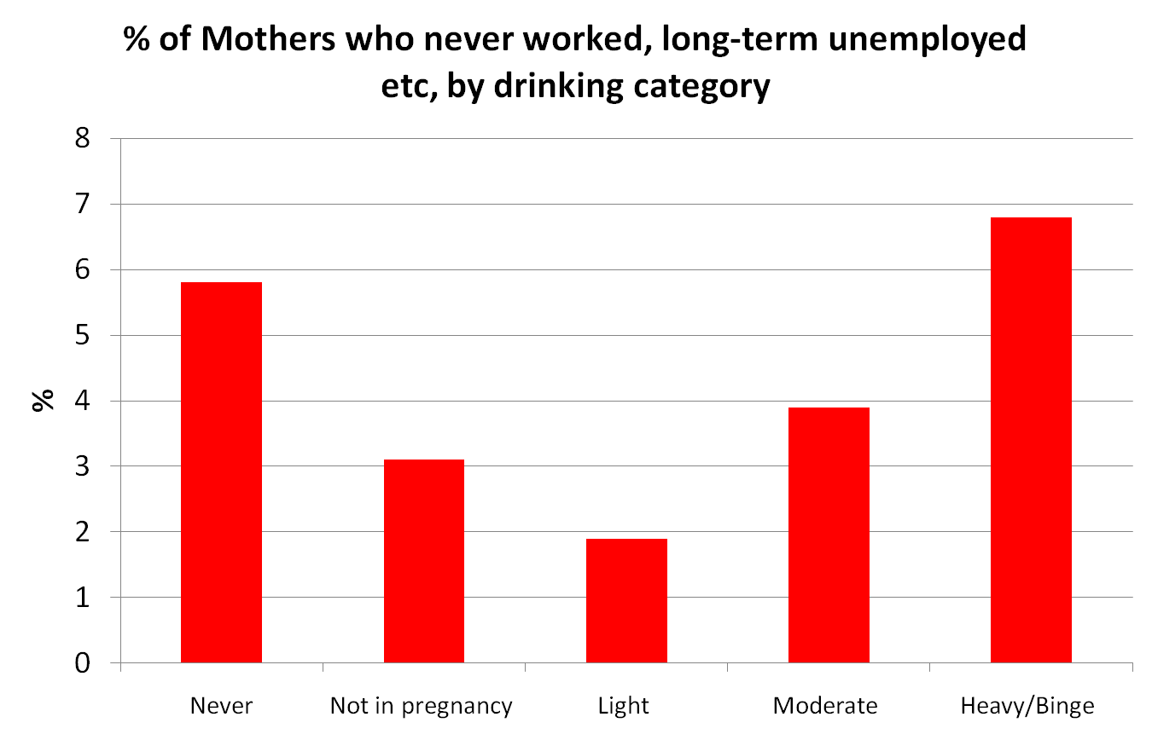
Kelly Y, Sacker A, Gray R et al. J Epidemiol Community Health (2010), doi:10.1136/jech.2009.103002

Slide 33
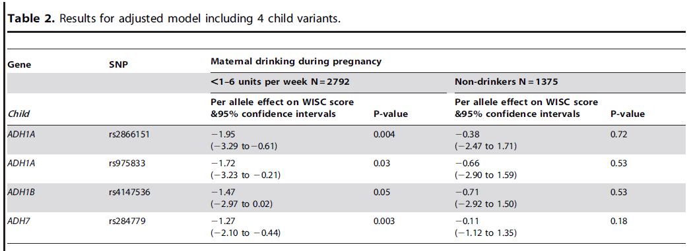
Maternal Alcohol Dehydrogenase and Offspring IQ

Slide 34
Alcohol dehydrogenase (ADH) risk allele score in offspring and offspring IQ, stratified by maternal alcohol intake during pregnancy
IQ Change
Women not drinking in pregnancy
All women
Women drinking during pregnancy
P value for interaction of risk allele score and drinking during pregnancy equals 0.009
Lewis S et al, PLoS One Nov 2012.

Slide 35
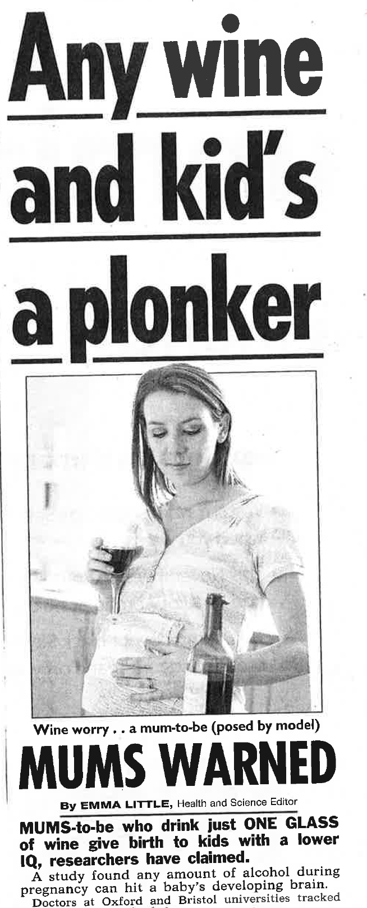

Slide 36
Multiple Variants, Multivariable MR, Two-Step MR and Network Models

Slide 37
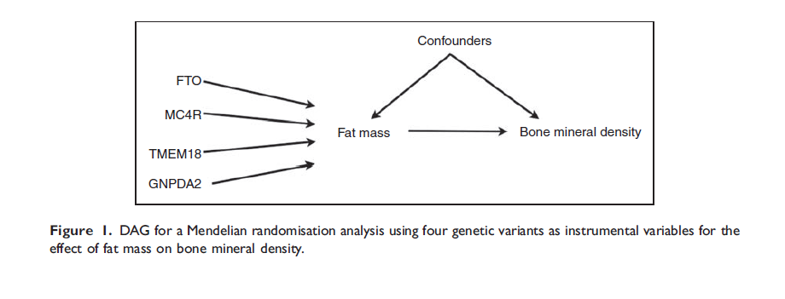
Using Multiple Genetic Variants as Instruments
Allelic scores
Palmer et al (2011) Stat Method Res
Testing multiple variants individually

Slide 38
Two Step Mendelian Randomization
(Mediation Analysis)
FTO
BMI
CHD
LDL
HMGCR
How much of the effect of BMI on CHD is mediated through LDL?
Can be done using two sample MR
Model can be fitted using SEM

Slide 39
Multivariable MR
SNP1
SNP2
Fat Mass
SNP3
Bone Mineral Density
(Osteoporosis)
SNP4
Lean Mass
SNP5

Slide 40
Multivariable MR
ξ₁
SNP1
SNP2
Fat Mass
SNP3
Bone Mineral Density
(Osteoporosis)
ξ₃
SNP4
Lean Mass
SNP5
ξ₂

Slide 41
Multivariable MR
SNP1
SNP2
Fat Mass
SNP3
Bone Mineral Density
(Osteoporosis)*
SNP4
Lean Mass
SNP5
*Difficult to fit in 2SLS
framework

Slide 42
Multivariable MR
ξ₁
SNP1
SNP2
Fat Mass
SNP3
Bone Mineral Density
(Osteoporosis)
ξ₃
SNP4
Lean Mass
SNP5
ξ₂
*This model is not identified

Slide 43
Mendelian Randomization and
Drug Targets

Slide 44
Late Stage Failure in Drug Trials
Cook et al. (2014) Nat Rev Drug Disc

Slide 45
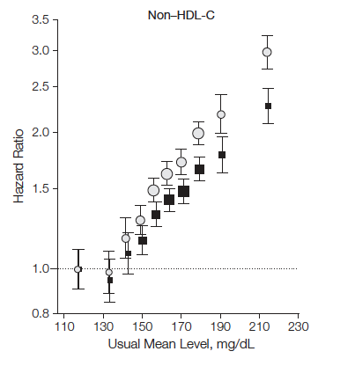
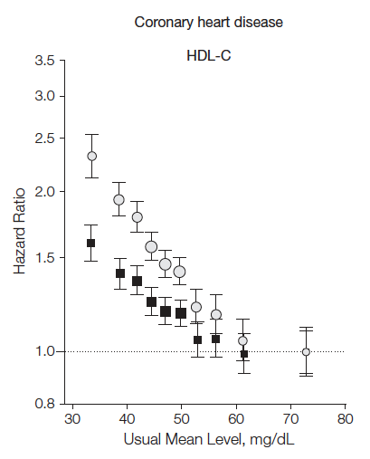
Association of LDL-C, HDL-C, and risk for coronary heart disease (CHD)
LDL-C
HDL-C
302K participants in 68 prospective studies
Emerging Risk Factors Collaboration, JAMA 2009

Slide 46
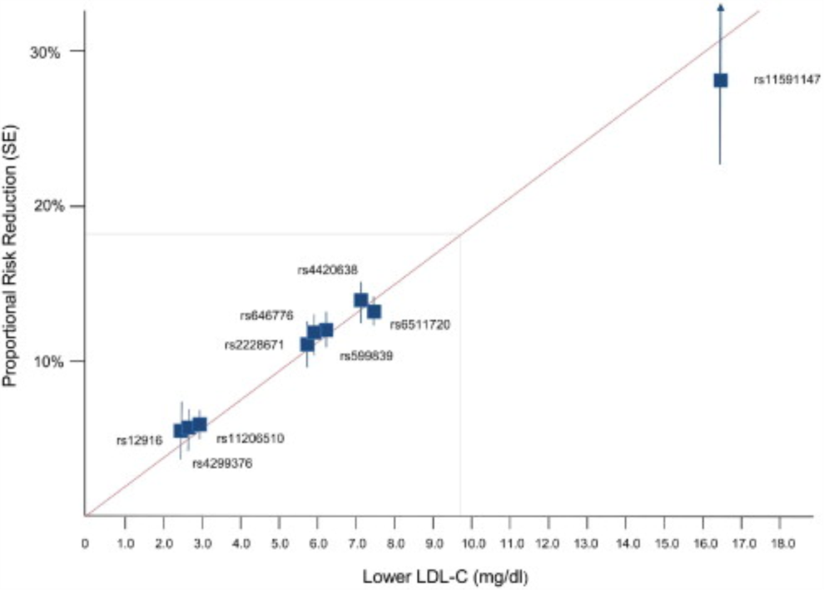
LDL and CHD Risk
Ference et al, JACC 2012

Slide 47
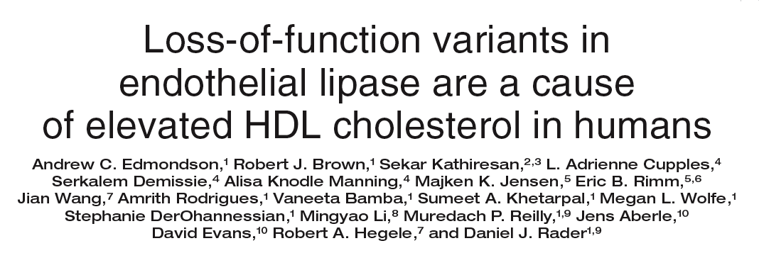
HDL: endothelial lipase Asn396Ser
2.6% of population carry Serine allele
higher HDL-C
No effect on other lipid fractions
No effect on other MI risk factors
Edmondson, J Clin Invest 2009

Slide 48
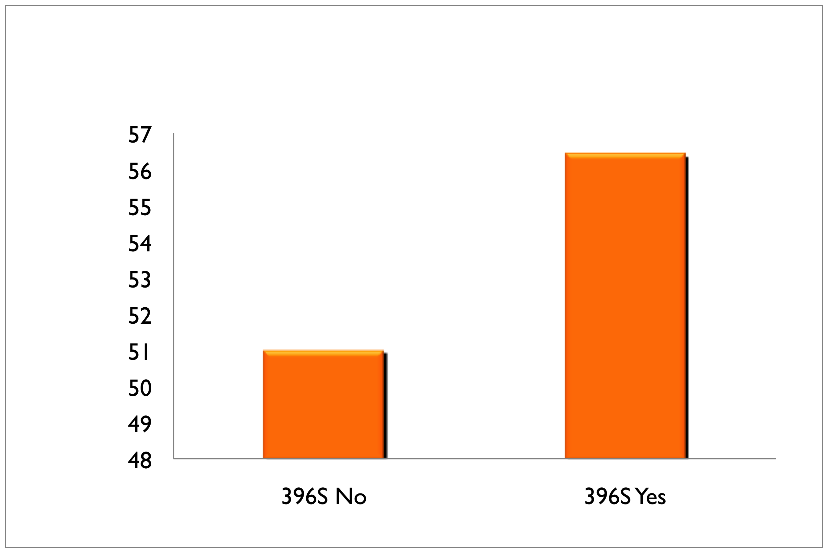
LIPG N396S and plasma HDL-C
HDL Difference
396S carriers have
5.5 mg/dl higher HDL-C
P<10⁻⁸
Notes:
Odds Ratio for MI:
0.54 (0.40 – 0.72)
P=2x10⁻⁵
N=3490 cases,
3497 controls

Slide 49
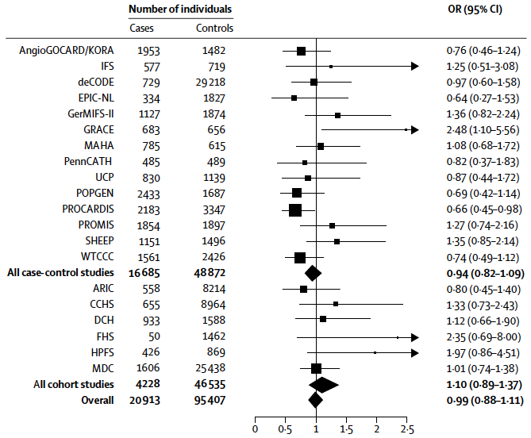
After testing in 116,320 people, summary OR for LIPG Asn396Ser is 0.99

Slide 50
Individuals who carry the HDL-boosting variant have the same risk for heart attack
as those who do not carry the variant

Slide 51
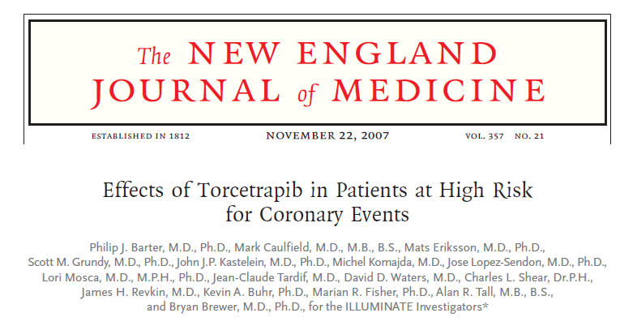
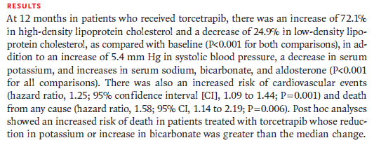

Slide 52
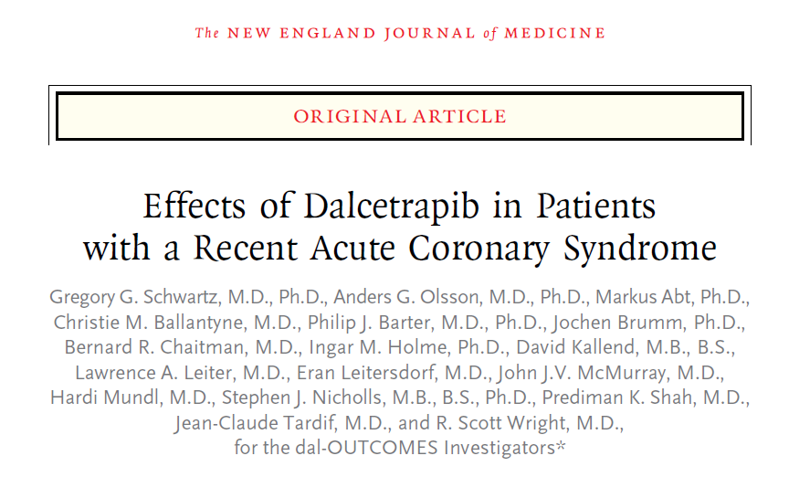
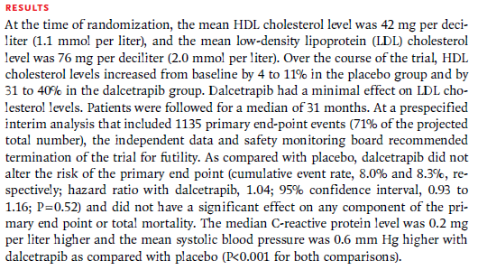

Slide 53
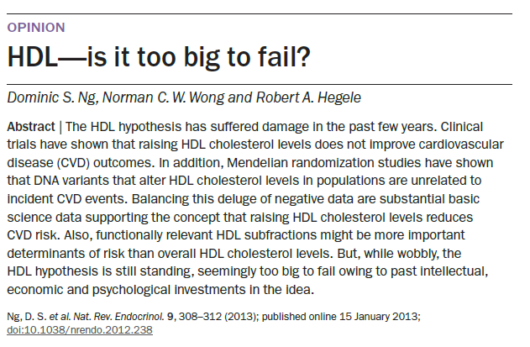

Slide 54
Limitations to Mendelian Randomisation
1- Pleiotropy
2- Population stratification
3- Canalisation
4- Power (also “weak instrument bias”)
5- The existence of instruments

Slide 55
MR References

Slide 56
Fitting Mendelian Randomization Models in R

Slide 57
Equivalence Between Directed Acyclic Graphs and SEMs
Confounders
SNP
Exposure
Outcome
ξ₁
ξ₂
SNP
Exposure
Outcome
β_{x}
β_{Y}

Slide 58
Simulation
U
β_{UX}
β_{UY}
Z
X
Y
β_{ZX}
β_{XY} = 0.1
ξ₁
ξ₂

Slide 59
Practical

Slide 60
Acknowledgments
George Davey Smith
Nic Timpson
Sek Kathiresan

