Slide 1
Estimating “SNP Heritability” using GCTA/GREML
David Evans
University of Queensland

Slide 2

Behavior Genetics Meeting Brisbane 2016
View from Evans’ Laboratory*
*Presenter makes no guarantees wrt veracity of
statements made in the course of this presentation

Slide 3



Behavior Genetics Meeting Brisbane 2016
Nick Martin

Slide 4
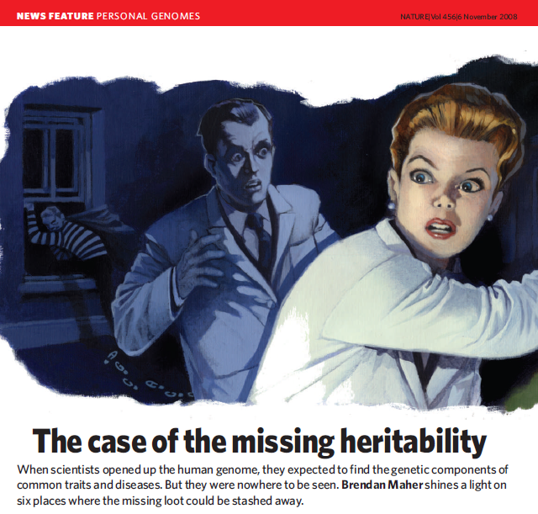
The Majority of Heritability for Most Complex Traits and Diseases is Yet to Be Explained
Maher (2009) Nature

Slide 5
Places the Missing Heritability Could be Hiding
In the form of common variants of small effect scattered across the genome
In the form of low frequency variants only partially tagged by common variants
Estimates of heritability from twin models are inflated (GASP!!!)

Slide 6
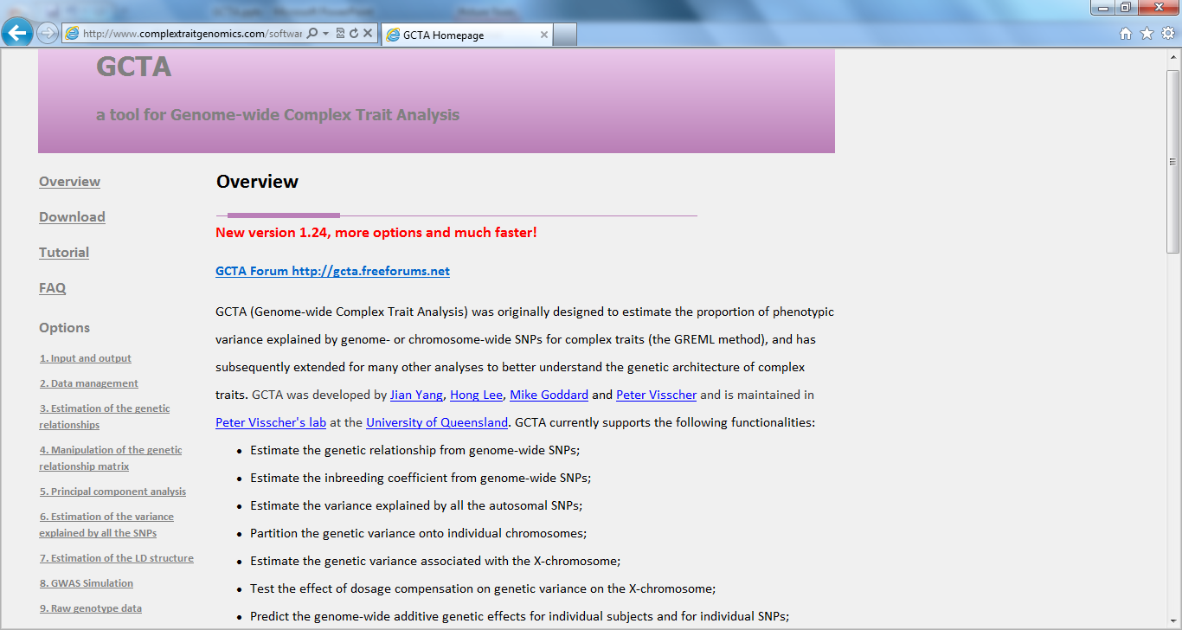


http://cnsgenomics.com/software/gcta/
Notes:
http://cnsgenomics.com/software/gcta/

Slide 7
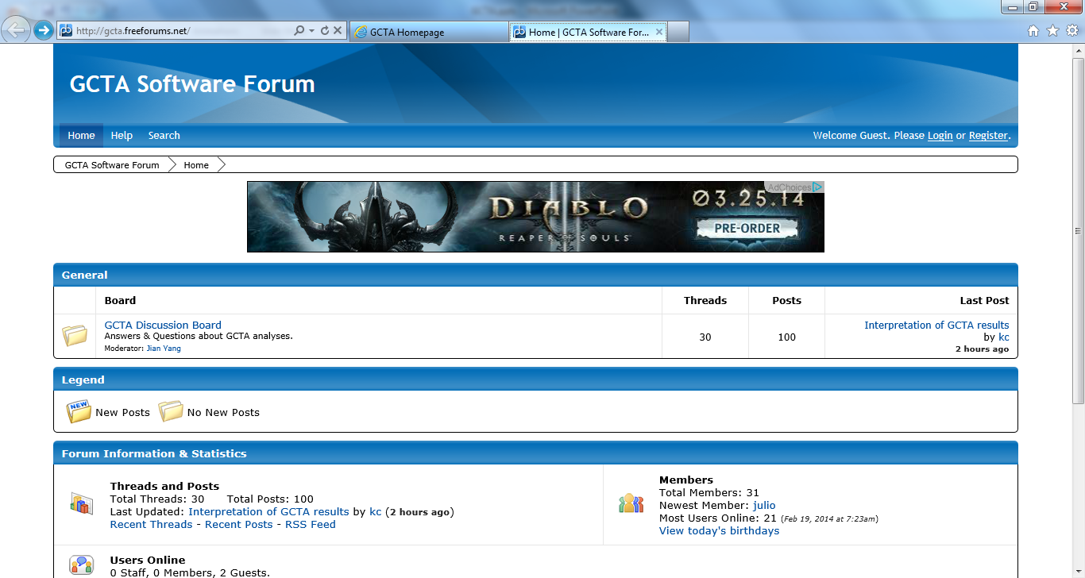

Slide 8
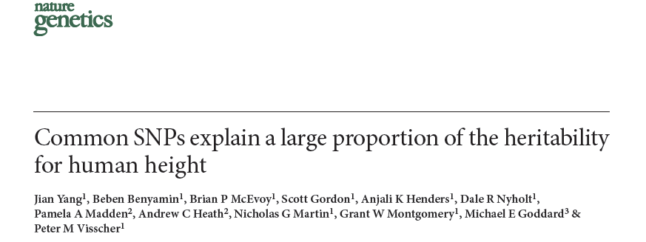
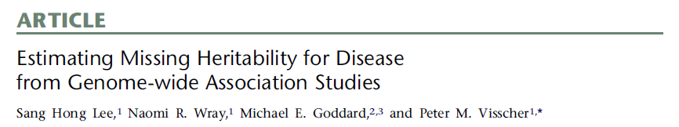
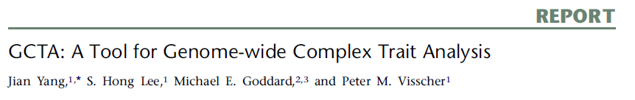

Slide 9
The Classical Twin Design
r_{g(MZ)} = 1
r_{g(DZ)} = 0.5
r_{c} = 1
A₁
C₁
E₁
A₂
C₂
E₂
a
c
e
a
c
e
P₁
P₂
a² + c² + e²
a² + c²
V_{MZ} =
a² + c²
a² + c² + e²
P₁ = aA₁ + cC₁ + eE₁
a² + c² + e²
½a² + c²
P₂ = aA₂ + cC₂ + eE₂
V_{DZ} =
½a² + c²
a² + c² + e²

Slide 10
Expected Covariance Matrix Twin Pairs
(AE Model)
V = Rσ²_{A} + Iσ²_{E}
=
σ²_{A}
+
σ²_{E}
=
σ²₁ σ₁₂
σ₂₁ σ²₂
1 r
r 1
1 0
0 1
σ²_{A +} σ²_{E} r σ²_{A}
rσ²_{A} σ²_{A +} σ²_{E}
.
.
(2 x 2)
(2 x 2)
(2 x 2)
(2 x 2)
V is the expected phenotypic covariance matrix
σ²_{A} is the additive genetic variance
σ²_{E} is the unique environmental variance
R is a matrix containing twice the kinship coefficient (r = 1 for MZ, r = 0.5 for DZ))
I is an identity matrix

Slide 11
The GCTA Design- Unrelateds
r_{g} = A_{ij}
A₁
E₁
A₂
E₂
a
e
a
e
P₁
P₂
P₁ = aA₁ + eE₁
a² + e²
A_{ij}a²
V =
A_{ij}a²
a² + e²
P₂ = aA₂ + eE₂

Slide 12
Expected Covariance Matrix - Unrelateds
V = Aσ²_{g} + Iσ²_{e}
σ²₁ … σ_{1n}
… … …
σ _{n1} … σ²_{n}
=
a₁₁ … a_{1n}
… … …
a _{n1} … a²_{nn}
σ²_{g}
+
1 0 0
0 1 0
0 0 1
σ²_{e}
.
.
(n x n)
(n x n)
(n x n)
V is the expected phenotypic covariance matrix
σ²_{g} is the additive genetic variance
σ²_{e} is the unique environmental variance
A is a GRM containing average standardized genome-wide IBS between individual i and j
I is an identity matrix

Slide 13


GCTA- Genetic Relationship Matrix

Slide 14
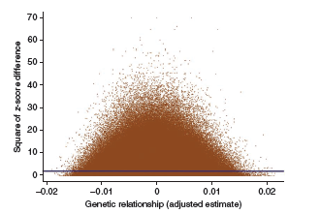
Intuitively...
If a trait is genetically influenced, then individuals who are more genetically similar should be more phenotypically similar
Can be thought of like a Haseman- Elston regression

Slide 15
GCTA Process
Two step process
Estimate GRM
Exclude one from each pair of individuals who are >2.5% IBS (closely related individuals exert undue influence and may share common environments)
Estimate variance components via “REML”

Slide 16
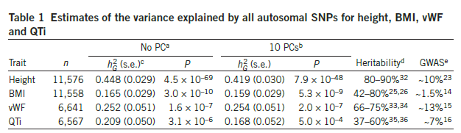
GCTA- Some Results
*
Adapted from
Yang et al. (2011) Nat Genet

Slide 17
GCTA Interpretation
GCTA explains the proportion of variance explained by SNPs on the microarray (“SNP heritability”)
GCTA does not estimate “heritability”
GCTA does not estimate the proportion of trait variance due to common SNPs

Slide 18
Extending the Model - Genome Partitioning
22
V = Σ A_{c}σ²_{g,c} + Iσ²_{e}
c = 1
The genetic component can be partitioned further into e.g. different chromosomes, genic vs non-genic regions
A different GRM (A_{c}) needs to be computed for each of these components

Slide 19
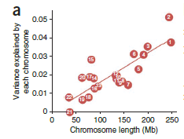
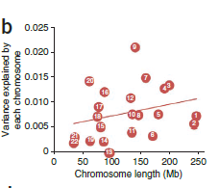
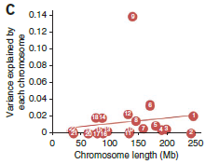
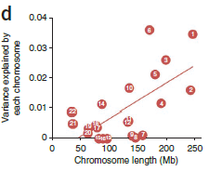
Extending the Model - Genome Partitioning
Height
BMI
Von Willebrand Factor
QT Interval
Adapted from
Yang et al. (2011) Nat Genet

Slide 20
Extending the Model: Gene-Environment Interaction
V = A_{g}σ²_{g} + A_{ge}σ²_{ge} + Iσ²_{e}
A_{ge} = A_{g} for pairs of individuals in the same environment and A_{ge} = 0 for pairs of individuals in different environments
“Environmental” factors could be sex or medical treatment for example

Slide 21
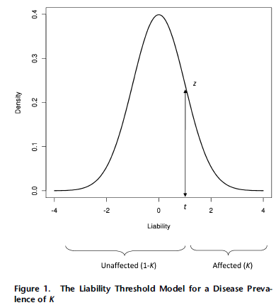

Extending the Model - Binary Traits
Assume an underlying normal distribution of liability
Transform estimates from the observed scale to the liability scale

Slide 22
Extending the Model – BinaryTraits
Estimate GRM
Exclude one from each pair of individuals who are >2.5% IBS
Estimate variance components via “REML”
Transform from observed scale to liability scale
Adjust estimates to take account of ascertainment (i.e. the fact that case-control proportions are not the same as in the population)

Slide 23
Extending the Model – Bivariate Association
Estimate the genetic and residual correlation between different traits/diseases
Individuals need not be measured on both traits

Slide 24
GREML-LDMS

Slide 25

Idea…
It should be obvious now, that pretty much all the models that we have touched on this week can be expressed within this GCTA framework
Yet only a small proportion of these have been parameterized in GCTA
Considerable scope exists for parameterization of the GCTA framework in Mx…

