Slide 1
The Causes of Variation
2016 International Workshop on Statistical Genetic Methods
for Human Complex Traits
Boulder, CO.
Lindon Eaves,
VIPBG, Richmond VA.
March 2016

Slide 2
GOALS – “Orientation”
To outline some of the basic issues that we will address this week
To set some of the issues in their historical context in the story of genetics and its application to human variation.

Slide 3
“Genetics”
The Study of
Variation and Heredity

Slide 4
“Variation”
“Why aren’t we all the same?”

Slide 5
“Heredity”
“Why do things run in families?”

Slide 6
“VARIATION”

Slide 7
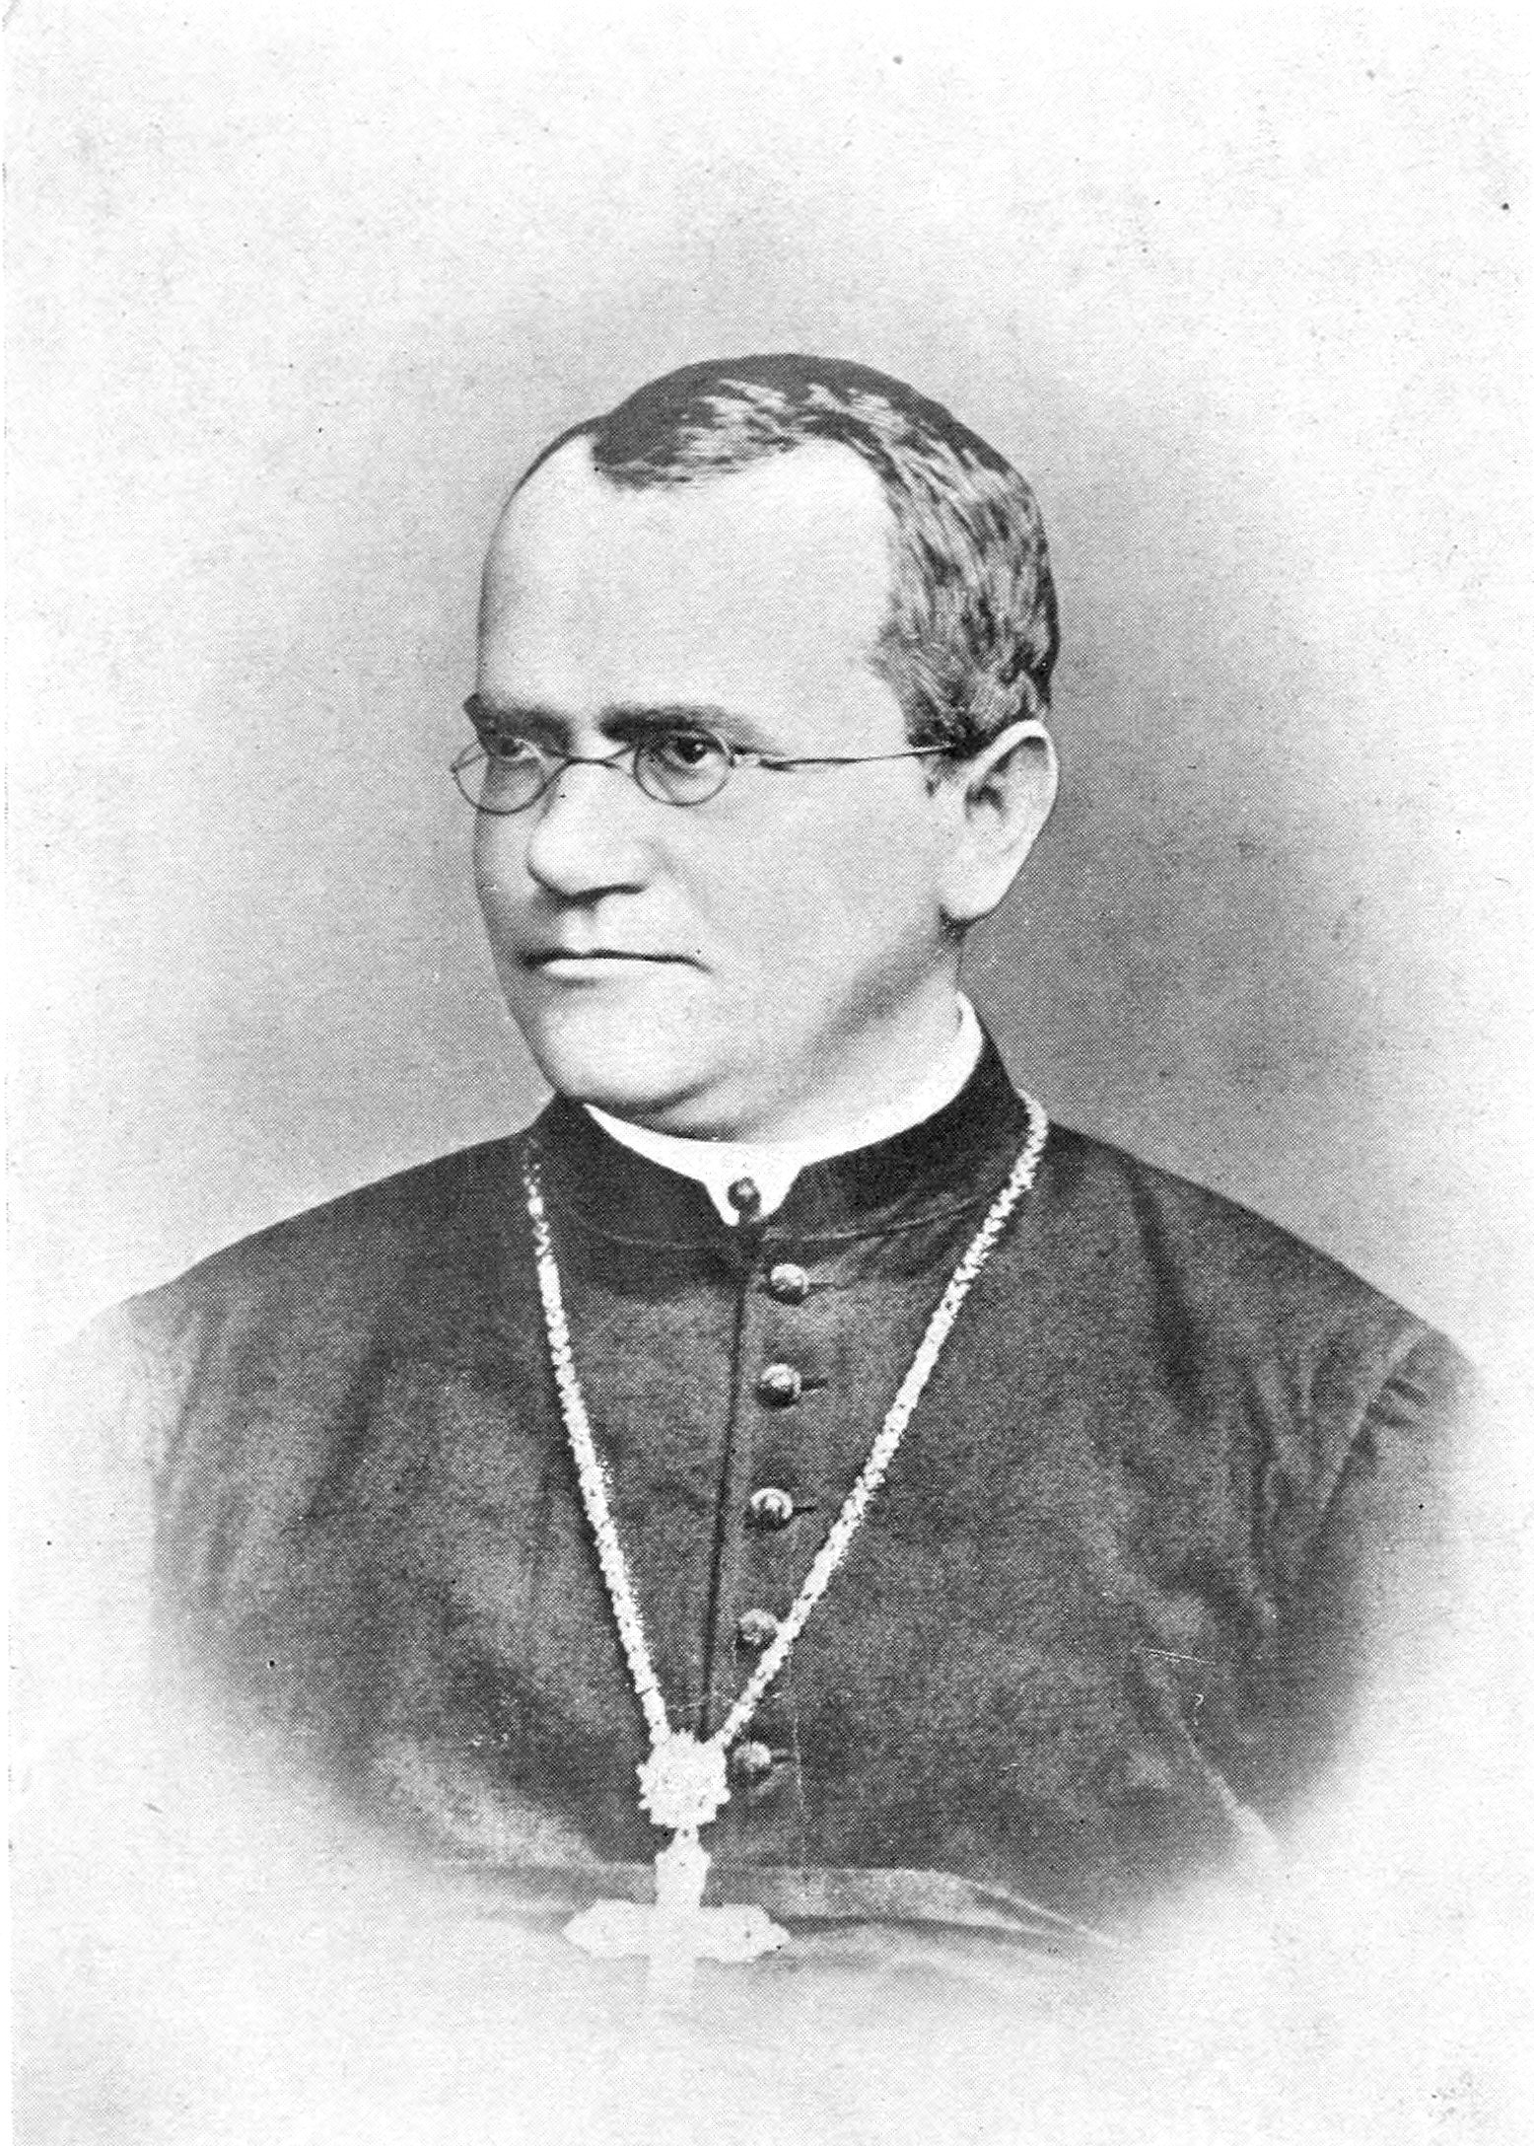

Slide 8
Gregor Mendel (1822-1885)
1865: Experiments in Plant Hybridisation

Slide 9
Mendel
Binary traits (“White vs Pink”)
Particulate (“Mendelian”) Inheritance
Simple mathematical and statistical laws
Corresponded to behavior of chromosomes
Explained inborn errors of metabolism ->Medical genetics, “gene-hunting”
Provided Mechanism for Natural Selection
Illuminated by structure of DNA

Slide 10
Continuous variation

Slide 11
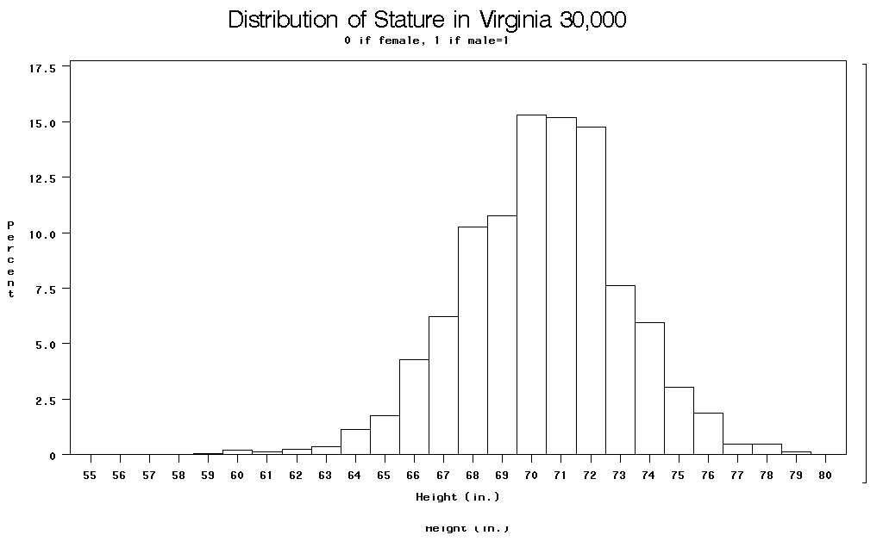

Slide 12
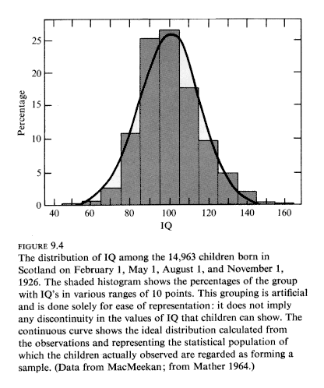

Slide 13
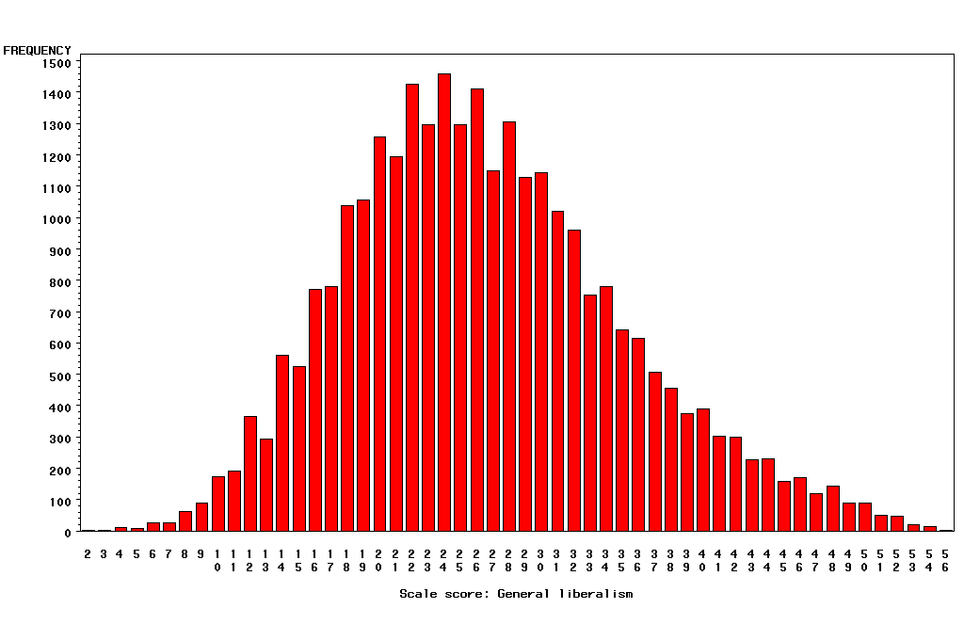
“Liberalism”

Slide 14
Categorical Outcomes
Often called “threshold traits” because people “affected” if they fall above some level (“threshold”) of a measured or hypothesized continuous trait.

Slide 15
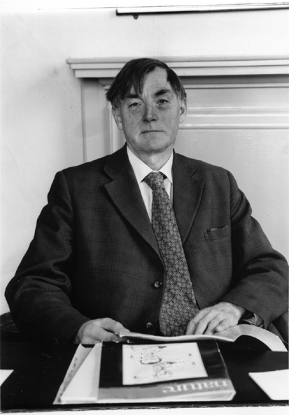
Douglas Scott Falconer, FRS, FRSE (1913-2004)
1965 Inheritance of liability to certain diseases estimated from
incidence among relatives., Ann. Hum. Genet.29:51ff.
1960 Introduction to Quantitative Genetics. Edinburgh: Oliver and Boyd.

Slide 16
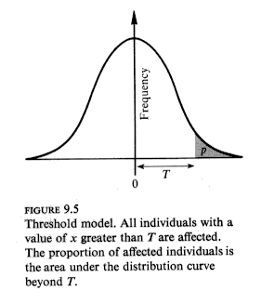

Slide 17
∞
Relationship between continuous normal “liability”
and risk of “diagnosis” (see I.R.T.)
Probability
of
Diagnosis
1
0.5
0
-∞
0
t
+∞
Liability
(Trait Value)
Notes:
Consider e.g. “hypertension”: liability is blood pressure (contininous measure); diagnosis is doctor deciding you are “hypertension”.
Also, e.g. “diabetes” and “fasting glucose”; “republican” and “conservatism”. “Genius” and “IQ”. Etc.

Slide 18
Question that bugs me:
How do you get from “liability” to “catastrophe”?

Slide 19
“Heredity”

Slide 20
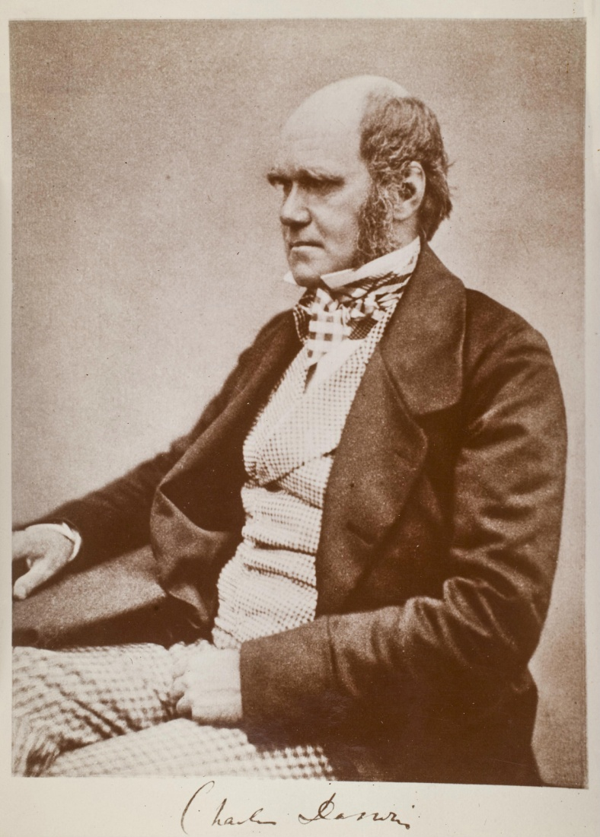

Slide 21
Charles Darwin (1809-1882)
1865: On the Origin of Species

Slide 23
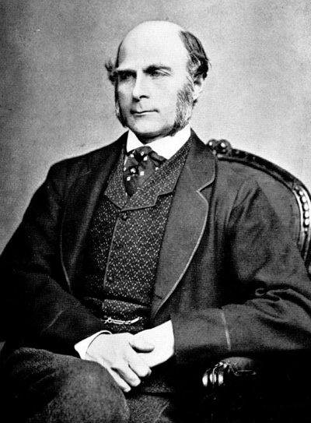
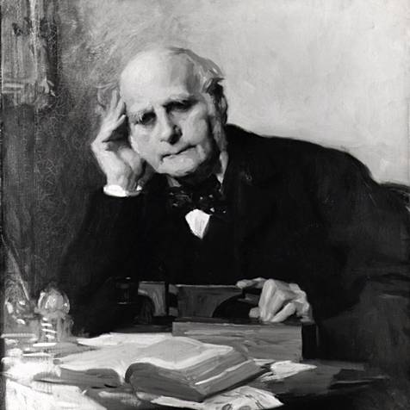
Notes:
Astonishing intellectual curiosity: 3-volume biography by his graduate student (Karl Pearson). Self-styled “gentleman”
i.e. didn’t need to earn his living. Could afford to do research. Many interests: numbers (devised vest with grid of pockets to accumulate contingency table from observations); finger-prints; composite photographs; family history (pedigree methods); statistics (devised correlation coefficient);
Measured family resemblance; collected first “twin” data (though Augustine hit on the method in the 4th Cent. Ch. 5 of Civitas Dei.)

Slide 24
Francis Galton (1822-1911)
1869: Hereditary Genius
1883: Inquiries into Human Faculty and its Development
1884-5: Anthropometic Laboratory at “National Health Exhibition”
Notes:
Astonishing intellectual curiosity: 3-volume biography by his graduate student (Karl Pearson). Self-styled “gentleman”
i.e. didn’t need to earn his living. Could afford to do research. Many interests: numbers (devised vest with grid of pockets to accumulate contingency table from observations); finger-prints; composite photographs; family history (pedigree methods); statistics (devised correlation coefficient);
Measured family resemblance; collected first “twin” data (though Augustine hit on the method in the 4th Cent. Ch. 5 of Civitas Dei.)

Slide 25
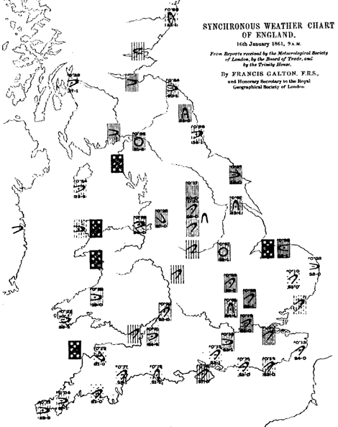
Galton’s Other Work e.g. Meteorology

Slide 26
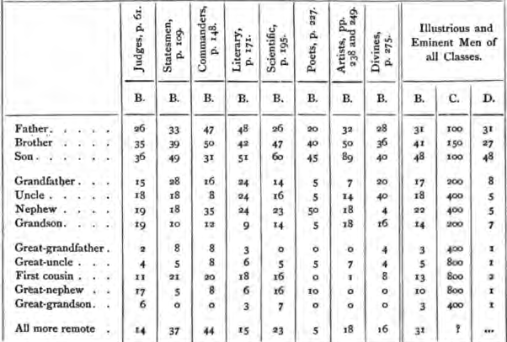
Hereditary Genius (1869, p 317)

Slide 27
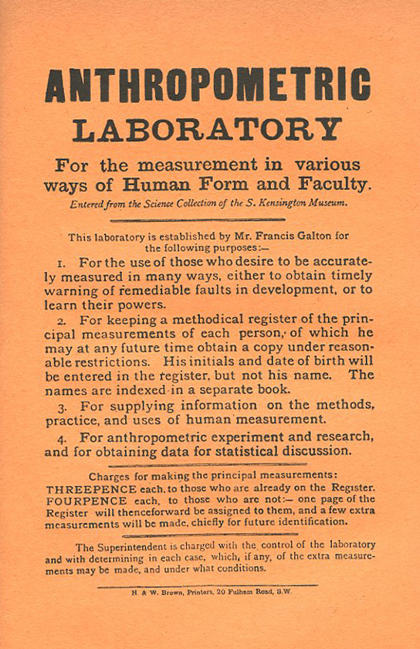
Galton’s Anthropometric Laboratory (1884-1885)

Slide 28
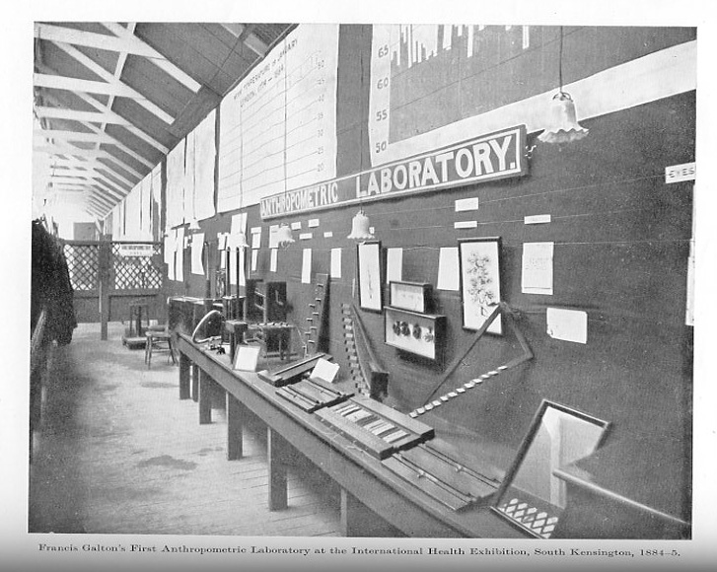

Slide 29
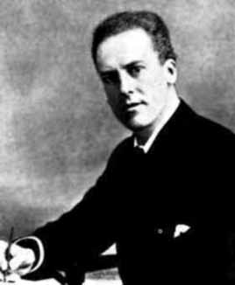
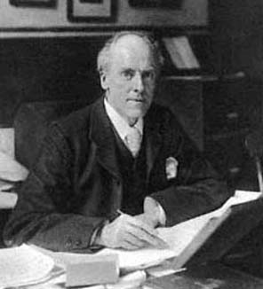

Slide 30
Karl Pearson (1857-1936)
1903: On the Laws of Inheritance in Man: I Physical Characteristics (with Alice Lee)
1904: II Mental and Moral Characteristics
1914: The Life, Letters and Labours of Francis Galton

Slide 31
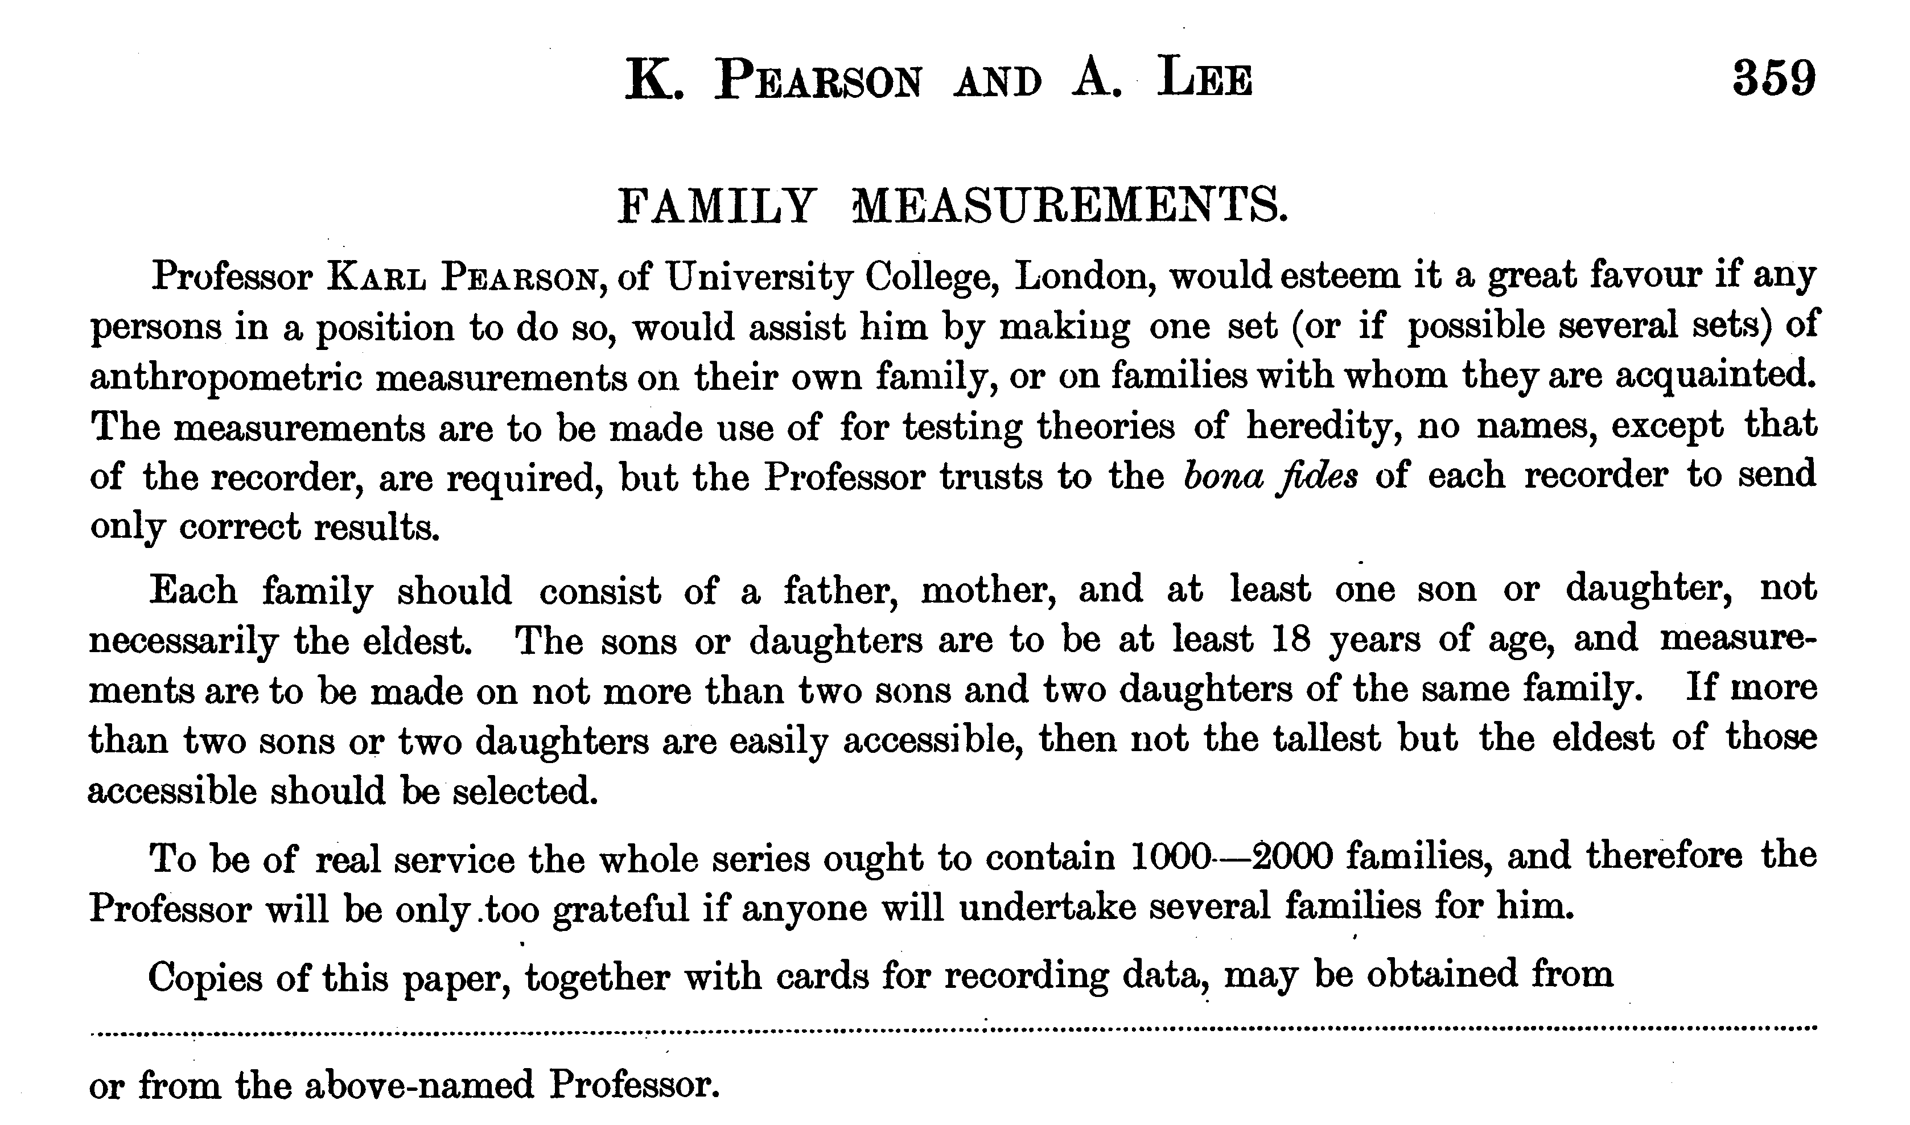

Slide 32
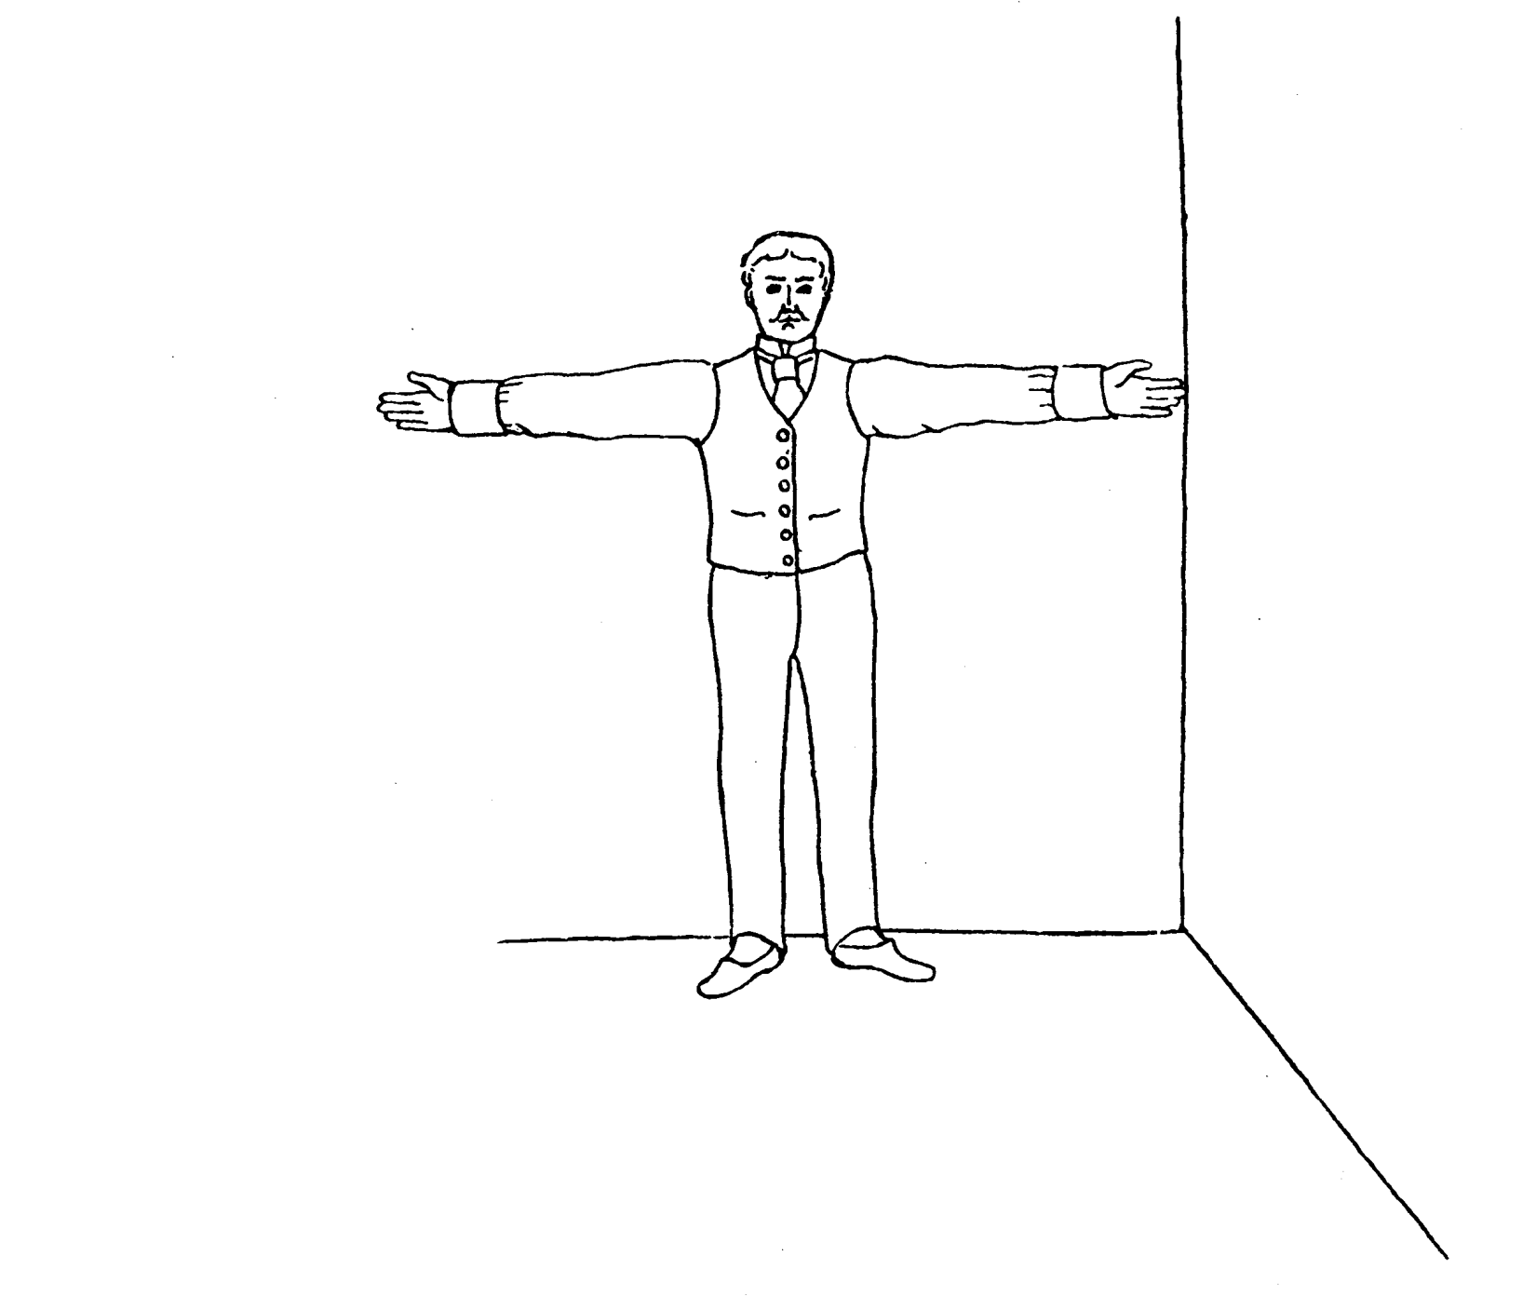
Pearson and Lee’s diagram for measurement of “span” (finger-tip to finger-tip distance)

Slide 33
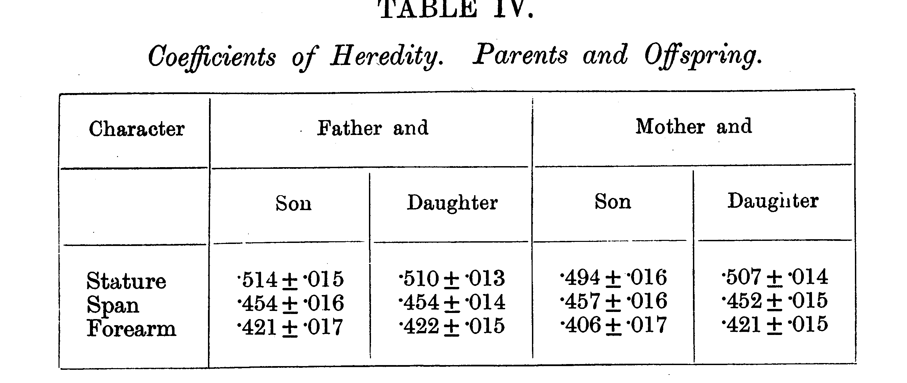
From Pearson and Lee (1903) p.378

Slide 34
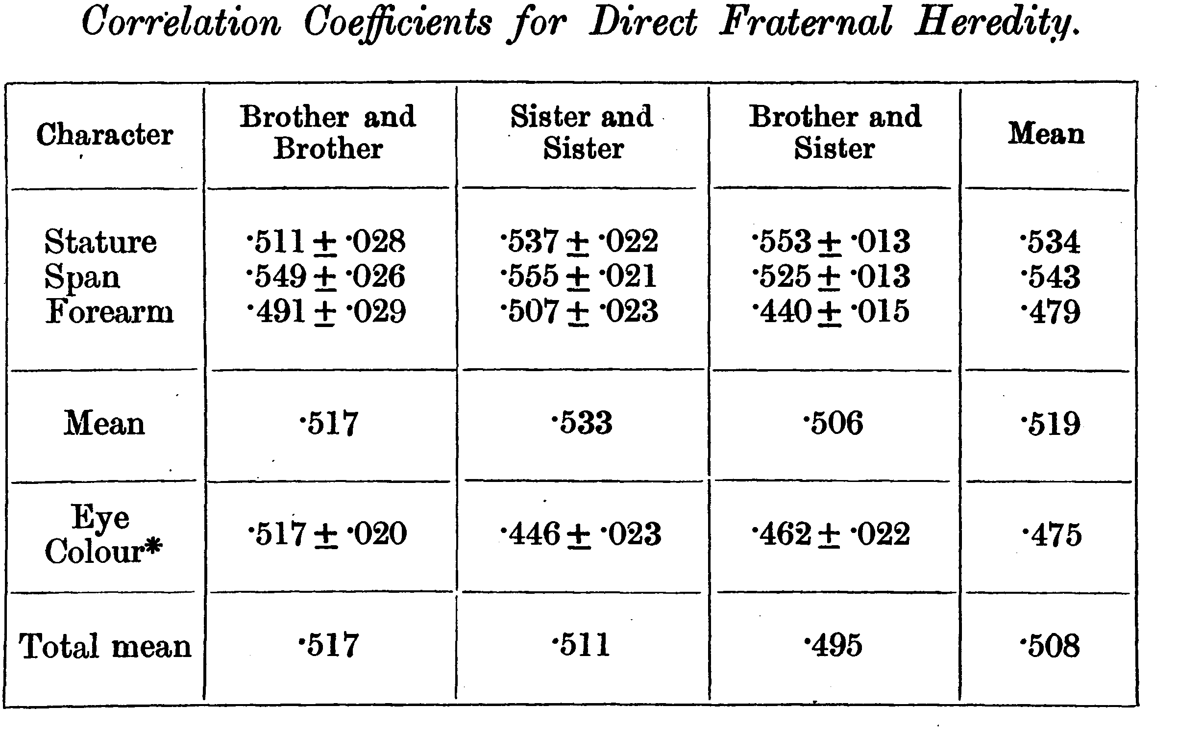
From Pearson and Lee (1903) p.387

Slide 35
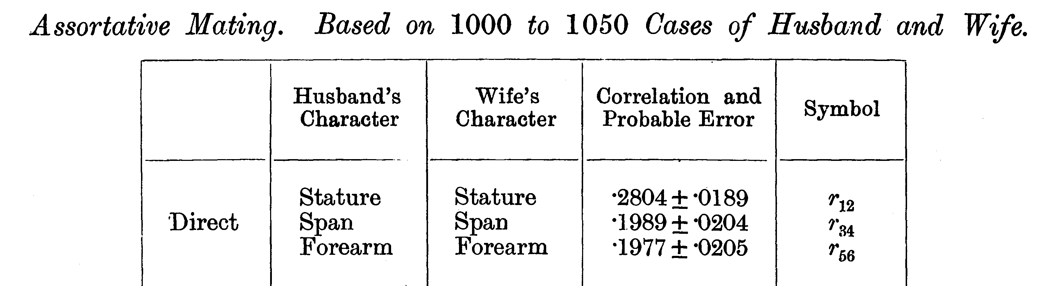
From Pearson and Lee (1903) p. 373

Slide 36
Modern Data
The Virginia 30,000 (N=29691)
The Australia 22,000
(N=20480)

Slide 37
ANZUS 50K: Extended Kinships of Twins
Parents of Twins
Siblings of Twins
Spouses of Twins
Twins
Offspring of Twins
© Lindon Eaves, 2009

Slide 38
Overall sample sizes
Relationship | # of pairs
Parent-offspring Siblings | 25018 18697
Spouses | 8287
DZ Twins MZ Twins | 5120 4623

Slide 39
Nuclear Family Correlations for Stature
(Virginia 30,000 and OZ 22,000)
Notes:
Notice: effects of mother and father equal; correlations for sibs close to parents;
Slight correlation between mates (assortative mating).

Slide 40
Nuclear Family Correlations for Stature and Liberalism/Conservatism
(Virginia 30,000)
Notes:
Compare with stature: notice how much greater assortative mating.

Slide 41
Nuclear Family Correlations for Liberalism/Conservatism
(Virginia 30,000 and Australia 22,000)

Slide 42
Nuclear Family Correlations for Stature and EPQ Neuroticism
(Virginia 30,000)

Slide 43
Nuclear Family Correlations for Socially Significant Variables
(Virginia 30,000)

Slide 44
Nuclear Family Correlations for Socially Significant Variables
(Australia 22K)

Slide 45
The (Really!) BIG Problem
Families are a mixture of genetic and social factors

Slide 46
The Extended Phenotype
World
Parents
Me
Spouse
Siblings
Child
Extended Phenotype

Slide 47
A Basic Model
Phenotype=Genotype+Environment
P=G+E {+f(G,E)}
f(G,E) = G-E “Interplay”
i.e. Genotype-environment interaction (GxE) and G-E correlation (rGE)

Slide 48
GxE Interaction and Correlation
GxE: SENSITIVITY to E controlled by G
rGE: EXPOSURE to E correlated with (“depends on”) G
Lots of good plant and animal models for both

Slide 49
Sources of rGE
Environment is “caused by” (“selected by”) genetic characteristics of subject (“active/evocative” e.g. “niche selection”)
Environment is “affected by” genetic characteristics of relatives (mothers, fathers, siblings, “passive”)
Both are (may be) dynamic, temporal, developmental

Slide 50
Galton’s Solution:
      Twins
      (Though Augustine may have got there first – 5th cent.)

Slide 51
One (?ideal) solution
Twins separated at birth

Slide 52
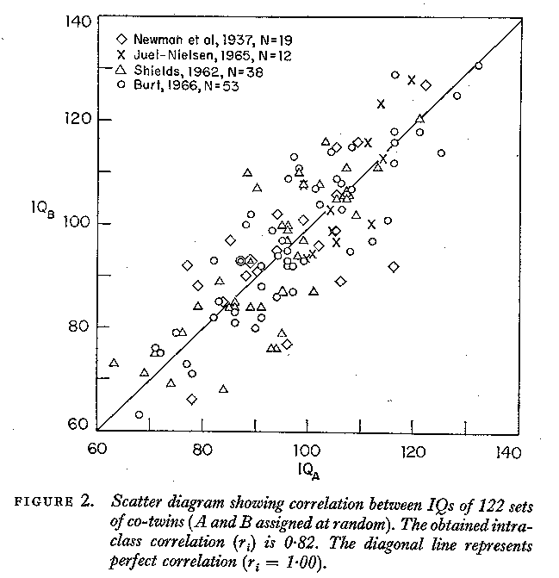

Slide 53
But separated MZs are rare

Slide 54
An easier alternative:
Identical and non-identical twins reared together:
Galton (Again!)

Slide 55
IDENTICAL TWINS
MONOZYGOTIC: Have IDENTICAL genes (G)
Come from the same family (C)
Have unique experiences during life (E)

Slide 56
FRATERNAL TWINS
DIZYGOTIC: Have DIFFERENT genes (G)
Come from the same family (C)
Have unique experiences during life (E)

Slide 57
Figure 9. The correlation between twins for stature (data from the Virginia Twin Study of Adolescent Behavioral Development).
Data from the Virginia Twin Study of Adolescent Behavioral Development

Slide 58
Data from the Virginia Twin Study of Adolescent Behavioral Development

Slide 59
Twin Correlations for Adult Stature
(Virginia 30,000 and Australia 22,000)

Slide 60
Twin Correlations for Stature and Liberalism
(Virginia 30,000 and Australia 22,000)

Slide 61
Twin Correlations for Stature and Liberalism
(Virginia 30,000 and Australia 22,000)

Slide 62
Twin Correlations for Socially Significant Variables
(Virginia 30,000)

Slide 63
Twin Correlations for Socially Significant Variables
(Australia 22,000)

Slide 64
Twin correlations for gene expression
York et al.

Slide 65
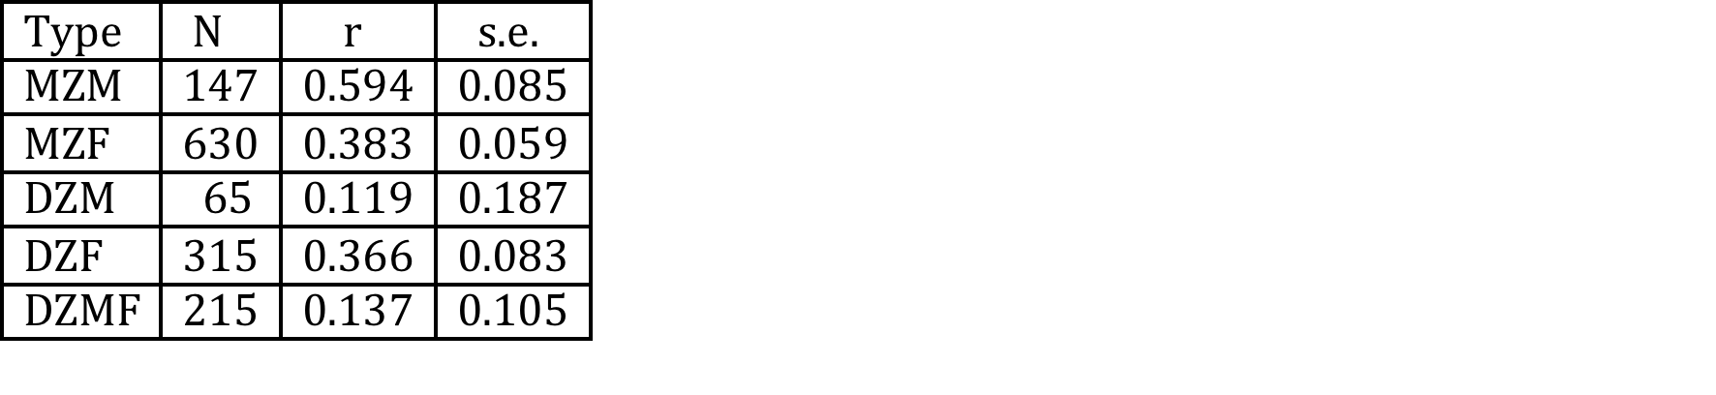
Twin correlations for attitudes to gun control

Slide 66
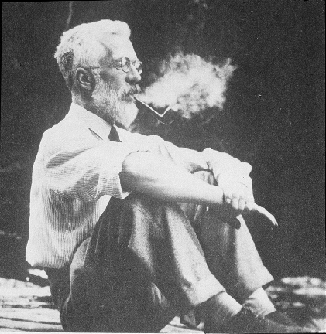

Slide 67
Ronald Fisher (1890-1962)
1918: On the Correlation Between Relatives on the Supposition of Mendelian Inheritance
1921: Introduced concept of “likelihood”
1930: The Genetical Theory of Natural Selection
1935: The Design of Experiments

Slide 68
Fisher developed mathematical theory that reconciled Mendel’s work with Galton and Pearson’s correlations

Slide 69
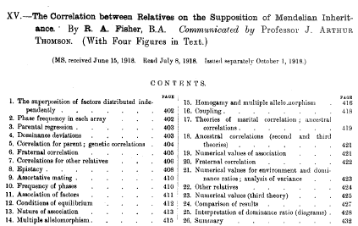

Slide 70
a.
b.
c.

Slide 71
Fisher (1918): Basic Ideas
Continuous variation caused by lots of genes (“polygenic inheritance”)
Each gene followed Mendel’s laws
Environment smoothed out genetic differences
Genes may show different degrees of “dominance”
Genes may have many forms (“mutliple alleles”)
Mating may not be random (“assortative mating”)
Showed that correlations obtained by e.g. Pearson and Lee were explained well by polygenic inheritance
Let to “Biometrical Genetics” (Mather, Jinks etc.)

Slide 72
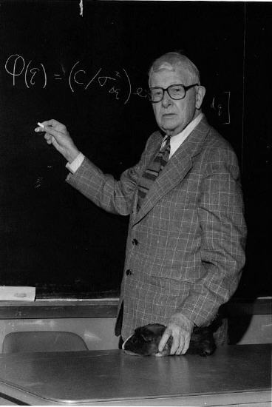

Slide 73
Sewall Wright (1889-1988
1984. Evolution and the Genetics of Populations:
Genetics and Biometric Foundations (4 vols.)
1934. The method of path coefficients. Ann. Math. Staiist. 5: 161-215

Slide 74
Path diagram for the effects of genes and environment on phenotype
Genotype
Environment
G
r
Latent variables
E
h
e
P
Measured variable
Phenotype

Slide 75
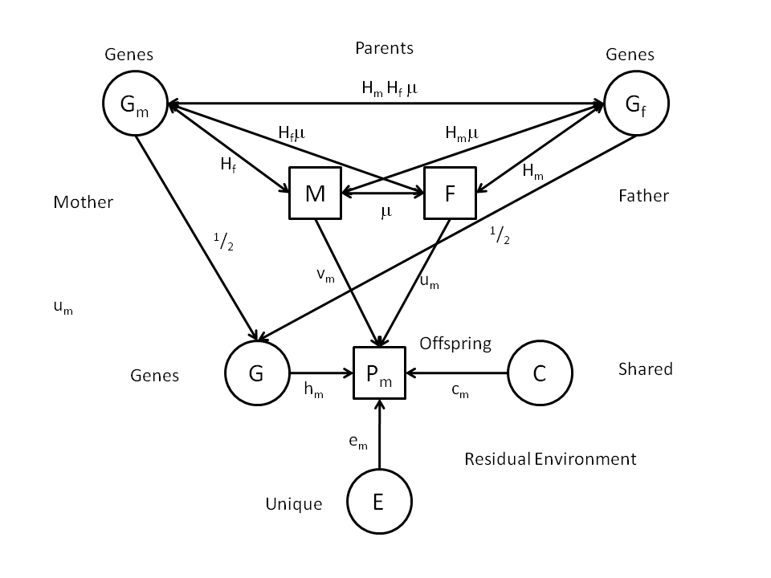
Genetic AND Cultural inheritance?
Notes:
Diagram shows possible causes – called “Path Diagram” (Sewall Wright, 1921).
Will deal with these later in the course.

Slide 76
Development

Slide 77
a. Genetic variation in developmental change: time series with common genes and time-specific environmental “innovations”
Genes
G
h
h
h
h
h
Phenotype
T0
b
T1
b
T2
b
T4
b
T5
Age
e
e
e
e
e
E1
E2
E3
E4
E5
Environment

Slide 78
Attitudes over the life-span

Slide 79
Children of Twins (“COT”)
Parents of Twins
Siblings of Twins
Spouses of Twins
Twins
Offspring of Twins

Slide 80
Gestational Age
Racial Differences in Genetic and Environmental Risk to Preterm Birth
Timothy P. York, Jerome F. Strauss,
Michael C. Neale, Lindon J. Eaves
PLoS One. 2010 Aug 25;5(8):e12391.

Slide 81
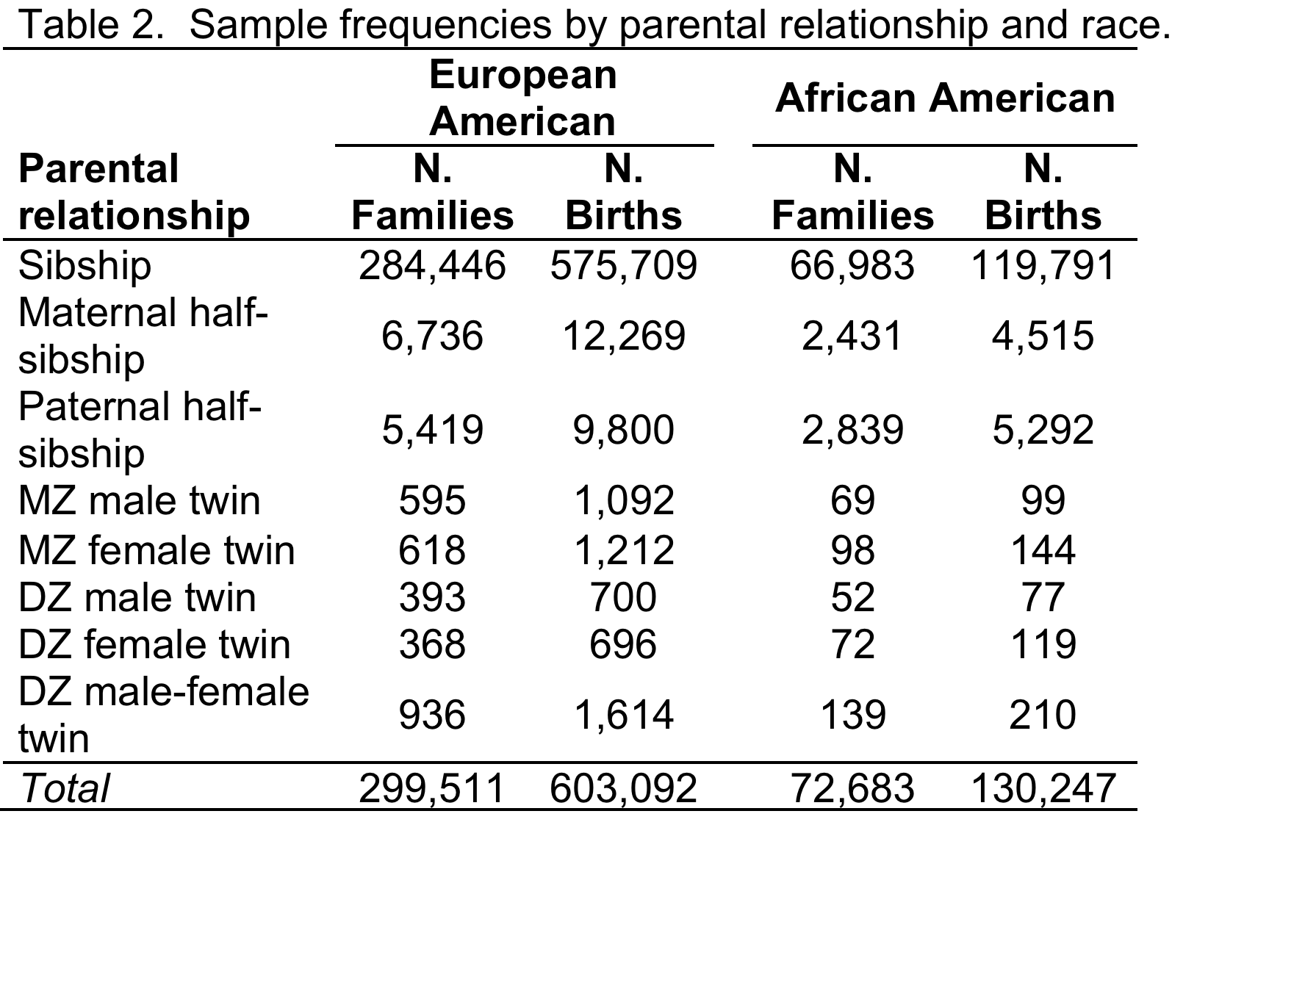

Slide 82
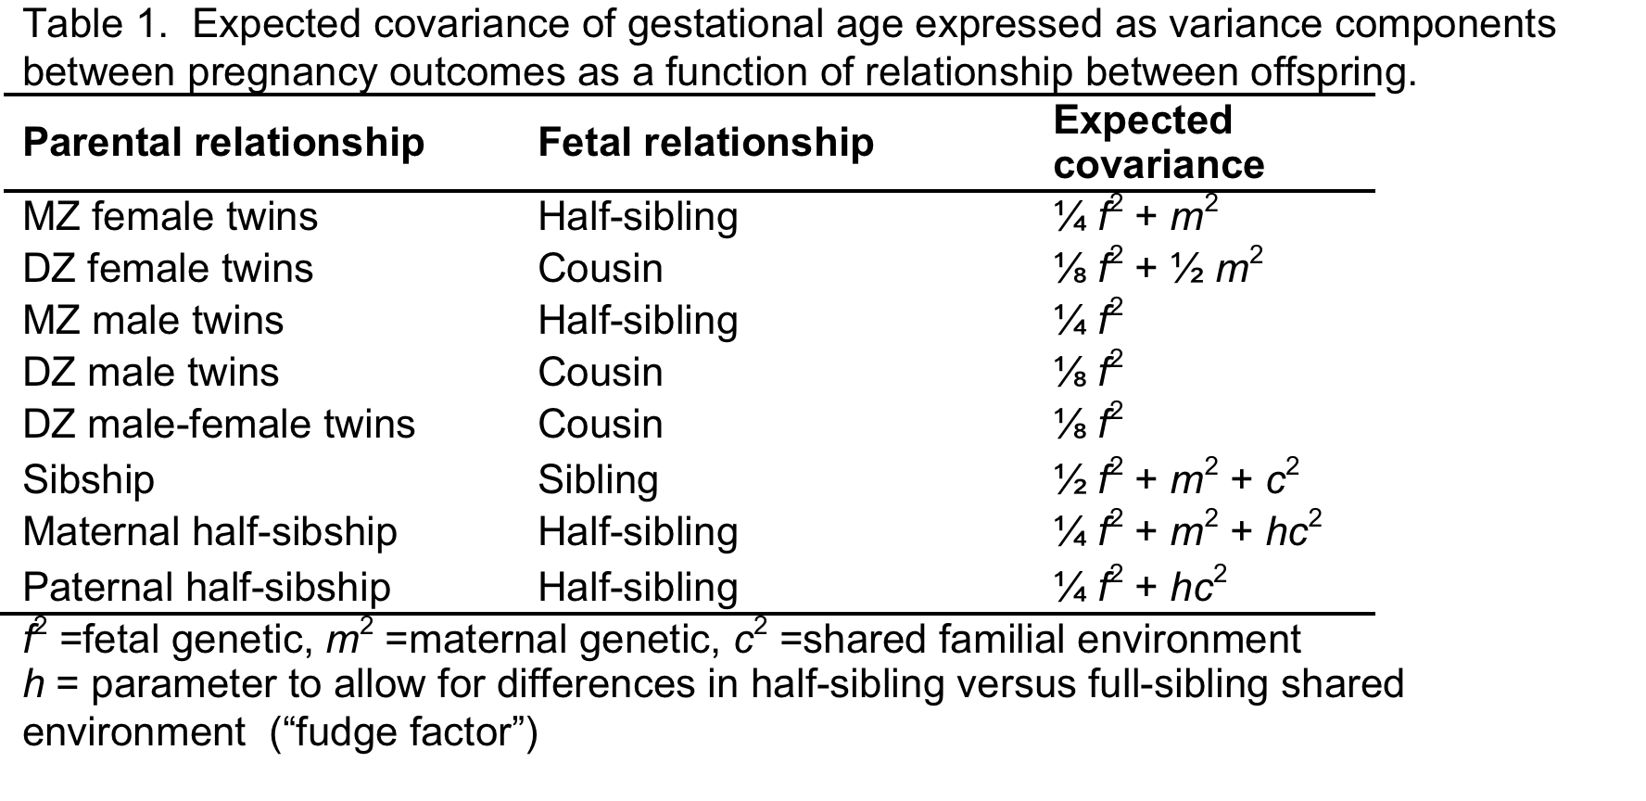

Slide 83
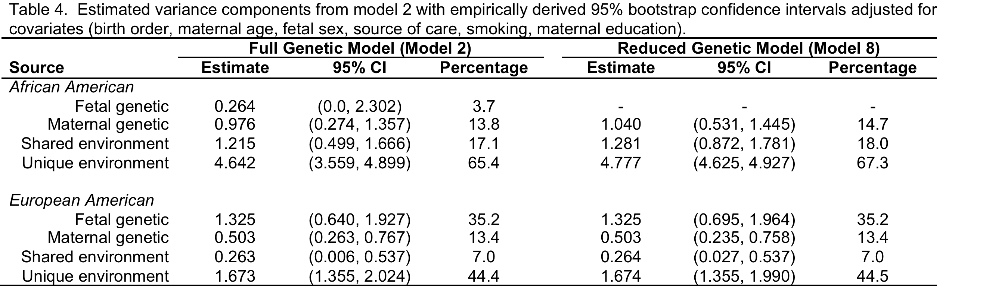

Slide 84
“Mating”

Slide 85
Spouses of Twins (“SPOT”)
Parents of Twins
Siblings of Twins
Spouses of Twins
Twins
Offspring of Twins

Slide 86
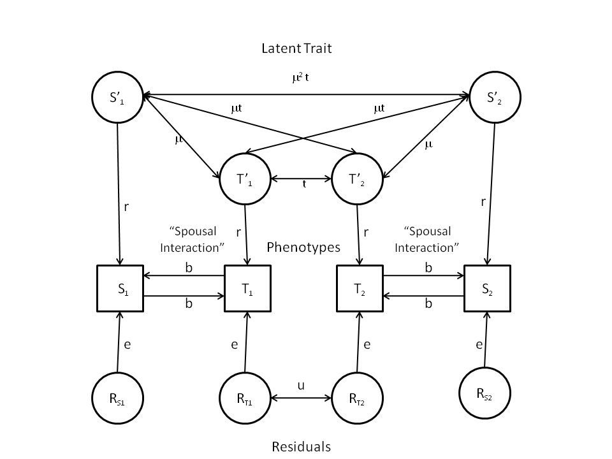
“Twins and Spouses”

Slide 87
f(G,E)
Genotype x Environment Interaction (“GxE”)
Genotype-Environment Correlation
(“rGE”)

Slide 88
(“Passive”) rGE

Slide 89
Twins and Parents

Slide 90
Twins and Parents (“TAP”)
Parents of Twins
Siblings of Twins
Spouses of Twins
Twins
Offspring of Twins
© Lindon Eaves, 2009

Slide 91
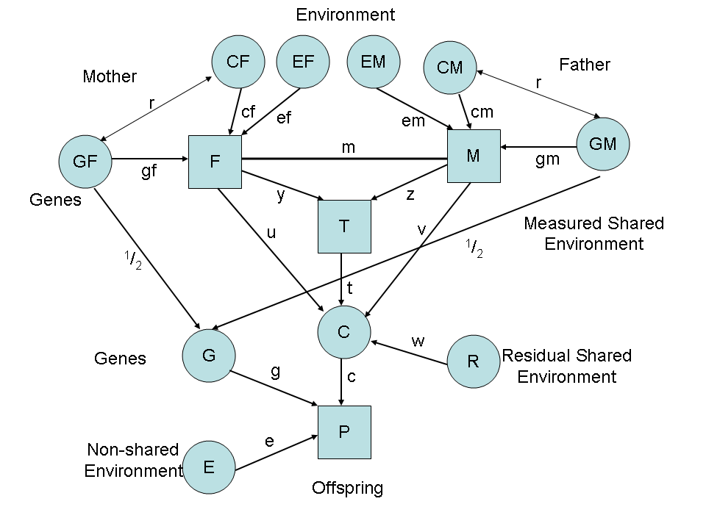
Parental Neglect and Anti-Social Behavior
Eaves et al., 2010

Slide 92
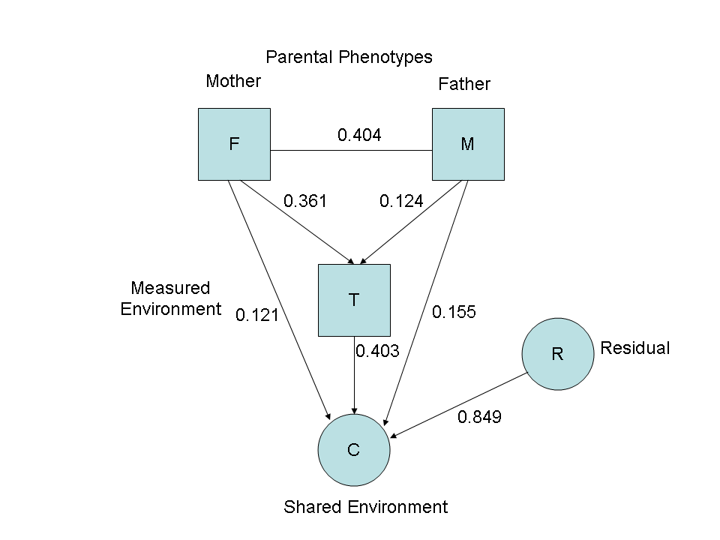
Environmental pathways

Slide 93
GxE

Slide 94
Genetic Variance and Shared Life Events in Adolescent Females

Slide 95
Putting it all together?

Slide 96
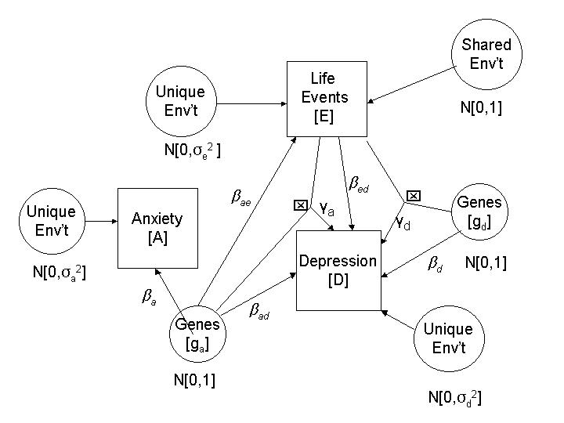
Multiple Genetic Pathways to Depression
Eaves et al. 2003

