Slide 1
Biometrical Genetics
2016 International Workshop on Statistical Genetic Methods
for Human Complex Traits
Boulder, CO.
Lindon Eaves,
VIPBG, Richmond VA.
March 2016

Slide 2
Biometrical Genetics
How do genes contribute to statistics (e.g. means, variances, skewness, kurtosis)?

Slide 3
Some Literature:
Mather K (1949) Biometrical Genetics: the Study of Continuous Variation. London UK: Methuen.
Mather K, Jinks JL (1982) Biometrical Genetics: the Study of Continuous Variation (3rd Ed.). London UK: Chapman Hall.
Jinks JL, Fulker DW (1970): Comparison of the biometrical genetical, MAVA, and classical approaches to the analysis of human behavior. Psychol Bull 73(5):311-349.
Kearsy MJ, Pooni HS (1996) The Genetic Analysis of Quantitative Traits. London UK: Chapman Hall.
Falconer DS, Mackay TFC (1996). Introduction to Quantitative Genetics, 4th Ed. Harlow, UK: Addison Wesley Longman.
Neale MC, Cardon LR (1992). Methodology for Genetic Studies of Twins and Families. Ch 3. Dordrecht: Kluwer Academic Publisher. (See revised ed. Neale and Maes, pdf on VIPBG website)

Slide 4
Requires synthesis of two intellectual traditions…..

Slide 5
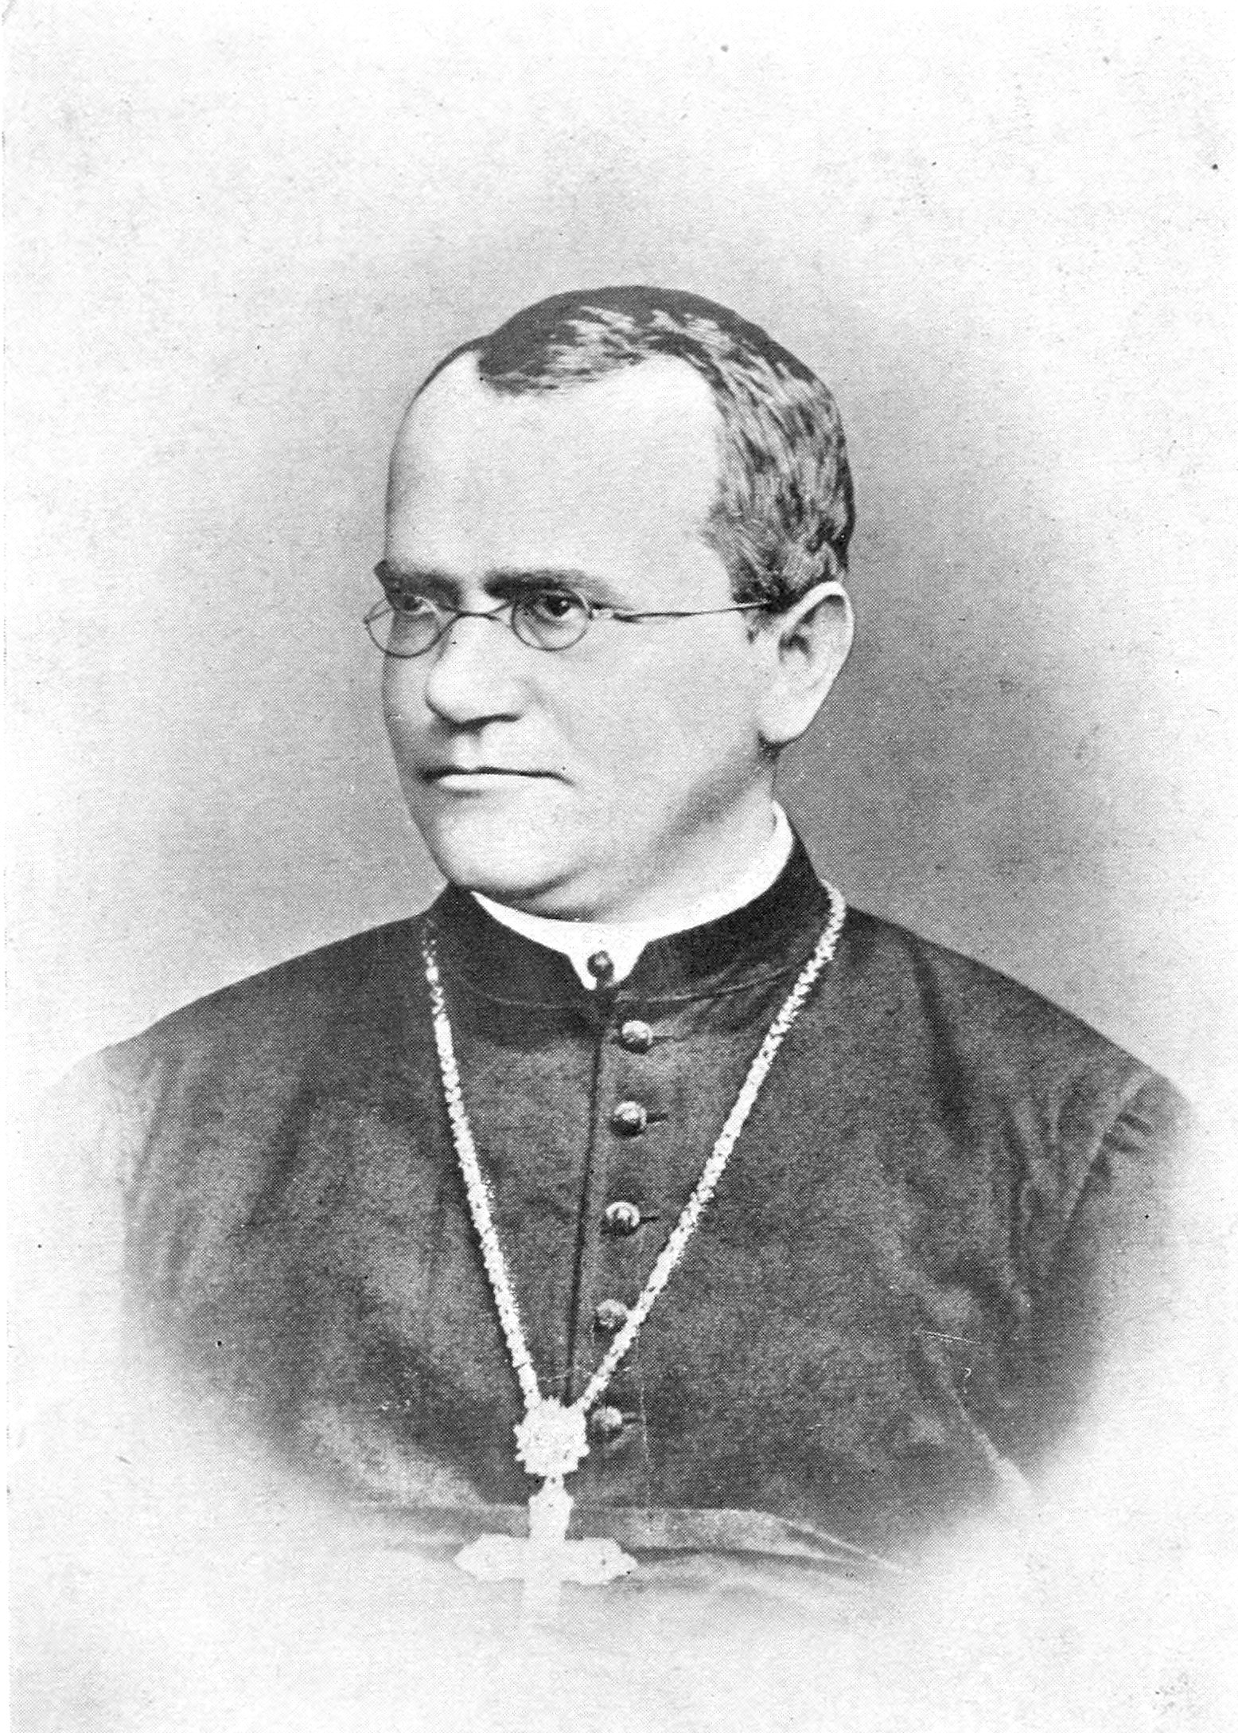

Slide 6
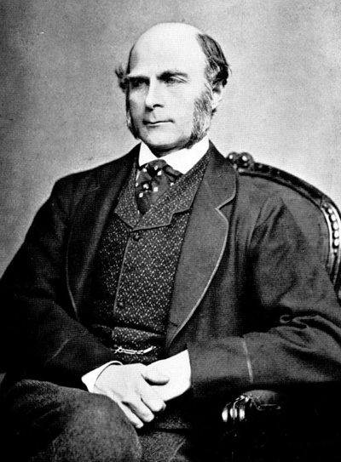
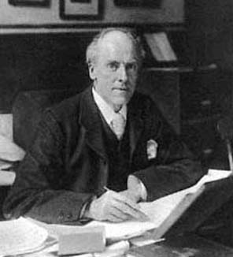

Slide 7
“Mendelian” Crosses
with Quantitative Traits

Slide 8
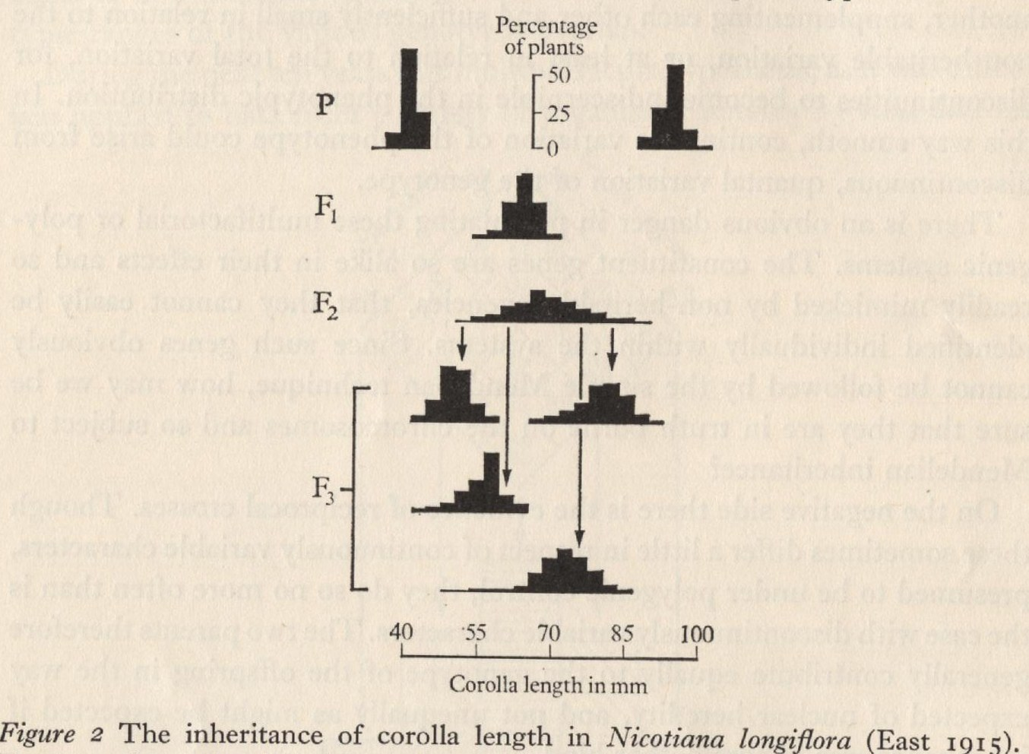
Mendelian Basis of Continuous Variation?
Experimental Breeding Experiments

Slide 9
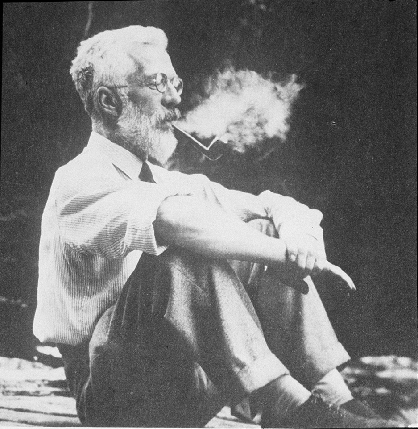
Ronald Fisher (1890-1962)
1918: The Correlation Between Relatives on the Supposition of Mendelian Inheritance
1921: Introduced concept of “likelihood”
1930: The Genetical Theory of Natural Selection
1935: The Design of Experiments

Slide 10
Fisher (1918): Basic Ideas
Continuous variation caused by lots of genes (“polygenic inheritance”)
Each gene followed Mendel’s laws
Environment smoothed out genetic differences
Genes may show different degrees of “dominance”
Genes may have many forms (“mutliple alleles”)
Mating may not be random (“assortative mating”)
Showed that correlations obtained by e.g. Pearson and Lee were explained well by polygenic inheritance

Slide 11
a.
b.
c.

Slide 12
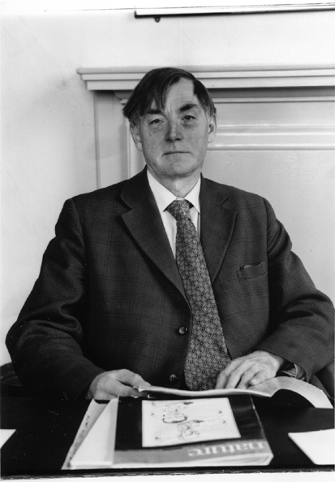
Douglas Scott Falconer, FRS, FRSE (1913-2004)
1965 Inheritance of liability to certain diseases estimated from
incidence among relatives., Ann. Hum. Genet.29:51ff.
1960 Introduction to Quantitative Genetics. Edinburgh: Oliver and Boyd.

Slide 13
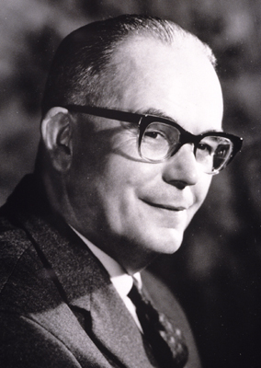
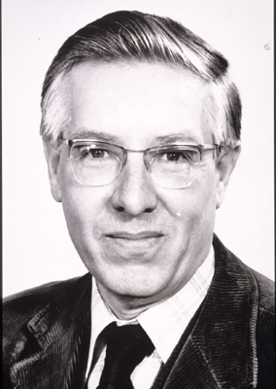
Kenneth Mather, FRS (1911-1990) John Jinks, FRS (1929-1987)

Slide 14
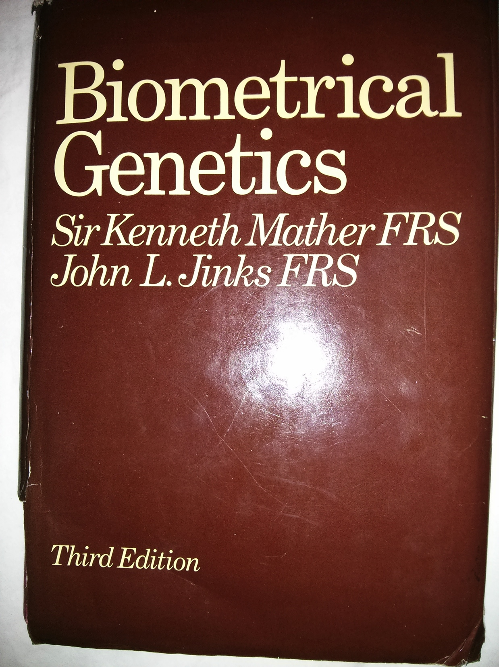

Slide 15
“Biometrical Genetics”
Parsimonious specification of genetic influences in terms of effects and frequencies of individual genes (“model-building”)
“Sensitivity to the environment” (GxE) is a phenotype like any other and analyzed with similar models
rGE modeled by specifying genetic effects on environment e.g. effects of sibling and maternal genotype on home environment
Systematic approach to choosing between different interpretations of the same data (“model-fitting”) e.g. effects of maternal genotype

Slide 16
Biometrical Genetics
Worked out on experimental organisms
Experimental manipulation of genotype – inbreeding and crossing
Experimental control of environment – measurement and randomization
Large, powerful, randomized genetic studies reveal subtleties of genetic systems – dominance, epistasis, linkage, GxE, environmental effects of genes, number of genes, genetic correlation, development…..

Slide 17
Model organisms

Slide 18
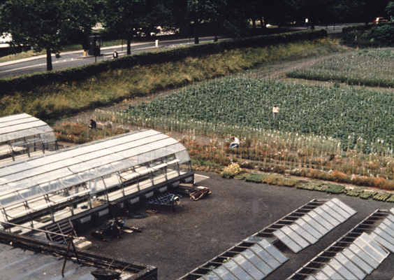

Slide 19
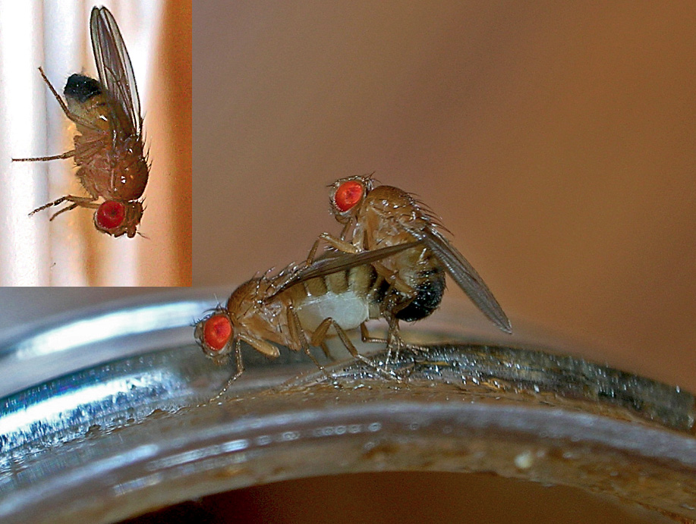

Slide 20
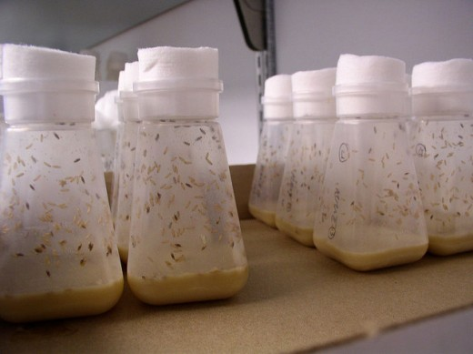

Slide 21
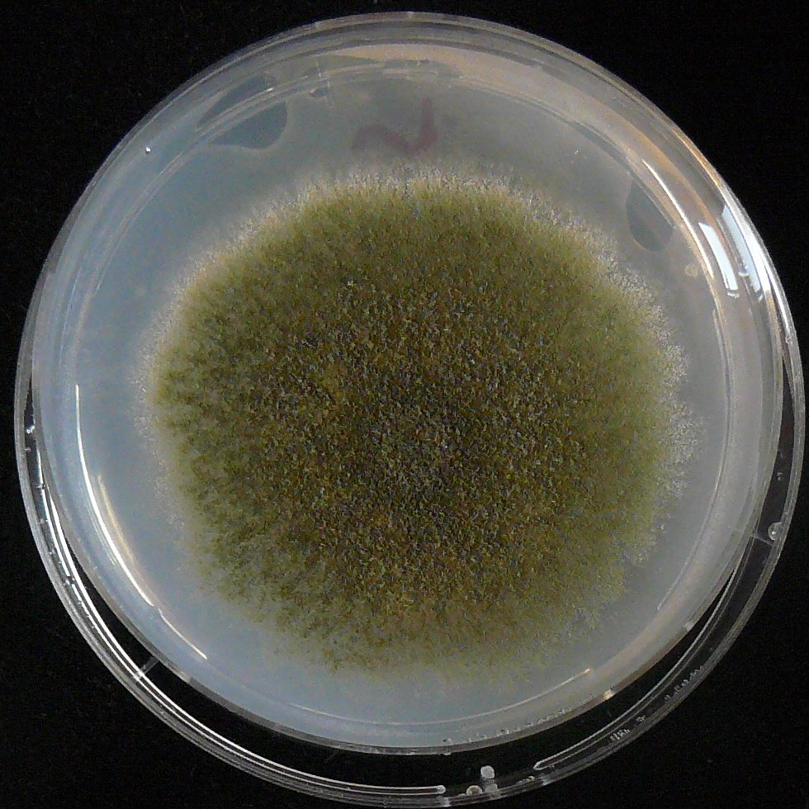

Slide 22
A “Good” Model
Fits the data
Explains a lot of different data in terms of relatively few theoretical constructs
Predicts and embraces new data without substantial modification or post-hoc explanation (“fudging”)
See e.g. Lakatos I, Musgrave A (1970, Eds.) “Criticism and the Growth of Knowledge” Cambridge: Cambridge U.P.
Also: Urbach, P (1974 ) Progress and degeneration in the IQ debate. Brit. J. Phil. Sci. 25:235-259.

Slide 23
“Sociologists are like foootbol team:
zey play ze game, lose, zen shout
‘goals don’t count’”
Imre Lakatos, c. 1972.

Slide 24
“The Logic of Scientific Discovery”
NO
Fits?
YES
Revise
Publish
estimates
Model-Fitting
Theory
Model
Data
Model-building
Study design
Data collection

Slide 25
Assumptions (Initially)
Autosomal inheritance
No epistasis
No sex-dependent gene expression
Random mating
Genes of relatives (e.g. mothers) do not affect phenotype directly
No GxE (see Mather and Jinks for GxE)
No G-E correlation
Simple model for environment
Effects of selection/mutation too small to affect result.

Slide 26
“ASSUMPTIONS”
Are made “for the time being” to reflect ideas about how the world works.
Are meant to be tested.

Slide 27
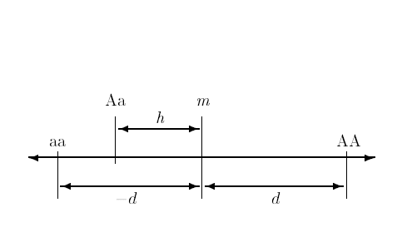
Basic Model for Effects of a Single Gene on a Quantitative Trait
Mid-homozygote
Decreasing
Increasing
Dominance
deviation
Homozygous effect

Slide 28
Notation is a pain!
Effect Mather (1949) Falconer (1965)
Additive d a
Dominance h d
Makes no difference to the “truth”.

Slide 29
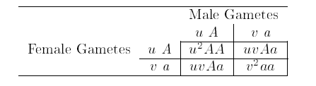
Derivation of Genotype Frequencies
“Hardy-Weinberg Equilibrium”

Slide 30

Genotype Frequencies
in Randomly Mating Population
“Hardy-Weinberg Equilibrium”
frequencies

Slide 31


What is the mean expected to be?
Note: Effects measured from mid-homozygote (“m”)

Slide 32

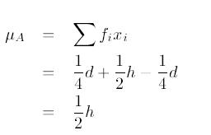
With equal allele frequencies (easier!) put u=v= ½
And the mean is expected to be….

Slide 33
How does A/a affect the variance?

Slide 34
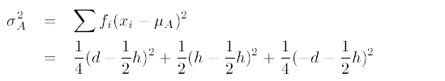
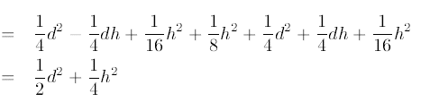
Equal allele frequencies u=v= ½
Dominance component
Additive component

Slide 35
Q: What happens with lots of genes?
A: The effects of the individual genes add up.
IF… the genes are independent
(“linkage equilibrium”)
Requires random mating, complete admixture

Slide 36
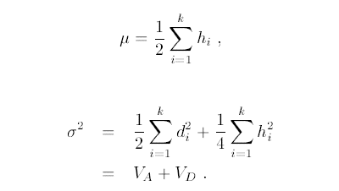
So:
Additive Genetic Variance
Dominance Genetic Variance

Slide 37
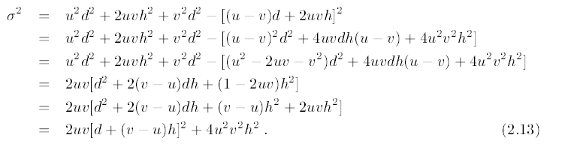
Additive and Dominance Components:
Unequal allele frequencies.
Can show (see e.g. Mather, 1949)
Q: What happens when u=v?
V_{A} V_{D}

Slide 38
Bottom line:
With unequal allele frequencies can still separate V_{A} and V_{D} but their definitions change

Slide 39
VA+VD
VA
VD

Slide 40
What about the environment???

Slide 41
Two main sources of environment
Individual experiences – not shared with siblings:
V_{E}
“Family” environment – shared with siblings:
V_{C}

Slide 42
So: the TOTAL variance
(Genes + Environment) is:
V_{P} = V_{A}+V_{D}+V_{E}+V_{C}

Slide 43
“Heritability”
“Broad” heritability:
h²_{b}=(V_{A}+V_{D})/V_{P}
Proportion of total variance explained by genes
“Narrow” heritability:
h²_{n}=V_{A}/V_{P}
Proportion of total variance explained by additive (homozygous) genetic effects (predicts response to selection – Fisher, 1930)

Slide 44
IMPORTANT
Genetic and environmental components of variance and heritabilities are not universal “constants”.
Genetic parameters depend on the frequencies and effects of the alleles influencing the phenotype. Environmental components depend on the disrtibutions and effects of the saleient environmental factors.
BOTH depend on genetic and cultural history of population(s) under study.

Slide 45
So far: have looked at effects on total variance…
How do V_{A} and V_{D} affect the correlations between relatives?

Slide 46
Contribution of genes to correlation between relatives (r):
r = C/V_{P}
Where C=Covariance between relative pairs
“C” depends of kind of relationship (sibling, parent-offspring, MZ twin etc)
But can also be expressed in terms of V_{A} and V_{D}

Slide 47
Approach
For a given relationship, work out expected frequencies of
each type of pair (AA, aa etc.)
Write phenotypes of each type of relative
Compute cross-products of phenotypes of members of
type of pair
Each cross-product by the corresponding frequency
Add the result of “4” across all pair types
The answer is the covariance you want (if you have done
the algebra right!)

Slide 48
For equal allele frequencies….

Slide 49
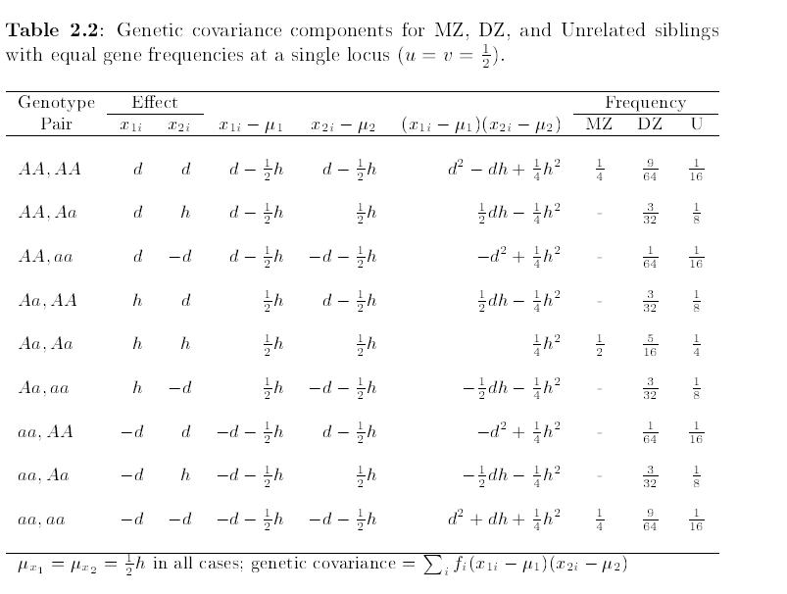

Slide 50
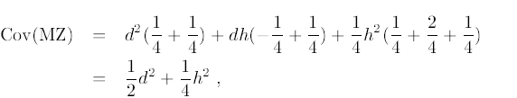
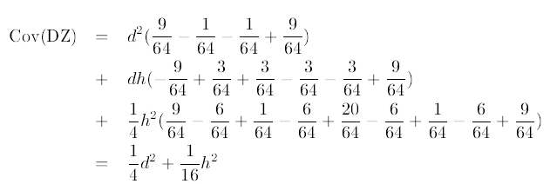
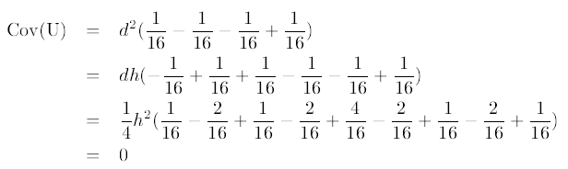
Contribution of one gene to covariance:

Slide 51
Notice that terms in d² and h² are separated – but their coefficients change as a function of relationship

Slide 52
Can add over all genes to get total contribution to covariance
Cov(MZ) = V_{A} + V_{D}
Cov(DZ) = ½V_{A} + ¼V_{D}
Cov(U)= 0

Slide 53
Can use the same approach for other relationships

Slide 54
Contributions of V_{A} and V_{D} to covariances between relatives (ignoring environment)
Relationship | Contribution to Covariance
 | V_{A} | V_{D}
Total variance | 1 | 1
Sibling (DZ twin) | ½ | ¼
MZ twin | 1 | 1
Half-sibling | ¼ | 0
First cousin | ¹/₈ | 0
Parent-offspring | ½ | 0
Avuncular | ¼ | 0
Grand-parent | ¹/₈ | 0
Unrelated | 0 | 0

Slide 55
Example correlations between relatives (ignoring environment)
Relationship | Expected correlation
 | V_{A} = 1; V_{D} = 0 | V_{A} = 1; V_{D} = 0.5
Total variance | 1 | 1.5
Sibling (DZ twin) | 0.5 | 0.375
MZ twin | 1.0 | 1
Half-sibling | 0.25 | 0.167
First cousin | 0.125 | 0.083
Parent-offspring | 0.5 | 0.333
Avuncular | 0.25 | 0.167
Grand-parent | 0.125 | 0.083
Unrelated | 0 | 0

Slide 56
Adding effects of Environment
V_{P} = V_{A} + V_{D} + V_{E} + V_{C}
Cov(MZ) = V_{A} + V_{D} + V_{C}
Cov(DZ) = ½V_{A} + ¼V_{D} + V_{C}
Cov(UT) = V_{C}
Etc.

Slide 57
To get the expected correlations
Just divided expectations by expected total variance
Results are proportional contributions of V_{A}, V_{D} etc. to total variance

Slide 58
Practice (paper and pencil)
Set “d” = 1
Pick an “h” (e.g. h=-1.0,-0.5,0,0.5,1.0)
Pick a frequency for the increasing (A) allele (e.g. u=0.25, 0.5, 0.75)
Work out μ, VA and VD
Tabulate on board

Slide 59
Substitute in algebra:
Get your own parameter values
μ = (u-v)d + 2uvh
V_{A}=2uv[d + (v-u)h]²
V_{D}=4u²v²h²

Slide 60
Plotting Effect of Allele frequency on Genetic Variance Components (“R”)
d<-1 # Homozygous effect ("additive")
h<-1 # Heterozygous deviation ("dominance")
u<-seq(0.01,0.99,by=.01) # Vector of frequencies of increasing allele
v<-1-u # Frequencies of decreasing allele
VA<-2*u*v*(d+(v-u)*h)^2 # Additive genetic variance
VD<-4*u*u*v*v*h*h # Dominance genetic variance
VP<-VA+VD # Total (genetic) variance
# Plot results
plot(u,VP,type="l",
main="VA (red) and VD (green) as function of increasing allele frequency",
xlab="Frequency of increasing allele",ylab="Variance component")
# Add line for VA
lines(u,VA,col="red")
# Add line for VD
lines(u,VD,col="green")

Slide 61
VA+VD
VA
VD

Slide 62
Multliple variables

Slide 63
Pleiotropy πλείων ("more“) τρόπος ("way“)
Locus A/a AA Aa aa
Effect on trait 1 +d_{1a} +h_{1a} -d_{1a}
Effect on trait 2 +d_{2a} +h_{2a} -d_{2a}
Locus B/b BB Bb bb
Effect on trait 1 +d_{1b} +h_{1b} -d_{1b}
Effect on trait 2 -d_{2b} +h_{2b} +d_{2b}

Slide 64
“Genetic Correlation”
Locus A/a
A/a
a₁
a₂
P₁
P₂
Trait 2
Trait 1
b₁
b₂
Locus B/b
B/b

Slide 65
Multiple Scenarios
a₁ a₂ b₁ b₂ r_{g}
+ + + + +
+ - + - ?
+ 0 0 + ?
+ + + - ?

Slide 66
Multiple Scenarios
a₁ a₂ b₁ b₂ r_{g}
+ + + + +
+ - + - -
+ 0 0 + ?
+ + + - ?

Slide 67
Multiple Scenarios
a₁ a₂ b₁ b₂ r_{g}
+ + + + +
+ - + - -
+ 0 0 + 0
+ + + - ?

Slide 68
Multiple Scenarios
a₁ a₂ b₁ b₂ r_{g}
+ + + + +
+ - + - -
+ 0 0 + 0
+ + + - (0)

