Slide 1
Genetic simplex model
in the classical twin design
Conor Dolan & Sanja Franic
Boulder Workshop 2016

Slide 2
Two general approaches to longitudinal modeling
(not mutually exclusive)
Markov models:
(Vector) autoregressive models for continuous data
(Hidden) Markov transition models discrete data
Growth curve models:
Focus on linear and non-linear growth curves
Typically multilevel or random effects model
Which to use?
Use the model that fit the theory / data / hypotheses

Slide 3
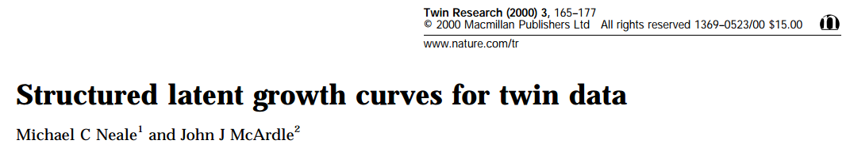
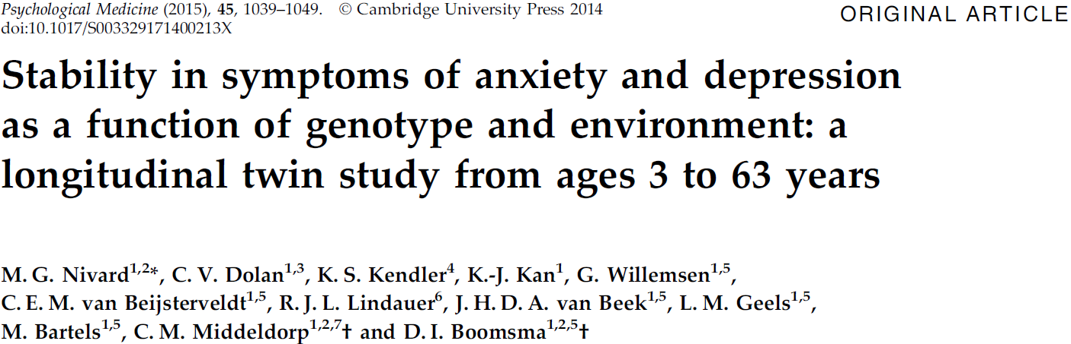
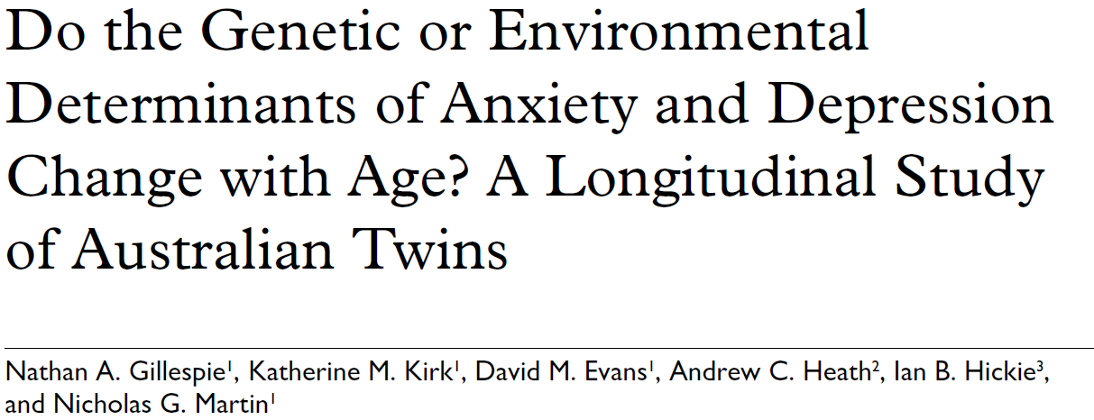
Growth curve modeling ? If you’re interested in growth
trajectories. Linear or non-linear:
Autoregressive modeling ? If you’re mainly interested in stability.
Can be combined (this afternoon)

Slide 4
First order autoregression model. A (quasi) simplex model (var(e)>0).
ζx
ζx
ζx
b2,1
b3,2
b4,3
x1
x2
x3
x4
1
1
1
1
y1
y2
y3
y4
1
1
1
1
e1
e2
e3
e4
b₀₂
b₀₃
b₀₁
b₀₄
1
Notes:
Ar(1) as a phenotypic model. Interest in stability, not interest in individual growth curves

Slide 5
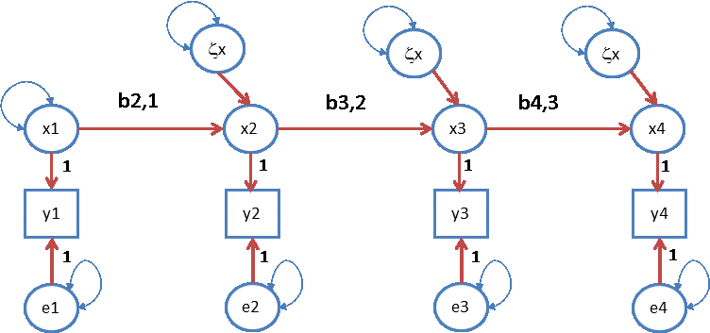
First order autoregression model. A quasi simplex model (var(e)>0).
var(x₁)
true score
var(e₁)
“error”
var(y_{t}) = var(x_{t}) + var(e_{t})
var(x_{t}) = b_{t-1,t}² var(x_{t-1}) + var(ζx_{t})
cov(x_{t},x_{t-1}) = b_{t-1,t}var(x_{t-1})
cov(y_{t},y_{t-1}) = b_{t-1,t}var(x_{t-1})
y_{ti} = b_{0t} + x_{ti} + e_{ti}
x_{ti} = b_{t-1,t} x_{t-1i} + ζx_{ti}
Notes:
Ar(1) as a phenotypic model. Regression models. Regression info

Slide 6
First order autoregression model.
var(e₁)
var(e₄)
Identification issue: var(e₁) and var(e_{t}) are not identified. Solution set to zero, or equate
var(e₁) = var(e₂) , var(e₃) = var(e₄)
Notes:
Ar(1) as a phenotypic model

Slide 7
var(y_{t}) = var(x_{t}) + var(e_{t})
var(x_{t}) = b_{t-1,t}² var(x_{t-1}) + var(ζx_{t})
cov(x_{t},x_{t-1}) = b_{t-1,t}var(x_{t-1})
cov(y_{t},y_{t-1}) = b_{t-1,t}var(x_{t-1})
Standardized stats part I:
“Reliability” at each t, rel(y_{t}) :
rel(y_{t}) = var(x_{t}) / {var(x_{t}) + var(e_{t})}
Interpretation: % of variance in y_{t} due to latent x_{t}

Slide 8
var(y_{t}) = var(x_{t}) + var(e_{t})
var(x_{t}) = b_{t-1,t}² var(x_{t-1}) + var(ζx_{t})
cov(x_{t},x_{t-1}) = b_{t-1,t}var(x_{t-1})
cov(y_{t},y_{t-1}) = b_{t-1,t}var(x_{t-1})
Standardized stats part II:
Stability at level of X, stab(X_{t},X_{t-1}):
b_{t-1,t}² var(x_{t}) / {b_{t-1,t}² var(x_{t-1}) + var(ζx_{t})}
Interpretation: % of the variance in x_{t} due to x_{t-1}

Slide 9
var(y_{t}) = var(x_{t}) + var(e_{t})
var(x_{t}) = b_{t-1,t}² var(x_{t-1}) + var(ζx_{t})
cov(x_{t},x_{t-1}) = b_{t-1,t}var(x_{t-1})
cov(y_{t},y_{t-1}) = b_{t-1,t}var(x_{t-1})
Standardized stats part III:
Correlation t,t-1, cor(t,t-1):
b_{t-1,t} var(x_{t-1}) / {sd(y_{t-1}) * sd(y_{t})}
sd(y_{t}) = √(var(x_{t}) + var(e_{t}))
var(x_{t}) = b_{t-1,t} var(x_{t-1}) + var(ζx_{t})
Interpretation: strength of linear relationship

Slide 10
.51
.51
.51
ζx
ζx
ζx
1
.7
.7
.7
x1
x2
x3
x4
1
1
1
1
y1
y2
y3
y4
1
1
1
1
e1
e2
e3
e4
.25
.25
.25
.25
Covariance matrix
1.250 0.70 0.49 0.343
0.700 1.25 0.70 0.490
0.490 0.70 1.25 0.700
0.343 0.49 0.70 1.250
Correlation matrix
1.0000 0.560 0.392 0.2744
0.5600 1.000 0.560 0.3920
0.3920 0.560 1.000 0.5600
0.2744 0.392 0.560 1.0000

Slide 11
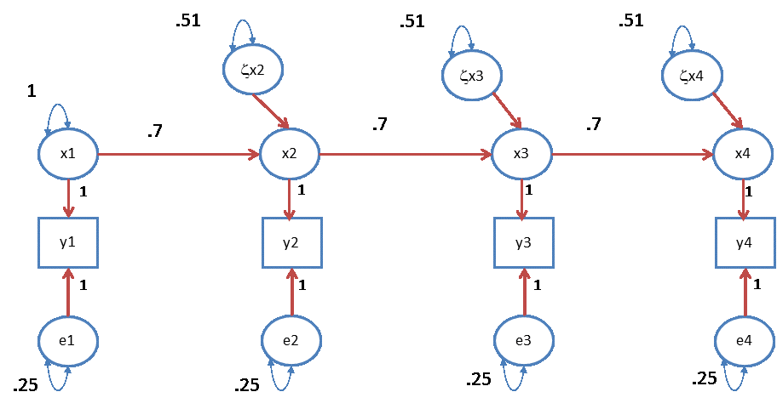
reliability: rel(x_{t}) = var(x_{t}) / {var(x_{t}) + var(e_{t})}
= 1/ (1+.25) = 1/1.25 = .8
R²: b_{t-1,t}² var(x_{t-1}) / {b_{t-1,t}² var(x_{t-1}) + var(ζx_{t})}
= {.7² * 1} / (.7² * 1 + .51) = .49/1 = .49
cor(t,t+1) : b_{t-1,t} var(x_{t-1}) / {sd(y_{t-1}) * sd(y_{t})}
={.7 * 1} / {√ 1.25*√1.25} = .56

Slide 12
0
0
0
ζx2
ζx3
ζx4
x1
x2
x3
x4
1
1
1
1
y1
y2
y3
y4
1
1
1
1
e1
e2
e3
e4
What happens if var(ζxt) = 0?

Slide 13
Special case: factor model var(ζx_{t}) (t=2,3,4) = 0
b_{2,1}
b_{3,2}
b_{4,3}
x1
x2
x3
x4
1
1
1
1
y1
y2
y3
y4
1
1
1
1
e1
e2
e3
e4
x1
y1
y2
y3
y4
1
1
1
1
e1
e2
e3
e4

Slide 14
Multivariate decomposition of phenotypic covariance matrix (TxT, say T=4):
Σ_{ph} = Σ_{A} + Σ_{C} + Σ_{E}
Σ_{ph1} Σ_{ph12}
Σ_{ph12} Σ_{ph2} =
Σ_{A} + Σ_{C} + Σ_{E} r⊗Σ_{A} + Σ_{C} + Σ_{E}
r⊗Σ_{A} + Σ_{C} + Σ_{E} Σ_{A} + Σ_{C} + Σ_{E}
(r=1 or .5)

Slide 15
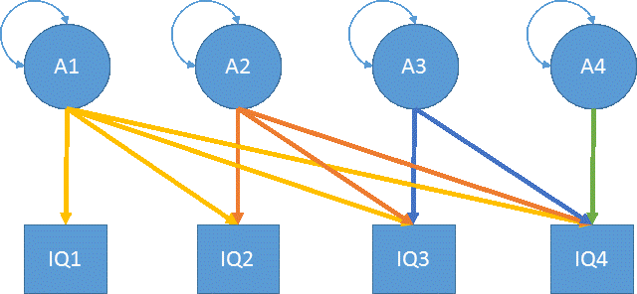
Σ_{ph} = Σ_{A} + Σ_{C} + Σ_{E}
Estimate Σ_{A} using a Cholesky-decomp
Σ_{A} = Δ_{A}Δ_{A}^{t}
Δ_{A} = δ₁₁ 0 0 0
δ₂₁ δ₂₂ 0 0
δ₃₁ δ₃₂ δ₃₃ 0
δ₄₁ δ₄₂ δ₄₃ δ₄₄

Slide 16
Σ_{ph} = Σ_{A} + Σ_{C} + Σ_{E}
Model Σ_{A} using a simplex model
Σ_{A} = (Ι−Β)_{A}⁻¹ Ψ_{A} (Ι−Β)_{A}^{-1t} + Θ_{A}

Slide 17
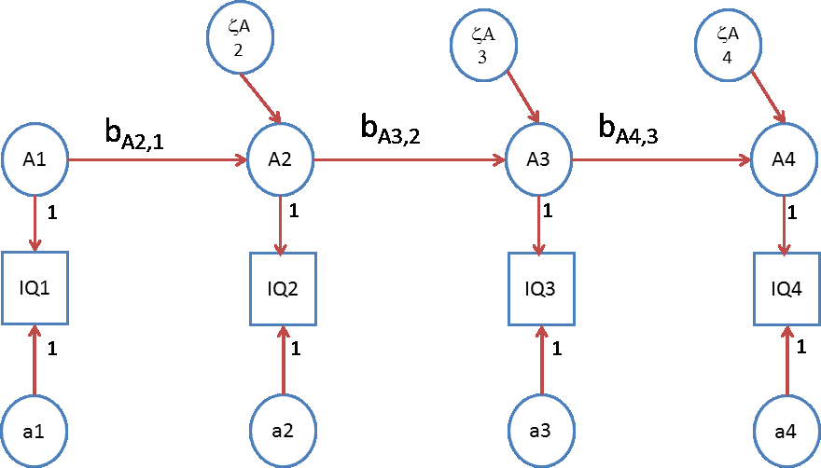
Σ_{A} = (Ι−Β_{A}) ⁻¹ Ψ_{A} (Ι−Β_{A}) ⁻¹ ^{t} + Θ_{A}
Β_{A} = 0 0 0 0
b_{A21} 0 0 0
0 b_{A32} 0 0
0 0 b_{A43} 0

Slide 18
Σ_{A} = (Ι−Β_{A}) ⁻¹ Ψ_{A} (Ι−Β_{A}) ⁻¹ ^{t} + Θ_{A}
Ψ_{A} = var(A₁) 0 0 0
0 var(ζ_{A2}) 0 0
0 0 var(ζ_{A3}) 0
0 0 0 var(ζ_{A4})

Slide 19
Σ_{A} = (Ι−Β_{A}) ⁻¹ Ψ_{A} (Ι−Β_{A}) ^{−1τ} + Θ_{A}
Θ_{A} = var(a₁) 0 0 0
0 var(a₂) 0 0
0 0 var(a₃) 0
0 0 0 var(a₄)
required:
var(a1) = var(a2)
var(a3) = var(a4)

Slide 20
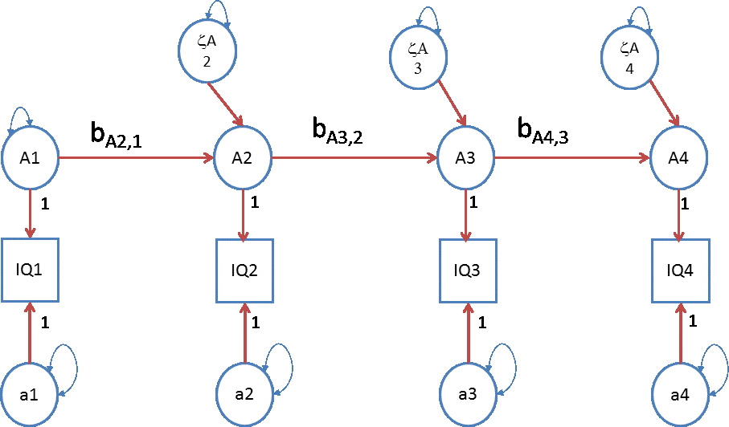
The genetic A simplex

Slide 21
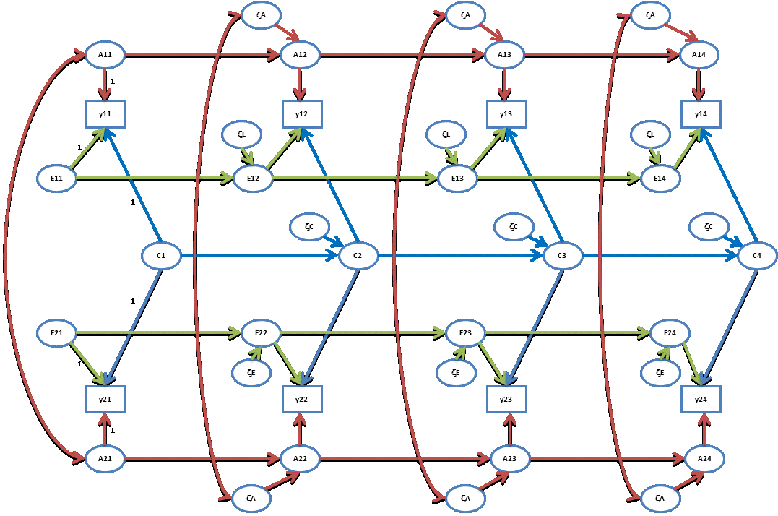

Slide 22
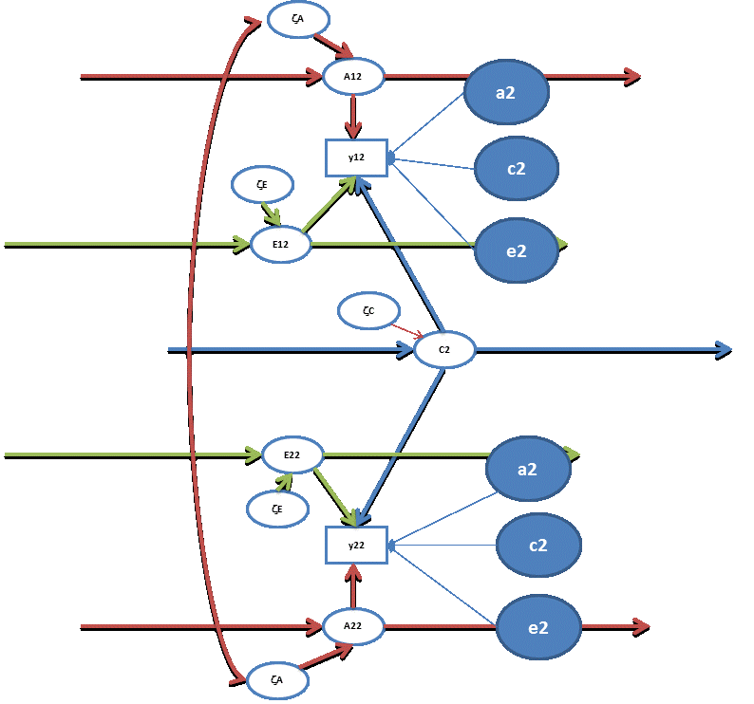
Occasion specific effects
required:
var(a1) = var(a2)
var(a3) = var(a4)
var(e1) = var(e2)
var(e3) = var(e4)
var(c1) = var(c2)
var(c3) = var(c4)

Slide 23
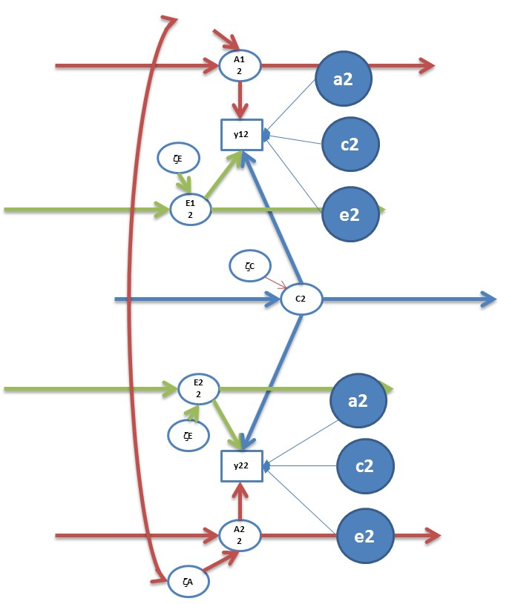
Question: h², c², and e² at each time point?
var(y_{t}) =
{var(A_{t}) + var(a_{t})} + {var(C_{t}) + var(c_{t})} + {var(E_{t}) + var(e_{t})}
h²= {var(A_{t}) + var(a_{t})} / var(y_{t})
c²= {var(C_{t}) + var(c_{t})} / var(y_{t})
e²= {var(E_{t}) + var(e_{t})} / var(y_{t})

Slide 24
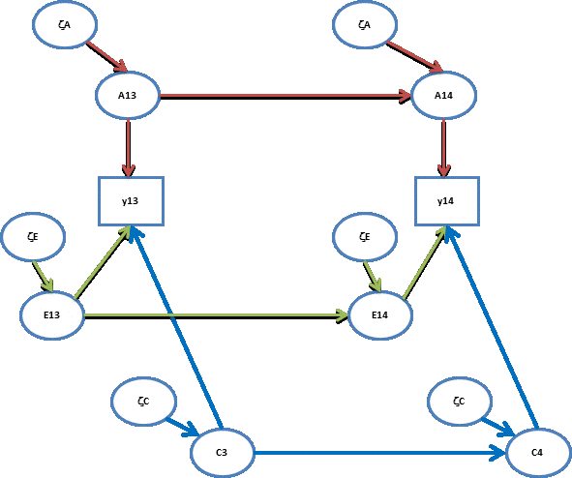
contributions to stability (A,C,E) t-1 to t
b_{At-1,t}² var(A_{t-1}) / {b_{At-1,t}² var(A_{t-1}) + var(ζA_{t})}
b_{Ct-1,t}² var(C_{t-1}) / {b_{Ct-1,t}² var(C_{t-1}) + var(ζC_{t})}
b_{Et-1,t}² var(E_{t-1}) / {b_{Et-1,t}² var(E_{t-1}) + var(ζE_{t})}

Slide 25
contributions of A to Phenotypic stability t-1 to t
b_{At-1,t}² var(A_{t-1})
{b_{At-1,t}² var(A_{t-1}) + var(ζA_{t})} + {b_{Ct-1,t}² var(C_{t-1}) + var(ζC_{t})}
+ {b_{Et-1,t}² var(E_{t-1}) + var(ζE_{t})}

Slide 26
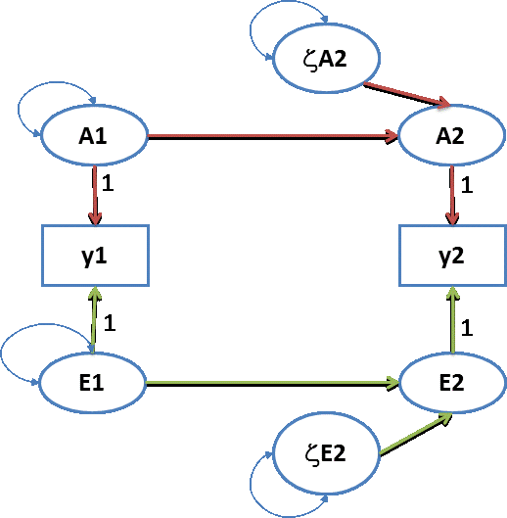
.0195
Σ_{A} = .2 .184
.184 .2
.2
.95
Σ_{A} = .8 .4
.4 .8
.8
Σ_{y} = Σ_{A} + Σ_{A} = 1 .584
.584 1
.5
.6
h² at t=1? answer: .2 (e²=.8)
h² at t=2? answer: .2 (r²=.8)
correlation between A1 and A2? .184 / (√.2*√.2) = .92
correlation between E1 and E2? . 4 / (√.8*√.8) = .50
covariance between Y1 and Y2? .584
contribution of A to covariance Y1 and Y2? .184/.584 = .315
contribution of E to covariance Y1 and Y2? .4/.584 = .685

Slide 27
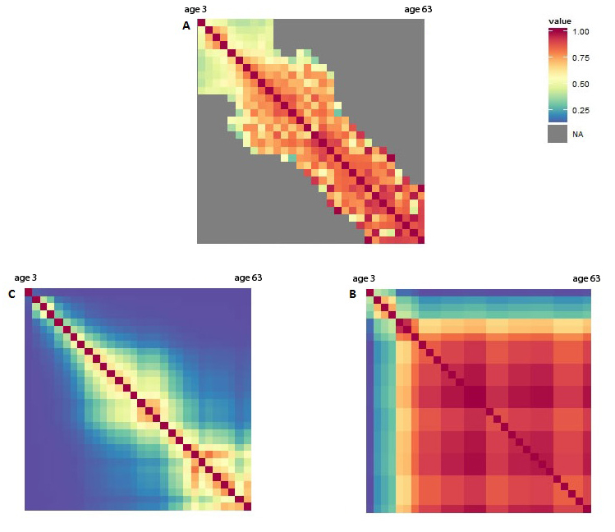
Nivard et al, 2014
Anx/dep stability due to A and E from 3y to 63 years

Slide 28
Sanja’s Practical: the genetic simplex model applied
to FSIQ at 4 occasions.
But first ....
Variations on the theme

Slide 29
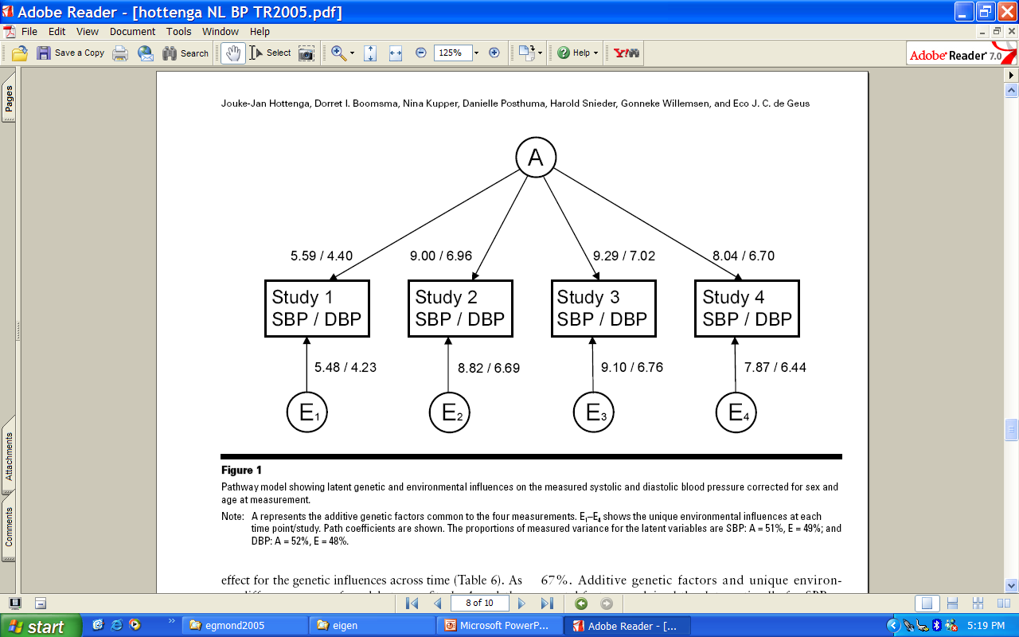
Hottenga, etal. Twin Research and Human Genetics, 2005

Slide 30
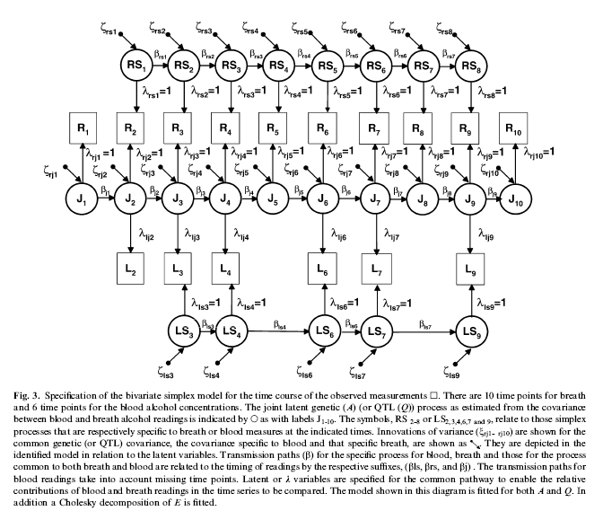
Birley et al. Behav Genet 2005

Slide 31
“Niche-picking”
During development children seek out and create and are furnished surrounding (E) that fit their phenotype.
A smart child growing up will pick the niche that fits her/her phenotypic intelligence.
A anxious child growing up may pick out the niche that least aggrevates his / her phenotypic anxiety.
Phenotype of twin 1 at time t -> environment of twin 1 at time t+1

Slide 32
Mutual influences
During development children’s behavior may contribute to the environment of their siblings.
A smart child growing up will pick the niche that fits her/her phenotypic intelligence and in so doing may influence (contriibute to) the environment of his or her sibling.
A behavior of an anxious child may be a source of stress for his or her siblings.
Phenotype of twin 1 at time t -> environment of twin 2 at time t+1

Slide 33
a
a
a
A
A
A
A
y
y
y
y
e
e
e
E
E
E
E
c
c
c
C
C
C
C
E
E
E
E
e
e
e
y
y
y
y
A
A
A
A
a
a
a
A, C, E uncorrelated

Slide 34
A
A
A
A
A
A
A
1
y
α₁
y
α₂
y
α₃
y
E
E
E
1
β₁
β₂
β₃
E
E
E
E
E
E
E
E
1
β₁
β₂
β₃
E
E
E
α₁
α₂
α₃
y
y
y
y
1
A
A
A
A
A
A
A

Slide 35
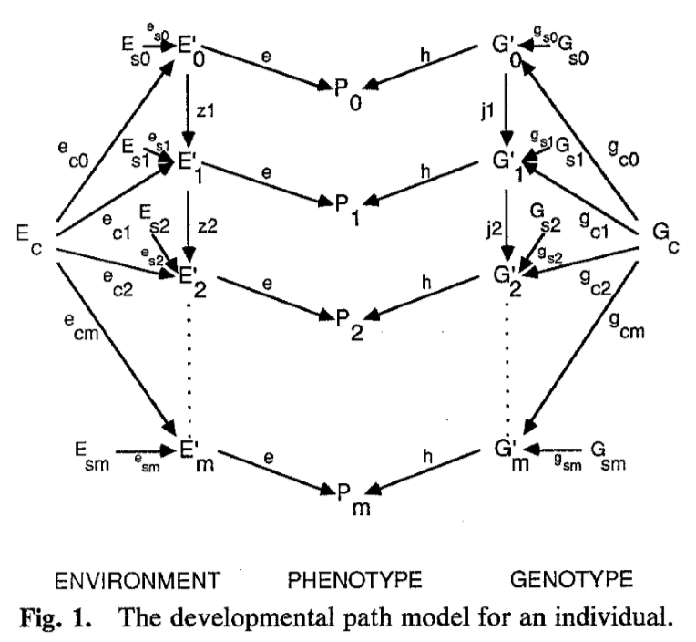

Slide 36

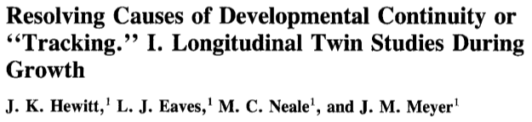
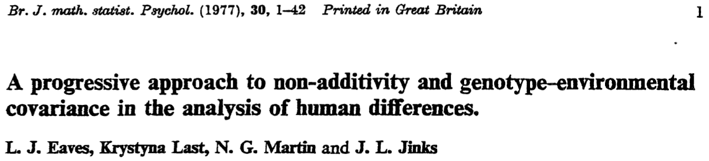
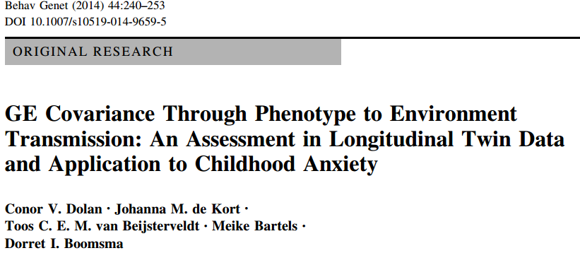
Environments selected by genotypes (Scarr & McCartny, 1983;
Plomin, DeFries & Loehlin, 1977)
Sibling effects (Carey, 1986, Behav Genet 16:319–341)

Slide 41
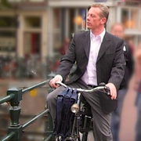
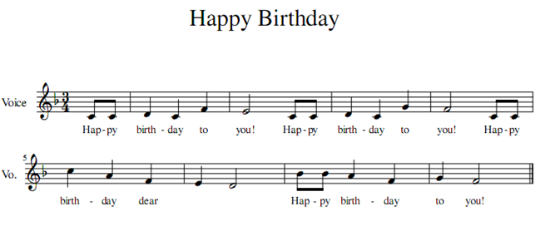
Mi - chael

