Slide 1
Continuously moderated effects of A,C, and E in the twin design
Conor V Dolan & Sanja Franić
Boulder Twin Workshop
March 8, 2016
Includes slides by Sophie van der Sluis & Marleen de Moor

Slide 2
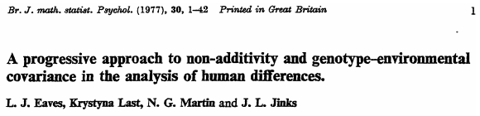
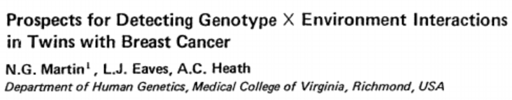
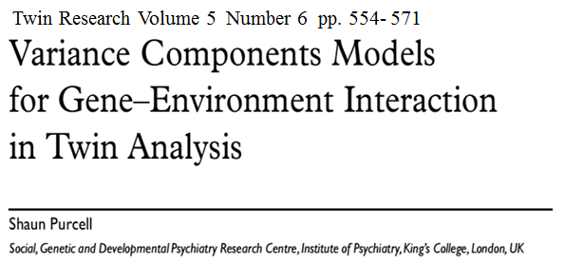
1977
Acta Genet Med GemelloI36:5·20 (1987)
1987
(open)Mx
Michael C.Neale
19?? - 2016
2002
MANY PAPERS Substantive & Methods

Slide 3
Standard AE model
1 or .5
A
E
A
E
a
e
a
e
1
m
pheno
Twin 1
pheno
Twin 2
m
1
Ph_{i} – m = a*A_{i} + e*E_{i}
Notes:
Basic AE model (leave C out for now).

Slide 4
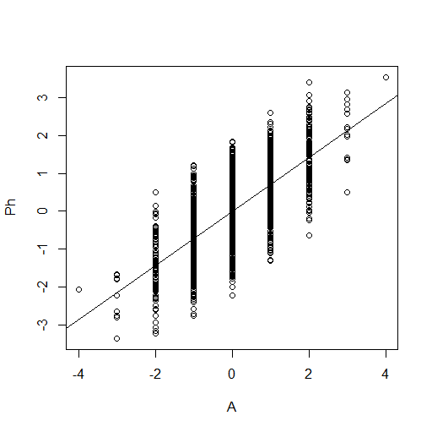
Environmental
Dispersion
Variance of
E given G score
Phenotypic
scores
Genetic level (score on A)
Ph_{i} – m = a*A_{i} + e*E_{i}
Homoskedastic model: e is constant over levels
of A: environmental effects are the same given any A
Notes:
Suppose we measured A and regressed Ph on A. The regression model is linear and homoskedastic: the variance of the residuals are contant over the levels of the the predictor (A). Here we regrees Ph on A, so the residuals are actually E.

Slide 5
Environmental
Dispersion
Variance of
E given G score
Phenotypic
scores
Genetic level (score on A)
G x E as “genetic control” of sensitivity to different environments: heteroskedasticity e=f_{e}(A)
Environmental effects (e) systematically vary with A
Notes:
Heteroskedastic residuals E: the variance of E is NOT the same for different values of A. E variance is the manifestation of environmental contributions to Phenotypic individual differences: So the contributions of E dependent in magnitude on the value of A. Heteroskedasticity here is the manifestation of GxE.

Slide 6
Conditional
variance of A
given E
Phenotypic
scores
Environmental level (score on E)
G x E as “environmental control” of genetic effects: heteroskedasticity (a=f_{a}(E)).
Notes:
We can apply the same reasoning if we encounter heteroscedasticity in the regression of Ph on E. The magnitude of genetic effects depends on the level of E.

Slide 7
Genetic
variance
or (and)
Environmental
variance given M
Phenotypic
scores
Moderator level (score on moderator)
Moderation of effects (A,C,E) by measured moderator M: heteroskedasticity (a=f_{a}(M), c=f_{c}(M), e=f_{e}(M)).
Notes:
Suppose we regress Ph on a measured moderator variable M. That is a variable which we suspect influences the effects of A, C, or E. Again this interaction (MxA, MxC, MxE) shows up as heteroscedasticity.

Slide 8
Sex X A interaction:
Sex as a moderation of A effects
Is the magnitude of genetic influences on ADHD the same in boys and girls?
Notes:
Sex or gender (if you prefer) may be a moderator of genetic effects (A). Sex differences in var(A) may be view as heteroscedasticity.

Slide 9
Other examples binary moderators
A effects moderated by marital status:
Unmarried women show greater levels of genetic influence on depression (Heath et al., 1998).
A effects moderated by religious upbringing:
religious upbringing diminishes A effects on the personality trait of disinhibition (Boomsma et al., 1999).
Binary moderator: multigroup approach
Notes:
Other examples

Slide 10
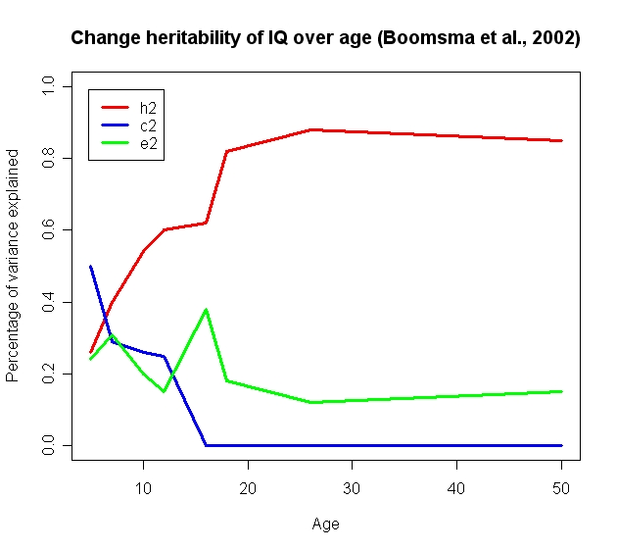
Continuous moderation
Age as a moderator of standardized A, C, E variance components
Notes:
10
Age as the moderator of the effects of A,C,E (on IQ) here expressed in standardized variance components

Slide 11
Tucker-Drob & Bates (2015): Unstandardized variance components
Notes:
Age as the moderator of the effects of A,C,E (on IQ) here expressed in standardized variance components

Slide 12
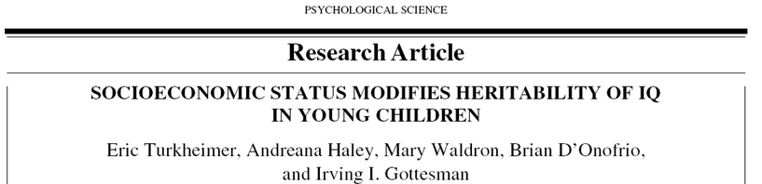
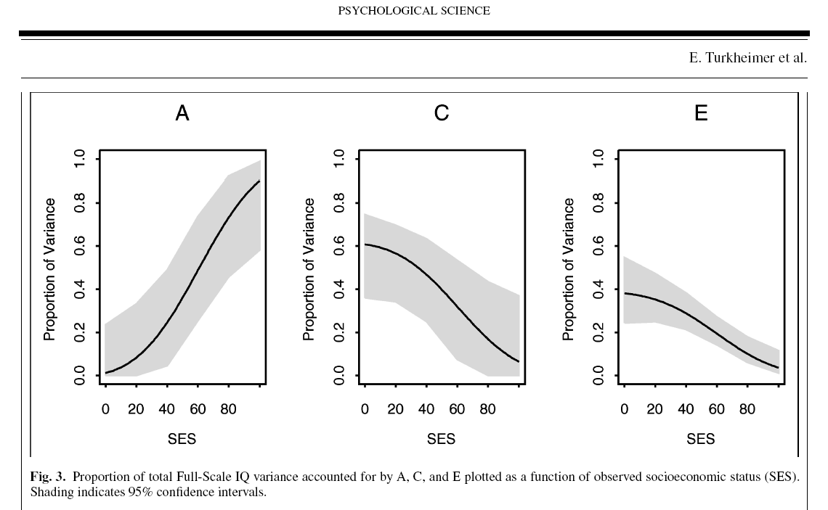
A,C,E effects moderated by SES
Notes:
Famous example FSIQ and SES – again standarized variance components.

Slide 13
Continuous Moderators not amenable to multigroup approach
… treat the moderator as continuous
(OpenMx)
Notes:
Yes ! But how?

Slide 14
Standard ACE model
1 or .5
1
A
C
E
A
C
E
c
a
c
a
e
e
m
pheno
Twin 1
pheno
Twin 2
m
1
1
Notes:
Explain regression on unit

Slide 15
Standard ACE model +
Main effect on Means
A
C
E
A
C
E
c
a
c
a
e
e
1
Pheno
Twin 1
Pheno
Twin 2
1
m+ β_{M} M1
m+β_{M}M2
Notes:
Main effects of moderator M on the phenotype. This is just a linear regression of the phenotype on the moderator M

Slide 16
res1
res1
m
pheno
Twin 1
1
pheno
Twin 1
1
m+ β_{M} M1
M1
β_{M}
equivalent
The regression of Phenotype on M ...
What is left is the residual, subject to ACE modeling.
Notes:
Explain the notation, explain the triangle

Slide 17
Summary stats (no moderator)
Means vector
Covariance matrix (r = 1 or r=½)
m m
Notes:
Now in terms of sum stats. Nothing here

Slide 18
Allowing for a main effect of the moderator M
Means vector
Covariance matrix (r = 1 or r=½)
Notes:
Moderation of the mean. Regression, the variance components are based on the regression residuals

Slide 19
Standard ACE model + main effect and effect on A path
A
C
E
A
C
E
c
c
a+β_{X}M₁
e
a+β_{X}M₂
e
m+ β_{M} M1
m+ β_{M} M2
Twin 1
Twin 1
Twin 2
1
Twin 2
1
M has main effect + moderation of A effect (a + β_{M}M₁)
Notes:
Extend the moderation from mean to effect of A

Slide 20
A
C
E
a+β_{X}M₁
c
e
m+ β_{M} M1
Twin 1
1
Twin 1
Suppose M is binary (0/1)
M₁=0 → mean= m & A effect = a
M₁=1 → mean= m+ β_{M} & A effect = a+β_{X}
Notes:
Extend the moderation from mean to effect of A simple case of M=0 vs M=1

Slide 21
Full moderation
A
C
E
A
C
E
c+β_{Y}M₁
c+β_{Y}M₂
a+β_{X}M₁
a+β_{X}M₂
e+β_{Z}M₁
e+β_{Z}M₂
m+β_{M}M1
m+β_{M}M2
Twin 1
Twin 1
Twin 2
1
Twin 2
1
Notes:
Full moderation of effects of A,C,E by the Moderator M

Slide 22
Main Effect on phenotype (linear regression)
Effect path loadings: Moderation effects (A x M, C x M, E x M interaction)
Notes:
If a variable mediates an effect,
significant in the means model, β_{M} > 0
significant increase in a, c or e when β_{M} is fixed to 0
If a variable moderates an effect
β_{X}>0, β_{Y}>0, or β_{Z} > 0
irrespective of β_{M} or any reduction in a, c or e.

Slide 23
Expected variances
Standard Twin Model:
Var(P) = a² + c² + e²
Moderation Model:
Var(P|M) =
(a + β_{X}M)² + (c + β_{Y}M)² + (e + β_{Z}M)²
P|M mean “the phenotype given a value on M”
or “the phenotype conditional on M”
Notes:
Look at variances

Slide 24
Expected MZ / DZ covariances
Cov(P₁,P₂|M)_{MZ} =
(a + β_{X}M)² + (c + β_{Y}M)²
Cov(P₁,P₂|M)_{DZ} =
0.5*(a + β_{X}M)² + (c + β_{Y}M)²
Notes:
Look at covariances

Slide 25
Var (P|M) =
(a + β_{X}M)² + (c + β_{Y}M)² + (e + β_{Z}M)²
h² |M = (a + β_{X}M)² / Var (P|M)
c² |M = (c + β_{Y}M)² / Var (P|M)
e² |M = (e + β_{Z}M)² / Var (P|M)
(h²|M + c²|M + e²|M) = 1
Standardized conditional on value of M
Notes:
Look at standarizatoin

Slide 26
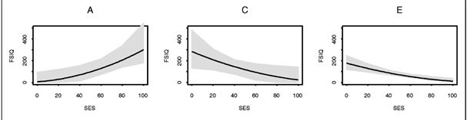
Turkheimer study SES
Moderation of unstandardized variance components (top)
Moderation of standardized variance components (bottom)
Notes:
Before and after standardization

Slide 27
1/.5
1
But what have we assumed concerning M?

Slide 28
The M is a measured variable
1
twin
M
M may seem to be environmental
(sociaal support, employment, marital status)

Slide 29
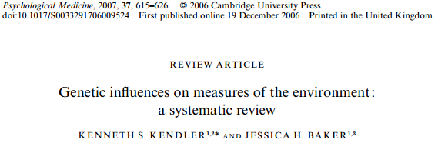
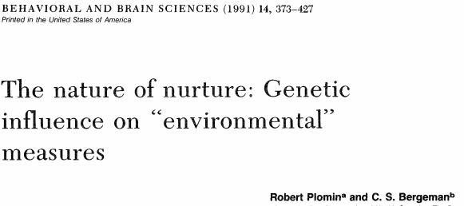
“Environmental” measures display genetic variance
See Kendler & Baker, 2006
See Plomin & Bergeman, 199
Notes:
Why do so-called environmental effects (E) display genetic effects? this could be due to Ph->E transmission as this allows for an effect of A on E (mediated by Ph).

Slide 30
Full Cholesky bivariate model
MZ = DZ = 1
MZ=1 / DZ=.5
MZ = DZ = 1
A_{c}
E_{u}
E_{u}
A_{c}
C_{c}
C_{u}
MZ=1
DZ=.5
C_{u}
C_{c}
E_{c}
A_{u}
A_{u}
E_{c}
e_{u}
e_{u}
a_{c}
c_{u}
a_{u}
c_{u}
a_{c}
c_{c}
a_{u}
c_{c}
c_{m}
c_{m}
e_{c}
e_{c}
e_{m}
a_{m}
a_{m}
e_{m}
M1
T1
T2
M2
var(T) = {e_{c}²+c_{c}²+a_{c}²} + {e_{u}²+c_{u}²+a_{u}²}
Notes:
30
If this is the case, treat the M as a phenotype like any other, i.e., subject to ACE modeling

Slide 31
M with its own ACE + ACE cross loadings.
MZ = DZ = 1
MZ=1 / DZ=.5
MZ = DZ = 1
A_{c}
E_{u}
E_{u}
A_{c}
C_{c}
C_{u}
MZ=1
DZ=.5
C_{u}
C_{c}
A_{u}
A_{u}
E_{c}
E_{c}
e_{u} + b_{eu}*M1
e_{u} + b_{eu}*M2
a_{c}
c_{u} + b_{cu}*M1
c_{u} + b_{cu}*M2
a_{c}
c_{c}
a_{u} + b_{au}*M2
c_{c}
c_{m}
c_{m}
e_{c}
a_{u} + b_{au}*M1
e_{c}
e_{m}
a_{m}
a_{m}
e_{m}
M1
T1
T2
M2
Notes:
31
Now add moderation

Slide 32
Can we treat M as a fixed effect in this manner
(given correct type I error rates, i.e., equal to α)?
1/.5
1
Not generally....
Notes:
Can we do this?

Slide 33
OK if #1: r(M1,M2) = 0
MZ = DZ = 1
E_{u}
E_{u}
C_{u}
MZ=1
DZ=.5
C_{u}
E_{c}
A_{u}
A_{u}
E_{c}
e_{u} + b_{eu}*M1
e_{u} + b_{eu}*M2
c_{u} + b_{cu}*M1
c_{u} + b_{cu}*M2
e_{c}
a_{u} + b_{au}*M1
a_{u} + b_{au}*M2
e_{c}
e_{m}
e_{m}
M1
T1
T2
M2
Notes:
33
Quite special!

Slide 34
Ok if #2: r(M1,M2) = 1
MZ = DZ = 1
MZ = DZ = 1
E_{u}
E_{u}
C_{c}
C_{u}
MZ=1
DZ=.5
C_{u}
C_{c}
A_{u}
A_{u}
e_{u} + b_{eu}*M1
e_{u} + b_{eu}*M2
c_{u} + b_{cu}*M1
c_{u} + b_{cu}*M2
c_{c}
c_{c}
c_{m}
a_{u} + b_{au}*M1
a_{u} + b_{au}*M2
c_{m}
M1
T1
T2
M2
Notes:
34
Ok for age, SES any variable that is correlated 1 between the twins

Slide 35
What to do otherwise? Fit this model
MZ = DZ = 1
MZ=1 / DZ=.5
MZ = DZ = 1
A_{c}
E_{u}
E_{u}
A_{c}
C_{c}
C_{u}
MZ=1
DZ=.5
C_{u}
C_{c}
E_{c}
A_{u}
A_{u}
E_{c}
e_{u} + b_{eu}*M1
e_{u} + b_{eu}*M2
a_{c}
c_{u} + b_{cu}*M1
c_{u} + b_{cu}*M2
a_{c}
c_{c}
c_{c}
c_{m}
a_{u} + b_{au}*M1
a_{u} + b_{au}*M2
c_{m}
e_{m}
a_{m}
e_{c}
e_{c}
a_{m}
e_{m}
M1
T1
T2
M2
Notes:
35
What to do if you want to treat M as fixed regressor

Slide 36
1
1 / .5
E
C
A
A
C
E
c + β_{c}*M1
c + β_{c}*M2
e + β_{e}*M1
a + β_{a}*M2
e + β_{e}*M2
a + β_{a}*M1
β_{0k} + β_{1k}*M1 + β_{2k}*M2
β_{0k} + β_{1k}*M2 + β_{2k}*M1
1
T1
T2
1
But what have assumed concerning the covariance between M and T?
I.e., the paths e_{c} c_{c} & a_{c} ....
Notes:
36
It can be shown that these regression coefficients usually need to differ between MZ and DZ twins.

Slide 37
MZ = DZ = 1
MZ=1 / DZ=.5
MZ = DZ = 1
A_{c}
E_{u}
E_{u}
A_{c}
C_{c}
C_{u}
MZ=1
DZ=.5
C_{u}
C_{c}
E_{c}
A_{u}
A_{u}
E_{c}
e_{u} + b_{eu}*M1
e_{u} + b_{eu}*M2
a_{c}
c_{u} + b_{cu}*M1
c_{u} + b_{cu}*M2
a_{c}
c_{c}
c_{c}
c_{m}
a_{u} + b_{au}*M1
a_{u} + b_{au}*M2
c_{m}
e_{m}
a_{m}
e_{c}
e_{c}
a_{m}
e_{m}
M1
T1
T2
M2
But what about the common paths e_{c} c_{c} & a_{c} ....

Slide 38
MZ = DZ = 1
MZ=1 / DZ=.5
MZ = DZ = 1
A_{c}
E_{u}
E_{u}
A_{c}
C_{c}
C_{u}
MZ=1
DZ=.5
C_{u}
C_{c}
E_{c}
A_{u}
A_{u}
E_{c}
e_{u} + b_{eu}*M1
e_{u} + b_{eu}*M2
a_{c} + b_{ac}*M1
c_{u} + b_{cu}*M1
c_{u} + b_{cu}*M2
a_{c} + b_{ac}*M2
c_{c} + b_{cc}*M1
c_{c} + b_{cc}*M2
c_{m}
a_{u} + b_{au}*M1
a_{u} + b_{au}*M2
c_{m}
e_{m}
a_{m}
e_{c} + b_{ec}*M1
e_{c} + b_{ec}*M2
a_{m}
e_{m}
M1
T1
T2
M2
Notes:
38
One way to model moderation is to use Purcell’s model, which is especially handy if the moderator is continuous.
In the moderation model proposed by Purcell in 2002, the path loadings are allowed to vary as a function of the moderator.
For each individual twin, the moderator values are read in directly and feature in the model as fixed variables.
In the bivariate parameterization, the moderator features twice: as a ‘normal’ variable whose variance is decomposed,
and as a moderator affecting the crosspaths as well as the loadings unique to the trait of interest.
Advantage of this model is that the covariance between M and T can also fluctuate as a function of the moderator itself.
Disadvantage:
lots of parameters need to be estimated.
Moderator and trait variables needs to have same measurement level

Slide 39
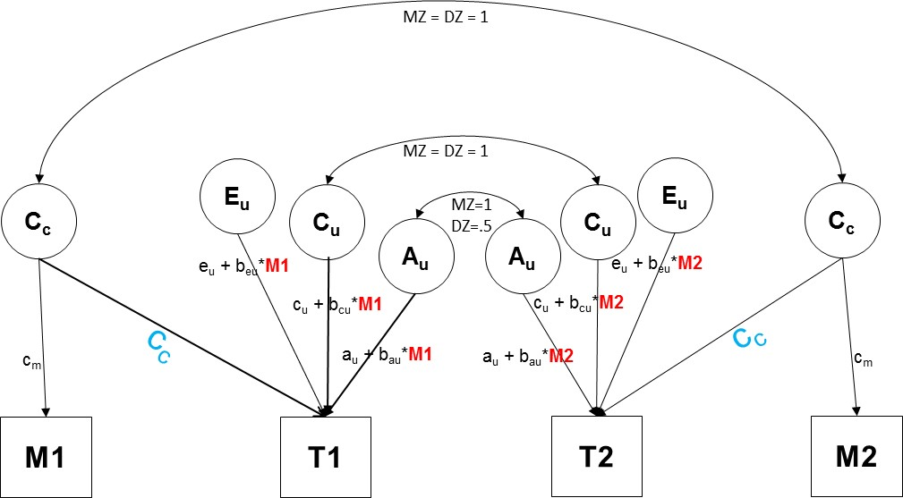
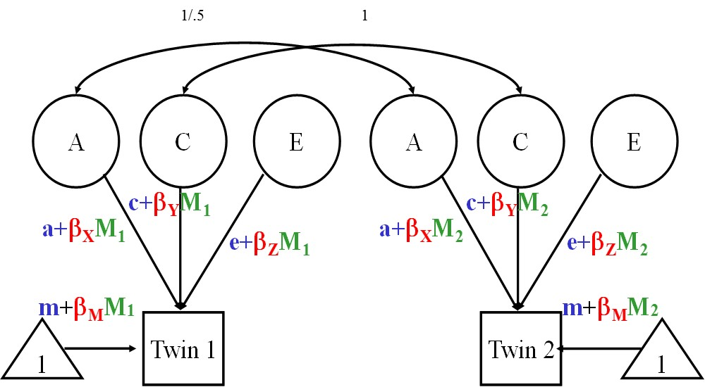
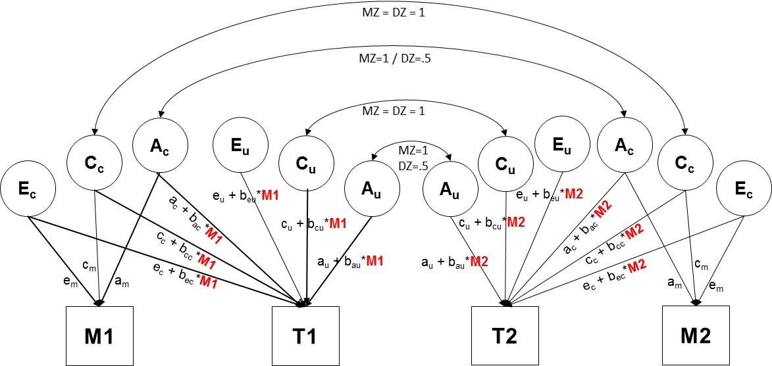
Use standard regression approach if crosspaths not moderated and Cov(M1,M2) = 0 or 1:
=
Otherwise use full model:

Slide 40
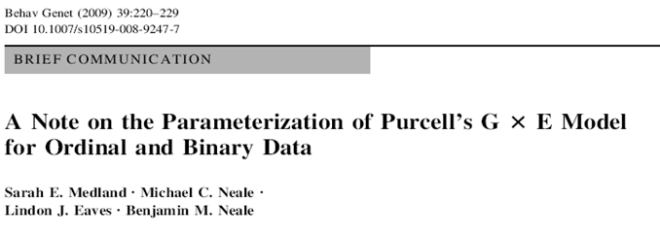
categorical data
Continuous data
  Moderation of means and variances
Ordinal data
  Moderation of thresholds and variances
  See Medland et al. 2009

Slide 41
Non linear moderation? Extend the model from linear to linear + quadratic. E.g.,
e_{c} + b_{ec1}*M1 + b_{ec2}*M1²

Slide 42
What about >1 number of moderators?
Extend the model accordingly
e_{c} + b_{ec1}*SES + b_{ec2}*AGE
With possible interaction:
e_{c} + b_{ec1}*SES + b_{ec2}*AGE + b_{ec3}*(AGE *SES)

Slide 43
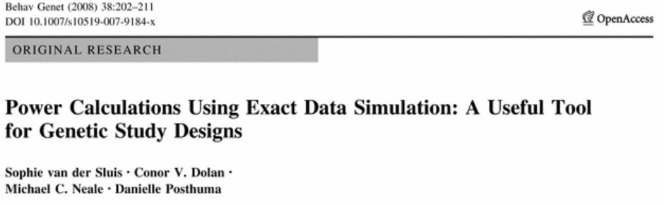
What about power given such extensions?
Do power calculation.... by simulation or by exact simulation

Slide 44
Sanja Franic’s Practical
Replicate findings from Turkheimer et al. with twin data from NTR
Phenotype: FSIQ
Moderator: SES in children
cor(M1,M2) = 1
Data: 205 MZ and 225 DZ twin pairs
5 years old

Slide 45
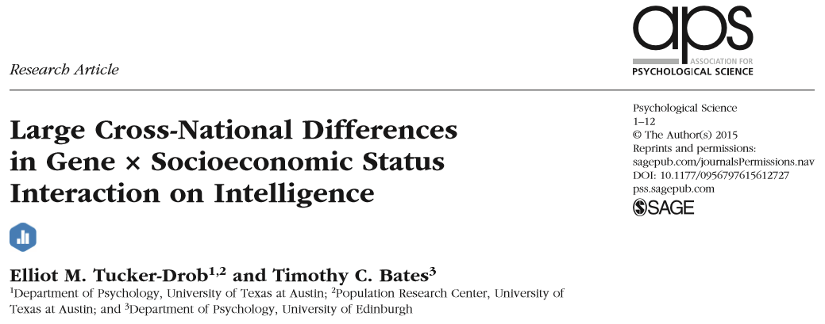
Interested in this specifically? Talk to T.C.Bates (present).
Psych Science 2015

Slide 46
4 additional slides.
It is “common knowledge” that GE covariance, r(AE) may appear to give rise to GxE. That is GxE may be due to r(AE).
The following 4 slides show how this may be the case

Slide 47
r(AE) can look like AxE... how?
Consider a single diallelic genetic variant
AA (p^2) AB (2pq) BB (q^2), q=1-p
GV
E
a
e
Suppose we have measured GV and E and we regress Ph on E
E is ordinal with 5 levels
Ph
Notes:
So A is replaced by a genetic variant, a di-allelic locus and E is ordinal with 5 levels.

Slide 48
p
Ph
AA
var(Ph|E)
AB
homoskedastic
BB
Notes:
Homoskedastic residual variance. in Regression of Ph on E. This is the standard regression model. Note that the red dots represent the genotype values associated with AA, AB and BB (say +d, 0 and –d). I introduced jitter in the plot (the red small dots) just to make it visible that there are many individuals with these genotypic values.

Slide 49
p
Ph
AA
var(Ph|E)
AB
heteroskedastic
BB
Notes:
heteroskedastic residual variance due to GxE. the standard case. A (GV) and E are uncorrelated by the effects of GV depend on E, as you can see at the top left.

Slide 50
p
Ph
AA
var(Ph|E)
AB
heteroskedastic!
BB
Notes:
heteroskedastic residual variance yes.... but not due to GxE! due to the role that allele freq p plays in the AE correlation.
But the heteroskedasticity itself is of GxE... The allele freq necessarily varies with E as that is the cause of the r(AE). Note that the heteroskedasticity is many manifest in a nice fanspread, but in the differences in variance due to the locus. the variance is 2*p*(1-p)*d. Now p varies with E, giving rise to r(AE).

