Slide 1
Phenotypic factor analysis
Conor V. Dolan & Abdel Abdellaoui
Biologische Psychologie, VU, Amsterdam
Boulder Workshop - March 2016

Slide 2
Phenotypic factor analysis
A psychometric statistical technique to investigate the dimensionality of related variables in terms of common latent variables (a.k.a. common factors).
A data reduction statistical technique to summarize or reduce a number related variables to one or a few summary variables. Not a causal model.

Slide 3
16 depression items (with response categories 5)
I feel lonely
I feel confused or in a fog
I cry a lot
I worry about my future.
I am afraid I might think or do something bad
I feel that I have to be perfect
I feel that no one loves me
I feel worthless or inferior
I am nervous or tense
I lack self confidence I am too fearful or anxious
I feel too guilty
I am self-conscious or easily embarrassed
I am unhappy, sad or depressed
I worry a lot
I am too concerned about how I look
I worry about my relations with the opposite sex
A psychometric analysis:
Investigate the dimenionality of the item responses in terms of substantive latent variables. A causal hypothesis: the latent variable (“depression”) causes the item response.
A data reduction analyses:
Reduce the dimensionality of the data from 16 variables to a 1 (or 2 or 3) variables, while retaining as much information as possible (principal component analysis; PCA).
Notes:
library(MASS)
#
nf=1; N=250; nitem=16
#
residuals=matrix(0,N,16)
items=matrix(0,N,16)
dep=matrix(rnorm(N,0,1),N,1) # latent common factor
#
fl=matrix(c(.10,.15,.12,.11,.12,.13,.14,.15,.16,.14,.13,.14,.14,.15,.13,.12),nitem,1) # factor loadings
th=diag(c(1-fl)) # residual variances
fl=sqrt(fl)
#
residuals=mvrnorm(N,rep(0,nitem),Sigma=th)
items=dep%*%t(fl)+residuals
factanal(items,factors=1)->fa1
cor(fl,fa1$loadings)
3

Slide 4
The linear common factor model
as a statistical (regression) model - formal representation
as a causal – psychometric - model
- what is a common factor substantively?
- implication in terms of data summary and causal modeling
- why is the factor model relevant to genetic modeling?
- what can we learn about the phenotypic common factors from twin data?

Slide 5
If you understand linear regression,
you understand a key ingredient of the linear factor model
…and of many statistical models including
genetic covariance structure modeling

Slide 6
Path diagram regression model “regression of Y on X”:
The model: Y_{i} = b0 + b1*X_{i} + e_{i}
The implied model for the mean:
mean(Y) = b0 + b1*mean(X)
mean(Y) = b0 (if mean(X) = 0)
The implied model for the covariance matrix:
x y x y
x s²_{x} s_{xy} = s²_{x} b1*s²_{x}
y s_{xy} s²_{y} b1*s²_{x} b1²*s²_{x} + s²_{e}
s²_{x}
X
b1
Y
b0
1
1
e
s²_{e}

Slide 7
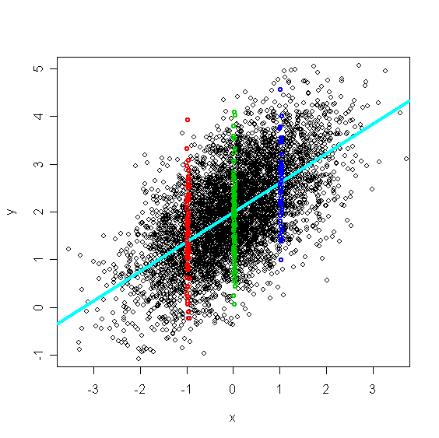
red: the data points of cases with x=-1
green: the data points of cases with x=0
dark blue: the data points of cases with x=1
Distributional assumption in linear regression concerns the y given (conditional on) a fixed value of x
Two important aspects: Linearity, Homoskasticity
Notes:
These figure illustrate what we mean by the conditional distribution of y given a fixed value of x. Consider the conditioning on x=-1. The mean of the read data points equals b0+b1*(-1), ie. the predicted value given x=-1. The variance about the mean is due to the variance of e, the residual.
The variance of e (see the red histogram) afterall expresses the prediction error: y-b0-b1*(-1) = e. Homoscedasticity is evident in the fact that the histograms are much a like: approximately normal, with equal variance and means of zero.
The independent variable (or variables) is treated as fixed, in the sense that we do not make any distributional assumptions about x. So the statements "b contains fixed parameters", and "x is a fixed regressor" involve different meanings of the term fixed. The parameters are fixed because they do not vary over cases. The predictor is fixed because we make no distributional assumption concerning x. Fixed used with two different meanings: confusing!

Slide 8
Single common factor model: A set of linear regression equations
x
b1
y1
b1 is a regression coefficient (slope parameter)
Y_{i} = b0 + b1*X_{i} + e_{i}
ε1
η
λ1 is a factor loading (a regression coefficient by a different name!)
λ1
λ4
λ2
λ3
y1
y2
y3
y4
ε1
ε2
ε3
ε4
Notes:
The common factor model as applied to continuous variables (indicators), y1, y2, y3, and y4, is actually a model of 4 linear regression models: 4 dependent variables and 1 independent (eta). The problem is that the independent variable is not observed…. however this is still a collection of regression coefficients.

Slide 9
η
y_{i1} =τ₁ + λ₁η_{i} + e_{i}
λ1
y1
The implied model for the covariance matrix:
 | η | y
η | σ²_{η} | λ₁σ²_{η}
y | λ₁σ²_{η} | λ₁²σ²_{η} + σ²_{ε}
ε1
Mean(y₁)= τ₁ + λ₁Mean(η) = τ₁
R² = (λ₁² * σ²_{η} ) / (λ₁² * σ²_{η} + σ²_{ε})
9
Notes:
9
We are familiar with the linear regression model (regress y on x). The model conveyed here does not include the intercept (b0) because we have centered the data.
The model can be conveyed in the equation, or in the path diagram. The implied covariance matrix is also given.

Slide 10
But what is the point if the common factor (the independent variable, η) is not observed?
Notes:
The regression model comes with the famous R-square effect size (percentage of variance explained). So each regression model in the common factor model must also come with an R-squared. Only R-squared is not usually the term that is used in the common factor model. !

Slide 11
Single common factor model: A set of linear regression equations
η
λ1
λ2
λ4
λ3
y1
y2
y3
y4
1
1
1
1
ε1
ε2
ε3
ε4
Implies a covariance matrix:
Notes:
The same results beut for the common factor model: model conveyed in equations, as a path model and the implied covariance matrix.
How is the implied covariance matrix actually calculated? How do we get from the equations to Sigma?

Slide 12
A set of linear regression coefficients expressed
as a single matrix equation: using matrix algebra
y_{i} – t = Λη_{i} + ε_{i}
Matrix algebra is
1) Notationally Efficient
2) Basis of Multivariate Statistics
Notes:
We are going to express the model in matrix algebraic terms…So first we are going to go over the necessary matrix algebra.

Slide 13
ny number of variables
ne number of common factors
y_{i} – t = Λη_{i} + ε_{i}
ny x 1
ny x ne
ne x 1
ny x 1
t = t₁
t₂
t₃
t₄
y_{i} = y_{i1}
y_{i2}
y_{i3}
y_{i4}
ε_{i} = ε_{i1}
ε_{i2}
ε_{i3}
ε_{i4}
Λ = λ₁
λ₂
λ₃
λ₄
η_{i} = η_{i}
1 x 1
ny x 1

Slide 14
ny number of variables
ne number of common factors
y_{i} = Λη_{i} + ε_{i}
Centered t = 0!
ny x 1
ny x ne
ne x 1
ny x 1
σ²_{y1} = E[y₁y₁] = E[(λ₁η_{i} + ε_{i} )(λ₁η_{i} + ε_{i} )] =
E[(λ₁η_{i}λ₁η_{i} + λ₁η_{i}ε_{i} + ε_{i}λ₁η_{i} + ε_{i}ε_{i} )] =
E[λ₁η_{i}λ₁η_{i}] + E[λ₁η_{i}ε_{i}] + E[ε_{i}λ₁η_{i}] + E[ε_{i}ε_{i} ] =
λ₁λ₁E[η_{i}η_{i}] + λ₁E[η_{i}ε_{i}] + λ₁E[ε_{i}η_{i}] + E[ε_{i}ε_{i} ] =
λ₁λ₁E[η_{i}η_{i}] + E[ε_{i}ε_{i} ] = λ₁²σ²_{η} + σ²_{ε}
Notes:
We already know that the regression model y=b0+b1*x+e implies a decomposition of variance of y: into a part that is “explained” by x and a residual part.
Here is the same decomposition for the regression of y1 on eta. Can you follow the steps?

Slide 15
ny number of variables
ne number of common factors
y_{i} = Λη_{i} + ε_{I}
Centered t = 0!
ny x 1
ny x ne
ne x 1
ny x 1
Σ_{y} = E[y*y^{t}] = E[(Λη_{i} + ε_{i})(Λη_{i} + ε_{i})^{t}] = (1)
E[(Λη_{i} + ε_{i})(η_{i}^{t}Λ^{t} + ε_{i}^{t})] = (2)
E[Λη_{i} η_{i}^{t}Λ^{t} + Λη_{i}ε_{i}^{t} + ε_{i}η_{i}^{t}Λ^{t} + ε_{i}ε_{i}^{t} ] = (3)
E[Λη_{i} η_{i}^{t}Λ^{t} ] + E[Λη_{i}ε_{i}^{t} ] + E[ε_{i}η_{i}^{t}Λ^{t}] + E[ε_{i}ε_{i}^{t} ] = (4)
ΛE[η_{i} η_{i}^{t}]Λ^{t} + ΛE[η_{i}ε_{i}^{t} ] + E[ε_{i}η_{i}^{t}]Λ^{t} + E[ε_{i}ε_{i}^{t} ] = (5)
Σ_{y} = ΛE[η_{i} η_{i}^{t}]Λ^{t} + E[ε_{i}ε_{i}^{t} ] = ΛΨΛ^{t} + Θ (6)
Notes:
And here is exactly the same, but applied to the set of linear equations simultaneously. It is a lot of greek letters, but what is going on really is just the matrix manipulations applied to the common factor linear equations. Note the terms in red are zero by definition in this model. Can you follow the steps?
Why bother you with this? Because the LISREL syntax includes the matrices shown in eq. 6 (in purple). In the LISREL syntax the are called ly, ps, and te.

Slide 16
ny number of variables
ne number of common factors
y_{i} = Λη_{i} + ε_{i}
ny x 1
ny x ne
ne x 1
ny x 1
Σ_{y} = E[yy^{t}] = E[(Λη_{i} + ε_{i})(Λη_{i} + ε_{i})^{t}] = ΛΨΛ^{t} + Θ
E[η_{i} η_{i}^{t}] = Ψ and E[ε_{i} ε_{i}^{t}] = Θ
You can represent this model in OpenMx using matrices
Notes:
Here it is again, but without the intermediate steps. ‘ne’ and ‘ny’ are used in the LISREL syntax to indicate the number of observed variables and the number of latent variable (etas).

Slide 17
n3 n4 n5 n6
n3 35.376 0.624 0.204 0.685
n4 15.807 18.159 0.154 0.586
n5 4.956 2.668 16.640 0.225
n6 19.023 11.654 4.274 21.769
?
N=361, Female 1st year psychology students (University of Amsterdam)
Notes:
If we choose plausible values for the parameters in the model – the elements in lambda (ly), theta (te) and psy (ps) – then we can calculate the expected or model covariance matrix.

Slide 18
The chi2 goodness of fit test (χ²=1.36, df=2) suggest that the model fits well. The observed covariance structure is consistent with my theory.
Σ_{y} = ΛE[η_{i} η_{i}^{t}]Λ^{t} + E[ε_{i}ε_{i}^{t} ] = ΛΨΛ^{t} + Θ
1 (fixed)
Λ^{t} = [5.059 3.100 1.005 3.758]
diag(Θ) = [9.684 8.500 15.584 7.587]
Ψ = [1] (fixed)
Ν
R² = (λ₁² * σ²_{η} ) / (λ₁² * σ²_{η} + σ²_{ε})
5.06
var(n1) = 5.06² + 9.68 =35.27
rel(n1) = 5.06² / 35.27 = .725
(R² in regression of y1 on N)
What about y3?
3.76
Observed covariance matrix
35.278
15.763 18.109
4.942 2.661 16.594
18.970 11.622 4.262 21.709
3.10
1.00
y1
y2
y3
y4
1
1
1
1
Expected covariance matrix (Σ_{y})
35.278
15.682 18.109
5.085 3.115 16.594
19.011 11.649 3.777 21.709
ε1
ε2
ε3
ε4
9.68
8.50
15.5
7.58
Notes:
Why df=2? Count the observed statistics (S, 10), and the estimated parameters (P, i.e., 8): df = 10-8.

Slide 19
A technical aspect of the common factor model: scaling.
The mean and variance of the common factor? The common factor is latent!
Scale by setting the mean to zero. (μ_{η} = 0)
Scale by fixing variance to “sensible value” (σ_{η}² = 1)
Scale by making it dependent on an indicator by fixing a factor loading to 1 (λ₁=1)

Slide 20
But we know about scaling, because this model uses the same scaling
(var(E)=var(C)=var(A) = 1; mean(A)=mean(C)=mean(E)=0)
rMZ=rDZ=1
1
1
1
1
1
1
rMZ=1 or rDZ=.5
E
C
A
A
C
E
e
c
a
c
a
e
T1
T2
Notes:
In the classical twin model, the variance is decomposed in A, C and E.
Usually, the variances of the latent factors are fixed to 1 fo identification, and the path loadings are estimated, such that the variance of A, for example, is a^2.
So variance components can never become negative.
Assumption: homoskedactic: variance decomposition is equal in different subpopulations and under different environmental circumstances.

Slide 21
A technical aspect of the common factor model: scaling.
Scale the common factor by fixing to “sensible value” (σ_{η}² = 1)

Slide 22
A technical aspect of the common factor model: scaling.
Or making it dependent on an indicator by fixing a factor loading to a
“sensible value”, i.e., 1 (λ₁=1)

Slide 23
In summary:
The single common factor model can be used to test the hypothesis that the observed covariance or correlation matrix (say 4 neuroticism items) is consistent with a single common source of variance, the common factor (i.e., neuroticism).
This is established by estimating the parameters of the singel factor model and testing whether the observed covariance matrix equals the covariance matrix based on the estimated parameters (the “implied” or “expected” covariance matrix)
The parameters can also be used to evaluated the quality of the items or indicators
(R²: now much of the indicator variance is explained by the common factor?)
9 slides on interp

Slide 24
A substantive aspect of the common factor model: interpretation (that you bring to the model!)
Strong realistic view of the latent variable N:
N is a real, causal, unidimensional source of individual differences. It exists beyond the realm of the indicator set, and is not dependent on any given indicator set.
Causal - part I: The position of N determines causally the response to the items. N is the only direct cause of systematic variation in the items. I.e., if you condition on N, then the correlations among the items are zero: local independence (ε1,ε2,ε3,ε4 are uncorrelated).
Ν
λ1
λ4
λ2
λ3
n1
n2
n3
n4
1
1
1
1
ε1
ε2
ε3
ε4
Reflective indicators:
They reflect the causal action of the latent variable N

Slide 25
Causal - part I: The position of N determines causally the response to the items. N is the only direct cause of systematic variation in the items. I.e., if you condition on N, then the correlations among the items are zero: local independence (as it is called in psychometrics).
Ν
λ1
λ2
λ4
λ3
n1
n2
n3
n4
1
1
1
1
ε1
ε2
ε3
ε4
violation of local independence (correlated residuals 1 & 3)
Reflective indicators: They reflect the causal action of the latent variable N

Slide 26
A substantive aspect of the common factor model: interpretation (you bring to the model).
Causal part II: The relationship between any external variable (latent or observed) and the indicators is mediated by the common factor N: essence of “measurement invariance”.
If you condition on N, then the correlation between the external variables and the indicators is zero.
GV
sex
A
Ν
λ1
λ2
λ4
λ3
n1
n2
n3
n4
1
1
1
1
ε1
ε2
ε3
ε4

Slide 27
Direct relationships are supposed to be absent.
(these destroy unidimensionality….)
Interestingly, the classical twin design affords an omnibus test of the mediatory role of N
sex
Ν
λ1
λ2
λ4
λ3
n1
n2
n3
n4
1
1
1
1
ε1
ε2
ε3
ε4

Slide 28
A
C
E
Common pathway model
Psychometric model
Phenotypic unidimensionality N mediates all external sources of individual differences
N
n₁
n₂
n₃
n₄
n₅
n₆
n₇
n₈
n₉
Independent pathway model or Biometric model
Implies phenotypic multidimensionality…..
What about N in the phenotypic analysis? The phenotypic (1 factor) model was incorrect!
A
C
E
n₁
n₂
n₃
n₄
n₅
n₆
n₇
n₈
n₉
Notes:
Now, unless the violation of proportionality is large and we have enough power to detect it, the model with one latent variable may still fit.

Slide 29
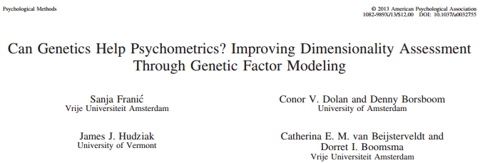
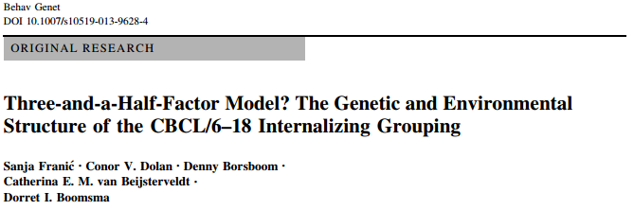
Common pathway vs
Independent
pathway model.

Slide 30
A different interpretation: factor analysis as a data summary.
Just a way to reduce multiple phenotypes into a single index.
General
health
Life style
diet
Cooper
Test score
Blood pressure
Life style smoke
BMI
Formative indicators. No causal interpretation: General Health does not cause smoking!
Notes:
However, the model appropriate for this situation is the independent pathway model, in which we specify direct influences of a c and e factors on item responses.

Slide 31
When to use a sum score?
requires careful interpretation
General
health
Genetic variant
A
E
C
Life style
diet
Cooper
Test score
Blood pressure
Life style smoke
BMI
General health
Sum these and analyze the phenotype “General Health”
Notes:
However, the model appropriate for this situation is the independent pathway model, in which we specify direct influences of a c and e factors on item responses.

Slide 32
APGAR
APGAR
Index of neonatal health
based on
5 formative indicators
item1
Appear-ance
item2
Pulse
Grimace
Activity
Respiration
Items are formative: itemscores form the APGAR score
Index variable = defined by formative items.
The APGAR is dependent on the formative items.
APGAR does not determine or cause the scores on the APGAR items
(e.g., APGAR does not cause poor respiration or blue appearance, obviously: poor respiration causes blue appearance).

Slide 33
Back to the common factor model !
Multiple common factors, CFA vs. EFA with rotation
EFA (always more than one common factor).
Aim: determine dimensionality and derive meaning of factors from factor loadings
Exploratory approach: How many latent variables? What is the pattern of factor loadings? Low on prior theory, but still involves choices.
How many latent variables: Screeplot, Eigenvalue > 1 rule, Goodness of fit measures (χ², RMSEA, NNFI), info criteria (BIC, AIC).
Pattern of factor loadings: Type of rotation (varimax, oblimin, many choices!).

Slide 34
EFA (two) factor model as it is fitted in standard programs: all indicators load on all common factors....
r = 0
η1
η2
y1
y2
y3
y4
y5
y6
e1
e2
e3
e4
e5
e6

Slide 35
y₁ = λ₁₁ η₁ + λ₁₂ η₂ + ε₁
y₂ = λ₂₁ η₁ + λ₂₂ η₂ + ε₂
y₃ = λ₃₁ η₁ + λ₃₂ η₂ + ε₃
y₄ = λ₄₁ η₁ + λ₄₂ η₂ + ε₄
y₅ = λ₅₁ η₁ + λ₅₂ η₂ + ε₅
y₆ = λ₆₁ η₁ + λ₆₂ η₂ + ε₆
η^{t} = [η₁ η₂]
Λ = λ₁₁ λ₁₂
λ₂₁ λ₂₂
… …
λ₅₁ λ₅₂
λ₆₁ λ₆₂
y_{i} = Λη_{i} + ε_{i}
ny x 1
ny x ne
ne x 1
ny x 1
Σ_{y} = Λ Ψ Λ^{t} + Θ
(ny x ny) (ny x ne)(ne x ne)(ne x ny) + (ny x ny)
Ψ = I = 1 0
0 1
Θ = diag(σ²_{ε1} σ²_{ε2} σ²_{ε3} σ²_{ε4} σ²_{ε5} σ²_{ε6})

Slide 36
y₁ = λ₁₁ η₁ + λ₁₂ η₂ + ε₁
y₂ = λ₂₁ η₁ + λ₂₂ η₂ + ε₂
y₃ = λ₃₁ η₁ + λ₃₂ η₂ + ε₃
y₄ = λ₄₁ η₁ + λ₄₂ η₂ + ε₄
y₅ = λ₅₁ η₁ + λ₅₂ η₂ + ε₅
y₆ = λ₆₁ η₁ + λ₆₂ η₂ + ε₆
Meaning of the common factors?
Based on these factor loadings? No...
unique values of Λ, but rotatable or transformable
ΛΜ = Λ∗, ΜΜ^{t} = I, so that Σ_{y} = Λ ΜΜ^{t}Λ^{t} + Θ = ΛΙΛ^{t} + Θ
M is called a rotation matrix … to obtain interpretable Λ∗

Slide 37
ΛΜ = Λ∗
Μ: Rotation matrix is calculated by maximizing a rotation criterion. These minimize or maximize loadings to improve interpretability.
Orthogonal rotation leaves common factors uncorrelated
Oblique rotation allows for correlation.
Rotation is just a transformation of results (no testing!).

Slide 38
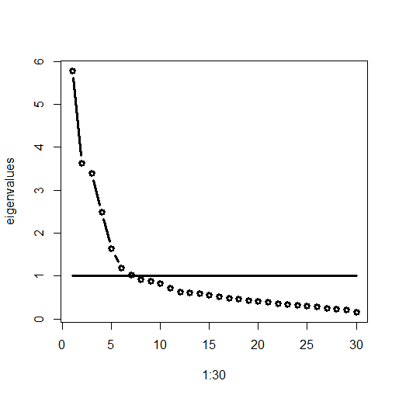
BIG 5 data 361 females students
30 indicators: expected 5 factors
Screeplot locate the “elbow joint” (5)
Eigenvalues > 1 rule (6?)

Slide 39
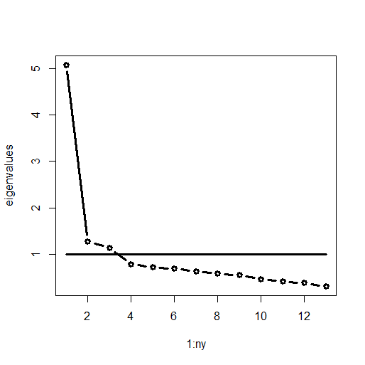
WAIS-III 1868 US adults: 13 subtests
expected 3 factors.
Screeplot locate the “elbow joint” (1)
Eigenvalues > 1 rule (3)
3 EFA factor model: Chi2(42) = 111.9

Slide 40
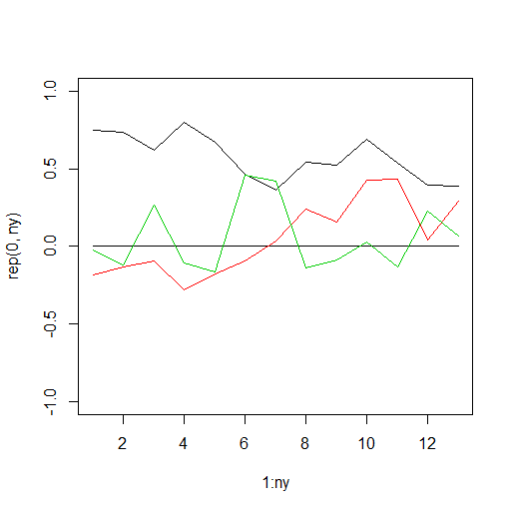
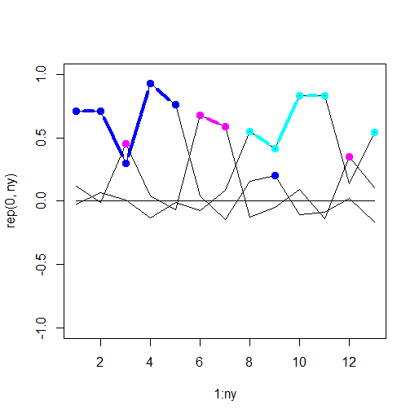
verbal
Non-verbal
Plot of unrotated factor loadings
Chi2(42) = 111.9
Promax rotated loadings (oblique)
Chi2(42) = 111.9

Slide 41
Expected model....but if we expect this, why use EFA?
correlated common factors
verbal
memory
visual
factor loadings
voca-bulary
simil-arities
inform
compre
digit span
let_num
pic-
comp
coding
block
design
matrices
symb search
object
residuals
Notes:
Stel dat ik precies weet welke indicatoren wel of niet op welke factor model laden? Oftewel: Stel ik weet welke factor ladingen nul zijn. Dan kan ik mijn model weer geven in een pad diagram waarin ik deze kennis weergeef: vocabulary laadt op verbal maar niet op memory; dus de regressie van vocabulary op verbal is niet nul, maar de regressie van vocabulary op memory is wel nul. Betekent dit dat vocabulary en memory ongecorreleerd zijn? NEE!!!!!! er is wel degelijk een relatie tussen vocabulary en memory maar die is gemedieerd door de factor verbal. Er is dus wel een relatie, maar geen directe regressie relatie.

Slide 42
CFA (two) factor model: impose a pattern of loadings based on theory , define the common factors based on prior knowledge.
r
η1
η2
y1
y2
y3
y4
y5
y6
e1
e2
e3
e4
e5
e6

Slide 43
y₁ = λ₁₁ η₁ + 0 η₂ + ε₁
y₂ = λ₂₁ η₁ + 0 η₂ + ε₂
y₃ = λ₃₁ η₁ + 0 η₂ + ε₃
y₄ = 0 η₁ + λ₄₂ η₂ + ε₄
y₅ = 0 η₁ + λ₅₂ η₂ + ε₅
y₆ = 0 η₁ + λ₆₂ η₂ + ε₆
η^{t} = [η₁ η₂]
Λ = λ₁₁ 0
λ₂₁ 0
… …
0 λ₅₂
0 λ₆₂
Ψ = 1
ρ 1 Θ = diag(σ²_{ε1} σ²_{ε2} σ²_{ε3} σ²_{ε4} σ²_{ε5} σ²_{ε6})
y_{i} = Λη_{i} + ε_{i}
ny x 1
ny x ne
ne x 1
ny x 1
Σ_{y} = Λ Ψ Λ^{t} + Θ
(ny x ny) (ny x ne)(ne x ne)(ne x ny) + (ny x ny)

Slide 44
Σ_{y} = Λ Ψ Λ^{t} + Θ
(ny x ny) (ny x ne)(ne x ne)(ne x ny) + (ny x ny)
factor correlation matrix (Ψ)
factor loading matrix (Λ)
residual covariance matrix (Θ)
In CFA, in contrast to EFA, you can impose all kinds of constraints on the parameters
In CFA, in constrast to EFA, you can estimate off-diagonal elements in the cov matrix of the residuals Θ
(e.g. to accommodate violations of local independence)

Slide 45
Suppose 3 indicators at 2 time points
r
v₁
v₂
f1
f2
1
1
d
b
a
c
y1
y2
y3
y4
y5
y6
v_{e1}
v_{e2}
v_{e3}
v_{e14}
v_{e5}
v_{e6}
e1
e2
e3
e4
e5
e6

Slide 46
Suppose 3 indicators at 2 time points
r
v₁
v₂
f1
f2
1
1
b=d
b=d
a=c
a=c
y1
y2
y3
y4
y5
y6
v_{e1}
v_{e2}
v_{e3}
v_{e14}
v_{e5}
v_{e6}
e1
e2
e3
e4
e5
e6

Slide 47
Suppose 3 indicators at 2 time points
r
v₁
v₂
f1
f2
1
b=d
1
b=d
a=c
a=c
y1
y2
y3
y4
y5
y6
e1
e2
e3
e4
e5
e6
v_{e1}=v_{e4}
v_{e2}=v_{e5}
v_{e3}=v_{e6}
v_{e1}=v_{e4}
v_{e2}=v_{e5}
v_{e3}=v_{e6}
Notes:
What would the presence of the correlated residual imply w.r.t. the strong causal interpretation of the common factors?

Slide 48
MZ=DZ=1
1
1
1
1
1
1
MZ=1 / DZ=.5
E
C
A
A
C
E
e
c
a
c
a
e
T1
T2
Equality constraints are nothing new!
Notes:
In the classical twin model, the variance is decomposed in A, C and E.
Usually, the variances of the latent factors are fixed to 1 fo identification, and the path loadings are estimated, such that the variance of A, for example, is a^2.
So variance components can never become negative.
Assumption: homoskedactic: variance decomposition is equal in different subpopulations and under different environmental circumstances.

Slide 49
What if I want to carry out a phenotypic factor analysis given twin data?
N pairs, but N*2 individual...
Ignore family relatedness treat N twin pairs as 2*N individuals ? OK does not effect estimate of the covariance matrix, but renders statistical tests invalid
(eigenvalues and scree plots are ok)
2) Ignore family relatedness treat N twin pairs as 2*N individuals use a correction for family clustering? OK convenient, the correction is built in in the Mplus program, can be programmed in OpenMx
3) Do the factor analysis in N twins and replicate the model in the other N twins? Ok, but not true replication (call it pseudo replication)
4) Do the factor analysis in twins separately and simultaneously, but include the twin 1 – twin 2 phenotypic covariances. Ok, but possibly unwieldy (especially is you have extended pedigrees).

Slide 50
Summary I: Exploratory factor analysis
how many common factors “underlie” the test scores....?
b) can we interpret the common factors by inspecting the rotated factor loadings...to understand the meaning of the common factors?
c) does it help interpretation to allow for correlated factors (oblique rotation)?
d) evaluate the reliability of the indicators.

Slide 51
Summary II: Confirmatory factor analysis.
a) test preconceived model in which the number of common factors and the pattern of factor loadings are given
b) evaluate the overall goodness of fit
c) evaluate the significance of the factor loadings, the values of the common factor correlations
d) evaluate measurement invariance w.r.t. a given external variable X: is the relationship between X and the indicators mediated by the common factor(s)?

Slide 52
Summary III: relevance of factor analysis to twin studies
a) It may be of interest to determine the dimensionality of items if the items are use to create a sum score (sum of items or symptom endorsement)
b) The decomposition of S_{ph} = S_{A} +S_{C} + S_{E} is based on a cholesky decomposition. Each covariance matrix SA, SC and SE may be subjected to factor analysis.
Summary IV: Relevance of twin studies to phenotypic factor analysis:
1) Common pathway model vs Independent pathway model.

Slide 53
Phenotypic Factor Analysis practical
1) EFA using the R routine factanal (a routine in R, not part of OpenMx):
13 WAIS subtests, unrotated and rotated 3 factor model
2) CFA using OpenMx.
Big 5 Neuroticism and Extroversion, 12 subtest: correlated 2 factor model

Slide 54
The linear common factor model: “continuous” indicators (7 point Likert scale is “continuous”)
What about ordinal or binary indicators?
Linear regression model is key ingredient in the linear factor model
Logistic or probit regression is a key ingredient in ordinal or discrete factor analysis.

Slide 55
The model for the Y_{i} = b0 + b1*X_{i} + e_{i}
E[Y|X=x˚] = b0 + b1*x˚
Logit:
E[Z|X=x˚] = Prob(Z=0|X=x˚) = exp(b0 + b1*x˚) / {1 + exp(b0 + b1*x˚)}
Probit:
E[Z|X=x˚] = Prob(Z=0|X=x˚) = Φ(b0 + b1*x˚), Φ(.) cumulative st. normal distribution
Replace X, observed predictor, but η, the common factor.

Slide 56
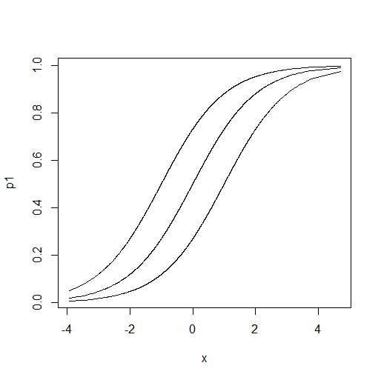
Do you like to go to parties? (y/n)
Prob(yes|X=x˚)
The probability of endorsement
The common factor Extraversion

Slide 57
correlated common factors
verbal
memory
visual
factor loadings
voca-bulary
simil-arities
inform
compre
digit span
let_num
pic-
comp
coding
block
design
matrices
symb search
object
residuals
Notes:
Stel dat ik precies weet welke indicatoren wel of niet op welke factor model laden? Oftewel: Stel ik weet welke factor ladingen nul zijn. Dan kan ik mijn model weer geven in een pad diagram waarin ik deze kennis weergeef: vocabulary laadt op verbal maar niet op memory; dus de regressie van vocabulary op verbal is niet nul, maar de regressie van vocabulary op memory is wel nul. Betekent dit dat vocabulary en memory ongecorreleerd zijn? NEE!!!!!! er is wel degelijk een relatie tussen vocabulary en memory maar die is gemedieerd door de factor verbal. Er is dus wel een relatie, maar geen directe regressie relatie.

Slide 58
general intelligence
second order common factor
ve_
res
m_res
vi_
res
first order common factor
verbal
memory
visueel
factor loadings
regression coeffients
voca-bulary
simil-arities
inform
compre
digit span
let_num
pic-
comp
coding
block
design
matrices
symb search
object
residuals
Notes:
Confirmatieve factor modellen bieden de mogelijkheid om hoge orde factoren te onderzoeken. Hierbij worden de correlaties tussen de eerste orde factoren (verbal, memory, visual) verklaard adhv een tweede orde factor. Dit is een invloedrijk model in IQ onderzoek.

