Slide 1
Structural Equation Modeling in R with OpenMx and umx
Tim Bates
tim.bates@ed.ac.uk

Slide 2
The latest umx from github
Workshop laptops have ≥ umx 1.1.5
If using your own laptop, get the latest version with:
# if you have not already
install.packages("devtools")
devtools:install_github("tbates/umx")
Whenever you update a package, pays to restart R

Slide 3
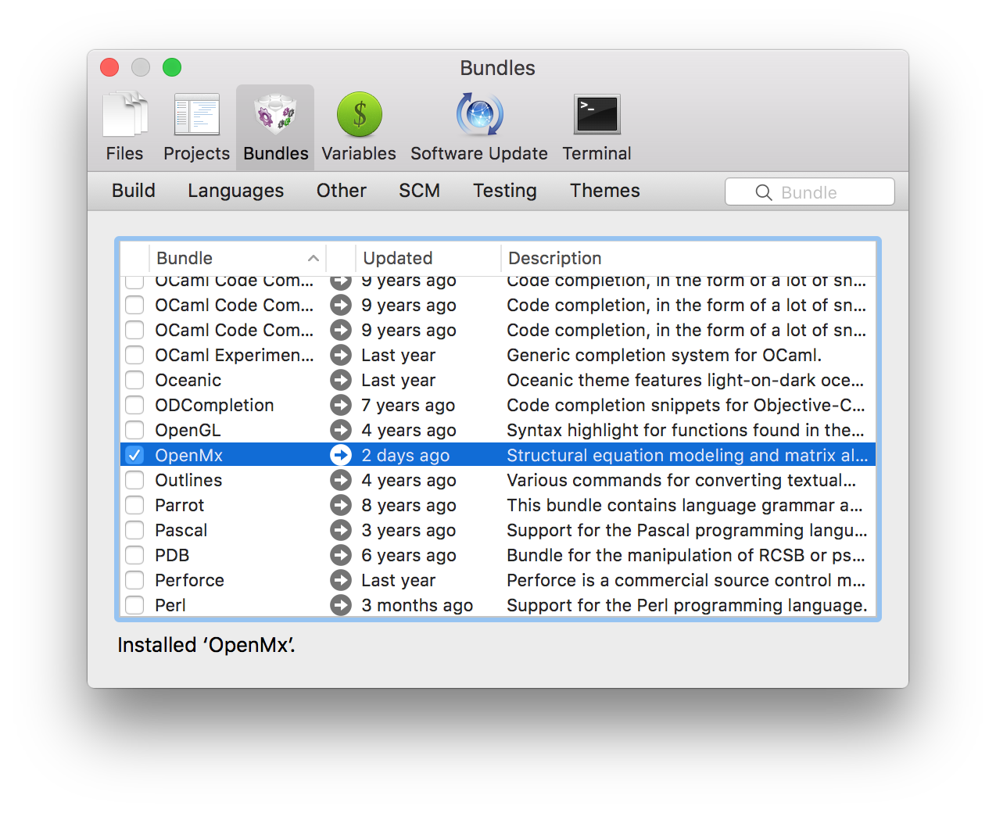
TextMate bundle
Scripting and analysis are greatly enhanced by working in a great environment.
My favorite is TextMate
It has bundles supporting R and for OpenMx
(maintained by us)

Slide 4
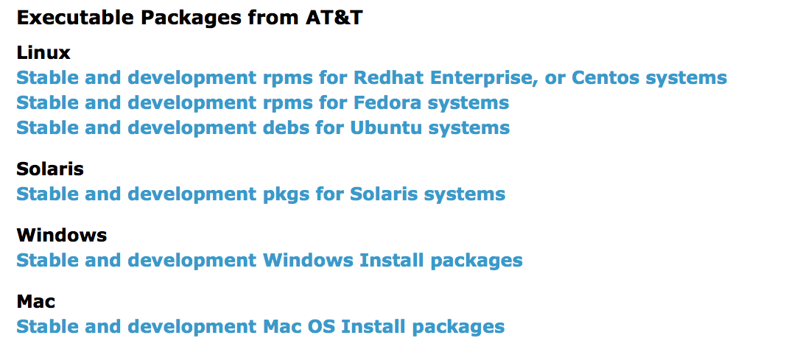
Wouldn’t it be great to get output plots!
http://www.graphviz.org/Download..php

Slide 5

plot(model)
Need to install an app that can open .dot “graphviz” files.
Then…
On Windows and Unix, plot() will make a pdf, and open it in your default pdf viewer (VISIO can import .dot)
On OS X, will output .dot file, and try and open it
Need to associate “.dot” filetype with graphviz for automatic plotting to work.
Omnigraffle to edit plots for publication.

Slide 6
Let’s run an ACE analysis
Get the script file “umxACE examples.R” from “timb/2016/”
umxACE()
Read the help ?umxACE
Copy available on dropbox also

Slide 7
We can do much more…
ADE model
What’s the difference for ACE and ADE?
umxACE with DZr = .25?
Common Pathway
umxCP()
Compare models
umxCompare(m1, m2)
Path-based SEM
umxRAM and umxPath

