Slide 1
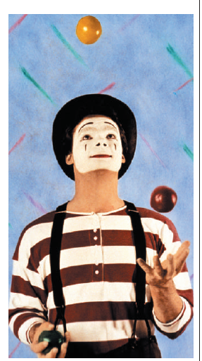
Gene-environment interaction
Dorret Boomsma
Vrije Universiteit Amsterdam
Dept Biological Psychology

Slide 2
No aspect of human behavior genetics has caused more confusion and generated more obscurantism than the analysis and interpretation of the various types of non-additivity and non-independence of gene and environmental action and interaction
(Eaves et al., 1977).

Slide 3
Often, the term GxE interaction is used to denote that both genes and environment are important.
A better term to describe this situation is "genotype-environment co-action“
(Martin, 2000)

Slide 4
GxE interaction:
different genotypes respond differently to the same environment
some genotypes are more sensitive to changes in the environment than others (different reaction ranges)
GE correlation:
nonrandom distribution of genotypes over environments

Slide 5
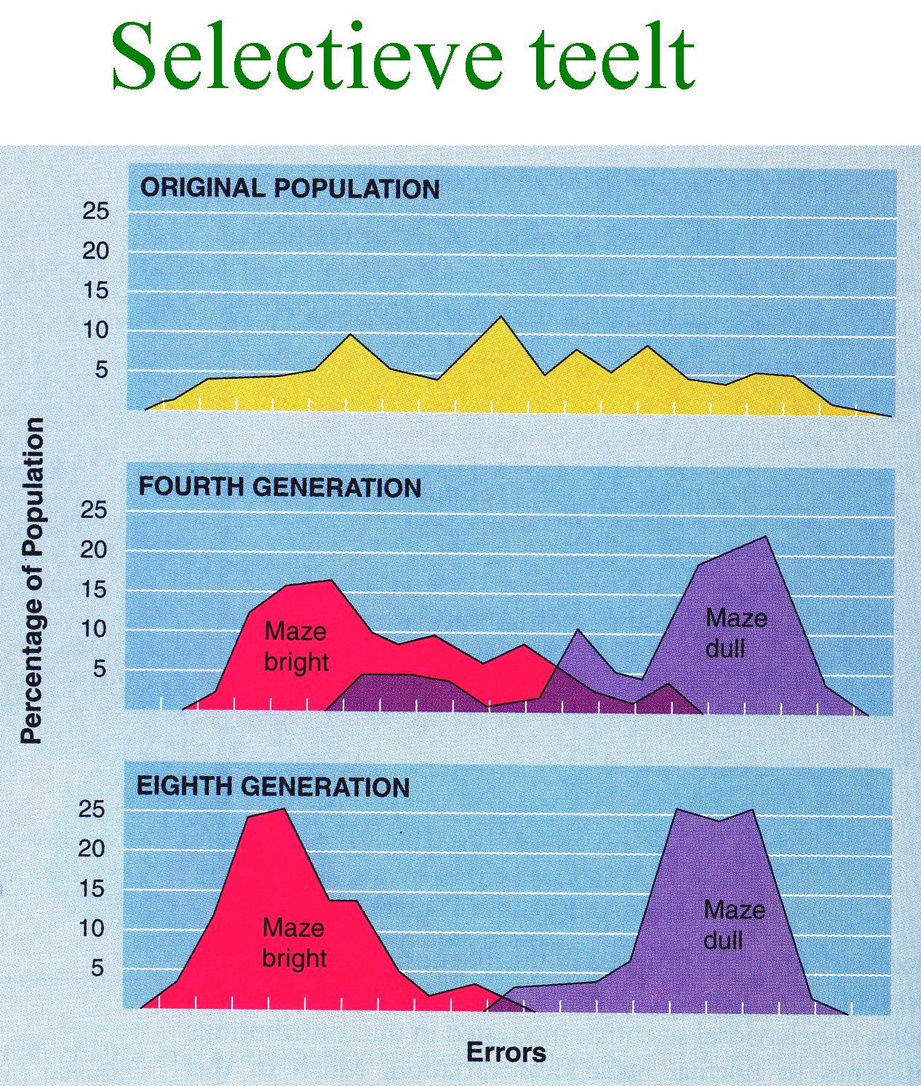
Maze learning performance in rats (Tyron): Selective breeding for bright and dull rats: success indicates a genetic basis for individual differences
Notes:
How to prove genetic factors matter in behavior
Tolman 1940’s later follow-up by Tyron.
Wild type’s errors in a maze, after some preliminary exploration (spatial memory).
After 8 generations two different strains with almost no overlap in behavior
Genes do matter for behavior

Slide 6
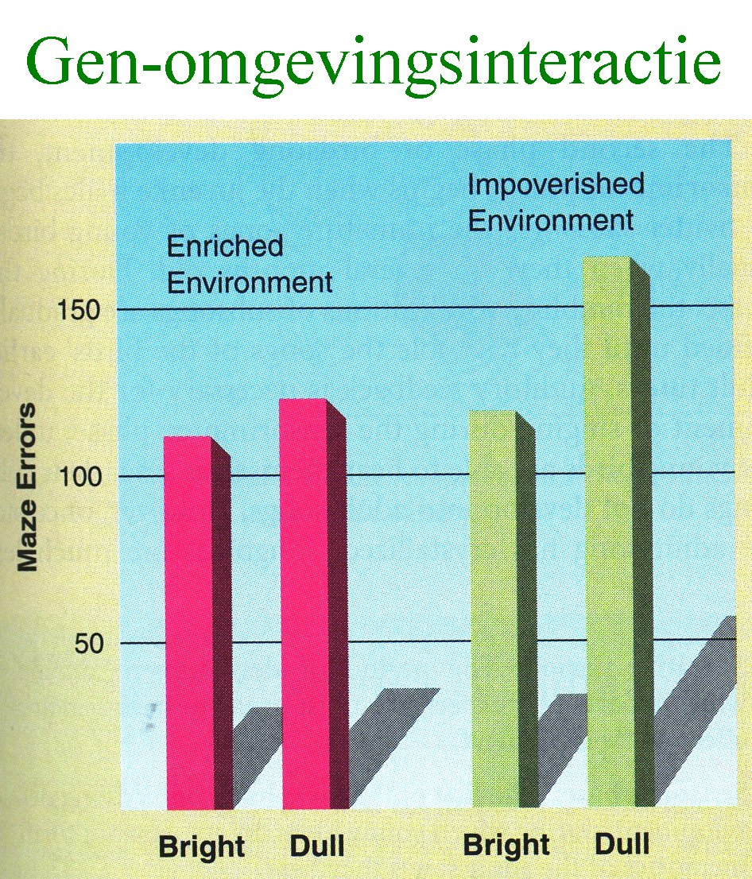
Gene-environment interaction: bright rats do better than dull rats in impoverished environment
Notes:
The genetic defect can be corrected by enrichment: large cage, stairs and tunnels, wheels, toys of colors and form, repeated interaction with other mice, and possibly other forms of enrichment that now escape me. Impoverished was only one step down from the normal lab cage, alone in a gray cage with minmal contacts at feeding/cage cleaning.
No disadvantage for the genetically maze bright mice, but a clear advantage for the maze dulls.

Slide 7
Several mechanisms may explain variation in a trait:
- genes and environment contribute additively
genes and environment interact:
*genes control sensitivity to the environment
*the environment controls gene expression
genes and environment are correlated: genes alter the exposure to environmental risk factors
Eaves LJ (1984) Genetic Epidemiology; Kendler KS, Eaves, LJ (1986) Am J Psychiatry; Boomsma DI, Martin NG (2002) in: Biological Psychiatry

Slide 8
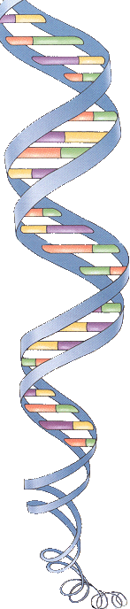
How can we study /estimate Heritability G-E interaction G-E correlation in humans (natural populations)?

Slide 9
MZ
Twin correlations for anxiety (young adult twins)
rMZ = 0.54 & rDZ = 0.25
Heritability 58% =2(.54-.25)
Twins and other relatives
r MZ = h² + c² + d²
r DZ = ½ h² + c² + ¼ d²
r full Sibs = ½ h² + c² + ¼ d²
r half Sibs = ¼ h² + (c²)
r adopted Sibs = c²
r parent-offspring = ½ h² + (c²)
DZ
MZ twins

Slide 10
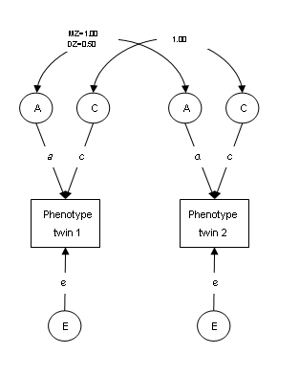
Heritability can depend on:
Sex; Age ; Birth Cohort ; Environmental Exposures
The influence of A (additive genes) is given by ‘a’; the effect of Common environment by ‘ c ‘ and the influence of random environment by ‘e ‘.
These parameters can be modified by other factors.
Purcell S, Sham P Variance components models for gene-environment interaction in quantitative trait locus linkage analysis. Twin Res. 2002 ,572-6.
Purcell S. Variance components models for gene-environment interaction in twin analysis. Twin Res. 2002, 554-71

Slide 11
Interaction (heterogeneity in the population): examples
Genotype x Sex
Genotype x Age
Genotype x Environment
Genotype x QTL (quantitative trait locus)

Slide 12
Genotype-environment interaction I:
The influence of genotype can be estimated conditional on sex, age or environmental exposure:
No interaction: influence of genes does not differ for subjects of different sex, age or different degrees of exposure
GxE interaction: genetic effects are modified by sex, age or exposure -> heritabilities differ between exposure-positive and exposure-negative groups

Slide 13
IQ heritability: Genotype x Age Interaction
Genes
Unique E
Common E

Slide 14
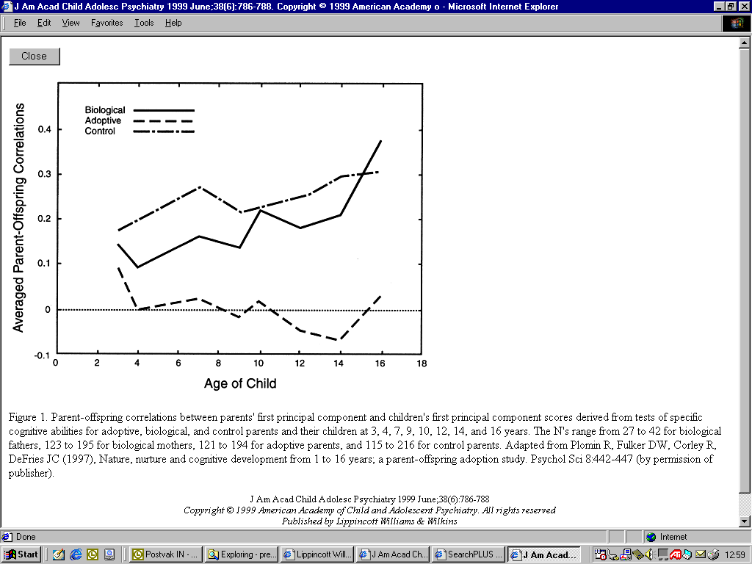
Genotype x age interaction: increase in heritability with age
Parent-offspring correlations for IQ.
Two upper lines: biological relatives;
lower line: adoptive relatives.
(Plomin et al. 1997)

Slide 15
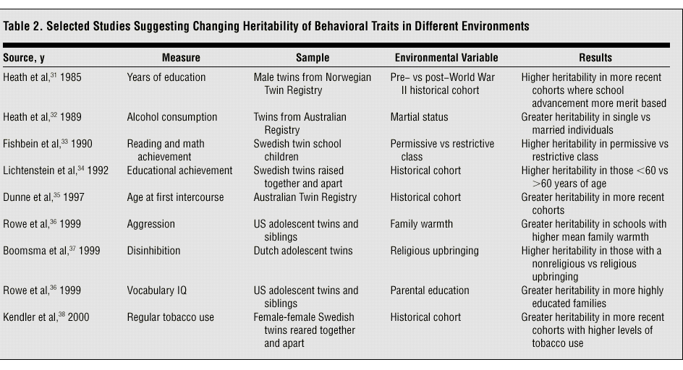
Genotype x Environment interaction
Kendler, Nov 2001, Archives General Psychiatry

Slide 16
Two theoretical models make different predictions regarding gene–environment interaction.
The diathesis– stress model predicts that genetic vulnerability (diathesis) in the presence of environmental stress, will increase the likelihood of behavioral problems (e.g., Rende and Plomin (1992) and also predicts that the heritability of the trait will be higher for children in at risk environments.
The bioecological model predicts that risk environments will mask genetic differences between children, whereas enriched environments will enable underlying genetic differences to be amplified (Bronfenbrenner and Ceci 1994; Scarr and McCartney 1983).

Slide 17
Heritability of Disinhibition in 1974 adolescent Dutch twin pairs with a religious or non-religious upbringing
Boomsma et al. (1999) Twin Research, 115-125

Slide 18
Genotype-environment interaction II:
Evidence for GxE interaction based on differences in heritabilities does not tell us if the same genes are expressed in different groups.
To address this issue, data from twins discordant for environmental exposure are required [or longitudinal data from twins measured under different environmental conditions].

Slide 19
Genotype-environment interaction III:
Data from twins discordant for environmental exposure are required to detect if the same genes are expressed under different environmental conditions.
GxE interaction can then be detected from the genetic correlation between traits. If the genetic correlation is high, then trait values in the two environments are determined by the same genes. If the genetic correlation is low, the trait is influenced by different genes in different environments.

Slide 20
r_{g}
r_{c}
r_{e}
A
C
E
A
C
E
a₁
c1
e₁
a₂
c₂
e₂
Time 1
Time 2
Phenotype at time 1 may have a different heritability (as evident from estimates for a, c and e) or may be influenced by different genes, as evident from genetic correlation.
Falconer & MacKay : chapter 19 (Introduction to Quantitative Genetics)

Slide 21
Genotype-environment correlation:
1. passive: parents transmit genes and environment to their children
2. reactive: people (also other than parents)
provide an environment for the child that is based on the child’s genotype
3. active: children select or create their own environments based on their genotype

Slide 22
The impact of GE interaction and correlation on standard twin models (Purcell, Twin Res, 2002)
Interaction: G x C -> G
G x E -> E
(genetic differences between siblings may be amplified by the common family environment)
Correlation G – C -> C
G – E -> G
(differences between families in the environment may have a genetic component)

Slide 23
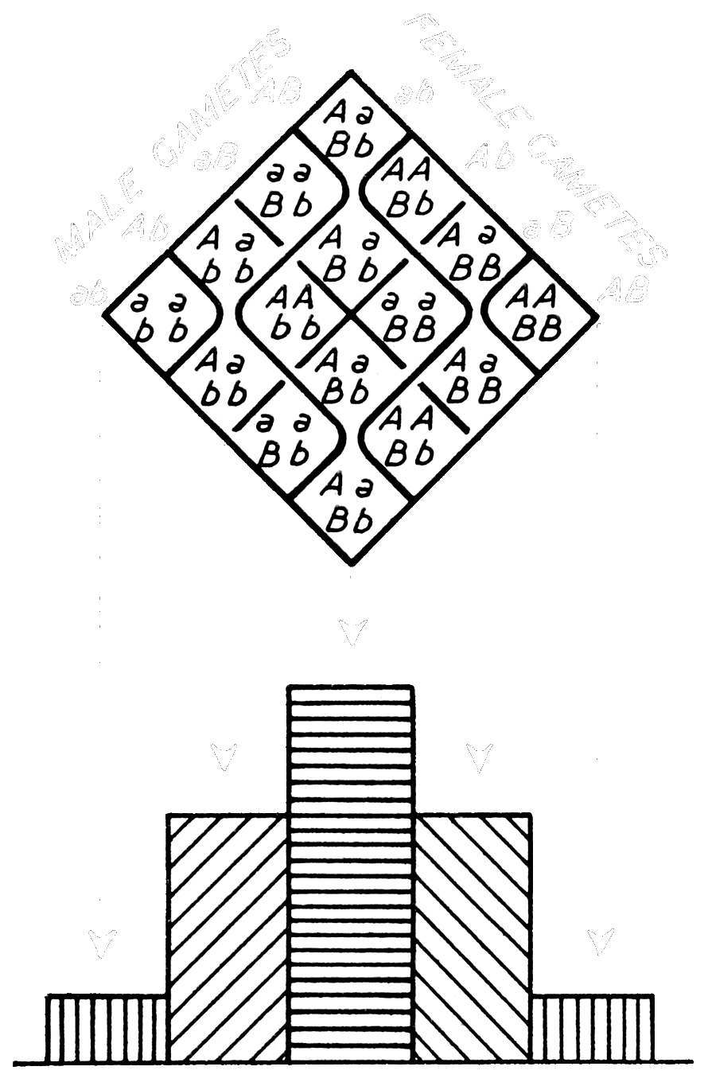
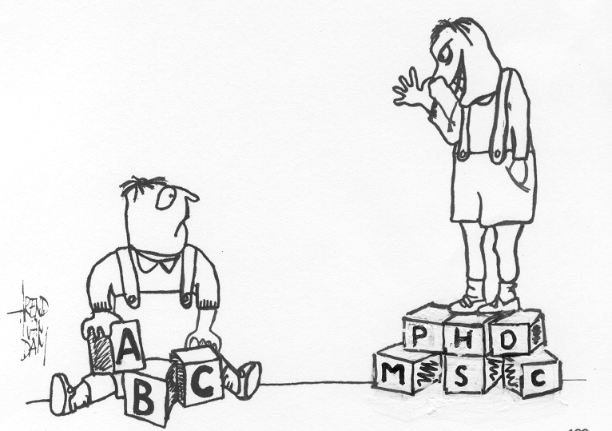
Punnett square
Genetics explains resemblances as well as differences between siblings growing up in the same family

Slide 24
r_{g}
r_{c}
r_{e}
A
C
E
A
C
E
a₁
c1
e₁
a₂
c₂
e₂
Twin 1
boy
Twin 2 girl
Phenotype in boys may have a different heritability (as evident from estimates for a, c and e) or may be influenced by different genes, or environments
What is wrong here

Slide 25
r_{g}
r_{c}
A
C
E
A
C
E
a₁
c1
e₁
a₂
c₂
e₂
Twin 1
boy
Twin 2 girl
Phenotype in boys may have a different heritability (as evident from estimates for a, c and e) or may be influenced by different genes, as evident from genetic correlation < 0.5. Or the correlation between common E is < 1.0.

Slide 26
