Slide 1
Sex-limitation Models
Meike Bartels
(Brad, Sarah, Hermine, Ben, Elizabeth, and most of the rest of the faculty that has contributed bits and pieces to various versions of this talk)

Slide 2
COPY FILES FROM:
Faculty/meike/2016/heterogeneity

Slide 6
Two primary differences between Males and Females.
Means Differences between the sexes
Regression coefficients (β) capture the differences between the mean levels of the trait between sexes
Not generally what we are talking about when discussion of Sex limitation, but very important nonetheless.

Slide 7
Two primary differences between Males and Females.
Variance Differences between the sexes
The key question is why there is more or less variation in one sex rather than the other
σ² capture the differences between the variation around the mean across the sexes

Slide 8
Both Mean and Variance Differences
If mean differences exist, but are ignored, they can induce variance differences
Makes it very important to include covariates/definition variables for sex when looking at sex limitation models

Slide 9
How can you have differences in variance?
Independent variables (millions of them) can influence the trait to different extents in different groups
or
Different independent variables can influence the trait in the different groups.

Slide 11
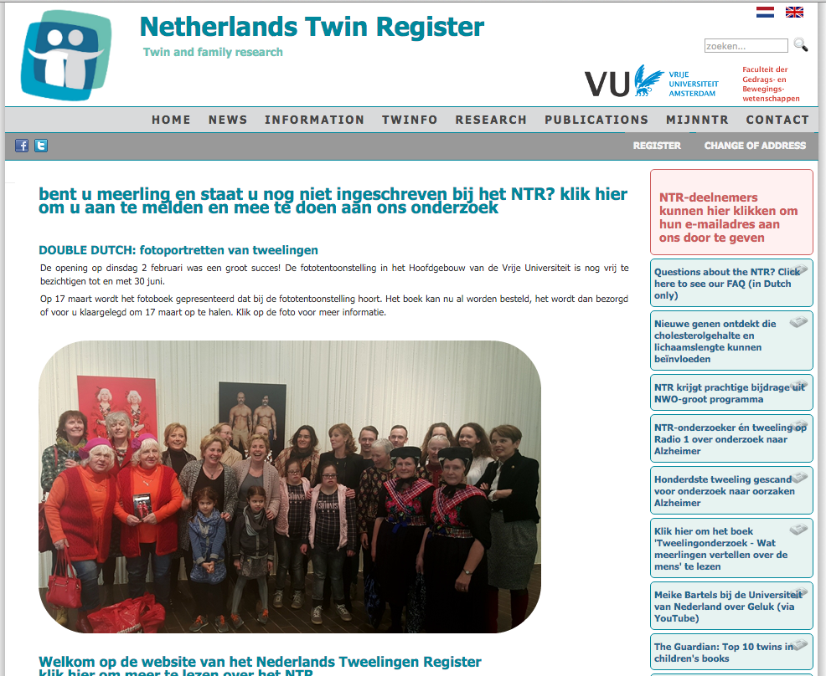
www.tweelingenregister.org

Slide 12
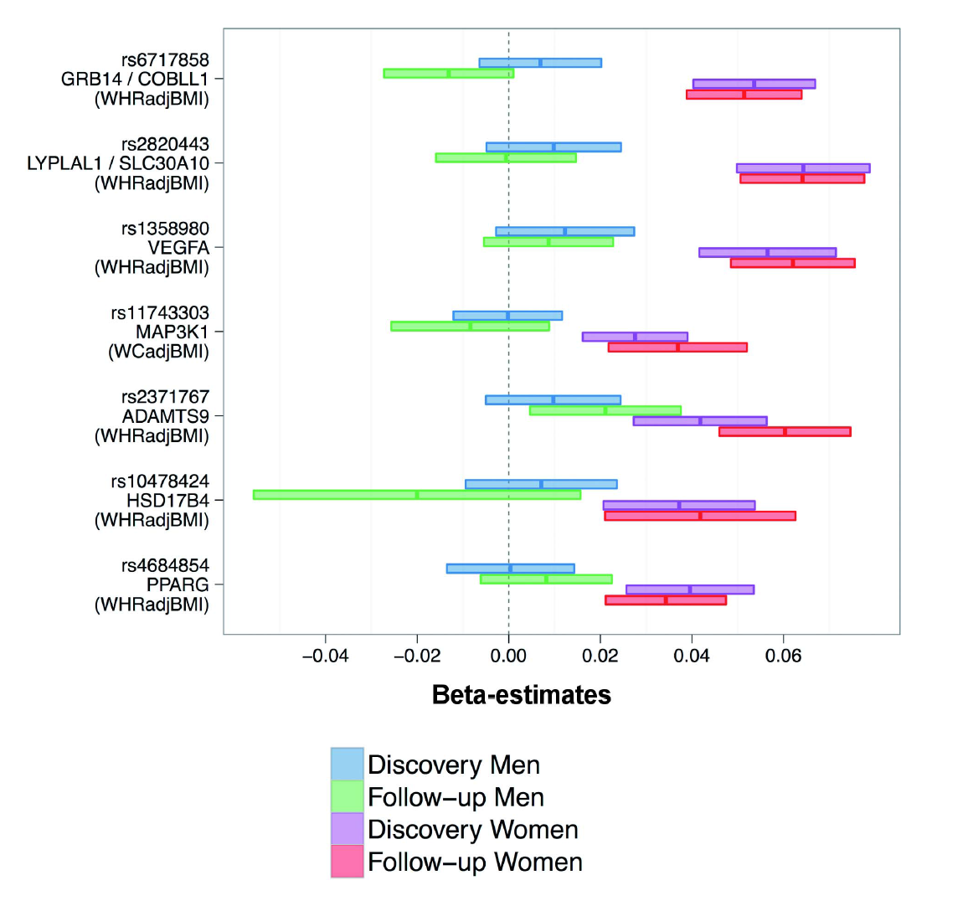
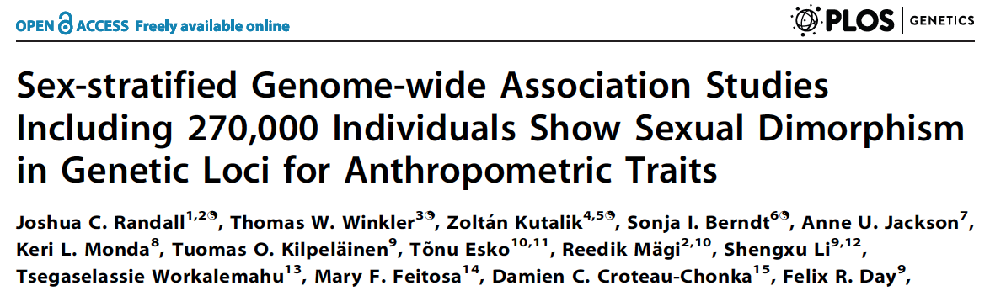
On all of the SNPs presented, women are affected by the polymorphism, while men are not.
Ergo, different genes “cause” the trait in males and females!
Or
Molecular evidence of qualitative sex limitation

Slide 13
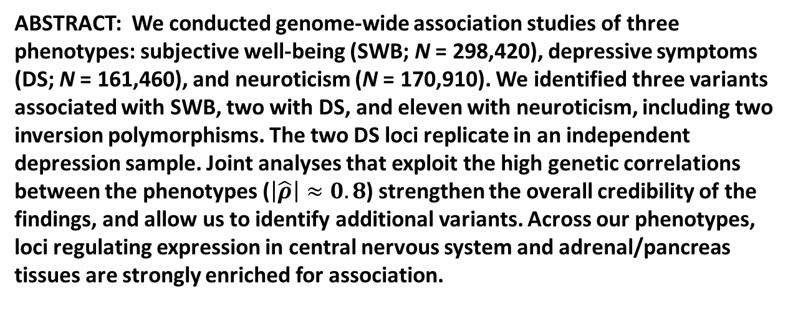
Genetic Associations with Subjective Well-Being
Also Implicate Depression and Neuroticism
ABSTRACT: We conducted genome-wide association studies of three phenotypes: subjective well-being (SWB; N = 298,420), depressive symptoms (DS; N = 161,460), and neuroticism (N = 170,910). We identified three variants associated with SWB, two with DS, and eleven with neuroticism, including two inversion polymorphisms. The two DS loci replicate in an independent depression sample. Joint analyses that exploit the high genetic correlations between the phenotypes ($\left|\hat{ρ}\right|≈0.8$) strengthen the overall credibility of the findings, and allow us to identify additional variants. Across our phenotypes, loci regulating expression in central nervous system and adrenal/pancreas tissues are strongly enriched for association.
Nature Genetics, accepted

Slide 14
Heterogeneity Questions
Univariate Analysis:
  What are the contributions of additive genetic, dominance/shared environmental and unique environmental factors to the variance?
Heterogeneity:
  Are the contributions of genetic and environmental factors equal for different groups,
  sex, race, ethnicity, SES, environmental exposure, etc.?

Slide 15
The language of heterogeneity
Are these differences due to differences in the magnitude of the effects (quantitative)?
  Is the contribution of genetic/environmental factors greater/smaller in males than in females?
Are the differences due to differences in the nature of the effects (qualitative)?
  Are there different genetic/environmental factors influencing the trait in males and females?

Slide 16
Look at the Correlations!

Slide 17
Homogeneity Model

Slide 18
Homogeneity
No heterogeneity
The same proportion (%) of variance due to A, C, E equal between groups
Total variance equal between groups
  V_{m} = V_{f}
Variance Components are equal between groups
  A_{m} = A_{f}
  C_{m} = C_{f}
  E_{m} = E_{f}

Slide 19
Scalar Heterogeneity Model

Slide 20
Scalar Heterogeneity
Scalar sex-limitation (Quantitative)
The proportion (%) of variance due to A, C, E alters by a scalar (single value
total variance not equal between groups
  Vm = k* Vf
  Am = k* Af
  Cm = k* Cf
  Em = k* Ef
k is scalar

Slide 21
Heterogeneity Model

Slide 22
Non-Scalar Heterogeneity
Non-Scalar sex-limitation, can be estimated without opposite sex pairs (Quantitative/Qualitative), but…
  Reduced power
The total variance and proportion (%) of variance due to A, C, E not equal between groups
  Vm ≠ Vf
  Am ≠ Af
  Cm ≠ Cf
  Em ≠ Ef
Parameters estimated separately

Slide 23
 | Male | Male
Male | ½ a_{m}² + c_{m}² + e_{m}² | ½ a_{m}² + c_{m}²
Male | ½ a_{m}² + c_{m}² | ½ a_{m}² + c_{m}² + e_{m}²

Slide 26
General Heterogeneity
Non-Scalar sex-limitation with opposite sex pairs (Quantitative & Qualitative)
The total variance and proportion (%) of variance due to A, C, E is not equal between groups
  Vm ≠ Vf
  Am ≠ Af
  Cm ≠ Cf
  Em ≠ Ef

Slide 27
What twin groups are needed for each Sex Limitation Model
Model Type | Data Requirements
Classical Twin Design | MZ & DZ Twins (Sex doesn’t matter)
Scalar Sex Limitation Model (Quantitative/Qualitative) | MZm, MZf, DZm & DZf Twins
General Sex Limitation Model (Qualitative & Quantitative) | MZm, MZf, DZm, DZf & DZo Twins

Slide 28
Practical
Open oneADE5ca_MB.R
Walk through the first part of the script
Run it
Look at the estimates
Run submodels
Be sure that you know what you are doing

Slide 29
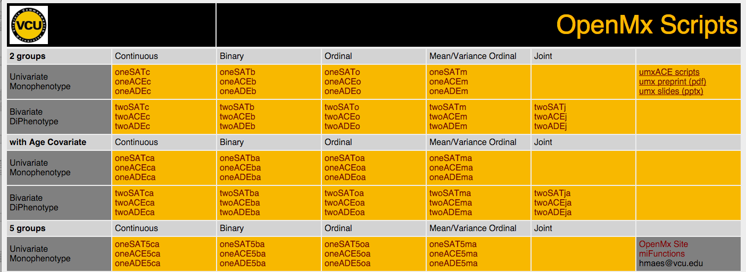
scriptsOpenMx.shtml

Slide 30
MEAN DIFFERENCES

Slide 31
Quantitative Sex-Differences

Slide 32
Quantitative Sex-Differences

Slide 33
Qualitative Sex-Differences

Slide 34
Full models and Submodels
 | ep | -2LL | df | AIC | dif -2LL | dif df | p
oneADErq5ca | 11 | 8229.5675 | 3643 | 943.56746
testCov | 9 | 8313.4336 | 3645 | 1023.4336 | 8.3866168e+01 | 2 | 6.1474203e-19
oneADEq5ca | 10 | 8248.9231 | 3644 | 960.92309 | 1.9355627e+01 | 1 | 1.0849905e-05
oneADE5ca | 7 | 8262.4116 | 3647 | 968.41157 | 3.2844108e+01 | 4 | 1.2855588e-06
oneAErq5ca | 9 | 8229.5675 | 3645 | 939.56746 | -1.3920853e-06 | 2 | 1.0000000e+00
oneErq5ca | 6 | 8992.6761 | 3648 | 1696.6760 | 7.6310861e+02 | 5 | 1.1052891e-162
oneAE5ca | 6 | 8265.9835 | 3648 | 969.98354 | 3.6416078e+01 | 5 | 7.8410016e-07
oneE5ca | 5 | 9010.0485 | 3649 | 1712.0484 | 7.8048101e+02 | 6 | 2.5384122e-165

