Slide 1




LD Score: theory
Benjamin Neale, Ph.D.
Analytic and Translational Genetics Unit, MGH
Stanley Center for Psychiatric Research & Program in Medical and Population Genetics, Broad Institute

Slide 2
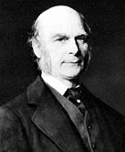
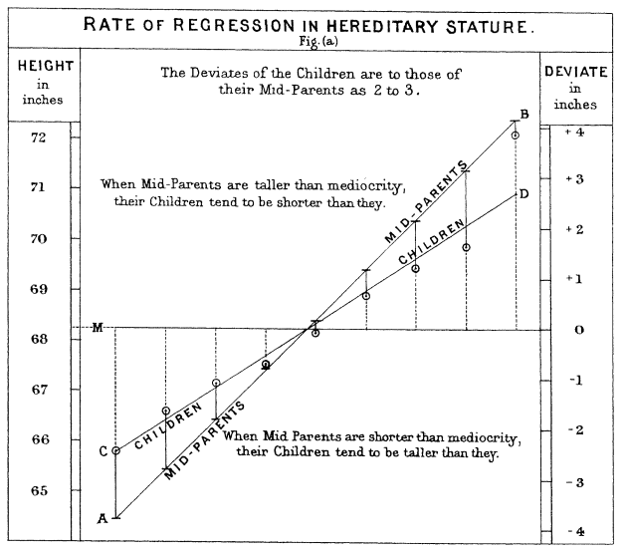
Francis Galton
Twin and family studies
Relatives are more similar than random pairs
Identical twins are more similar than fraternal twins
Average estimate of heritability 49%
69% of twin studies support a purely additive genetic model

Slide 3
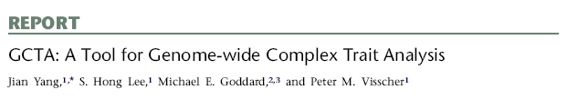
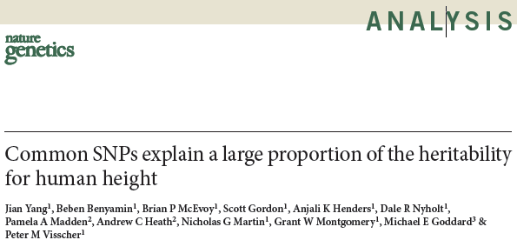
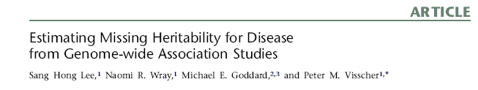
GREML/GCTA
Use estimated genetic similarity
heritability

Slide 4

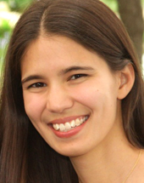
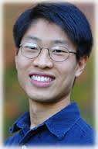
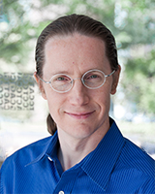

LD Score regression
With thanks
Brendan Bulik-Sullivan
Hilary Finucane
Po-Ru Loh
Mark Daly
Alkes Price

Slide 5
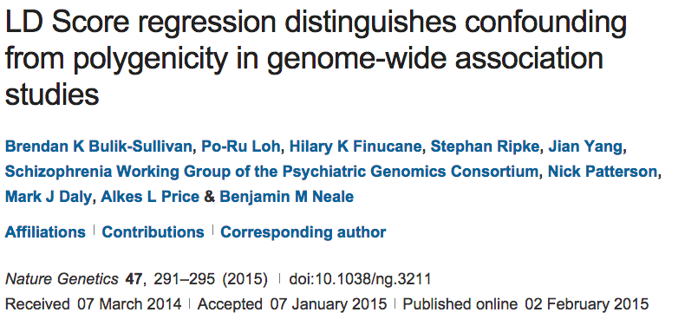
How does LD shape association?

Slide 6
How does LD shape association?
Lonely SNPs [no LD]
LD blocks

Slide 7
How does LD shape association?
Lonely SNPs [no LD]
LD blocks
*
Causal variants
*
Association
All markers correlated with a causal variant show association

Slide 8
How does LD shape association?
Lonely SNPs [no LD]
LD blocks
*
Causal variants
*
Association
Lonely SNPs only show association if they are causal

Slide 9
What happens under polygenicity?
Lonely SNPs [no LD]
LD blocks
*
Causal variants
Assuming a uniform prior, we see SNPs with more LD friends showing more association
The more you tag, the more likely you are to tag a causal variant

Slide 10
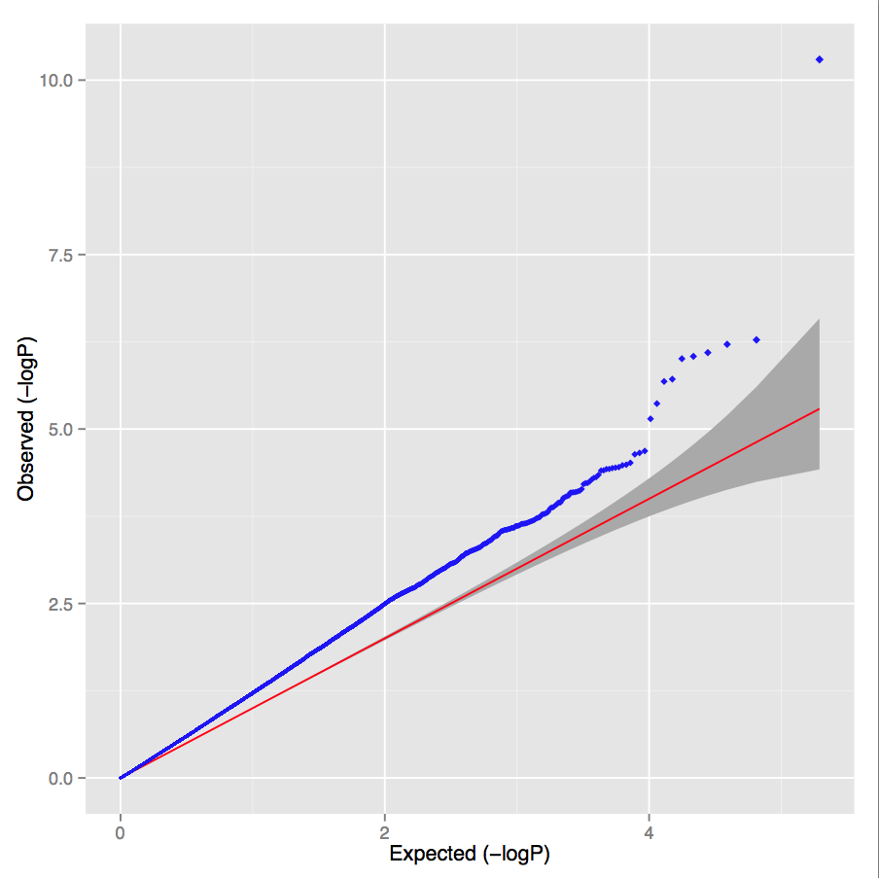
Simulated polygenic architecture
Lambda = 1.30 LD score intercept = 1.02

Slide 11
What happens under stratification?
Lonely SNPs [no LD]
LD blocks
*
Causal variants
Under pure drift we expect LD to have no relationship to differences in allele frequencies between populations

Slide 12
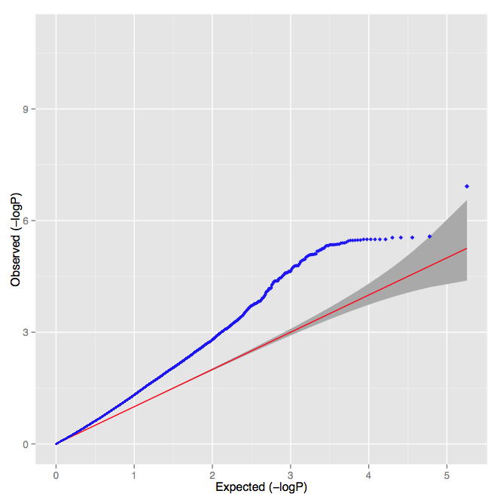
UK controls versus Sweden controls
Lambda = 1.30 LD score intercept = 1.32

Slide 13
PGC Schizophrenia
Lambda = 1.48
Intercept = 1.06
Slope p-value < 10⁻³⁰⁰
Overwhelming majority of inflation is consistent with polygenic architecture

Slide 14
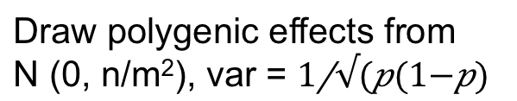
LD Score regression
Draw polygenic effects from
N (0, n/m²), var =
β
What is the E[χ²] for variant j?
New estimator of heritability
where N=sample size, M=# of SNPs, a=inflation due to confounding,
h²g is heritability (total obs.) and l_{j} is the LD Score
Bulik-Sullivan et al. Nature Genetics 2015
Yang et al. EJHG 2011

Slide 15
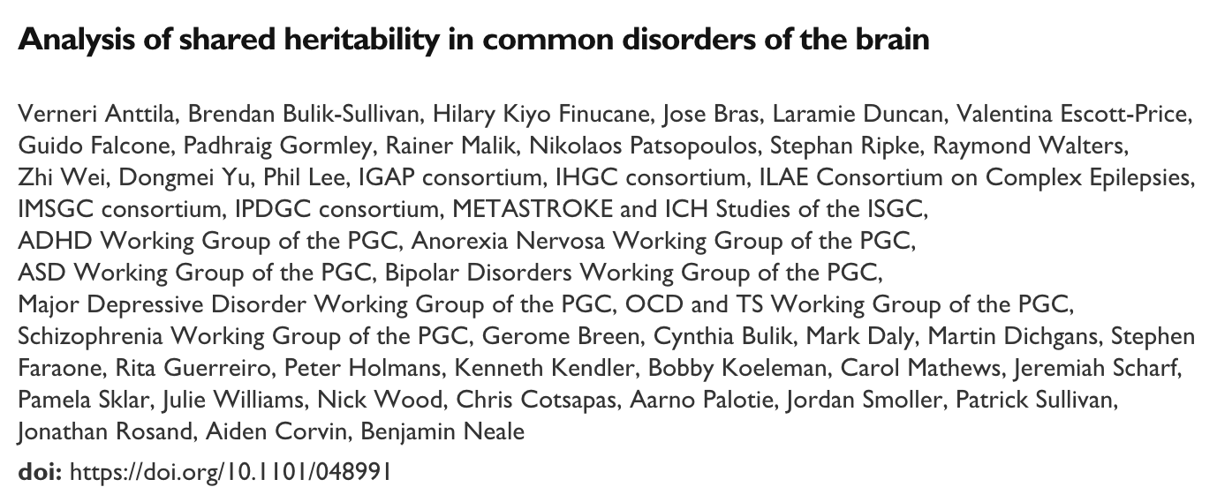
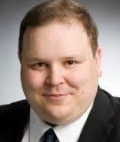

Brainstorm Project
Verneri Anttila
Aiden Corvin
Brendan Bulik-Sullivan
Hilary Finucane
Jonathan Rosand
Aarno Palotie
Mark Daly
Patrick Sullivan
Bobby Koeleman
Nick Wood
Julie Williams
Alessandro Biffi
Jeremiah Scharf
Kenneth Kendler
Stephan Ripke
Alkes Price
Chris Cotsapas
Padhraig Gormley
Zhi Wei
Rainer Malik
Hailiang Huang
Andrea Byrnes
Dongmei Yu
Laramie Duncan
Kai-How Farh
Namrata Gupta
Miriam Raffeld
…and many, many others
in their respective study groups

Slide 16
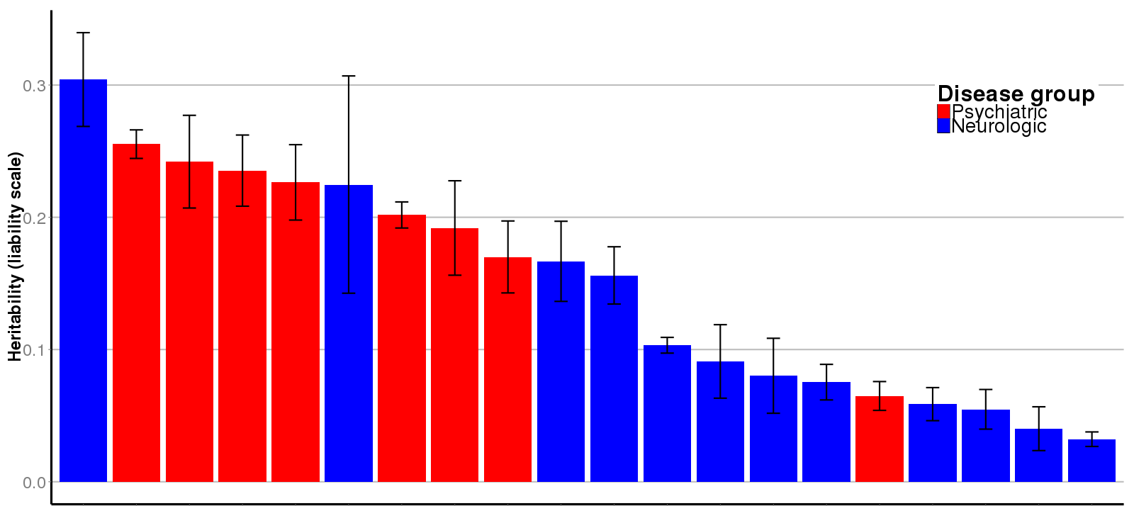
Univariate heritability from common variation
GGE = Generalized Epilepsy
SCZ = Schizophrenia
OCD = Obsessive Compulsive Disorder
AUT = Autism
TSY = Tourette’s Syndrome
ICH = Intracerebral Hemorrhage
BPD = Bipolar Disorder
MDD = Major Depressive Disorder
ANO = Anorexia Nervosa
MSC = Multiple Sclerosis
MWO = Migraine without Aura
MIG = Migraine
MWA = Migraine with Aura
EOS = Early Onset Stroke
AZD = Alzheimer’s Disease
ADD = Attention Deficit/Hyperactivity
EPI = Epilepsy (all)
ISS = Ischemic Stroke
NFE = Non-acquired focal epilepsy
PKD = Parkinson’s Disease
GGE
SCZ
OCD
AUT
TSY
ICH
BPD
MDD
ANO
MSC
MWO
MIG
MWA
EOS
AZD
ADD
EPI
ISS
NFE
PKD
It’s all heritable!

Slide 17
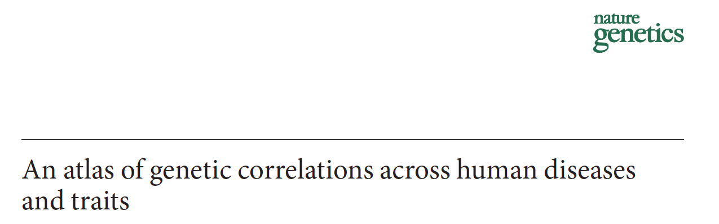
Genetic Correlation
Method in:

Slide 18
Potential sources of genetic correlation
Genetic
effects
Genetic
effects
Trait 1
Trait 2
Trait 1
Trait 2
Trait 1 exerts causal effect on Trait 2
Genetic effects influence
Trait 1 and Trait 2

Slide 19
LD Score regression
Genetic correlation
Trait 1
Slope estimates heritability

Slide 20
LD Score regression
Genetic correlation
Trait 1
We can a second trait and obtain two heritability estimates
Trait 2

Slide 21
LD Score regression
Genetic correlation
Trait 1
Z*Z = χ²
So we can estimate genetic covariance from the product of the Z-scores
Trait 2

Slide 22
LD Score regression
Genetic correlation
Trait 1
Z*Z = χ²
So we can estimate genetic covariance from the product of the Z-scores for the two traits
R_{G} = 0.5
Trait 2
R_{G}

Slide 23
LD Score regression
Genetic correlation
Trait 1
Here R_{G} = 0
This approach is robust to sample overlap as all variants are equally inflated
Trait 2
R_{G}

Slide 24
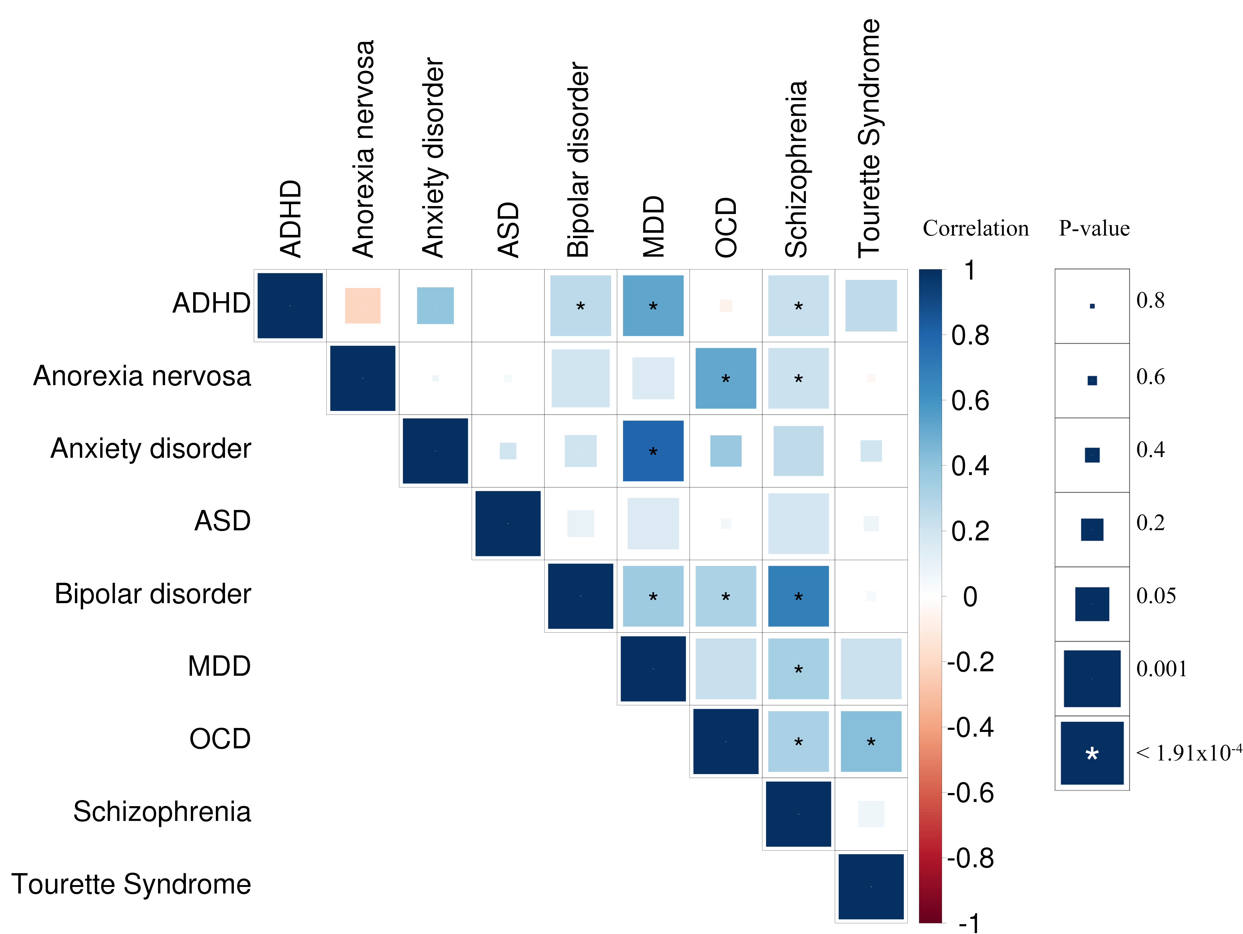
Brainstorm – within psychiatry

Slide 25
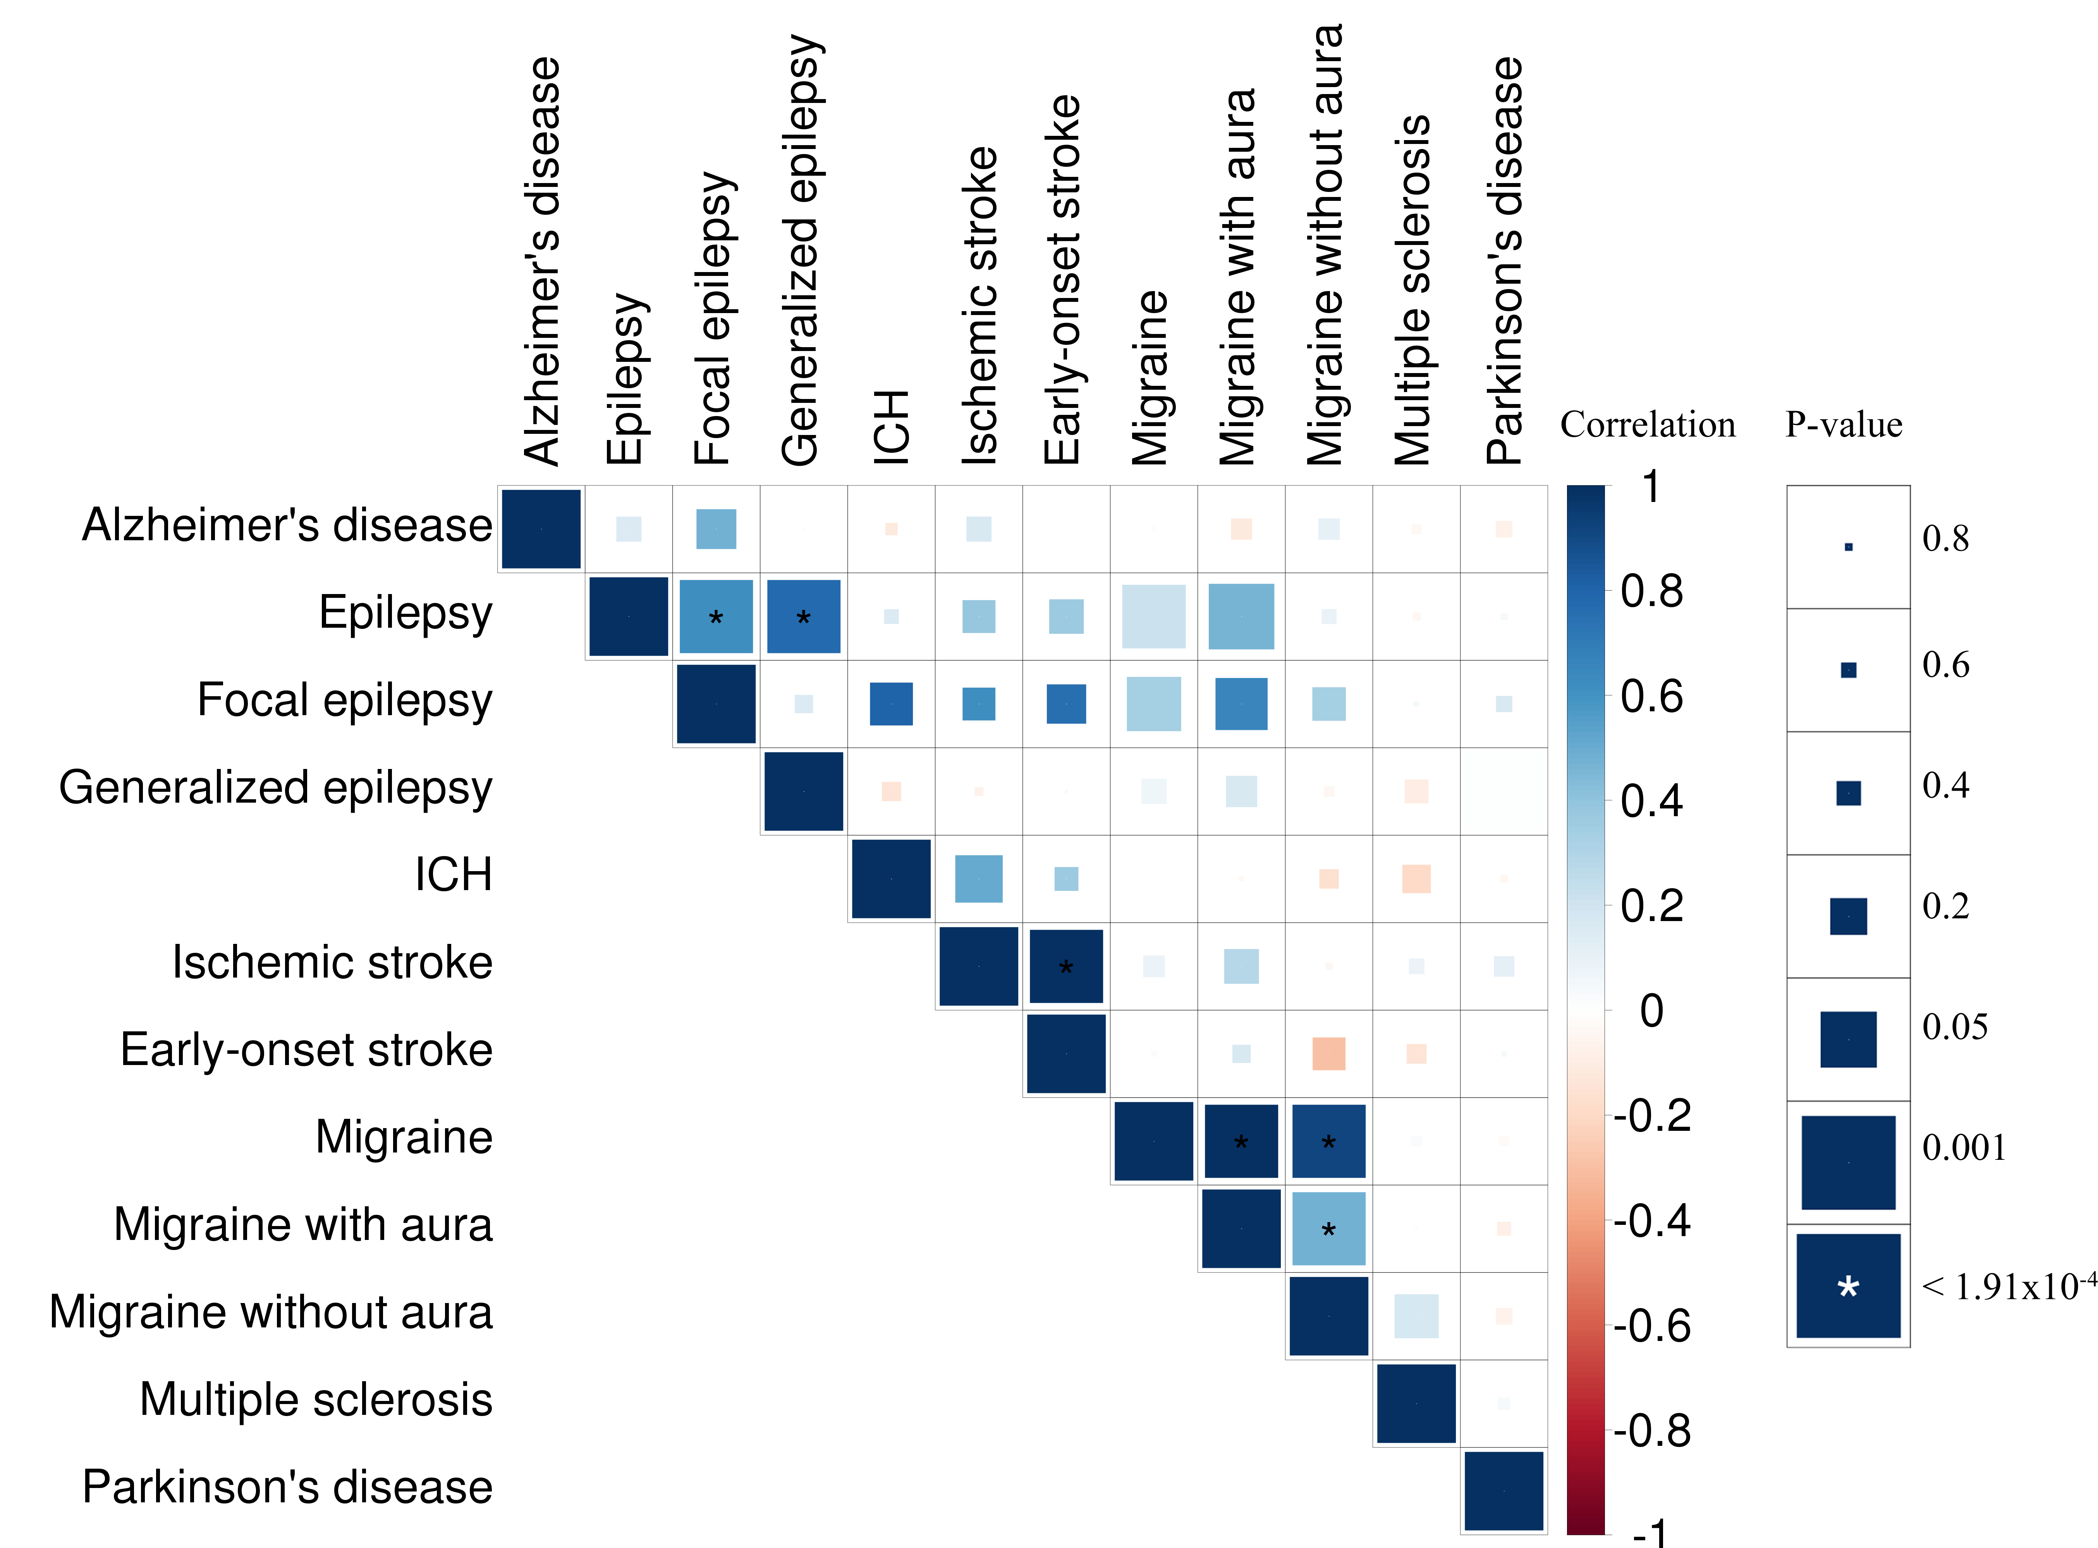
Brainstorm within neurology

Slide 26
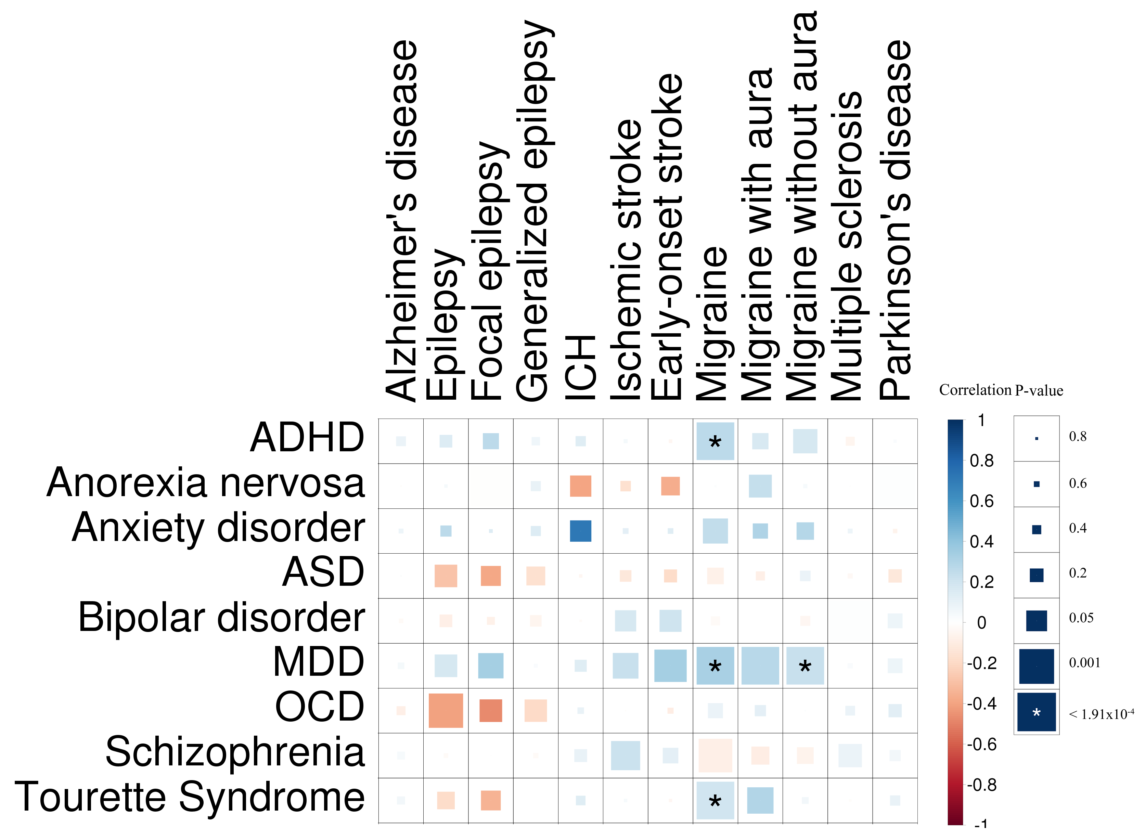
Brainstorm – across neurology and psychiatry

Slide 27
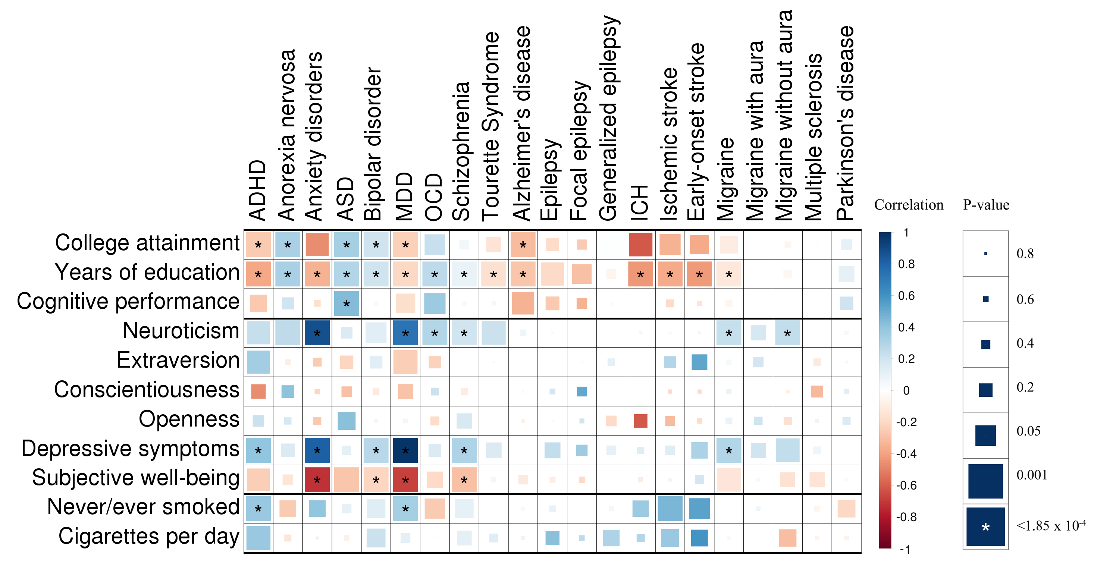
Brainstorm – take it further?

Slide 28
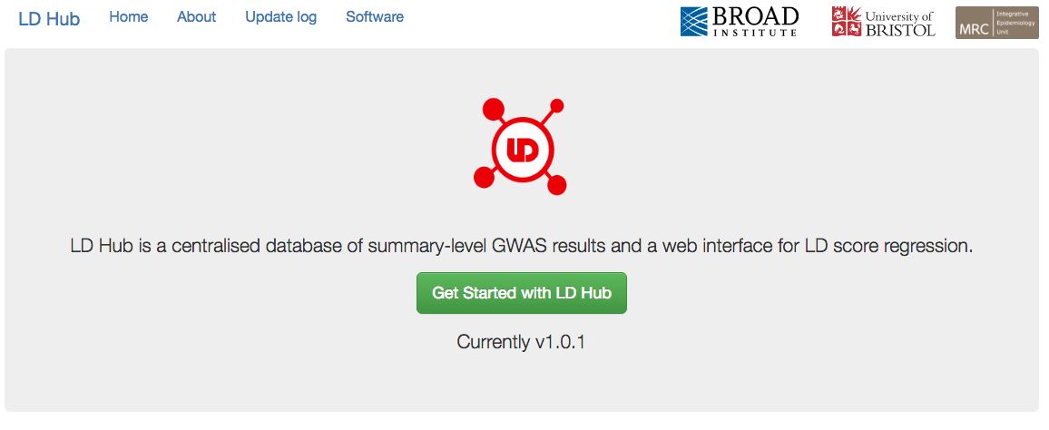

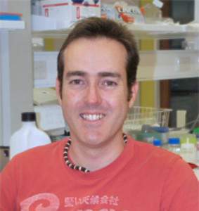
You can do it yourself ldsc.broadinstitute.org
Jie Zheng
David Evans

