Slide 1
Analysing imputed data in raremetalworker
http://genome.sph.umich.edu/wiki/RAREMETALWORKER
Accepts imputed data from the UMich imputation server
Runs linear regression
Calculates genomic relatedness
Corrects for genomic relatedness or known family structure using mixed linear model
(Binary work around coding data as 0/1 – Consider GMMAT as an alturnative)

Slide 2
What I like about it
Accepts imputed data in VCF format
Provide phenotype files in simple ped and dat format – multiple traits & covarates in the ped
Correctly models MZ twins & can cope with more than 1 set of twins in a family
Don’t need to duplicate the genotypes of the 2nd MZ – if you provide zygosity in your ped file & use known family structures
What I don’t like about it
Doesn’t output SE – you need to calculate 1/SQRT_V_STAT

Slide 3
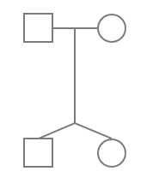
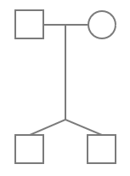
Family structure
Ped file
[ FID IID PID MID Sex ZYG Trait1 Cov1 ]
101 01 03 04 1 0 .32 18
101 02 03 04 2 0 .45 18
101 03 0 0 1 0 x x
101 04 0 0 2 0 x x
102 01 03 04 1 1 .56 17
102 02 03 04 1 1 .60 17
102 03 0 0 1 0 x x
102 04 0 0 2 0 1.2 40
--kinPedigree
Non MZ twins
(Can code DZ twins as 2 if you want)
MZ twins
(If there is a 2nd pair in the family code them as 3)

Slide 4
#without correcting for distant relatedness
raremetalworker --ped example.ped --dat example.dat --vcf example.vcf.gz --useCovariates --traitName QT1 --prefix ANALYSIS1
#estimate kinship from genomic data and use this to
#correct for relatedness
raremetalworker --ped example.ped --dat example.dat --vcf example.vcf.gz --useCovariates --traitName QT1 --kinSave --kinGeno --prefix ANALYSIS2

