Slide 1
Imputation
Sarah Medland
Boulder 2015

Slide 2
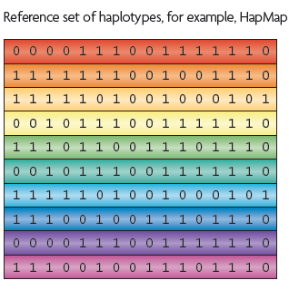
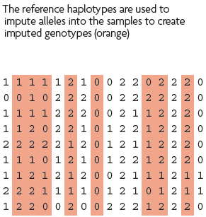
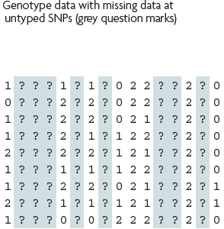
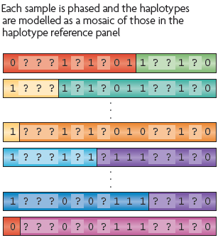
What is imputation? (Marchini & Howie 2010)

Slide 3
3 main reasons for imputation
Meta-analysis
Fine Mapping
Combining data from different chips
Other less common uses
sporadic missing data imputation
correction of genotyping errors
imputation of non-SNP variation

Slide 4
Combining data from different chips
Example
750 individuals typed on the 370K
550 individuals typed on the 610K
Power
MAF .2
SNP explaining 1% total variance
alpha 5e-08
N=1300, NCP 13.07, power .0331
N=750, NCP 7.54 , power .0034
N=550, NCP 5.53 , power .0009

Slide 5
Another way of looking at this

Slide 6
QQ-plot

Slide 7
Solution
Impute all individuals to a single reference based on the SNPs that overlap between the chips
Single distribution of NCP and power across all SNP
qq plot and manhattan describes the full sample with the same degree of accuracy

Slide 8
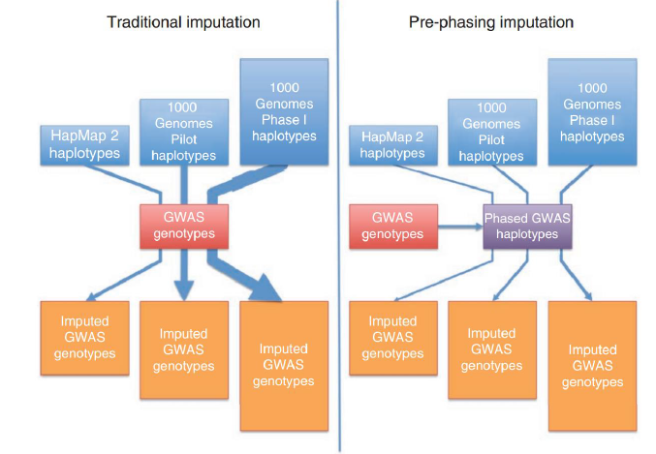
Ways to approach imputation
1000 Genomes Phase II haplotypes
Imputed GWAS genotypes

Slide 9
Imputation programs
minimac3
Impute2
Beagle – not frequently used
never use plink for imputation!

Slide 10
How do they compare
Similar accuracy
Similar features
Different data formats
minimac3 –> custom vcf format
individual=row snp=column
Impute2 –> snp=row individual=column
Different philosophies
Frequentist vs Bayesian

Slide 11
minimac3
http://genome.sph.umich.edu/wiki/Minimac3
Built by Gonçalo Abecasis, Yun Li, Christian Fuchsberger and colleagues
Analysis options
raremetalworker (continuous phenotypes & family/twin samples)
Format converter
http://genome.sph.umich.edu/wiki/DosageConvertor
Mach2qtl (continuous phenotypes)
Mach2dat (binary phenotypes)

Slide 12
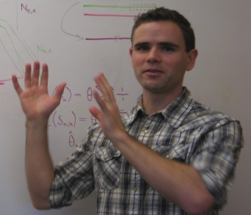
Impute2
https://mathgen.stats.ox.ac.uk/impute/impute_v2.html
http://genome.sph.umich.edu/wiki/IMPUTE2:_1000_Genomes_Imputation_Cookbook
Built by Jonathan Marchini, Bryan Howie and colleges
Downstream analysis options
SNPtest
Quicktest

Slide 13
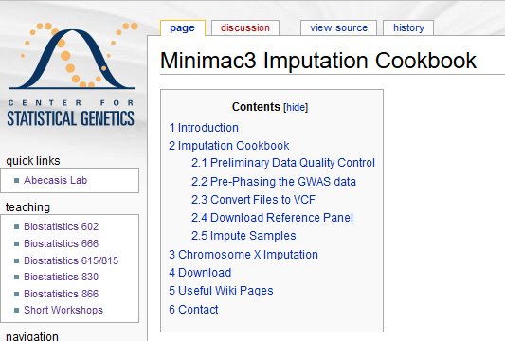
Files to practice with
http://genome.sph.umich.edu/wiki/Minimac3_Imputation_Cookbook

Slide 14
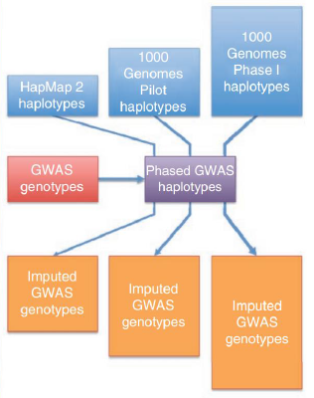
Today – discuss the 2 step approach
1000 Genomes Phase II haplotypes
Step 1
Step 2
Imputed GWAS genotypes

Slide 15
Options for imputation
DIY – Use a cookbook!
http://genome.sph.umich.edu/wiki/Minimac3_Imputation_Cookbook OR http://genome.sph.umich.edu/wiki/IMPUTE2:_1000_Genomes_Imputation_Cookbook
UMich Imputation Server
https://imputationserver.sph.umich.edu/
Sanger Imputation Server
https://imputation.sanger.ac.uk/

Slide 16
UMich imputation Server

Slide 17
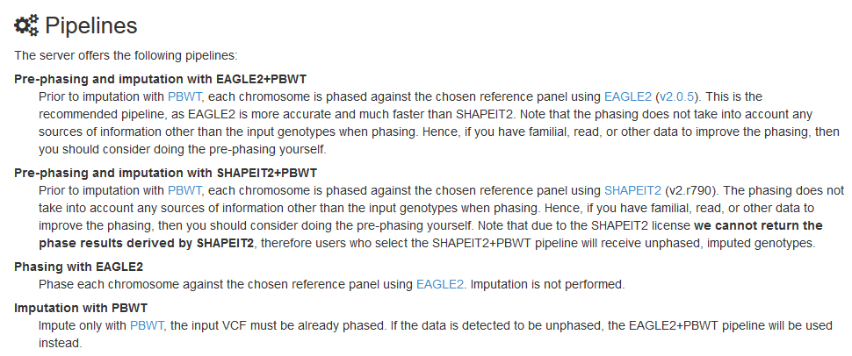
Sanger imputation server

Slide 18
Step 0 – Chose your reference
Current Publically Available References
HapMapII (no phased X data officially released)
HapMapIII
1KGP – phase 1 version v3
1KGP – phase 3 version v5
Future non-public references only available via custom imputation servers
HRC - 64,976 haplotypes 39,235,157 SNPs
CAPPA – African American/Carabbean
All ethnicities vs specific

Slide 19
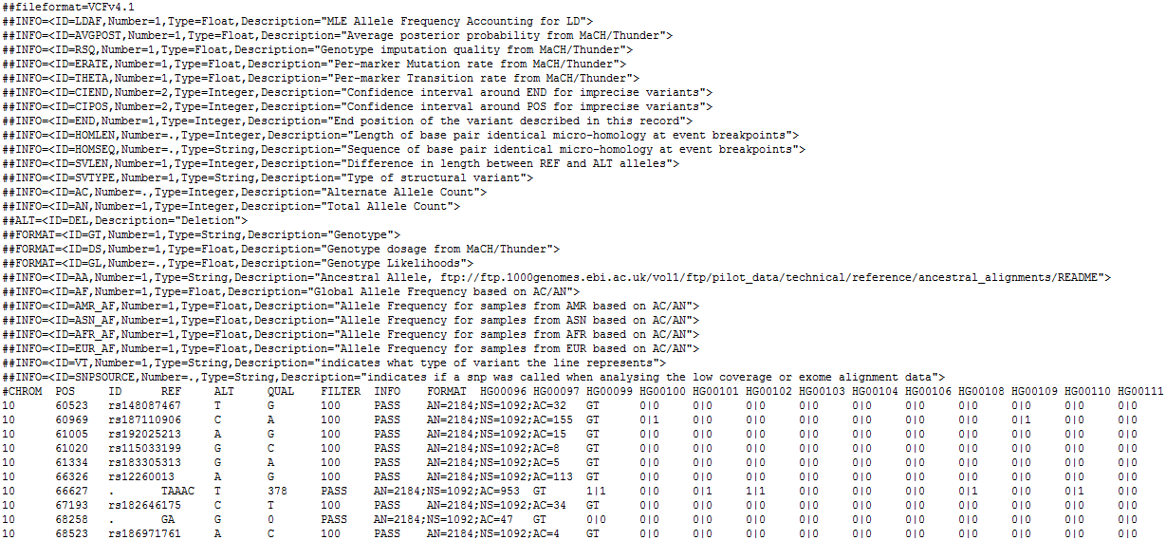
References are in vcf format
(more about this format tomorrow)

Slide 20
Not all references are equal!!
The Beagle and IMPUTE versions of the references contain variants that do not appear in the publically available 1KGP data!
The 1KGP references still contain multiple locations with more than 1 variant
&
Multiple variants in more than one place!

Slide 21
Step 0 – re-QC your data
Convert to PLINK binary format
Exclude snps with excessive missingness (>5%), low MAF (<1%), HWE violations (~P<10⁻⁴), Mendelian errors
Drop all strand ambiguous (palindromic) SNPs – ie A/T or C/G snps
Update build and alignment (b37)
Check strand!
Output your data in the expected format for the phasing program you will use
Check the naming convention for the program and reference you want to use
rs278405739 OR 22:395704

Slide 22
Strand, strand, strand
DNA is a double helix
A pairs with T and C pairs with G
There are two strands:
ATCTGGTACTCCAT
TAGACCATGAGGTA
Strand 1
Strand 2

Slide 23
Strand, strand, strand
What about SNPs?
ATCTGGT[A/C]CTCCAT
TAGACCA[T/G]GAGGTA
Strand 1
Strand 2

Slide 24
Strand, strand, strand
What’s the big/annoying problem?
ATCTGGT[A/T]CTCCAT
TAGACCA[T/A]GAGGTA
Strand 1
Strand 2

Slide 25
Strand, strand, strand
Two ambiguous SNP types
A/T and G/C
All others are resolved
How to check?
Allele frequencies [know your population]
LD [if you have raw data]
PLINK and METAL can re-orient strand
Remember the ambiguous ones!

Slide 26
Questions?
Before we move on to talking about phasing

Slide 27
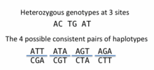
What is phasing
In this context it is really Haplotype Estimation
We take genotype data and try to reconstruct the haplotypes
Can use reference data to improve this estimation

Slide 28
Step 1 - Phasing
Input a diploid target sample and a library of reference haplotypes
Selection of conditioning haplotypes.
Eagle2 first identifies a subset of 10,000 conditioning haplotypes by ranking reference haplotypes according to the number of discrepancies between each reference haplotype and the homozygous genotypes of the target sample.

Slide 29
Generation of HapHedge data structure.
Eagle2 next generates a HapHedge data structure on the selected conditioning haplotypes.
The HapHedge encodes a sequence of haplo- type prefix trees (i.e., binary trees on haplotype prefixes) rooted at a sequence of starting positions along the chromosome, thus enabling fast lookup of haplotype frequencies

Slide 30
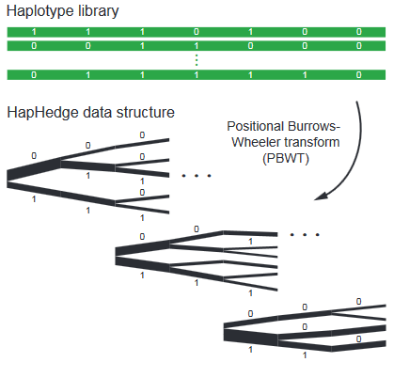

Slide 31
Exploration of the diplotype space.
Having prepared a HapHedge of conditioning haplotypes, Eagle2 performs phasing using a HMM
Consolidates reference haplotypes sharing common prefixes reducing computation.

Slide 32
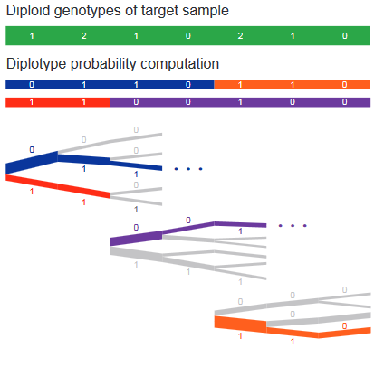

Slide 33
Step 1 – How to phase
Data is usually broken into manageable chunks
~20Mb
Each phased independently
./eagle
--vcfRef HRC.r1-1.GRCh37.chr20.shapeit3.mac5.aa.genotypes.bcf
--vcfTarget chunk_20_0000000001_0020000000.vcf.gz
--geneticMapFile genetic_map_chr20_combined_b37.txt
--outPrefix chunk_20_0000000001_0020000000.phased
--bpStart 1
--bpEnd 25000000
--chrom 20
--allowRefAltSwap

Slide 34
Step 2 - Imputation
Compares the phased data to the references and infers the missing genotypes. Calculate accuracy metrics
./Minimac3
--refHaps HRC.r1-1.GRCh37.chr1.shapeit3.mac5.aa.genotypes.m3vcf.gz
--haps chunk_1_0000000001_0020000000.phased.vcf
--start 1
--end 20000000
--window 500000
--prefix chunk_1_0000000001_0020000000
--chr 20
--noPhoneHome
--format GT,DS,GP
--allTypedSites

Slide 35
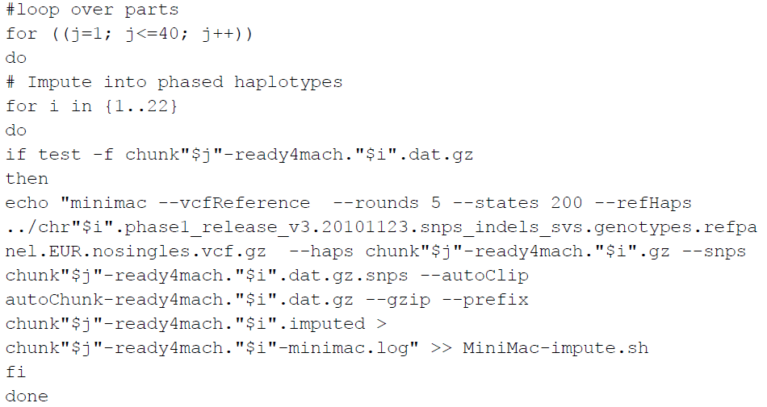
Imputing in minimac

Slide 36
Output
Info files

Slide 37
Output
3 main genotype output formats
Probs format (probability of AA AB and BB genotypes for each SNP)
Hard call or best guess (output as A C T or G allele codes)
Dosage data (most common – 1 number per SNP, 1-2)

Slide 38
Assessing accuracy of phasing
All phasing methods will make errors in the estimation of haplotypes - probability of error increases with length of imputed region
Problem – some programs are designed to run on small segments others on whole chromosomes
EAGLE2 currently considered the best
More work needed that compares like with like

Slide 39
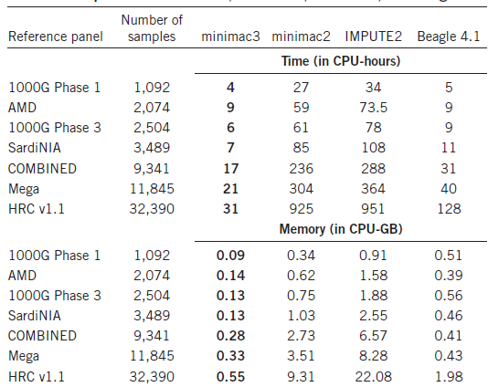
Timing & Memory
from
Das et al 2016
Prior to EAGLE2

Slide 40
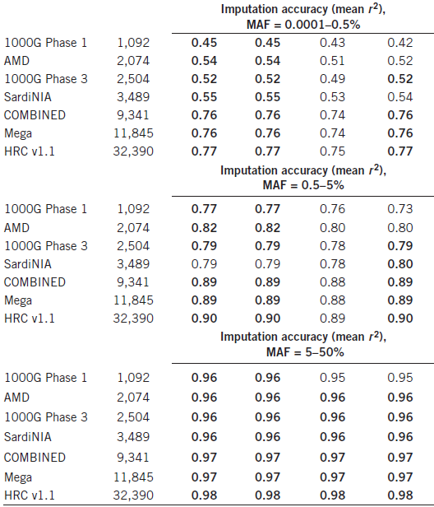
Accuracy of imputation methods

Slide 41
Questions?
Before we move on to talking about post imputation QC…

Slide 42
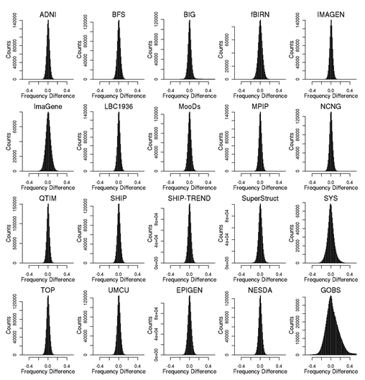
Post imputation QC
After imputation you need to check that it worked and the data look ok
Things to check
Plot r² across each chromosome look to see where it drops off
Plot MAF-reference MAF

Slide 43
Post imputation QC
See meta-analysis section
For each chromosome check N and % of SNPs:
MAF <.5%
With r² 0-.3, .3-.6,.6-1
If you have hard calls or probs data HWE P < 10E-6
If you have families convert to hard calls and check for Mendelian errors (should be ~.2%)
% should be roughly constant across chromosomes

Slide 44
Post imputation QC
See meta-analysis session
Next run GWAS for a trait – ideally continuous, calculate lambda and plot:
QQ
Manhattan
SE vs N
P vs Z
Run the same trait on the observed genotypes – plot imputed vs observed

Slide 45
However, if you are running analyses for a consortium they will probably ask you to analyse all variants regardless of whether they pass QC or not…
(If you are setting up a meta-analysis consider allowing cohorts to ignore variants with MAF <.5% and low r2 – it will save you a lot of time)

Slide 46
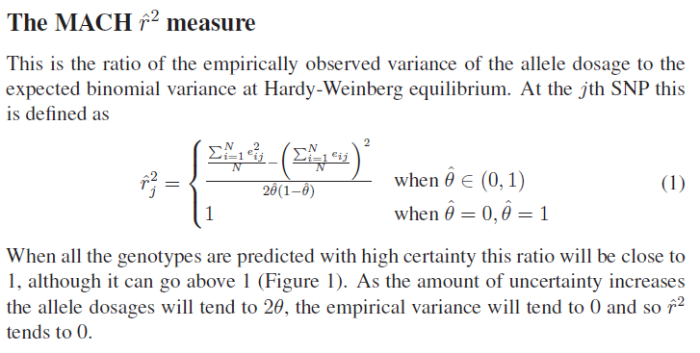
Issue – the r² metrics differ between imputation programs

Slide 47
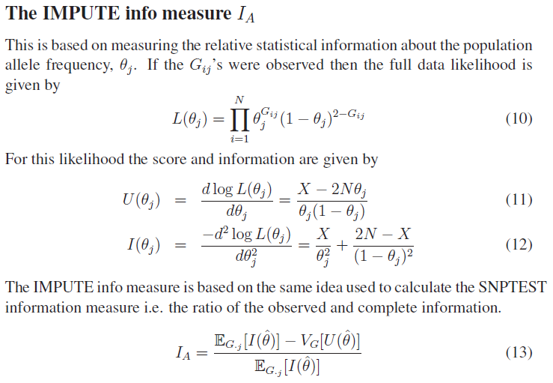
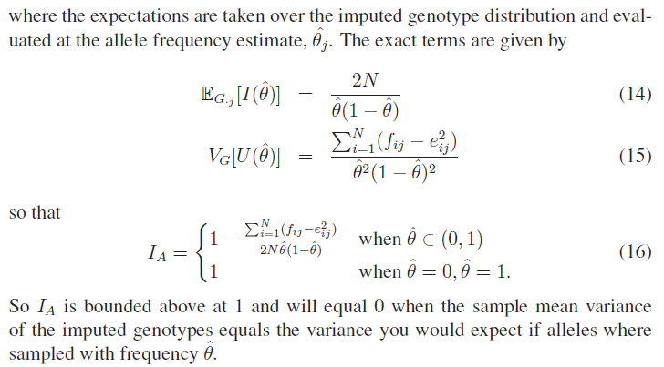

Slide 48
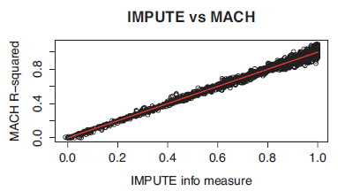
In general fairly close correlation
rsq/ ProperInfo/ allelic Rsq
1 = no uncertainty
0 = complete uncertainty
.8 on 1000 individuals = amount of data at the SNP is equivalent to a set of perfectly observed genotype data in a sample size of 800 individuals
Note Mach uses an empirical Rsq (observed var/exp var) and can go above 1

Slide 49
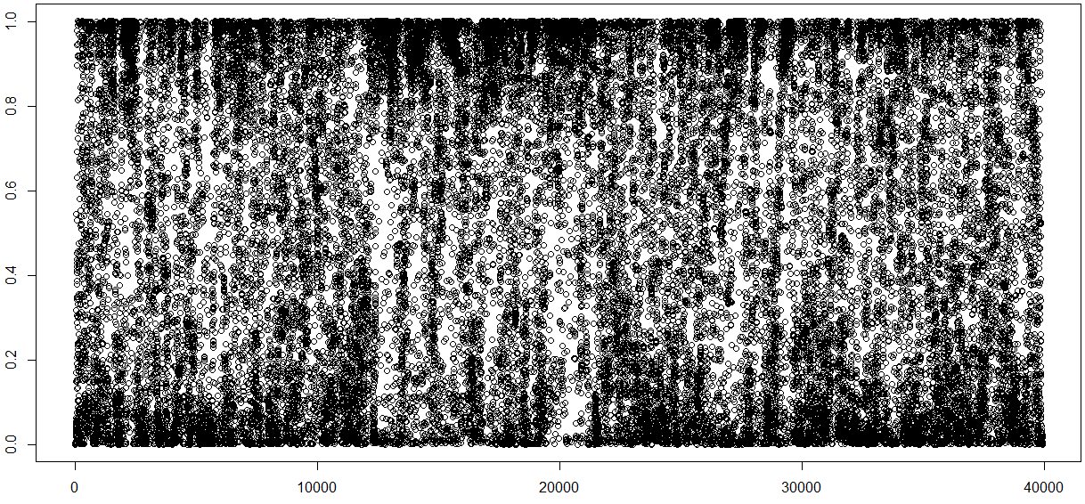
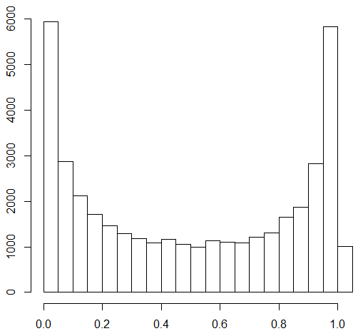
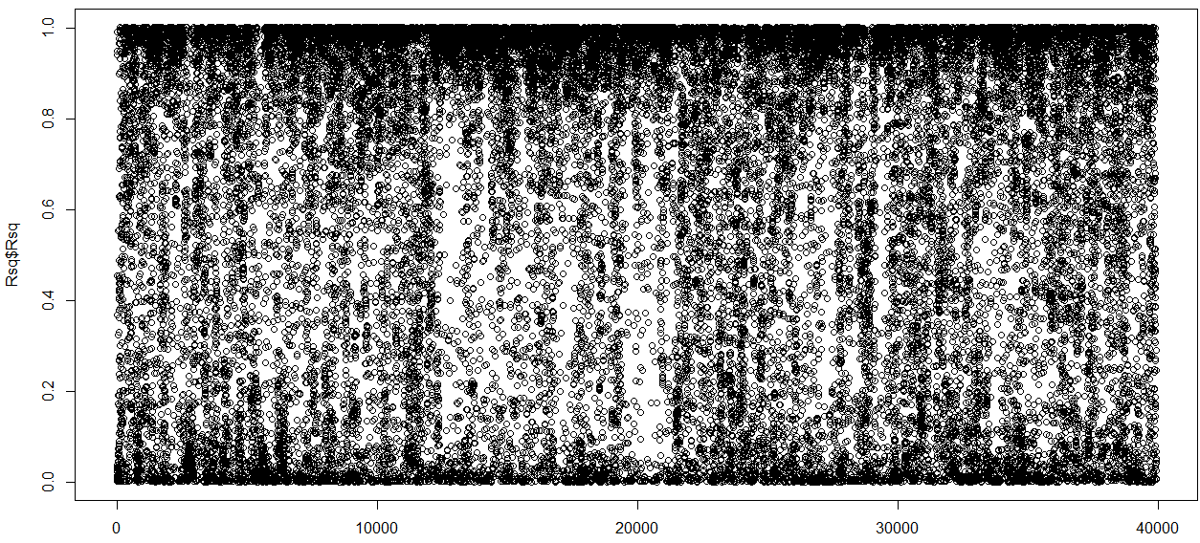
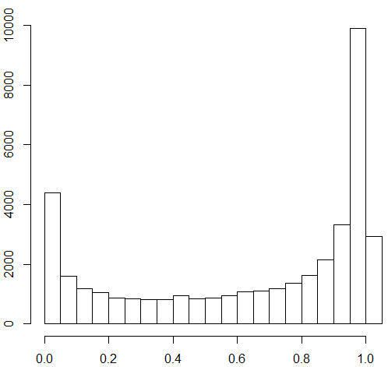
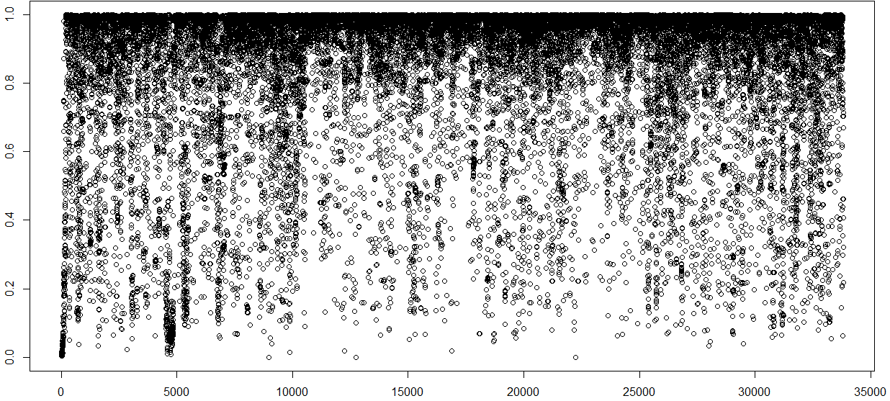
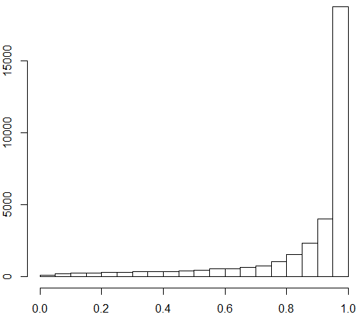
Bad
Imputation
Better Imputation
Good
Imputation

Slide 50
Choices of analysis methods

