Slide 1
More Plink + R plotting
Sarah Medland
2017

Slide 2
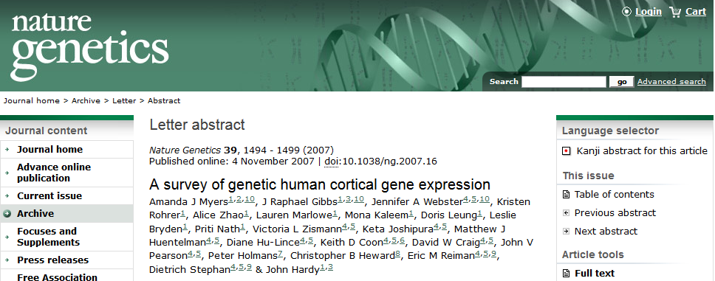
Todays Data
http://labs.med.miami.edu/myers/LFuN/LFuN.html
post-mortem gene expression in ‘brain’ tissue
N=364
Real data – unfiltered!
Notes:
2

Slide 3
Plink 2
Ungzip the ped file
gzip –d adgwas.ped
Read in data and make a bed file
plink --ped xxxxx --map xxxx
--out myersNoQC --make-bed

Slide 4
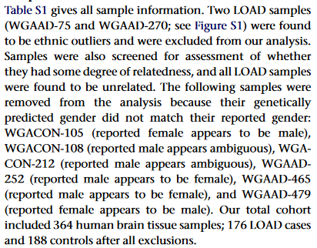
Plink 2
Remove person WGACON120 (duplicate) & others dropped in the analyses
Make a list of FID and IIDs that we want to drop in a file called drop.list

Slide 5
Plink 2
Read in data, filter it and make a bed file
Plink --bfile myersNoQC --geno .05 --mind .05 --maf .05 --hwe 1e-06 --remove drop.list --out myersQC --make-bed

Slide 6
Plink 2
There are 8650 expression phenotypes available
Chose 1 of the probes from Table 2
plink --bfile myersQC --pheno xxxxx --pheno-name xxxxx --assoc --out myersADgwas

Slide 7
Plink 2
Rerun using the non Qced data
plink --bfile myersNoQC --pheno xxxxx --pheno-name xxxxx --assoc --out myersAD_NoQC

Slide 8
Take a look at your output
Head
Tail
sort –fg –k 9 myersADgwas.qassoc | head -20
sort –fg –k 9 myersAD_NoQC.qassoc | head -20

Slide 9
Load your results into R and lets make plots
res<-read.table(“myersADgwas.qassoc”, header=T)
head(res)
max(res$P)
min(res$P)
as.data.frame(table(res$CHR))

Slide 10
Plotting GWAS results
Install qqman
Chose CRAN mirror
Expects headers: SNP CHR BP P
library(qqman)
manhattan(res)
Also see http://genome.sph.umich.edu/wiki/Code_Sample:_Generating_Manhattan_Plots_in_R

Slide 11
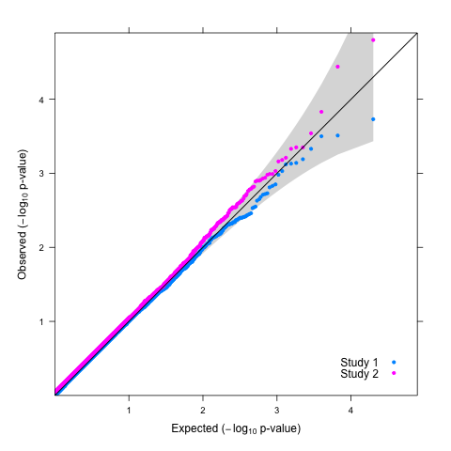
QQ plot with confidence intervals
http://genome.sph.umich.edu/wiki/Code_Sample:_Generating_QQ_Plots_in_R
source(“qqunif.R”)
qqunif.plot(res$P)

