Slide 1












30th International Workshop on Statistical Genetic Methods for Human Complex Traits
Ben Neale (codirector)
David Evans (codirector)
Jeff Barrett
Pak Sham
Goncalo Abecasis
Mike Neale
Hermine Maes
Sarah Medland
Dorret Boomsma
Abdel Abdellaoui
Meike Bartels
Camellia Minica
Christian de Leeuw
John Hewitt (host)
Jeff Lessem
Matt Keller
Cotton Seed
Stacey Cherny
Danielle Posthuma
Brad Verhulst
Manuel Ferreira
Tim Poterba
Hilary Martin
Jenny van Dongen
Rob Kirkpatrick
Pete Hatemi, Chris Zorn

Slide 2

The genetics of complex traits: historical context and current challenges
Nick Martin
Queensland Institute
of Medical Research
Brisbane
Boulder workshop
March 6, 2017

Slide 3
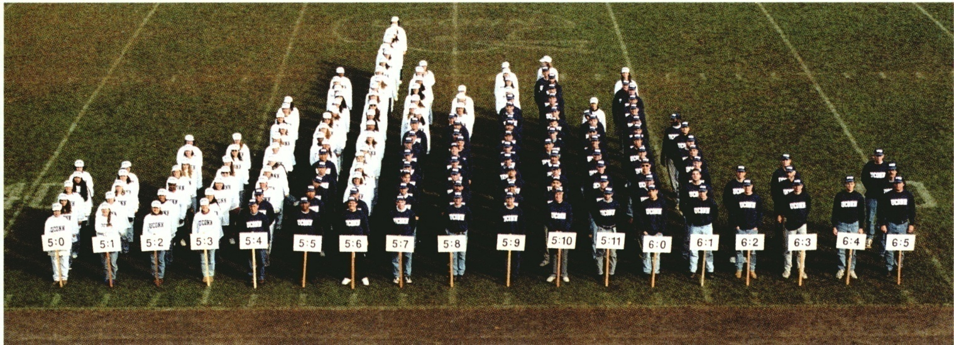
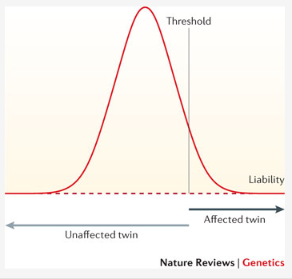
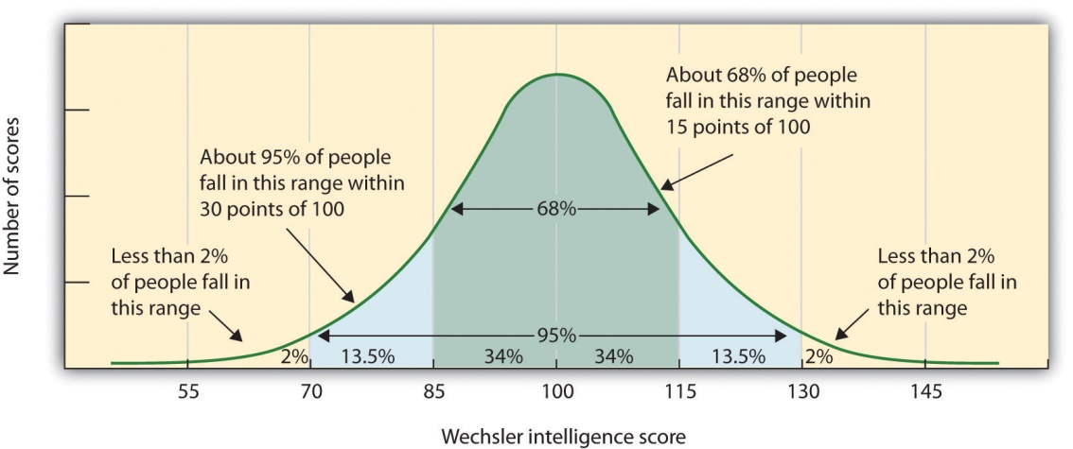
Human variation: Height
Human variation: IQ

Slide 4
Genetic Epidemiology:
Stages of Genetic Mapping
Are there genes influencing this trait?
  Genetic epidemiological (twin / family) studies OR heritability based on measured genetic variants
Where are those genes?
  Linkage analysis
What are those genes?
  Association analysis (meta-analysis / pathway)
How do they work beyond the sequence?
  Epigenetics, transcriptomics, proteomics
What can we do with them ?
  Translational medicine

Slide 5
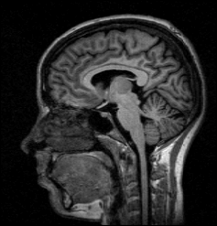
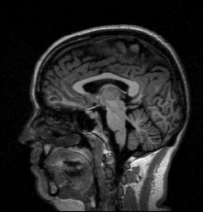
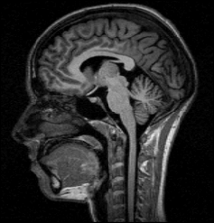
Brain volume (ml) in MZ twin pairs
Brain volume in DZ twin pairs
Twin 1
Twin 1
1400
1400
1200
1200
1000
1000
Twin 2
Twin 2
800
800
800
1000
1200
1400
800
1000
1200
1400

Slide 6
Total mole count for MZ and DZ twins
MZ twins - 153 pairs, r = 0.94
DZ twins - 199 pairs, r = 0.60
400
400
300
300
Twin 1
Twin 1
200
200
100
100
0
0
0
100
200
300
400
0
100
200
300
400
Twin 2
Twin 2

Slide 7
4 Stages of Genetic Mapping
Are there genes influencing this trait?
  Genetic epidemiological studies
Where are those genes?
  Linkage analysis
What are those genes?
  Association analysis
What can we do with them ?
  Translational medicine

Slide 8
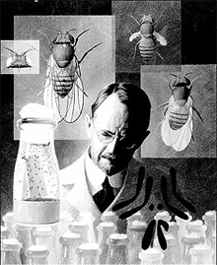
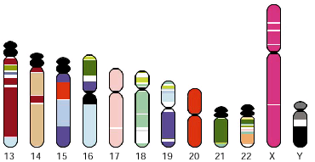
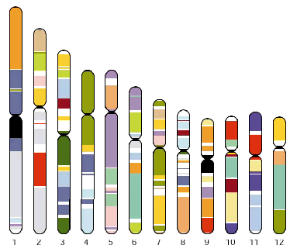
Linkage analysis
Thomas Hunt Morgan – discoverer of linkage

Slide 9
x
1/4
1/4
1/4
1/4

Slide 10
IDENTITY BY DESCENT
Sib 1
Sib 2
4/16 = 1/4 sibs share BOTH parental alleles IBD = 2
8/16 = 1/2 sibs share ONE parental allele IBD = 1
4/16 = 1/4 sibs share NO parental alleles IBD = 0

Slide 11
Total nevus count correlations by IBD class at D9S942
IBD = 0 (51 PAIRS)
IBD = 1 (99 PAIRS)
IBD = 2 (49 PAIRS)
MZ (156 PAIRS)
Heterogeneous (χ²₂=12.58, p=0.002)

Slide 12
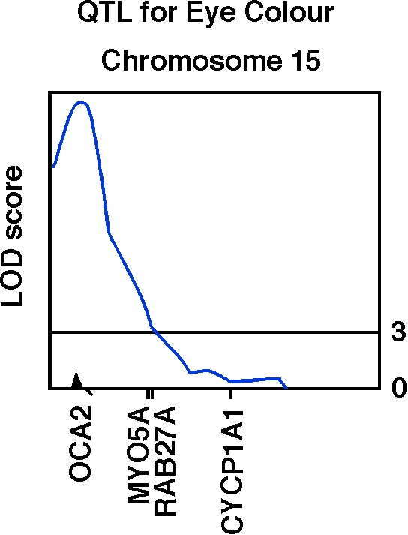
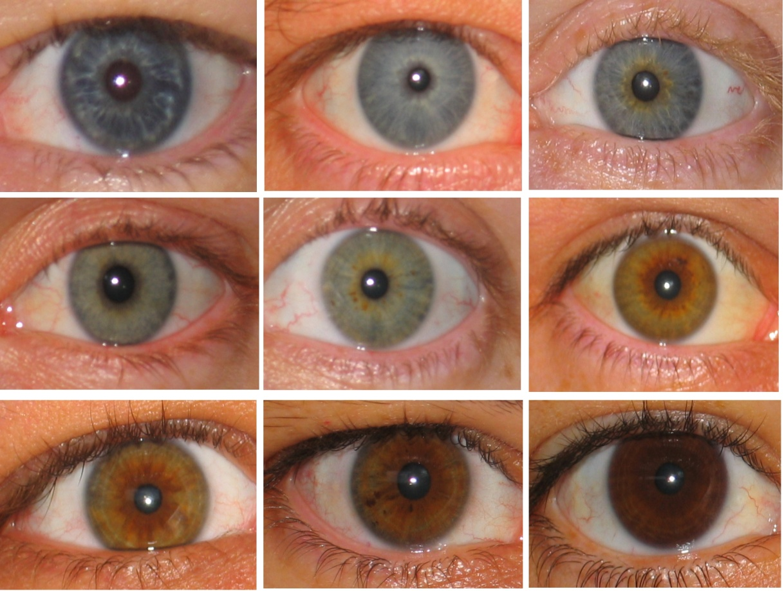
Human OCA2 and eye colour
Zhu et al., Twin Research 7:197-210 (2004)

Slide 13
Linkage analysis is badly underpowered for complex traits with small gene effect sizes
So we need a much more sensitive way to find the genes

Slide 14
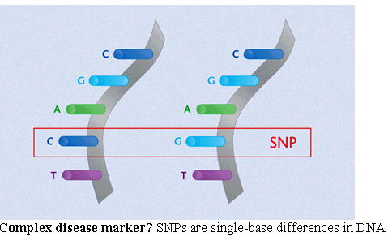
Association analysis
looks for correlation between specific alleles and phenotype (trait value, disease risk)
Single Nucleotide Polymorphisms (SNPs)

Slide 15
Linkage disequilibrium
David Evans

Slide 16
Linkage disequilibrium
time

Slide 17
Indirect association
this SNP will be associated with disease

Slide 18
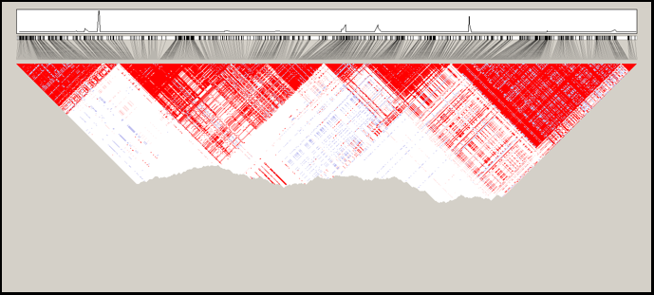
Linkage disequilibrium blocks
Jeff Barrett

Slide 19
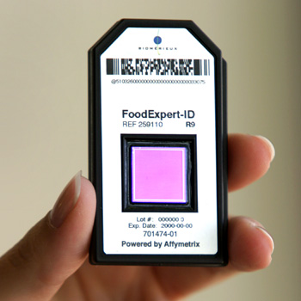
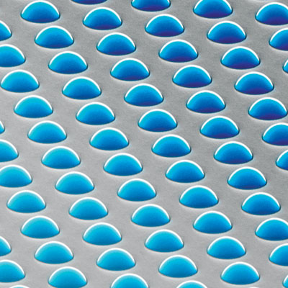
High density SNP arrays – up to 1 million SNPs

Slide 20
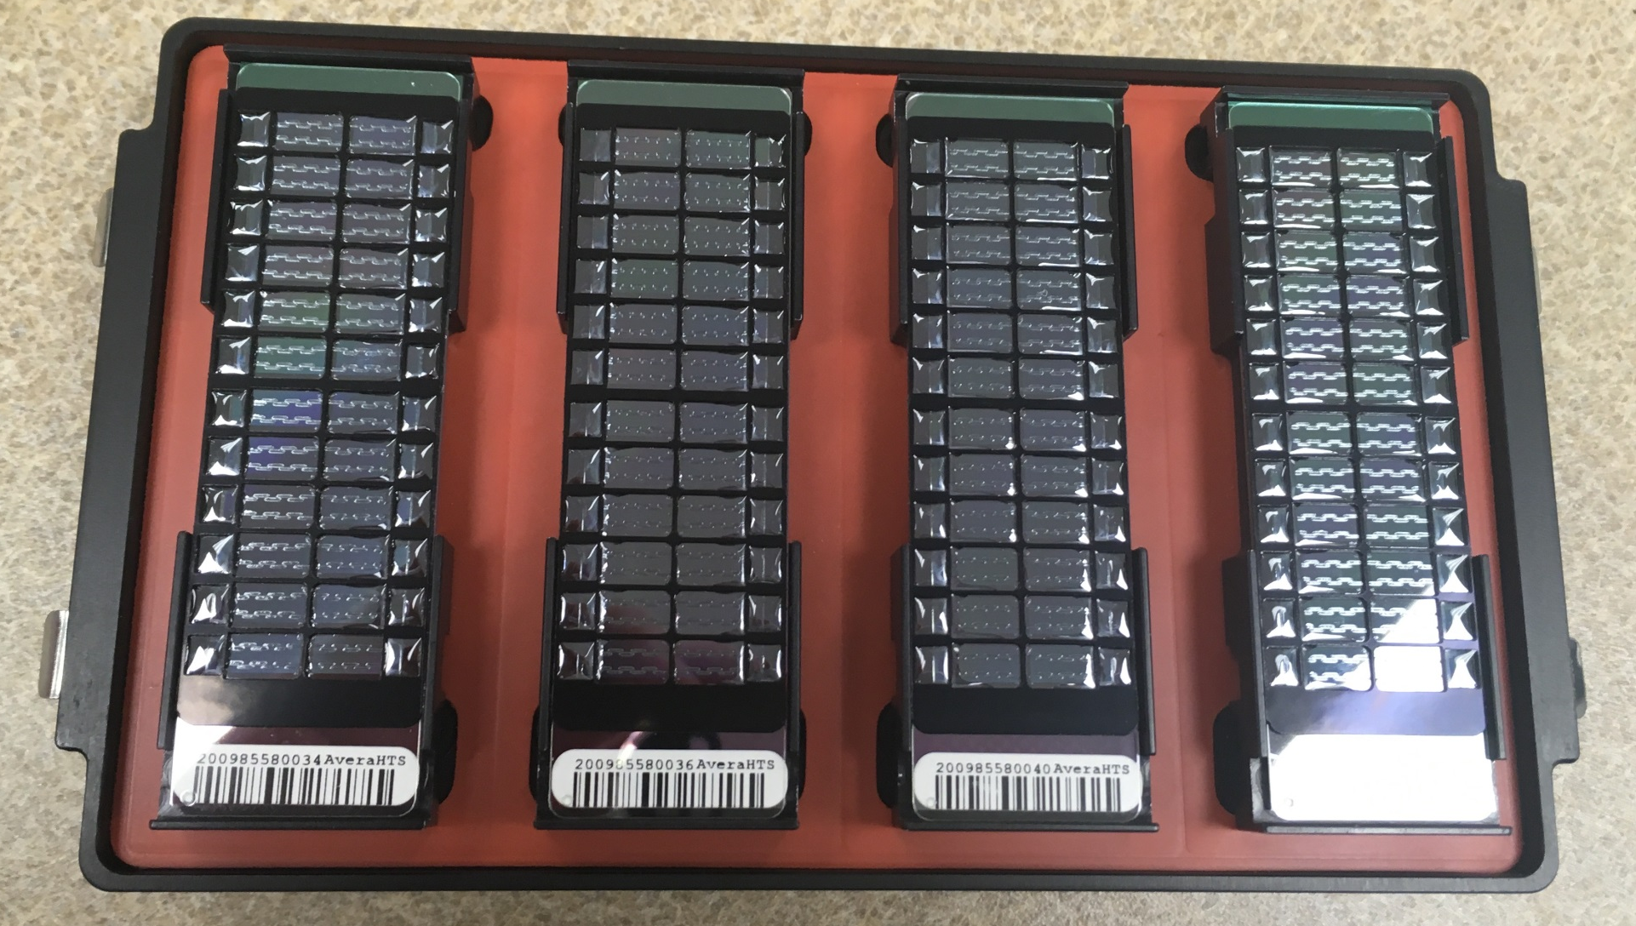
High density SNP arrays – up to 1 million SNPs
The new Infinium® Global Screening Array (GSA). Illumina received orders for more than 3 million samples from The Broad Institute and deCODE, Avera Health, ….. Erasmus MC, Life and Brain, and 23andMe.

Slide 21
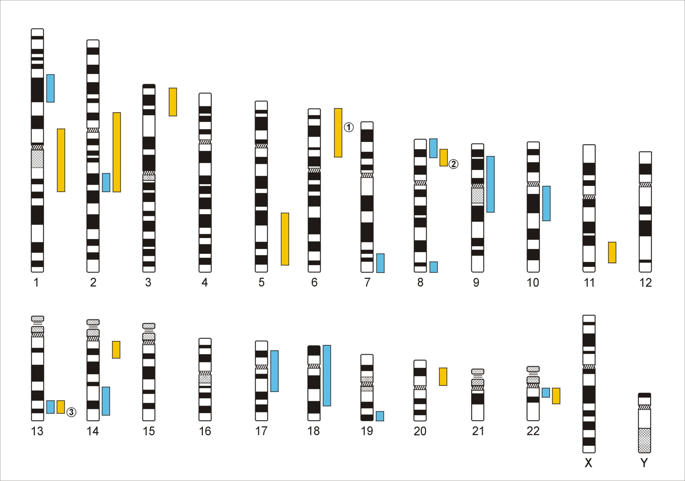
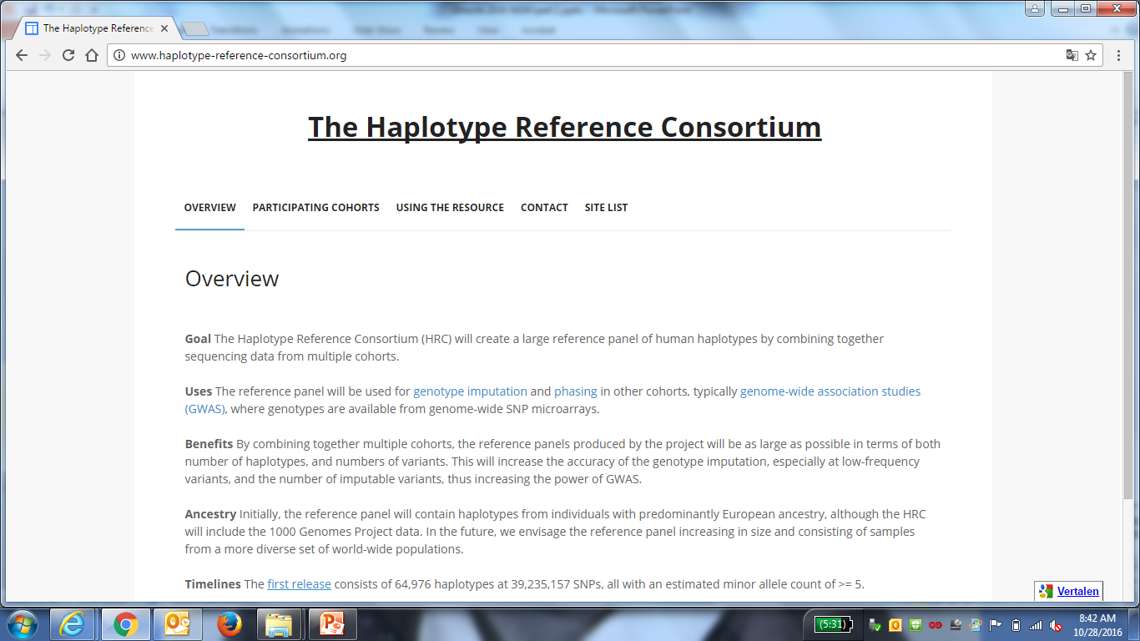
Genome-Wide Association Studies
500,000 – 5,000,000 SNPs
Human Genome - 3,1x10⁹ Base Pairs
Notes:
In a GWA the Genome which contains xx SNPs is examined using … SNPs

Slide 22
Genetic Case Control Study
Controls
Cases
G/T
G/G
T/T
T/T
T/T
T/G
T/G
T/T
T/G
T/G
G/G
T/G
T/G
T/T
Allele G is ‘associated’ with disease

Slide 23
Allele-based tests (case-control)
Each individual contributes two counts to 2x2 table.
Test of association
where
X² has χ² distribution with 1 degrees of freedom under null hypothesis.
 | Cases | Controls | Total
G | n_{1A} | n_{1U} | n_{1·}
T | n_{0A} | n_{0U} | n_{0·}
Total | n_{·A} | n_{·U} | n··

Slide 24
Simple Regression Model of Association
(continuous trait)
Y_{i} = α + βX_{i} + e_{i}
where
Y_{i} = trait value for individual i
X_{i} = number of ‘A’ alleles an individual has
1.2
1
0.8
Y
0.6
0.4
0.2
0
X
0
1
2
Association test is whether β > 0

Slide 25
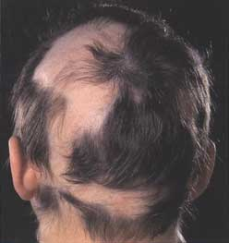
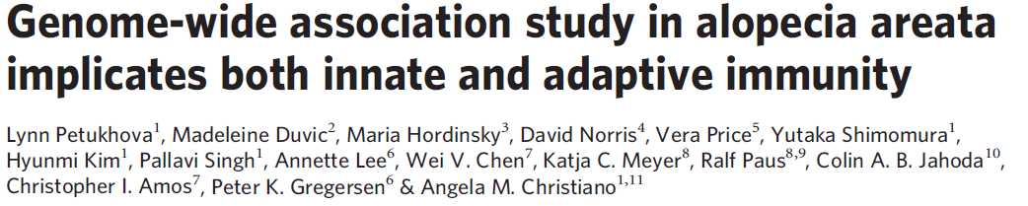
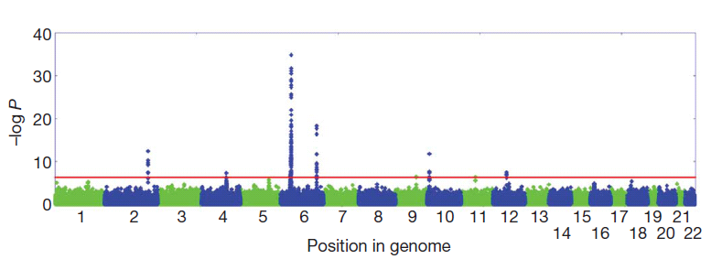

Slide 26
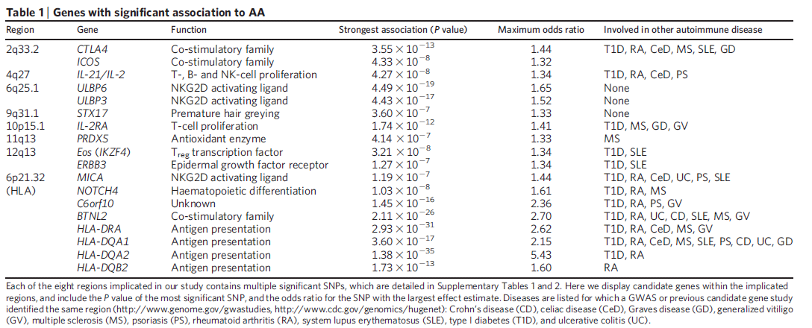
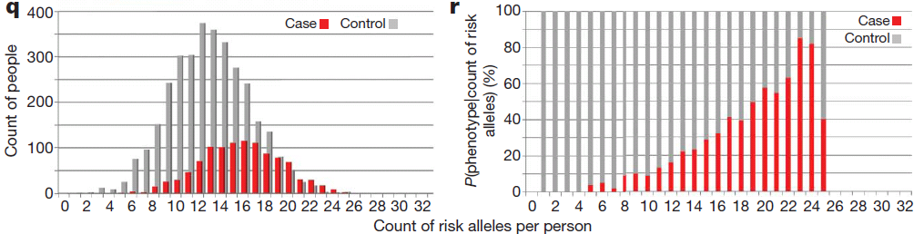

Slide 27
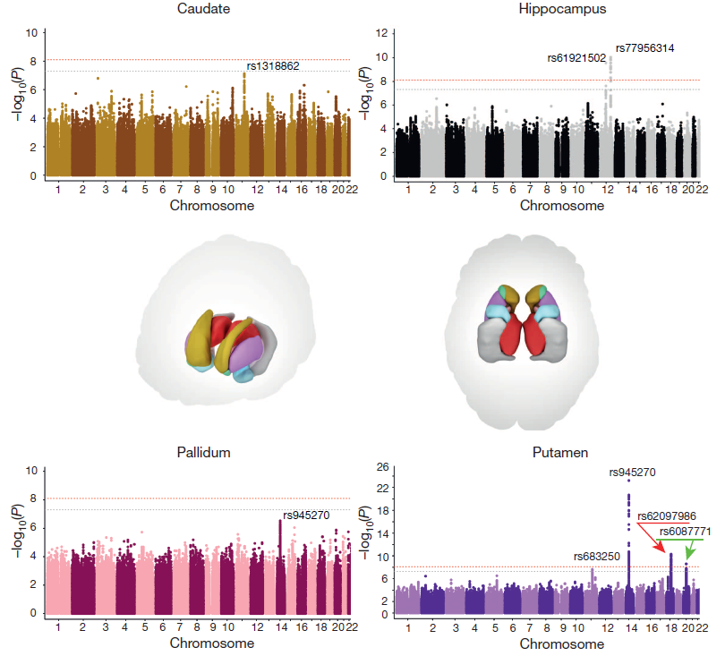
Sarah
Medland

Slide 28
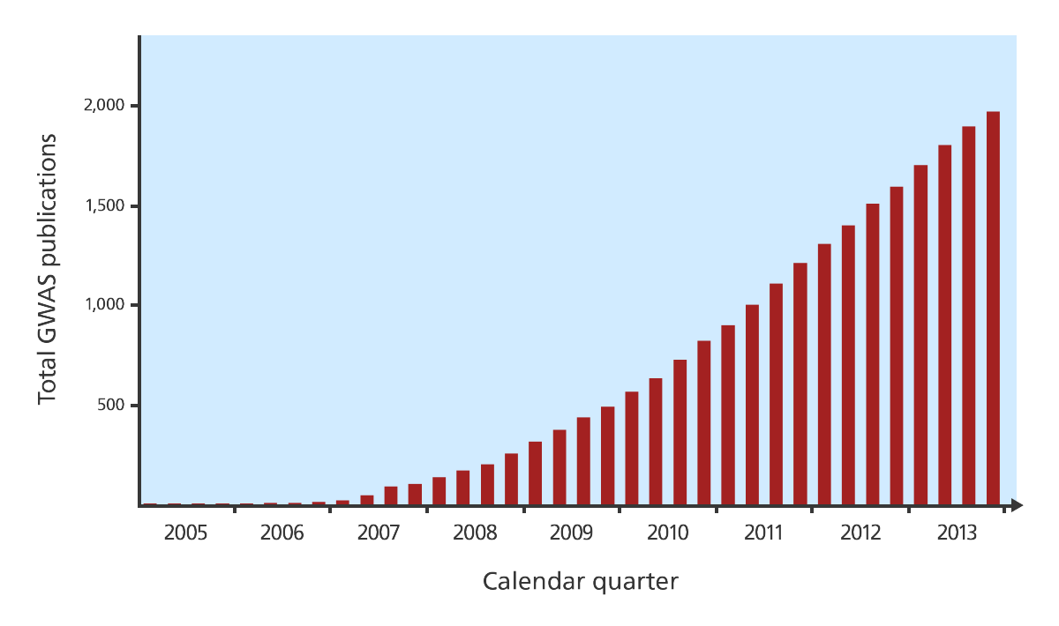
GWAS publications since 2005

Slide 29
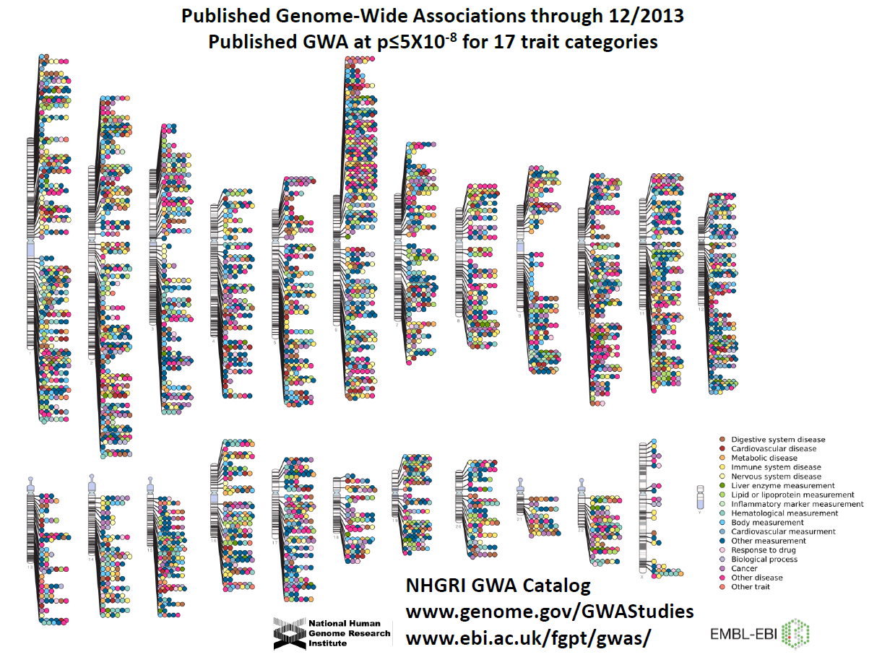

Slide 30
Ways to add value
Find the right target gene

Slide 31
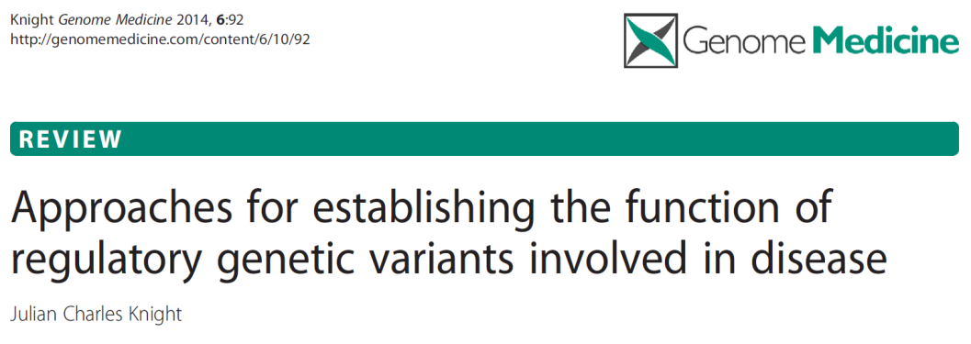
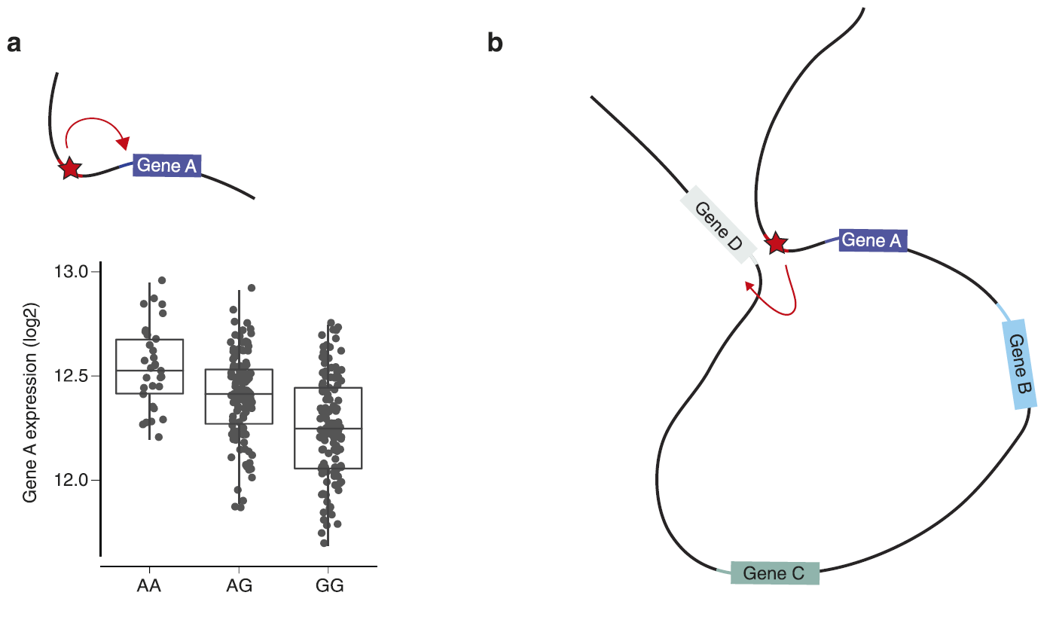
A local cis-acting variant in a regulatory element affects allele-specific transcription factor binding affinity and is associated with differential expression of gene A (see chart)

Slide 32
The same variant can modulate expression of gene D at a distance through DNA looping that brings the regulatory enhancer element close to the promoter of gene D on the same chromosome.

Slide 33
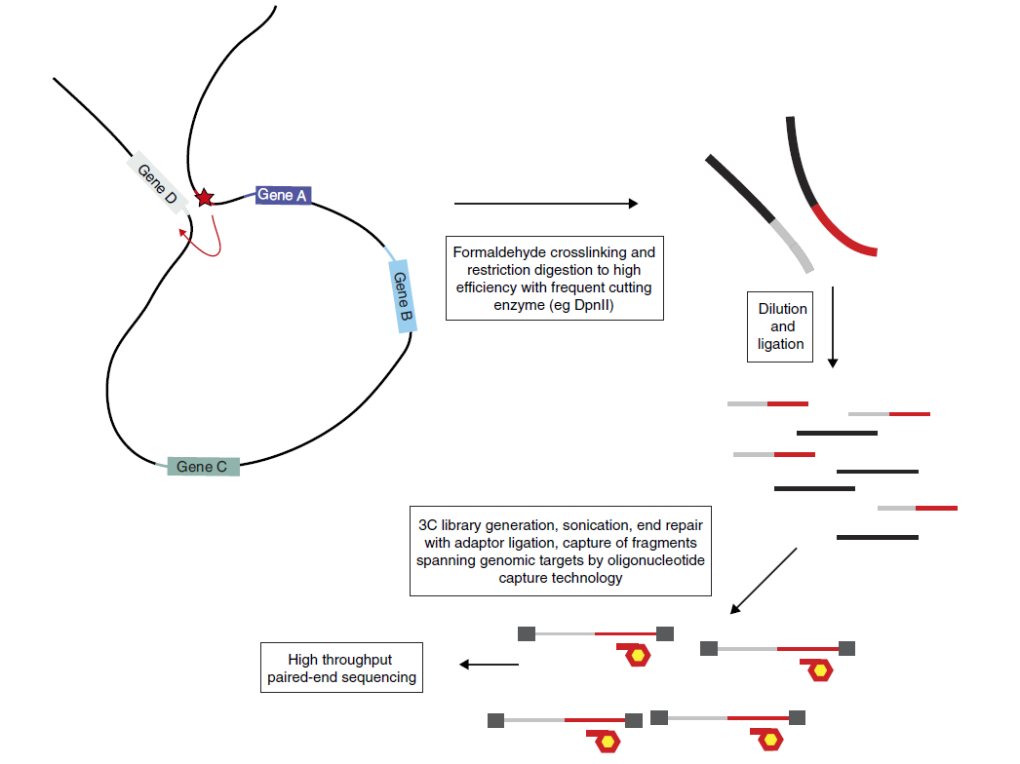
Chromatin conformation capture (3C) to find the target of a disease-associated SNP within an enhancer element
Can detect interactions from ~20kb to ~800kb

Slide 34
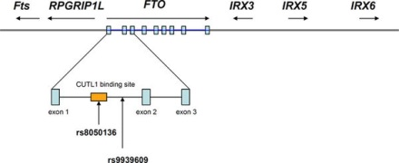
Obesity-associated variants within FTO form long-range functional connections with IRX3
Smemo et al 2014

Slide 35
Ways to increase power
Imputation

Slide 36
Imputation
a g a g t t g a g g g a a c c t g a g a a
t g a g a c g a g g g a a a t t g a g a c
t g c g a c g g t g a t t c t c c a g a c
a g c g a c g a t g g t a c t t g a t c a
t a a g t t a g t a a t t c c c g a g c a
t g c a a t g a g g g a a a t t g t t a a
a g a g a c g g g g g a a a t t c t g c c
Reference haplotypes via sequencing studies
eg. 1000 Genomes Project
g a g g t a a
g c t a t t c
a t g g t t a
g c g g c a a
g c t g t t c
g c g g c a a
g t g g t a c
a t t a c a a
Slide from Jonathan Marchini

Slide 37
Imputation
a g a g t t g a g g g a a c c t g a g a a
t g a g a c g a g g g a a a t t g a g a c
t g c g a c g g t g a t t c t c c a g a c
a g c g a c g a t g g t a c t t g a t c a
t a a g t t a g t a a t t c c c g a g c a
t g c a a t g a g g g a a a t t g t t a a
a g a g a c g g g g g a a a t t c t g c c
Reference haplotypes via sequencing studies
eg. 1000 Genomes Project
? g ? ? ? a ? ? g ? g ? ? ? t ? ? a ? ? a
? g ? ? ? c ? ? t ? a ? ? ? t ? ? t ? ? c
? a ? ? ? t ? ? g ? g ? ? ? t ? ? t ? ? a
? g ? ? ? c ? ? g ? g ? ? ? c ? ? a ? ? a
? g ? ? ? c ? ? t ? g ? ? ? t ? ? t ? ? c
? g ? ? ? c ? ? g ? g ? ? ? c ? ? a ? ? a
? g ? ? ? t ? ? g ? g ? ? ? t ? ? a ? ? c
? a ? ? ? t ? ? t ? a ? ? ? c ? ? a ? ? a
Slide from Jonathan Marchini

Slide 38
Imputation
a g a g t t g a g g g a a c c t g a g a a
t g a g a c g a g g g a a a t t g a g a c
t g c g a c g g t g a t t c t c c a g a c
a g c g a c g a t g g t a c t t g a t c a
t a a g t t a g t a a t t c c c g a g c a
t g c a a t g a g g g a a a t t g t t a a
a g a g a c g g g g g a a a t t c t g c c
Reference haplotypes via sequencing studies
eg. 1000 Genomes Project
g a g g t a a
g c t a t t c
a t g g t t a
g c g g c a a
g c t g t t c
g c g g c a a
g t g g t a c
a t t a c a a
Imputation of unobserved alleles via matching of shared haplotypes
Slide from Jonathan Marchini

Slide 39
Imputation
a g a g t t g a g g g a a c c t g a g a a
t g a g a c g a g g g a a a t t g a g a c
t g c g a c g g t g a t t c t c c a g a c
a g c g a c g a t g g t a c t t g a t c a
t a a g t t a g t a a t t c c c g a g c a
t g c a a t g a g g g a a a t t g t t a a
a g a g a c g g g g g a a a t t c t g c c
Reference haplotypes via sequencing studies
eg. 1000 Genomes Project
a g a g t a g a g g g t a c t t g a t c a
t g c g a c g g t g a t t c t t c t g c c
t a a a a t g a g g g a a a t t g t t a a
t g a g a c g a g g g a a c c c g a g c a
a g c g a c g a t g g t a a t t c t g c c
a g a g a c g a g g g a a c c t g a g a a
t g c a a t g a g g g a a a t t g a g a c
t a a g t t a g t a a t t c c t g a t c a
Imputation of unobserved alleles via matching of shared haplotypes
Slide from Jonathan Marchini

Slide 40
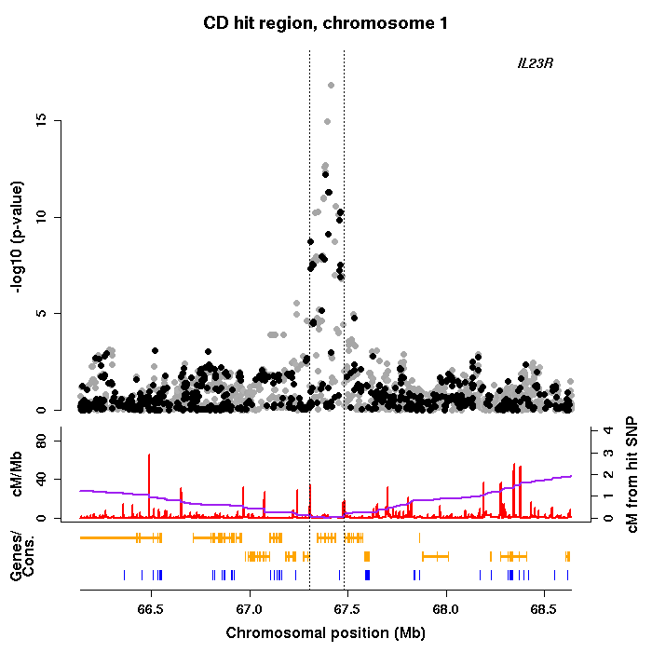
Imputation
a g a g t t g a g g g a a c c t g a g a a
t g a g a c g a g g g a a a t t g a g a c
t g c g a c g g t g a t t c t c c a g a c
a g c g a c g a t g g t a c t t g a t c a
t a a g t t a g t a a t t c c c g a g c a
t g c a a t g a g g g a a a t t g t t a a
a g a g a c g g g g g a a a t t c t g c c
GWAS of imputed genotypes
Increased power
Better resolution
Facilitates meta-analysis
a g a g t a g a g g g t a c t t g a t c a
t g c g a c g g t g a t t c t t c t g c c
t a a a a t g a g g g a a a t t g t t a a
t g a g a c g a g g g a a c c c g a g c a
a g c g a c g a t g g t a a t t c t g c c
a g a g a c g a g g g a a c c t g a g a a
t g c a a t g a g g g a a a t t g a g a c
t a a g t t a g t a a t t c c t g a t c a
Slide from Jonathan Marchini

Slide 41
Ways to increase power
Increase sample size

Slide 42
Selected quantitative traits Selected diseases
Number of Loci Identified is a Function of Sample Size
Visscher PM, et.al. (2012) Am J Hum Genetics

Slide 43
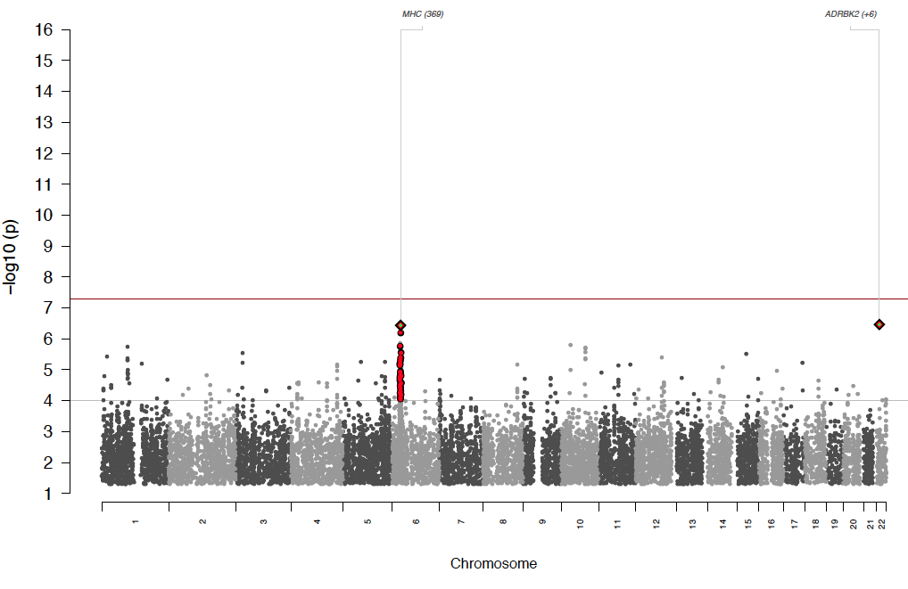
Schizophrenia 2009
ISC 2009
3K cases
Dramatic progress in GWAS for Schizophrenia

Slide 44
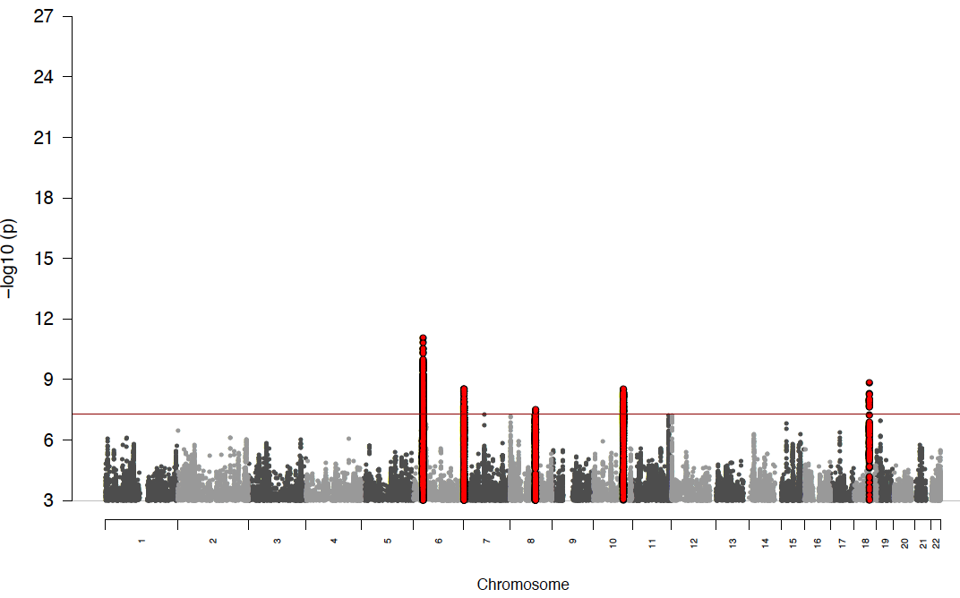
ISC 2009
3K cases
PGC1 - 2011
9K cases
5 loci

Slide 45
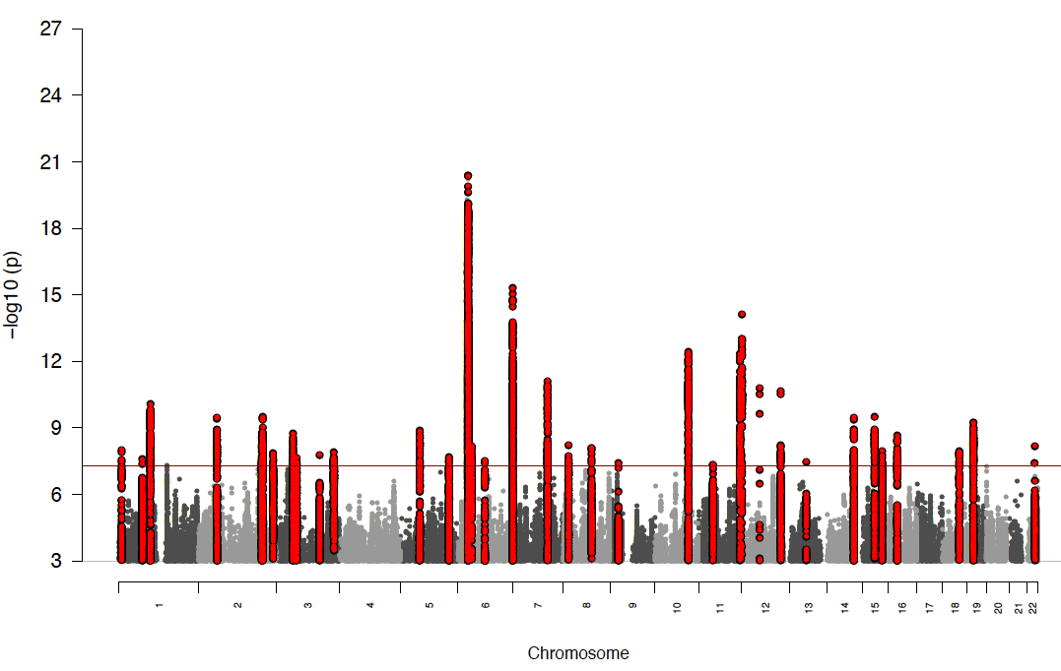
ISC 2009
3K cases
PGC1
9K cases
5 loci
PGC1 + Sweden
2012 - 14K cases
22 loci

Slide 46
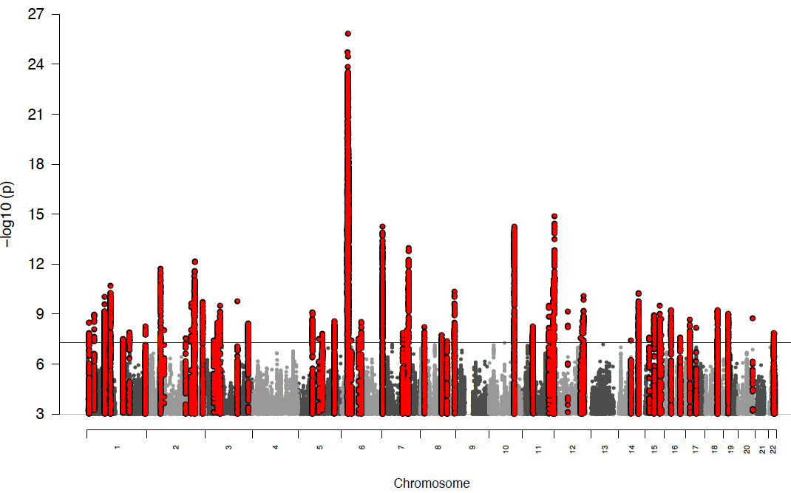
ISC 2009
3K cases
PGC1
9K cases
5 loci
PGC1 + Sweden
14K cases
22 loci
PGC2 2013
31K cases
78 loci
Rank #3

Slide 47
ISC 2009
3K cases
PGC1
9K cases
5 loci
PGC1 + Sweden
14K cases
22 loci
PGC2 2013
31K cases
78 loci
Rank #3

Slide 48
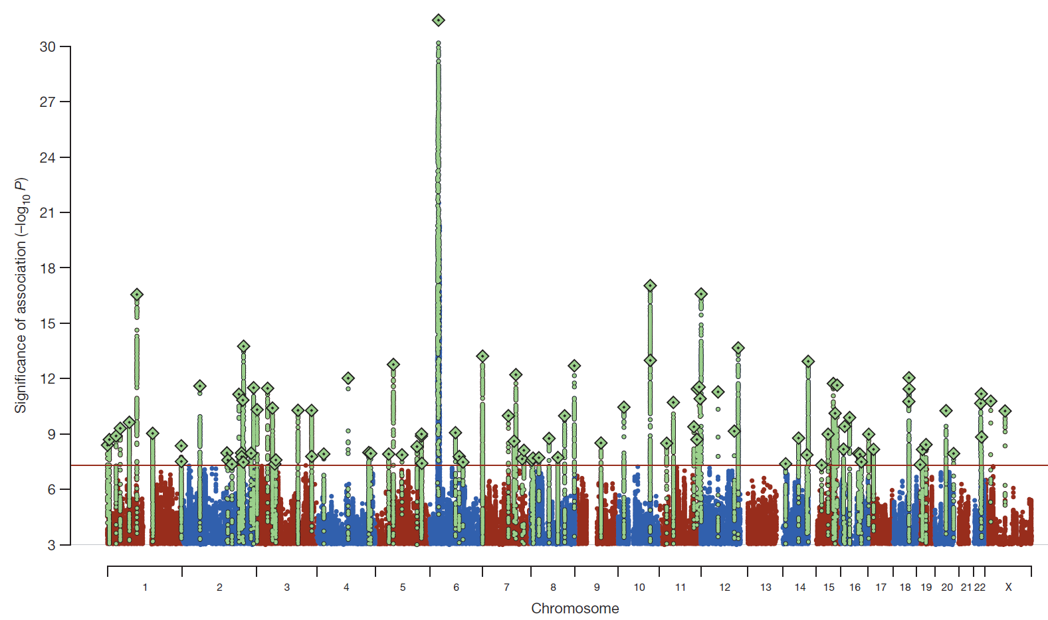
Schizophrenia: meta-analysis of 49 case control samples (34,241 cases and 45,604 controls)
JULY 2014
128 independent SNPs
(P<5e-8, r²<0.1, 3Mb windows)
108 different regions (conservative)
2 4 J U LY 2 0 1 4 | VO L 5 1 1 | N AT U R E | 4 2 1

Slide 49
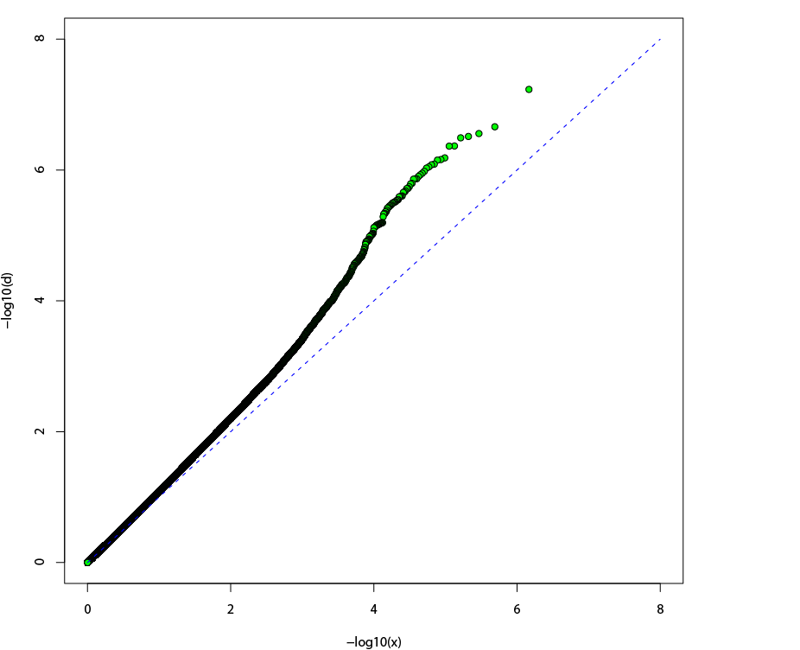
Schizophrenia (ISC) Q-Q plot
Consistent with:
Stratification?
Genotyping bias?
Distribution of true
polygenic effects?
Observed -log10(p)
λ = 1.092
Expected -log10(p)

Slide 50
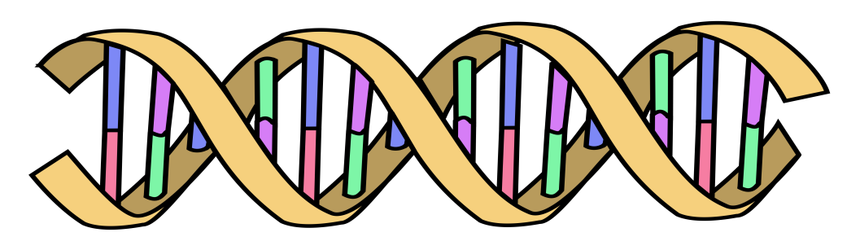
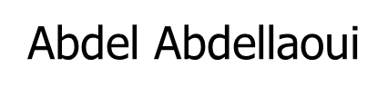
Polygenic Risk Scores
Polygenic Risk Scores capture (part of) someone’s genetic “risk” by summing all risk alleles weighted by the effect sizes estimated in a Genome-Wide Association Study (GWAS)
1×-.02 + 2×.01 + 1×.002 + 0×.03 + 2×.025
Polygenic score:
AC
CC
TT
.052
GG
AT
Effect sized from GWAS
β_{C}=-.02
β_{G}=.01
β_{A}=.002
β_{G}=.03
β_{T}=.025

Slide 51
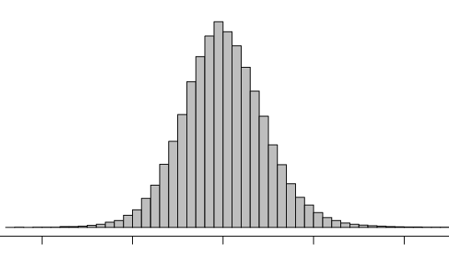
Indexing polygenic variance with large sets of weakly associated alleles
Discovery
set
Target
set
Do target cases
have a higher
allele load?
Top 20% independent SNPs
Score # of
“nominal risk alleles”
Individuals’
“polygenic scores”
ISC
→ ISC
→ Independent SCZ studies (MGS, O’Donovan)
→ Bipolar disorder (STEP-BD, WTCCC)
→ Non-psychiatric disease (WTCCC)
Douglas Levinson, Pablo Gejman,
Jianxin Shi and colleagues

Slide 52
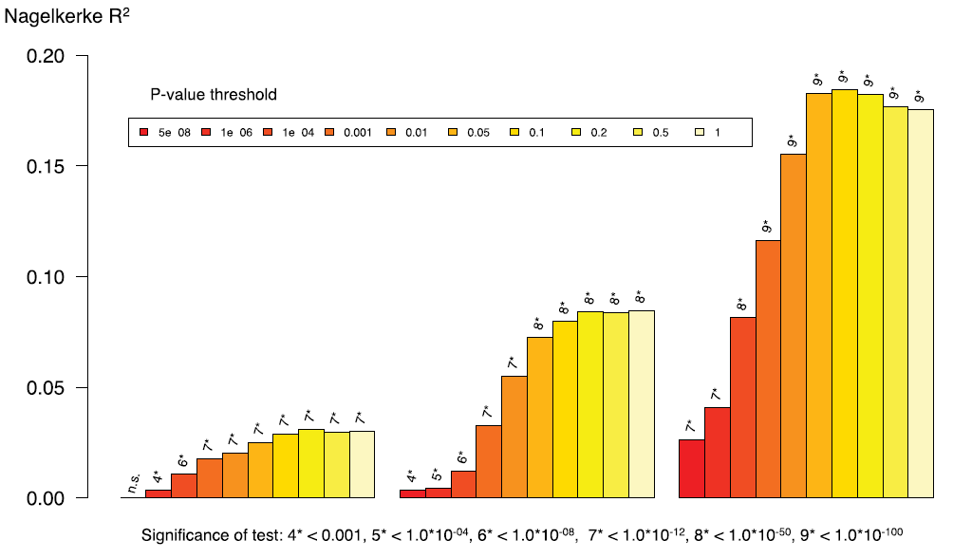
Polygenic risk score for schizophrenia using MGS sample as target
and ISC, PGC1, and PGC2 as prediction samples (minus MGS!)
PGC2
32,838 cases
44,357 controls
PGC1
9,320 cases
10,228 controls
ISC
2,615 cases
3,338 controls

Slide 53
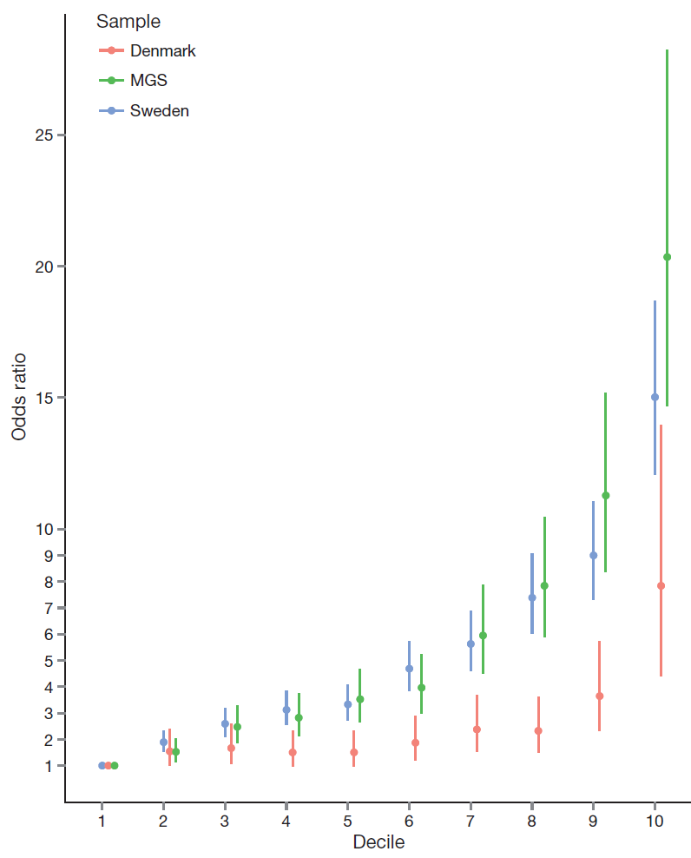
Odds ratio for schizophrenia by
polygenic risk score (PRS) decile in the Sweden, Denmark, and Molecular Genetics of Schizophrenia (US+Oz) studies.
includes Oz
“Given the need for measures that index liability to schizophrenia, the ability to stratify individuals by PRS offers new opportunities for clinical and epidemiological research.”
Risk alleles and weights were derived from ‘leave one out’ analyses in which those samples were excluded from the GWAS meta-analysis. The threshold for selecting risk alleles was P<0.05.

Slide 54
Ways to increase power
Combine GWAS with MWAS

Slide 55

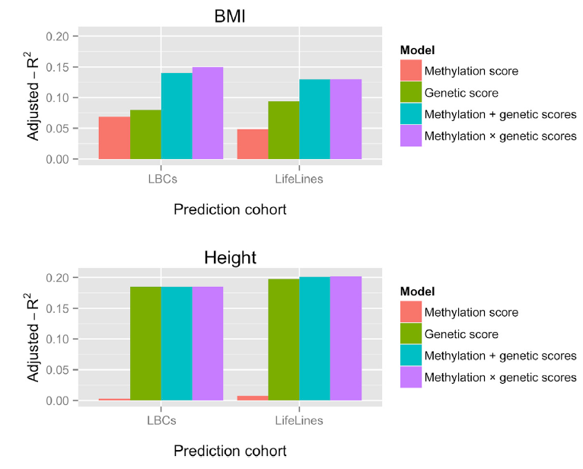

Slide 56
Ways to increase power
Refine the phenotype

Slide 57
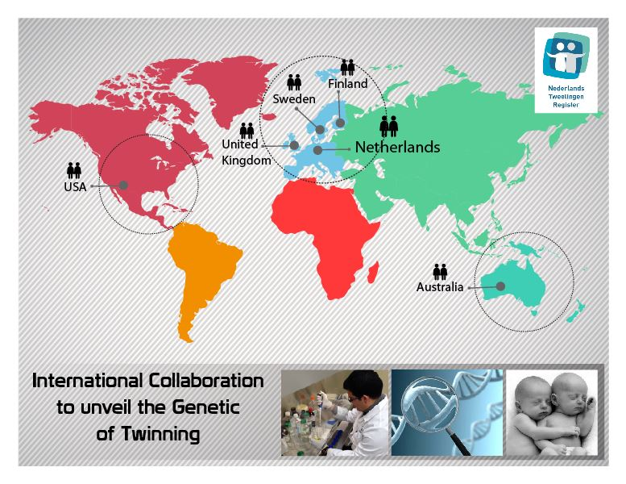
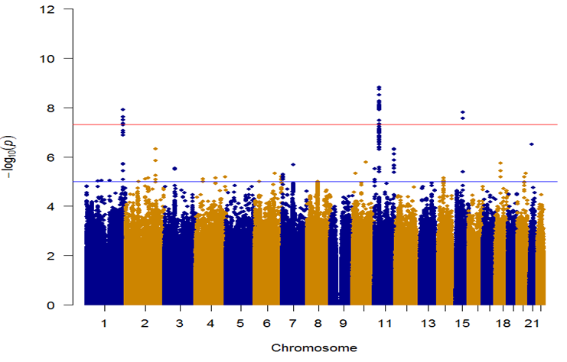
Twinning Gwas Consortium
GWAS for being ‘mother of DZ twins’
(only worked for spontaneous twining)
SNP 2, P=1.53E-09
SNP 1, P=1.22E-08
SNP 3, P=1.563E-08

Slide 58
The importance of accurate phenotyping: GWAS for Being a Mother of DZ Twins - Before and after removing mothers who had used assisted reproductive technology
Hamdi Mbarek
SNP 1, P=1.22E-08
SNP 2, P=1.53E-09
SNP 3, P=1.563E-08

Slide 59
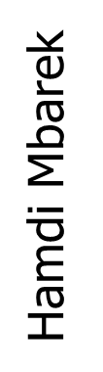
Being a Mother of DZ Twins
GWAS meta-analysis
Cohort | Cases | Controls | Total
Australia (QIMR) | 606 (725) | 6556 (7805) | 7162
USA (MCTFR) | 568 | 1862 | 2430
Netherlands (NTR) | 806 (928) | 4535 (4542) | 5341
Total | 1980 | 12953 | 14933
Cases ≠ Assisted Reproductive Technology (ART)
Controls = parents with no DZ twins
Numbers in red (including ART cases/ Twins related controls)
Notes:
928-806=122
725-606=119
Removing 250 cases
Ctrl 1256

Slide 60
Ways to increase power
Combine related phenotypes

Slide 61
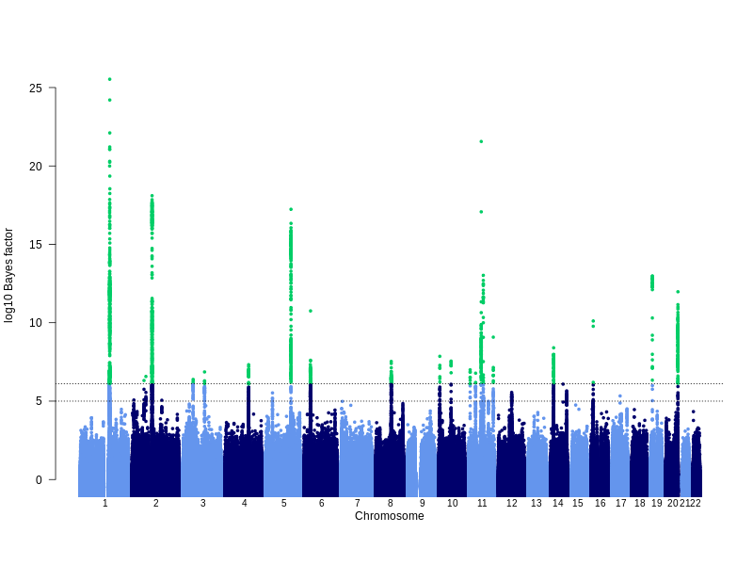
GWAS for eczema (21k cases, 98k controls, 27 hits)
Lavinia Paternoster
Notes:
Manhattan plot showing results of the trans-ethnic meta-analysis.
Explain bayes factor and cut-off equivalent to p-value 5x10-8

Slide 62
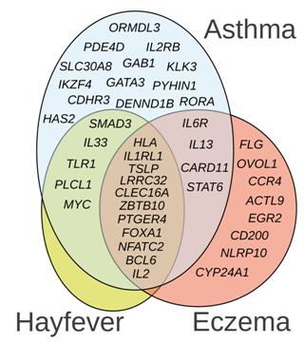
Risk factors overlap
(Thomsen 2006; van Beijsterveldt 2007)
ENVIRONMENTAL risk factors:
20% to 70% shared
COMMON TRIGGERS
GENETIC risk factors:
40% to 60% shared
COMMON MOLECULAR MECHANISMS
Manuel Ferreira

Slide 63
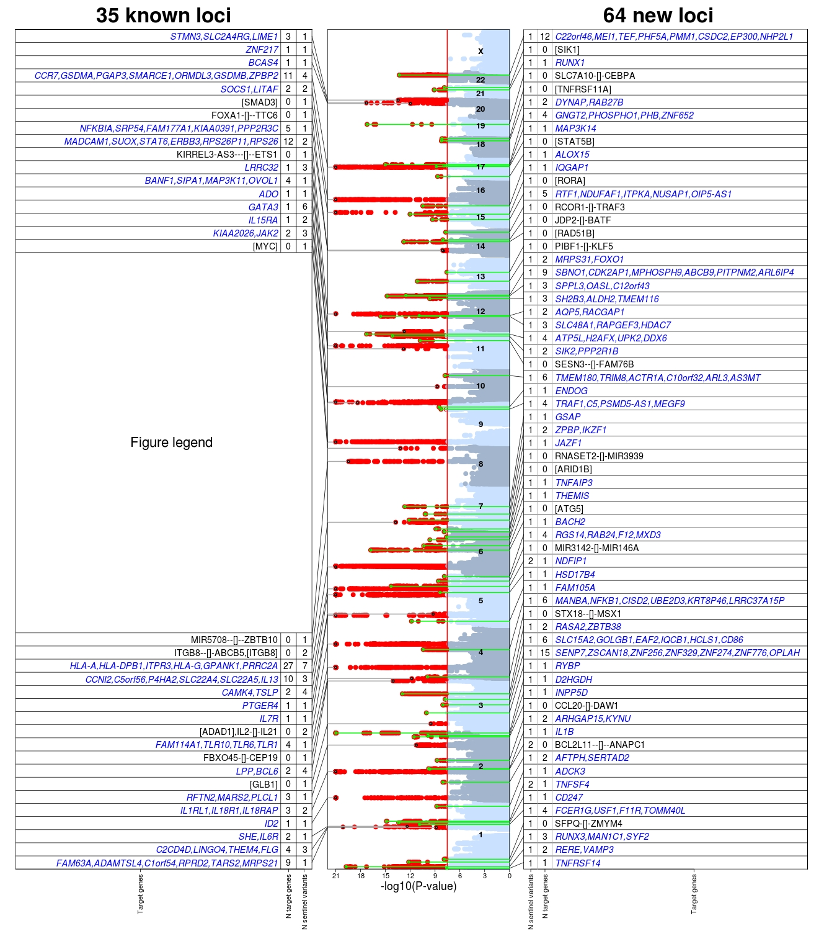
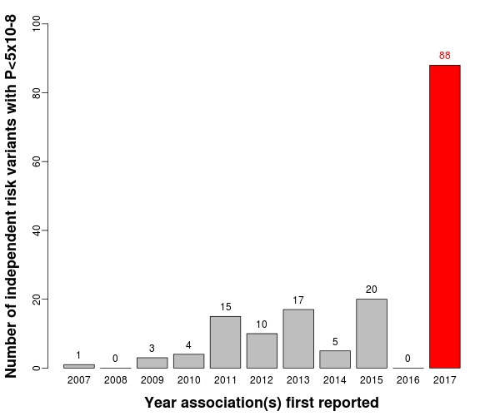
Manuel Ferreira

Slide 64

Only 13/199 risk variants have disease-specific effects
30/199 risk variants influence age-of-onset
Manuel Ferreira

Slide 65
Ways to increase power
Use ungenotyped relatives as proxy cases (GWAX)

Slide 66


(GWAX)
For late-onset or rapidly lethal diseases it may be more practical to identify family members of cases.

Slide 67

Meta-analysis results for GWAX + case-control studies
New hits are shown in red

Slide 68
Ways to exploit power
Investigate genetic correlation

Slide 69


included participants with European ancestry from 23andMe (N = 59,225) and two samples (GPC-1 and GPC-2) from the Genetics of Personality Consortium (GPC).
GPC-1 (N = 17,375) contains data on agreeableness, conscientiousness and openness
GPC-2 (N = 63,661) contains information on extraversion and neuroticism.
N = 122,886

Slide 70

Genetic correlations (rg) between personality traits (23andMe sample) and psychiatric disorders

Slide 71
Pushing power to the limit
Search for rare variants

Slide 72

used an ExomeChip11 to test the association between 241,453 variants (of which 83% are coding variants with a MAF ≤ 5%) and adult height variation in 711,428 individuals (discovery and validation sample sizes were 458,927 and 252,501, respectively)
The ExomeChip is a genotyping array designed to query in very large sample sizes coding variants identified by whole-exome DNA sequencing of approximately 12,000 participants

Slide 73


Slide 74
Ways to spend $$$$
Sequence the genome

Slide 75

The White House - June 26, 2000
Venter
Clinton
Collins

Slide 76

It took 4 months, a handful of scientists and ~ US$1.5 mil to sequence the genome of DNA pioneer James Watson

Slide 77

Cost of sequencing
Reminder: human genome 3 Gigabases
Due to error rate, we tend to sequence 20-30X to obtain high quality sequence i.e. 60-90Gb → currently ~$1000/genome
https://www.illumina.com/content/dam/illumina-marketing/documents/products/illumina_sequencing_introduction.pdf
Hilary Martin

Slide 78


Slide 79



Slide 80




Slide 81
A good use of money?
Whole genome sequencing for complex traits

Slide 82


WES/WGS to Find Genes for Common Disease
Fuchsberger et al 2016
2,657 WGS + 12,940 WES - 4 loci (~$6M/locus at current prices, plus storage/analysis)
GWAS 26,488 cases and 83,964 controls - 62 loci (~$61k/locus) [Mahajan et al 2014]
“variants associated with T2D were overwhelmingly common and most fell in regions previously identified by GWAS”
“Genome sequencing in much larger numbers of individuals is needed”!!!
Notes:
No evidence for synthetic association ie rare variants that by chance cluster no common haplotypes
$6M vs $43k

Slide 83
Ways to get a Nobel prize
Find the causal variant that is actionable

Slide 84
Schizophrenia: meta-analysis of 49 case control samples (34,241 cases and 45,604 controls)
JULY 2014
128 independent SNPs
(P<5e-8, r²<0.1, 3Mb windows)
108 different regions (conservative)
2 4 J U LY 2 0 1 4 | VO L 5 1 1 | N AT U R E | 4 2 1

Slide 85



Slide 86


From: Decreased Dendritic Spine Density on Prefrontal Cortical Pyramidal Neurons in Schizophrenia
Arch Gen Psychiatry. 2000;57(1):65-73. doi:10.1001/archpsyc.57.1.65
Basilar dendrites and spines on dorsolateral prefrontal cortex layer 3 pyramidal neurons from normal control subject (A) and 2 subjects with schizophrenia (B and C). The calibration bar equals 10 µm.

Slide 87



Slide 88



Slide 89


Schematic of the findings and model of Sekar et al.4. Careful refinement of the schizophrenia GWAS locus in the MHC revealed that structural alleles of the C4 locus increase schizophrenia risk. These structural alleles increase C4A RNA levels in human brain, which predict a subsequent increase in C3, increasing synaptic pruning. A mouse knockout of C4 demonstrated that C3 levels decreased and synaptic pruning in the visual system was disrupted, which may be consistent with the model whereby an increase in human C4A expression results in increased synaptic pruning in schizophrenia. Points of potential convergence of other influences that may increase risk for this complex condition, such as environment and other genetic influences, are also indicated.

Slide 90



Slide 91


“We estimate that selecting genetically supported targets could double the success rate in clinical development. Therefore, using the growing wealth of human genetic data to select the best targets and indications should have a measurable impact on the successful development of new drugs.”

Slide 92







www.targetvalidation.org
Jeff Barrett

Slide 93

We also run two journals (1)
Editor: John Hewitt
Editorial assistant Christina Hewitt
Publisher: Kluwer /Plenum
Fully online
http://www.bga.org

Slide 94

Editor: Nick Martin
Publisher: Cambridge University Press
Fully online
Fast turnaround
First submission free to workshop participants!!!!!☺

Slide 95
The End

Slide 96

Genome-wide meta-analysis of cognitive empathy: heritability, and correlates with sex, neuropsychiatric conditions and traits, and subcortical volumes
Varun Warrier^{1,16}, Katrina Grasby², Florina Uzefovsky¹, Roberto Toro^{3,4,5}, Paula Smith¹, Bhismadev Chakrabarti⁶, Jyoti Khadake⁷, Nadia Litterman⁸, Jouke-Jan Hottenga^{9,10,11}, Gitta Lubke^{9,12}, Dorret Boomsma⁹, Nicholas G Martin², Peter K Hatemi¹³, Sarah E Medland², David A Hinds⁸, Thomas Bourgeron^{3,4,5,15}, and Simon Baron-Cohen^{1,14,15,16}
MZ correlation (r = .31)
DZ correlation (r = .09)

Slide 97


Genome-wide meta-analysis of cognitive empathy (Eyes test)
in females (n=44,574)
Common single nucleotide polymorphisms (SNPs) explained 20% of the twin heritability and 5.6% (P = 1.72 x 10⁻¹³) of the total trait variance in both sexes.
significant genetic correlation between the Eyes Test and:
  Empathy Quotient
  openness (NEO-FFI)
  measures of educational attainment and cognitive aptitude
genetic determinants of striatal volumes (caudate nucleus, putamen, and nucleus accumbens) are positively correlated with the genetic determinants of performance on the Eyes Test.
Varun Warrier.....Simon Baron-Cohen

Slide 99
r_{MZ} = r_{DZ} = 1
r_{MZ} = 1, r_{DZ} = 0.5
E
E
^
C
r_{MZ} = 1, r_{DZ} = π
C
e
e
c
A
A
c
a
Q
Q
a
q
q
Twin 1 mole count
Twin 2 mole count

Slide 100
GWAS for eczema (21k cases, 98k controls, 27 hits)
Lavinia Paternoster
Notes:
Manhattan plot showing results of the trans-ethnic meta-analysis.
Explain bayes factor and cut-off equivalent to p-value 5x10-8

Slide 101




Slide 102


Examples of Previously Unsuspected Associations between Certain Conditions and Genes and the Related Metabolic Function or Pathway, According to Genomewide Association Studies
Manolio T. N Engl J Med 2010;363:166-176

Slide 103

Examples of loci shared by conditions or traits previously thought to be unrelated, according to Genomewide Association Studies
Manolio T. N Engl J Med 2010;363:166-176

Slide 104

Functional classifications of 465 Trait-Associated SNPs and the SNPs in Linkage Disequilibrium with them
Manolio T. N Engl J Med 2010;363:166-176

Slide 105

Correlations of presumed regulatory regions defined from GWAS
DNaseI peaks indicate regions of open chromatin accessible to the transcription apparatus and transcription factor binding sites where this this apparatus attached to the DNA
Manolio, Nature Reviews Genetics, August 2013

Slide 106
Fine-mapping identifies multiple independent sets of breast cancer risk SNPs at 10q21.2
tgSNP
SNPs in Region 2 regulate NRBF2, 600 kb away
 | Region 1 | Region 2 | Region 3 | Region 4
SNP | rs10995201 | chr10:64258684:D | rs7922449 | rs9971363
OR (overall br ca) | 0.85 (0.83,0.88) | 0.93 (0.91,0.95) | 1.06 (1.04.1.08) | 0.94 (0.92,0.97)
P value | 1.05 x 10⁻²⁹ | 4.24 x 10⁻¹⁴ | 1.68 x 10⁻⁷ | 1.2 x 10⁻⁵
Putative causal SNPs | 11 | 6 | 17 | 17
Darabi et al, under review

Slide 107

Comparison of adjusted odds ratios and previously reported case–control odds ratios at established risk loci for three diseases with publicly available summary statistics. Each point represents a previously reported risk variant and its corresponding effect size.

Slide 108
Effective sample sizes of case–control versus proxy case–control association designs in the UK Biobank. To adjust for power when considering proxy cases, we divided the effective sample size for proxy cases and controls by four.

Slide 109
Own (human) DNA sequence
DNA sequence others
DNA sequence micro-organims
Gene expression is a function of e.g. sex, age and environment
Gene expression
Epigenetics
Environment/exposome/society
Environment/exposome/society
Biomarkers
-omics
Behavior, extended phenotype, society
Omics includes: Cytome, Editome, Pharmacogenome, Connectome, Metagenome, Glycome, Ionome, Lipidome, Metabolome, Metallome, Proteome, Physiome, Mechanome, Membranome, Antibodyome, Microbiome
Slide made for KNAW professorship by Dorret Boomsma

Slide 110
Polygenic Risk Scores
Polygenic Risk Scores capture (part of) someone’s genetic “risk” by summing all risk alleles weighted by the effect sizes estimated in a Genome-Wide Association Study (GWAS)

Slide 111
PRS: weights from GWA (β from the association analysis)
PRS = weights * number of risk alles, summed over genome-wide SNPs; this is done for every individual in the study:
1×-.02 + 2×.01 + 1×.002 + 0×.03 + 2×.025
Polygenic score:
AC
GG
CC
TT
.092
AT
Effect sizes from GWAS
β_{C}=-.02
β_{G}=.01
β_{A}=.002
β_{G}=.03
β_{T}=.025

