Slide 1
GCTA Practical 2

Slide 2
Goal: To use GCTA to estimate h²_{SNP} from whole genome sequence data & understand how MAF/LD patterns influence biases

Slide 3
GCTA practical: Real genotypes, simulated phenotypes
Genotype Data to Make the Genetic Relatedness Matrix (GRM)
Whole Genome Sequence used to make GRM
1,000 Genomes + UK10K sequence data
All variants included (except singletons)
Relatedness<0.05
N = 3,363
Plink used to create the GRM (--make-grm-bin)
ALREADY DONE

Slide 4
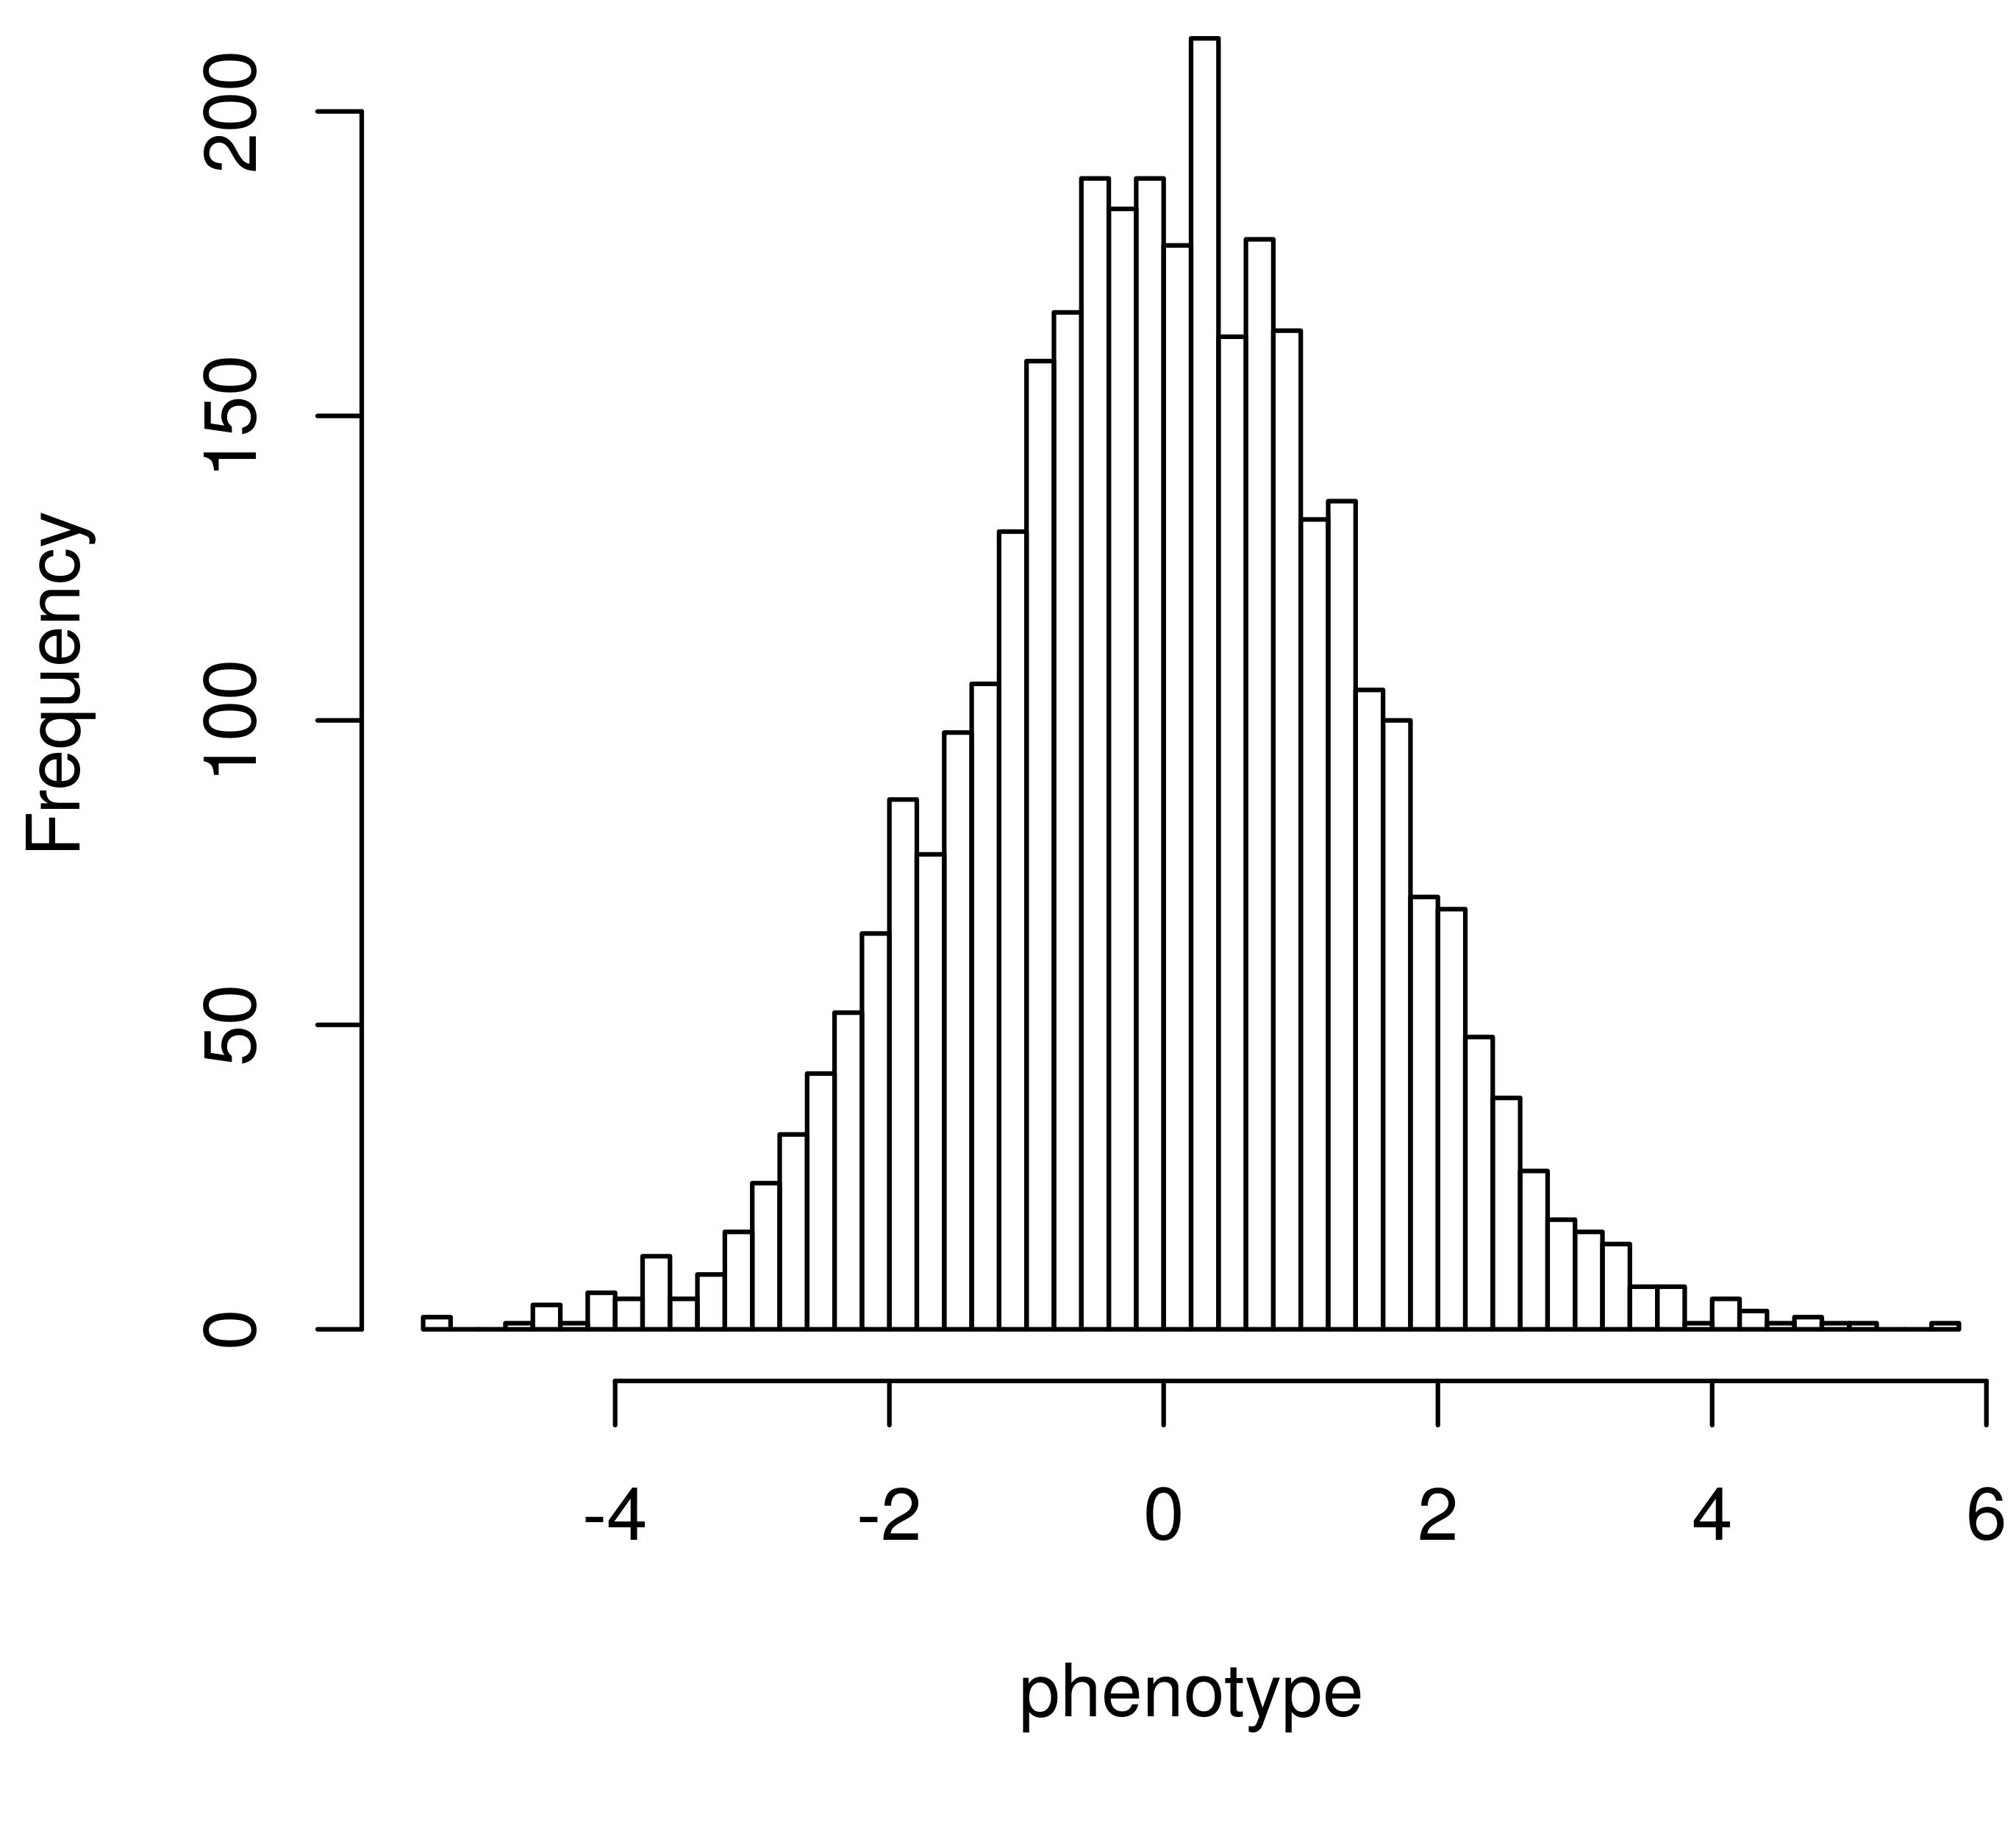
GCTA practical: Real genotypes, simulated phenotypes
Simulated phenotypes with a standard polygenic model
1,000 causal variants
Randomly from whole genome sequence data
Realistic LD & MAF with respect to SNP array data used to create the GRM
3 Different Phenotypes:
Vary the MAF of the Causal variants
Random: drawn from all sequenced variants
Rare: 0.0025 < MAF < 0.01
Common: MAF > 0.05

Slide 5
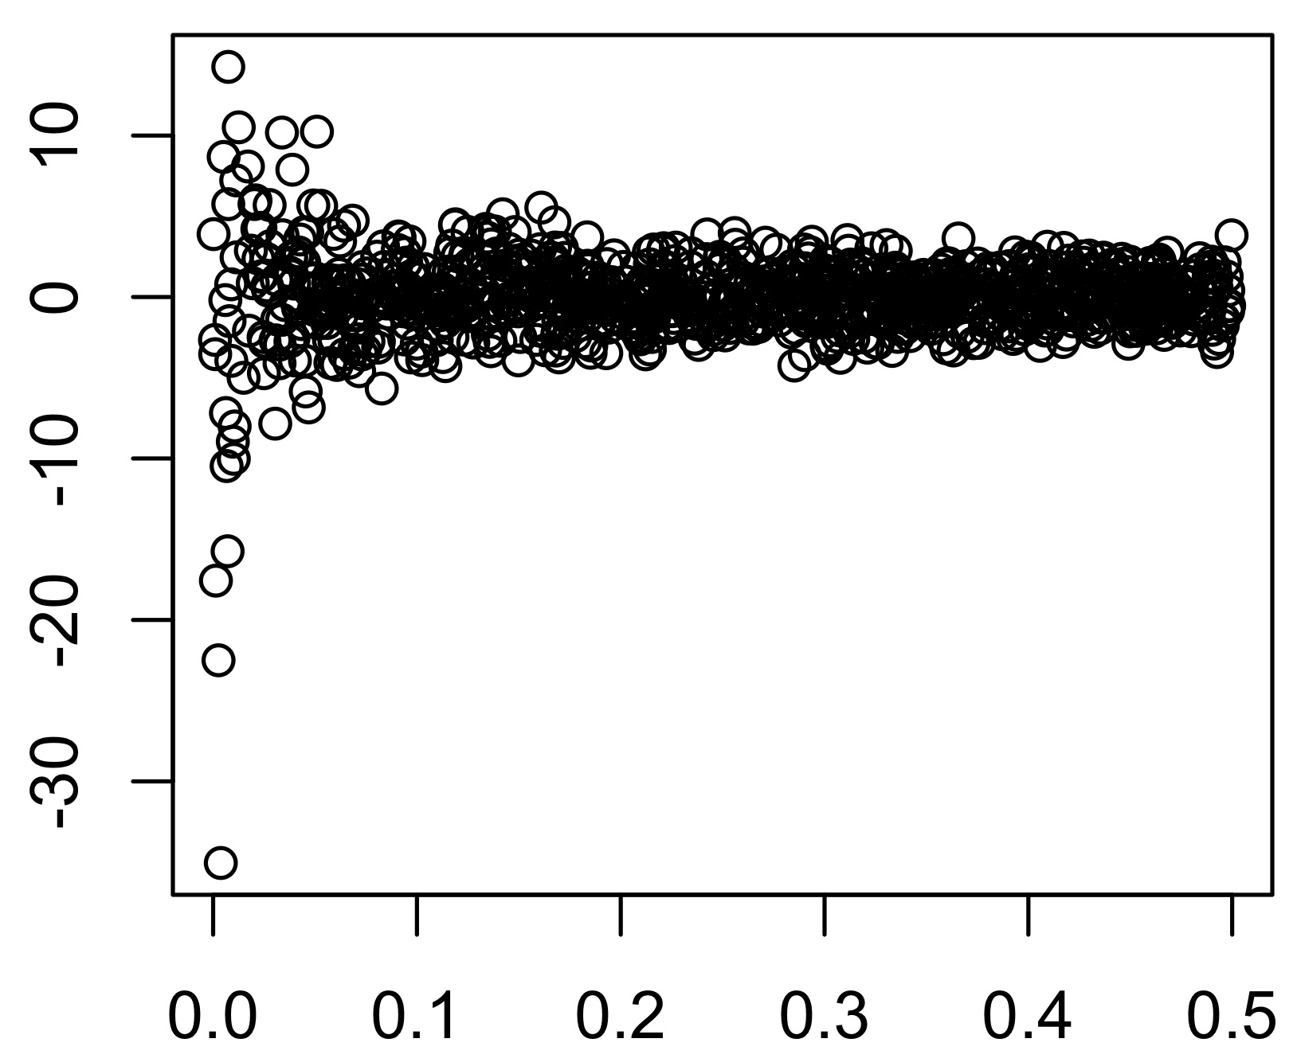
GCTA practical: Real genotypes, simulated phenotypes
Simulated phenotypes with a standard polygenic model
1,000 causal variants
Randomly from whole genome sequence data
Realistic LD & MAF with respect to SNP array data used to create the GRM
3 Different Phenotypes:
Vary the MAF of the Causal variants
Random: drawn from all sequenced variants
Rare: 0.0025 < MAF < 0.01
Common: MAF > 0.05
β_{k}
MAF

Slide 6
MAF of SNP array markers and whole genome sequence

Slide 7
GCTA Practical
Data already loaded on local drives
LOCATION: /faculty/luke/2017/Wednesday_practical_2
GET DATA:
Open terminal
TYPE: cp –r /faculty/luke/2017/Wednesday_practical_2 /YOUR/HOME/DIRECTORY/HERE/
TYPE: cd /YOUR/HOME/DIRECTORY/HERE/Wednesday_practical_2

Slide 8
GCTA Practical
TYPE: ls
GRM:
WGS.rel05.grm.bin (binary file with GRM elements)
WGS.rel05.grm.N.bin (binary file with the number of SNPs used to create the GRM)
WGS.rel05.grm.id (id file with family ID and individual ID listed)
Phenotype:
pheno_randomCVs.txt

Slide 9
GCTA Practical: RUN GCTA
COMMAND:
Randomly chosen CVs:
gcta --grm-bin WGS.rel05 --pheno pheno_randomCVs.txt --reml --out WGSgrm.random --thread-num 4

Slide 10
GCTA Practical: GCTA OUTPUT
Randomly Drawn CVs:
TYPE: cat WGSgrm.random.hsq
Source Variance SE
V(G) 1.040127 0.379450
V(e) 0.976229 0.381714
Vp 2.016356 0.049236
V(G)/Vp 0.515845 0.188371
logL -2873.277
logL0 -2877.338
LRT 8.121
Df 1
Pval 0.002188
n 3363

Slide 11
GCTA Practical: GCTA OUTPUT
Randomly Drawn CVs:
TYPE: cat WGSgrm.random.hsq
Source Variance SE
V(G) 1.040127 0.379450
V(e) 0.976229 0.381714
Vp 2.016356 0.049236
V(G)/Vp 0.515845 0.188371
logL -2873.277
logL0 -2877.338
LRT 8.121
Df 1
Pval 0.002188
n 3363
h²_{SNP}
TRUE h² = 0.5

Slide 12
GCTA Practical: GCTA OUTPUT
Randomly Drawn CVs:
TYPE: cat WGSgrm.random.hsq
Source Variance SE
V(G) 1.040127 0.379450
V(e) 0.976229 0.381714
Vp 2.016356 0.049236
V(G)/Vp 0.515845 0.188371
logL -2873.277
logL0 -2877.338
LRT 8.121
Df 1
Pval 0.002188
n 3363
h²_{SNP}
TRUE h² = 0.5
95% CI: 0.51-1.96*0.188 = 0.146
0.51+1.96*0.188 = 0.885
Unbiased estimate

Slide 13
GCTA Practical: GCTA OUTPUT
Randomly Drawn CVs:
TYPE: cat WGSgrm.random.hsq
Source Variance SE
V(G) 1.040127 0.379450
V(e) 0.976229 0.381714
Vp 2.016356 0.049236
V(G)/Vp 0.515845 0.188371
logL -2873.277
logL0 -2877.338
LRT 8.121
Df 1
Pval 0.002188
n 3363
Likelihood Ratio Test
Testing if V(G) > 0
2*(-2873.277--2877.338) = 8.1
X² test, 1 df

Slide 14
GCTA Practical: RUN GCTA
COMMANDS:
Rare CVs:
gcta --grm-bin /path/to/data/WGS.rel05 --pheno path/to/data/pheno_rareCVs.txt --reml --out WGSgrm.rare --thread-num 4
Common CVs:
gcta --grm-bin /path/to/data/WGS.rel05 --pheno path/to/data/pheno_commonCVs.txt --reml --out WGSgrm.common --thread-num 4

Slide 15
GCTA Practical: GCTA OUTPUT
Randomly Drawn CVs:
Rare CVs (0.0025 < MAF < 0.01):
TYPE: cat WGSgrm.random.hsq
Source Variance SE
V(G) 1.040127 0.379450
V(e) 0.976229 0.381714
Vp 2.016356 0.049236
V(G)/Vp 0.515845 0.188371
logL -2873.277
logL0 -2877.338
LRT 8.121
Df 1
Pval 0.002188
n 3363
TYPE: cat WGSgrm.rare.hsq
Source Variance SE
V(G) 0.423509 0.358354
V(e) 1.535181 0.364253
Vp 1.958689 0.047950
V(G)/Vp 0.216220 0.183335
logL -2820.059
logL0 -2820.765
LRT 1.412
Df 1
Pval 0.1173
n 3363
h²_{SNP}
TRUE h² = 0.5
Downward bias
(small N = large SE)

Slide 16
GCTA Practical: GCTA OUTPUT
Randomly Drawn CVs:
Rare CVs (MAF> 0.05):
TYPE: cat WGSgrm.random.hsq
Source Variance SE
V(G) 1.040127 0.379450
V(e) 0.976229 0.381714
Vp 2.016356 0.049236
V(G)/Vp 0.515845 0.188371
logL -2873.277
logL0 -2877.338
LRT 8.121
Df 1
Pval 0.002188
n 3363
TYPE: cat WGSgrm.common.hsq
Source Variance SE
V(G) 1.670281 0.382601
V(e) 0.322239 0.380868
Vp 1.992520 0.048599
V(G)/Vp 0.838276 0.191079
logL -2855.224
logL0 -2865.809
LRT 21.171
Df 1
Pval 2.101e-06
n 3363
h²_{SNP}
TRUE h² = 0.5
Upward bias
(small N = large SE)

Slide 17
GCTA Practical – MAF-stratified
MAF-stratified GREML – partition variance among MAF bins
Multiple GRMs included in the model, same otherwise
Data:
Change to MGRM directory.
TYPE: cd MGRM

Slide 18
GCTA Practical – MAF-stratified
GRMs:
WGS.rel05.common.* (all variants with MAF > 0.05)
WGS.rel05.uncommon.* (0.0025 < MAF < 0.05)
WGS.rel05.rare.* (MAF<0.0025)
Phenotype:
pheno_randomCVs.txt (CVs randomly drawn from all sequence variants)
MGRM list
List of GRM paths and prefixes
TYPE: cat mgrm.list.txt

Slide 19
GCTA Practical: RUN GCTA with multiple GRMs
COMMAND:
Randomly Drawn CVs:
gcta --mgrm mgrm.list.txt --pheno pheno_randomCVs.txt --reml --reml-no-lrt --out mgrm.randomCV --thread-num 4

Slide 20
GCTA Practical: GCTA OUTPUT MGRM MODEL
TYPE: cat mgrm.randomCV.hsq
Source Variance SE
V(G1) 0.303900 0.184182
V(G2) 0.127654 0.309142
V(G3) 0.653199 0.328909
V(e) 0.926493 0.435653
Vp 2.011246 0.049641
V(G1)/Vp 0.151100 0.091277
V(G2)/Vp 0.063470 0.153765
V(G3)/Vp 0.324773 0.164408
Sum of V(G)/Vp 0.539344 0.215105
logL -2872.894
N 3363

Slide 21
GCTA Practical: RUN GCTA with multiple GRMs
Try running with different phenotypes
Common CVs
Rare CVs

