Slide 1
GCTA Practical 1

Slide 2
Goal: To use GCTA to estimate h²_{SNP} from SNP array data for a single polygenic phenotype

Slide 3
Simulation: Useful to test assumptions, performance, understanding of reality. Allows flexibility in altering conditions
Two general approaches:
Simulate phenotype from real genotype data
Real patterns of LD, polymorphism, stratification, allele frequency
Often used to assess how methods perform
Simulate both genotype and phenotype data
More control over the demography, allele frequency
Programs to do this in either forward-time (e.g., GeneEvolve [Tahmasbi & Keller 2016]) or coalescent (e.g., Hudson’s ms to generate genotypes)

Slide 4
GCTA practical: Real genotypes, simulated phenotypes
Genotype Data to Make the Genetic Relatedness Matrix (GRM)
Similar to what might be collected for a GWAS study with SNP array data
1,000 Genomes + UK10K sequence data
Using Affymetrix Axiom Array positions

Slide 5
GCTA practical: Real genotypes, simulated phenotypes
GRM: Axiom Array Positions
MAF > 0.05
HWE p < 10⁻⁵
N = 3,363
Relatedness < 0.05
GRM ALREADY CONSTRUCTED (plink or gcta)
GRM ELEMENTS:
$A_{ij}=\frac{1}{m}\sum_{k}^{m}{\frac{(x_{ik}−2p_{k})(x_{jk}−2p_{k})}{2p_{k}(1−p_{k})}}$
$$var\left(y\right)=A{σ }_{v}^{2}+ I{σ }_{e}^{2}$$
h²_{SNP} = σ²_{v} / (σ²_{v} + σ²_{e})

Slide 6
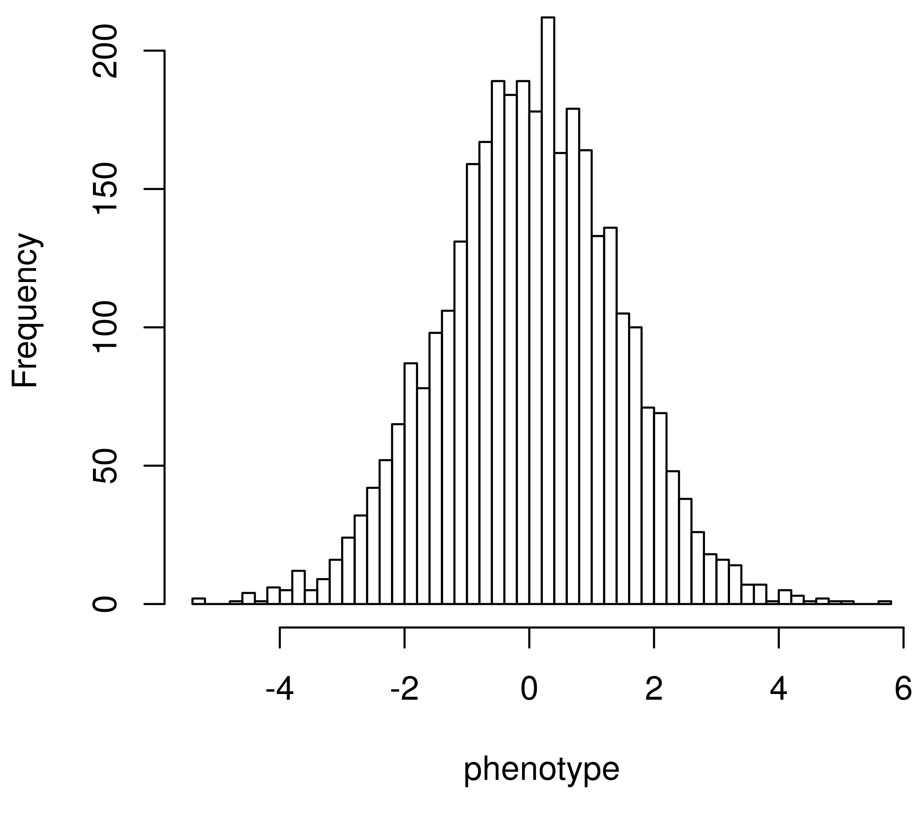
GCTA practical: Real genotypes, simulated phenotypes
Simulated phenotypes with a standard polygenic model
1,000 causal variants
Randomly from whole genome sequence data
Realistic LD & MAF with respect to SNP array data used to create the GRM
Phenotypes
y_{i} = g_{i} + e_{i}
g_{i}

Slide 7
Real genotypes, simulated phenotypes
Simulated phenotypes with a standard polygenic model
y_{i} = g_{i} + e_{i}
g_{i} = ∑w _{ik}β_{k}
w_{ik} = 0/1/2 genotype
β_{k} = allelic effect size
~N(0,1/[2p_{k}(1-p_{k})])
p_{k} = MAF
g_{i}’s normalized
w_{i} = [0, 1, 2, 1]
β = [2.2, -1.16, 4.1, -0.01]
g_{i} = (2.2*0) + (-1.16*1) + (4.1*2) + (-0.01*1)

Slide 8
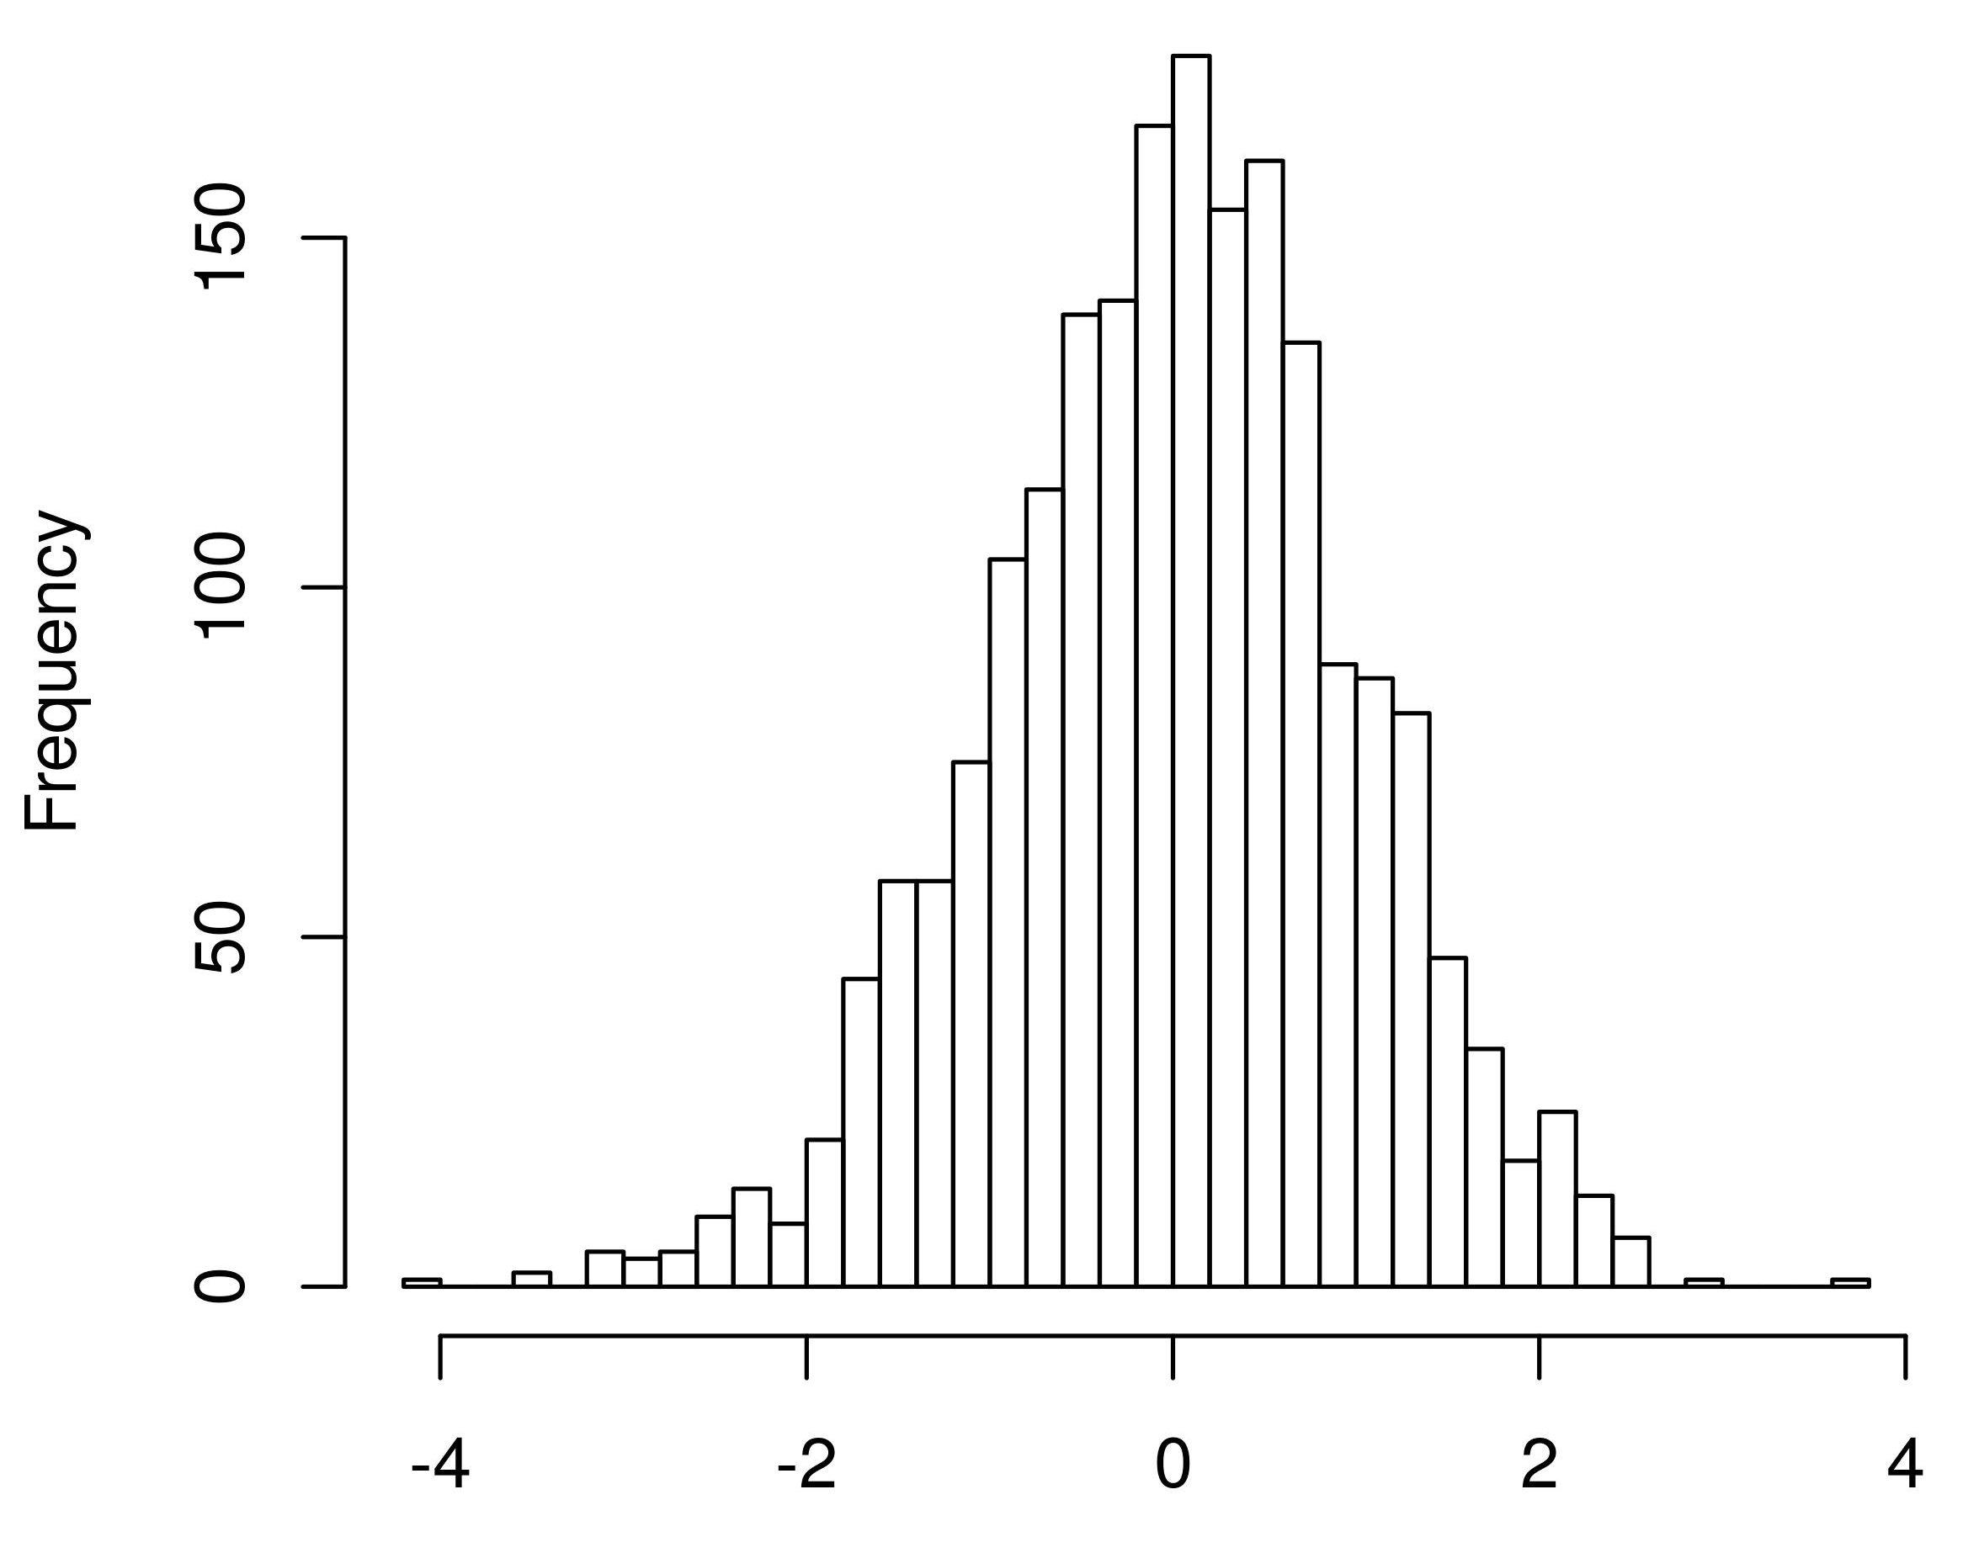
Real genotypes, simulated phenotypes
Simulated phenotypes with a standard polygenic model
y_{i} = g_{i} + e_{i}
g_{i} = ∑w _{ik}β_{k}
w_{ik} = 0/1/2 genotype
β_{k} = allelic effect size
~N(0,1/[2p_{k}(1-p_{k})])
p_{k} = MAF
g_{i}’s normalized
Genotypic Value

Slide 9
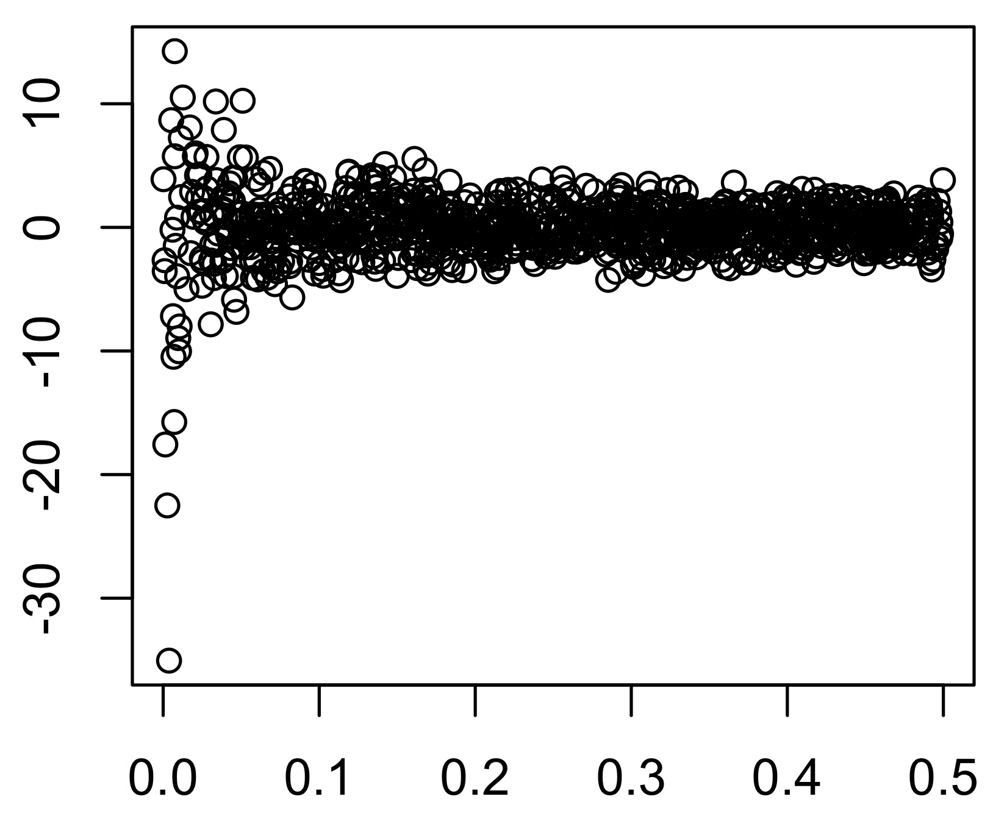
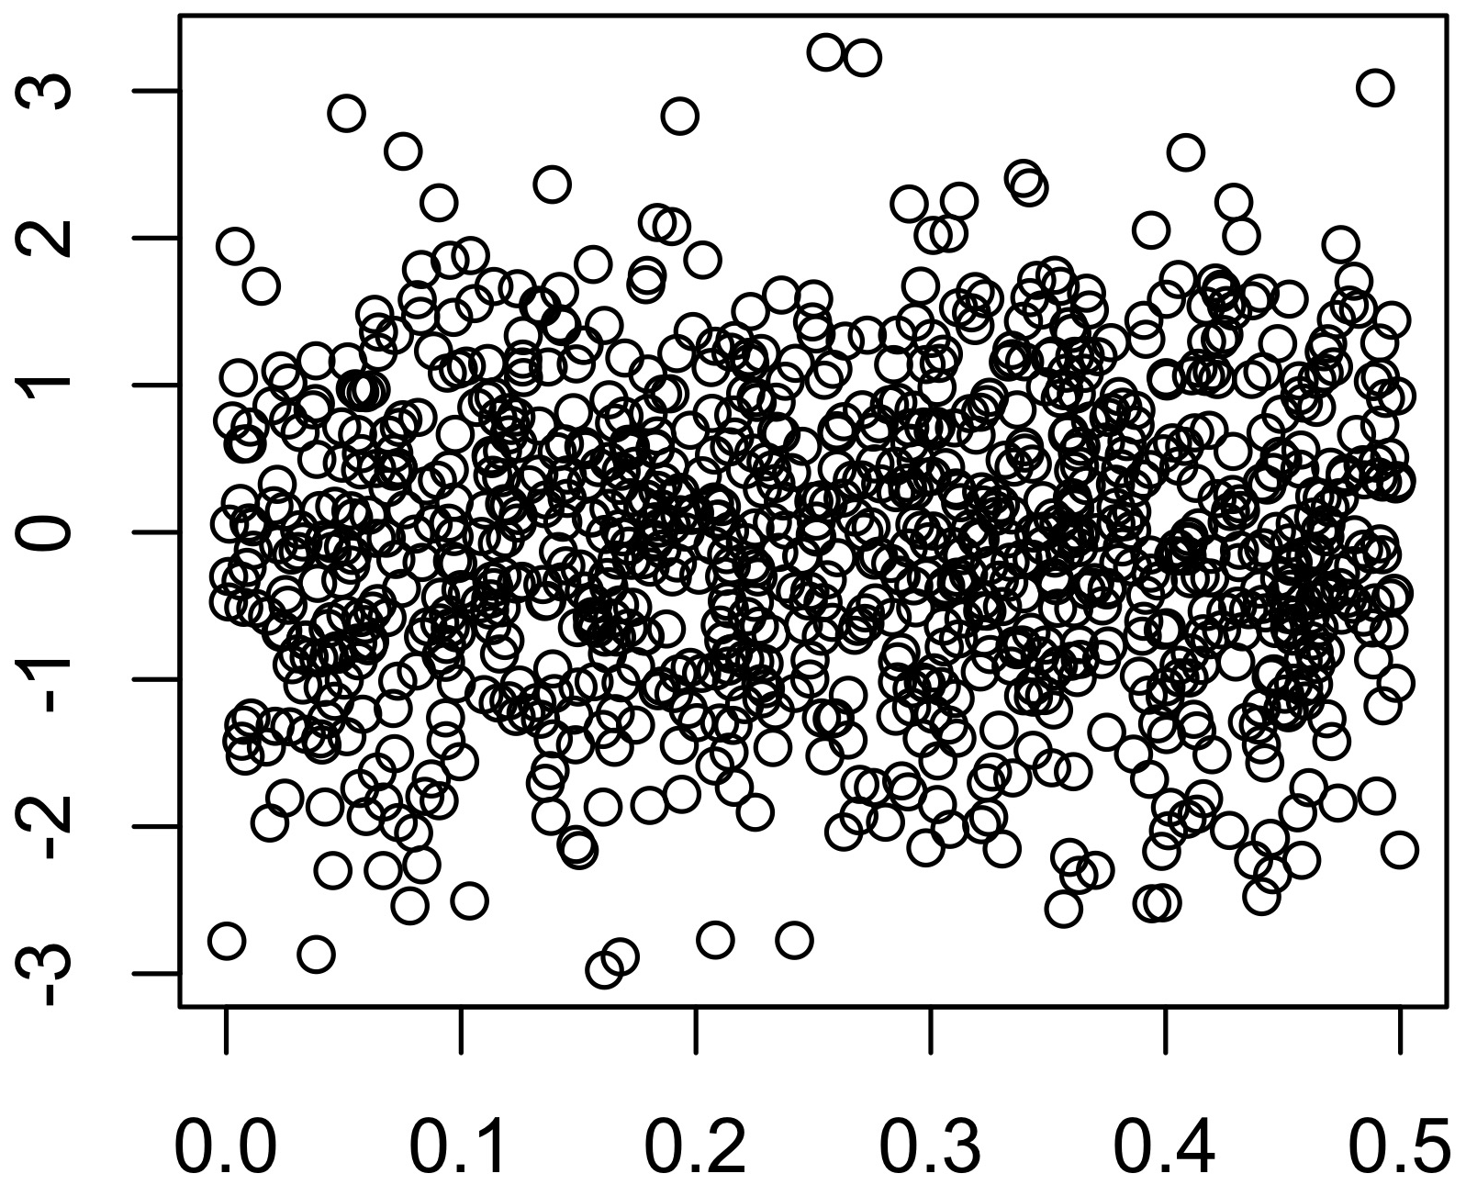
Real genotypes, simulated phenotypes
Simulated phenotypes with a standard polygenic model
y_{i} = g_{i} + e_{i}
g_{i} = ∑w _{ik}β_{k}
β_{k} ~N(0,1/[2p_{k}(1-p_{k})])
β_{k} ~N(0,1)
β_{k}
uniform
GCTA model
Assumptions?
Model (GRM)?
Causal variants?
MAF
MAF

Slide 10
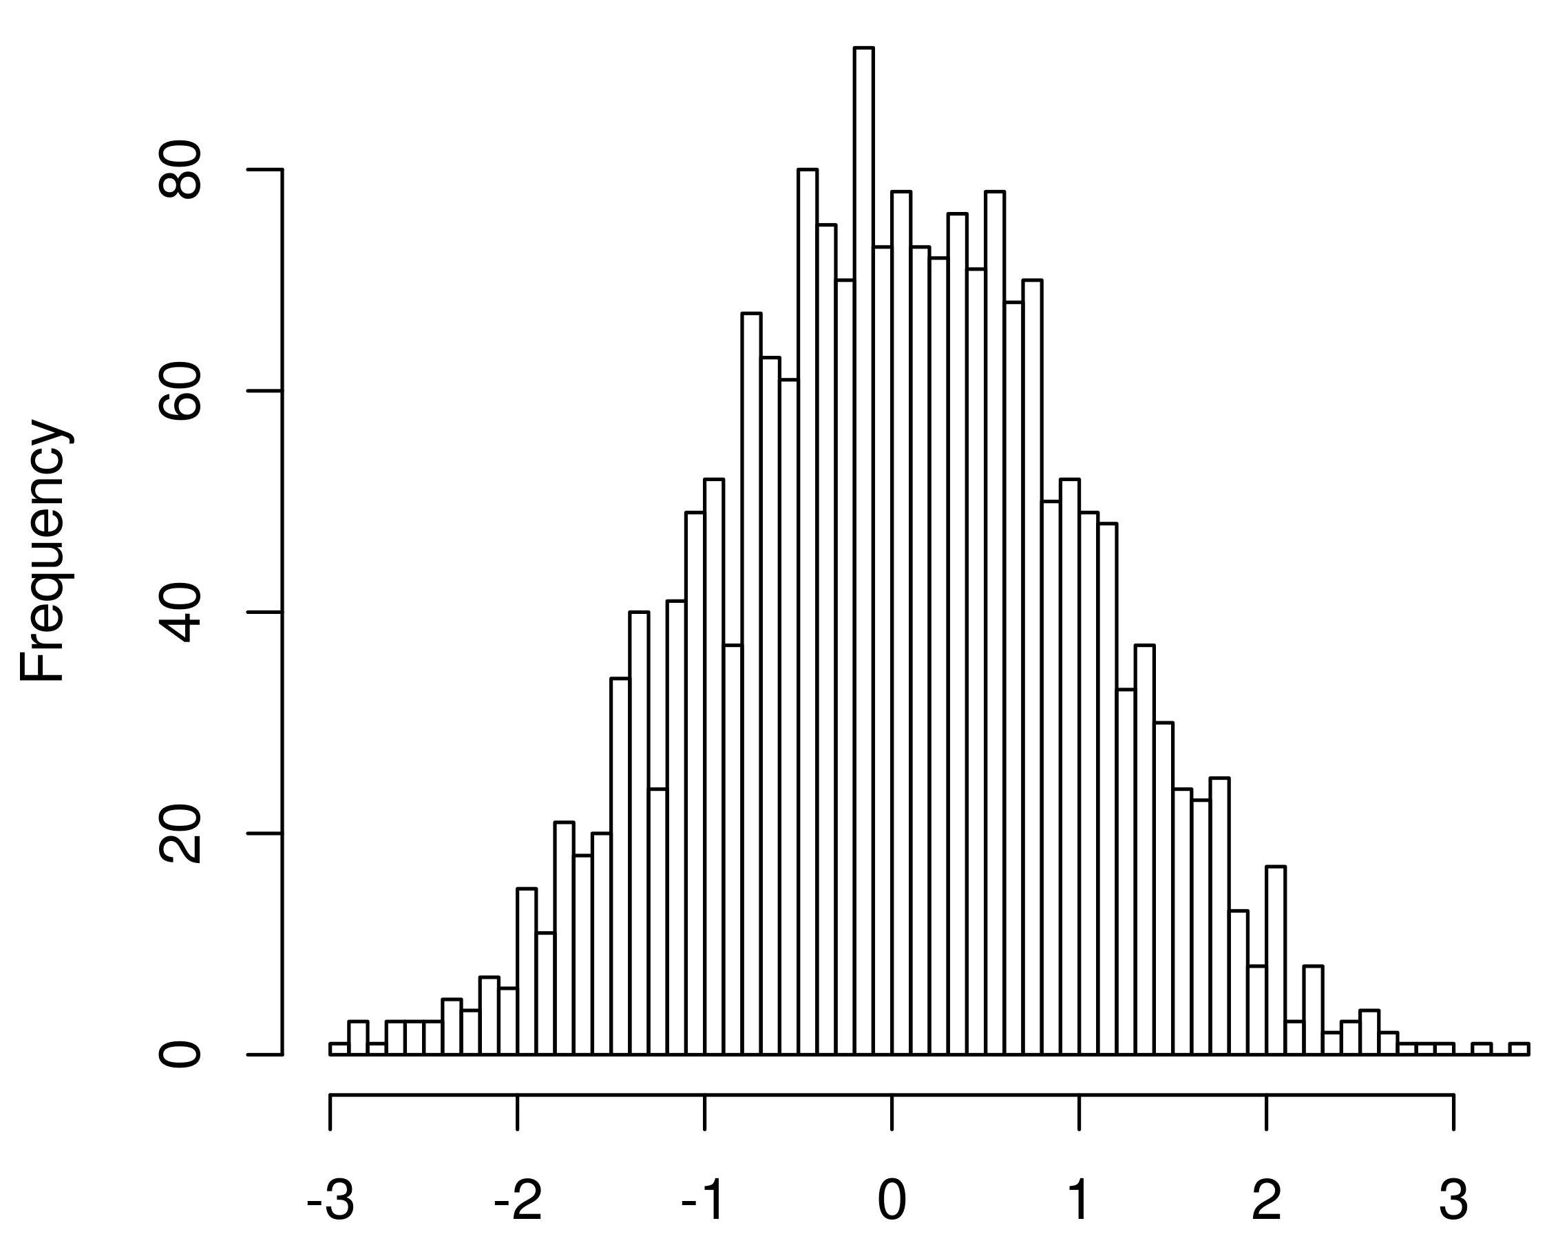
GCTA practical: Real genotypes, simulated phenotypes
y_{i} = g_{i} + e_{i}
Add error ~N(0, (1- h²)/h²)
Simulated h² = 0.5
Genotypic values
Error
_{Phenotype}

Slide 11
GCTA Practical
Data already loaded on local drives
LOCATION: /faculty/luke/2017/Wednesday_practical_1
GET DATA:
Open terminal
TYPE: cp –r /faculty/luke/2017/Wednesday_practical_1 /YOUR/HOME/DIRECTORY/HERE/
TYPE: cd /YOUR/HOME/DIRECTORY/HERE/Wednesday_practical_1

Slide 12
GCTA Practical
TYPE: ls
GRM:
SNPs.rel05.grm.bin (binary file with GRM elements)
SNPs.rel05.grm.N.bin (binary file with the number of SNPs used to create the GRM)
SNPs.rel05.grm.id (id file with family ID and individual ID listed)
Phenotype:
pheno_randomCVs.txt

Slide 13
GCTA Practical
TYPE: head SNPs.rel05.grm.id
head /path/to/data/SNPs.rel05.grm.small.txt
Example of the information in the GRM

Slide 14
GCTA Practical
TYPE: head SNPs.rel05.grm.small.txt
Example of the information in the GRM
$$A_{ij}=\frac{1}{m}\sum_{k}^{m}{\frac{(x_{ik}−2p_{k})(x_{jk}−2p_{k})}{2p_{k}(1−p_{k})}}$$

Slide 15
GCTA Practical
TYPE: head pheno_randomCVs.txt

Slide 16
GCTA Practical: RUN GCTA
GCTA COMMAND LINE:
Very similar to plink, uses -- flags
You must give it:
GRM prefix
Phenotype file
Analysis to perform

Slide 17
GCTA Practical: RUN GCTA
COMMAND:
gcta --grm-bin SNPs.rel05 --pheno pheno_commonCVs.txt --reml --out SNPgrm --thread-num 4

Slide 18
GCTA Practical: RUN GCTA
COMMAND:
gcta --grm-bin SNPs.rel05 --pheno pheno_commonCVs.txt --reml --out SNPgrm --thread-num 4
OUTPUT:
TYPE: cat SNPgrm.hsq
Source Variance SE
V(G 0.024886 0.220215
V(e) 0.991848 0.214227
Vp 2.016735 0.049553
V(G)/Vp 0.508191 0.106992
logL -2851.499
logL0 -2865.440
LRT 27.881
df 1
Pval 6.449e-08
n 3362

Slide 19
GCTA Practical: RUN GCTA
COMMAND:
gcta --grm-bin SNPs.rel05 --pheno pheno_commonCVs.txt --reml --out SNPgrm --thread-num 4
OUTPUT:
TYPE: cat SNPgrm.hsq
Source Variance SE
V(G 0.024886 0.220215
V(e) 0.991848 0.214227
Vp 2.016735 0.049553
V(G)/Vp 0.508191 0.106992
logL -2851.499
logL0 -2865.440
LRT 27.881
df 1
Pval 6.449e-08
n 3362
h²_{SNP}
TRUE h² = 0.5

Slide 20
GCTA Practical: RUN GCTA
COMMAND:
gcta --grm-bin SNPs.rel05 --pheno pheno_commonCVs.txt --reml --out SNPgrm --thread-num 4
OUTPUT:
TYPE: cat SNPgrm.hsq
Source Variance SE
V(G 0.024886 0.220215
V(e) 0.991848 0.214227
Vp 2.016735 0.049553
V(G)/Vp 0.508191 0.106992
logL -2851.499
logL0 -2865.440
LRT 27.881
df 1
Pval 6.449e-08
n 3362
h²_{SNP}
TRUE h² = 0.5
95% CI: 0.508-1.96*0.107 = 0.3
0.508-1.96*0.107 = 0.72
Unbiased

Slide 21
GCTA Practical: RUN GCTA
COMMAND:
gcta --grm-bin SNPs.rel05 --pheno pheno_commonCVs.txt --reml --out SNPgrm --thread-num 4
OUTPUT:
TYPE: cat SNPgrm.hsq
Source Variance SE
V(G 0.024886 0.220215
V(e) 0.991848 0.214227
Vp 2.016735 0.049553
V(G)/Vp 0.508191 0.106992
logL -2851.499
logL0 -2865.440
LRT 27.881
df 1
Pval 6.449e-08
n 3362
Likelihood Ratio Test
Testing if V(G) > 0
2*(-2851.499--2865.44) = 27.88
X² test, 1 df

Slide 22
GCTA Practical: RUN GCTA
COMMAND:
gcta --grm-bin SNPs.rel05 --pheno pheno_commonCVs.txt --reml --out SNPgrm --thread-num 4
OUTPUT:
TYPE: cat SNPgrm.hsq
Source Variance SE
V(G 0.024886 0.220215
V(e) 0.991848 0.214227
Vp 2.016735 0.049553
V(G)/Vp 0.508191 0.106992
logL -2851.499
logL0 -2865.440
LRT 27.881
df 1
Pval 6.449e-08
n 3362
WHAT FACTORS INFLUENCE THE ESTIMATE?

