Slide 1
Marker heritability
Biases, confounding factors, current methods, and best practices
Luke Evans, Matthew Keller

Slide 2
Background – What Matt Keller presented
GREML-SC: single genetic relatedness matrix (GRM) to estimate heritability (h²_{SNP})
Relate allele sharing at genome-wide SNPs to phenotypic similarity
Genetic Relatedness Matrix (GRM) is a proxy for allele sharing at causal variants (CVs)

Slide 3
Background – GCTA-style approach
Unrelated individuals (e.g., A_{ij} < 0.05)
Common markers from SNP arrays
(e.g., MAF > 0.05, m = 500,000 – 2.5M SNPs)
Low-moderate stratification in samples
E.g., UK Biobank, GoT2D, AMD
Homogeneous populations, e.g., North Finland Birth Cohort, Sardinia

Slide 4
Background – GCTA-style approach
GRM:
$A_{ij}=\frac{1}{m}\sum_{k}^{m}{\frac{(x_{ik}−2p_{k})(x_{jk}−2p_{k})}{2p_{k}(1−p_{k})}}$
Phenotype:
y_{i} = g_{i} + e_{i}
$var\left(y\right)=A{σ }_{v}^{2}+ I{σ }_{e}^{2}$
h²_{SNP} = σ²_{v} / (σ²_{v} + σ²_{e})

Slide 5
Examine biases using real genotypes and simulated phenotypes
Genotypes: Haplotype Reference Consortium whole genome sequences
Relatively homogeneous subset
Build GRM from
Axiom array positions only
Whole genome sequence variants
Vary the MAF of markers for GRM
GRM ELEMENTS:
$A_{ij}=\frac{1}{m}\sum_{k}^{m}{\frac{(x_{ik}−2p_{k})(x_{jk}−2p_{k})}{2p_{k}(1−p_{k})}}$

Slide 6
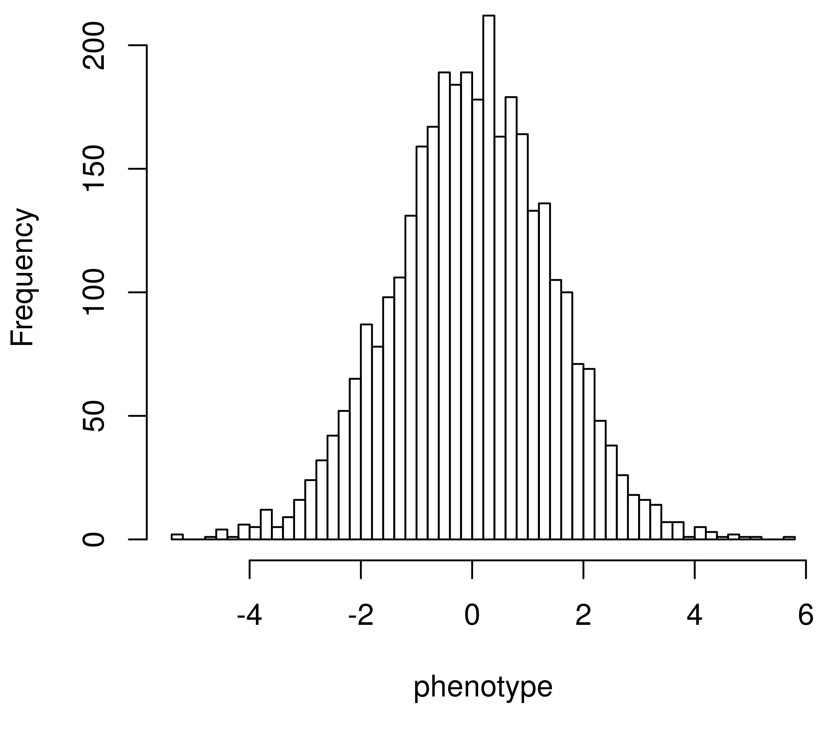
Examine biases using real genotypes and simulated phenotypes
Phenotypes: Simulated from whole genome sequence
1,000 CVs drawn randomly from sequence data
Vary the MAF of CVs
y_{i} = g_{i} + e_{i}
g_{i} = ∑w _{ik}β_{k}

Slide 7
CVs from whole genome sequence include many rare variants

Slide 8
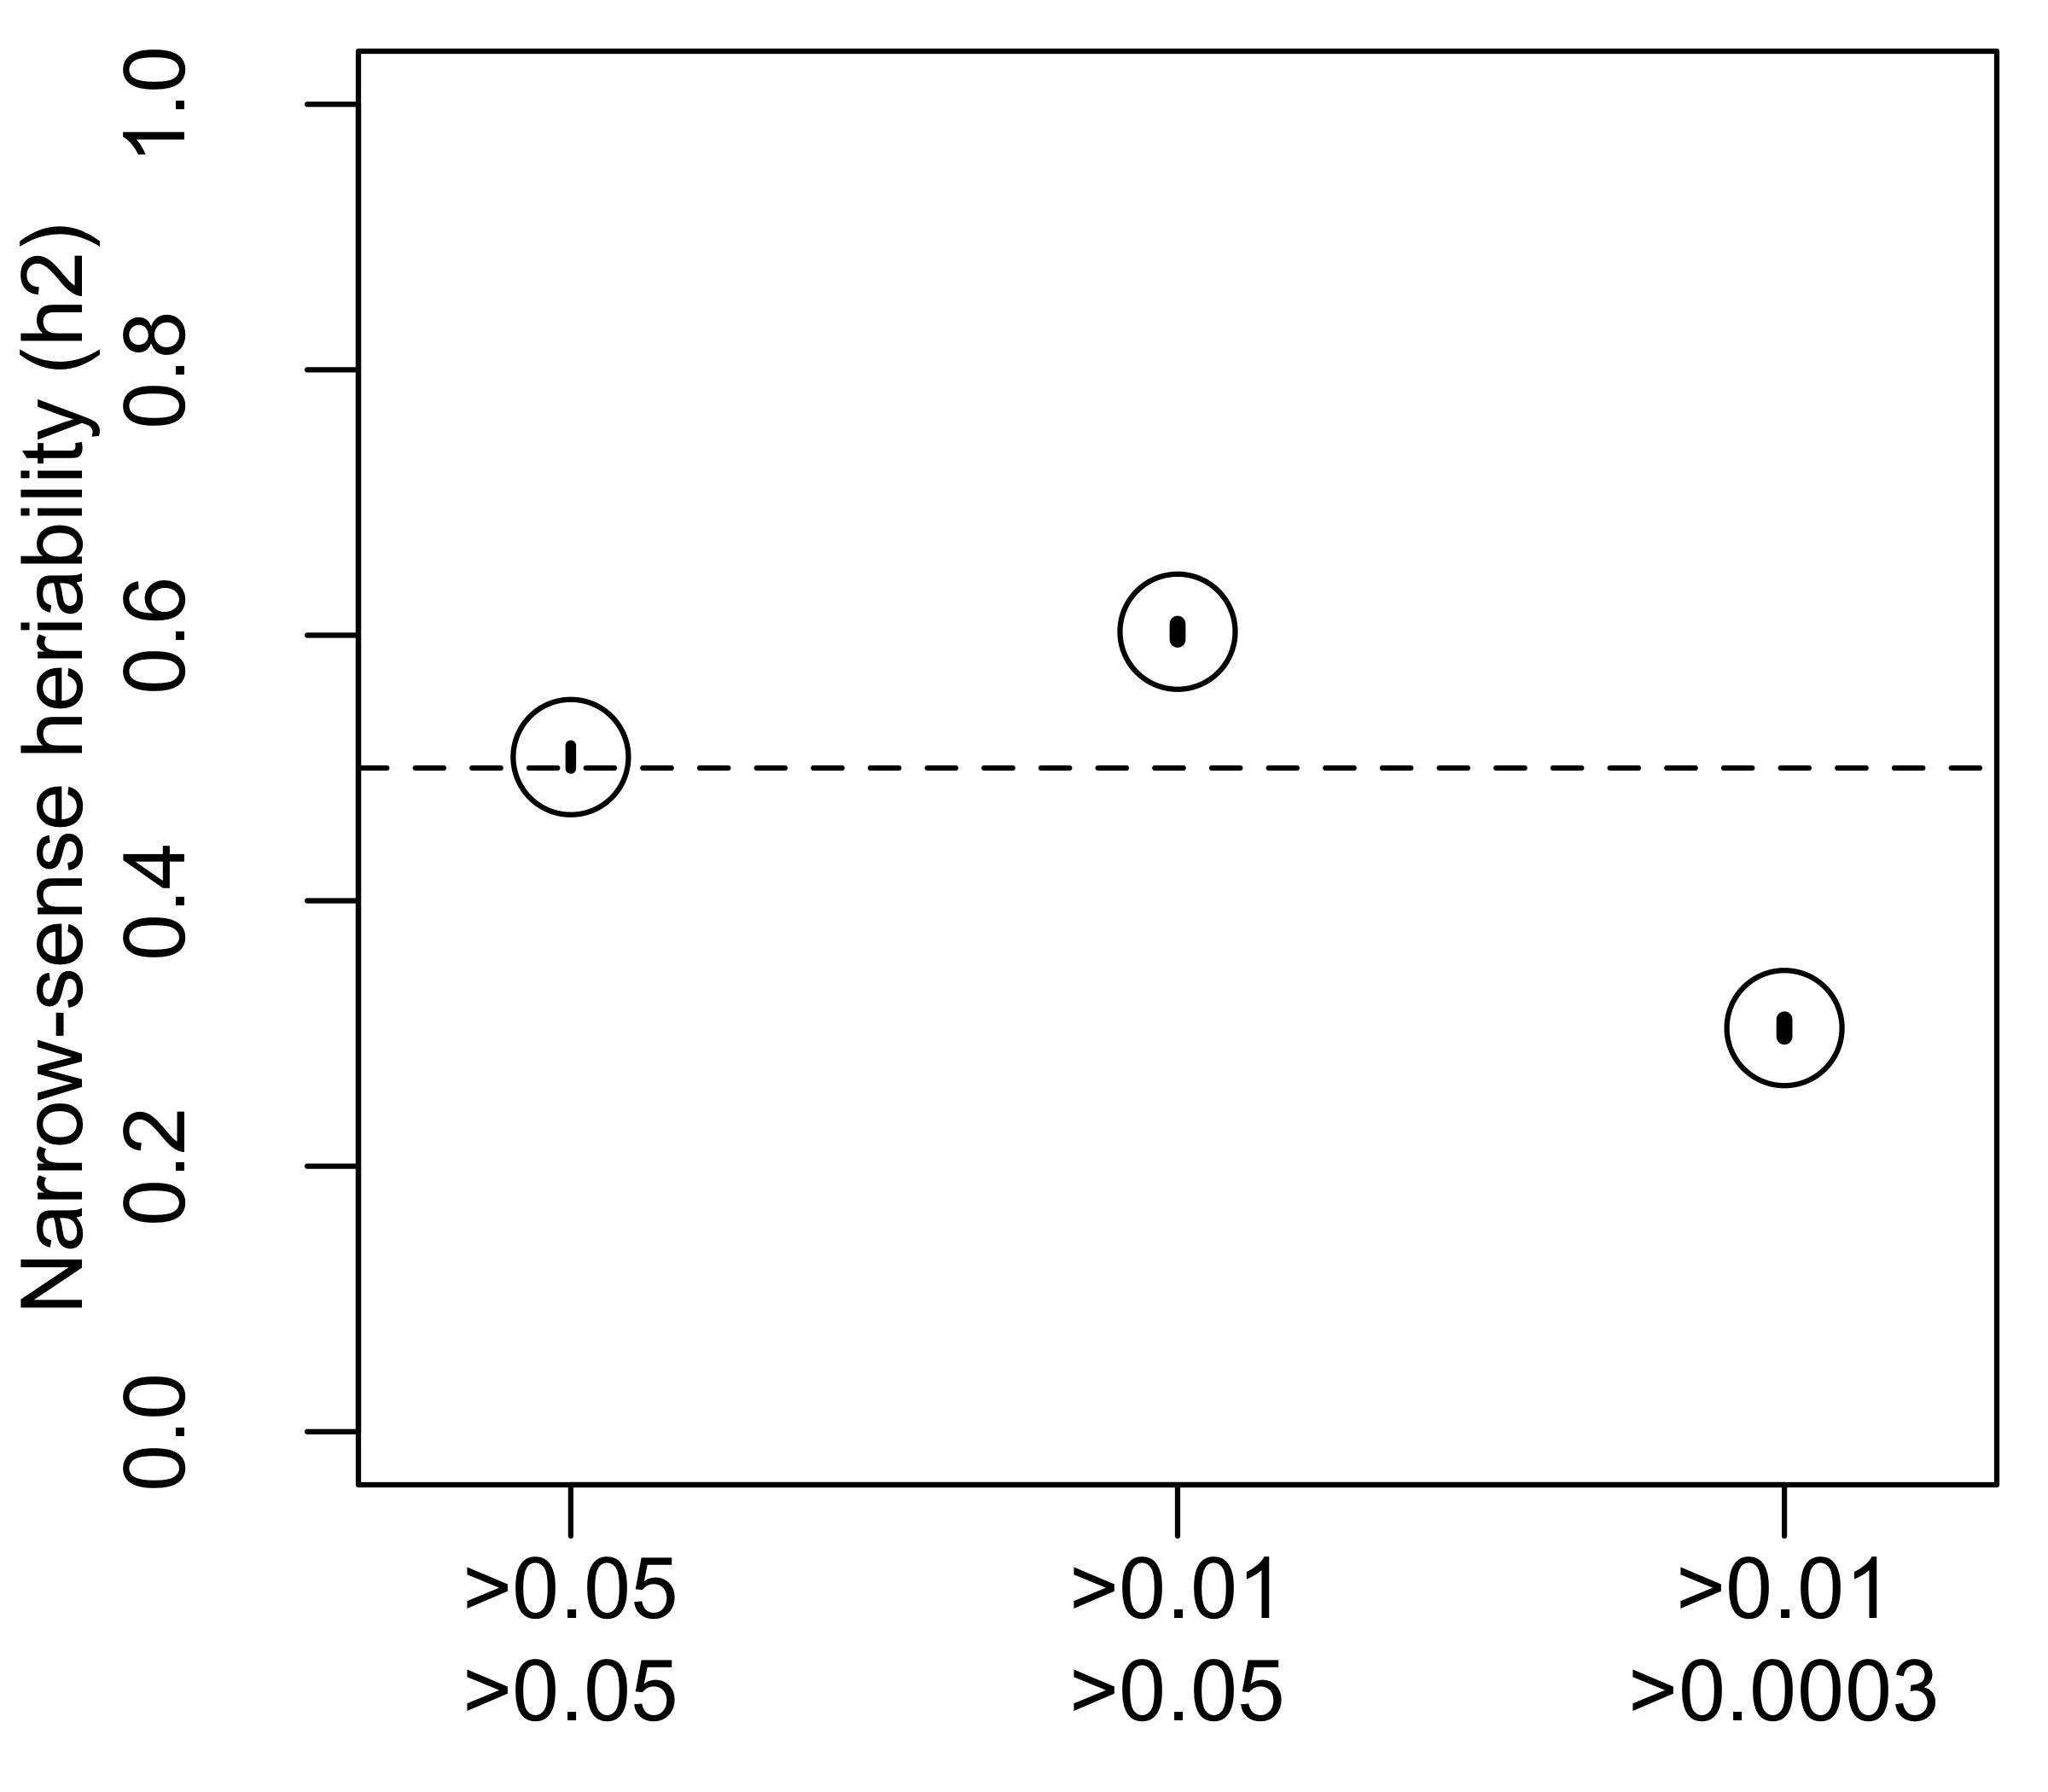
Simulated phenotypes, GRM from common Axiom array
Mean +/- 95% CI
100 replicates
common very common rarer
Causal Variant Minor Allele Frequency

Slide 9
Simulated phenotypes, GRM from common Axiom array
Unbiased estimate of heritability h²_{SNP} ~ h²
Mean +/- 95% CI
100 replicates
common very common rarer
Causal Variant Minor Allele Frequency

Slide 10
Simulated phenotypes, GRM from common Axiom array
Overestimated heritability
h²_{SNP} >> h²
Mean +/- 95% CI
100 replicates
common very common rarer
Causal Variant Minor Allele Frequency

Slide 11
Simulated phenotypes, GRM from common Axiom array
Underestimated heritability
h²_{SNP} << h²
Mean +/- 95% CI
100 replicates
common common common
common more common rarer
common very common rarer
Causal Variant Minor Allele Frequency

Slide 12
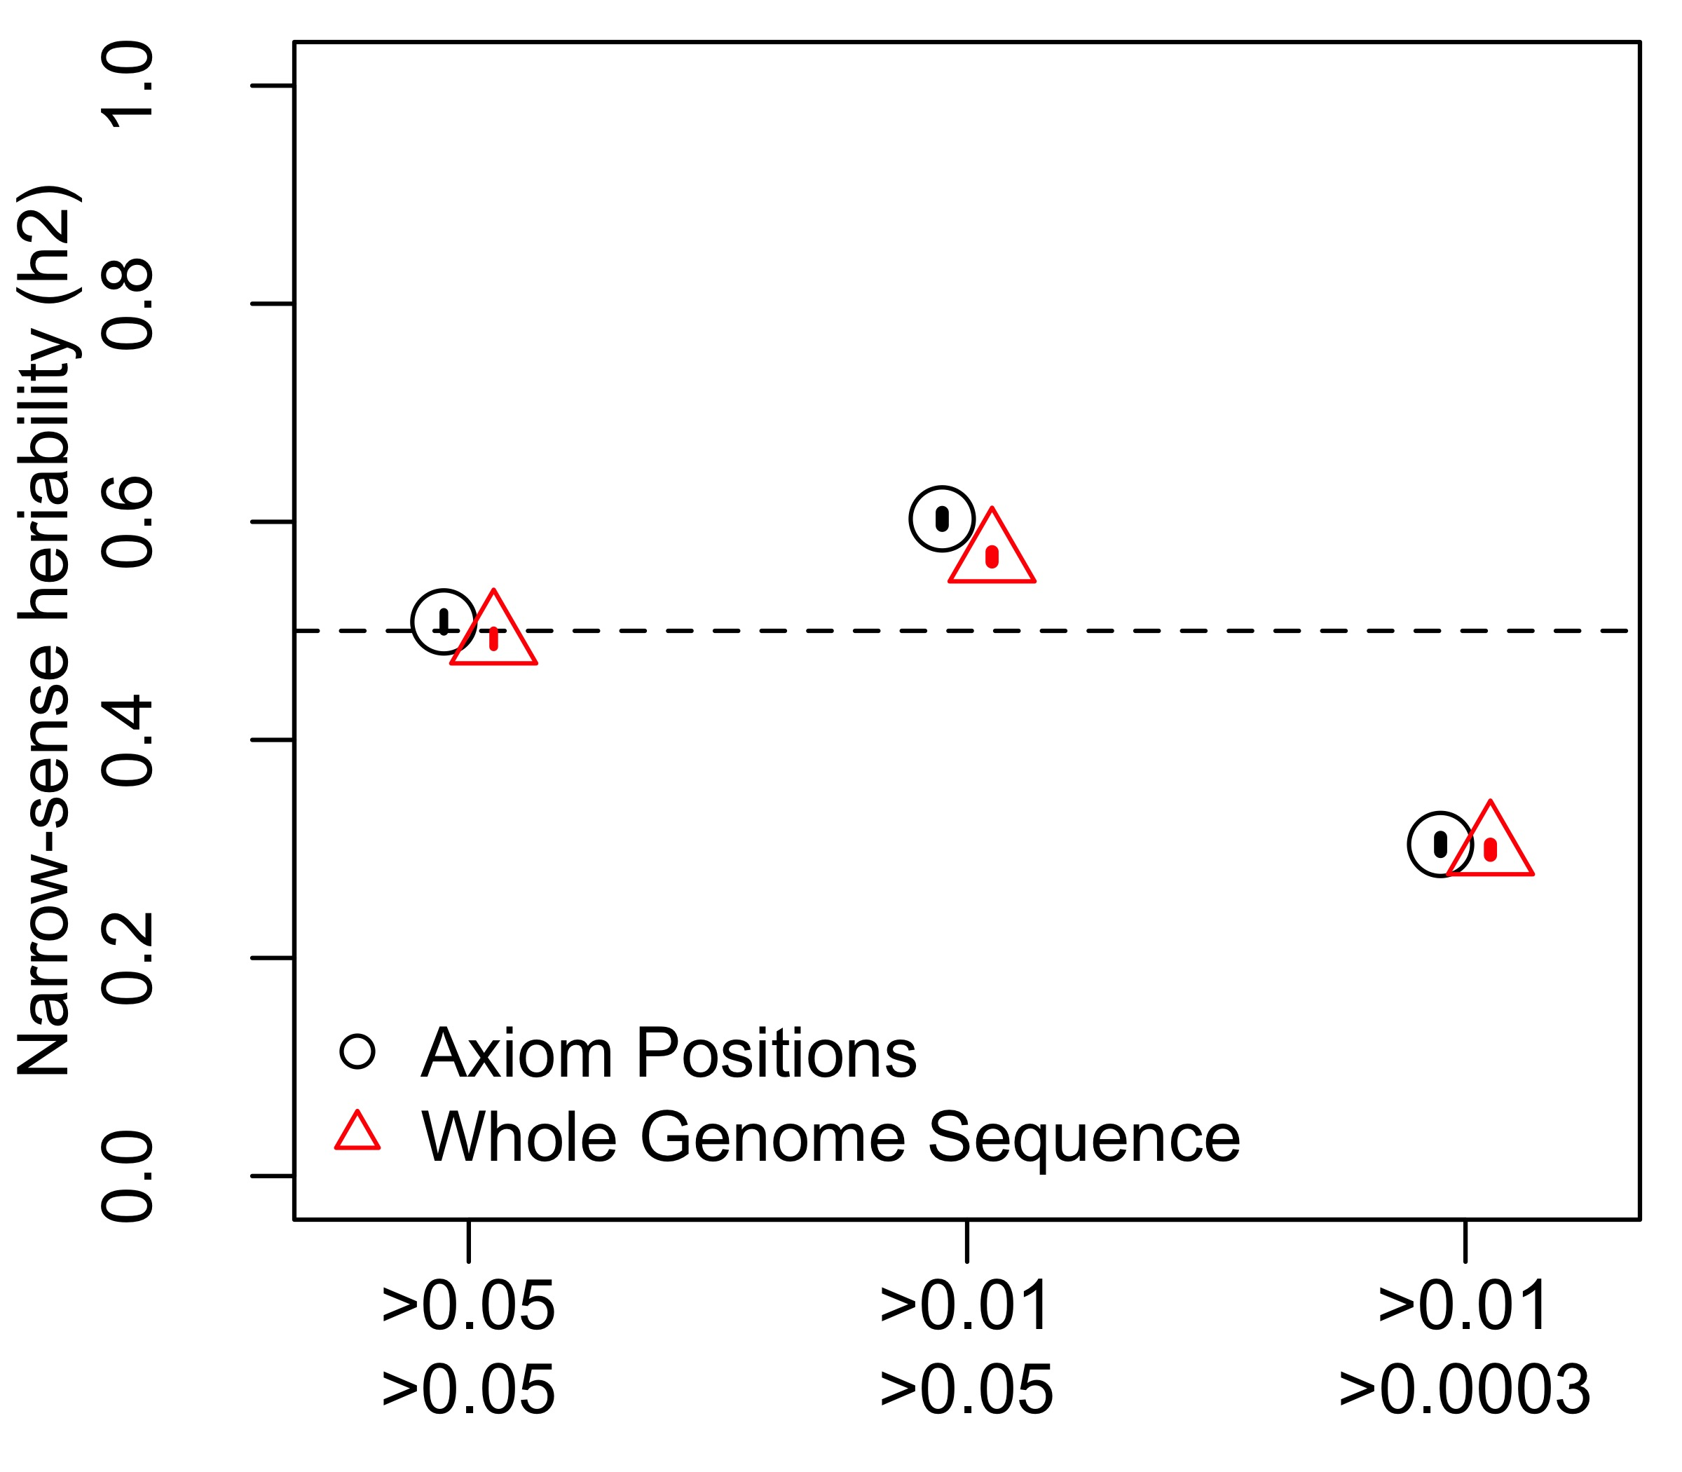
Simulated phenotypes GRM from common Whole Genome Sequence variants
Simply adding more common markers (e.g., WGS or imputed) won’t fix biases
GRM MARKERS:
Mean +/- 95% CI
100 replicates
common very common rarer
Causal Variant Minor Allele Frequency

Slide 13
CVs from whole genome sequence include many rare variants

Slide 14
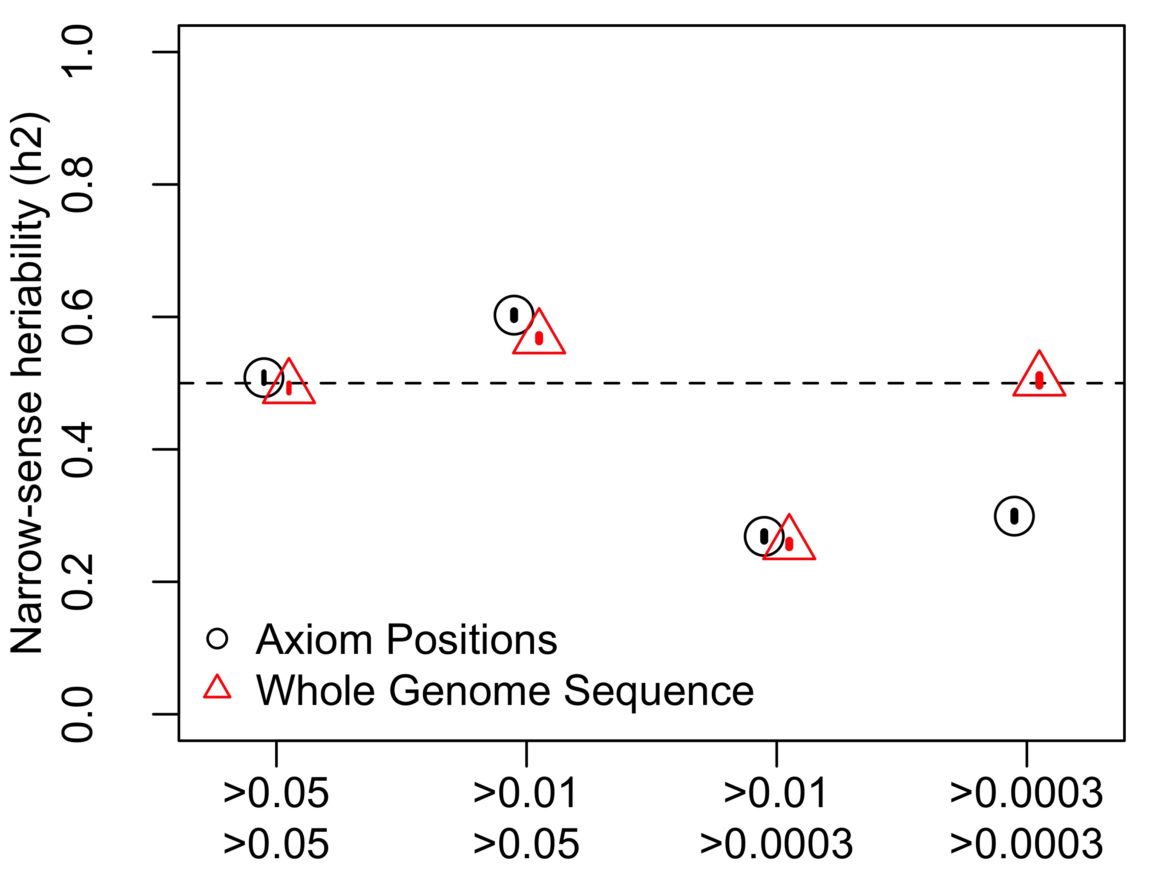
Simulated phenotypes, Axiom array or Whole Genome GRM
GRM includes all variants
CVs drawn from all variants
WGS MAF ≃ CV MAF UNBIASED
GRM MARKERS:
Mean +/- 95% CI
100 replicates
common very common rarer all variants
Causal Variant Minor Allele Frequency

Slide 15
Why is there a relationship between GREML-SC heritability estimates and MAF?
Unbiased estimates when marker MAF is the same as the CV MAF
Underestimated when CVs are rarer than the markers used
Overestimated when CVs are more common than the markers
MAF is related to LD, and LD is related to biases in h² estimation
Details: Wray 2005 Twin Res. Hum. Gen., Speed et al. 2012 AJHG, Yang et al. 2015 NG

Slide 16
MAF is related to LD – Wray 2005 Twin Res. Hum. Gen. Figure 1 Common SNPs can’t be in high LD with very rare SNPs
r² ≥ 0.2
r² ≥ 0.5
r² ≥ 0.8

Slide 17
When does GREML-SC correctly estimate h²?
LD among markers and between markers and CVs (Yang et al. 2015 NG)
h²_{SNP} = h²($\overline{r^{2}}$_{QM} / $\overline{r^{2}}$_{MM})
$\overline{r^{2}}$_{QM} = average LD between markers and CV genome-wide
$\overline{r^{2}}$_{MM} = average LD among markers genome-wide
GRM MARKERS:
MAF CVS
MAF GRM
common common rarer all variants
common very common common all variants

Slide 18
When does GREML-SC correctly estimate h²?
$\overline{r^{2}}$_{QM} == $\overline{r^{2}}$_{MM}
Unbiased estimate of h²
LD among markers and between markers and CVs (Yang et al. 2015 NG)
h²_{SNP} = h²($\overline{r^{2}}$_{QM} / $\overline{r^{2}}$_{MM})
$\overline{r^{2}}$_{QM} = average LD between markers and CV genome-wide
$\overline{r^{2}}$_{MM} = average LD among markers genome-wide
GRM MARKERS:
MAF CVS
MAF GRM
common common rarer all variants
common very common common all variants

Slide 19
When does GREML-SC correctly estimate h²?
LD among markers and between markers and CVs (Yang et al. 2015 NG)
h²_{SNP} = h²($\overline{r^{2}}$_{QM} / $\overline{r^{2}}$_{MM})
$\overline{r^{2}}$_{QM} = average LD between markers and CV genome-wide
$\overline{r^{2}}$_{MM} = average LD among markers genome-wide
$\overline{r^{2}}$_{QM} << $\overline{r^{2}}$_{MM}
Underestimate h²
GRM MARKERS:
MAF CVS
MAF GRM
common common rarer all variants
common very common common all variants

Slide 20
When does GREML-SC correctly estimate h²?
$\overline{r^{2}}$_{QM} >> $\overline{r^{2}}$_{MM}
Overestimate h²
LD among markers and between markers and CVs (Yang et al. 2015 NG)
h²_{SNP} = h²($\overline{r^{2}}$_{QM} / $\overline{r^{2}}$_{MM})
$\overline{r^{2}}$_{QM} = average LD between markers and CV genome-wide
$\overline{r^{2}}$_{MM} = average LD among markers genome-wide
GRM MARKERS:
MAF CVS
MAF GRM
common common rarer all variants
common very common common all variants

Slide 21
Heritability estimate related to LD patterns of markers and CVs
CV MAF:
Random from full distribution
Common
Uncommon
Rare
Very Rare
LD among markers and between markers and CVs (Yang et al. 2015 NG)
h²_{SNP} = h²($\overline{r^{2}}$_{QM} / $\overline{r^{2}}$_{MM})
$\overline{r^{2}}$_{QM} = average LD between markers and CV genome-wide
$\overline{r^{2}}$_{MM} = average LD among markers genome-wide
h²_{SNP}
$\overline{r^{2}}$_{QM} / $\overline{r^{2}}$_{MM}

Slide 22
Multiple Component GREML Yang 2011, Yang 2015
Can correct for many of these biases
GRMs from various MAF or LD bins
Bin variants into MAF and/or LD categories, create a GRM for each
GCTA will partition phenotypic variance among all GRMs (plus error)
Sum of all genetic variances is the total h²_{SNP}
Partitioned estimates can explore aspects of genetic architecture (e.g., rare vs. common variants)

Slide 23
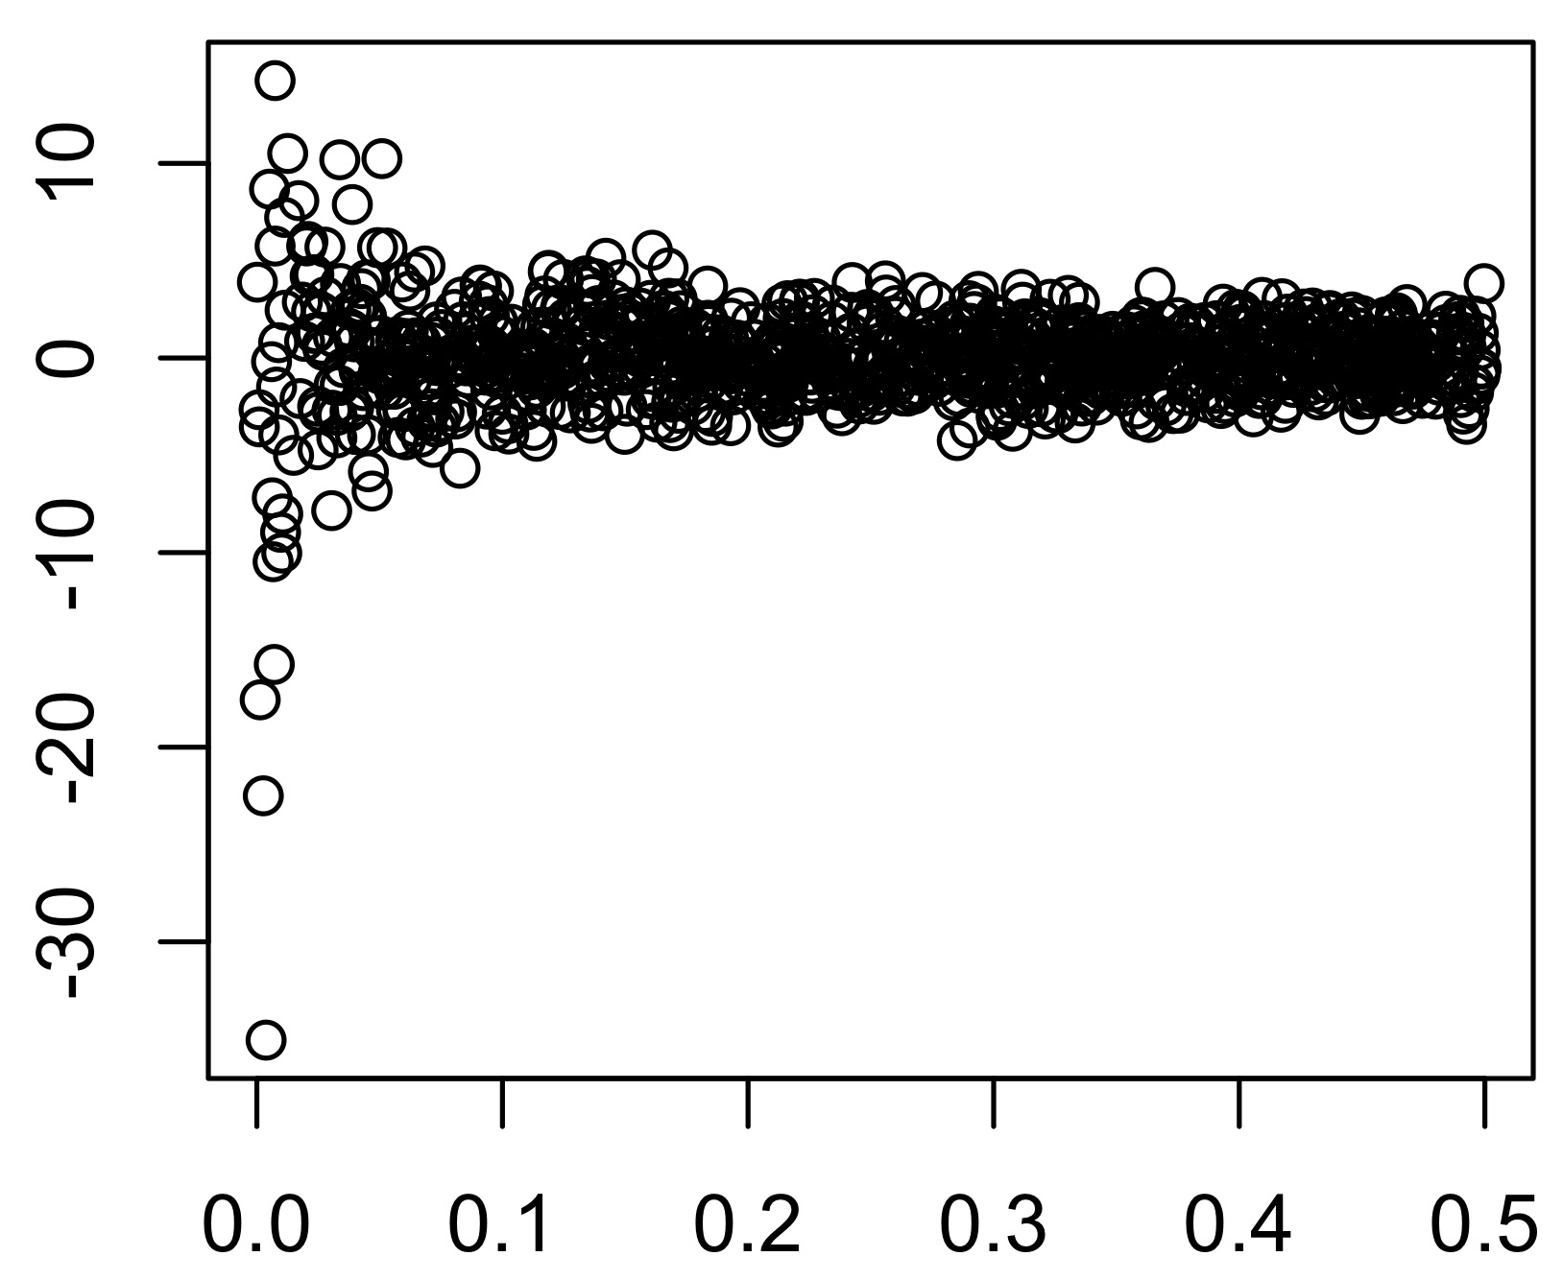
MAF-stratified approach: Allows the variance to change among MAF bins
β_{k} ~N(0,1/[2p_{k}(1-p_{k})])
$$V=\sum_{i}{Ai{σ }_{i}^{2}+ I{σ }_{e}^{2}}$$
β_{k}
Rare MAF bin
Uncommon MAF bin
Common MAF bin
Relationship between markers and causal variants within bins:
h²_{SNP} = h²($\overline{r^{2}}$_{QM} / $\overline{r^{2}}$_{MM})
MAF

Slide 24
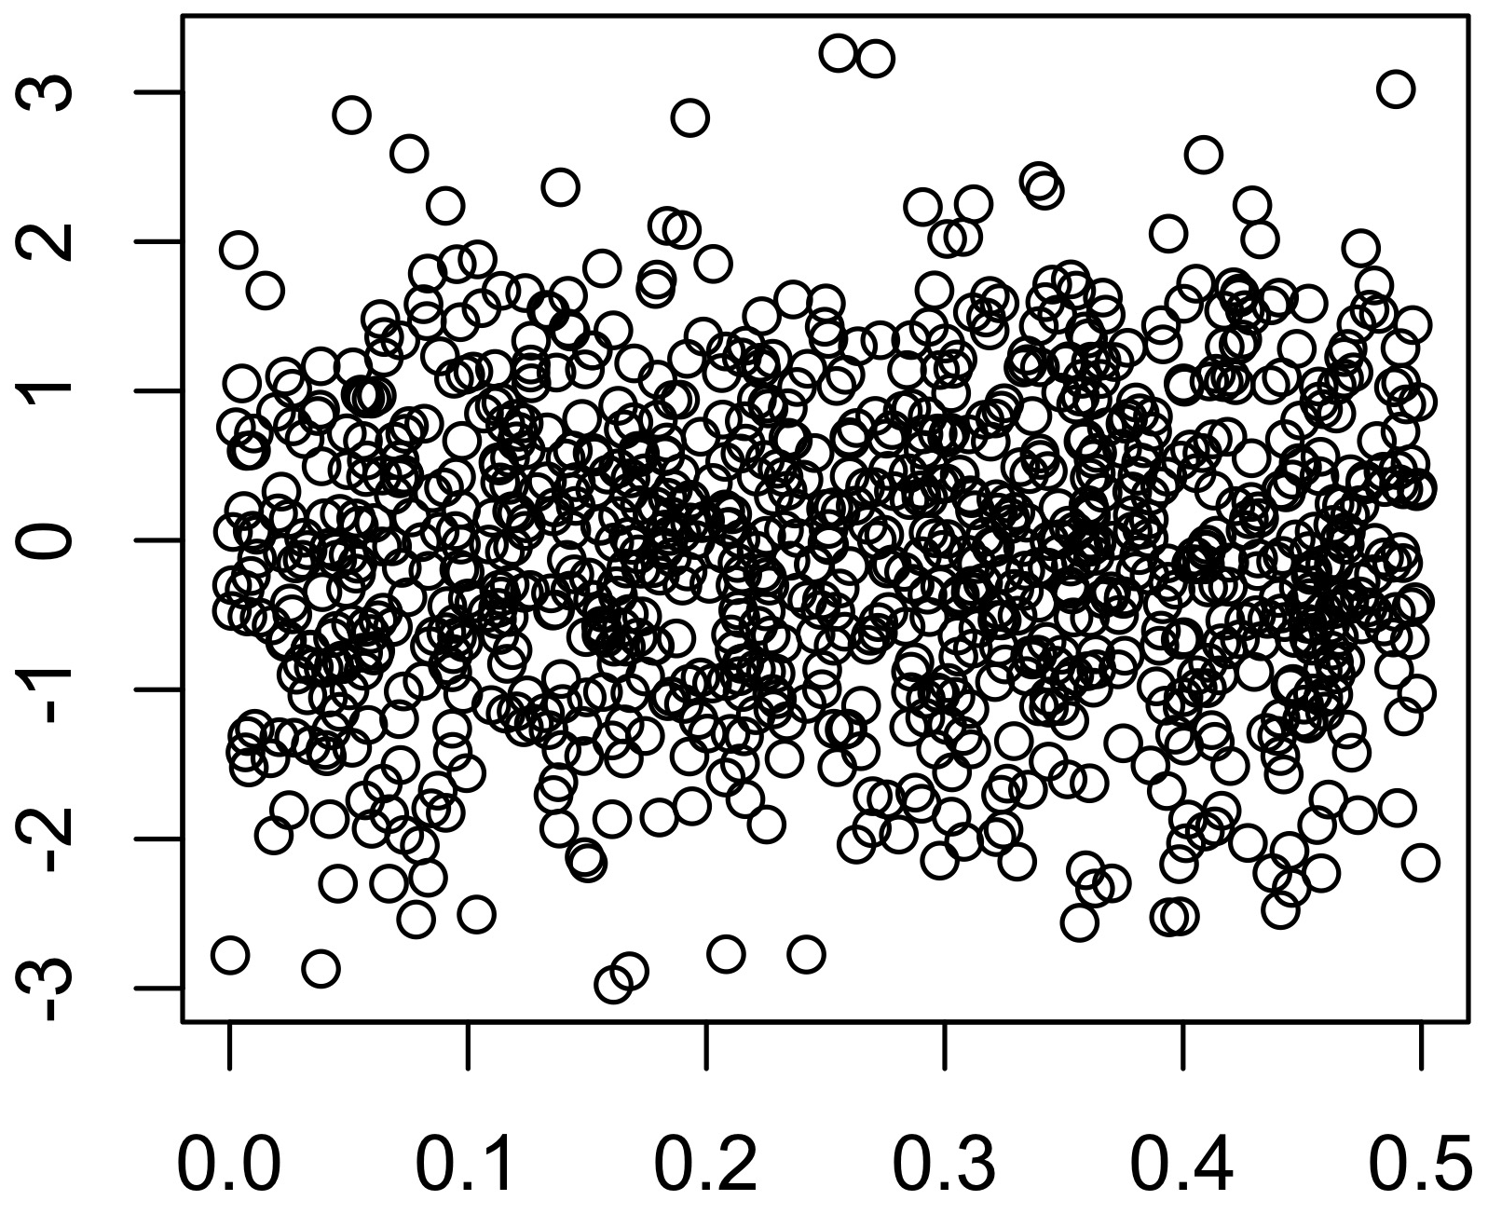
MAF-stratified approach: Allows the variance to change among MAF bins
β_{k} ~N(0,1/[2p_{k}(1-p_{k})])
β_{k} ~N(0,1)
β_{k}
MAF
MAF

Slide 25
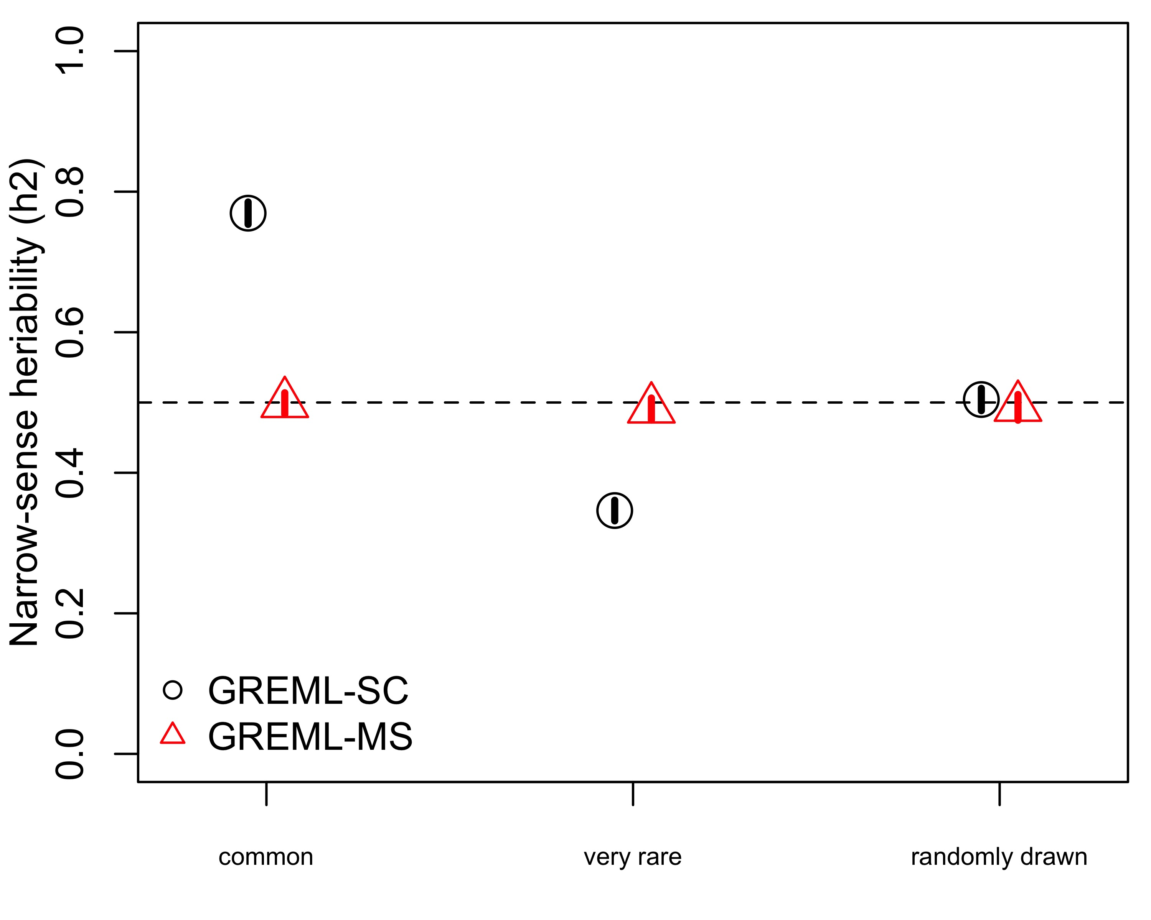
MAF-Stratified GREML is unbiased Whole genome sequence 4 MAF bins
common rare all variants
Causal Variant Minor Allele Frequency
MAF range of 1,000 random causal variants

Slide 26
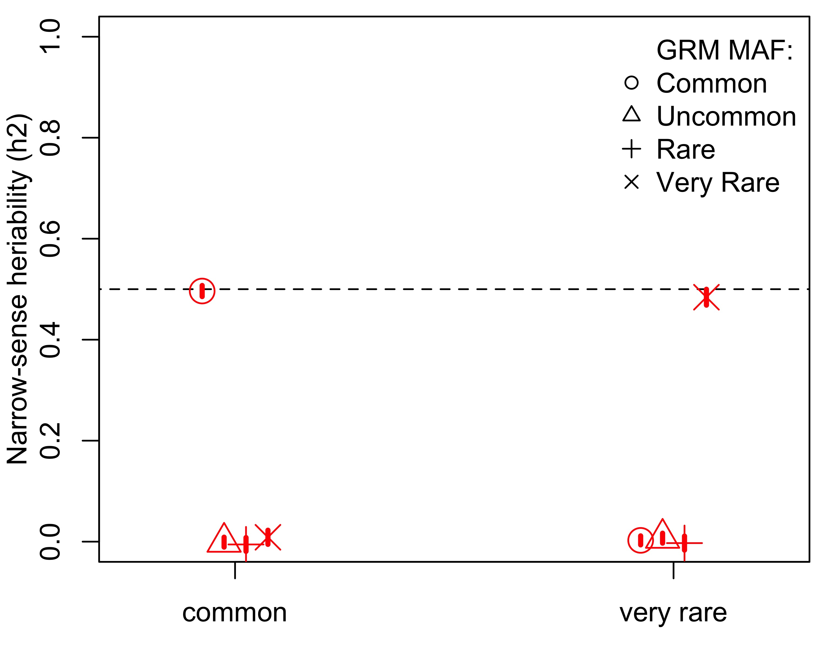
MAF-stratified GREML Correctly partitions variance to the correct MAF range
Causal Variant Minor Allele Frequency

Slide 27
PRACTICAL 2

Slide 28
Stratification: Population structure influences LD (and therefore h²_{SNP})
Europe-wide (HRC data)
Homogeneous Subset
Notes:
Make environmental sharing a separate slide
Fairly easily controlled by PCs
Separate but less recognized issue is the LD impacts of strat in the absence of environmental confounding
Ancestry PCs account for mean differences, and here, there may not be a mean difference, so controlling for ancestry PCs doesn’t remove effect of strat on LD (cor between CVs and markers)

Slide 29
Stratification and confounding
Remember stratification talks
Environments can also be confounded with ancestry
Other covariates – sex, batch, etc.
Typically, PC scores for some number of axes included as covariates (Price et al. 2010, Yang et al. 2014, etc.)
Covariates included correct for mean differences, but not the LD effects of stratification

Slide 30
Homogeneous Vs. Stratified Samples: h²_{SNP} = h²($\overline{r^{2}}$_{QM} / $\overline{r^{2}}$_{MM})
Rare, ancestry-informative alleles are in high LD, driving up LD scores
Homogeneous Sample
Stratified Sample
CV MAF:
Random from full distribution
Common
Uncommon
Rare
Very Rare
CV MAF:
Random from full distribution
Common
Uncommon
Rare
Very Rare
h²_{SNP}
h²_{SNP}
$\overline{r^{2}}$_{QM} / $\overline{r^{2}}$_{MM}
$\overline{r^{2}}$_{QM} / $\overline{r^{2}}$_{MM}
Notes:
Alter to have the homogeneous figure similar to this on same page. Point out shift in r2 ratios that lead to biases.

Slide 31
Homogeneous Vs. Stratified Samples: h²_{SNP} = h²($\overline{r^{2}}$_{QM} / $\overline{r^{2}}$_{MM})
Rare, ancestry-informative alleles are in high LD, driving up LD scores
Homogeneous Sample
Stratified Sample
CV MAF:
Random from full distribution
Common
Uncommon
Rare
Very Rare
CV MAF:
Random from full distribution
Common
Uncommon
Rare
Very Rare
h²_{SNP}
h²_{SNP}
Very rare variants have higher LD due to stratification
$\overline{r^{2}}$_{QM} / $\overline{r^{2}}$_{MM}
$\overline{r^{2}}$_{QM} / $\overline{r^{2}}$_{MM}
Notes:
Alter to have the homogeneous figure similar to this on same page. Point out shift in r2 ratios that lead to biases.

Slide 32
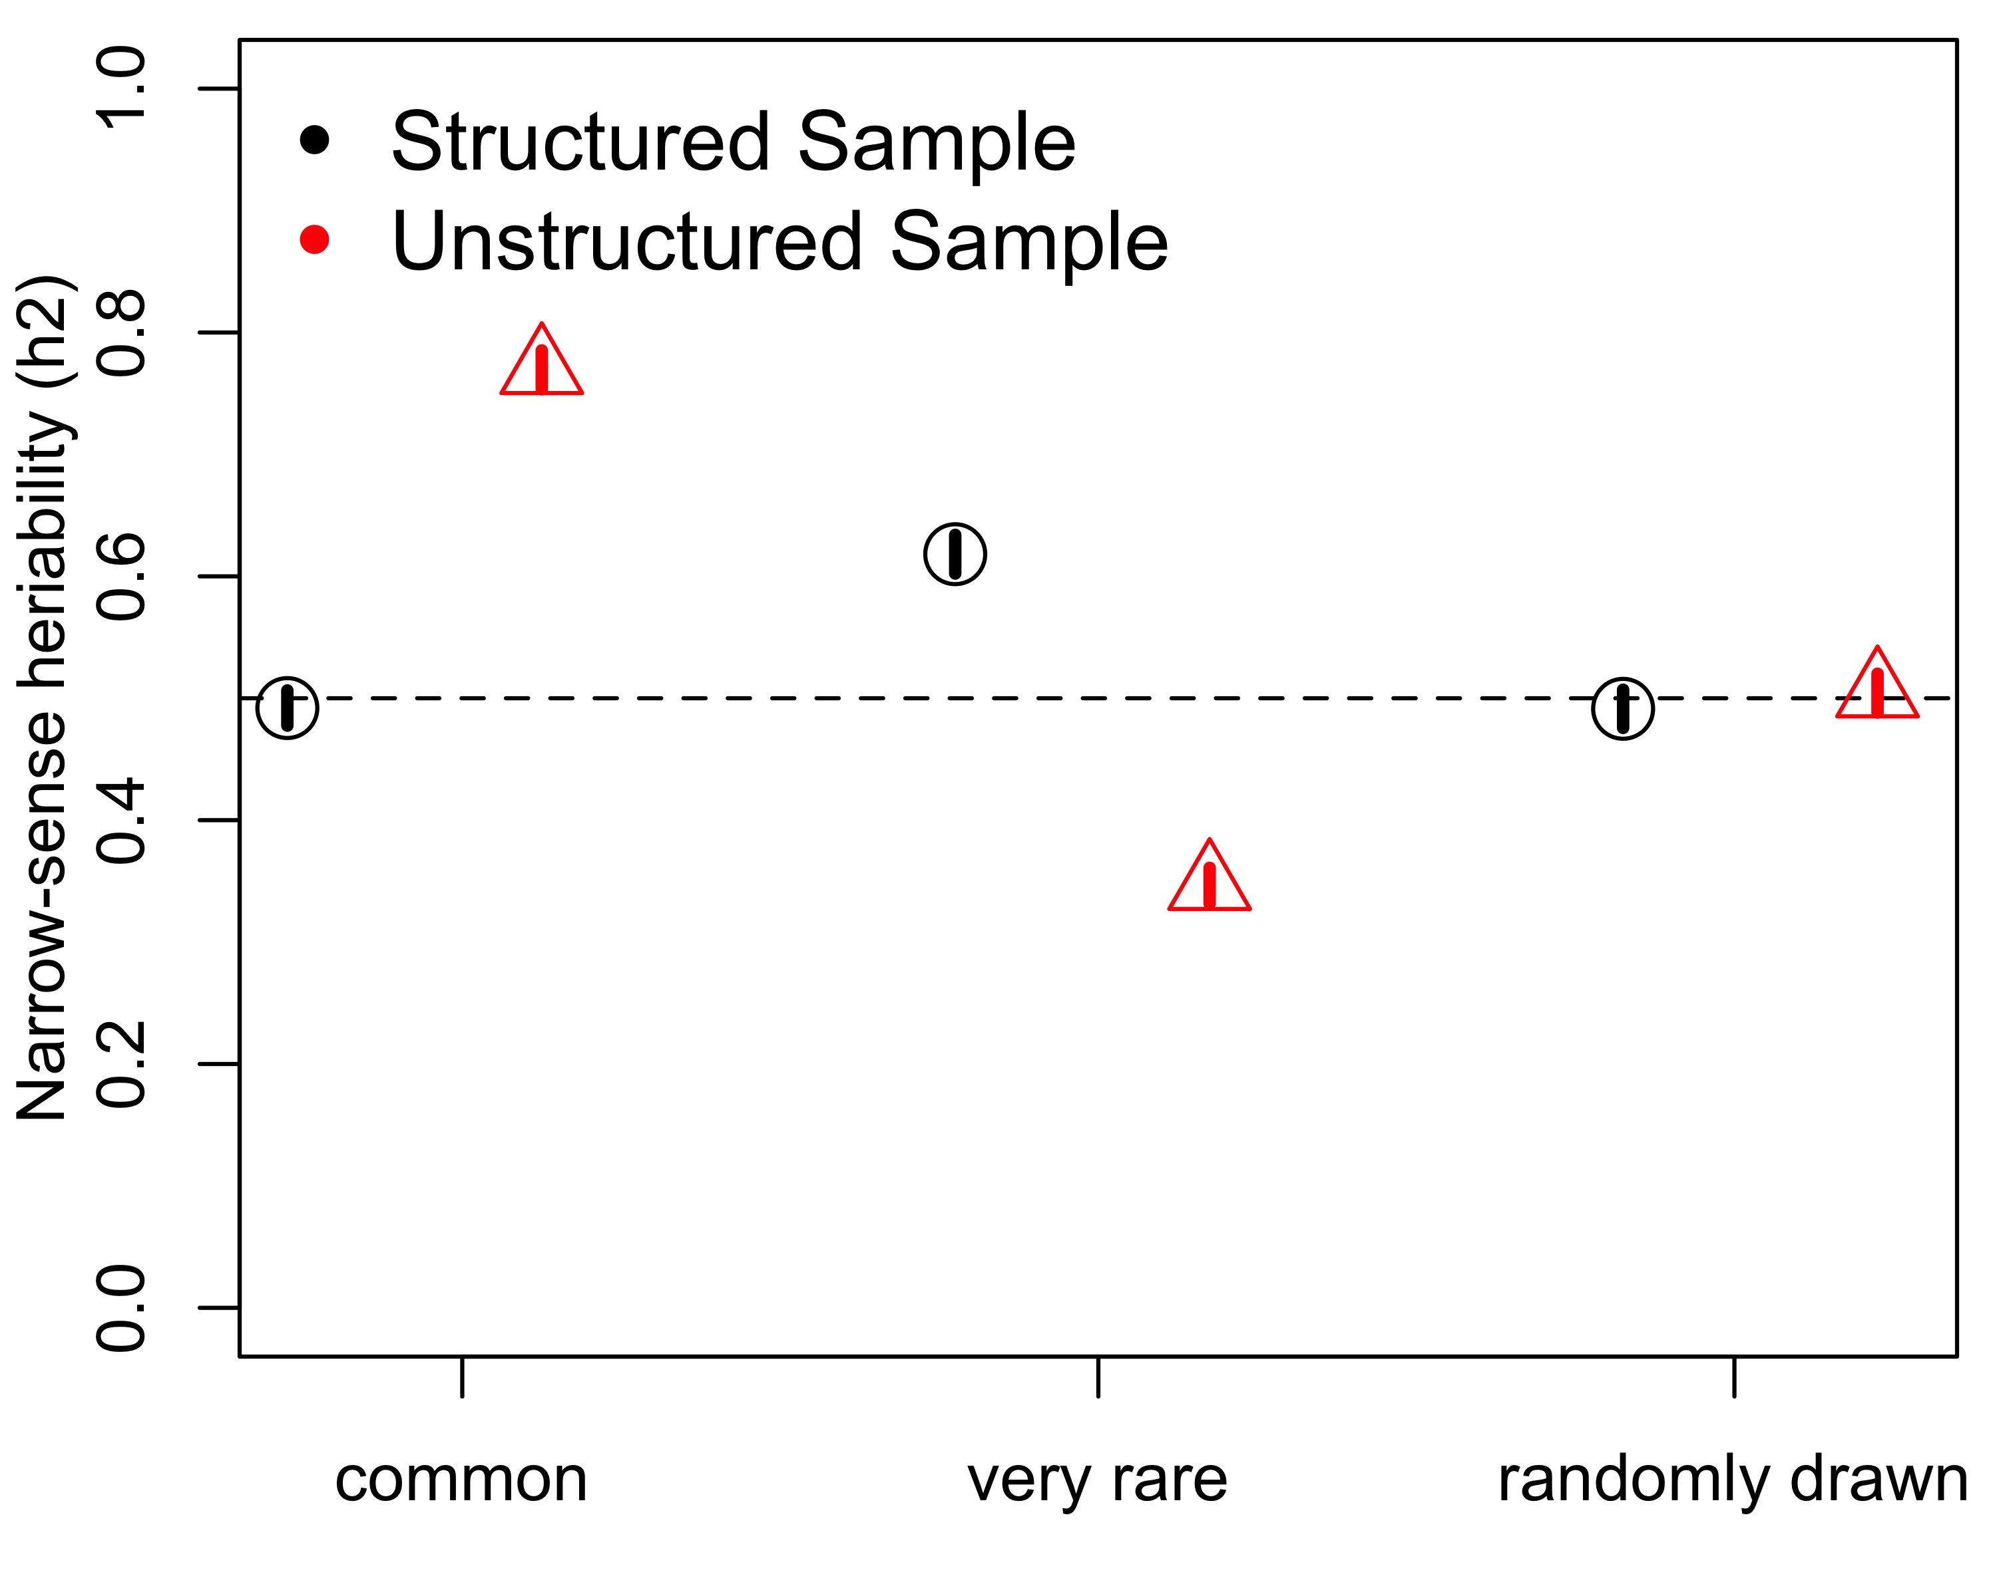
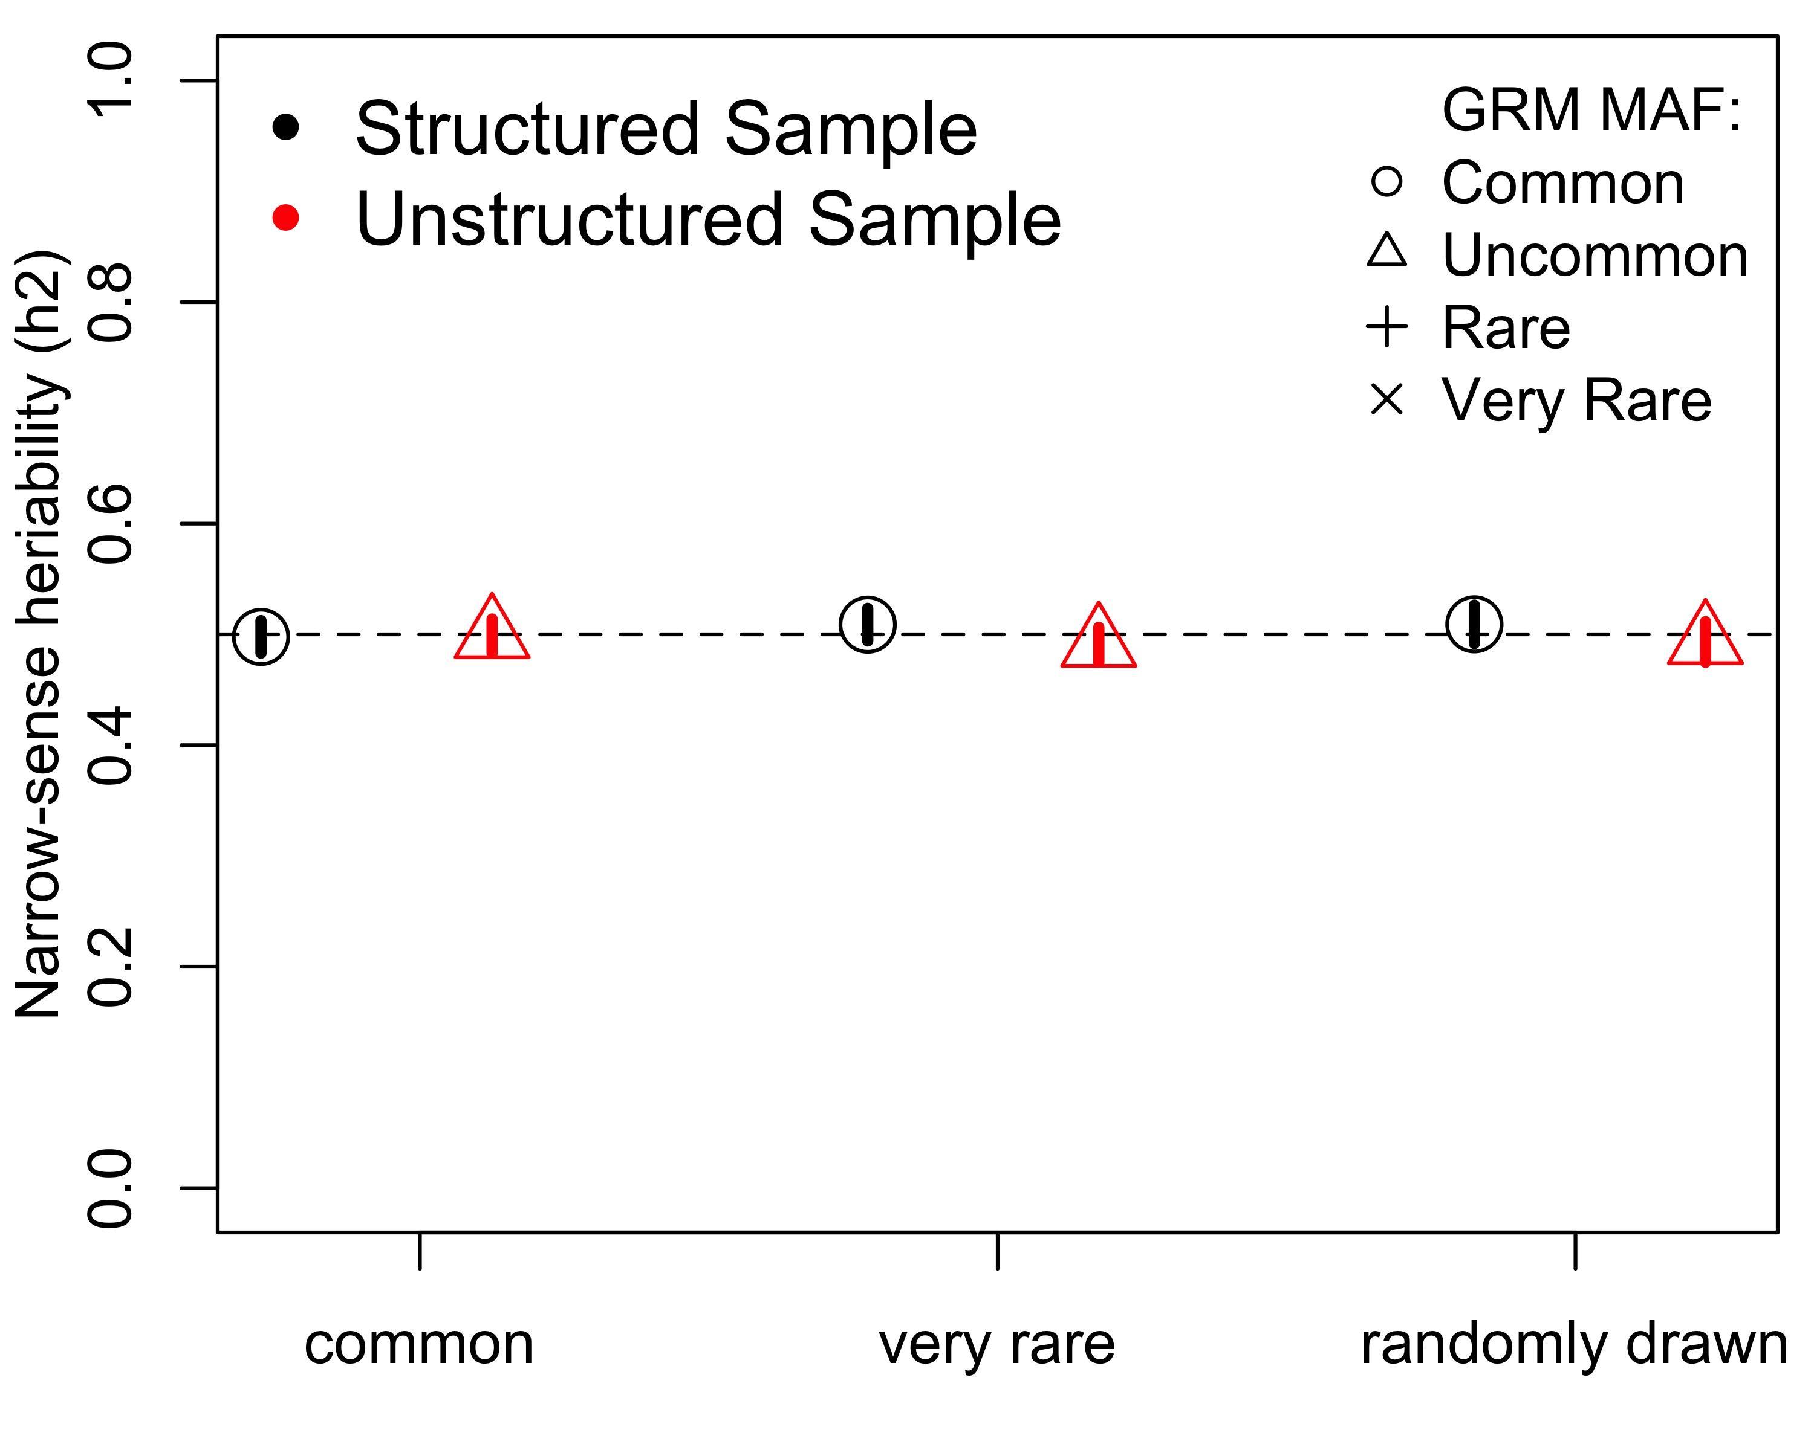
MAF-stratified or single component in homogeneous samples vs. structured samples
Single GRM using WGS
MAF-stratified GRMs using WGS
Causal Variant Minor Allele Frequency
Causal Variant Minor Allele Frequency

Slide 33
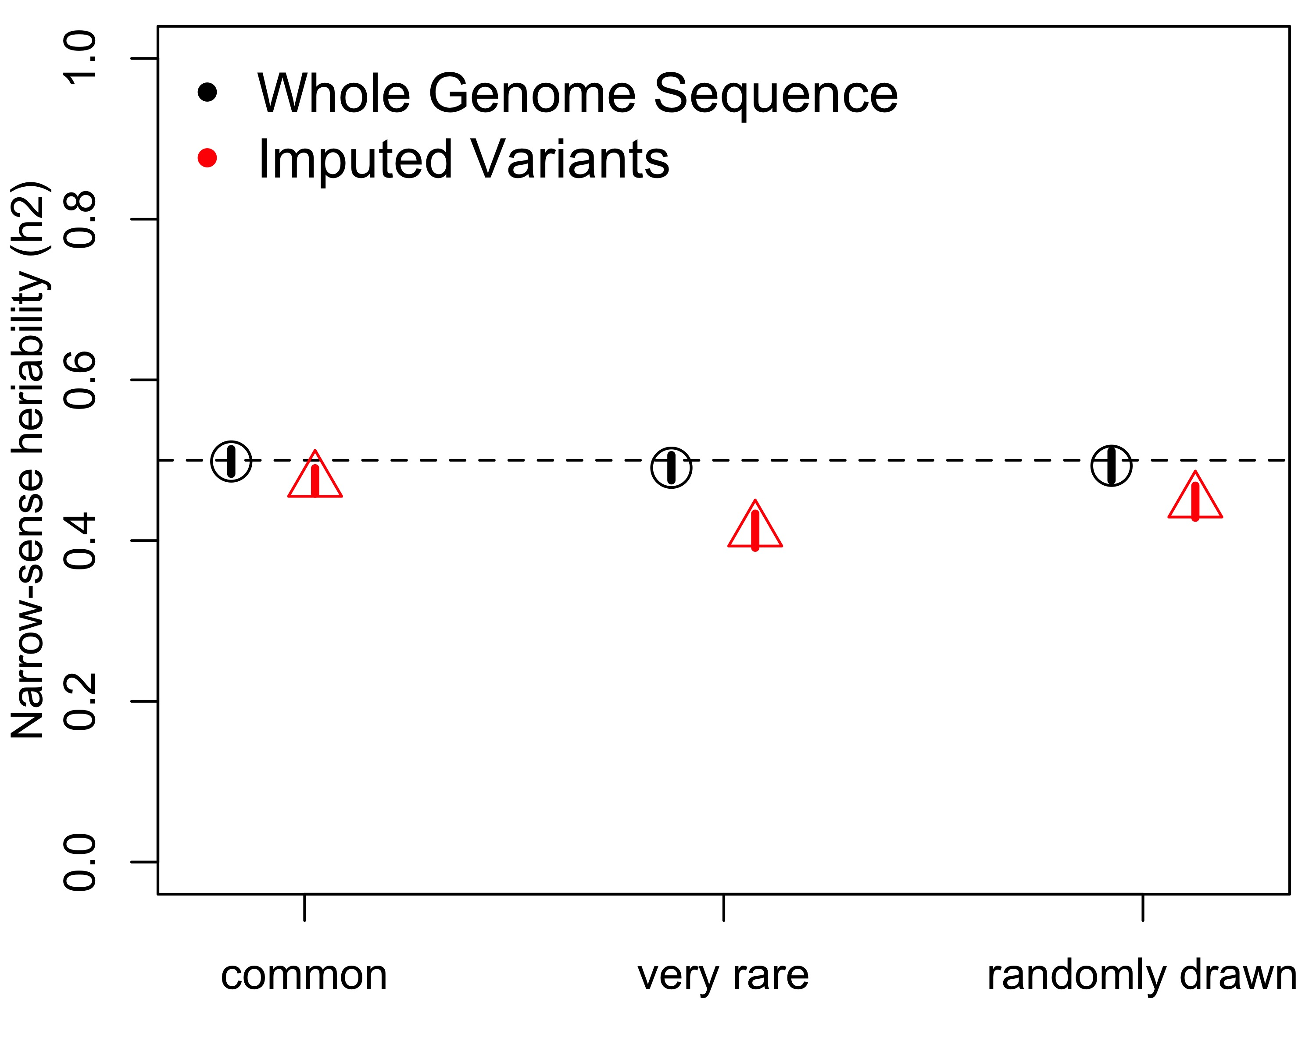
Imputation vs. genome sequence – GREML-MS
Causal Variant Minor Allele Frequency

Slide 34
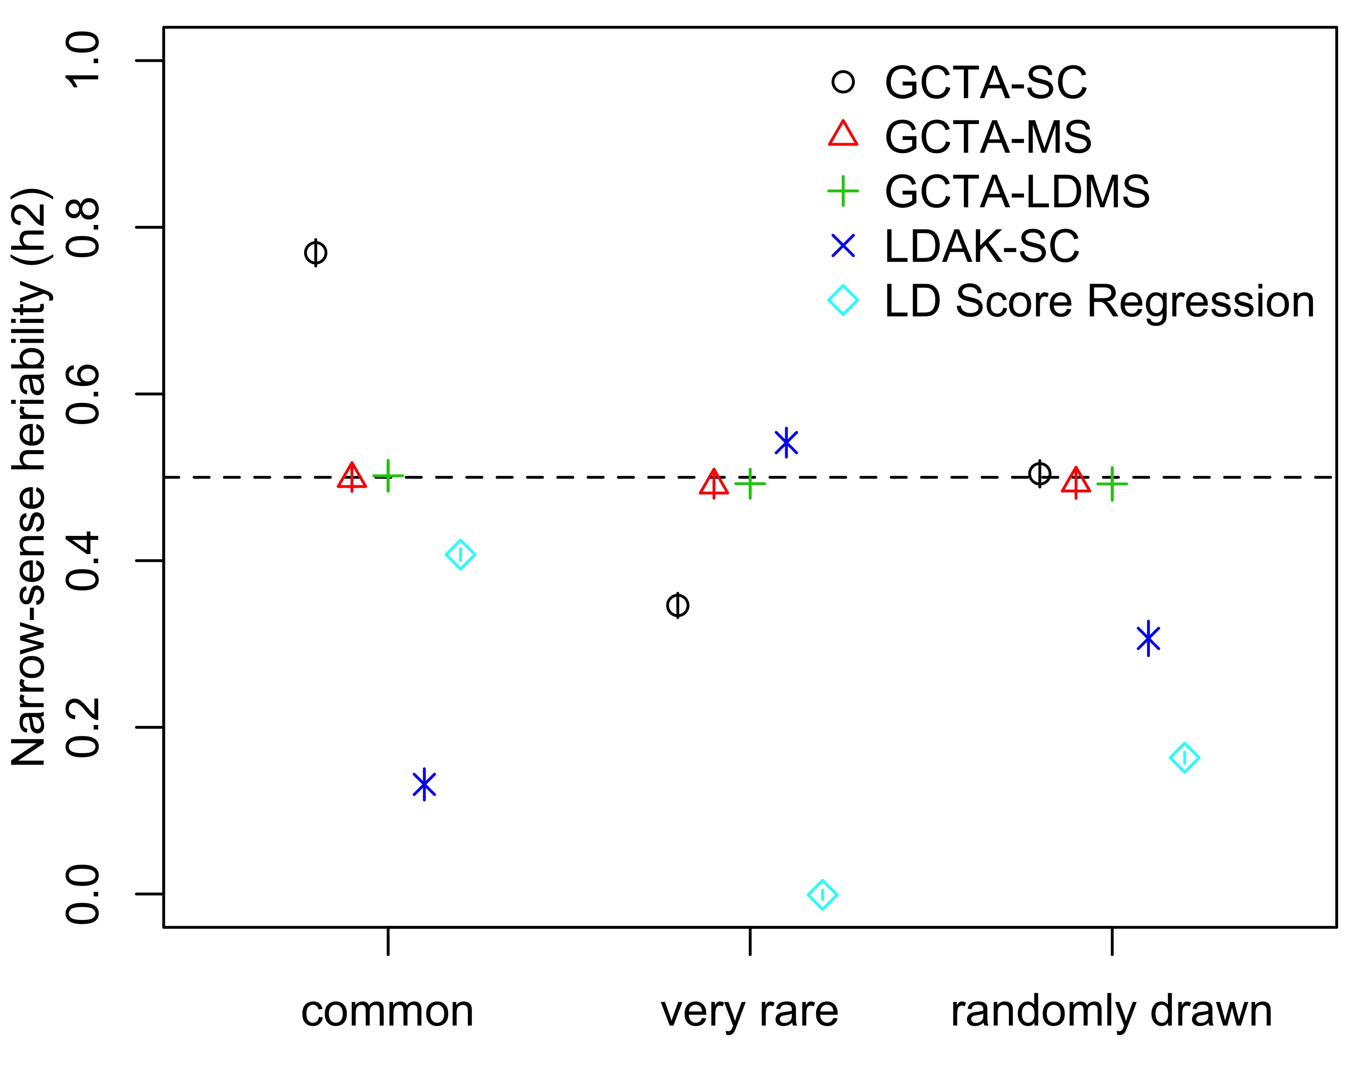
Numerous methods developed
Relative performance varies
Dependent on model & assumptions
Causal Variant Minor Allele Frequency

Slide 35
BEST PRACTICES:
Careful QC, appropriate covariates
Whole genome sequence is best
Impute! Use the Haplotype Reference Consortium.
Remove related individuals – these share confounding environmental effects, but this is avoided using unrelated samples.
Carefully interpret results from studies that use a single GRM in GREML. There are clear biases from this approach, yet most have used GREML-SC.
GREML-MS or GREML-LDMS are much preferred.
Notes:
GREML-SC
GREML-MS/LDMS
LD score regression
MENTION OTHER METHODS TESTED – MAKE NOTE THAT THEY PERFORM POORLY

