Slide 1
Mendelian Randomization
David Evans

Slide 2
Some Criticisms of GWA Studies…
So you have a new GWAS hit for a disease… so what!?
You can’t change people’s genotypes (at least not yet)
You can however modify people’s environments…
Mendelian Randomization is a method of using genetics to inform us about associations in traditional observational epidemiology and MUCH MUCH more…

Slide 3
This Session
Determining causality in epidemiology
Mendelian randomization (MR)
Examples of MR
Extensions to MR
Mining the Phenome / Hypothesis Free Causality
Practical

Slide 4
RCTs: the Gold Standard in Inferring Causality
RANDOMISED CONTROLLED TRIAL
Randomization
makes causal inference
possible
RANDOMIZATION METHOD
EXPOSED:
INTERVENTION
CONTROL:
NO INTERVENTION
CONFOUNDERS EQUAL BETWEEN GROUPS
OUTCOMES COMPARED BETWEEN GROUPS

Slide 5
The Need for Observational Studies
Randomized Controlled Trials (RCTs):
  Not always ethical or practically feasible eg anything toxic
  Expensive, requires experimentation in humans
  Should only be conducted on interventions that show very strong observational evidence in humans
Observational studies:
  Association between environmental exposures and disease measured in observational designs (non-experimental)
  eg case-control studies or cohort studies
  Reliably assigning causality in these types of studies is
  very limited

Slide 6
CHD risk according to duration of current Vitamin E
supplement use compared to no use
RR
Rimm et al NEJM 1993; 328: 1450-6

Slide 7
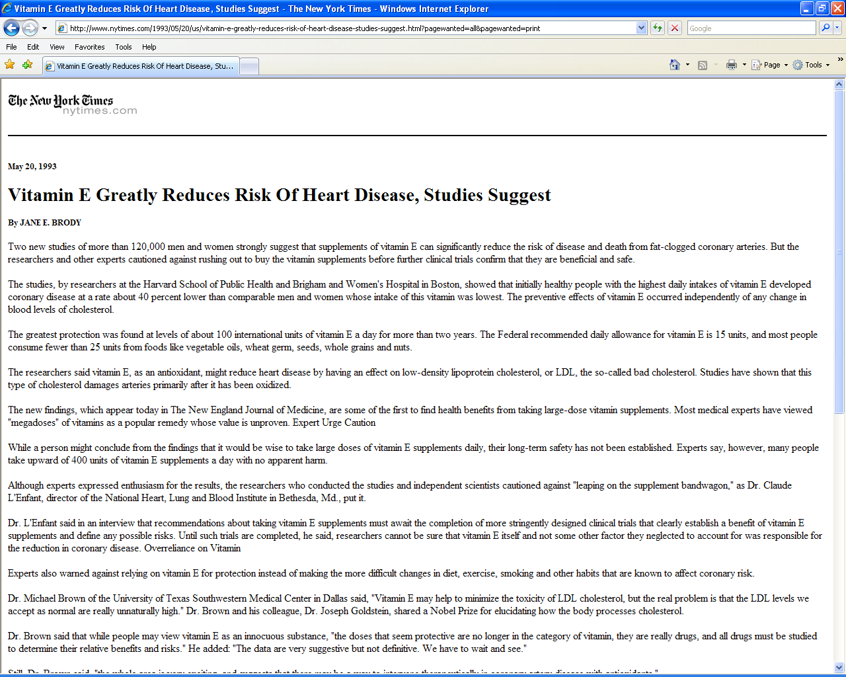

Slide 8


Slide 9
Use of vitamin supplements by US adults, 1987-2000
Percent
Source: Millen AE, Journal of American Dietetic Assoc 2004;104:942-950

Slide 10
Vitamin E supplement use and risk of Coronary Heart Disease
1.0
Stampfer et al NEJM 1993; 328: 144-9; Rimm et al NEJM 1993; 328: 1450-6; Eidelman et al
Arch Intern Med 2004; 164:1552-6

Slide 11
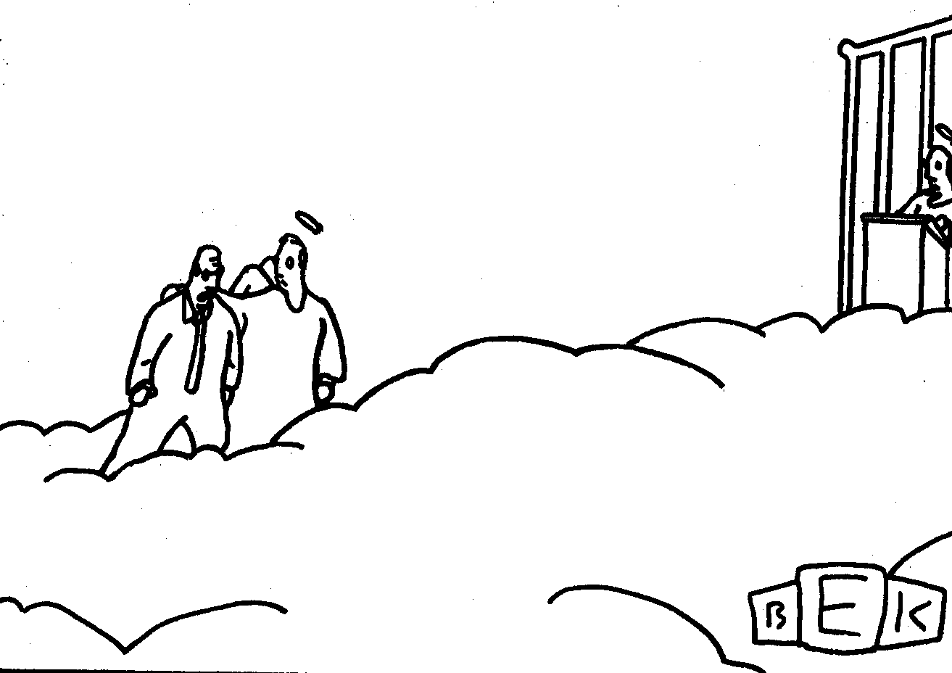
“Well, so much for antioxidants.”

Slide 12
Many other exaMPLEs vitamin c, vitamin a, HRT, many drug targets…….
What’s the explanation?

Slide 13
Vitamin E levels and confounding risk factors:
Childhood SES
Manual social class
No car access
State pension only
Smoker
Obese
Daily alcohol
Exercise
Low fat diet
Height
Leg length
Women’s Heart and Health Study
Lawlor et al, Lancet 2004

Slide 14
Confounding
Smoking, diet, alcohol, socioeconomic position….
Confounders
Exposure
Outcome
Vitamin E
Heart disease

Slide 15
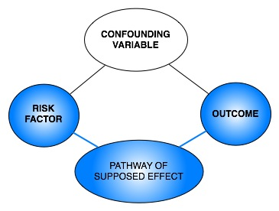
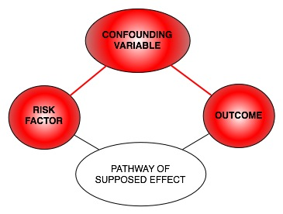
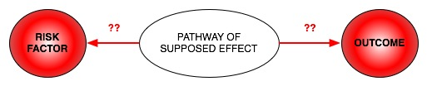
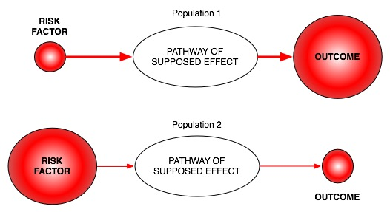
Classic limitations to “observational” science
Confounding
Reverse Causation
Bias

Slide 16

Mendelian randomization
How can it help observational epidemiology?

Slide 17
What is Mendelian randomization?
Mendelian randomization (MR) is an epidemiological technique that uses genetic variants as proxy measures for an environmental exposure
It is an application of “Instrumental Variable” (IV) analysis:
  it uses genetic variants as ‘instruments’ for the exposure of interest. An IV is a variable that is only associated with an outcome because of its association with the exposure
Confounders
Instrument
Exposure
Outcome

Slide 18
What does MR do?
Assess causal relationship between two variables
Estimate magnitude of causal effect
How does it do this?
By harnessing Mendel’s laws of inheritance

Slide 19
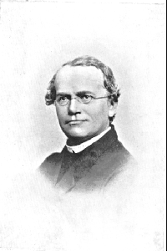
Mendel’s Laws of Inheritance
Segregation: alleles separate at meiosis and a randomly selected allele is transmitted to offspring
2. Independent assortment: alleles for separate traits are transmitted independently of one another
Mendel in 1862

Slide 20
Mendelian randomization and Mendel’s Laws
The laws of Mendelian genetics imply:
Groups of individuals defined by genotype
should only differ with respect to the locus under study
[and closely related loci in LD with that locus]
This means genotypes can proxy for some
modifiable risk factors because:
There should be no confounding of genotype
by behavioural, socioeconomic or
physiological factors
[except factors influenced by nearby loci,
or due to population stratification]
Mendel in 1862

Slide 21
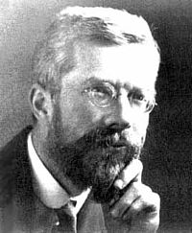
Fisher and Confounding
“Generally speaking the geneticist, even if he
foolishly wanted to, could not introduce
systematic errors into comparison of
genotypes, because for most of the relevant
time he has not yet recognized them”
Fisher (1952)

Slide 22
Mendelian randomization and RCTs
MENDELIAN RANDOMIZATION
RANDOMISED CONTROLLED TRIAL
+ independent assortment
RANDOM SEGREGATION
OF ALLELES
RANDOMISATION METHOD
EXPOSED: FUNCTIONAL ALLELLES
CONTROL: NULL ALLELLES
EXPOSED:
INTERVENTION
CONTROL:
NO INTERVENTION
CONFOUNDERS EQUAL BETWEEN GROUPS
CONFOUNDERS EQUAL BETWEEN GROUPS
OUTCOMES COMPARED BETWEEN GROUPS
OUTCOMES COMPARED BETWEEN GROUPS

Slide 23
Mendelian randomization: Smoking and Lung Cancer
MENDELIAN RANDOMIZATION
RANDOMISED CONTROLLED TRIAL
+ independent assortment
RANDOM SEGREGATION
OF ALLELES
RANDOMISATION METHOD
Heavy Smokers:
C/C
Light/Non Smokers:
C/T or T/T
EXPOSED:
SMOKERS
CONTROL:
NON SMOKERS
CONFOUNDERS EQUAL BETWEEN GROUPS
CONFOUNDERS EQUAL BETWEEN GROUPS
LUNG CANCER COMPARED
BETWEEN GROUPS
LUNG CANCER COMPARED
BETWEEN GROUPS

Slide 24
Mendelian Randomization:
3 Core Assumptions
Confounders
(2)
X
SNP
Exposure
Outcome
(1)
X
(3)
(1) SNP is associated with the exposure
(2) SNP is NOT associated with confounding variables
(3) SNP ONLY associated with outcome through the exposure

Slide 25
Calculating Causal Effect Estimates
Confounders
SNP
Exposure
Outcome
β_{SNP-EXPOSURE}
? β _{CAUSAL EXP-OUTCOME}
β_{SNP-OUTCOME}
After SNP identified robustly associated with exposure of interest:
- Wald Estimator
- Two-stage least-squares (TSLS) regression

Slide 26
Calculating Causal Effect Estimates
Confounders
SNP
Exposure
Outcome
β_{SNP-EXPOSURE}
β_{CAUSAL EXP-OUTCOME}
β_{SNP-OUTCOME}
β_{SNP-OUTCOME}
β_{SNP-OUTCOME}
= β_{CAUSAL EXP-OUTCOME} x
β_{SNP-EXPOSURE}
Causal effect by
Wald Estimator* :
β_{SNP-EXPOSURE}
*Can be used in different samples (“Two sample MR”)

Slide 27
Calculating Causal Effect Estimates
Confounders
SNP
Weight
BP
β_{SNP-WEIGHT}
β_{CAUSAL WEIGHT-BP}
0.5kg
β_{SNP-BP}
0.9mmHg
BP and weight:
0.9 mmHg/allele
0.5 kg/allele
=1.8 mmHg/kg
β_{SNP-OUTCOME}
= change in outcome
per unit change in exposure
Causal effect by
Wald Estimator* :
β_{SNP-EXPOSURE}
*Can be used in different samples (“Two sample MR”)

Slide 28
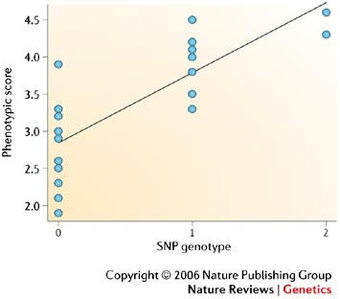
Calculating Causal Effect Estimates
Confounders
SNP
Exposure
Outcome
β_{SNP-EXPOSURE}
? β _{CAUSAL EXP-OUTCOME}
β_{PREDICTED VALUE-OUTCOME}
Two-stage
Least Squares
(2SLS):
(1) Regress exposure on SNP & obtain predicted values
(2) Regress outcome on predicted exposure (from 1st stage regression)
(3) Adjust standard errors
*Needs to be done in the one sample (“Single sample MR”)

Slide 29
Calculating Causal Effect Estimates
Confounders
SNP
Exposure
Outcome
β_{SNP-EXPOSURE}
? β _{CAUSAL EXP-OUTCOME}
β_{PREDICTED VALUE-OUTCOME}
Two-stage
Least Squares
(2SLS):
(1) Regress exposure on SNP & obtain predicted values
(2) Regress outcome on predicted exposure (from 1st stage regression)
(3) Adjust standard errors
This gives you: difference in outcome per unit change in (genetically-predicted) exposure
Genetically determined exposure → “randomized” → can ascribe causality
(if assumptions are met)
*Needs to be done in the one sample (“Single sample MR”)

Slide 30
MR Example using CRP
C-Reactive Protein (CRP) is a biomarker of inflammation
It is associated with BMI, metabolic syndrome, CHD and a number of other diseases
It is unclear whether these observational relationships are causal or due to confounding or reverse causality
This question is important from the perspective of intervention and drug development

Slide 31
Using a genetic instrument for
proinflammatory CRP
U
CRP genotype
Cardiometabolic
traits
CRP
TWO ALTERNATIVES
If CRP DOES NOT causally affect cardiometabolic traits:
CRP gene variant should NOT be related to cardiometabolic traits
If CRP CAUSALLY affects metabolic traits:
CRP gene variant should also be related to these metabolic traits

Slide 32
“Bi-directional Mendelian Randomization”:
Testing causality and reverse causation
?
FTO
Genotype
BMI
CRP
CRP
Genotype
?

Slide 33
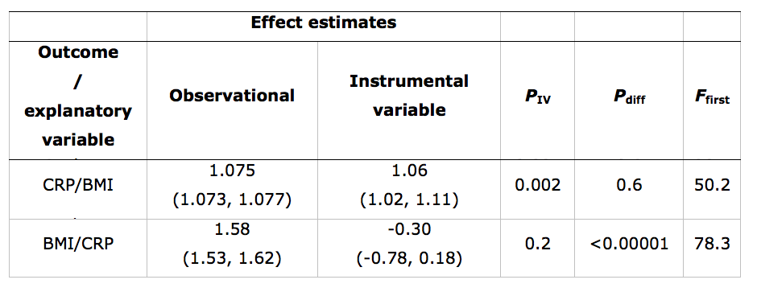
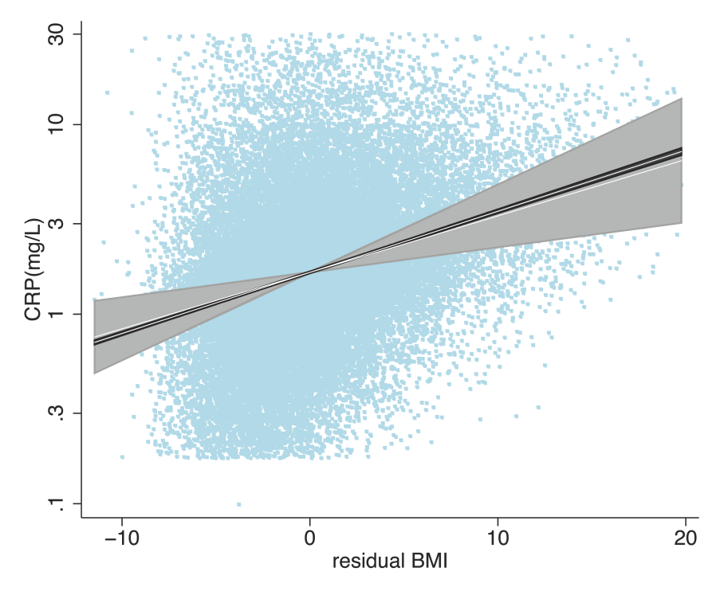
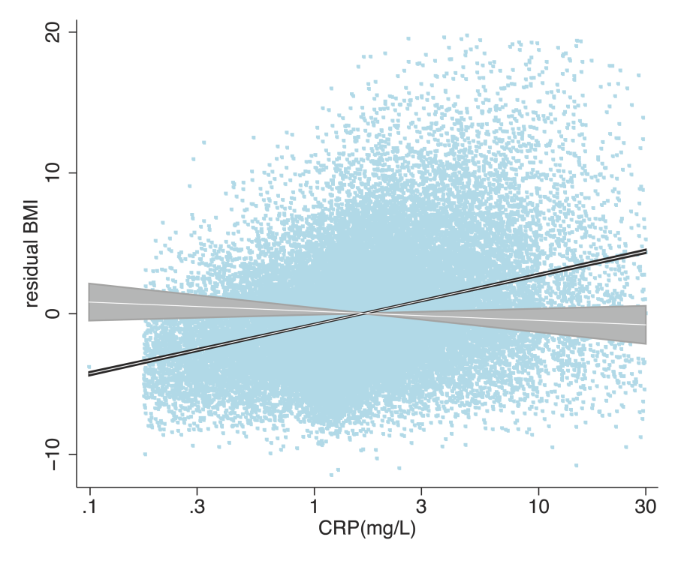

Slide 34
Limitations to Mendelian Randomization
1- Population stratification
2- Canalisation (“Developmental compensation”)
3- The existence of instruments
4- Pleiotropy
5- Power (also “weak instrument bias”)

Slide 35
Pleiotropy
Genetic variant influences more than one trait
Pleiotropy only violates MR’s assumptions if it involves a pathway outside that of the exposure and is a pathway that affects your outcome
Violation
B 1
B 2
Outcome
Outcome
G
Exposure
B1
Exposure
B1
B 2
B 2
G
G

Slide 36
Power and Weak Instruments
Power:
  Genetic variants explain very small amounts of phenotypic variance in a given trait
  VERY large sample sizes are generally required
Weak instruments:
  Genetic variants that are weak proxies for the exposure
  Results in biased causal estimates from MR
Different impact of the bias from weak instruments:
  Single Sample MR: to the confounded estimate
  Two-Sample MR: to the null

Slide 37
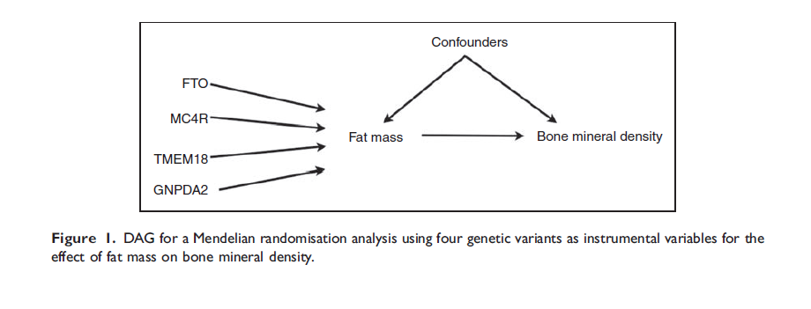
Using Multiple Genetic Variants as Instruments
Palmer et al (2011) Stat Method Res
Allelic scores
Testing multiple variants individually
Meta-analyse individual SNPs

Slide 38

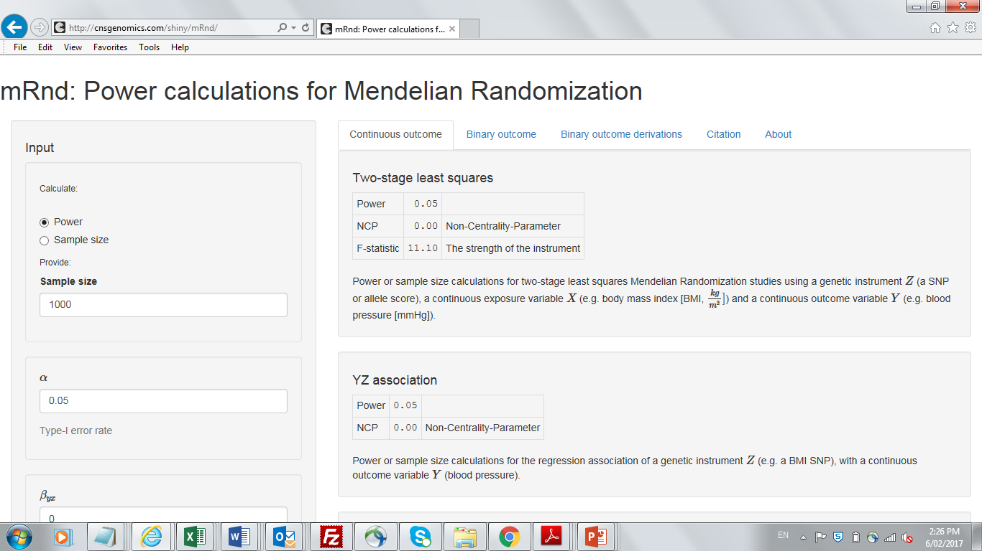
http://cnsgenomics.com/shiny/mRnd/

Slide 39
Using MR to Inform Mother-Offspring Associations

Slide 40
U
Maternal
SNP
Maternal
Exposure
Child
Outcome

Slide 41
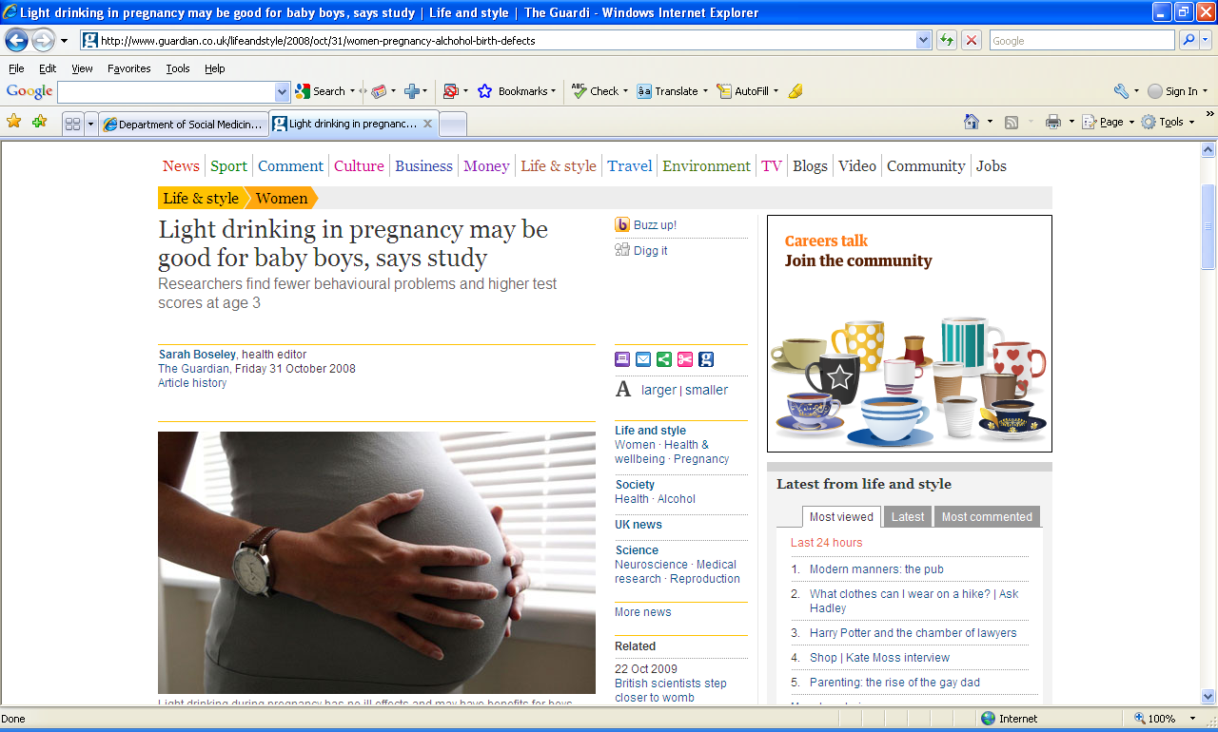

Slide 42
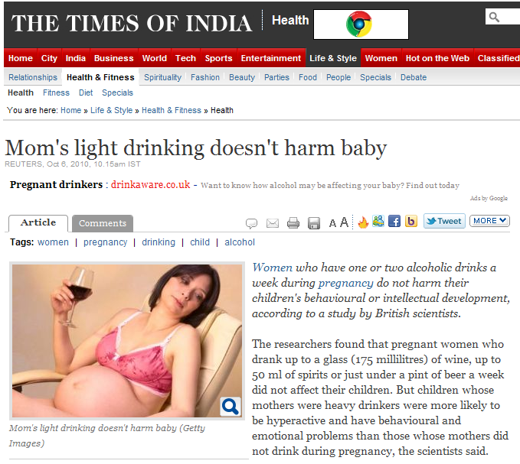

Slide 43
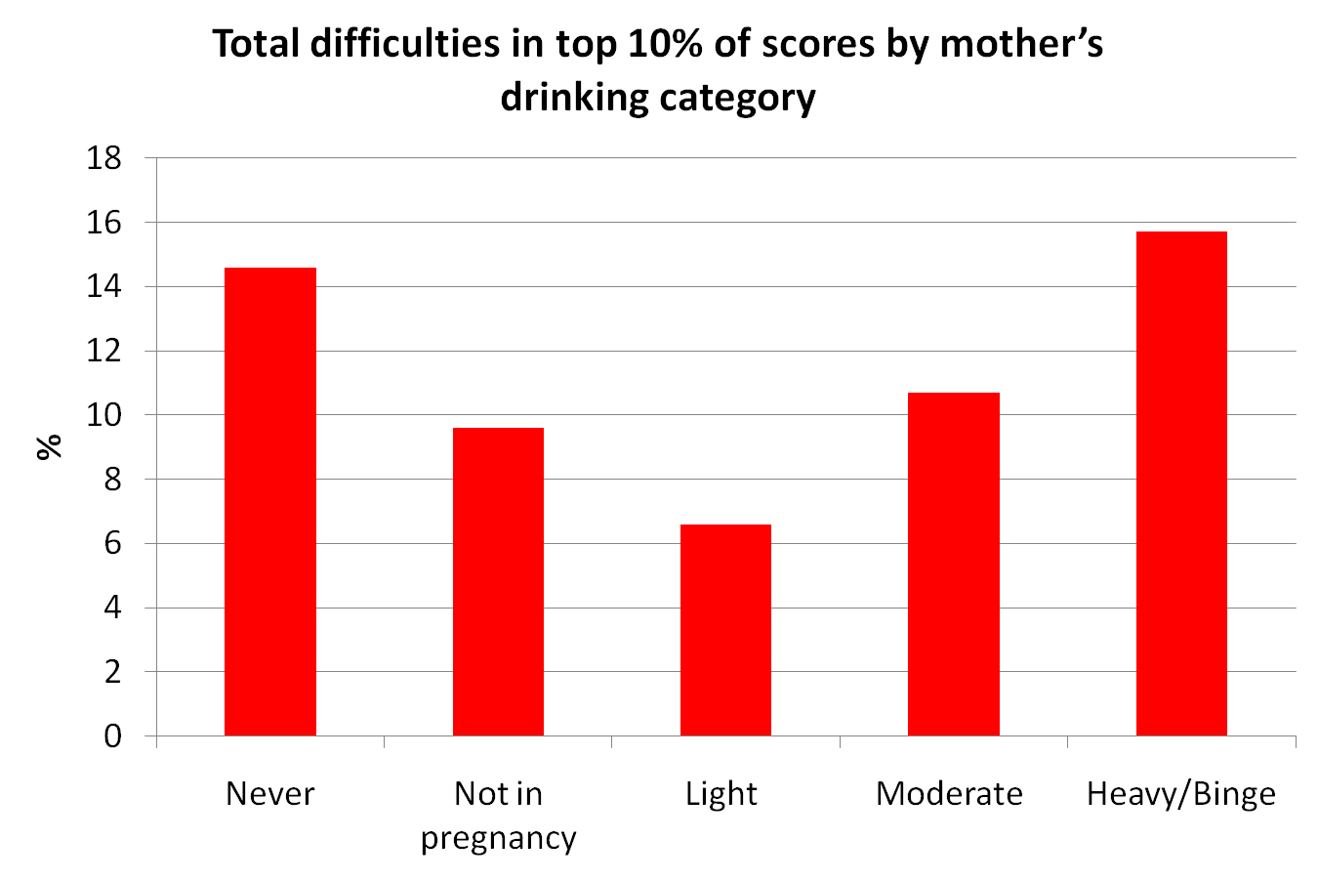
Kelly Y, Sacker A, Gray R et al. J Epidemiol Community Health (2010), doi:10.1136/jech.2009.103002

Slide 44
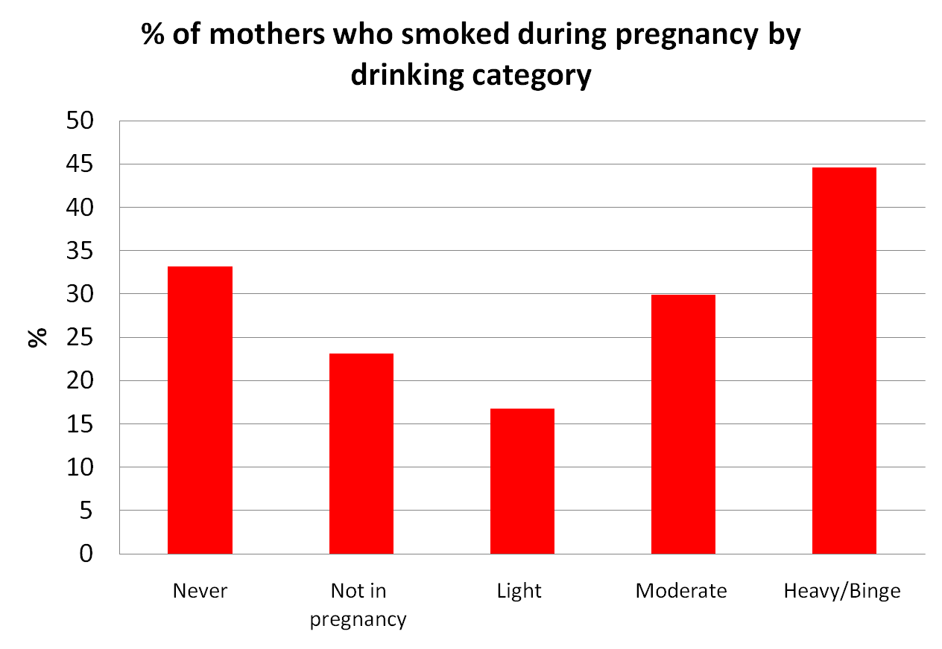
Kelly Y, Sacker A, Gray R et al. J Epidemiol Community Health (2010), doi:10.1136/jech.2009.103002

Slide 45
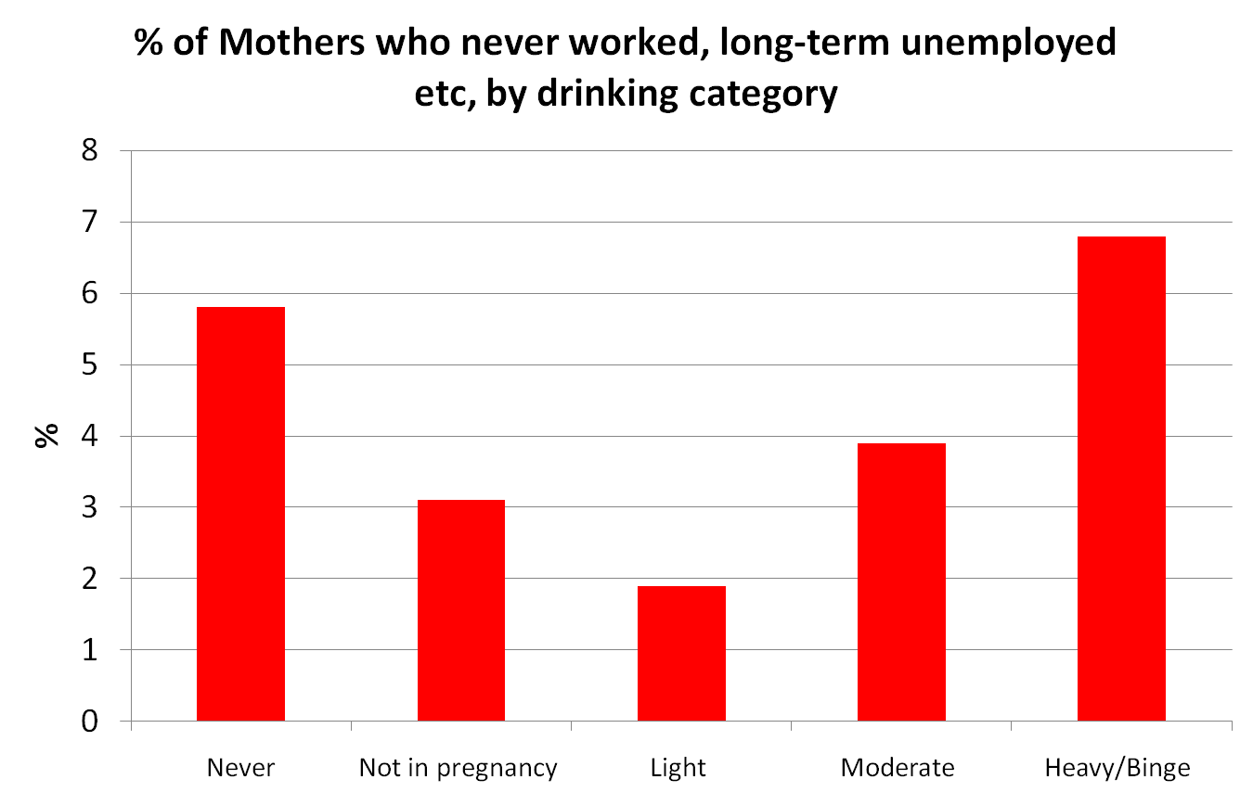
Kelly Y, Sacker A, Gray R et al. J Epidemiol Community Health (2010), doi:10.1136/jech.2009.103002

Slide 46
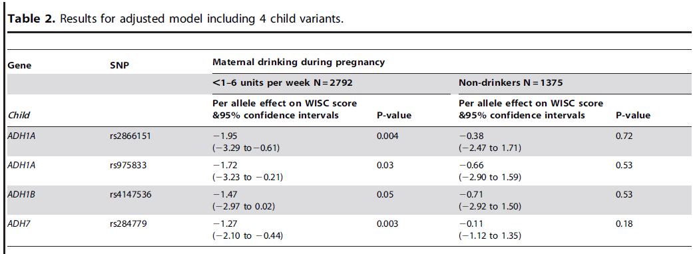
Maternal Alcohol Dehydrogenase and Offspring IQ

Slide 47
Alcohol dehydrogenase (ADH) risk allele score in offspring and offspring IQ, stratified by maternal alcohol intake during pregnancy
IQ Change
Women not drinking in pregnancy
All women
Women drinking during pregnancy
P value for interaction of risk allele score and drinking during pregnancy equals 0.009
Lewis S et al, PLoS One Nov 2012.

Slide 48
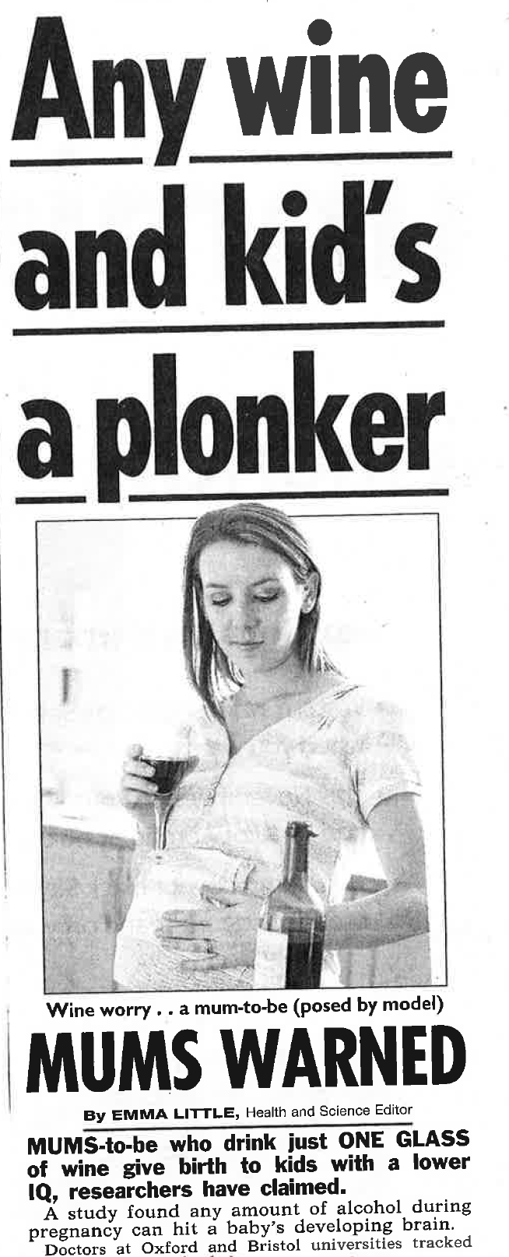


Slide 49
Two Step Mendelian Randomization
(Mediation Analysis)
FTO
BMI
CHD
LDL
HMGCR
How much of the effect of BMI on CHD is mediated through LDL?
Can be done using two sample MR

Slide 50
Multivariable MR
SNP1
SNP2
Fat Mass
SNP3
Bone Mineral Density
(Osteoporosis)
SNP4
Lean Mass
SNP5

Slide 51
Mendelian Randomization and
Drug Targets
Thanks Sek Kathiresan

Slide 52
Late Stage Failure in Drug Trials
Cook et al. (2014) Nat Rev Drug Disc

Slide 53
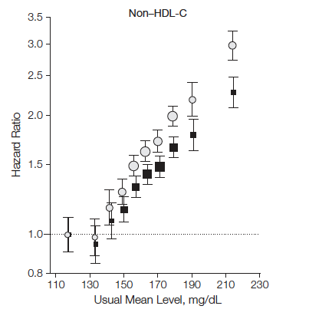
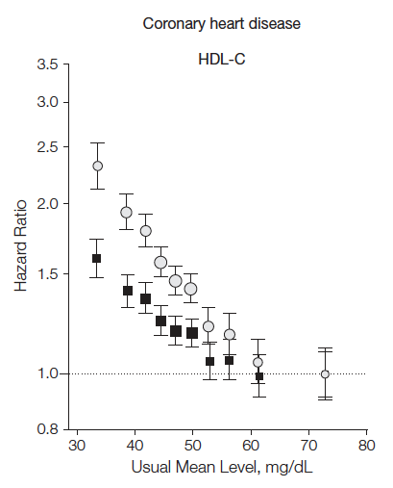
Association of LDL-C, HDL-C, and risk for coronary heart disease (CHD)
LDL-C
HDL-C
302K participants in 68 prospective studies
Emerging Risk Factors Collaboration, JAMA 2009

Slide 54
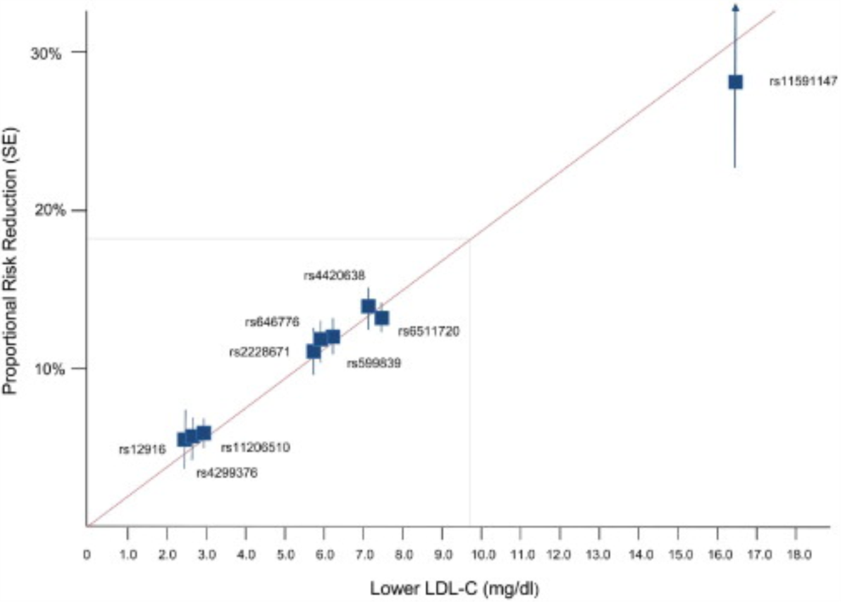
LDL and CHD Risk
Ference et al, JACC 2012

Slide 55
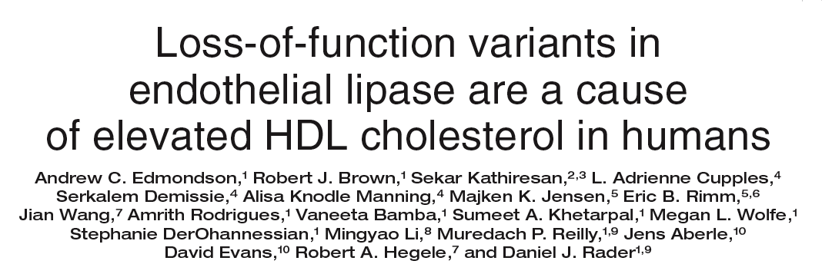
HDL: endothelial lipase Asn396Ser
2.6% of population carry Serine allele
higher HDL-C
No effect on other lipid fractions
No effect on other MI risk factors
Edmondson, J Clin Invest 2009

Slide 56
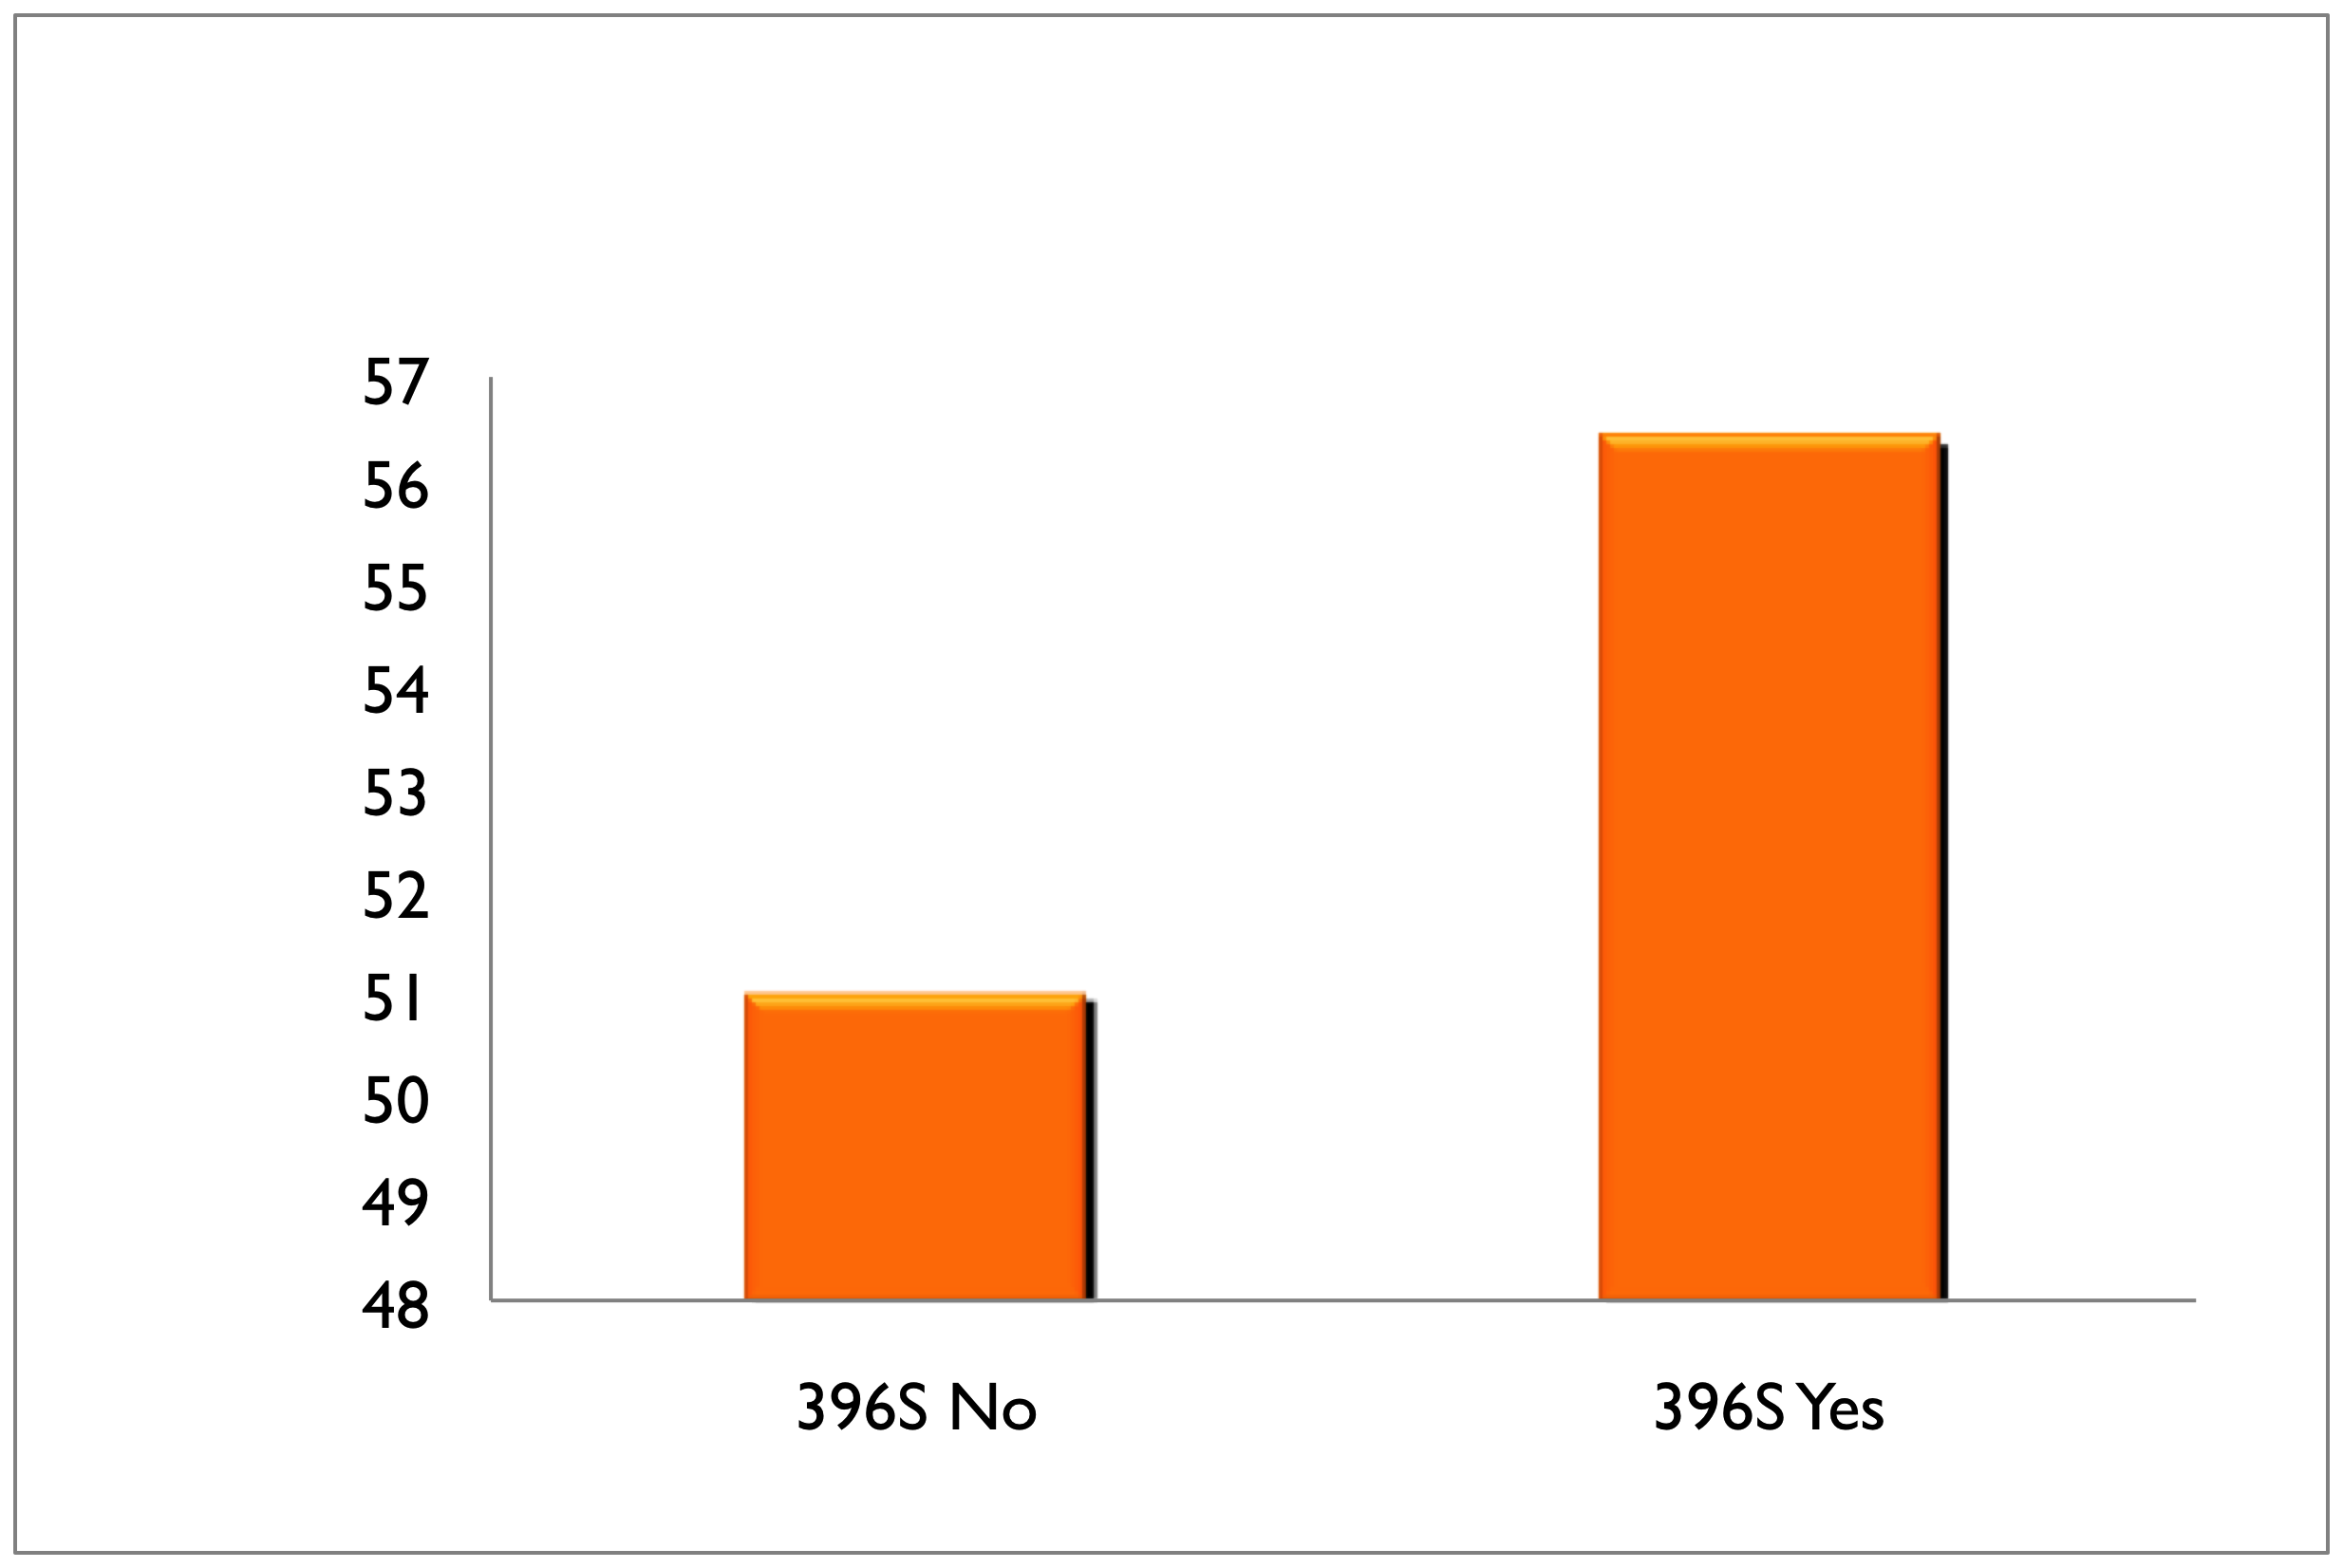
LIPG N396S and plasma HDL-C
HDL Difference
396S carriers have
5.5 mg/dl higher HDL-C
P<10⁻⁸
Notes:
Odds Ratio for MI:
0.54 (0.40 – 0.72)
P=2x10⁻⁵
N=3490 cases,
3497 controls

Slide 57
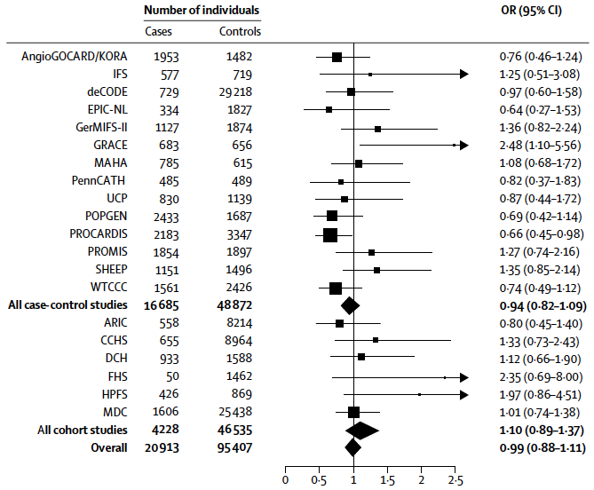
After testing in 116,320 people, summary OR for LIPG Asn396Ser is 0.99

Slide 58
Individuals who carry the HDL-boosting variant have the same risk for heart attack
as those who do not carry the variant

Slide 59
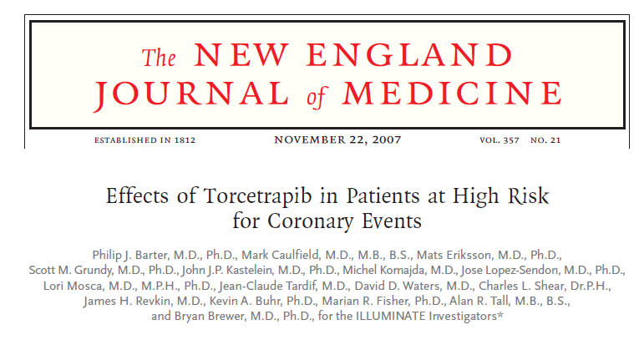
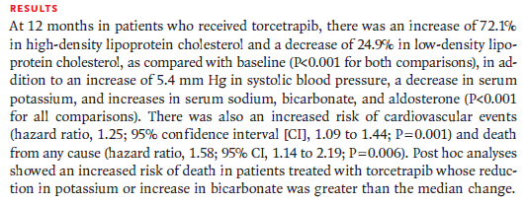

Slide 60
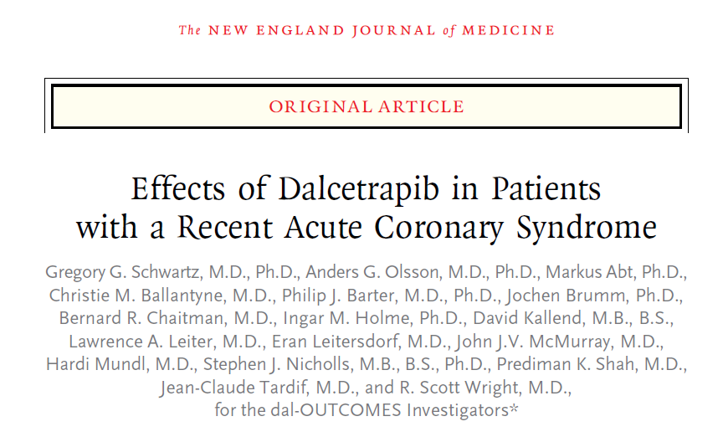
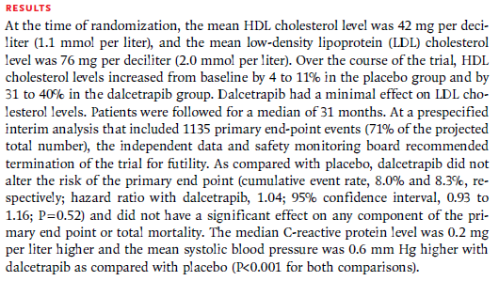

Slide 61
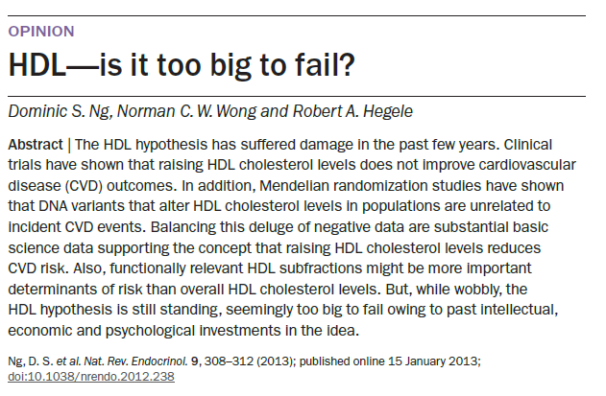

Slide 62
Mining the Phenome

Slide 63
“Mining the Phenome” (Using Allelic Scores)
SNP1
SNP2
SNP3
SNP4
Intermediate
Disease
(Gene expression)
...
(Methylation)
(Metabolomics)
SNP_{N}
(Proteomics)
Evans et al. (2013) PLoS Genet
Notes:
2 conceptual advances in paper

Slide 64
Using Anonymous Genome-wide Allelic Scores to Inform Causality (?)

Slide 65
GW Scores NOT Good For Causal Inference

Slide 66
Mining the Phenome and Hypothesis-Free Causality
Evans & Davey Smith (2015) Ann Rev Genom Hum Genet

Slide 67
Transcriptome-wide Association Studies

Slide 68



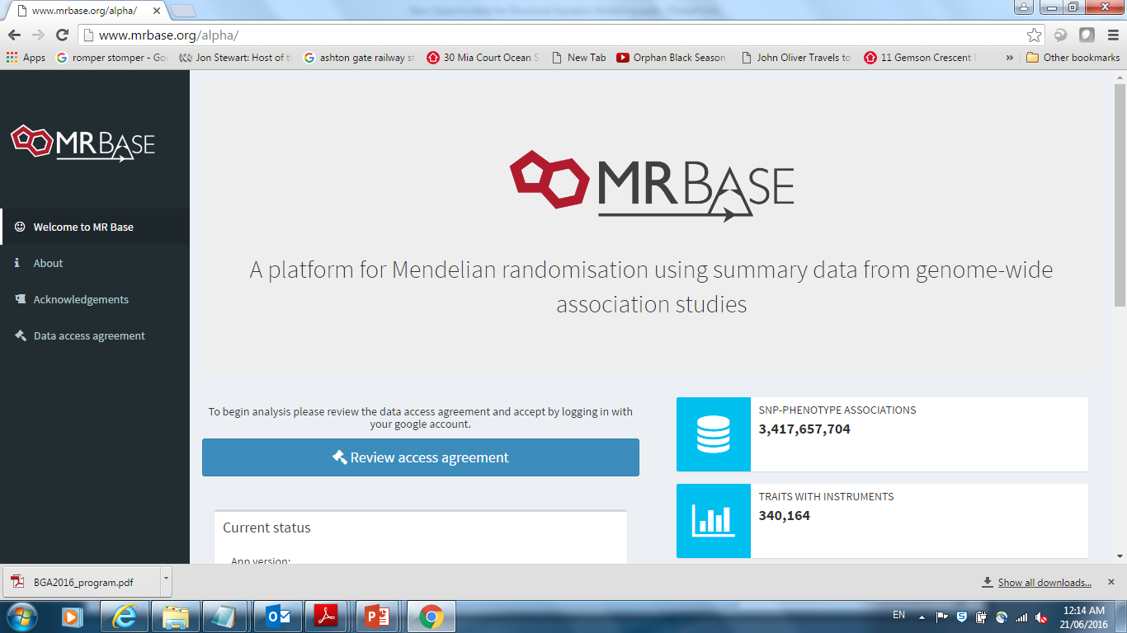
MR Base
http://www.mrbase.org/
Jie “Chris” Zheng
Gib Hemani
Phil Haycock

Slide 69
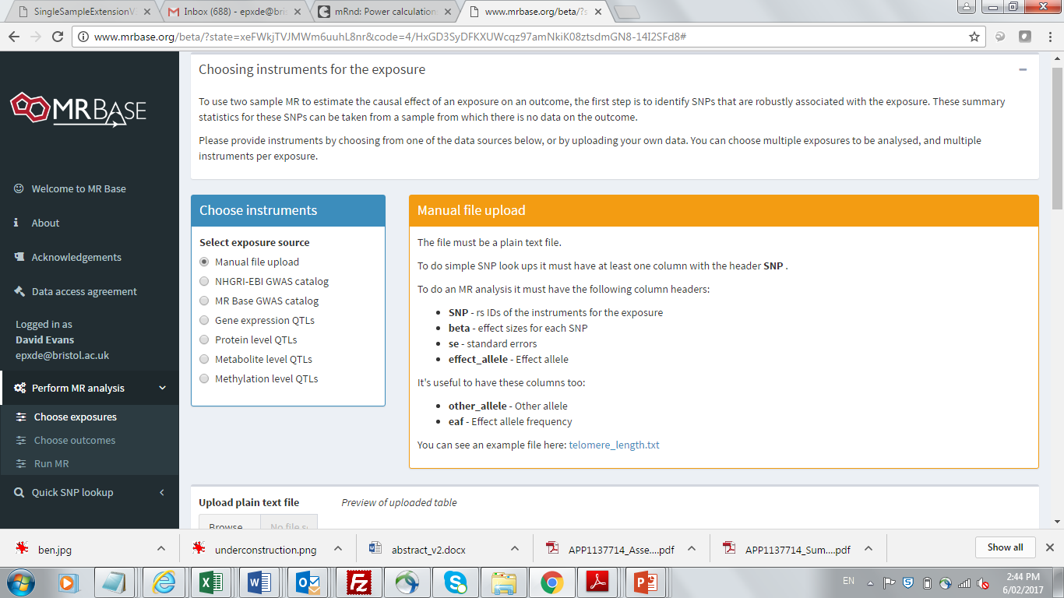

Slide 70
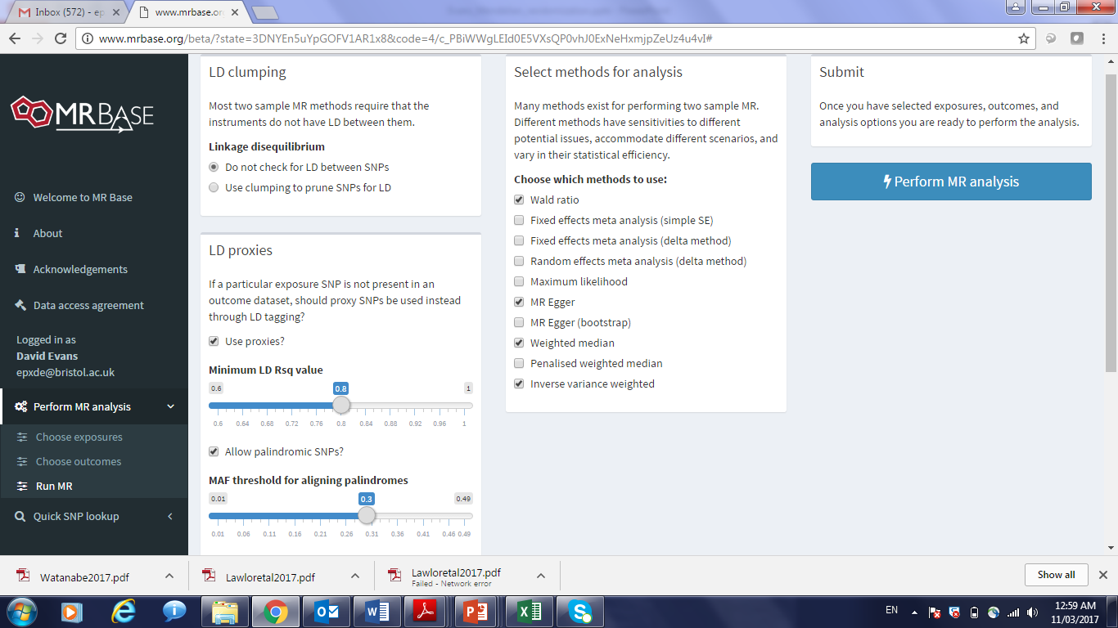

Slide 71
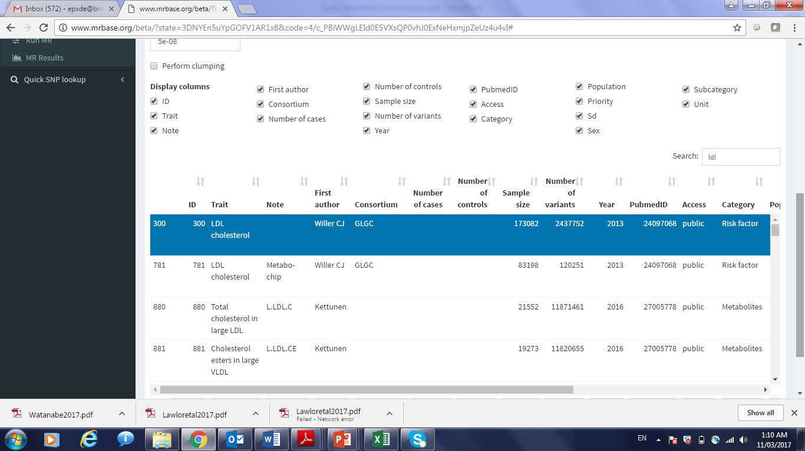

Slide 72
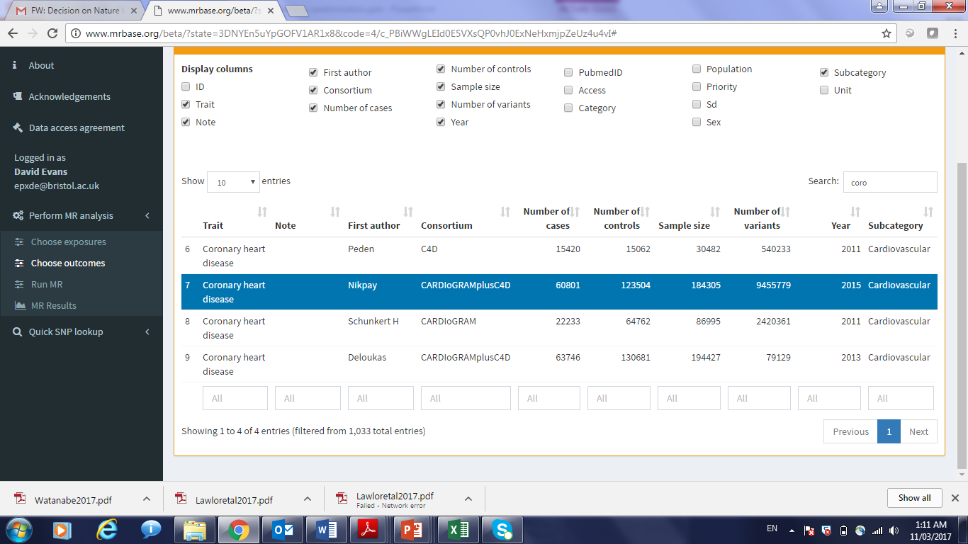

Slide 73
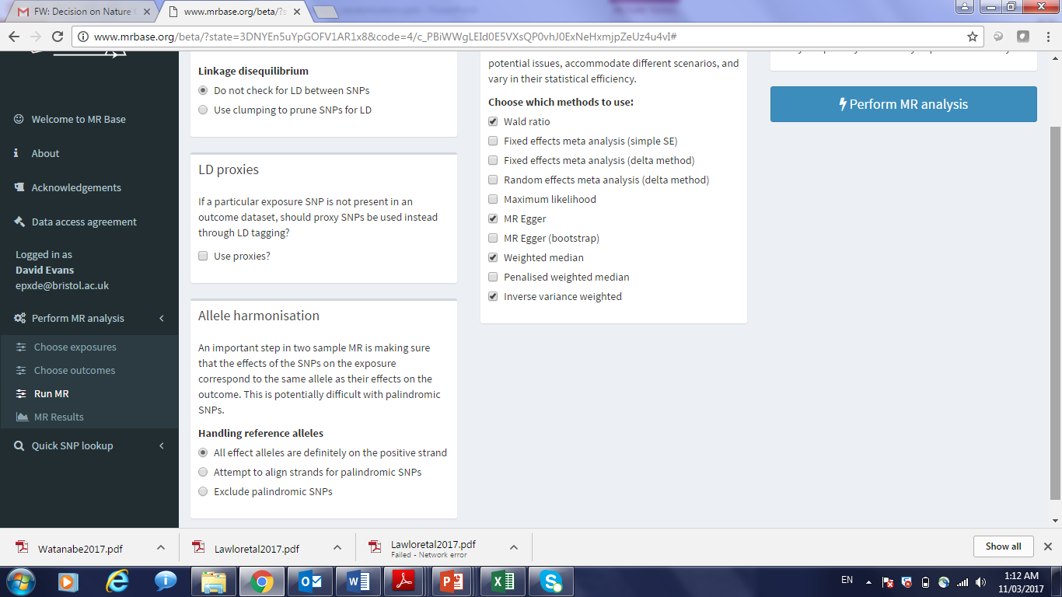

Slide 74
Useful References
Bowden et al (2015). Mendelian randomization with invalid instruments: effect estimation and bias detection through Egger regression. Int J Epidemiol, 44, 512-25.
Bowden et al (2016). Consistent estimation in Mendelian randomization with some invalid instruments using a weighted median estimator. Genet Epidemiol, 40, 304-14.
Brion et al (2013). Calculating statistical power in Mendelian randomization studies. Int J Epidemiol, 42(5), 1497-501.
Burgess & Thompson (2015). Multivariable Mendelian randomization: the use of pleiotropic genetic variants to estimate causal effects. Am J Epidemiol, 181, 251-60.
Davey-Smith & Hemani (2014). Mendelian randomization: genetic studies for causal inference in epidemiological studies. Hum Mol Genet, 23(1), R89-98.
Davey-Smith & Ebrahim (2003). “Mendelian randomization”: can genetic epidemiology contribute to understanding environmental determinants of disease? IJE, 32, 1-22.
Evans & Davey-Smith (2015). Mendelian randomization: New applications in the coming age of hypothesis free causality. Annu Rev Genomics Hum Genet, 16, 327-50.

Slide 75
Practical

