Slide 1
Mendelian randomization with invalid instruments: Egger regression and Weighted Median Approaches
David Evans

Slide 2
What is the problem?
Mendelian Randomization (MR) uses genetic variants to test for causal relationships between phenotypic exposures and disease-related outcomes
Due to the proliferation of GWAS, it is increasingly common for MR analyses to use large numbers of genetic variants
Increased power but greater potential for pleiotropy
Pleiotropic variants affect biological pathways other than the exposure under investigation and therefore can lead to biased causal estimates and false positives under the null

Slide 3
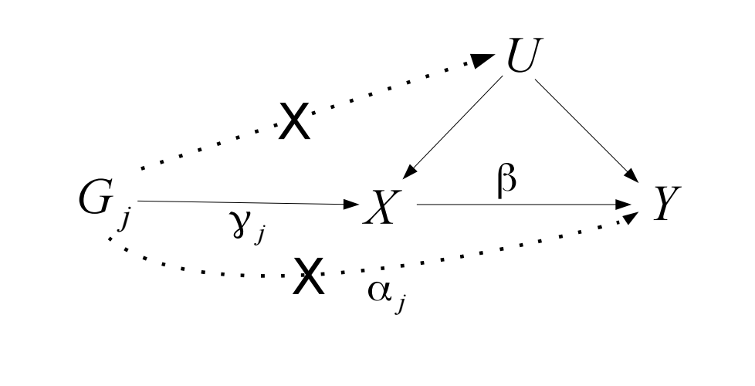
Two Sample MR: Single Variants
Wald = Beta-GY
Beta-GX
Causal estimate using Wald method:
Notes:
Single causal estimate from the ratio estimator / Wald method

Slide 4
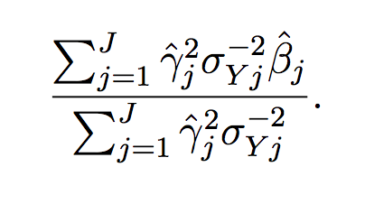
Two Sample MR: Multiple Variants
Causal estimate using IVW
from summarised data:
(Approximates TSLS)
Notes:
With multiple genetic variants, causal effect estimated using TSLS – weighted average of the ratio estimates calculated using each genetic variant in turn.
If the genetic variants are uncorrelated, inverse-variance weighted estimated using summarized data can be calculated.
In infite samples IVW = TSLS, but will differ slightly in finite samples
Beta-hat = study specific IV estimates (YZ/XZ)

Slide 5
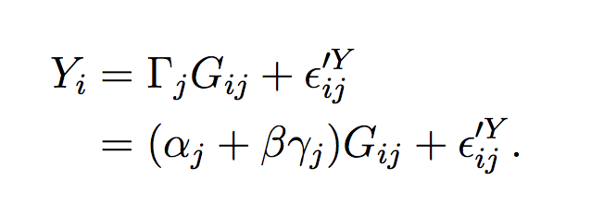
MR – with direct pleiotropy
.
Single variant Wald estimate:
Multiple variant
TSLS / IVW :
Notes:
Estimate will be biased unless alphaj = 0; or the alphaj’s cancel out

Slide 6
Egger Regression: Central concept
In Mendelian Randomization when multiple genetic variants are being used as IVs, Egger regression can:
Identify the presence of ‘directional’ pleiotropy
(biasing the IV estimate)
provide a less biased causal estimate
(in the presence of pleiotropy)

Slide 7
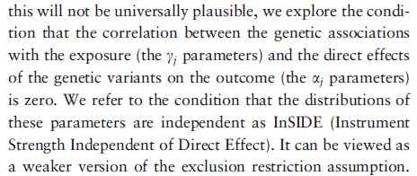
InSIDE Assumption
Relaxing MR’s assumptions
.
W
Notes:
Standard MR has 3 assumptions.
InSIDE relaxes the third assumption

Slide 8
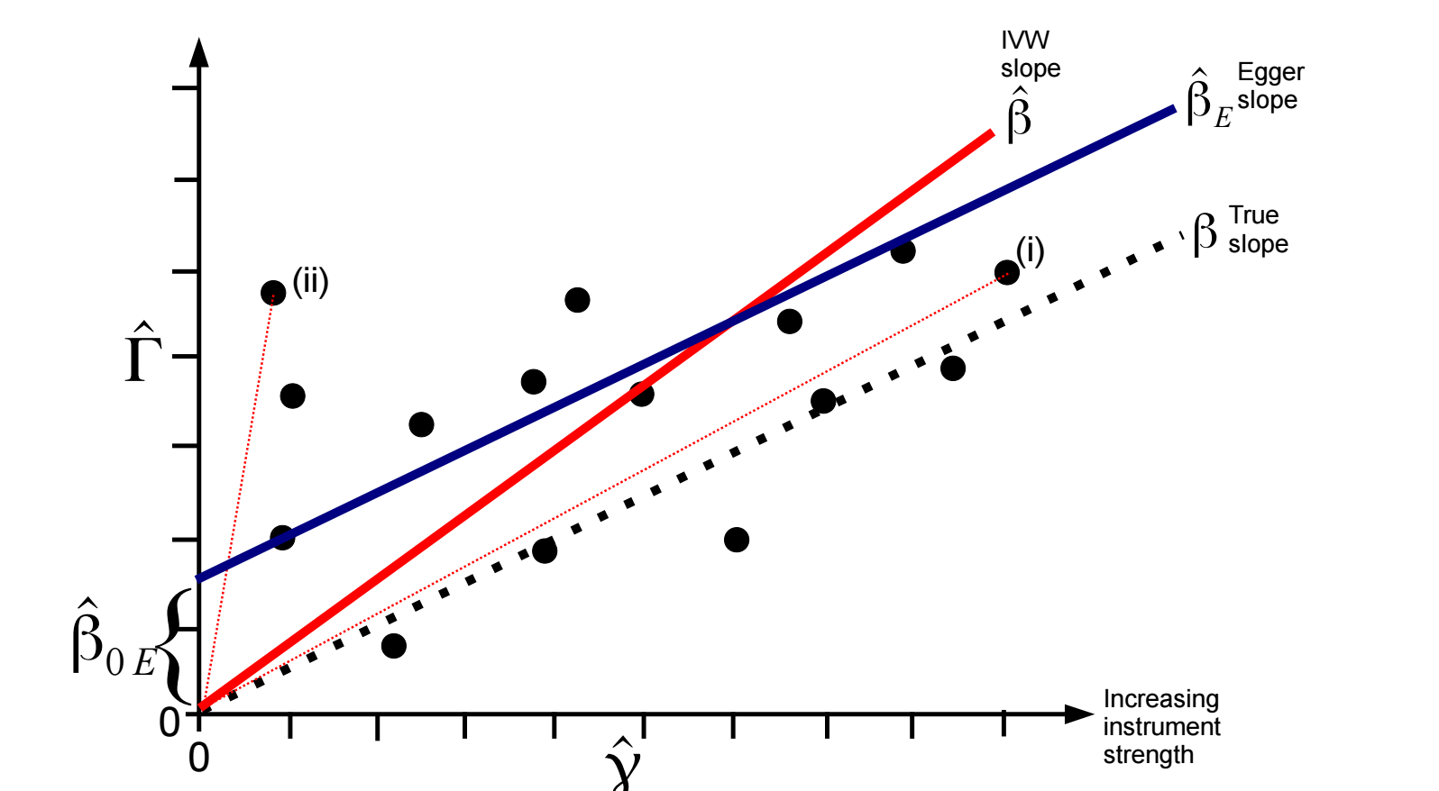
Example:
ALL INVALID INSTRUMENTS
INSIDE ASSUMPTION SATISFIED
SNP – outcome association
SNP – exposure association
Notes:
This is equal to the coefficient
from a weighted regression of the gene–outcome association
estimates (^C j) on the gene–exposure association estimates
(^cj) with the intercept constrained to zero, and
weighted by the inverse of the precision of the IV–outcome
coefficients (r2
Yj ).

Slide 9
InSIDE: Bias of ratio estimator
SNP – outcome association
SNP – exposure association
Notes:
Since bias is inversely proportional to SNP-exposure association, ratio estimates for stronger genetic variants (such as (i) ) will be on average closer to the true causal effect

Slide 10
Egger regression: Intercept not constrained to zero
Egger’s test assesses whether the intercept term is significantly different from zero. The estimated values of the intercept can be interpreted as the average pleiotropic effect across all genetic variants. An intercept term different from zero indicates directional pleiotropy
Notes:
Egger’s test assesses whether the intercept term is significantly different from zero. This will occur if estimates from weaker genetic variants are more skewed towards higher/lower values compared with estimates from stronger genetic variants.
The estimated values of the intercept can be interpreted as average pleiotropic effect across all genetic variants.
An intercept term different from zero indicates overall directional pleiotropy (ie pleiotropy not balanced around the null)

Slide 11
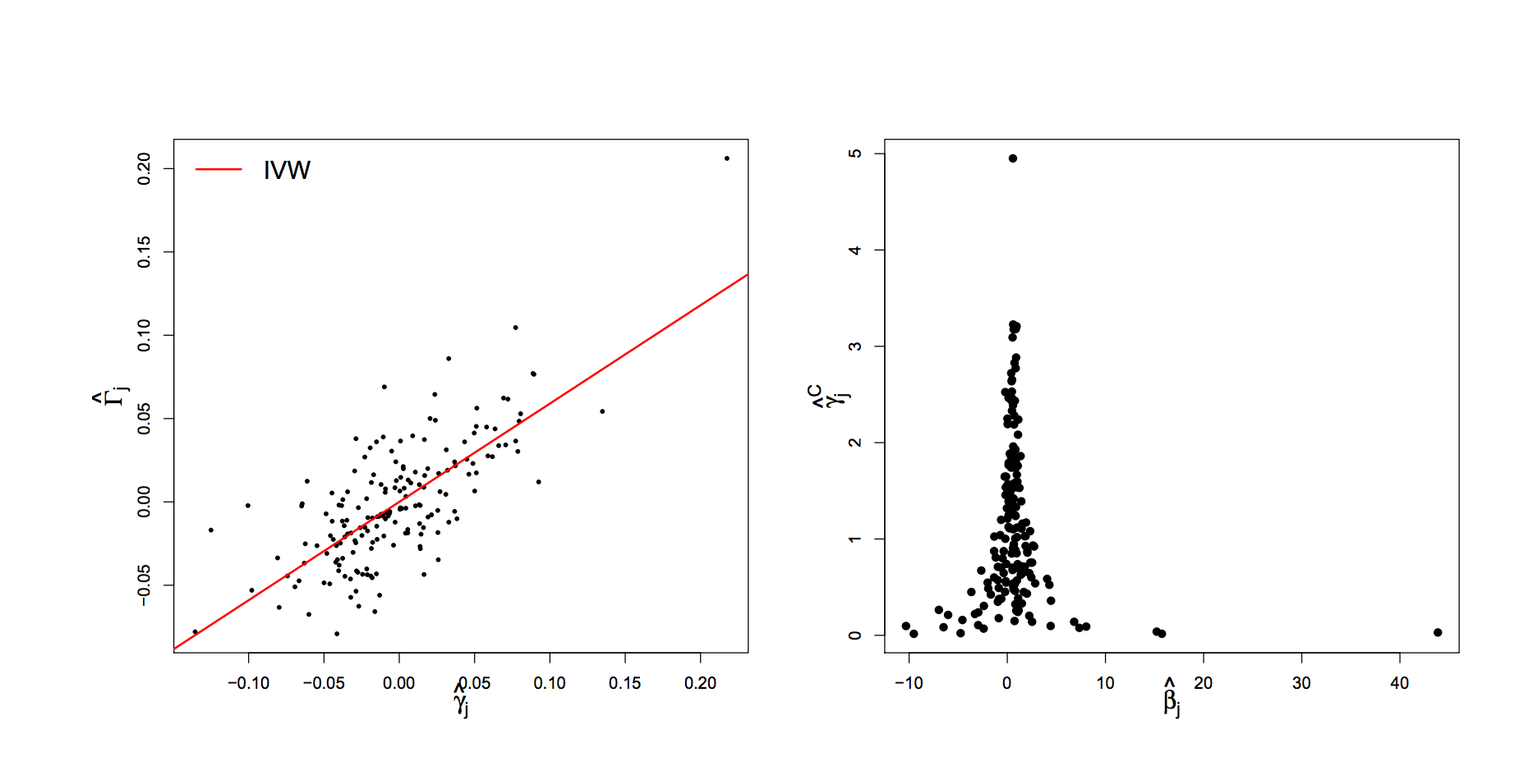
Height and lung function
SNP-Lung Function
SNP-Height
SNP - Height
Causal estimate
IVW = 0.59 (95% CI: 0.50, 0.67 )
Egger = 0.58 (95% CI: 0.50, 0.67); intercept -0.001 p=0.5
Notes:
180 variants for height
Funnel plot suggests little asymmetry present (indicative of no directional pleiotropy); supported by concordance between egger test and IVW, and the lack of significant intercept

Slide 12
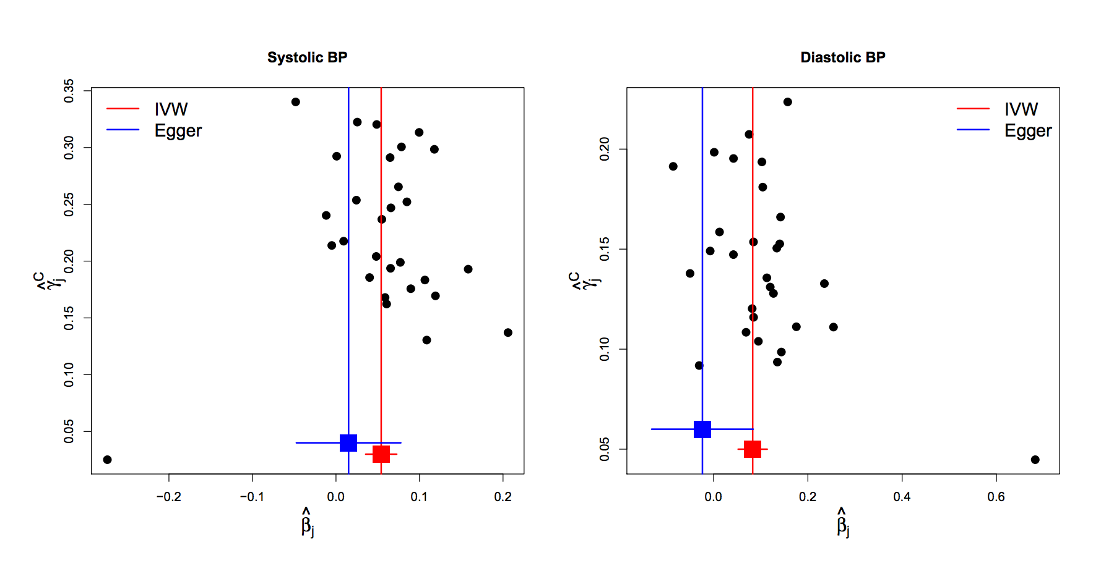
BP and Coronary Disease
FUNNEL PLOTS
Visual evidence for asymmetry
Notes:
Some asymmetry is present in these funnel plots, consistent with directional pleiotropy
Eg for SBP, 10 of the 13 weakest variants have IV estimates greater than the IVW causal effect

Slide 13
BP and Coronary Disease
FUNNEL PLOTS
Notes:
Some asymmetry is present in these funnel plots, consistent with directional pleiotropy
Eg for SBP, 10 of the 13 weakest variants have IV estimates greater than the IVW causal effect

Slide 14
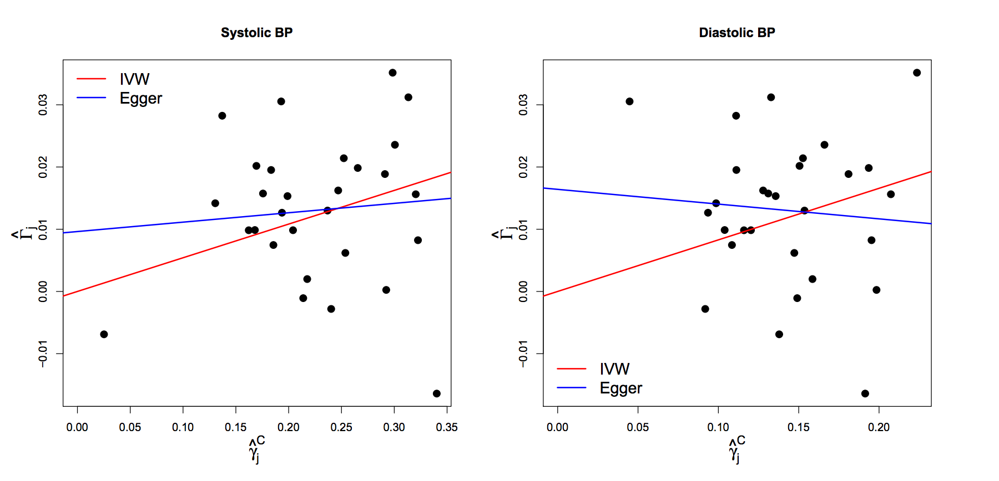
BP and Coronary Disease Scatter Plots
Egger test for intercept p=0.2
Egger test for intercept p=0.054
Notes:
Intercepts deviate from zero but not strong statistical evidence for difference!

Slide 15
BP and Coronary Disease
FUNNEL PLOTS
IVW= 0.054 logOR/mmHg p=4x10⁻⁶
Egger =0.015 logOR/mmHg p=0.6
IVW= 0.083 logOR/mmHg p=1x10⁻⁵
Egger =-0.024 logOR/mmHg p=0.7

Slide 16
Simple Median Method
Order instrumental variables estimates and take the median
Like all subsequent estimators it enjoys a 50% breakdown limit

Slide 17
Weighted Median Method
^
γ_{j}²
w_{j}’
w_{j}’ =
___
w_{j} =
____
σ²_{Yj}
Σ_{j}w_{j}’

Slide 18
Penalized Weighted Median Method
Although the invalid IVs do not contribute directly to the median estimate, they do
influence it in small samples
Like all subsequent estimators it enjoys a 50% breakdown limit

Slide 19
Penalized Weighted Median Method
One way of minimizing this problem is down-weighting the contribution to the analysis of genetic variants with heterogeneous ratio estimates
Heterogeneity between estimates can be quantified by Cochrane’s Q statistic:
The Q statistic has a chi-squared distribution on J – 1 degrees of freedom under the null hypothesis of no heterogeneity
Each individual component of Q has a chi-square distribution with 1 df. Bowden proposes using a one sided upper P value (denoted q_{j}):
Q = Σ_{j}Q_{j}
=
^
^
Σ_{j}w_{j}’(β_{j} - β)²
w_{j}* = w’_{j} × min(1, 20q_{j})

Slide 20
Penalized Weighted Median Method

Slide 21
References
Mendelian randomization with invalid instruments: effect estimation and bias detection through Egger regression. Bowden J, Davey Smith G, Burgess S.
Int J Epidemiol. 2015 Apr;44(2):512-25.
Consistent Estimation in Mendelian Randomization with Some Invalid Instruments Using a Weighted Median Estimator. Bowden J, Davey Smith G, Haycock PC, Burgess S. Genet Epidemiol. 2016 May;40(4):304-14.

