Slide 1
METAL Practical
You have ran a GWA analysis.
We will take the results file and a second results file to run a meta-analysis using METAL
Copy files from faculty/meike/2017/metal-practical to your own folder

Slide 2
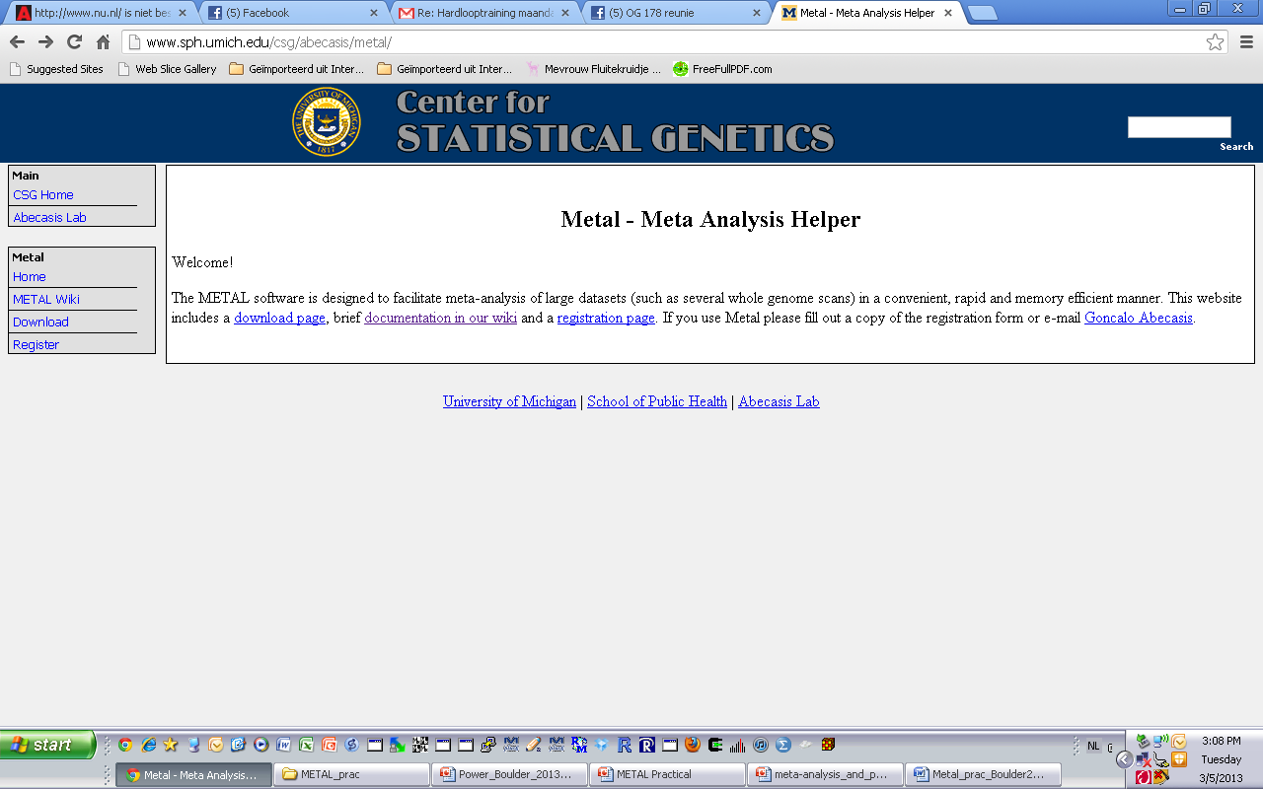
METAL
http://www.sph.umich.edu/csg/abecasis/metal/
Documentation can be found at the metal wiki:
http://genome.sph.umich.edu/wiki/Metal_Documentation

Slide 3
METAL
Metal is flexible
By default, METAL combines p-values across studies (sample size, direction of effect)
Alternative, standard error based weights (but beta and standard error use same units in all studies)

Slide 4
METAL
Requires results files
‘Driver’ file
Describes the input files
Defines meta-analysis strategy
Names output file

Slide 5
Steps
Check format of results files
Ensure all necessary columns are available
Modify files to include all information
Prepare driver file
Ensure headers match description
Crosscheck each results file matches Process name
Run metal

Slide 6
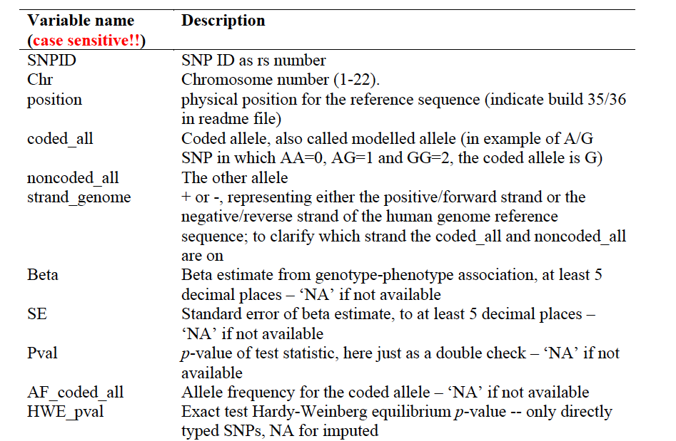
Results Files
Previously asked for standard columns in SOP
Current procedure is to upload complete files (results and info files)

Slide 7
INPUT FILES
We will use the GWAs results (results1.txt)
We will use a second set of results (results2.txt)

Slide 8
Columns METAL uses
SNP
OR
SE [for standard error meta-analysis]
P-value [for Z-score meta-analysis]
If we had two samples of different sizes we would have to add an N/weight column

Slide 9
Meta-analysis running
We will run meta-analysis based on effect size and on test statistic
For the weights of test statistic, I’ve assumed that the sample sizes are the same
METAL defaults to weight of 1 when no weight column is supplied

Slide 10
Step 2: driver file: meta_run_file
# PERFORM META-ANALYSIS based on effect size and on test statistic
# Loading in the input files with results from the participating samples
# Note: Order of samples is …[sample size, alphabetic order,..]
# Phenotype is ..
# MB March 2017
MARKER SNP
ALLELE A1 A2
PVALUE P
EFFECT log(OR)
STDERR SE specifies column names
PROCESS results1.txt
PROCESS results2.txt processes two results files
OUTFILE meta_res_Z .txt Output file naming
ANALYZE Conducts Z-based meta-analysis from test statistic
CLEAR Clears workspace
SCHEME STDERR Changes meta-analysis scheme to beta + SE
PROCESS results1.txt
PROCESS results2.txt processes two results files
OUTFILE meta_res_SE .txt Output file naming
ANALYZE Conducts effect size meta-analysis

Slide 11
Larger Consortia
# Labels
SEPARATOR TAB
MARKER cptid
ALLELE EFFECT_ALLELE OTHER_ALLELE
EFFECT BETA
PVALUE PVAL
FREQ EAF
WEIGHT N
# Options
SCHEME SAMPLESIZE
MINMAXFREQ ON
AVERAGEFREQ ON
GENOMICCONTROL 0.999
# Process files
PROCESS CLEANED.1958T1D.LS.gz
PROCESS CLEANED.BASE.LS.gz
PROCESS CLEANED.HNRSoexpr.LS.gz
PROCESS CLEANED.HRS.LS.gz
PROCESS CLEANED.NHSBRCA.LS.gz
PROCESS CLEANED.RUSHMAP.LS.gz
PROCESS CLEANED.1958WTC.LS.gz
PROCESS CLEANED.EGCUT370.LS.gz
PROCESS CLEANED.HNRSomni1.LS.gz
PROCESS CLEANED.KORAF3.LS.gz
PROCESS CLEANED.NHSCHD.LS.gz
PROCESS CLEANED.TEDS.LS.gz
PROCESS CLEANED.AGES.LS.gz
PROCESS CLEANED.EGCUTOMNI.LS.gz
PROCESS CLEANED.HPFSCHD.LS.gz
Etc
####################################################################
# Analyse and output
MINWEIGHT 50000
ANALYZE HETEROGENEITY
QUIT

Slide 12
Running metal
metal < metal_run_file
metal is the command
metal_run_file is the driver file
This will output information on the running of METAL things to standard out [the terminal]
It will spawn 4 files:
2 results files: meta_res_Z1.txt + meta_res_SE1.txt
2 info files: meta_res_Z1.txt.info + meta_res_SE1.txt.info

Slide 13
Output
Overview of METAL commands
Any errors
And your best hit from meta-analysis

Slide 14
To load into Haploview
We have to change the header
In the same directory run:
./reformat.sh
This changes 1st column name to SNP
We can then load the meta-analysis results files into haploview
Same as before but load in the meta_res_Z1.txt
Make sure to include gwas-example.bim

Slide 15
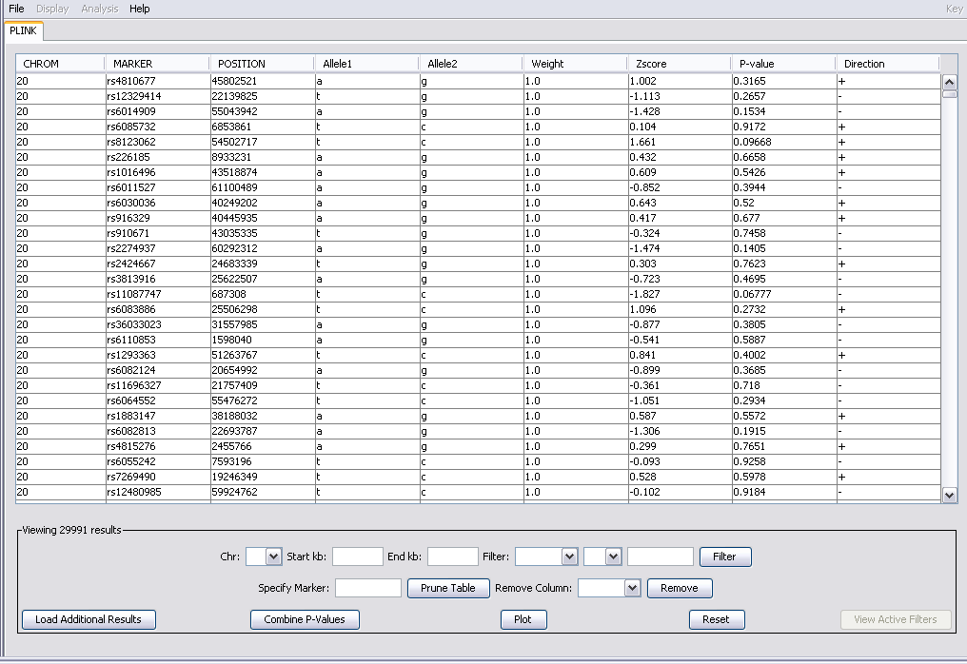

Slide 16
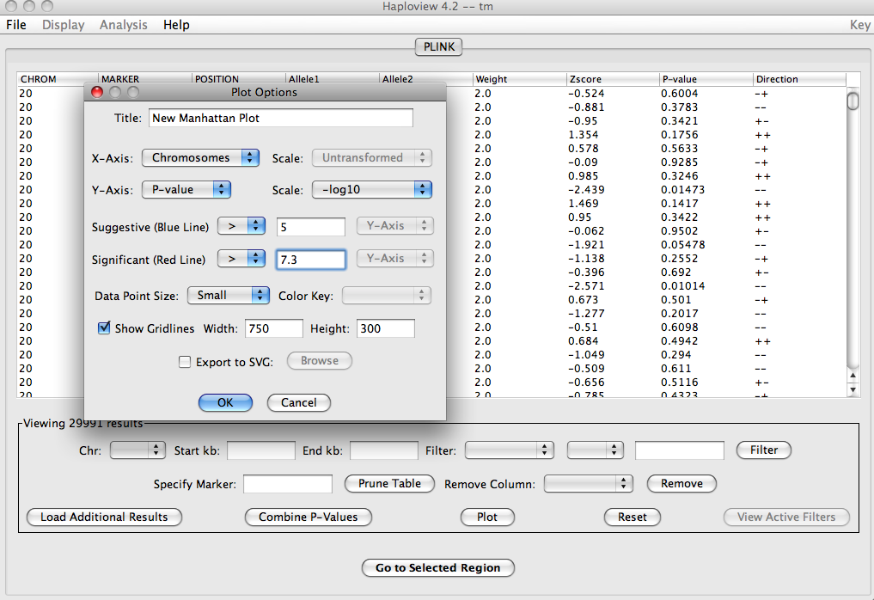
Plot

