Slide 1
Quality Control Using EasyQC & Meta-Analysis in METAL
Meike Bartels & Bart Baselmans

Slide 2
GWAMA
Large Collaborative Studies to increase sample size
Different Cohorts run their own GWA and upload summary statistics
To make these projects successful and trustworthy, we need rigorous organisation AND quality control (QC)

Slide 3
SOP

Slide 6
298,420 individuals
181 scientists
145 institutions
167 different files

Slide 7
Okbay et al., Nature Genetics, 2016

Slide 8
EasyQC
For the well-being GWAMA, we used EasyQC for QC-ing the GWAS summary statistics
Positive experience because it provides guidelines how to perform QC at the:
At the study file level
The meta-file level
And the meta-analysis OUTPUT level

Slide 9
What needs to be detected
File name errors -> sounds simple doesn’t it, but with 167 files it is essentiel that all files can be traced back to a specific cohort
Incorrect specification of the Phenotype
Flipped alleles
Duplicated SNPs
Bad imputation quality
Association issues from incorrect analysis models
Population stratification
Improper model adjustments
Unaccounted relatedness of individuals

Slide 10
These errors
Limit the contribution of a specific cohort to the meta-analysis
or
Inflate the number of type I errors <- DANGER!!

Slide 11
Descriptive Summary Statistics
Participating cohorts were asked to complete a descriptive statistics summary file for their sample
8 cohorts did not specify their question, or did not report the distribution of the question (no categories specified)
3 cohorts that actually gave lower values to higher wellbeing (reversed coding)
8 cohorts that did not map the categories to numeric values, but where the first option was higher wellbeing (suspicious reversed coding)

Slide 12
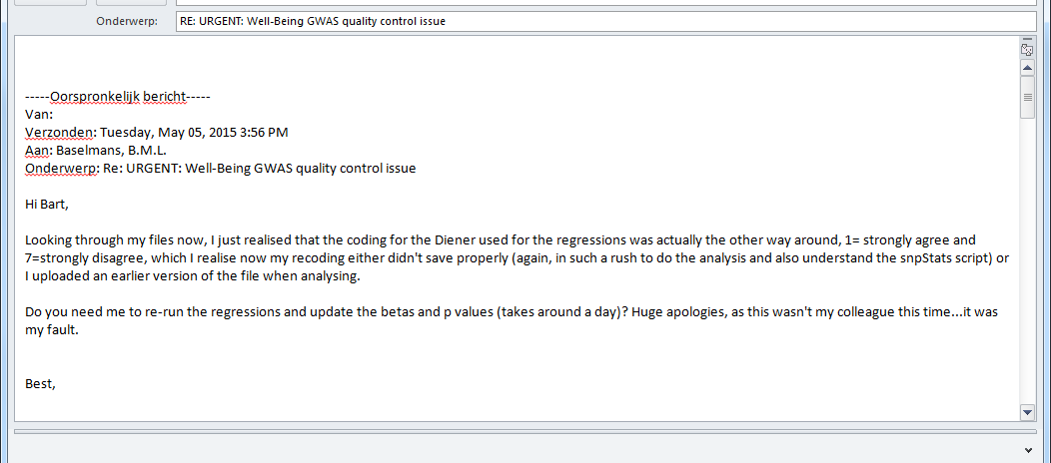
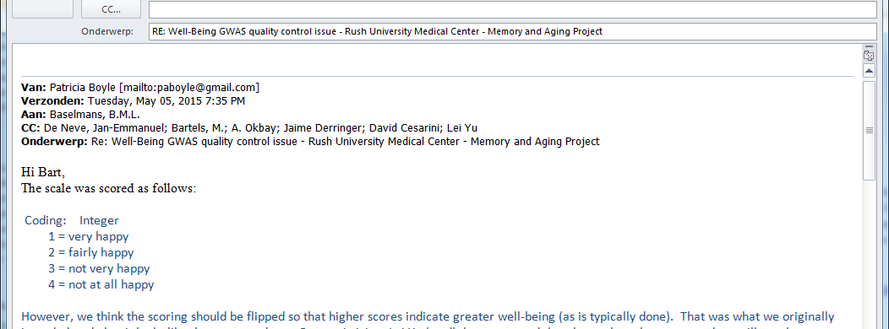

Slide 15
QC workflow- step 1
Step 1: File level QC
This stage involves cleaning of the data
Deleting poor quality data
Provide summaries to judge data quality
Think about
Monomorphic SNPs
Missingness (e.g. P-values, Beta’s, SE’s and more)
Nonsensical information (e.g Alleles other than A, C, G or T, or pvalues larger than 1 or smaller than 0 etc)
Harmonization of SNP identifiers

Slide 16
QC workflow – step 2
Step 2: Meta level QC
This stage consists of the cross -study comparison of statistics to identify study specific problems.
Think about
QQ-plots – to detect early signs of inflation that might be an indication of relatedness problems
PZ plots -> by B/SE you calculate the corresponding Z statistics. From Z you can obtain P, which can be compared to the actual reported P-value.
AF plots -> compare the reported allele frequencies to a reference data set

Slide 17
QC workflow – step 3
Compare results with the other data-analyst and resolve any issues remaining

Slide 18
Practical today
Focus on Step 1 and Step 2

Slide 19
faculty/meike/2017/EasyQC
faculty/meike/2017/Metal

Slide 20
EASY QC Practical
Write down on the whiteboard
Number of removed indels
Number of removed badly imputed SNPS
How many SNPs not in reference set?
How many SNPs with MAF below threshold?

Slide 21
OUTPUT
Write down on the whiteboard
Number of removed indels -> 3666
Number of removed badly imputed SNPS ->15
How many SNPs not in reference set? ->32
How many SNPs with MAF below threshold? ->8569

Slide 22
CHECK FINAL DATA
The cleaned file
Zless CLEANED.PRATICAL.gz | head | column -t

Slide 23
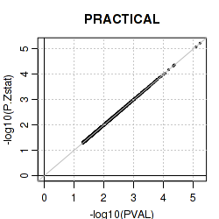
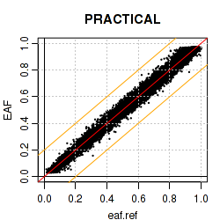
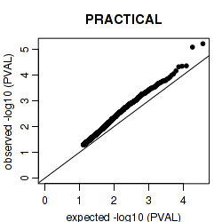
CHECK PLOTS

Slide 24
CHECK OUTPUT SUMMARY
Check .rep file
You open this file in excel-like programms
Import second and third column
2nd: number of SNPs in input file
3rd: number of SNPs that survived your QC
Check also other columns

