Slide 1

Analysis of next-generation sequencing data using PLINK/SEQ
Douglas Ruderfer
douglas.ruderfer@mssm.edu
Boulder Workshop
March 4th 2015

Slide 2
Sequencing technologies
Alignment and variant calling
Gene testing methodology
Variant annotation
Covered
earlier
today
Focus for this session:
What to expect from a sequencing
Study? what the data look like?
genotype-phenotype analysis?
Analyzing sequencing data

Slide 3
Overview
Brief introduction to sequence analysis
  Quality control in sequencing studies
Getting familiar with PLINK/SEQ
  Basic command format
  Some initial commands
PLINK/SEQ Practical
  Viewing sequencing data
  Filtering or QC-ing data
  Annotation within PLINK/SEQ
  Variant and Gene based association

Slide 4
QC: things to watch out for in sequencing datasets

Slide 5
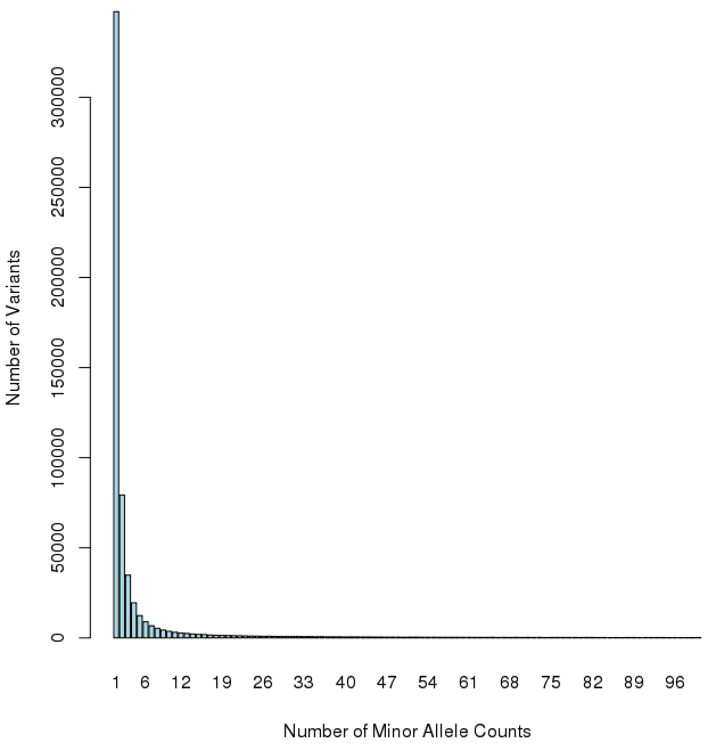
Most variants are rare
Many or most variants will be seen only once, nearly all will be seen only a few times
Some variant based QC metrics used in GWAS are less effective
Hardy-Weinberg Equilibrium
Allele frequency comparison to population or other controls
Similar concerns exist as in GWAS
Population structure
Batch effects
Low quality samples
Plus additional sequencing issues (alignments, homo-polymer runs, indels, etc)
Allele counts from 5k exomes

Slide 6
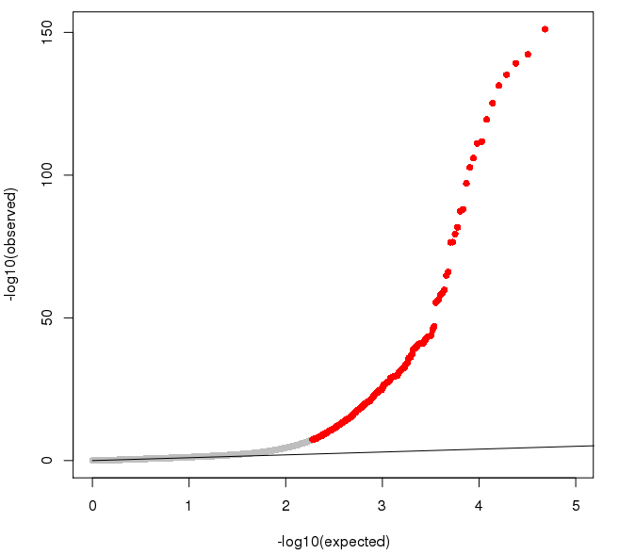
Sequence analysis requires extensive QC
qq-plot from association in exome sequencing data (1000 cases, 2500 controls)
Excessive inflation persists despite:
Ancestry matched sample
Sequencing being done at the same center with the same technology
Variants being called across all samples together
Lots of technical errors to identify that requires specific QC for sequencing data
Threshold | # SNPs
5x10⁻⁸ | 507
5x10⁻⁷ | 610
5x10⁻⁶ | 755
5x10⁻⁵ | 1000
5x10⁻⁴ | 1451

Slide 7
Levels of QC for sequencing data
At the individual’s genotype
  Allele balance, read depth, consistent local LD, mapping quality, etc.
  GQ/PL are a summary representation (good but not perfect)
At the variant site for all individuals
  Hardy-Weinberg equilibrium (less effective for rare variants), proportions of high quality genotypes
  Variant calling filter (PASS)
At the individual level for the whole exome/genome
  Number of variants, singletons, % in dbSNP, IBS between pairs, mean coverage, Transition/Transversion ratio (TiTv), heterozygosity
At the whole sample level
  TiTv, number of variants, % dbSNP

Slide 8
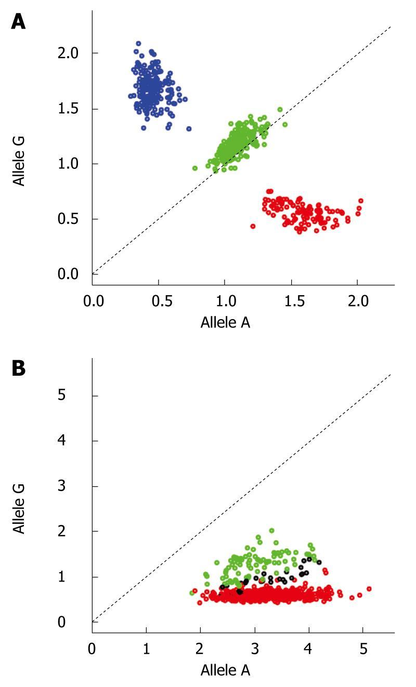
What is the sequencing equivalent of the GWAS intensity plots?
Since most variants are rare we can look at technical properties of the genotype call

Slide 9
Viewing raw data of a single variant in a single individual provides a lot of info
G
G
G
G
G
Sequencing reads
G
G
G
G
ACGTGACTGACTGCATGACTGTATGCGATGAT
Reference sequence

Slide 10
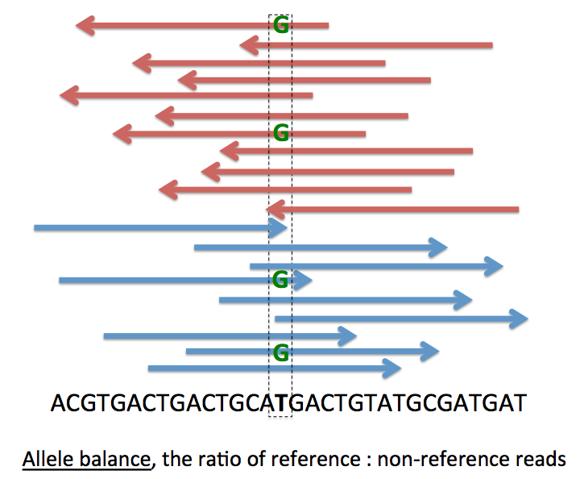
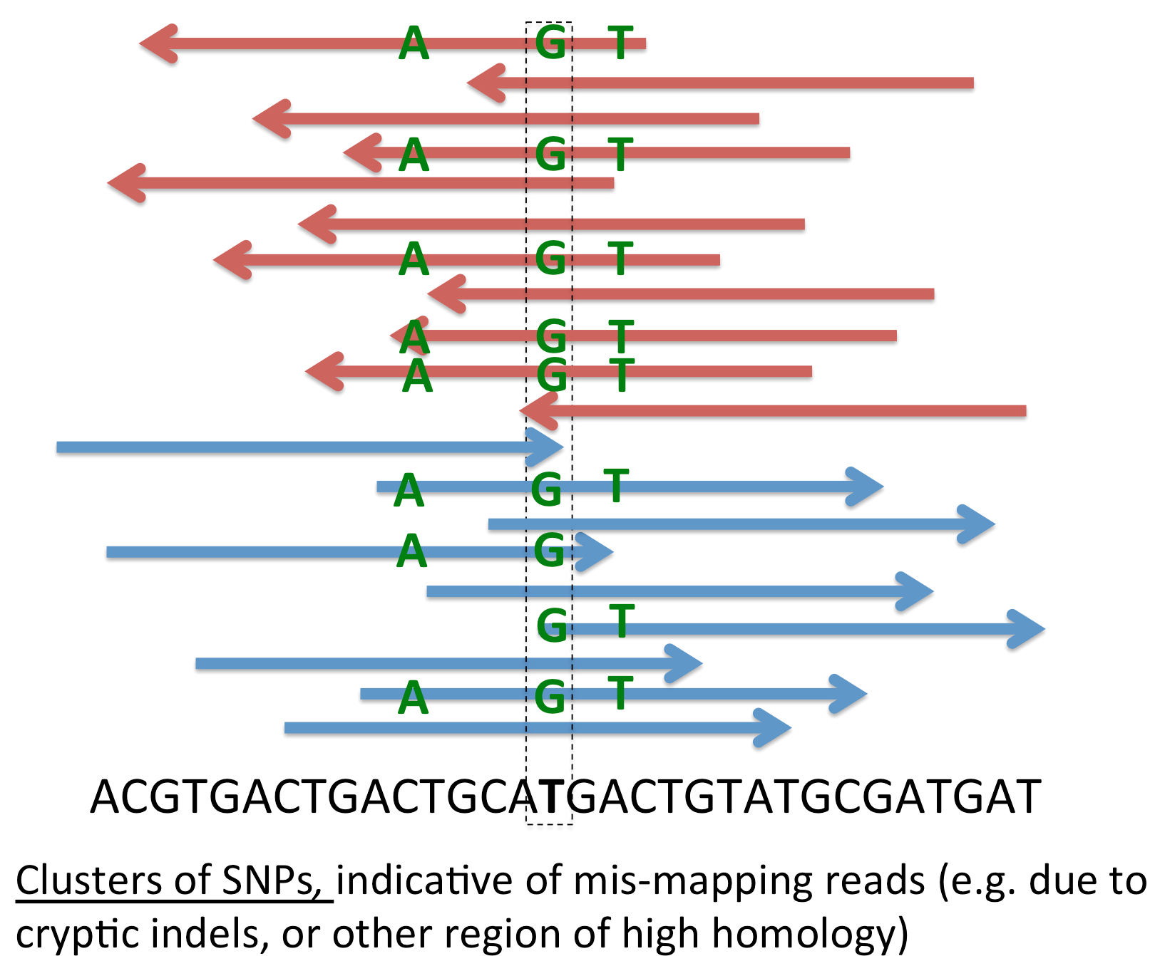
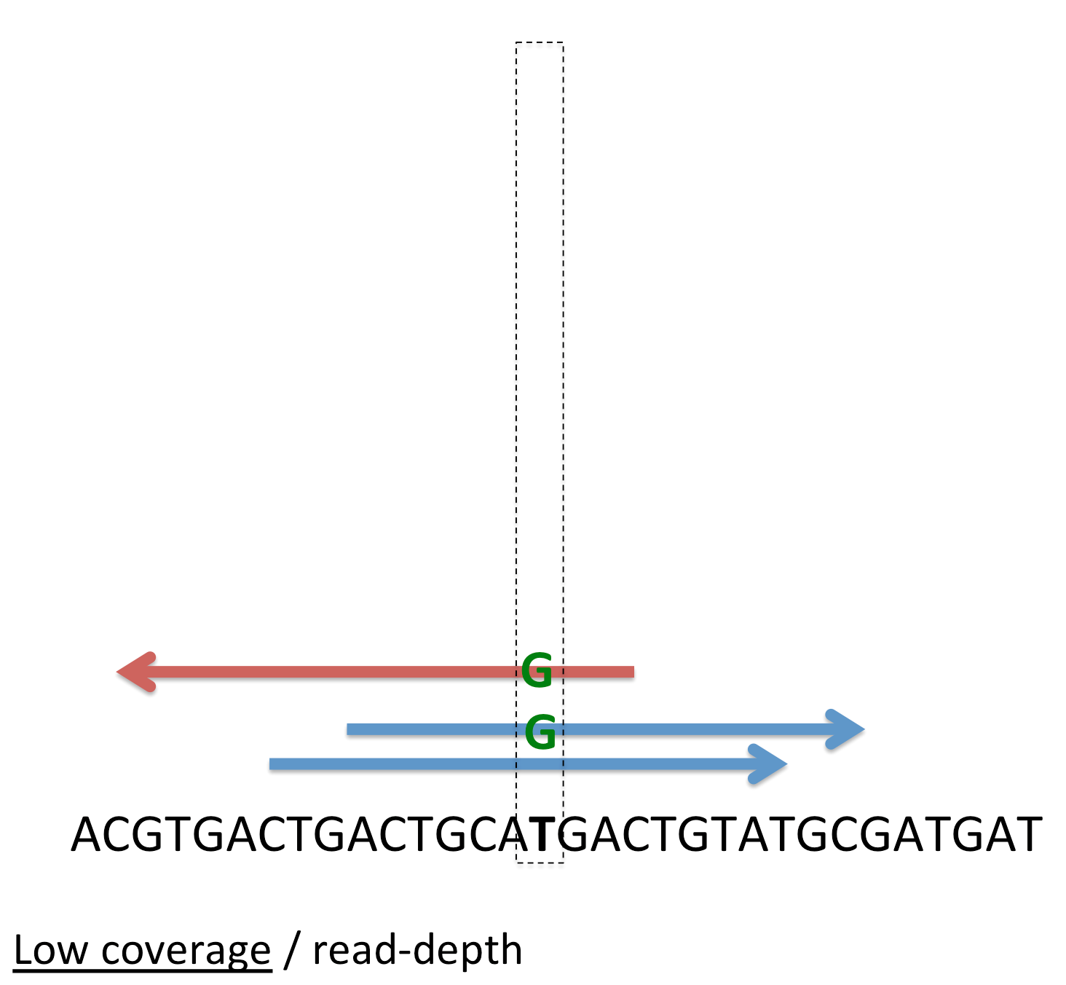
Common visual identification of likely genotype errors
Reflect often unknown, complex confounding influence of factors in DNA preparation,
exome capture technology, alignment, SNP calling algorithm or QC filters:
means that directly combining data across different studies is difficult.

Slide 11
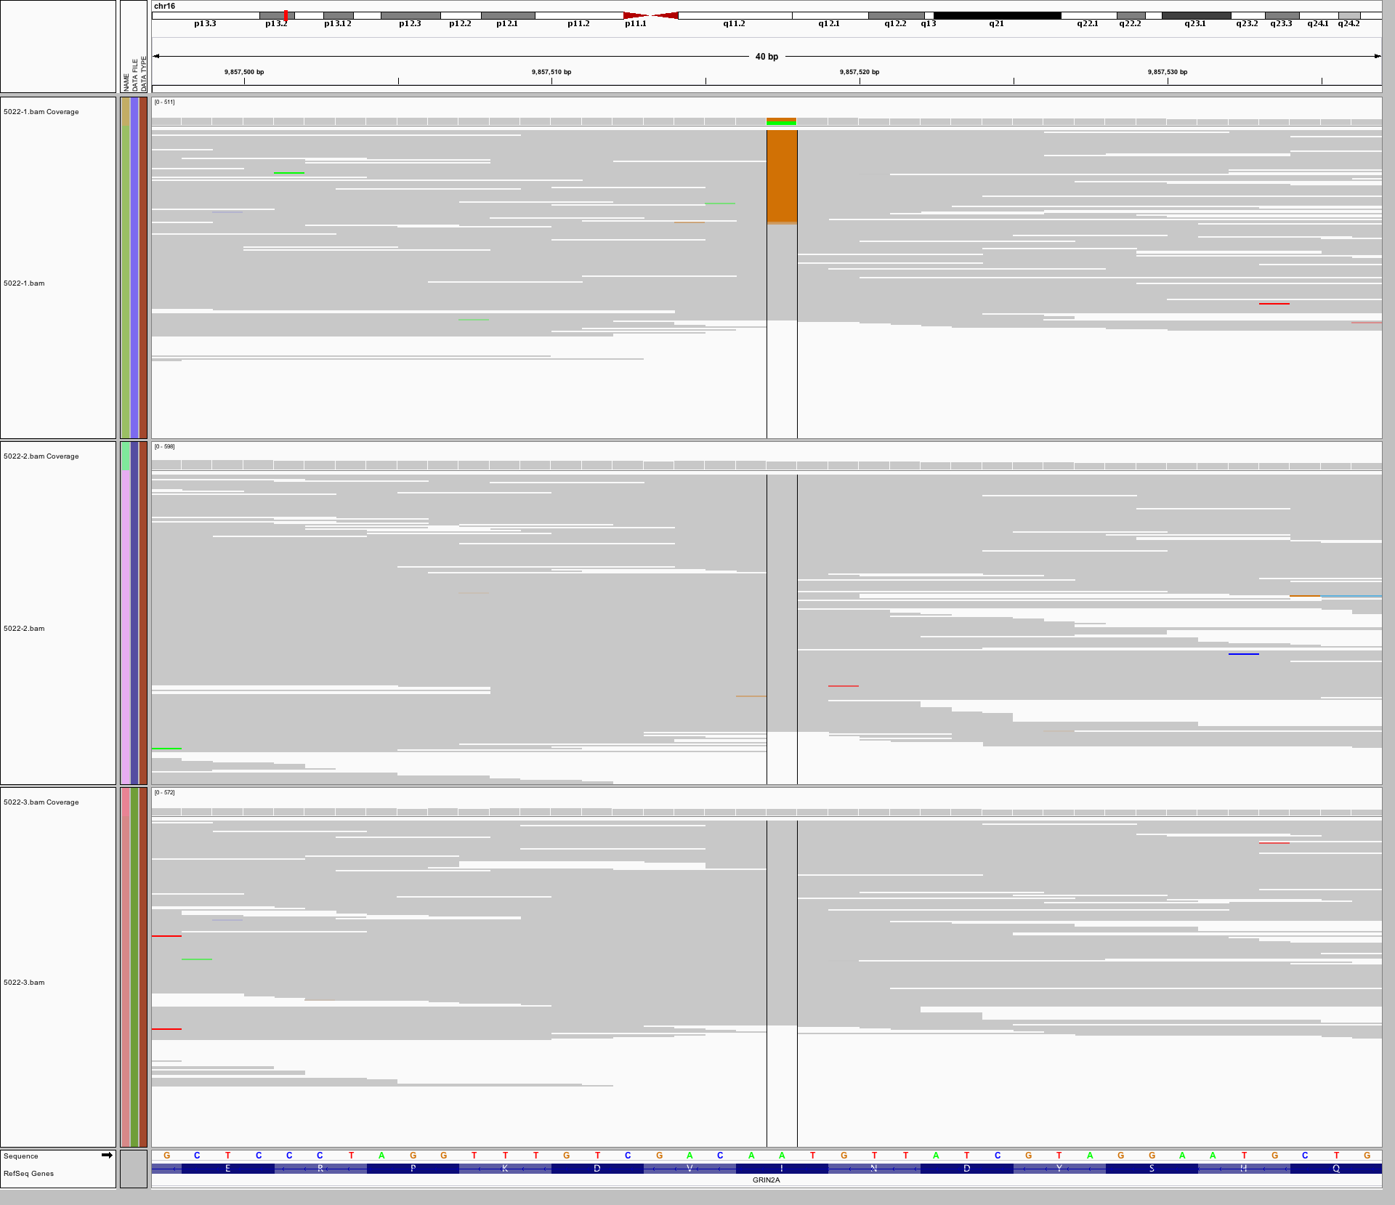
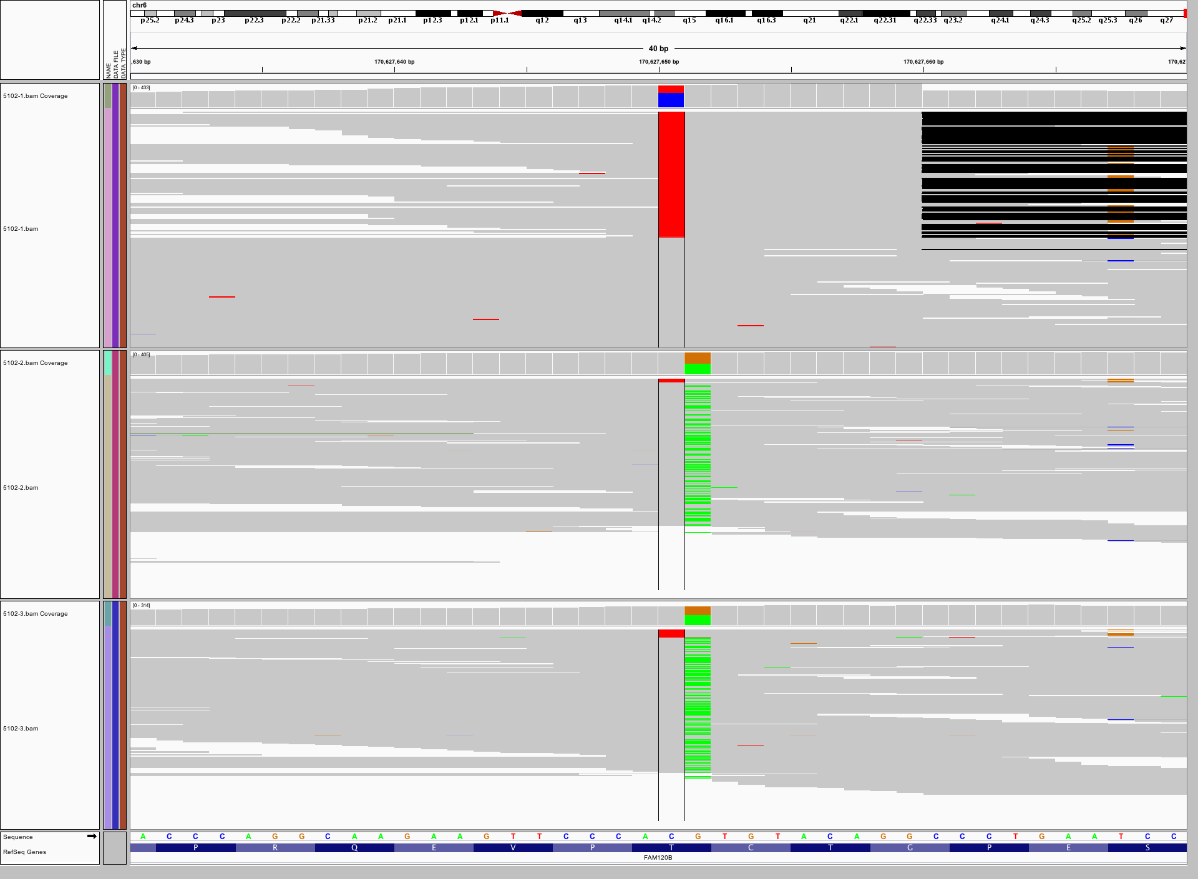
Screening for de novo mutation = an exquisite way to find strange sequencing errors
A validated de novo mutation…
… and one that did not
Proband
Father
Mother
40 bases
Parents also have some (red) non-reference reads
Both parents heterozygous for adjacent base
Proband also has apparent de novo deletion nearby (black)
Gray lines = 10s-100s of reads with reference
allele piled up across region
Colored : reads containing a non-reference site
IGV : Integrative Genome Viewer

Slide 12
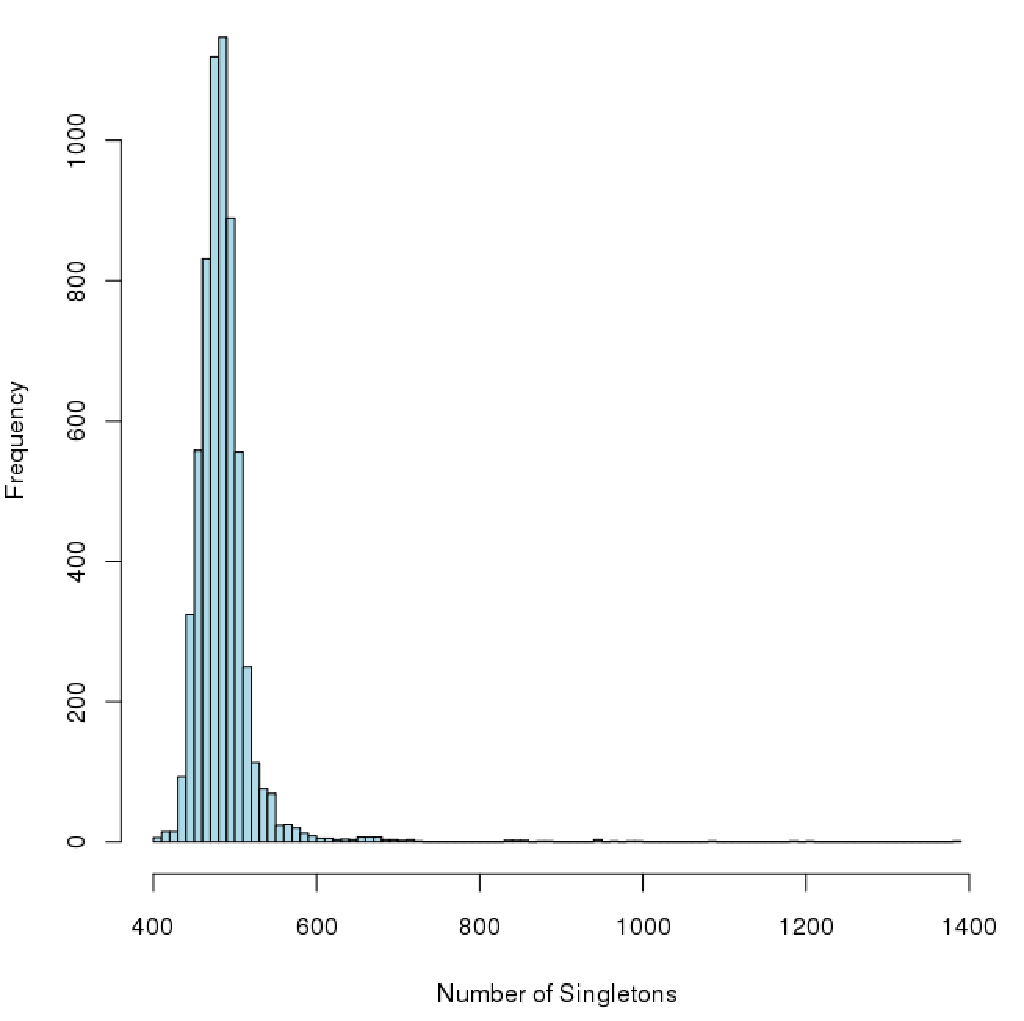
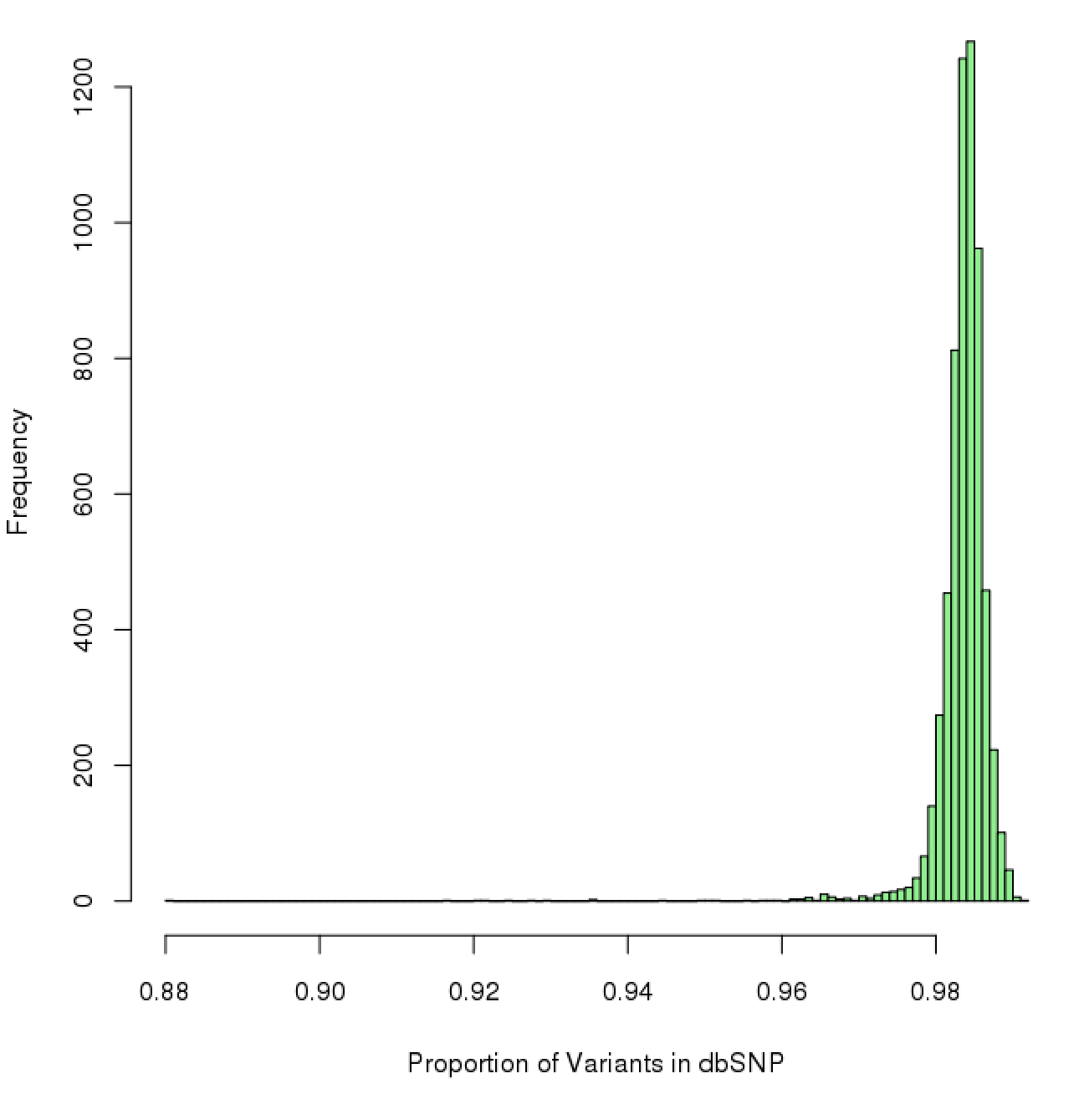
Outlier individuals can be identified from summary statistics
Number of singletons
Proportion of variants in dbSNP
Indication of random technical sequencing artifacts or population substructure

Slide 13
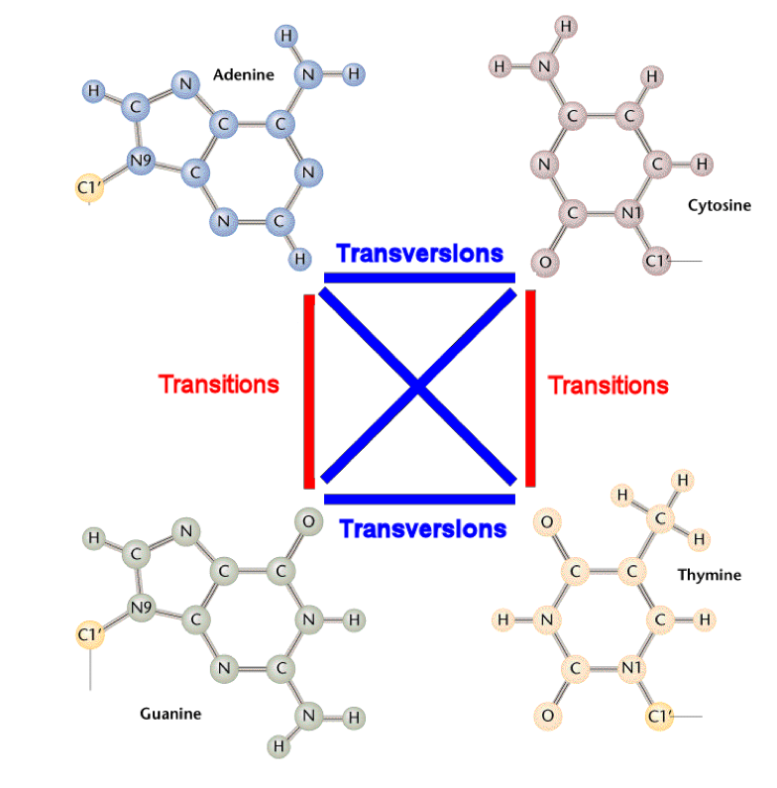
Genomic properties can also be used to assess quality
two-ring purines
one-ring pyrimidines
There is an expectation for the proportion of mutations seen across the genome
The human genome should have a 2:1 transitions to transversions
If data were a series of random mutations you’d get a 1:2 transition to transversion rate
Useful as a quality control measure per individual as well as over the entire dataset
http://www.mun.ca/biology/scarr/Transitions_vs_Transversions.html

Slide 14
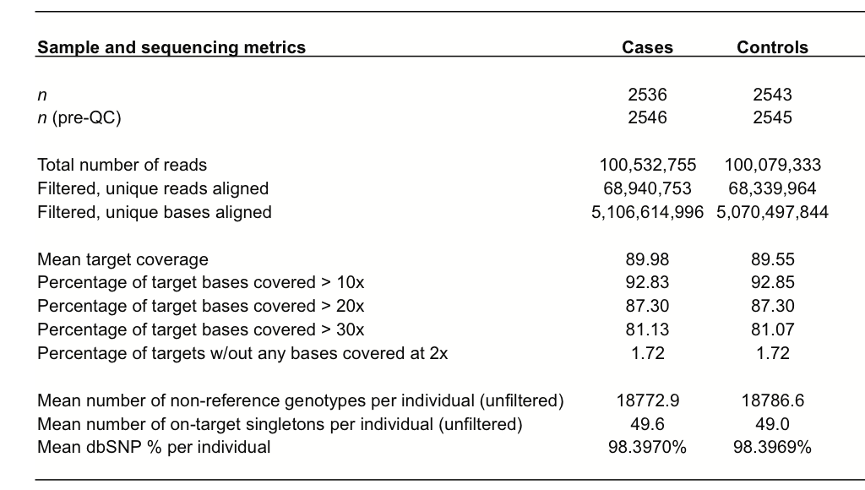
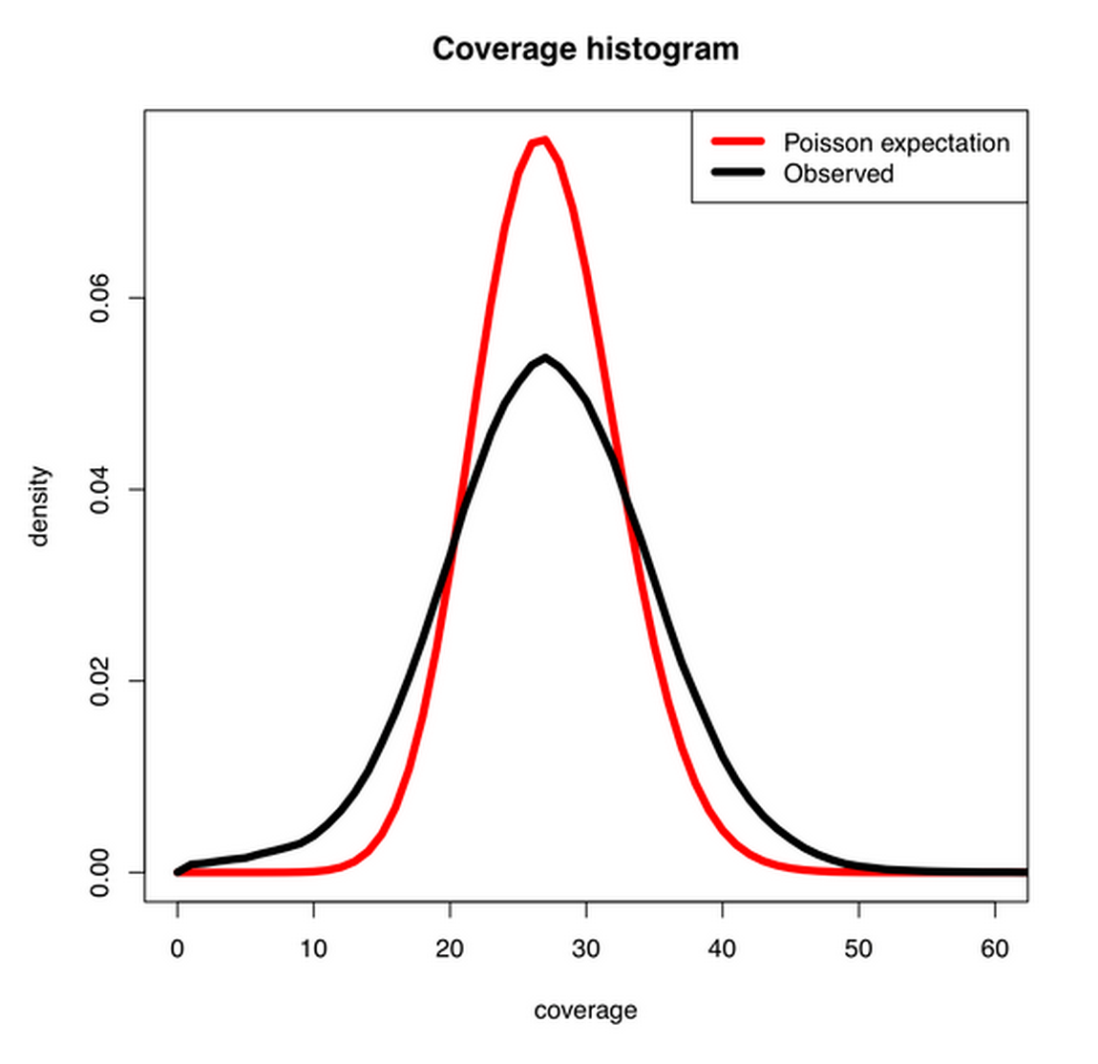
Coverage (read depth) is variable
High depth whole genome
sequencing (27x)
High depth exome sequencing (90x)
High mean coverage is necessary for adequate coverage across the exome/genome
Variant detection is dependent on read depth

Slide 15
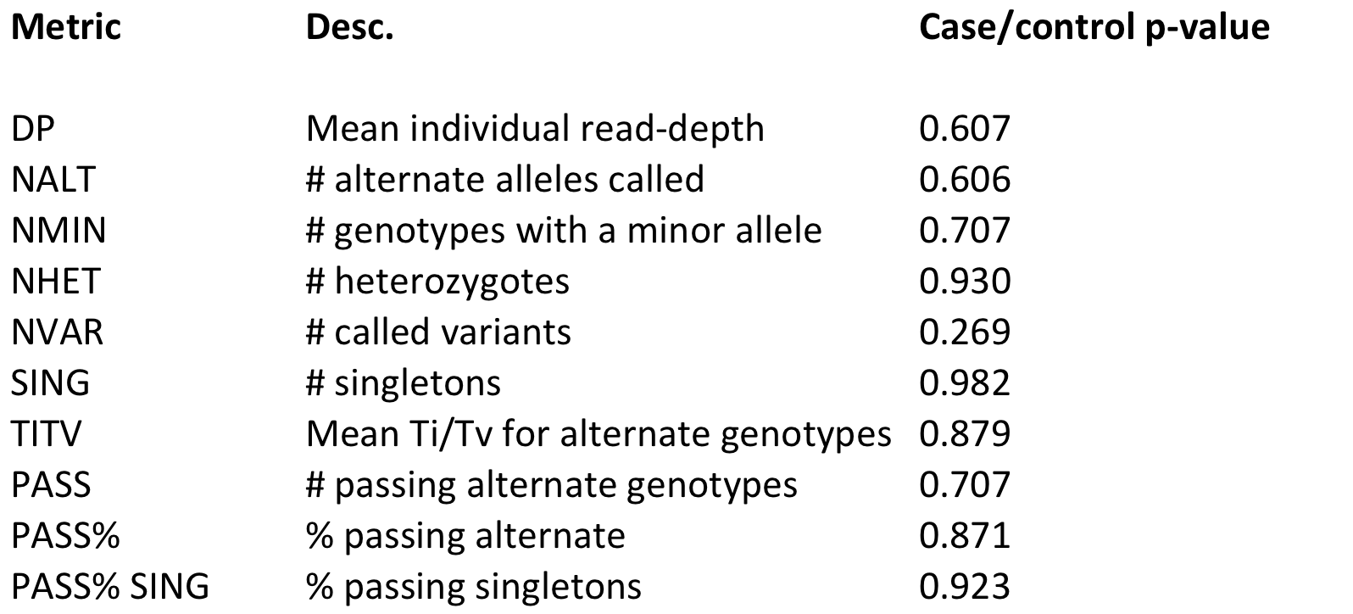
Cases and controls should be well-matched with respect to technical attributes of the dataset

Slide 16
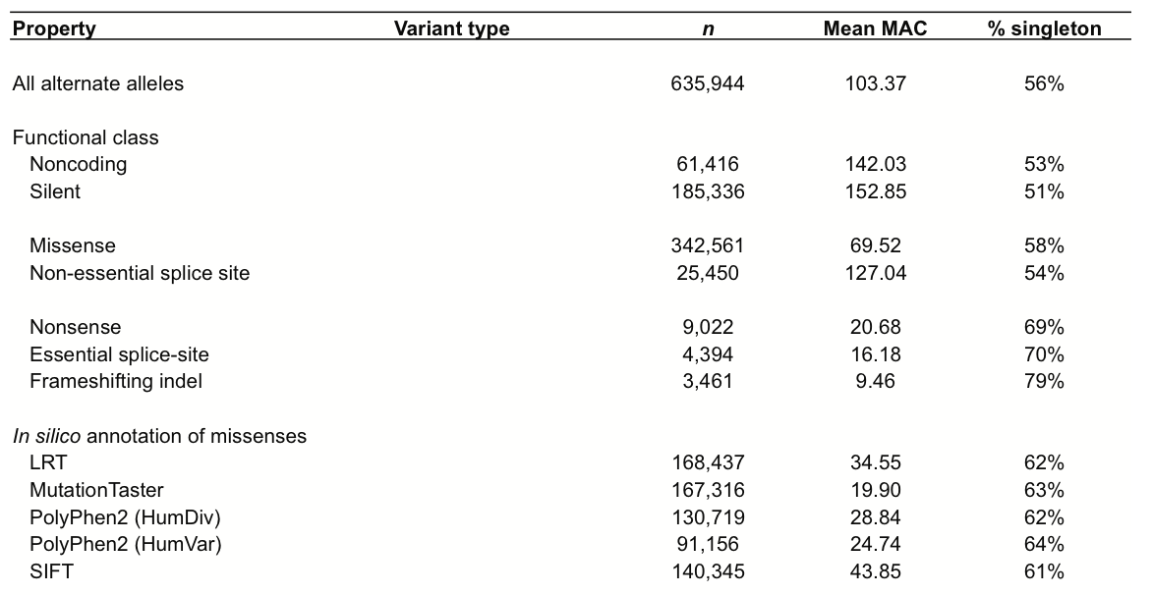
Functional annotation of variants
Allele frequency by annotation
Deleterious of annotation tracks with allele frequency

Slide 17
PLINK/SEQ practical

Slide 18
Initial questions
Who here has experience working with sequencing data?
How many have used PLINK/SEQ?
  How may consider themselves already well versed with PLINK/SEQ?
Of those with no experience, how many have immediate plans to work sequencing data?

Slide 19
Socrative
www.socrative.com
Student Login: Room a550ae41
Fill out first quiz now!

Slide 20
Getting started
mkdir PSEQpractical
cd PSEQpractical
cp /faculty/douglas/PSEQpractical/* ./
ln –s /opt/pseq/resources resources
ln –s /opt/pseq/vcf vcf

Slide 21
PLINK/SEQ is one of many tools to analyze sequencing data
EPACTS
  http://genome.sph.umich.edu/wiki/EPACTS
RvTests
  http://zhanxw.github.io/rvtests/
Score-seq
  http://dlin.web.unc.edu/software/score-seq/
Granvil
  http://www.well.ox.ac.uk/GRANVIL/index.shtml
SKAT
  http://www.hsph.harvard.edu/skat/
…. many others

Slide 22
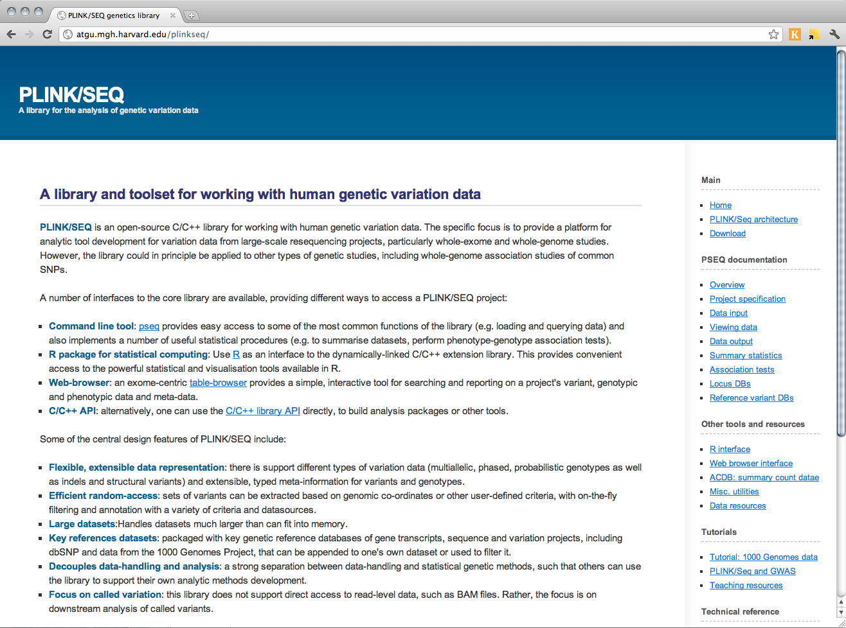
PLINK/SEQ: a toolset for NGS variation datasets
http://atgu.mgh.harvard.edu/plinkseq/
VCF as primary input
Focus on analysis of rare variation
Extensible meta-information on locus, genotypes, individuals
Bundled with key reference databases that can be directly intersected with one’s own project
Command-line and R library; web-based GUI under-development

Slide 23
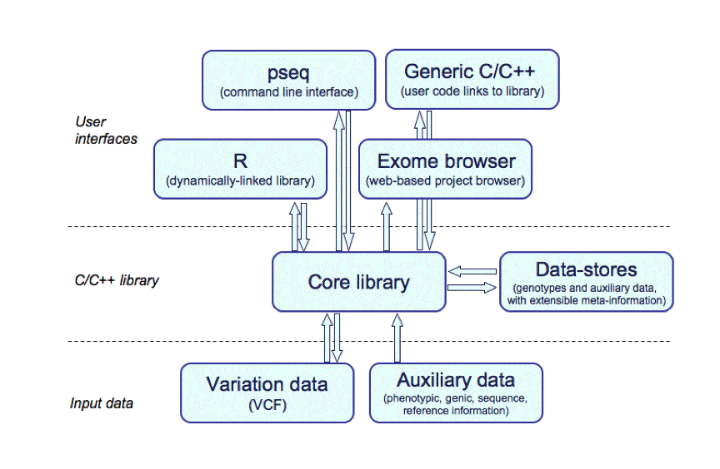

Slide 28
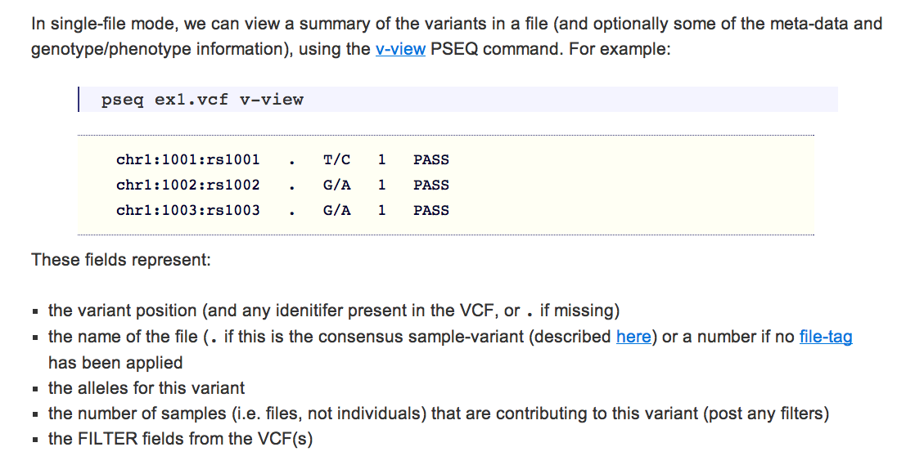

Slide 29
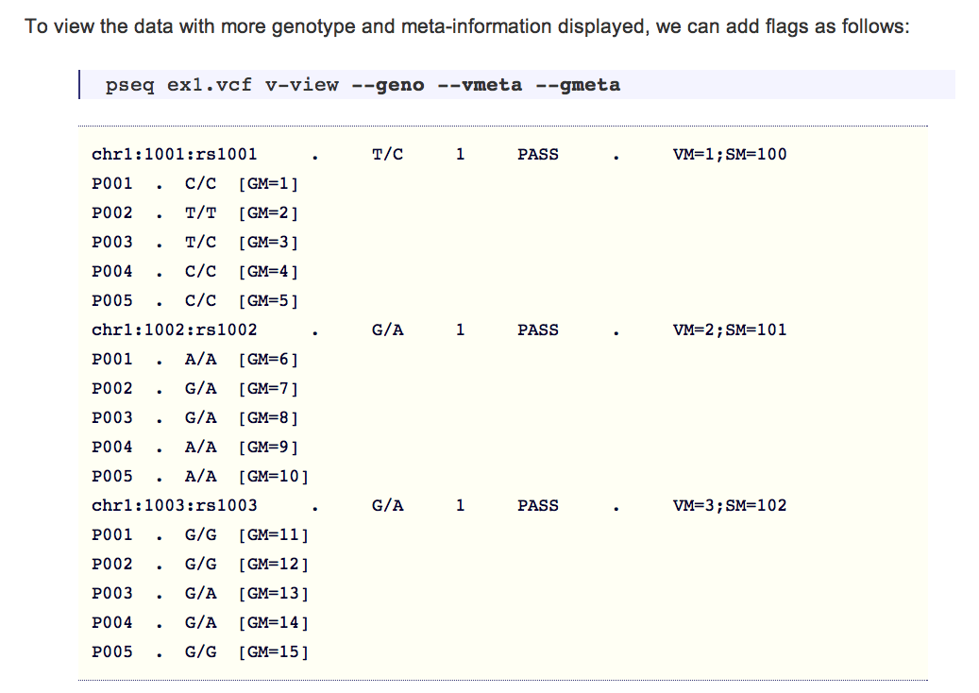

Slide 30
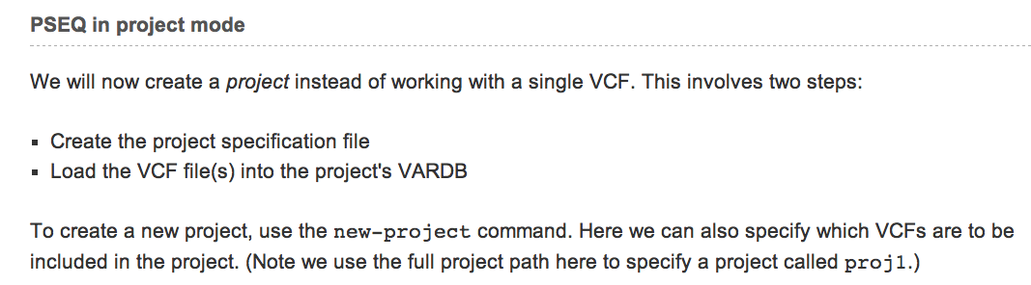
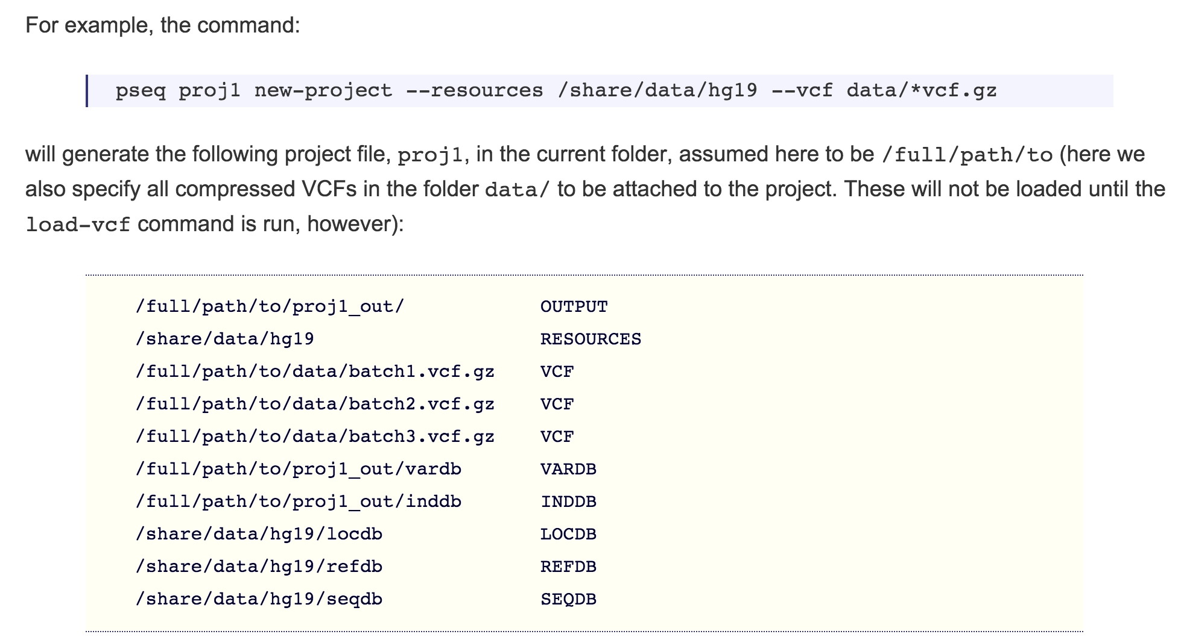

Slide 31
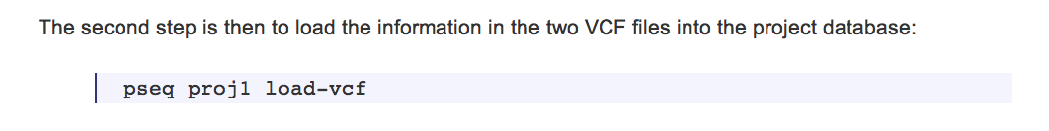
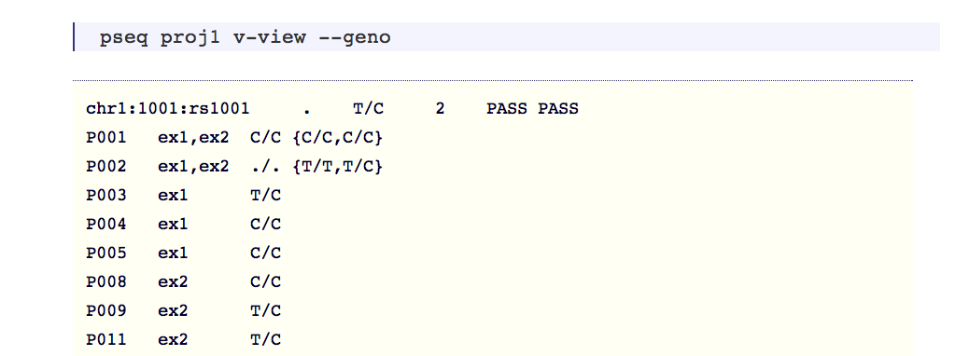
{ -- continues -- }

Slide 32
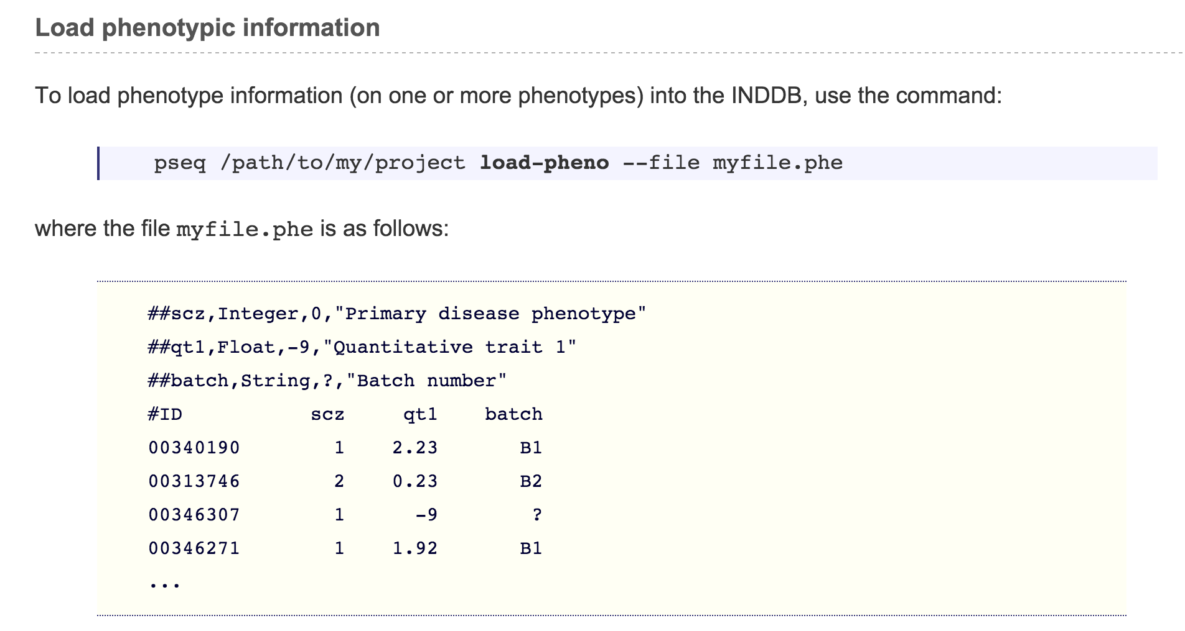

Slide 33
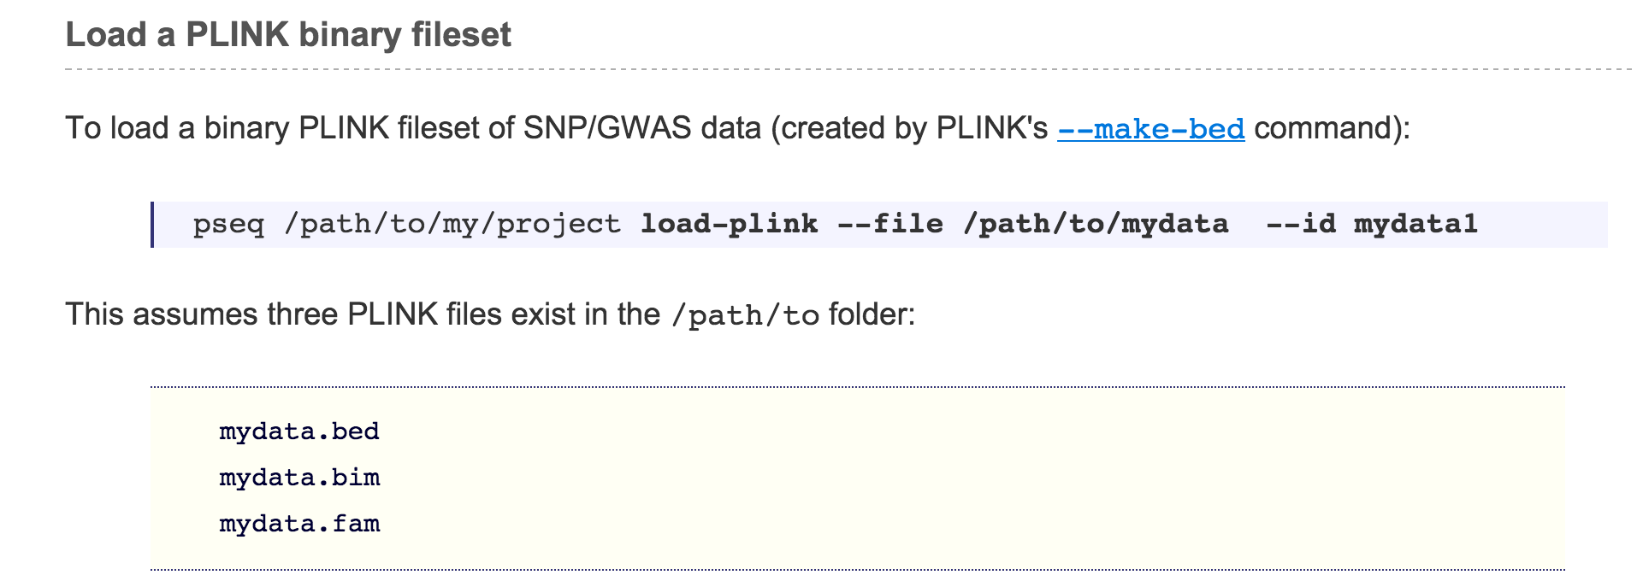
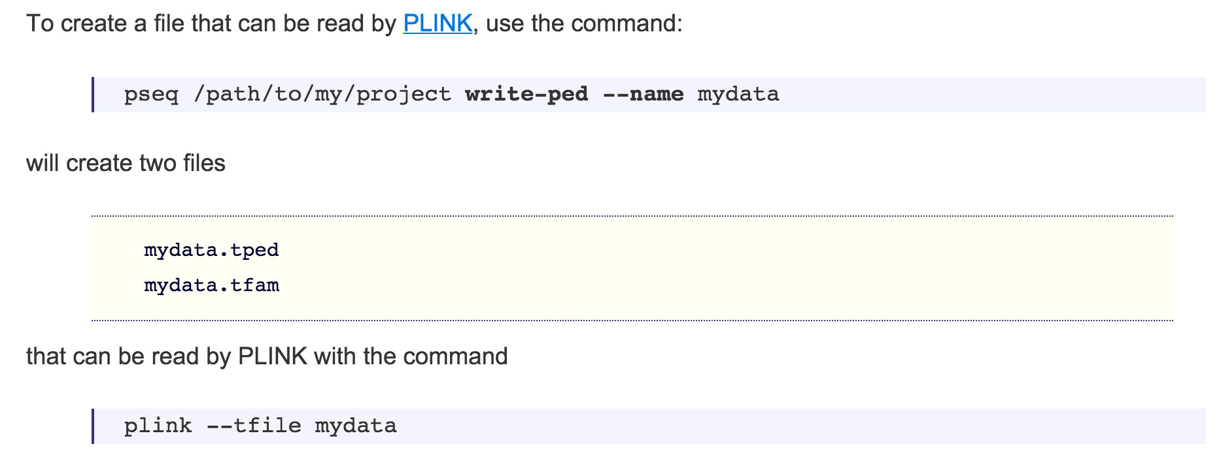

Slide 35
PSEQ practical
Open a couple of terminals
Open PSEQpractical.txt (emacs, pico, nano, less)
We’ll look at the data & step through the initial steps of the tutorial together, followed by some questions

