Slide 1





Next Generation Sequencing Studies
Benjamin Neale, Ph.D.
Assistant Professor
Analytic and Translational Genetics Unit
Massachusetts General Hospital
Institute Member
Broad Institute of Harvard and MIT

Slide 2
Next generation sequencing papers

Slide 3
Next generation sequencing papers
~11,200 papers
~5,300 in human
Of which ~1,100 are reviews

Slide 4
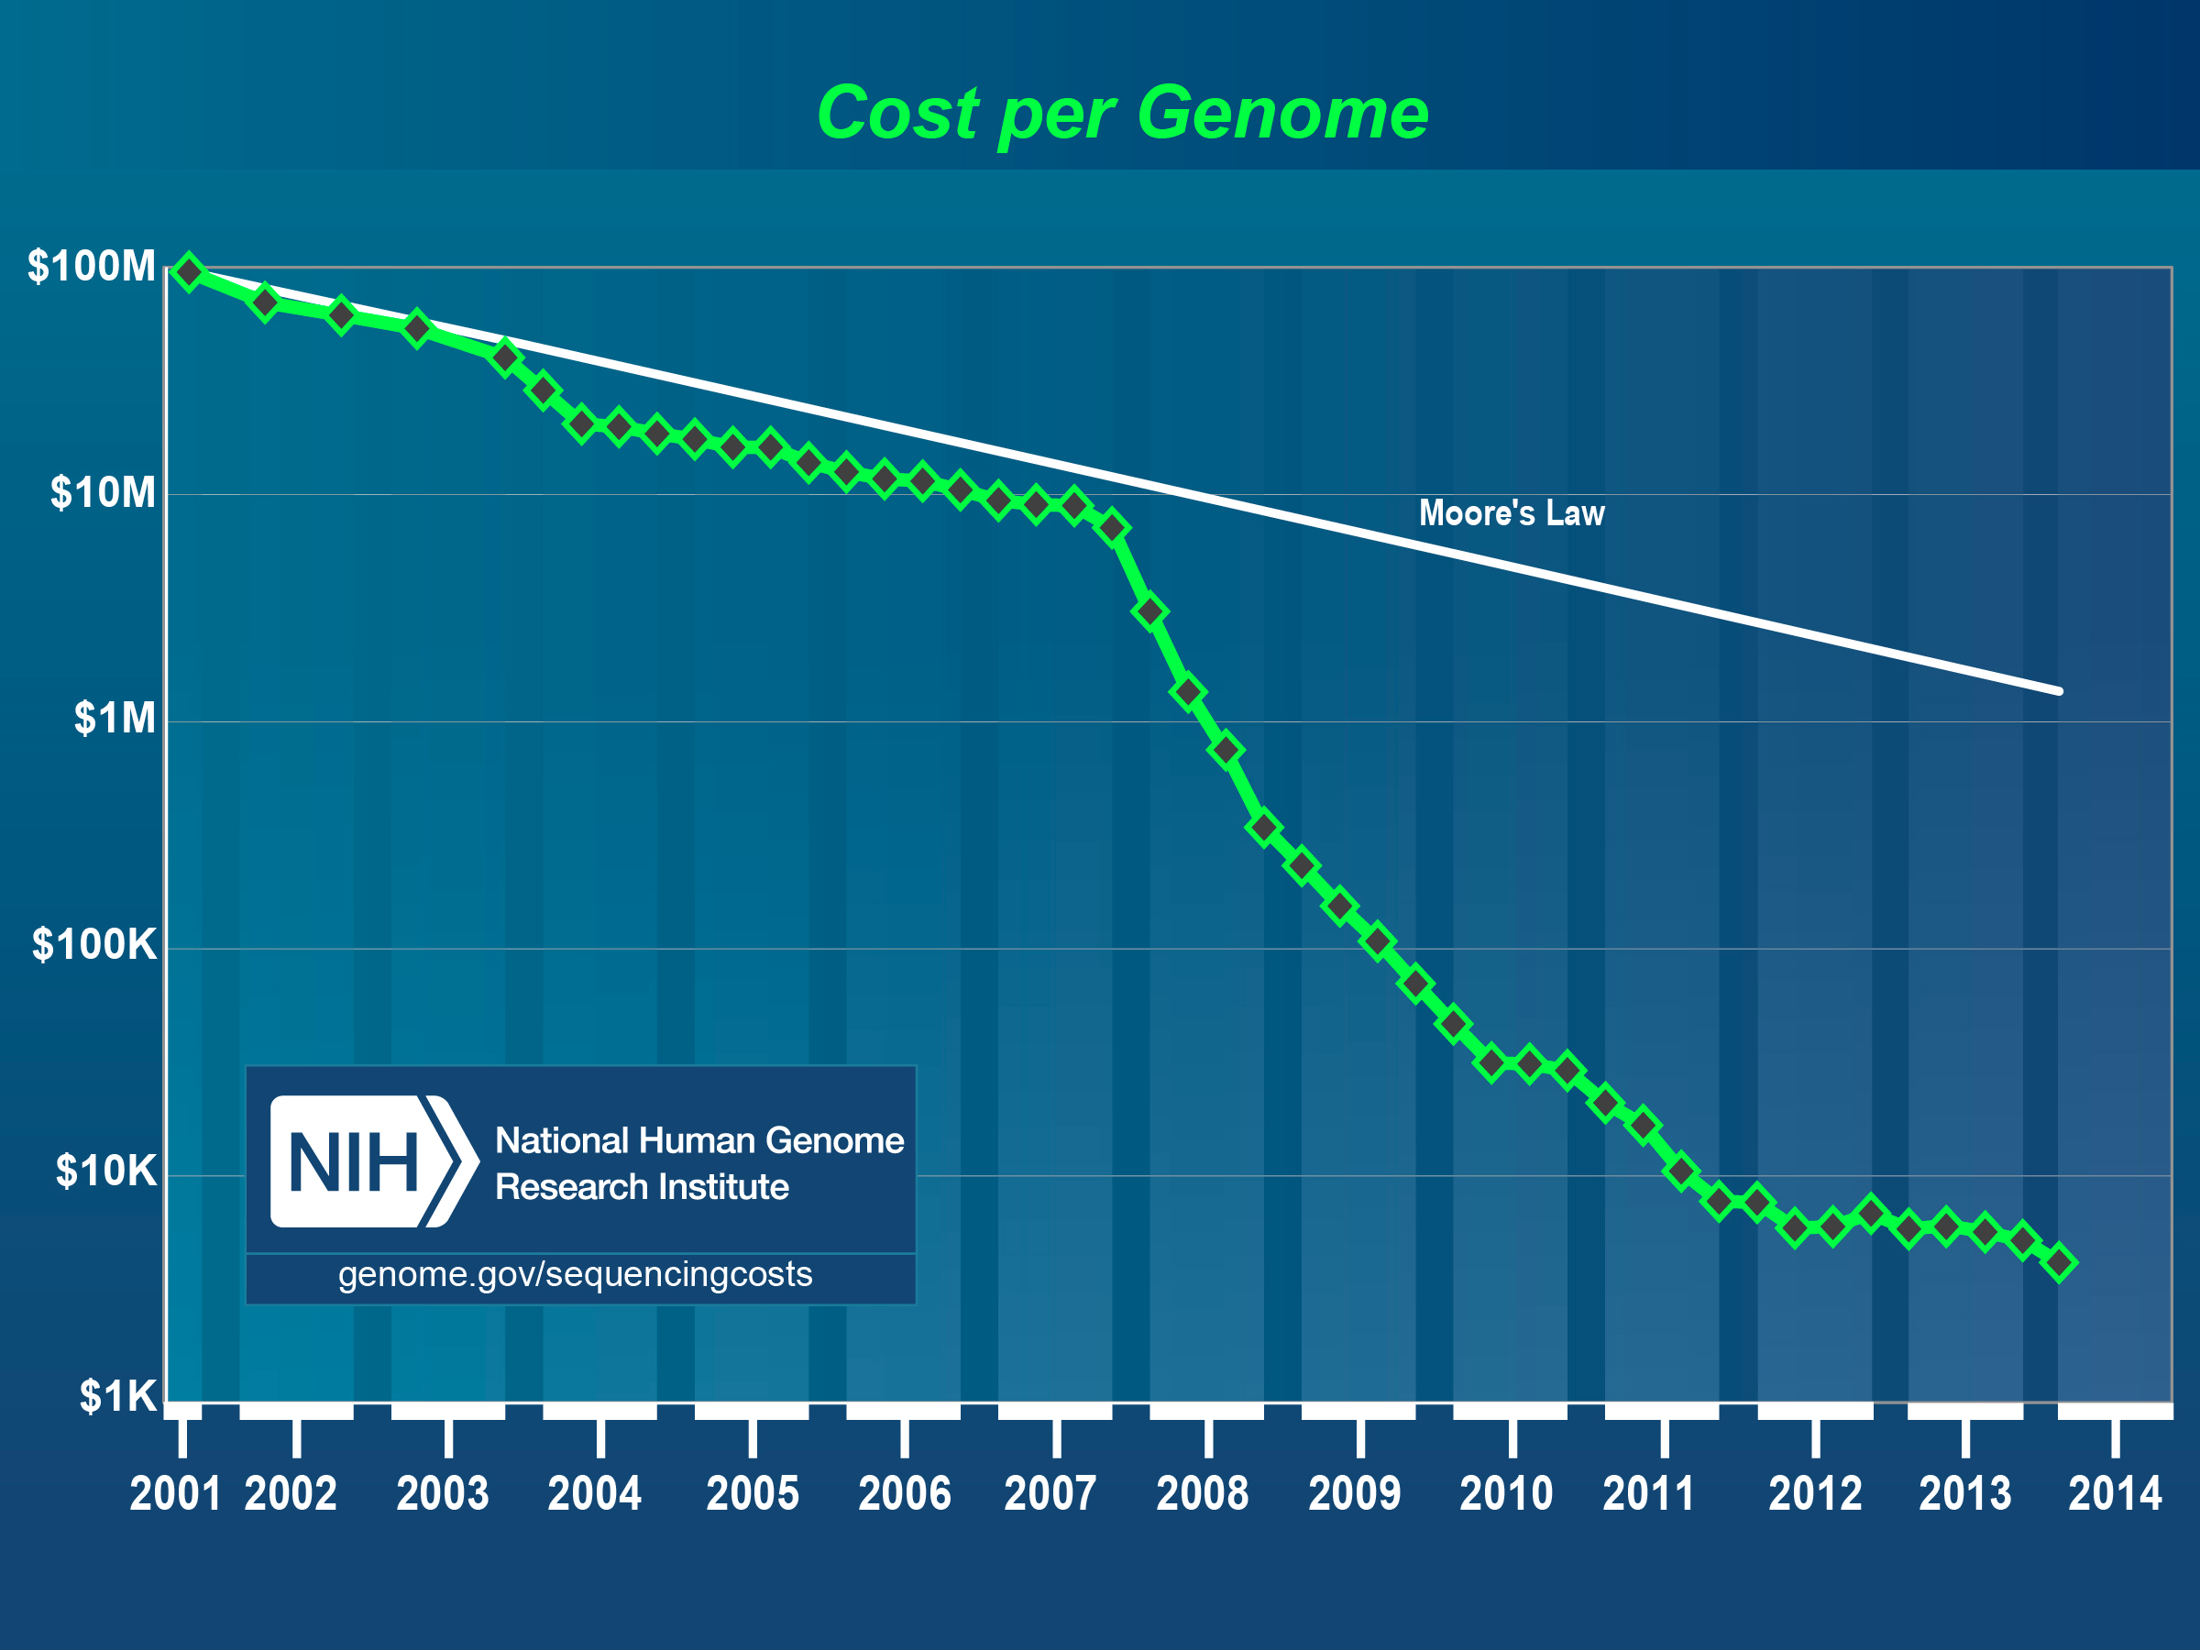
Genome.gov

Slide 5
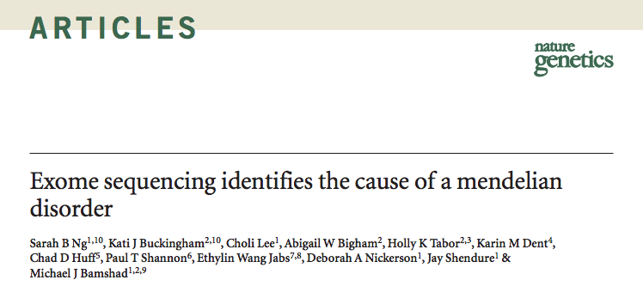
Direct Sequencing has
Enormous Potential…

Slide 6
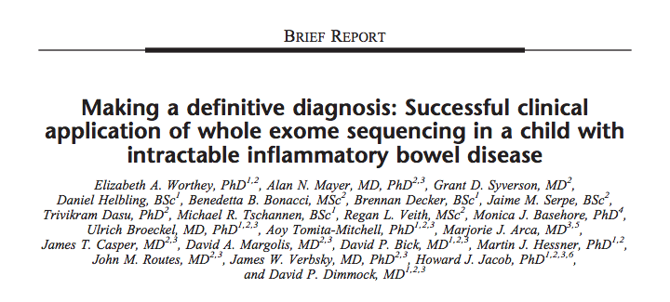
Direct Sequencing has
Enormous Potential…

Slide 7
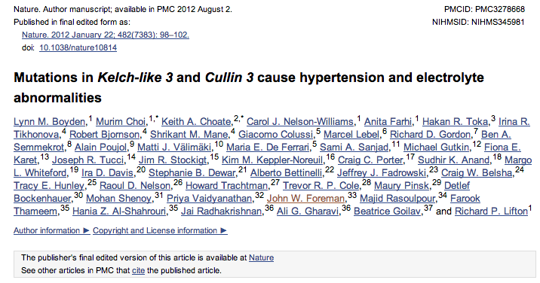
Direct Sequencing has
Enormous Potential…

Slide 8
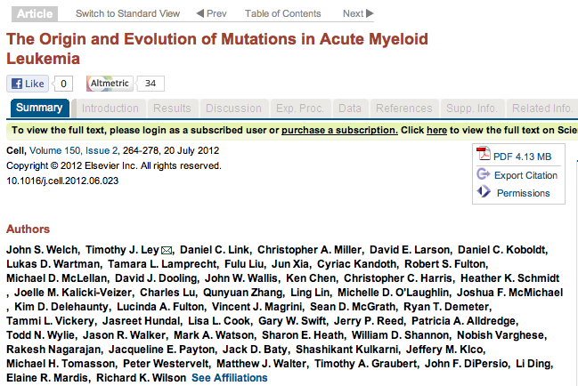
Direct Sequencing has
Enormous Potential…

Slide 9
…and tremendous challenges
Managing and processing vast quantities of data into variation
Interpreting millions of variants per individual
  An individual’s genome harbors
    ~80 point nonsense mutations
    ~100-200 frameshift mutations
    Tens of splice mutants, CNV induced gene disruptions
For very few of these do we have any conclusive understanding
of their medical impact in the population

Slide 10
So where does this data originate?

Slide 11
Exome vs Genome
Exome
~1.5% of genome
All exons
  Some pseudogenes missed
Deeper coverage
  Average 60-180x
Useful for Mendelian disease
Requires library construction
Genome
Almost entire genome
Much lower pass
  Currently 4-30x
Useful for structural variation/CNVs
Shotgun sequence
  Randomly shear and capture

Slide 12
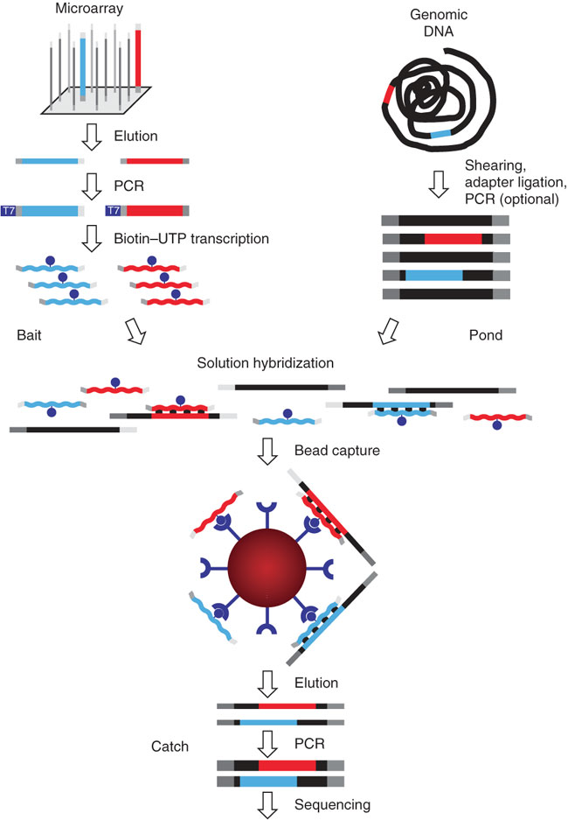
Next Generation Sequencing
Hybrid Selection – Targeted
Steps:
Generate pool of oligonucleotides
PCR amplify
In vitro transcription for single strand RNA bait
Steps:
Randomly shear DNA
Ligate an adapter
PCR amplify
Bait anneals to pond material
Captured by the magnetic bead
PCR amplified
Analyzed on a next-gen sequence machine
Gnirke et al. Nat. Biotechnology, 2009

Slide 13
From unmapped reads to true genetic variation in next-generation sequencing data
Raw short reads
Mapping and alignment
Solexa
Region 1
Region 2
SOLiD
Human reference genome
454
A single run of a sequencer generates ~50M ~75bp short reads for analysis
The origin of each read from the human genome sequence is found
Quality calibration and annotation
Identifying genetic variation
Region 1
Region 2
Region 1
Region 2
Human reference genome
Human reference genome
SNP
The quality of each read is calibrated and additional information annotated for downstream analyses
SNPs and indels from the reference are found where the reads collectively provide evidence of a variant

Slide 14
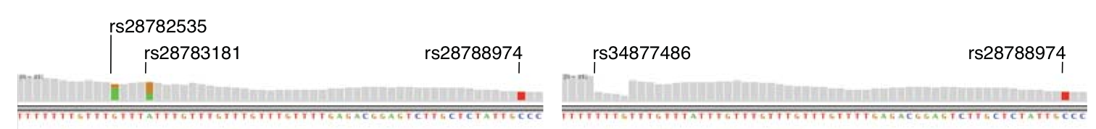
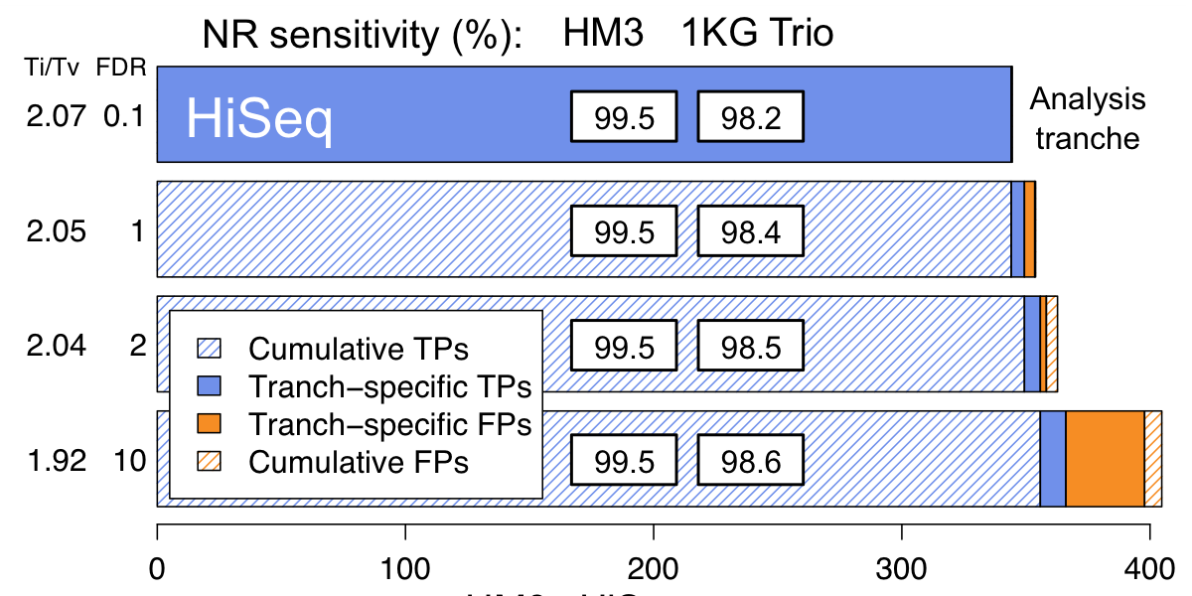
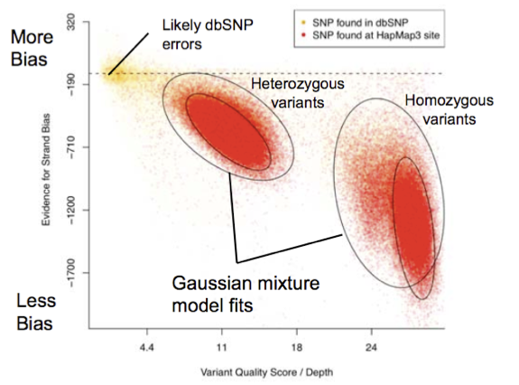
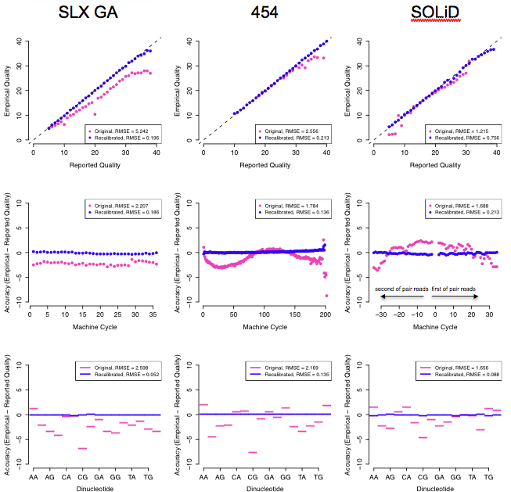
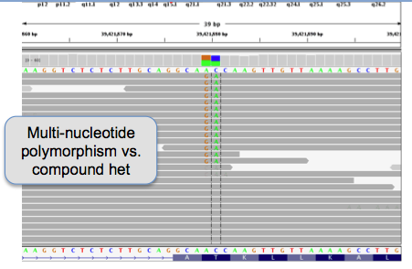
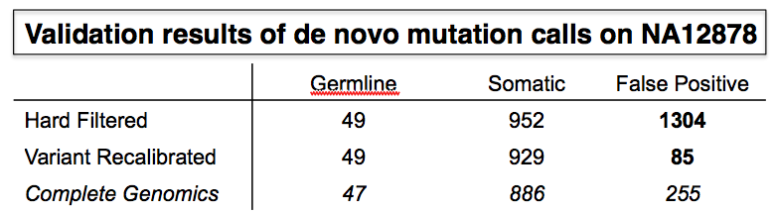
Developing cutting-edge data processing and analysis methods
Local realignment
Variation discovery and genotyping
Novel SNPs found
Base quality score recalibration
Adaptive error modeling
Read-backed phasing
VariantEval

Slide 15
Challenges
Mapping/alignment
Quality score recalibration
Calling variants

Slide 16
Finding the true origin of each read is a computationally demanding and important first step
Region 1
Region 2
Region 3
Reference genome
Mapping and alignment algorithm
Enormous pile of short reads from NGS
Detects correct read origin and flags them with high certainty
Detects ambiguity in the origin of reads and flags them as uncertain
Solexa : BWA
454 : SSAHA
SOLiD : Corona
Robust, accurate ‘gold standard’ aligner for NGS
Developed by Li and Durbin
Recently replaced MAQ, also by Li and Durbin, used for last 2 years
Hash-based aligner with high sensitivity and specificity with longer reads
ABI-designed tool for aligning in color-space
SAM/BAM files

Slide 17
The SAM file format
Data sharing was a major issue with the 1000 genomes
  Each center, technology and analysis tool used its own idiosyncratic file formats – no one could exchange data
The Sequence Alignment and Mapping (SAM) file format was designed to capture all of the critical information about NGS data in a single indexed and compressed file
  Becoming a standard and is now used by production informatics, MPG, and cancer analysis groups at the Broad
Has enabled sharing of data across centers and the development of tools that work across platforms
More info at http://samtools.sourceforge.net/

Slide 18
Local realignment around indels

Slide 19
Base Quality Score Recalibration
SLX GA
454
SOLiD
Complete Genomics
HiSeq
second of pair reads
first of pair reads
second of pair reads
first of pair reads
second of pair reads
first of pair reads

Slide 20

The Genome Analysis Toolkit (GATK) enables rapid development of efficient and robust analysis tools
Eric Banks
Supports any BAM-compatible aligner
Initial alignment
Genome Analysis Toolkit (GATK) infrastructure
All of these tools have been developed in the GATK
They are memory and CPU efficient, cluster friendly and are easily parallelized
They are now publically and are being used at many sites around the world
MSA realignment
Q-score recalibration
Traversal engine
Multi-sample genotyping
SNP filtering
Analysis tool
Provided by framework
Implemented by user
More info: http://www.broadinstitute.org/gsa/wiki/

Slide 21
Bayesian SNP Caller
Likelihood for the genotype
Prior for the genotype
Likelihood of the data given the genotype
Bayesian model
L(G|D) = P(G) P(D|G)
Initial alignment
Prior genotype probabilities enforce variant expectation rates
Likelihood of data computed using pileup of bases and associated quality scores at given locus
L(G|D) computed for all 10 genotypes
Confidence in call given by
MSA realignment
Q-score recalibration
T=3 or 5 common
Genotyping
SNP filtering

Slide 22
Technology and algorithms are maturing

Slide 23
Core QC concepts
Coverage
  # reads at a position
Transition:Transversion ratio (Ti:Tv or Ts:Tv)
  Within vs between type (purine or pyrimidine)
 | A | C | G | T
A | - | Tv | Ti | Tv
C | Tv | - | Tv | Ti
G | Ti | Tv | - | Tv
T | Tv | Ti | Tv | -
Random Ti:Tv = 0.5 ; Exome Ti:Tv > Genome Ti:Tv (roughly 3.25 and 2.25 respectively)

Slide 24
Core QC Concepts II
Singleton, doubleton, … n-ton
  # of copies of non-reference allele
Case:control counts
  Consider each set of n-ton
Mutation types
  Synonymous/Silent – Same amino acid
  Missense – Different amino acid
  Nonsense – Premature stop codon
  Function – All but synonymous

Slide 25
Core Concepts III
Read length: # bases assayed by sequencer
  Varies by technology
  Shorter the read, harder the alignment
Mapping Quality Score
  Measure of how well (uniquely) the read maps
Base Alignment Quality
  Probability of the base being misaligned

Slide 26
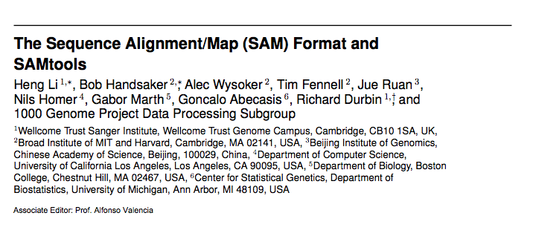
File types
SAM/BAM format – stores read data

Slide 27
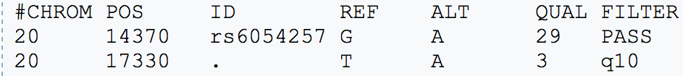
File types
Variant Call File: VCF
Chromosome
SNP ID
Alternate Allele
Filter column
Position
Reference Allele
Quality Score
Info field contains meta-data
Format specifies the genotype format
Individual genotype
follows format structure

