Slide 1
Genetic study design
Benjamin Neale
IBG workshop
March 3rd 2015

Slide 2
 | Common variation | Rare variation
Abundance | ~ 10⁷ | 10⁹?
Population specific? | No | Often
Correlation | High | Low
Selection | Unlikely | Possible
Best technology | Array genotyping | Sequencing

Slide 3

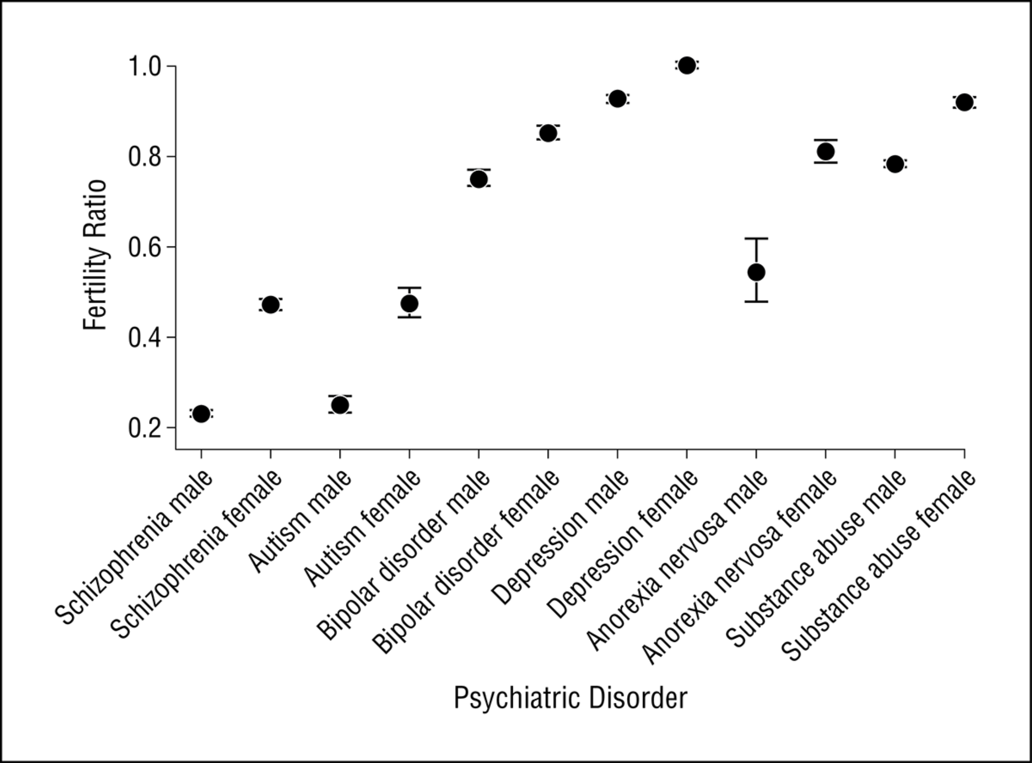
From: Fecundity of Patients With Schizophrenia, Autism, Bipolar Disorder, Depression, Anorexia Nervosa, or Substance Abuse vs Their Unaffected Siblings
JAMA Psychiatry. 2013;70(1):22-30. doi:10.1001/jamapsychiatry.2013.268
Ramifications:
Common and low frequency variants can be plentiful at very low effect sizes (OR < 1.1)
Large effect alleles must be extremely rare
Figure Legend:
Figure 1. Fertility ratios for individuals with schizophrenia, autism, bipolar disorder, depression, anorexia nervosa, and substance abuse. A fertility ratio of 1 (highlighted) represents that of the general population.
Date of download: 3/5/2014
Copyright © 2014 American Medical Association. All rights reserved.

Slide 4
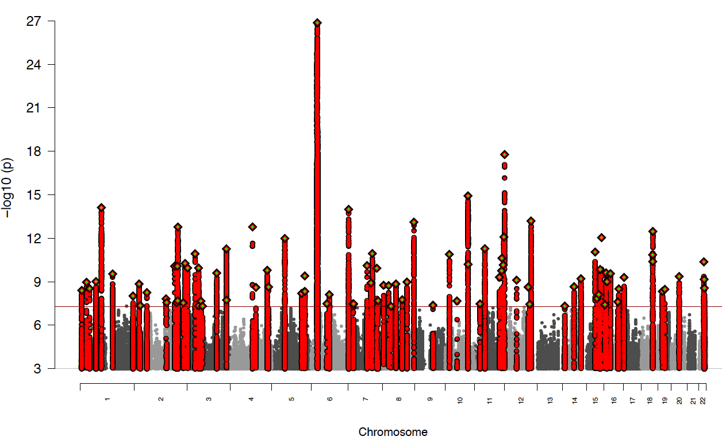
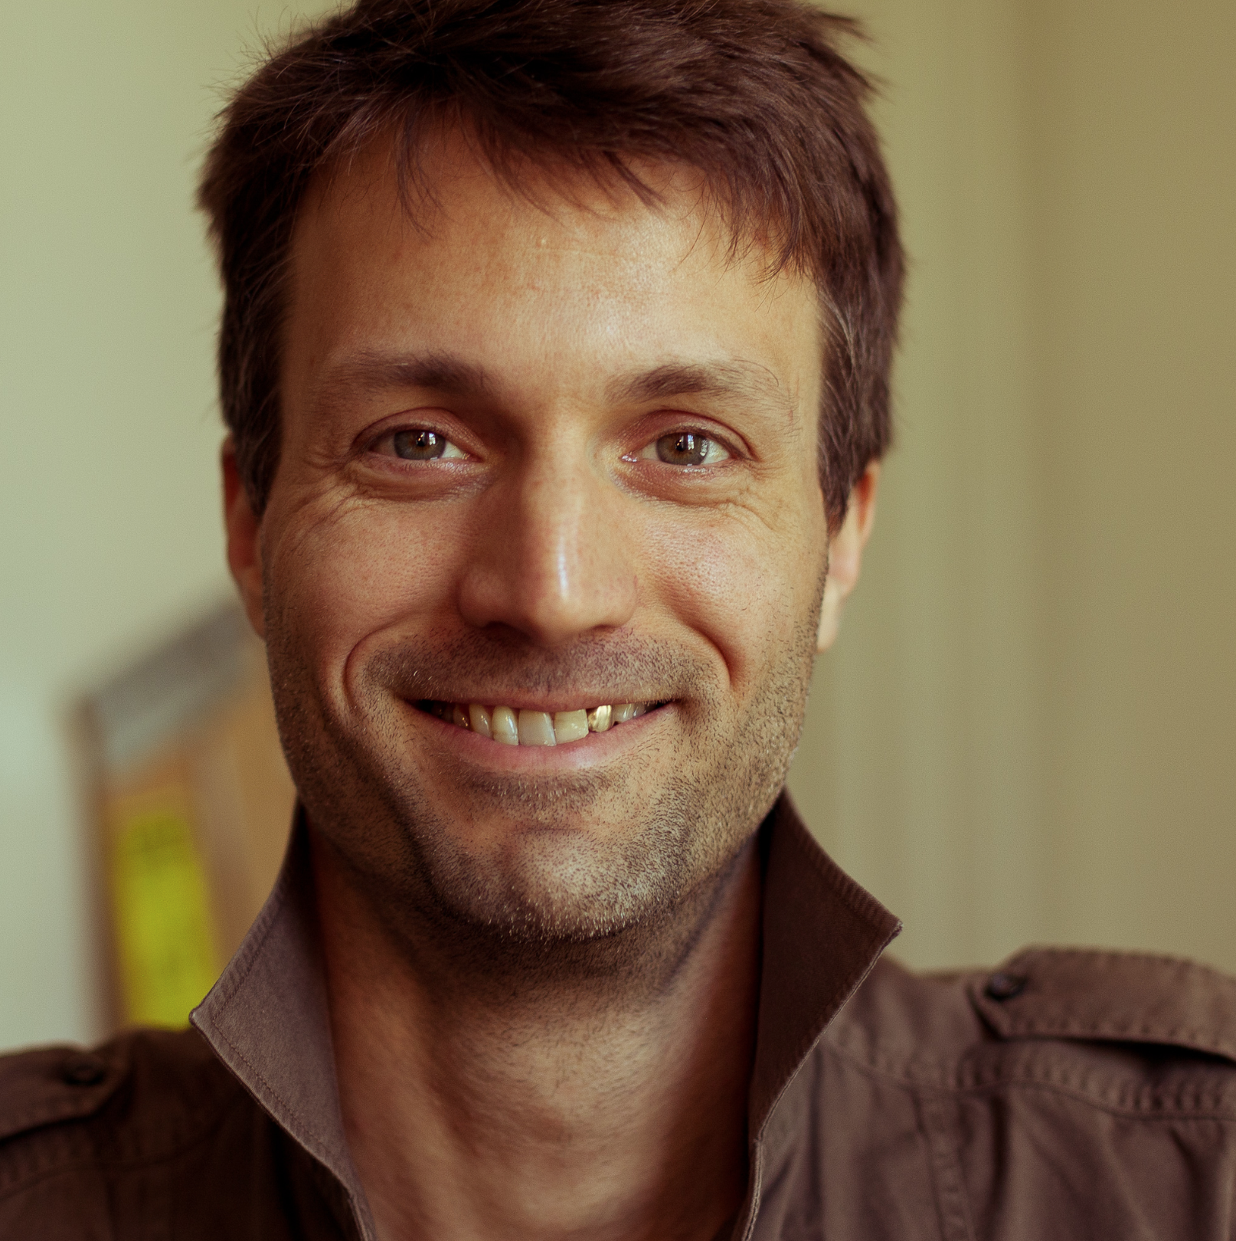


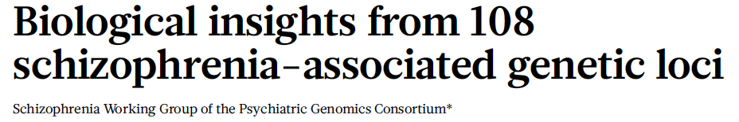
PGC SCZ v2: Genomewide association in schizophrenia with 37,000 cases
More than 100 distinct regions of
associated to schizophrenia!!!
July 22, 2014

Slide 5
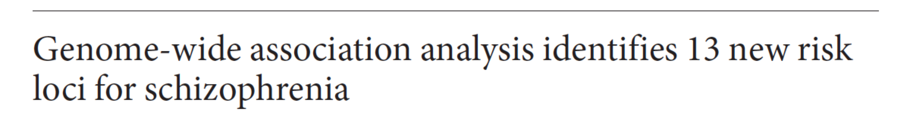
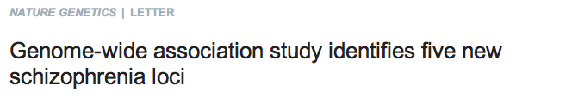
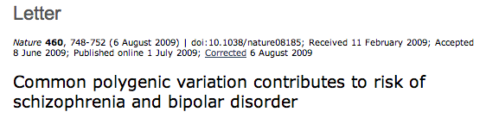
GWAS locus discovery is improving
Incl. replication
Freeze May 2013
Freeze Jan. 2013
WCPG Hamburg 2012
Incl. SWE + CLOZUK
SAB 2012
Mark Daly
Notes:
out

Slide 6
Results over time
HLA region
association
9K cases 12K controls

Slide 7
Results over time
HLA region
association
19K cases 20K controls

Slide 8
Results over time
HLA region
association
26K cases 28K controls

Slide 9
Results over time
HLA region
association
31K cases 39K controls

Slide 10
Results over time
HLA region
association
38K cases 50K controls

Slide 11
Results over time
HLA region
association
38K cases 50K controls

Slide 12
Power for locus identification
HLA region
association
Power
38K cases 50K controls

Slide 13

Where we were (Power for 5K/5K)

Slide 14
Effect sizes are small for common variants for complex traits

Slide 15
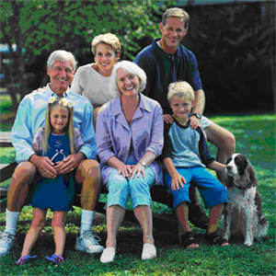
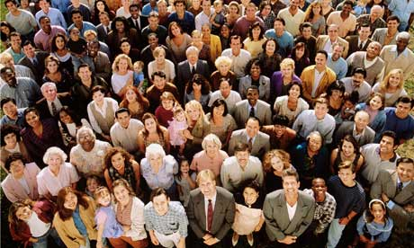
Goal: Understanding genomic basis of disease
Family-based
Linkage Mapping
Population-based
Association Mapping
Rare Inherited:
Monogenic
Common Inherited:
Polygenic

Slide 16
Goal: Understanding genomic basis of disease
Common variant association study
Test if a common variant occurs
at different freq. in cases vs. population
Rare variant association study
Test if rare variants occur
at different freq in cases vs. population
Population-based
association study
Common > 1 heterozygote per 100 people (>0.5%)
Rare* < 1 heteroyzgote per 100 people (<0.5%)
*Contingent on sample size – aim for ~60 or fewer copies

Slide 17
Common versus rare
Binary trait – e.g., disease (schizophrenia) or tail of distribution (LDL> 200 md/dl)
Common variants
Rare variants
Pick SNP
Pick a gene
Which mutations to aggregate?
• coding region
• non-synonymous
Which mutations to filter?
• By type (disruptive? missense?)
• By frequency
• By predicted function
Compare in cases vs controls,
Infer effect size
Compare in cases vs controls,
Calculate effect size

Slide 18
Key Questions
Choice of variants Relative value of variants:
    disruptive (stop, fs, splice) vs missense?
Frequency threshold Optimal threshold T*:
      Constant or depend on gene?
Sample size Number of cases, as a function of:
            gene properties, relative risk, strategy
Special approaches Isolated populations?
      De novo mutations?
Whole-genome From exome to non-coding regions?

Slide 19
Genetic Model
Burden tests for typical gene, with two classes of mutations
Burden test: Choose alleles and count
Typical gene: 1500 bp coding region, median mutation rate
Silent: μ_{S} = 5.6 x 10⁻⁶
Disruptive μ_{D} = 1.7 x 10⁻⁶
Missense μ_{M} = 12.8 x 10⁻⁶
Mutation classes: Selection coefficient Excess disease risk
Neutral: 0 0
Null: s λ
Silent: All Neutral
Disruptive All Null
Missense Null: Neutral = α: 1-α
Typical gene α = 25% (Ignore hypomorphs)
Missense-null: disruptives = 2:1
All null: disruptives = 3:1

Slide 20
Interpreting selection coefficient, s
Selection Range 10⁻³-10⁻¹
Direct selection:
s = (λπ)s_{D}
s = selection on allele; λ = increase in risk; π = prevalence;
s_{D} = selection against disease
Schizophrenia (prevalence 1%, fitness cost 50%?)
allele with 10-fold risk has s = 10^{-1.7}
Type 2 Diabetes (prevalence 10%, fitness cost 1%)
allele with 3-fold risk has s = 10^{-2.5}

Slide 21
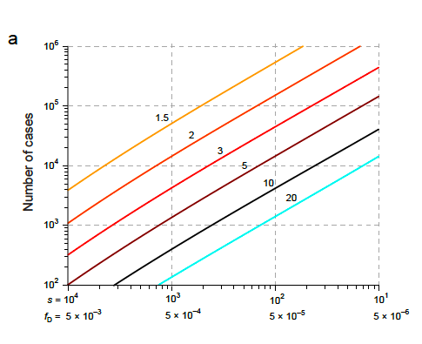
RVAS Strategy #1: Use only disruptive alleles
Concept
• Disruptive alleles
are pure class of nulls
• Easy to interpret:
enrichment = effect size
• Sample size depends on
fD (or s) and λ
Bottom line: Need LOTs of cases unless λ is big and s is small
λ = 20 10 5 3 2
Weak selection 260 770 2700 8400 28,000
Intermediate 2600 7700 27,000 84,000 280,000 10x higher
Strong 26,000 77,000 270,000 840,000 2.8 million 100x higher

Slide 22
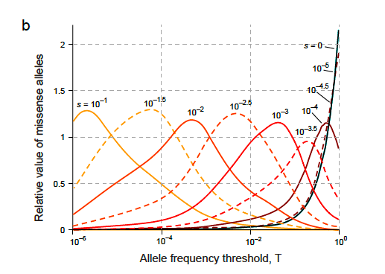
RVAS Strategy #2: Add missense filtered by frequency
Concept
• Missense nulls 2x as abundant
as disruptive alleles
• If could recognize nulls,
could cut sample size by 3x
• But missense neutrals dilute
the signal.
• Try to sort wheat from chaff
with frequency threshold
• Depends on s, still imperfect
ratio never higher than α
Bottom line: With optimal frequency threshold T*,
adding missense can decrease sample size by ~2-fold
Optimal threshold differs for each genes, based on selection coefficient

Slide 23
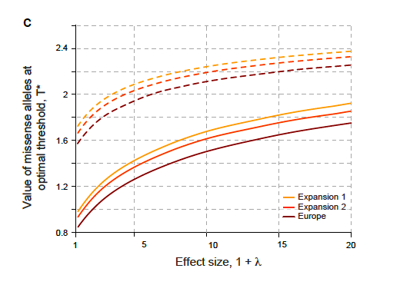
RVAS Strategy #3: Add missense filtered by ‘function’
Concept
• Missense nulls 2x as abundant
as disruptive alleles
• If could recognize nulls,
could cut sample seize by 3x
• Use optimal threshold T*
plus Polyphen
Bottom line: With optimal frequency threshold T*
adding missense can decrease sample by ~2-fold
With optimal frequency threshold T* + PolyPhen
adding missense can decrease sample by ~2.5-fold

Slide 24
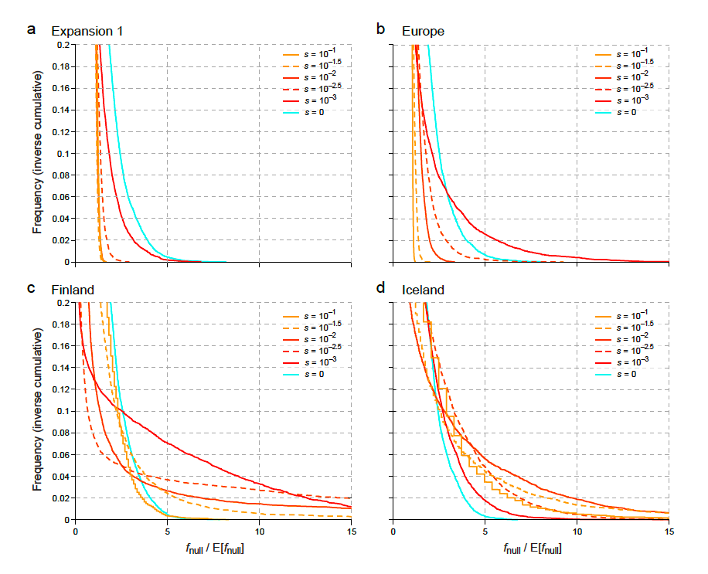
RVAS Strategy #4: Isolated populations
Concept
• Sample size depends on CAF (combined allele frequency) f_{D}
• Find population where f_{D} is larger than expected (given s)
• Bottlenecks widen the distribution of f_{D}
Bottom line:
In isolated populations,
some genes easier to find
some harder to find

Slide 25
RVAS Strategy #5: De novo mutations
Concept
• Study de novo disruptives only
(in effect, very stringent frequency threshold)
• Compare cases vs. controls
Allele frequency is mutation rate: f_{D} = μ_{D} = s x 10⁻⁶
Seems inefficient: With 20-fold risk, requires 100,000 cases!!
But if disease risk is HUGE Autism (We’ll talk about this on Thursday):
CHD8 shows 3 denovo in 1078 cases, corresponding to 300-fold disease risk!
[Note: advantage in estimating background frequency]
Bottom line: De novo can be useful for genes
with HUGE effects and STRONG selection

Slide 26
There’s more to genetics than gene-finding

Slide 27
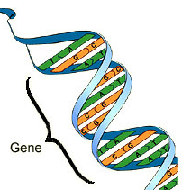


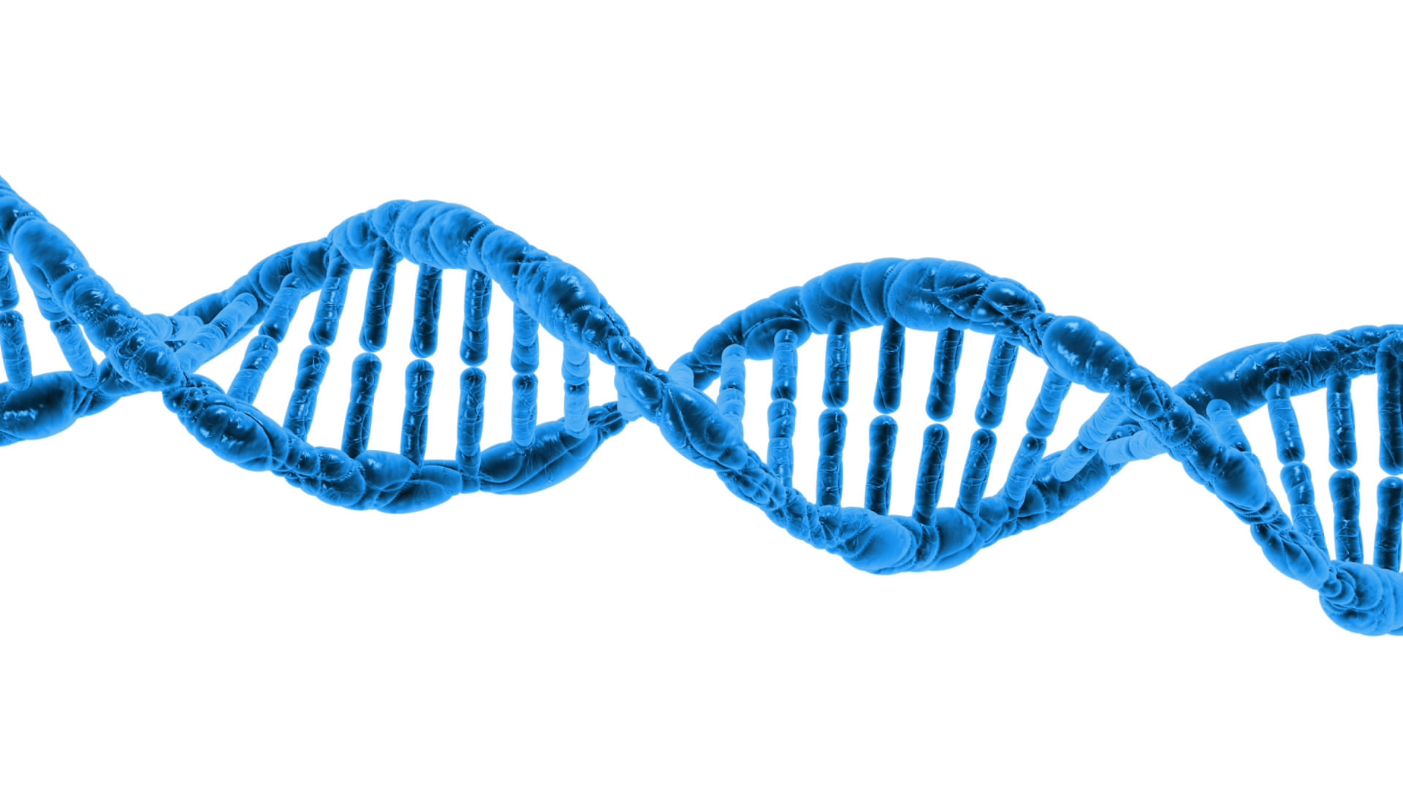
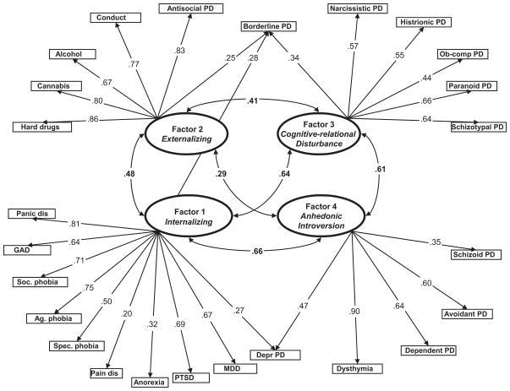
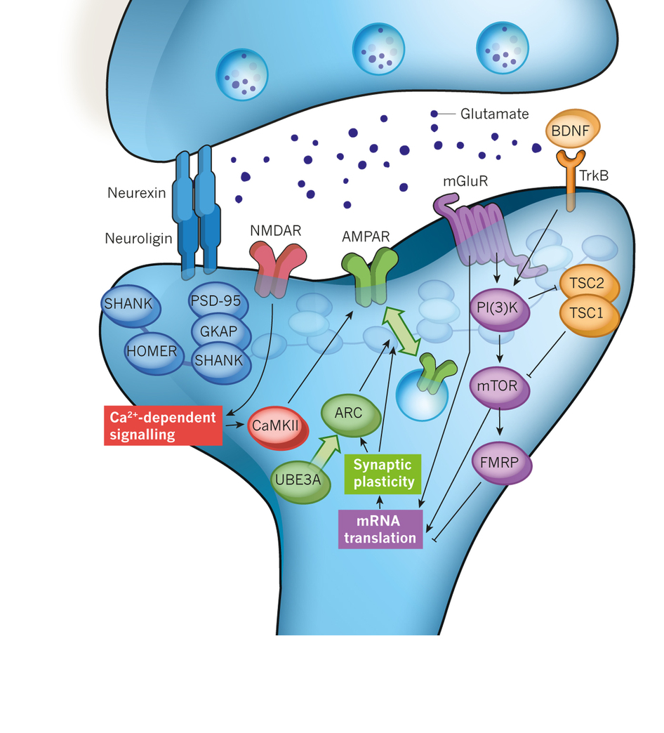
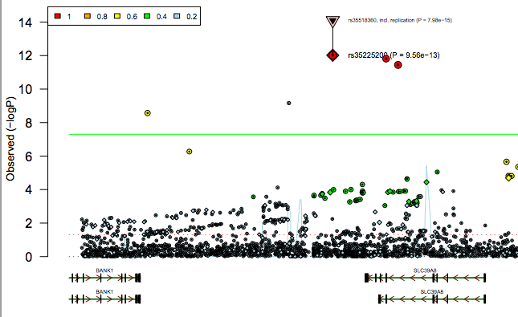
Population level
Epidemiology
Genetic
architecture
Gene
Nosological
implications
Pathways
Network
Variant

Slide 28
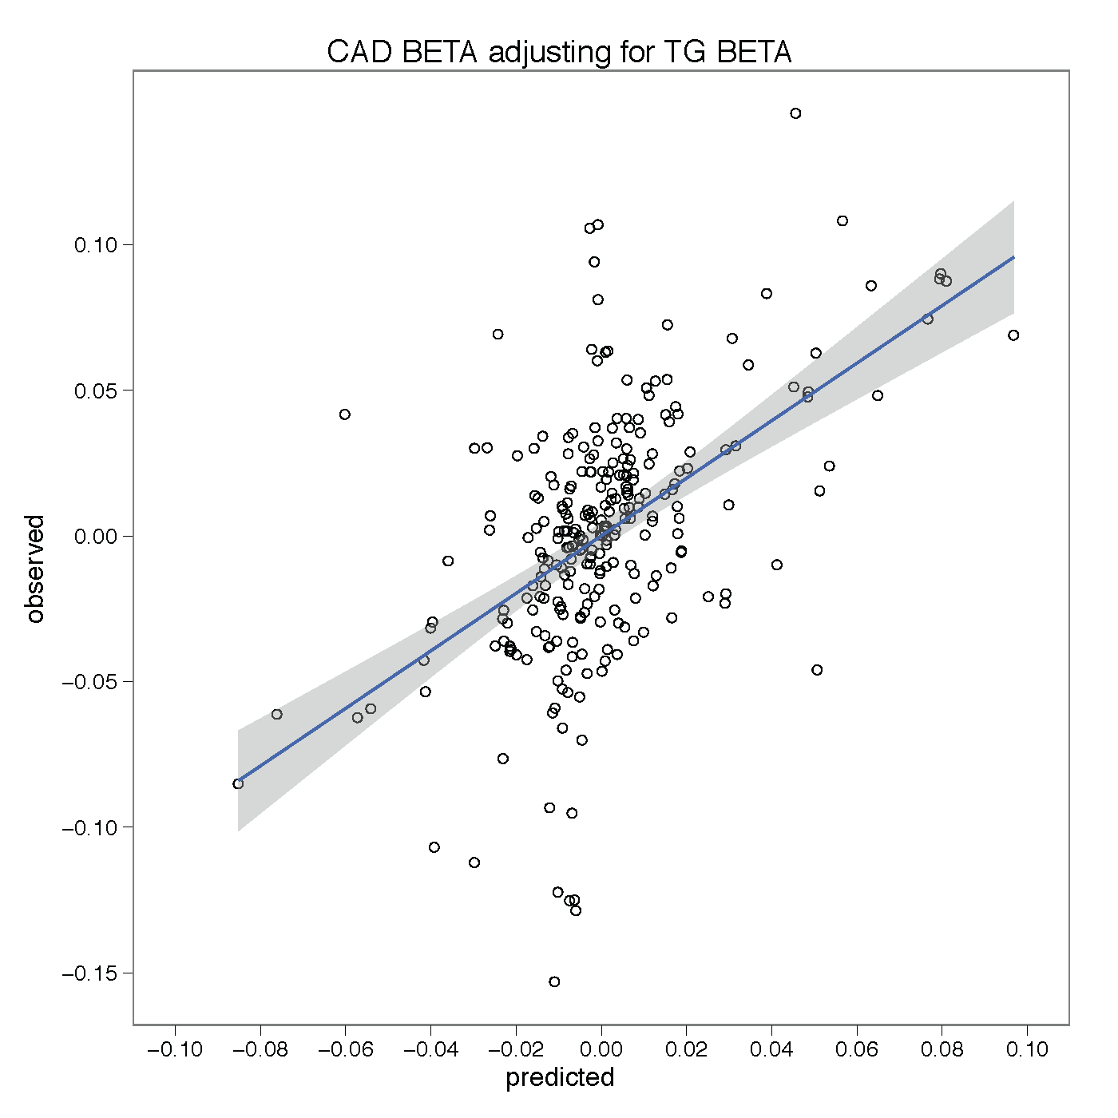
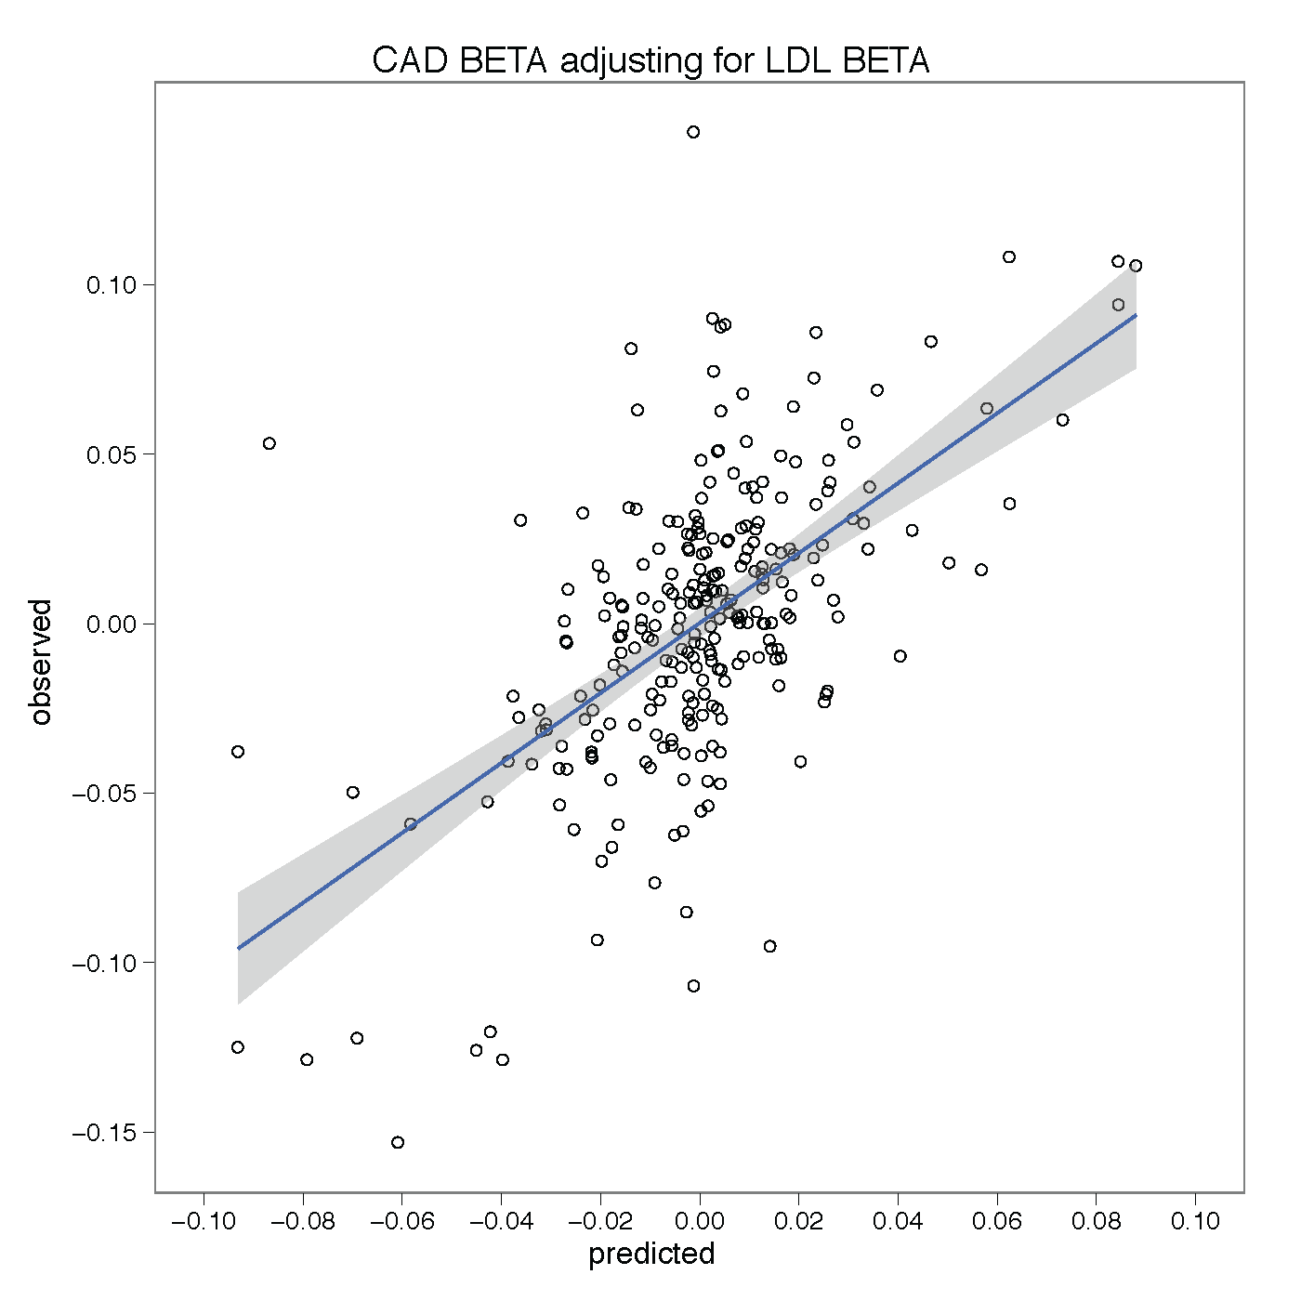
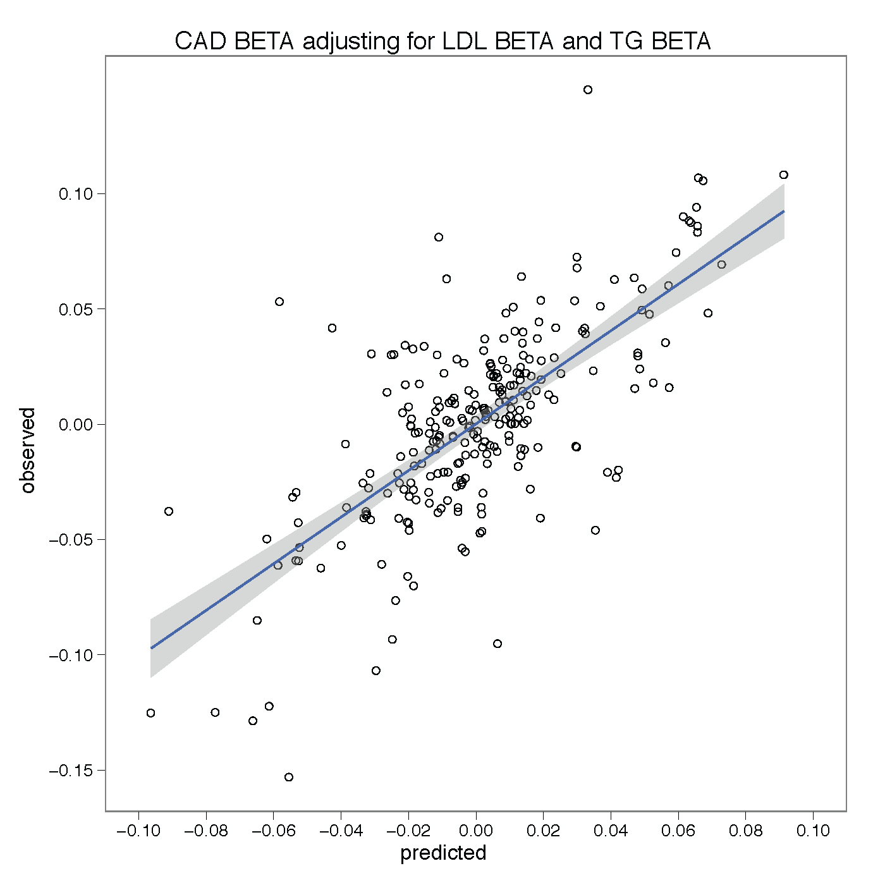
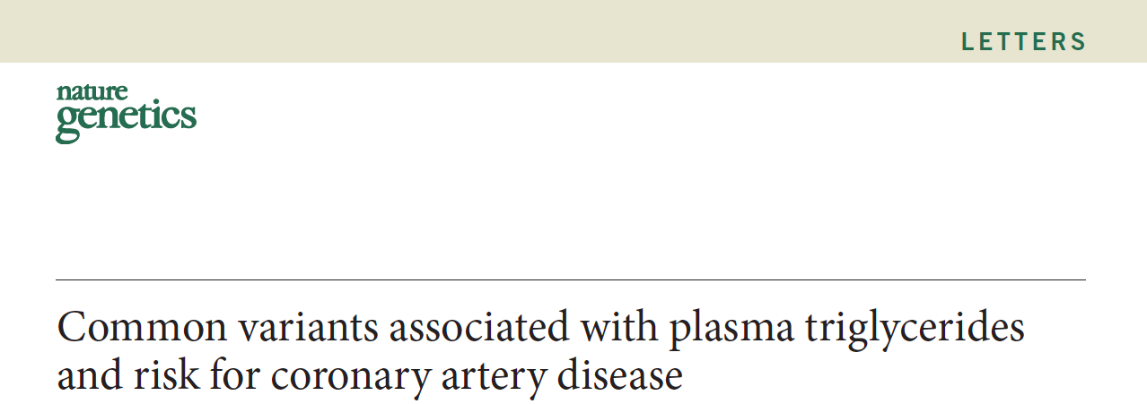
Epidemiology
Genome-wide significant loci
provide the opportunity to
evaluate the relevance of
intermediate phenotypes on
risk to disease.
A model consisting of both
LDL and TG explains more CAD risk
than either trait alone
r² = 0.56

Slide 29
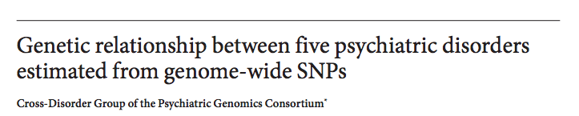
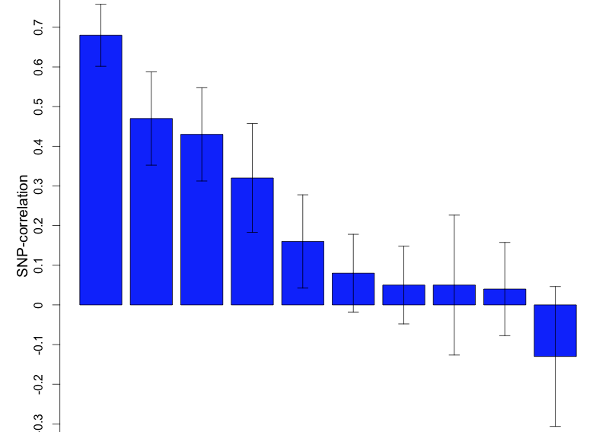
Nosology
Significant
Non-significant
Schizophrenia/ADHD
Schizophrenia/Bipolar
Bipolar/Major Depression
Bipolar/ADHD
Schizophrenia/Major Depression
Major Depression/Autism
Major Depression/ADHD
Bipolar/Autism
Schizophrenia/Autism
ADHD/Autism
Genetic correlation as a means to understand relationship across disease

Slide 30
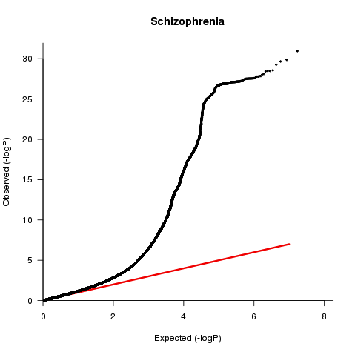
Architecture
More LD
More association
Much of the LD is
to common variation
Demonstrated role for
common variation

Slide 31
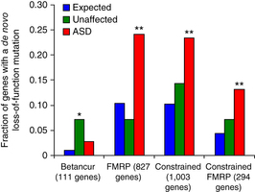
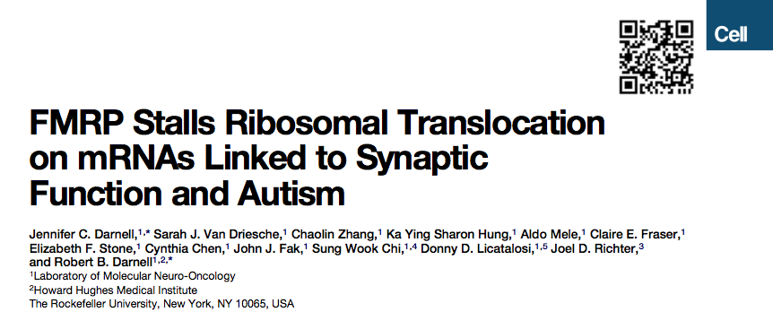
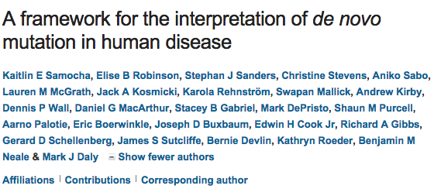
FMRPi enrichment
in de novo hits for
autism
Pathway
Network
Consistent with:
Mechanistic overlap
or
Correlated ascertainment

Slide 32
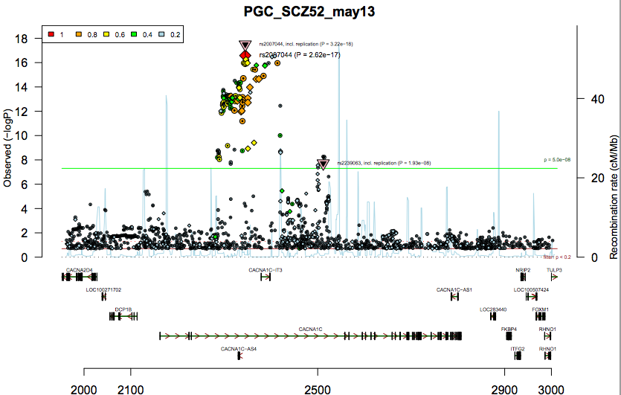
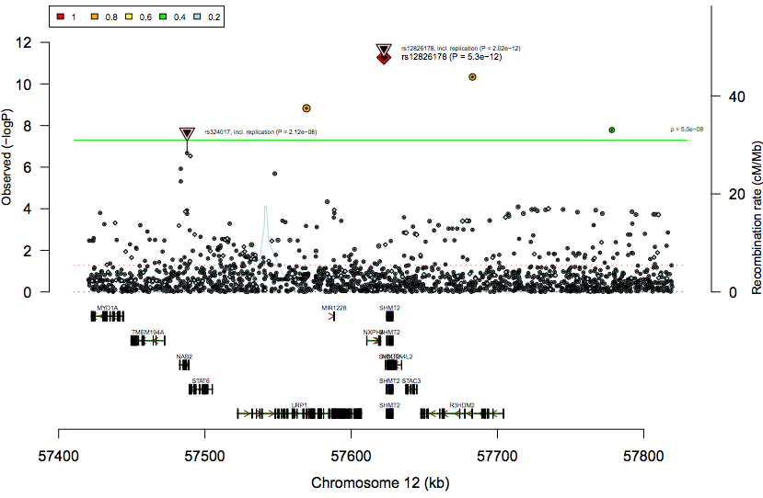
Sometimes it’s easier
SCN2A
de novo variants
4 putative LoF
5 missense mutations
P<1e-8
Gene
Sometimes it’s harder
Most GWAS loci
unknown gene
Almost all GWAS loci
unknown function

