Slide 1
Fine-mapping and annotation aka stuff
Benjamin Neale, Ph.D.
Boulder workshop
March 6th 2015

Slide 2

with gratuitous thanks to Hailiang Huang for fine-mapping slides

Slide 5
Bayesian method with flat prior
Develop a posterior probability function
  X: genotype of SNPs in a high density region
  Y: phenotypes of all samples
  M: “model”, i.e., which variant is associated with which phenotype. Multiple variants and multiple phenotypes are allowed.
Steepest
descent app.
Penalty for
model size
Penalty for
model complexity
Constant
Log-likelihood
Notes:
The method I proposed to do is a Beyesian based method. We identify the best model in the region by maximizing the posterior prob of the model given the genotype and phenotypes. Can be calculated in the Bayesian way as the summation of the two terms. Prob of data given the model and the prior of the model. Multi-level response. Any model with a valid likelihood function can be used. When you add a new variant, you improve the loglik, need to pay a price for making the model more complex. To prevent adding more variants than necessary to the model. Natural thershold for conditional study.

Slide 6
Credible set of SNPs
  A 95% credible set of SNPs, S, is defined as
Denominator: Probability of all models
Notes:
As we discussed earlier, don’t expect we are able to identify the single causal variant every time. Some variants will be in LD and are ties as the ‘causal’ candidates. We account for this by proposing a subset of SNP that we are 95% sure containing the causal variant. That means. The summation of the posteriior prob for the SNPs in the credible set accoutns for 95% of the total prob.

Slide 7
Greedy search for the best model
Notes:
Mention other approaches (luke, Kyle, Michel)

Slide 8
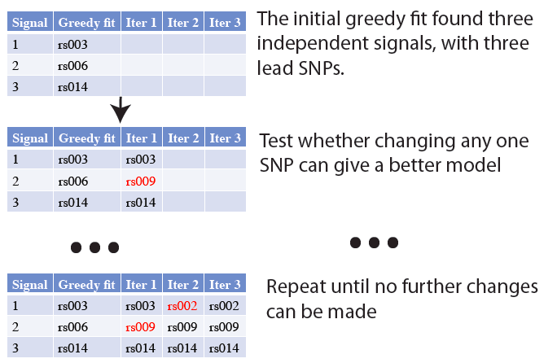
Repositioning
We ran repositioning on 37 loci with >1 signals
  28 loci have no change
  9 loci converged in 1 iteration

Slide 9
Flowchart
# of Variants after QC and imputation
Raw data
CD=19,802 UC=14,864 control=34,897
 | ALL | HD region
Raw data | 192,402 | 126,346
Pass Ordinary QC | 157,307 | 98,746
After imputation | - | 392,018
QC genotype data
CD=18,603 UC=14,307 control=33,938
Imputation (IMPUTE2)
# dense iCHIP regions = 184
184 high density loci in iCHIP
163 known risk loci from Jostins et al.
Fine mapping methods
Hailiang Huang
Luke Jostins
Michel Georges
Evaluation of credible sets
Comparison among methods/enrichment of functional variants/eQTL analysis
110 high density loci that
cover 103 known risk loci
Notes:
Overview of the pipeline, raw data goes through the QC and imputation. Most of samples passed the QC, and the imputation added back some of the variants that failed QC, and provided a high density coverage in the 184 iCHIP loci.
3 methods in paralle

Slide 10
Size of credible sets
16 single-variant credible sets are identical

Slide 11
Enrichment: Coding variants
# of variants in credible set | # of credible sets | #(%) of credible sets contain a coding variant | #(%) of coding variants in credible sets | P-value
1-5 | 87 | 16 (18.4%) | 16(10%) | 1E-11
6-10 | 25 | 2 (8.0%) | 2 (1.0%) | 0.70
11-15 | 18 | 0 (0.00%) | 0 (0.0%) | 0.18
16-20 | 12 | 1 (8.3%) | 1 (0.4%) | 0.73
21-50 | 22 | 4 (18.2%) | 5 (0.7%) | 0.84
51-100 | 8 | 4 (50.0%) | 5 (1.0%) | 1.0
101+ | 5 | 1 (20.0%) | 1 (0.1%) | 0.008
In high-density regions:
Total 1KG variants: 235,695
Total coding: 2,268
Proportion: <1.0%

Slide 12
Enrichment: Variants within 20kb of exon
# of variants | # of sets | #(%) of credible sets | #(%) of variants | P-value
1-5 | 87 | 10 (11.5%) | 12 (7.3%) | 0.0001
6-10 | 25 | 5 (20.0%) | 5 (2.6%) | 0.43
11-15 | 18 | 2 (11.1%) | 3 (1.3%) | 0.64
16-20 | 12 | 3 (25.0%) | 3 (1.4%) | 0.81
21-50 | 22 | 11 (50.0%) | 15 (2.2%) | 0.57
51-100 | 8 | 2 (25.0%) | 12 (2.2%) | 0.64
101+ | 5 | 4 (80.0%) | 8 (1.0%) | 0.07
In high-density regions:
Total 1KG variants: 235,695
Total within 20bp: 4,616
Proportion: 2.0%
Notes:
Non-coding but within 20 CDS

Slide 13
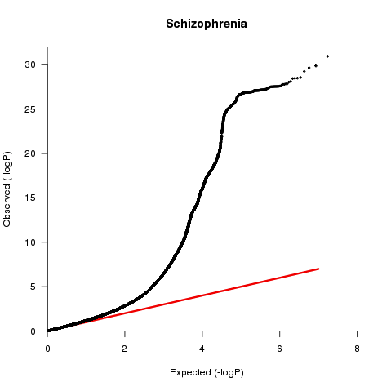
Test Statistic Inflation
Genome-wide distribution of test statistics from large GWAS deviate strongly from the null

Slide 14
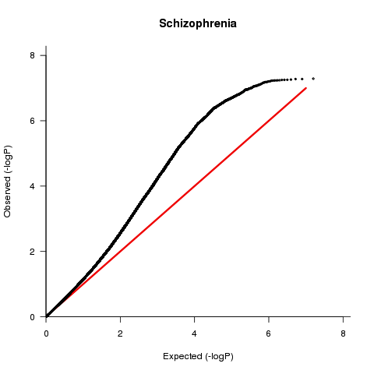
Test Statistic Inflation
Even when all gwsig loci (+/- 1 MB, 10MB for MHC) removed

Slide 15
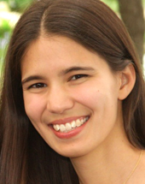




Acknowledgements
Brendan Bulik-Sullivan
Hilary Finucane
Po-Ru Loh
Mark Daly
Alkes Price

Slide 16
Challenge
What more could we say now about the genetics and of neurological and psychiatric traits, given
  We have lots of GWAS data
  A few phenotypes have many loci, but most don’t
  The phenotypes are largely co-morbid

Slide 17
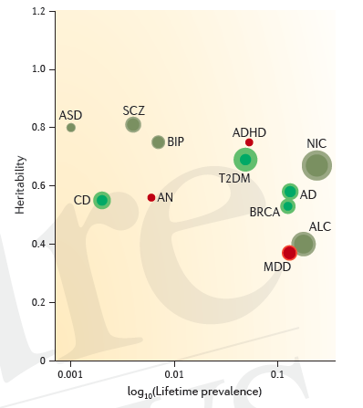
Not all heritabilities are the same
Cross-disorder group of the Psychiatric Genetics Consortium.
Genetic relationship between five psychiatric disorders estimated from
genome-wide SNPs. Nat Genet. 2013 Sep;45(9):984-94.
Sullivan, Daly, O’Donovan. Genetic architectures of psychiatric
disorders: the emerging picture and its implications.
Nat Rev Genet. 2012 Jul 10;13(8):537-51.

Slide 18
Simulation of a genetic signal in polygenic architecture

Slide 19
Simulation of a genetic signal in polygenic architecture
LD blocks

Slide 20
Simulation of a genetic signal in polygenic architecture
Lonely SNPs [no LD]
LD blocks

Slide 21
Simulation of a genetic signal in polygenic architecture
LD Block
Lonely SNP

Slide 22
Simulation of a genetic signal in polygenic architecture
LD Block
Lonely SNP
*
Causal SNP

Slide 23
Simulation of a genetic signal in polygenic architecture
LD Block
Lonely SNP
*
Causal SNP
Sim 1

Slide 24
Simulation of a genetic signal in polygenic architecture
LD Block
Lonely SNP
*
Causal SNP
Sim 1
*
*

Slide 25
Simulation of a genetic signal in polygenic architecture
LD Block
Lonely SNP
*
Causal SNP
Sim 1
*
*

Slide 26
Simulation of a genetic signal in polygenic architecture
LD Block
Lonely SNP
*
Causal SNP
Sim 1
*
*
Sim 2
*
*

Slide 27
Simulation of a genetic signal in polygenic architecture
LD Block
Lonely SNP
*
Causal SNP
Sim 1
*
*
Sim 2
*
*

Slide 28
Simulation of a genetic signal in polygenic architecture
LD Block
Lonely SNP
*
Causal SNP
Sim 1
*
*
Sim 2
*
*
*
*
Sim 3

Slide 29
Simulation of a genetic signal in polygenic architecture
LD Block
Lonely SNP
*
Causal SNP
Sim 1
*
*
Sim 2
*
*
*
*
Sim 3

Slide 30
Simulation of a genetic signal in polygenic architecture
LD Block
Lonely SNP
*
Causal SNP
Sim 1
*
*
Sim 2
*
*
*
*
Sim 3
...
Sim N
*
*

Slide 31
Simulation of a genetic signal in polygenic architecture
LD Block
Lonely SNP
*
Causal SNP
Sim 1
*
*
Sim 2
*
*
*
*
Sim 3
...
Sim 20
*
*
Prob for
1 causal SNP
9/20
1/20
4/20
1/20
5/20

Slide 32
Simulation of a genetic signal in polygenic architecture
LD Block
Lonely SNP
*
Causal SNP
Assuming a uniform prior, we see SNPs with more LD friends showing more association
ie., the more you tag, the more likely you are to tag a causal variant
Sim 1
*
*
Sim 2
*
*
*
*
Sim 3
...
Sim 20
*
*
Prob for
1 causal SNP
9/20
1/20
4/20
1/20
5/20

Slide 33
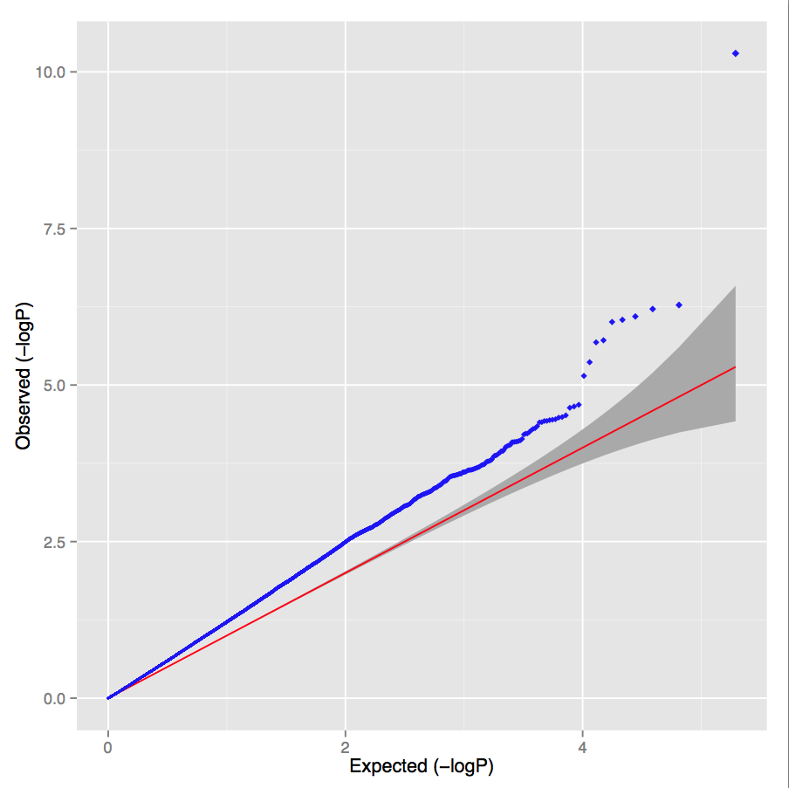
Polygenic Architecture
Lambda = 1.30; LD score regression intercept = 1.02

Slide 34
What happens under genetic drift?
LD Block
Lonely SNP
Probability
of drift

Slide 35
What happens under genetic drift?
LD Block
Lonely SNP
Probability
of drift
1/5
1/5
1/5
1/5
1/5

Slide 36
What happens under genetic drift?
LD Block
Lonely SNP
Probability
of drift
1/5
1/5
1/5
1/5
1/5
Under pure drift we expect LD to have no relationship to differences in allele frequencies between populations

Slide 37
Let’s do GWAS to test this:
UK controls versus Sweden controls

Slide 38
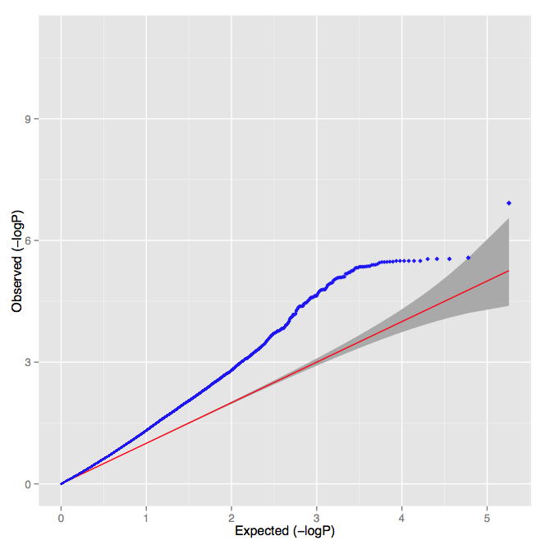
Population Stratification
Lambda = 1.30; LD score regression intercept = 1.32

Slide 39
PGC Schizophrenia
Lambda = 1.48
Intercept = 1.06
p-value < 10⁻³⁰⁰
Overwhelming majority of inflation is consistent with polygenic architecture

Slide 40
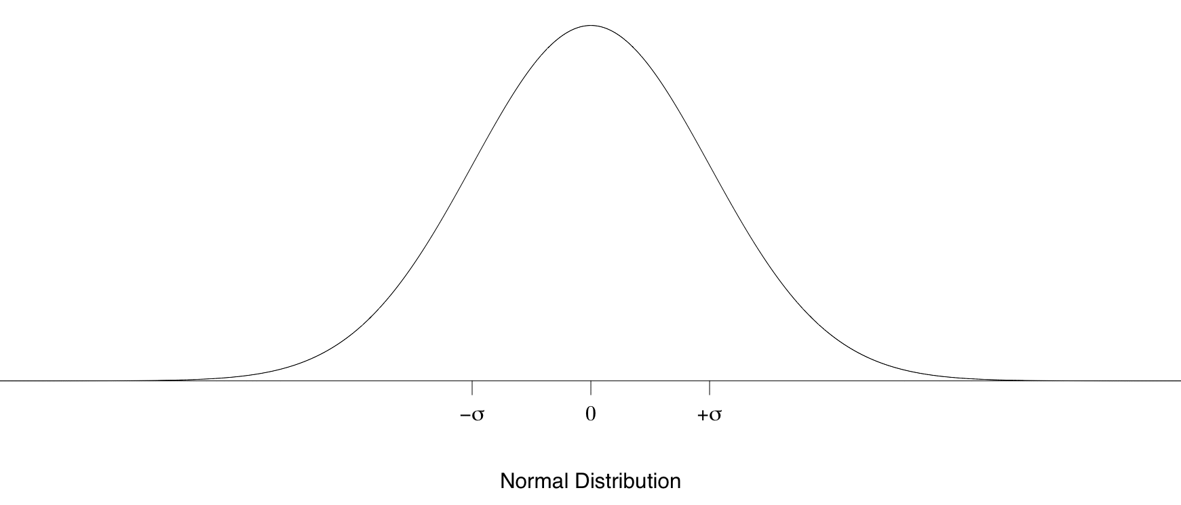


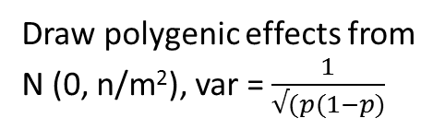
LD score method
Draw polygenic effects from
N (0, n/m²), var = $\frac{1}{√(p(1−p)}$
What is the E[χ²] for variant j?
β
where N=sample size, M=# of SNPs, a=inflation due to confounding,
h²g is heritability (total obs.) and l_{j} is the LD Score
*
*
*
*
*
*
Bulik-Sullivan et al. Nature Genetics 2015
*

Slide 41
Two key extensions
What is the contribution to common variant heritability for each functional class
  leverage each class of variant
Is there evidence for genetic correlation across phenotypes
  Do we see an overlap in the direction of the effects genome-wide

